Slide 1
Introduction to Gastrointestinal Pathology
Dr Marjorie Walker
Cellular Pathology
St Mary’s Hospital

Slide 2
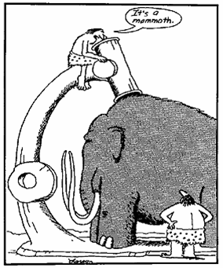
Pathology
Specialty practice that deals with all aspects of disease
Pathogenesis (cause)
Clinical expression (effect)
Monitors disease progression and treatment

Slide 3
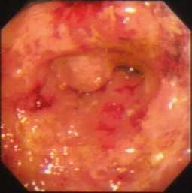
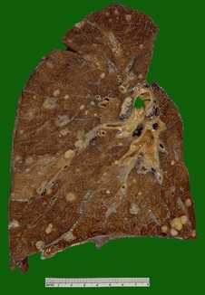
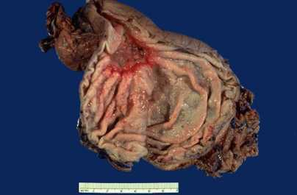
Histopathology
Diagnosis
Staging of cancer -TMN
Monitor disease and treatment

Slide 4
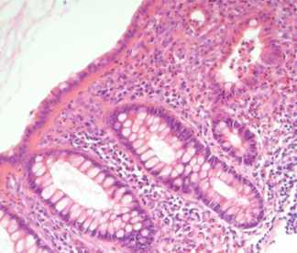
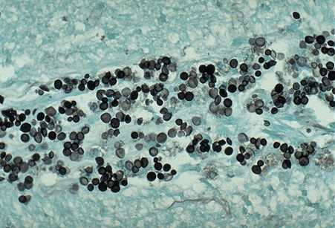
How are sections obtained to make a diagnosis?
Identify specimen with unique number
“Cut up” to cassettes
Dehydrate tissue –”Process to paraffin wax”
Cut thin sections – rehydrate & stain (H&E)
Special stains - Silver Gram, ZN, Mucin (AB/PAS) Immunoperoxidase

Slide 5
How long does a histopathology result take to reach the clinician?
Specimens “fix” in formalin
Process sections taken at cut up - overnight
Sections cut and stained - morning
Sections reported by histopathologist – afternoon
For large specimens - 2-3 days
Small biopsies can be processed in a day
Rapid processing 4-5 hours - in by 1pm out by 5pm
Frozen sections - within 20 minutes.

Slide 6
GIT Pathologies
Inflammation- Erythema, ulcer
    Acute, chronic, granulomatous
    Immune reaction, autoimmune
    Infection
    Atrophy, metaplasia, dysplasia
    Tumour – Polyps, ulcer, submucosal tumour
    Epithelial, lymphoid, mesenchymal, neuroendocrine
  Benign
  Malignant – cancer – adenocarcinoma, lymphoma

Slide 7
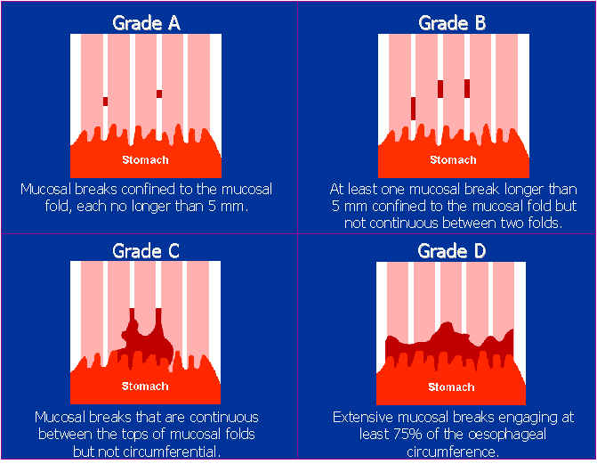
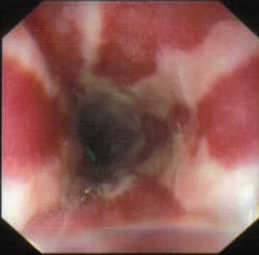
Endoscopy & Surgery – do we always need histopathology? - Oesophagitis

Slide 8
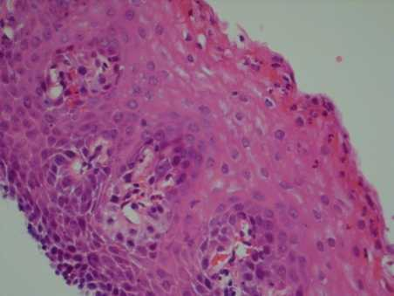
Pathology
DIS , BCH
Infiltration of eosinophils, (IEE) & neutrophils (IEN) Capillary congestion (CC)
Rubio CA et al Am J Clin Path 2006;125: 432-437, De Hertogh G et al Aliment Pharmacol Ther 2006;24 Suppl 2: 17-26, Villanacci V et al Digestion 2001;64:1-8, Mangano MM et al Mod Pathol. 1992;5:191-6.

Slide 9
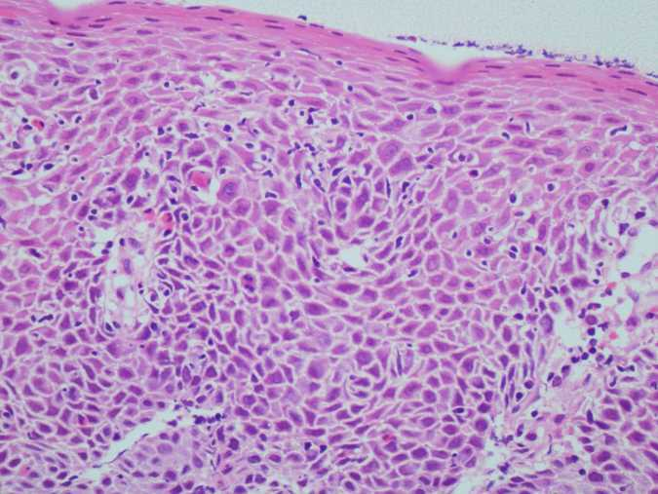
DIS IELS IEEs BCH

Slide 10

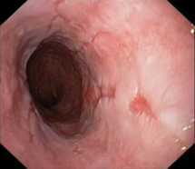
Montreal definition of GERD, Vakil N et al Am J Gastroenterol 2006;101:1900–1920

Slide 11
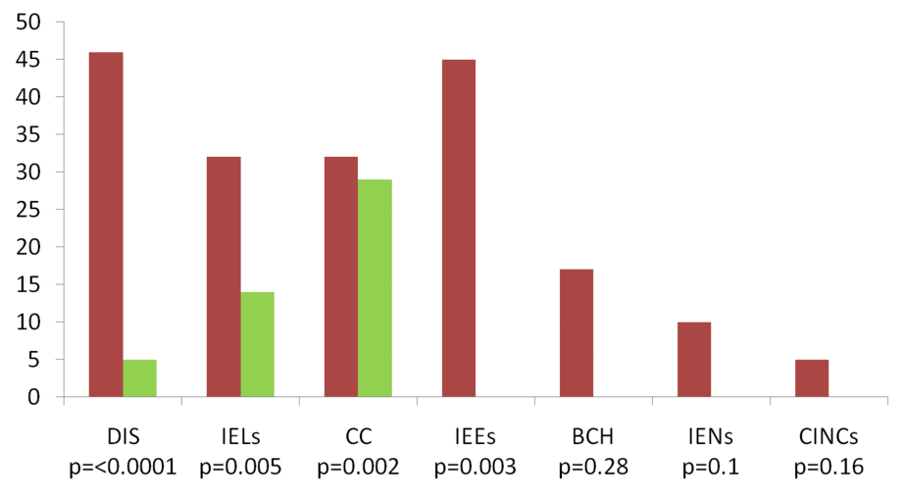
Reflux symptoms but no endoscopic esophagitis n=78 vs. controls n=23

Slide 12
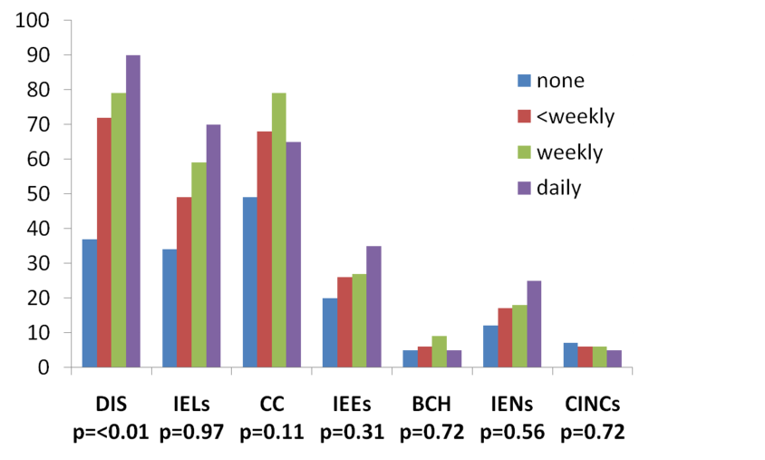
Pathology & Frequency of Symptoms
% subjects

Slide 13
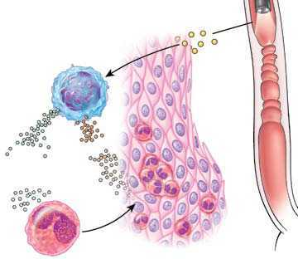
EOSINOPHILIC OESOPHAGITIS (EO)
Food/ aero allergen
TH 2 cell
IL13
eotaxin 3
IL5
Nonevski I T et al. Cleveland Clinic Journal of Medicine 2008;75:623-633

Slide 14
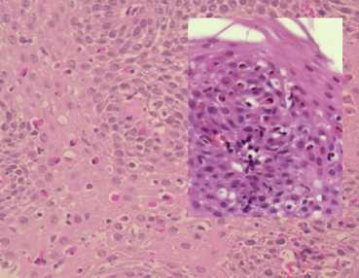
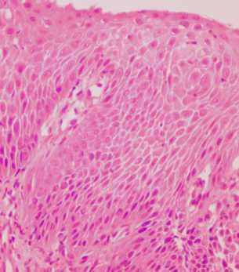
Histopathology of EO
≥15 eosinophils/ 1 HPF (peak count),
eosinophil microabscesses with superficial layering
basal cell hyperplasia
GORD, Crohn’s disease, CTD, HES, infection, drug hypersensitivity.

Slide 15
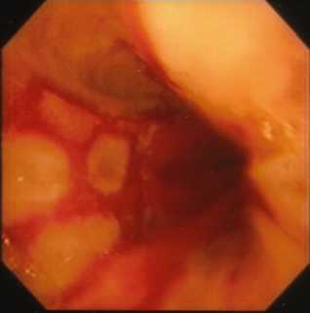
Reflux may lead to CLO
(Barrett’s oesophagus)
BIOPSY..
To establish diagnosis
Biopsy endoscopically visible columnarisation and record site of biopsy in relation to GOJ and incisors
Surveillance
x4 quadrantic biopsies every 2cm in the columnar segment
Biopsy any SUSPICIOUS lesion

Slide 16
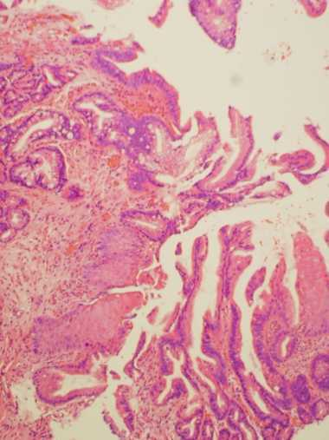
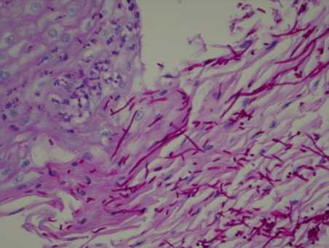
CLO and candida

Slide 17
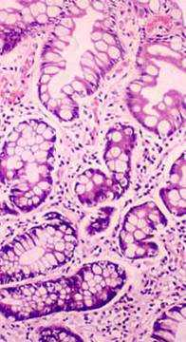
Metaplasia – Dysplasia - Ca
Metaplastic glandular epithelium
Dysplasia
Adenocarcinoma
surveillance
– repeated endoscopy & biopsy to detect early neoplastic change

Slide 18
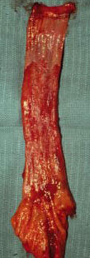
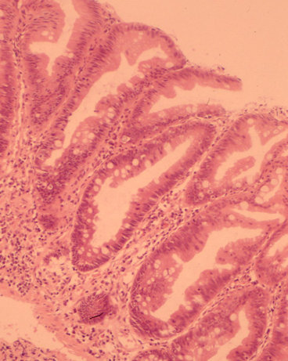
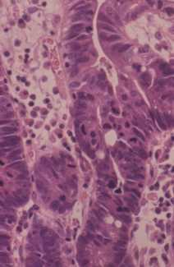
Intestinal metaplasia -
dysplasia

Slide 19
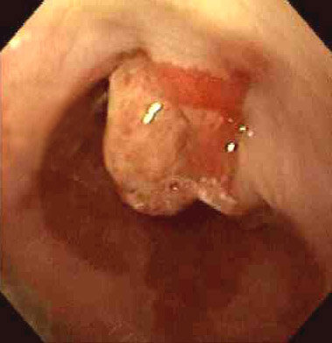
Risk of progression to cancer:
Male
> 45yrs of age
> 8cm stretch CLO
Duration of reflux
Early age onset
Duodeno-gastro-oesophageal reflux
Ulceration, tumour or stricture
Family history of cancer

Slide 20
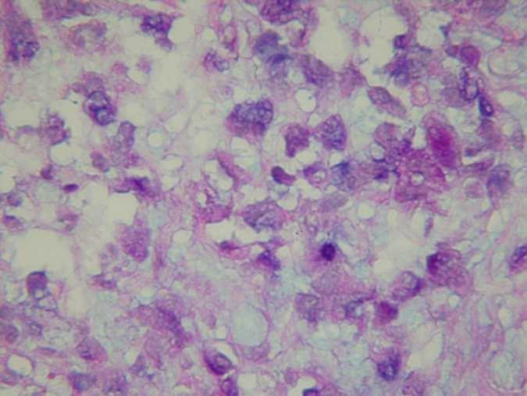
Histology AB/PAS

Slide 21
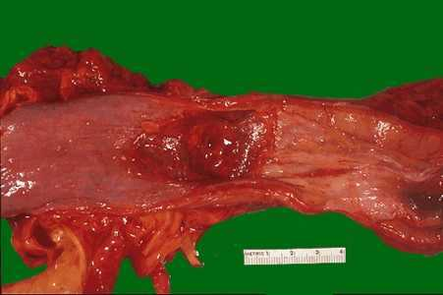
Most of the oesophagus is squamous epithelium - SCC oesophagus
Dysphagia, anorexia, weight loss
90% mid/lower
invasion into muscularis propria
30-40% have invasion of mediastinum; 50% LN mets
cytology plus biopsy is recommended

Slide 22
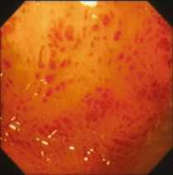
Gastritis - pathology
Reactive/ reflux/ chemical gastropathy
HLO associated gastritis
PPI effect
Granulomatous
Lymphocytic
Autoimmune
Other infection (Travel, PPIs, IMS)

Slide 23

Gastritis
Gastric biopsies:
Biopsy antrum and body, place in same container for the diagnosis of gastritis
Use CLO test for Helicobacter pylori diagnosis if not taking biopsies for histological assessment

Slide 24
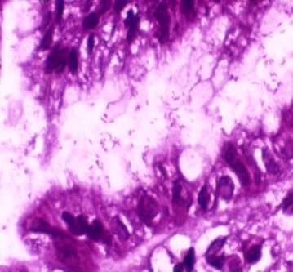
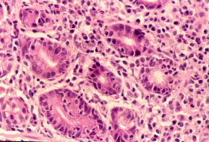
Biopsy of gastric antrum
Helicobacter associated gastritis
chronic inflammation
- lymphocytes
acute inflammation
- neutrophils

Slide 25
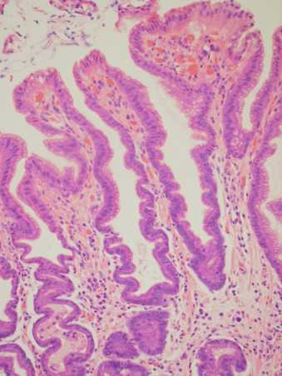
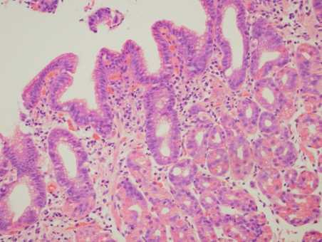
Reactive/ reflux/chemical gastritis
Antral Body

Slide 26
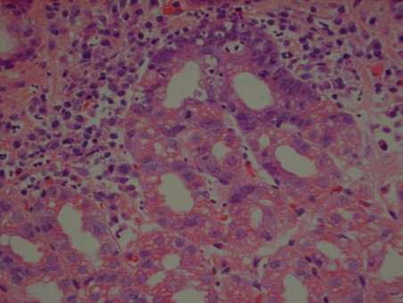
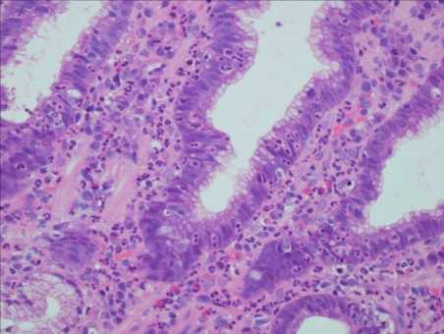
Combined HLO/ reactive

Slide 27
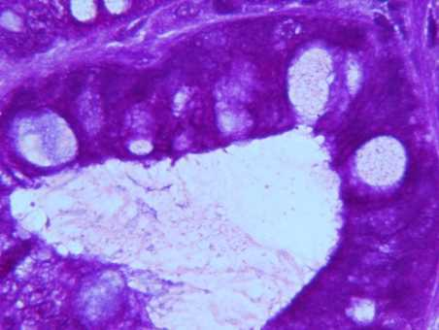
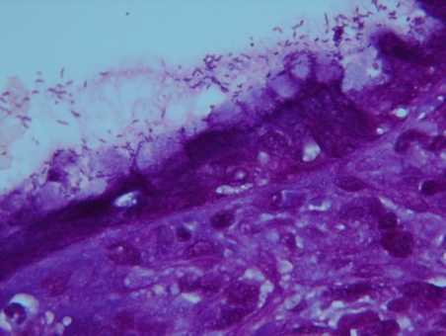
GIM-ve GIM +ve

Slide 28
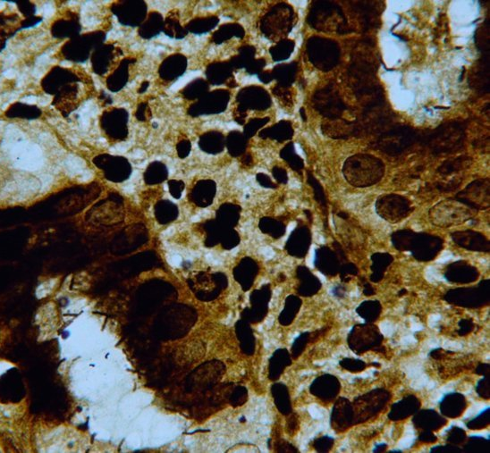
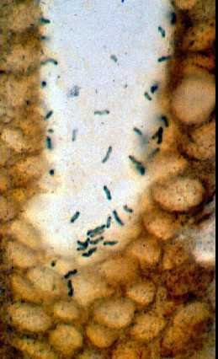

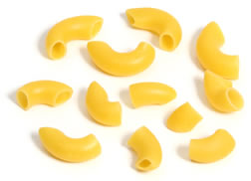
NHpH Hp
Notes:
Comparison, longer tightly spiralled fuselli of NHpH, unlike macaroni Hp

Slide 29
Changing prevalence of H. pylori

Slide 30
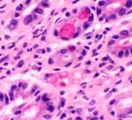
Other gastritis
Infection IMS
CMV, Herpes Virus, strongyloides
Inflammatory bowel disease
Crohn’s Disease
LG
Autoimmune

Slide 31
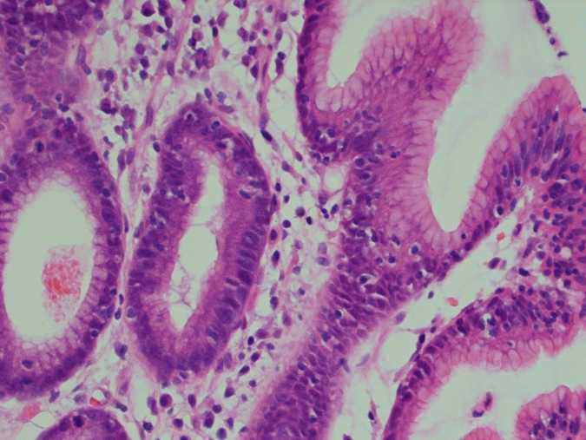
LG

Slide 32
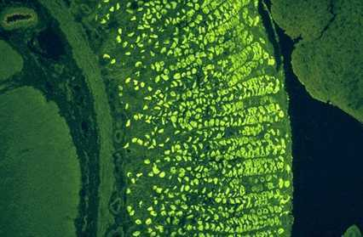
Pernicious anaemia
cause
parietal cell antibodies 90%
IF antibodies 60%
pattern
chronic gastritis,
BODY ATROPHY
outcome
variable - vitamin B12 atrophy, cancer

Slide 33
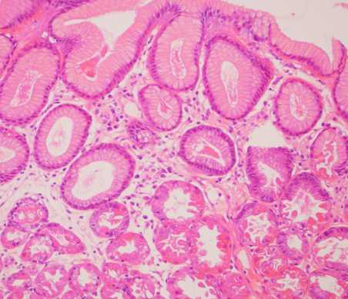
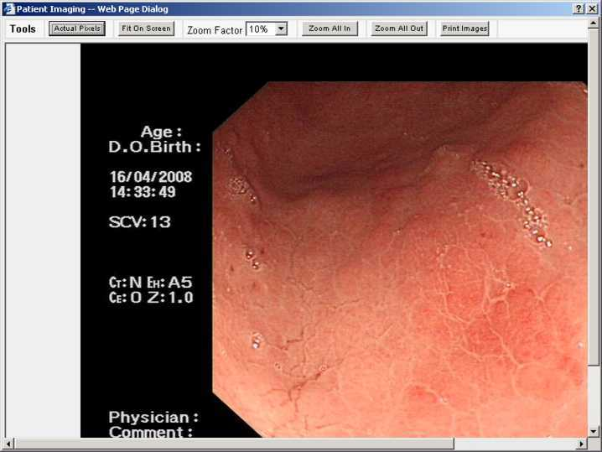
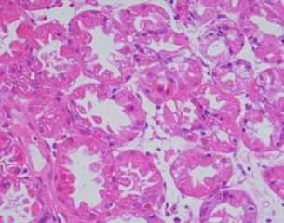
PPIs & the gastric milieu and infections
PPI effect,
gastric body mucosa
Notes:
Alterations in gastric flora by acid suppression?

Slide 34
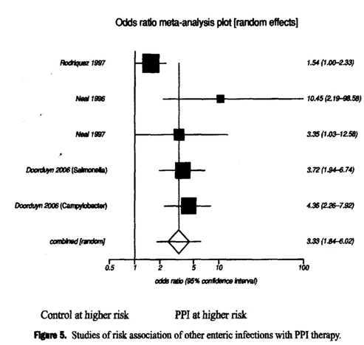
PPIs & enteric infections
Increased risk of taking acid suppression in those with enteric infections (OR 2.55, 95% CI 1.53–4.26
Association greater for PPI use (OR 3.39, 95% CI 1.84–6.02) compared with H2RA use (OR 2.03, 95% CI 1.05–3.92).
Leonard J, Am J Gastroenterol. 2007 ;102:2047-56

Slide 35
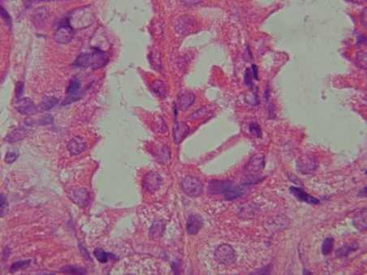
Consider before prescribing:
those at high risk of developing enteric infections (e.g. travel)
those at risk of developing C. difficile
risk of deleterious effects of enteric infections (e.g. frail and elderly)
Mechanically ventilated patients
Notes:
(e.g. hospitalized patients on antibiotics),

Slide 36
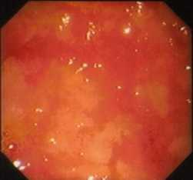
Atrophy & IM
Loss of specialised glands, metaplasia from columnar to intestinal type
Autoimmune
HLO
Bile reflux (antrum)

Slide 37
Risk of progression for IM and dysplasia to cancer
H. pylori strong risk factor for gastric cancer, if IM/Atrophy
Risk is increased x8 over a long time interval (at least 15 years)
H. pylori
IM/A
Cancer

Slide 38
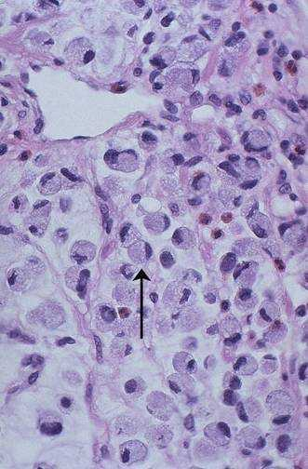
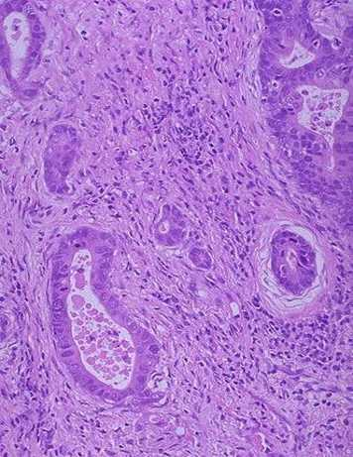
Histological type?

Slide 39

Coeliac disease
~ 1 /100 of population
Only 10–15% affected are clinically diagnosed
2% in Sweden
http://www.nice.org.uk/nicemedia/pdf/CG86FullGuideline.pdf
Walker et al Gastroenterology 2010; 139: 112-119
year5.skola.edu.mt/.../
Notes:
Coeliac disease is common compared to original estimates ¹⁹ and is believed to be present in up to 1 in 100 of the population although only about 10–15% affected are clinically diagnosed ³. This is the only autoimmune disease where both the antigen (gluten) and the responsible genes (which are necessary but not sufficient for disease) are known.
39

Slide 40
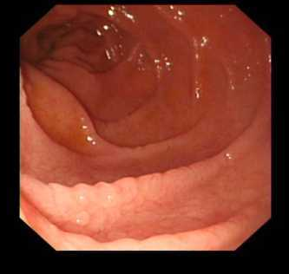
Endoscopy and Biopsy
Proximal small intestine, extends variably to jejunum
Biopsies should be taken across a circular fold to avoid crushing artefact
4 - 6 biopsies for diagnosis

Slide 41


Architecture
3 - 4 villi, correct orientation necessary
Notes:
normal crypt: villus ratio is variably cited at 3:1-5:1 but even 2:1, 1.82:1 and 1:1
41

Slide 42

Intraepithelial lymphocytes
Number
<40 ?
<25 ?
<20 ?
Notes:
The cited normal number of IELs has been quoted as traditionally <40 ³⁶, but as these were calculated in biopsies taken distally in the small bowel by Crosby capsule where IELs are greater in number. It is now acceptable to take <25 ³⁷, and some suggest even 20 ³⁸
42

Slide 43
Malabsorption
1. Maldigestion: gastrectomy and consequent SIBO, bile salt and enzyme deficiencies.
2. SI mucosal insufficiency: enteropathy and mural neuromuscular problems
3. Microbial: infection and bacterial overgrowth
Owens SR, Greenson JK. The pathology of malabsorption:current concepts. Histopathology 2007; 50: 64-82

Slide 44

Small Intestine neoplasia
Adenocarcinoma
Lymphoma
Carcinoid
Coeliacs, FAP
Nebulous presentation
Pain, weight loss

Slide 45

Small intestinal mass

Slide 46
Carcinoid syndrome
1% with carcinoid tumors, 20% with widespread metastases
Elevated levels of 5 hydroxy-indoleacetic acid (5-HIAA), blood and urine
Normally liver deactivates vasoactive amines (serotonin, histamine, bradykinin, others) released from carcinoid tumors; clinical symptoms occur if liver metastases are present or if tumor venous blood flow bypasses the liver

Slide 47


Carcinoid

Slide 48

Lymphoma

Slide 49

Histology

Slide 50
LGIT
IBD
Adenomas
Carcinoma
Infection

Slide 51


UC Crohn’s

Slide 52
Consensus criteria favouring UC over infective colitis.
Architectural changes
  Distorted crypt architecture
  Crypt atrophy
  Villous surface epithelium
Cellular changes
  Paneth cell metaplasia
Inflammatory changes:
  Increased plasma cell/lymphocyte infiltrate
  Basal lymphoid aggregates
Sensitivity 97%
Specificity 97%
Tanaka M et al. Scand J Gastroenterol. 1999;34(1):55-67.

Slide 53
Adenomas
tubular
villous
tubulovillous (a mixture of the two)
serrated (a more recently recognised category)

Slide 54

Adenoma – Carcinoma sequence

Slide 55
Adenoma - Carcinoma
Adenoma vs. carcinoma
= absence or presence of invasion
Malignant epithelial cells acquire
  Ability to degrade extracellular (stromal) matrix ---basement membranes
  Ability to adhere to degraded or new extracellular matrix (ECM)
  Ability to move into the newly degraded ECM

Slide 56

Colon cancer
adenocarcinomas
#2 cause of cancer deaths in USA
Affects 5% of US population during their lifetime
Peak age 60-79; < 20% before age 50
5% due to mutations in mismatch repair genes, 1% due to mutations in familial adenomatous polyposis gene

Slide 57
Infections in the LGIT
Infectious colitis (specific microorganisms): actinomycosis, adenovirus, amoebic, balantidiasis, basidiobolomycosis, Campylobacter, Candida, Chagas disease, Clostridium botulinum, CMV, Cryptosporidium, E coli, Fasciola, histoplasmosis, HIV, HSV, infectious (acute self limited), mycobacteria, rotavirus, Salmonella, Schistosomiasis, Shigella, spirochetosis, Strongyloides, syphilis, trichuriasis, tuberculosis, typhoid fever, Vibrio cholera, Yersinia

Slide 58


C. difficile
Summit lesion
Eruptive/volcano lesion

Slide 59




Schistosomiasis (S. Mansoni)

Slide 60
GIT Pathologies
Inflammation- Erythema, ulcer
    Acute, chronic, granulomatous
    Immune reaction, autoimmune
    Infection
    Atrophy, metaplasia, dysplasia
    Tumour – Polyps, ulcer, submucosal tumour
    Epithelial, lymphoid, mesenchymal, neuroendocrine
  Benign
  Malignant – cancer – adenocarcinoma, lymphoma

