Slide 1
Sex steroid hormones in perinatal life I: programming of the HPG axis
Imperial College London
Glenda Gillies
17 Jan 2013

Slide 2
Aims: To review the genetic and epigenetic influences on sex differentiation of the neuroendocrine control of reproduction (pre-clinical studies).
Learning objectives
1. State the essential features of the hypothalamo-pituitary-gonadal (HPG) axis in adult males and females.
2. Distinguish between genetic and hormonal influences on sexual differentiation of the embryo.
3. Define 'organisational' and 'activational' influences of gonadal steroids.
4. Describe some neuroanatomical and functional differences between the male and female hypothalamus and discuss the experimental evidence which supports the view that these differences are hormonally mediated.
5. Explain the evidence, gained from experimental animals, which suggests that, during a critical period of development, the masculinizing effects of testosterone on the hypothalamic centres governing reproductive functions and behaviours are mediated via oestrogen receptors after conversion of testosterone to oestrogen by central aromatases.
6. Understand some mechanisms that mediate the masculinizing/defeminizing actions of testosterone in the developing brain
7. Note that in other sexually dimorphic brain regions, such as the spinal nucleus of the bulbocavernosus, androgen receptors appear to play a dominant role in sex differentiation, possibly via a secondary rather than primary influence.

Slide 3
General reading list
Arnold AP (2009) The organizational/activational hypothesis as the foundation for a unified theory of sexual differentiation of all mammalian tissues. Hormones & Behavior. 55:570-8.
Bakker J et al (2006) Alpha-fetoprotein protects the developing female mouse brain from masculinization and defeminization by estrogens. Nature Neuroscience 9: 220-6 see Tutorial 4
Breedlove SM. Sexual differentiation of the nervous system. Chapter 7, In: “Principles of Neural Science”. Fourth Edition; Eds: Kandell ER, Schwartz JH, Jessell TM. pp1131-1148.x matters for neuroscience.
Morris JA, Jordan CL, Breedlove SM (2004) Sexual differentiation of the vertebrate nervous system. Nature Neuroscience 7: 1034-1039.
McCarthy, MM (2008). Estradiol and the developing brain. Physiol Rev 88: 91-134.
Schwarz JM, et al. 2008. Estradiol induces dendritic spines by enhancing glutamate release independent of transcription: a mechanism for organizational sex differences. Neuron 58 (4): 584-598. see Tutorial 3

Slide 4
Revision
Sex differentiation of the hypothalamic circuitry regulating reproductive functions is critical for survival of the species

Slide 5
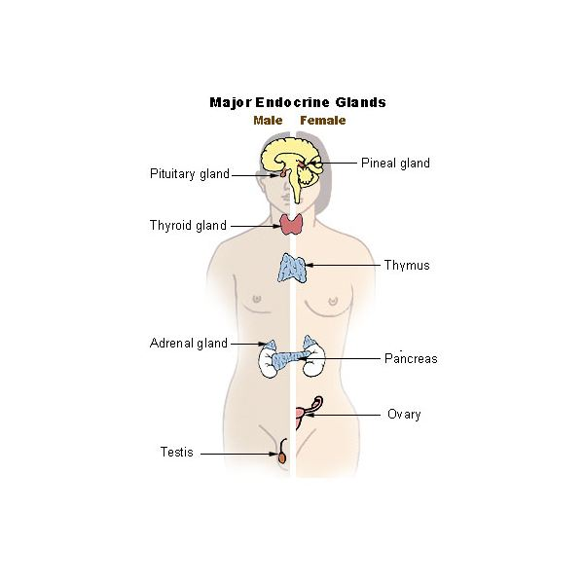
The Hypothalamo-pituitary gonadal axis – controller of reproduction and the prototype for brain sex differences
Rising levels of E2
Hypothalamus
Gonadotrophin releasing hormone
Pituitary gland
Pituitary
Gonadotrophins
LH/FSH
Thyroid gland
LH surge
Adrenal gland
Oestrogens
Progesterone
Ovary
Ovary
Testis
Testerone
Ovulation
Males have a different hard-wiring of hypothalamic neuronal circuitry
Notes:
But I diverge from sex differences. This summarizes why sex differences in hypothalamic circuitry are important for reproduction and reproductive behaviours.
The hypothalamic neurones governing the hypothalamo pituitary gonadal axis produce gonadotrophin releasing hormone that stimulates release of the gonadotrophins, LH and FSH and, consequently, oestrogens and progesterone from the ovaries or testosterone from the testes. As E2 levels rise over the menstrual cycle, this stimulates the gonadotrophin releasing hormone neurones, which generated an LH surge that is the trigger for ovulation and, in rats, the trigger for sexual receptivity. If you give E2 to males, they cannot mount an LH surge and this is one example that suggests that the hypothalamic hard-wiring is different between the sexes.

Slide 6
Early/mid follicular and luteal phases
Late follicular phase
HPG axis
Hypothalamus
pulsatile GnRH
release
GnRH
Pituitary
FSH/LH
androgens
oestrogens
progesterone
Gonads
female
male
female

Slide 7
MALES
HIGHER CENTRES
-ve
HYPOTHALAMUS
-ve
Pulsatile release
GnRH (LHRH)
ANTERIOR PITUITARY GLAND
-ve
FSH
LH (ICSH)
TESTIS
Sertoli cells
Leydig (interstitial) cells
ANDROGENS
Testosterone
DHEA and androstenedione
Spermatogenesis
Secondary sex organs

Slide 8
ovulation
20
80
15
LH (U/l)
FSH (U/l)
10
40
5
0
0
2000
50
1000
25
Oestrogen (pmol/l)
Progesterone (nmol/l)
0
0
0
2
4
6
8
10
12
14
16
18
20
22
24
26
28
Days
Follicular phase
Luteal phase

Slide 9
FEMALE
HIGHER CENTRES
-ve (+ve)
-ve
HYPOTHALAMUS
GnRH
Pulsatile release cyclical changes
-ve
ANTERIOR PITUITARY GLAND
-ve (+ve)
FSH
LH
GF
CL
ovum
OESTROGEN
PROGESTERONE
Ovulation
Falling E & P, menses
Follicular phase (rising oestrogen)
Luteal phase (rising progesterone)
Fertilization, implantation

Slide 10
Overview
Genetic control of sex determination vs epigenetic control of sex differentiation
manifestation of sex differences in CNS related to reproductive functions
mechanisms for engendering sex differences: a critical period of sensitivity and a role for testosterone in masculinizing the brain

Slide 11
Definitions
Sex
Distinguishes male or female subjects according to the reproductive organs and functions that derive from the chromosomal complement (male XY or female XX sex chromosomes)
Gender
A [human] subject’s self-representation as male or female

Slide 12
Definitions
Dimorphisms
The occurrence of 2 forms within the same species
Sex dimorphisms occur in regions of human and animal brains important for
-Reproduction (hypothalamus)
-Cognition, memory and affect (hippocampus, amygdala, cortex)
-Sensorimotor control and reward (mesostriatal and mesolimbic pathways)
Cahill L Nature Neuroscience 2006;
Gillies GE & McArthur S. PharmRevs 2010

Slide 13
Definitions
In the male brain
Masculinization
Organization of a neural substrate permissive to the expression of male sexual behaviour, manifest in rats as mounting, thrusting/intromission, ejaculation
Defeminization
The loss of capacity as an adult to display female sexual behaviour, manifest as lordosis in rats – a stereotypic posture that signals receptivity to males.
The loss of capacity as an adult to respond to the activational effects of oestradiol and progesterone to induce female sexual behaviour

Slide 14
Definitions
In the female brain
Feminization –
A more recent concept, as studies have suggested an organizing role of prepubertal estradiol in the development of neural mechanisms that control female-typical sexual behaviour

Slide 15
Historical perspectives on sex differentiation
460 B.C. Thermal hypothesis (Empedokles of Akras). Conception in a cold uterus - female offspring; in a hot uterus - male
440 B.C. Hypothesis of laterality (Anaxagoras of Clazomenae). Right testis/horn of uterus - male offspring; left - female
384 - 322 B. C. Aristotle of Stagirus. Warm winds from the south during copulation - male offspring; cold winds - female

Slide 16
cf.
frogs - male phenotype if larvae develop at elevated water temperatures.
lizards - incubation of eggs >26ºC - males; <26 ºC - females
certain turtles - incubation of eggs < 26ºC - males; >32 ºC - females

Slide 17
Genetic vs Epigenetic factors governing sexual differentiation
21st Century
The early embryo is essentially female, or at least neutral.
Masculinization of the mammalian gonads is genetically determined
testes determining factor (TDF)/sex determining region (Sry) on Y chromosome.
Thereafter, differentiation of other sexual structures (internal and external genitalia) and the brain depends on the imprinting actions of hormones during fetal or neonatal life (epigenetic).

Slide 18
Genetic determination of sex and epigenetic influences on sex differentiation
XY
XX
Y-linked Sry gene

Slide 19
Genetic determination of sex and epigenetic influences on sex differentiation
XY
XX
Y-linked Sry gene
Formation of testis via unknown mechanisms in an embryo with no pre-existing male/female differences
Testosterone
Mullerian duct Inhibitory Factor
prevents development of
internal female genitalia

Slide 20
Genetic determination of sex and epigenetic influences on sex differentiation
XY
XX
Y-linked Sry gene
Formation of testis via unknown mechanisms in an embryo with no pre-existing male/female differences
Testosterone
Mullerian duct Inhibitory Factor
prevents development of
internal female genitalia
5α-reductase
Development and differentiation of the Wolffian duct giving rise to internal genitalia (epididymis, ductus
seminal vesicles)
Differentiation of external genitalia
(penis, penile urethra, scrotum)

Slide 21
Genetic determination of sex and epigenetic influences on sex differentiation
XY
XX
Y-linked Sry gene
Formation of testis via unknown mechanisms in an embryo with no pre-existing male/female differences
Testosterone
Mullerian duct Inhibitory Factor
prevents development of
internal female genitalia
aromatase
5α-reductase
Masculinization
of CNS
Development and differentiation of the Wolffian duct giving rise to internal genitalia (epididymis, ductus
seminal vesicles)
Differentiation of external genitalia
(penis, penile urethra, scrotum)

Slide 22
Genetic determination of sex and epigenetic influences on sex differentiation
XY
XX
Y-linked Sry gene
Development of Mullerian
duct, giving rise to
internal genitalia
(uterus, oviduct, ovary)
Formation of testis via unknown mechanisms in an embryo with no pre-existing male/female differences
Testosterone
Mullerian duct Inhibitory Factor
prevents development of
internal female genitalia
In absence of testosterone
external genitalia form
(clitoris, labia)
aromatase
5α-reductase
Masculinization
of CNS
Development and differentiation of the Wolffian duct giving rise to internal genitalia (epididymis, ductus
seminal vesicles)
Differentiation of external genitalia
(penis, penile urethra, scrotum)

Slide 23
Sex differences in circulating gonadal steroid hormone levels determine sex differences in the CNS.
Y chromosome
bipotential gonad differentiates into
testis
Endocrine environment
Genome
Phenotype

Slide 24
Sex differences in circulating gonadal steroid hormone levels determine sex differences in the CNS.
Y chromosome
bipotential gonad differentiates into testis
Endocrine environment
Genome
Early transient rise in circulating testosterone irreversibly masculinises the hypothalamic neural pathways regulating anterior pituitary secretions “organisational actions”
Phenotype

Slide 25
Sex differences in circulating gonadal steroid hormone levels determine sex differences in the CNS.
Y chromosome
bipotential gonad differentiates into testis
Endocrine environment
Genome
Early transient rise in circulating testosterone irreversibly masculinises the hypothalamic neural pathways regulating anterior pituitary secretions “organisational actions”
Phenotype
Post-pubertal sex steroid hormones activate and maintain sexual dimorphisms in the CNS
“activational actions”

Slide 26
Sex differences in circulating gonadal steroid hormone levels determine sex differences in the CNS.
Y chromosome
bipotential gonad differentiates into testis
Endocrine environment
Genome
Early transient rise in circulating testosterone irreversibly masculinises the hypothalamic neural pathways regulating anterior pituitary secretions “organisational actions”
Phenotype
Anatomical, morphological biochemical & functional consequences
Post-pubertal sex steroid hormones activate and maintain sexual dimorphisms in the CNS
“activational actions”

Slide 27
sex hormones and their actions in the brain
Steroidogensis in the developing testes is activated earlier in development than ovarian steroidogenesis
The brain develops in a different hormonal environment in males & females
In the developing brain, sex hormones influence
Neurogenesis
Migration
Neurite extension
Synaptogenesis
Growth factor production
Apoptosis
This establishes irreversible sex dimorphisms in specific neural circuits = sexual differentiation of the brain

Slide 28
Patterns of hormone exposure throughout life; a biological basis for sex differences in the brain
Sry gene on Y chromosome directs development of testes
Pubertal hormones activate sexually differentiated brain circuitry
Embryo is not sexually differentiated
conception
birth
puberty
death
rodents
Critical period for hormone-dependent sexual differentiation (organization) of the hypothalamus
Notes:
There is currently some debate as to whether genes on the Y sex chromosome, that is present only in males, contribute directly to brain sex differences, but the overwhelming evidence from basic science studies conclude that sex differentiation of the brain is primarily a hormone-dependent process.
For a short period after conception the is no difference in male and female embryos – in the brain or elsewhere. The Sry gene on Y chromosome then plays a key, indirect role, by directing the development of testes in males, which are transiently activated during development to secrete testosterone. This co-incides with a critical window when the hypothalamic circuitry is susceptible to masculinization or defeminization that persists throughout life. These circuits are, however, not activated until the pubertal rise in testosterone levels.
The experiments can’t be performed to establish if this is the case for humans, but the patterns of hormone exposure suggest that this is likely.

Slide 29
Patterns of hormone exposure throughout life
tissue aromatase activity + neurosteroidogenesis
Testosterone exposure in male rats
conception
birth
puberty
death
4 day
estrous
cycle
Estradiol exposure in female rats
LH surge &
ovulation
conception
birth
puberty
death
21 days
35-45
days
Gillies & McArthur Pharmacol Rev 62: 155-198, 2010

Slide 30
Plasma testosterone levels in pregnant rats and their offspring
male
female
2400
mother
2000
Testosterone
pg/ml
plasma
1600
1200
800
400
17
19
21
23
31
birth
Days post-fertilisation
modification after Weisz & Ward

Slide 31
*ORGANISATIONAL effects of gonadal steroids in the CNS
At critical developmental stages hormones induce specific neural substrates or circuits to develop differently in males and females such that they react differently at a later stage when they are exposed to the same hormonal environment. eg. the neural regulation of the hypothalamo-pituitary-gonadal (HPG) axis and sexual behaviour
These effects are irreversible.
*First described in 1959, Phoenix CH. Organising action of prenatally administered testosterone proprionate on the tissues mediating mating behavior in female guine-pigs. Endocrinology 65:163-96.

Slide 32
ACTIVATIONAL effects of gonadal steroids in the CNS
In adulthood, the response of a given neural element will differ depending on the hormonal environment e.g. even low dose androgens will make women more assertive and increase libido.
These effects are reversible.

Slide 33
Summary Testicular differentiation is the primary event in sex determination Sexual differentiation (body and brain) is controlled by gonadal secretions

Slide 34
Overview
Genetic control of sex determination vs epigenetic control of sex differentiation
manifestation of sex differences in CNS related to reproductive functions
mechanisms for engendering sex differences: a critical period of sensitivity and a role for testosterone in masculinizing the brain

Slide 35
Sex differences in the brain - control of reproductive-associated functions
Reproductive physiology
cyclicity in the patterns of pulsatile GnRH release in females
Reproductive behaviours
eg. lordosis (female) and mounting (male)
Reproductive-associated behaviours
eg. maternal/parenting behaviour, aggressive/territorial behaviour

Slide 36
Origins of sex differences in the control of reproductive function:
evidence that the brain important
evidence that testosterone is a driving force

Slide 37
1936 Caroll Pfeiffer: Sex differences in controlling reproductive behaviour, gonadal function and ovulation are determined by sex differences in the CNS

Slide 38
Ovarian tissue transplanted into:-
adult male rats (normal or castrated)
- grafts show normal follicular growth, but no ovulation
adult male rats castrated at birth
- cyclical ovulation occurs
Conclusion: Testicular factors (testosterone), present in early life, are the agents responsible for inhibiting ovulation by transplanted tissue.
Hypothesis: Neonatal testicular androgens could be causing sex differences at pituitary level or at higher centres

Slide 39
Testicular extracts given to neonatal female rats, prevented the LH surge and permanently blocked ovulation (‘masculinised’ the HPG axis).
Conclusion: A hormone-dependent sex difference could exist at the level of the anterior pituitary gland.
Ovulation will occur after hypophysectomy in the female rat followed by transplantation of a male pituitary gland beneath the hypothalamus.
Conclusion: Sex differences must lie in the brain and not the pituitary gland.

Slide 40
What is the experimental evidence that testosterone is the major driving force for masculinisation of the brain?
Focus:
Sex differences in the hypothalamic control of reproductive behaviour, gonadal function and ovulation.
Neuroanatomical and functional evidence

Slide 41
1. Neuroanatomical evidence in the sexually dimorphic nucleus of the preoptic area (SDN-POA) of the hypothalamus (influences copulatory behaviour in adult rats).

Slide 42
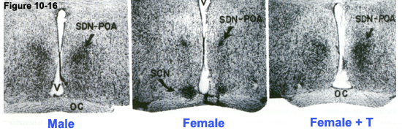
1. Neuroanatomical evidence in the sexually dimorphic nucleus of the preoptic area (SDN-POA) of the hypothalamus (influences copulatory behaviour in adult rats).
neonatal treatment

Slide 43
Development and sexual differentiation of the sexually dimorphic nucleus of the preoptic area (SDN-POA) in female ( ) and male ( ) rats.
600
Volume of SDN
% vs size 3 days
before birth
500
400
300
200
100
-3
-1
1
3
5
7
9
Humans - sex differences in SDN volume appear around
6 years of age when cell numbers decline in the female
modification after Gorski 1984

Slide 44
Influence of perinatal hormone environment on the volume of the SDN-POA
genetic female
genetic male
(* develops female genitalia
** normal genitalia)
100
*
80
Volume
of SDN
%
adult male
60
40
**
20
control
control
Gdx P1
TFM
testicular feminised
male
TP E16-P10
EB P2 100μg
TP P4 1.25mg
DES E16-P10
Gdx P1 + TP P2
Tamoxifen E16-P10
modification after
Gorski 1984

Slide 45
Conclusion
The organizational actions of testosterone in the HPG axis are mediated by estrogenic metabolites of testosterone

Slide 46
Length of gestation vs timing of critical period for CNS sexual differentiation
From MacLusky & Naftolin 1981

Slide 47
2. Functional evidence for early masculinization of the neural circuitry regulating the LH surge and, hence, ovulation.
Organizational actions of gonadal steroids imprint a male-type neural circuitry.

Slide 48
I. Experimental paradigm in adult animals: -ovariectomise (Ovx) adult female rats
- administer oestradiol (E2) followed 48h later by progesterone (P) to mimic the natural stimulus for an LH surge and ovulation
measure circulating LH
Follow similar paradigm in castrated (Cx) male rats, which will have the same basal sex hormone status as Ovx female rats

Slide 49
Hormonal masculinization/defeminization of hypothalamic circuitry regulating LH release
Female: adult Gdx
Male: adult Gdx
Male: neonatal Gdx
Circulating
LH
levels
E₂
P
E₂
P
E₂
P
48h
48h
48h
female: neonatal T
Male: neonatal aromatase inhibition
Circulating
LH
levels
E₂
P
E₂
P
48h
48h

Slide 50
Rats
T exposure in males
4 day
estrous cycle
X
X
E2 exposure in females
LH surge
& ovulation
T or E2
conception
birth
puberty
death
Defeminization of the brain –
‘the loss of capacity to respond to E2”
Notes:
As one example of the experimental hormonal manipulations that can be done to test this concept, administration of either T or E2 to newborn female rats can suppress the ability of E2 to stimulate an LH surge and ovulation in adulthood. Therefore, defeminization of the brain has also been defined as the loss of capacity to respond to E2, which will have relevance for later in my talk.

Slide 51
FOCUS: Sex differences in CNS - control of reproductive-associated functions
Reproductive physiology
cyclicity in the patterns of pulsatile GnRH release in females
Reproductive behaviours
eg. lordosis (female) and mounting (male)
Reproductive-associated behaviours
eg. maternal/parenting behaviour, aggressive/territorial behaviour
A role for ERs
in mediating
sex differentiation
in the brain

Slide 52
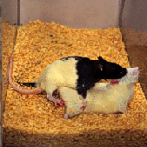
Reproductive behaviours

Slide 53
ER antisense oligonucleotides can reverse the effects of ‘androgenisation’ on sexual receptivity in female rats
Neonatally androgenised female (Neo T)
Neo T
+ vehicle
Neo T
+ antisense
Neo T
+ scrambled oligo
100
80
%
exhibiting
lordosis
60
40
20
adult
+ E&P
+E&P
adult Ovx, E+P
modification after McCarthy et al (1993) Endocrinol 133:433

Slide 54
Summary
Hormonal manipulations in experiments designed to test the hypothesis that testosterone masculinises the brain after aromatisation to oestradiol (“aromatization hypothesis”) include:
Neonatal Gdx in males +/- neonatal T, E2, DES, DHT
Neo T/DHT/DES/E2 to females
Neo aromatase inhibitors
Neo anti-estrogens (eg tamoxifen) or ER antisense oligonucleotides
Transgenic models (ERKOs; AR KOs; Aromatase KOs)
The outcome of such manipulations include effects on brain structure, function and behaviours relating to reproduction.

Slide 55
Why doesn’t oestrogen of maternal/placental or foetal origin masculinize the female fetal brain?

Slide 56
Pause

Slide 57
Why doesn’t oestrogen of maternal/placental or foetal origin masculinize the female fetal brain?
See also Tuorial 4

Slide 58
How does testosterone masculinise the brain after local aromatisation to estradiol?

Slide 59
Overview
Genetic control of sex determination vs epigenetic control of sex differentiation
manifestation of sex differences in CNS related to reproductive and non-reproductive functions
mechanisms for engendering sex differences: a critical period of sensitivity and a role for testosterone in masculinizing the brain

Slide 60
Macroscopic (regional size) and microscopic sex (synaptic connectivity and cellular morphology) differences in brain regions controlling reproductive functions
Preoptic area, POA (includes sexually dimorphic nucleus)
Arcuate nucleus, Arc
Ventromedial nucleus, VMN

Slide 61
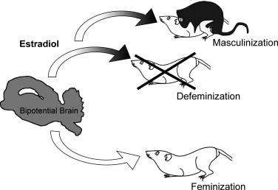
Three processes of brain sexual differentiation
Female by
default
Adapted from Schwartz JM & McCarthy MM J Steroid Biochem Mol Biol 2008, 109: 300-3006

Slide 62
Neonatal treatment of male rats castrated at birth (P1) with testosterone (500mg ), but not oil vehicle ( ) suppresses apoptosis (TUNEL stain) in SDN-mPOA, but not the lateral preoptic area
SDN
Lateral preoptic area
1.8
Total cells
undergoing
apoptosis
%
1.5
1.2
0.9
0.6
*
*
*
0.3
6
7
8
10
6
7
8
adapted from Breedlove SM
Days after birth

Slide 63
Preoptic area, POA
Median preoptic nucleus
Medial preoptic nucleus – includes SDN; controls copulation in males (m volume > f)
Lateral preoptic nucleus – non-REM sleep
Preoptic periventricular nucleus
SDN of the medial POA - major site for regulating male sexual behaviours in all vertebrate species studies
2-3 times as many dendritic spine synapses (excitatory input) in males compared with females
McCarthy MM Physiol Rev 2008, 88: 91-134

Slide 64
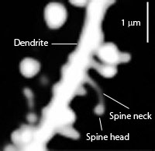
DENDRITIC SPINES
Small membranous protrusions from dendrites;
sites for receiving inputs from axons
normally excitatory (glutamatergic input)
A single neuron may have hundreds-thousands of dedndritic spines
Storage site for synaptic strength
May form and retract rapidly (seconds-minutes) in response to stimuli (synaptic plasticity)
Important for learning and memory

Slide 65
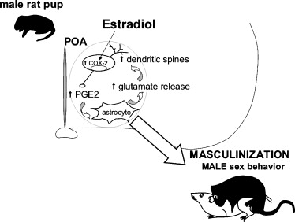
1
aromatised from T
up-regulates COX-2 & PGE2
4
3
2
A working model of estradiol-induced masculinization of preoptic area SDN neurons: males have a two to threefold greater density of spine synapses than females which is associated with male sexual behaviour in adulthood.
Adapted from Schwartz JM & McCarthy MM J Steroid Biochem Mol Biol 2008, 109: 300-306

Slide 66
Arcuate nucleus Arc Important role in regulating LH surge
Sexually dimorphic
GnRH-regulatory circuitry
High physiological levels of E2 in adult rats
have a transitory positive feedback on GnRH release to induce a synchronized burst of GnRH release; a trans-synaptic effect (GnRH neurones lack ERα, have few ERβ) in females
reduce axosomatic synapses (inhibitory inputs) exerted by GABAergic inter-neurons on GnRH neurones (disinhibition) in females
Greatly increases the density of dendritic spine synapses (glutamatergic inputs) to GnRH neurones in females
Adult gonadectomised males do not exhibit such responses because of hormonal programming during development
McCarthy MM Physiol Rev 2008, 88: 91-134

Slide 67
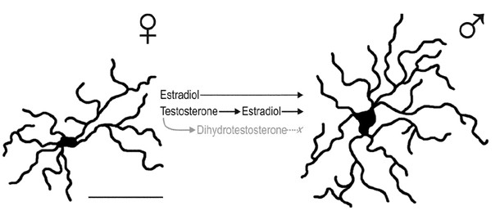
Immunocytochemical detection of GFAP on the first day of life (scale bar = 25 μM)
Arcuate nucleus
Sexually dimorphic
astrocyte morphology
Programmed by T converted to E2
Reduces synaptic contacts in Arc
In adult females shape varies across estrous cycle; greater ensheathment of arcuate neurons at midcycle (reduces GABAergic contacts?)
In adult males greater complexity of astrocyte morphology does not change with hormone manipulations

Slide 68
Arcuate nucleus – male rats Permanent elimination of synapses in newborn males (consequent on astrocyte structure) imprints sexually dimorphic neuroarchitecture

Slide 69
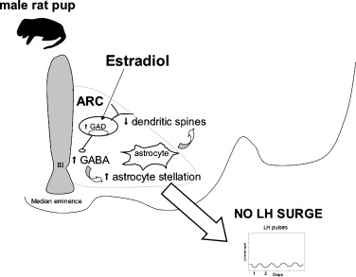

Slide 70
Ventromedial nucleus, VMN
Ventrolateral division is important for female sexual behaviour (lordosis)
In gdx females (not males) high physiological levels of E2 induce PR expression, increase spine and synaptic density and induce lordosis in presence of receptive male
Sex differences are due to testosterone (aromatised to estradiol) in the perinatal period

Slide 71
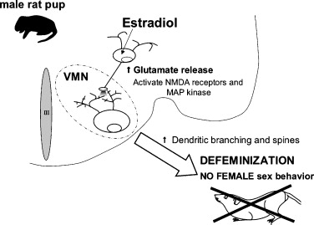
Renders male unable to display female sexual behaviour
Adapted from Schwartz JM & McCarthy MM J Steroid Biochem Mol Biol 2008, 109: 300-3006

Slide 72
Summary T after aromatisation to E2 acts via multiple mechanisms on neonatal hypothalamic neurones and glial cells to induce permanent structural changes and confer resistance to oestrogenic influences in adulthood.

Slide 73
Is the aromatization hypothesis universally applicable throughout the brain (Morris et al 2004)?

Slide 74
AVPV (a region of the POA)
hypothalamic anteroventral periventricular nucleus is involved in regulating ovulatory cycles.
Larger (more neurones) in females than males
Oestrogenic metabolites of testosterone induce apoptosis during development
Spinal nucleus of the bulbocavernosus
motor neurones in the lumbar spinal cord innervating striated muscles at the base of the penis
larger in males than females.
neurone survival is AR-dependent, but secondary to testosterone effects to prevent death of target muscle cells.

Slide 75
Conclusion: Overwhelming evidence demonstrates that sex differences in prenatal hormone exposure imprints sex differences in the brain (hypothalamus) in all experimental species studied. T/E2 uses distinct mechanisms to establish sex differences in different brain regions

Slide 76
? To what extent do findings on sexual differentiation of the hypothalamus in experimental species extend to 1. humans 2. other brain regions

Slide 77
Sex steroid hormones in perinatal life II: the human condition
Imperial College London
Glenda Gillies
17th Jan 2013

Slide 78
Learning objectives
Compare and contrast the in utero patterns of hormonal exposure in human male and female foetuses.
2. Describe some structural and behavioural sex differences in the human brain.
3. Provide examples of how perinatal hormones and postnatal experiences may influence human brain sex differences.
4. Explain how rodent studies suggest that sex linked genes influence brain sex differences

Slide 79
General reading list
Arnold AP. Burgoyne PS. (2004). Are XX and XY brain cells intrinsically different? Trends Endocrinol Metab. Jan-Feb;15(1):6-11.
Breedlove SM. Sexual differentiation of the nervous system. Chapter 7, In: “Principles of Neural Science”. Fourth Edition; Eds: Kandell ER, Schwartz JH, Jessell TM. pp1131-1148.x matters for neuroscience.
Hines M. Gender development and the human brain. Annu. Rev. Neurosci. 2011. 34:69-88
Morris JA, Jordan CL, Breedlove SM (2004) Sexual differentiation of the vertebrate nervous system. Nature Neuroscience 7: 1034-1039.
Swaab DF, Chung WCJ, Kruijver FPM, Hofman MA, Hestiantoro A (2004) Sex differences in the hypothalamus in the different stages of human life. Neurobiol Aging 24: S1-16.
Swaab DF 2004 Sexual differentiation of the human brain: relevance for gender identity, transsexualism and sexual orientation. Gynecol Endocrinol. 2004 Dec;19(6):301-12. Review

Slide 80
Is there evidence for an early testosterone surge in primates? If so, does it determine sex differences in the human brain?
Primates:
sexual differentiation of the brain is principally prenatal

Slide 81
Patterns of hormone exposure throughout life; a biological basis for sex differences in the brain
Sry gene on Y chromosome directs development of testes
Pubertal hormones activate sexually differentiated brain circuitry
Embryo is not sexually differentiated
conception
birth
puberty
death
Critical period for hormone-dependent sexual differentiation (organization) of the hypothalamus
rodents
Notes:
There is currently some debate as to whether genes on the Y sex chromosome, that is present only in males, contribute directly to brain sex differences, but the overwhelming evidence from basic science studies conclude that sex differentiation of the brain is primarily a hormone-dependent process.
For a short period after conception the is no difference in male and female embryos – in the brain or elsewhere. The Sry gene on Y chromosome then plays a key, indirect role, by directing the development of testes in males, which are transiently activated during development to secrete testosterone. This co-incides with a critical window when the hypothalamic circuitry is susceptible to masculinization or defeminization that persists throughout life. These circuits are, however, not activated until the pubertal rise in testosterone levels.
The experiments can’t be performed to establish if this is the case for humans, but the patterns of hormone exposure suggest that this is likely.

Slide 82
Patterns of hormone exposure throughout life; a biological basis for sex differences in the brain
Sry gene on Y chromosome directs development of testes
Pubertal hormones activate sexually differentiated brain circuitry
Embryo is not sexually differentiated
conception
birth
puberty
death
1st trimester – development of sexual anatomy
2nd & 3rd t trimester – brain sexual differentiation
Humans
Sexual differentiation of gonadal anatomy and the brain are separate events
Notes:
There is currently some debate as to whether genes on the Y sex chromosome, that is present only in males, contribute directly to brain sex differences, but the overwhelming evidence from basic science studies conclude that sex differentiation of the brain is primarily a hormone-dependent process.
For a short period after conception the is no difference in male and female embryos – in the brain or elsewhere. The Sry gene on Y chromosome then plays a key, indirect role, by directing the development of testes in males, which are transiently activated during development to secrete testosterone. This co-incides with a critical window when the hypothalamic circuitry is susceptible to masculinization or defeminization that persists throughout life. These circuits are, however, not activated until the pubertal rise in testosterone levels.
The experiments can’t be performed to establish if this is the case for humans, but the patterns of hormone exposure suggest that this is likely.

Slide 83
Fig 1 cont’d. Patterns of hormone exposure throughout life
Patterns of hormone exposure throughout life
Testosterone exposure in male humans
conception
birth
puberty
death
28 day
menstrual
cycle
Estradiol exposure in female humans
d1
LH surge
& ovulation
d28
conception
birth
puberty
menopause
death
9
months
10-13
years
Gillies & McArthur Pharmacol Rev 62: 155-198, 2010

Slide 84
Rats
T exposure in males
Critical
Window for sex differ-entiation
4 day
estrous cycle
LH surge
& ovulation
E2 exposure in females
conception
birth
puberty
death
21 days
35-45 days
Humans
Critical
Window for sex differ-entiation
?
T exposure in males
28 day
menstrual
cycle
E2 exposure in females
1
LH surge
& ovulation
28
conception
birth
puberty
menopause
death
9 months
10-13 years
Notes:
Here you can see that in both rats and humans there are similar patterns of exposure to testosterone, shown in blue, and E2 in pink.
I apologise to those of you who may object to the blue/pink sterotyping. I had thought of breaking away from this convention, but I once attended a symposium where the speaker had used other colours – yellow and green, I think, and many of the audeince found it utterly confusing, so I hope that it serves its purpose.
So, in both cases we see a transient rises in testosterone in early life, that then lies dormant until puberty. In rats the critical period occurs just before and after birth whereas in humans it is likely to occur around or just before mid gestation. Interestingly, the stage of brain development in humans at mid gestation corresponds approximately to birth in the rat, which is a precocious species.
The patterns of E2 exposure are also similar across species, with cyclicity emerging at puberty to trigger the LH surge and ovulation.

Slide 85
Pattern of LH and FSH secretion during development in the male primate
In humans sex determination begins around GD 7 weeks when Sertoli and Leydig cells form in males
Birth
LH/FSH
Testosterone
Testis size
Sertoli cell number
Foetal
life
Neonatal
life
Puberty
activation of
H-P axis
Adulthood

Slide 86
Sexual dimorphisms in the human brain - structure
Brain and body weight at birth is greater in males than females
Sex differences in regional volumes may resemble those seen in other mammalian species where early exposure to testosterone has been shown to be a determining factor.
The 3rd interstitial nucleus of the anterior hypothalamus (INAH-3) is the human homologue of the rodent SDN-POA (m > f= homosexual men)
Sex differences appear around 6 years of age (cell numbers decline in girls)
Amygdalar volume: men > women
Hippocampal volume, regional cortical thickness and gyrification: women > men

Slide 87
Sexual dimorphisms in the human brain – behavioural differences imply differences in circuitry and connectivity
On average
Children at ages when sex steroids hormone levels are low and do not show sex differences, show relatively large sex differences in play and activities
Girls prefer dolls; boys prefer toy vehicles and rough-and-tumble play

Slide 88
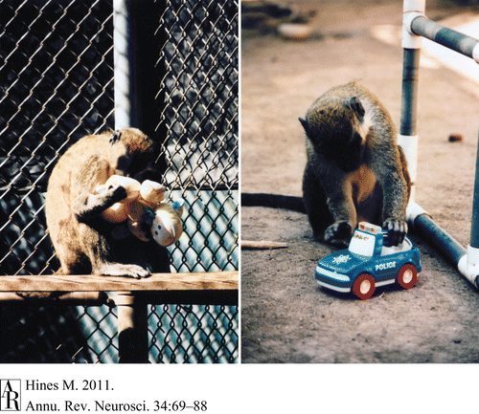
Female and male vervet monkeys conform to play with human children’s sex-typed toys

Slide 89
Sexual dimorphisms in the human brain – behavioural differences imply differences in circuitry and connectivity
On average
Children at ages when sex steroids hormone levels are low and do not show sex differences, show relatively large sex differences in play and activities
Girls prefer dolls; boys prefer toy vehicles and rough-and-tumble play
men perform better in visuospatial tasks
women perform better in verbal tasks
boys perform better in mathematical reasoning tasks
females show more empathy
males show more aggression
males display better accuracy at throwing balls at targets

Slide 90
Factors influencing human brain sex differences I. prenatal hormones II. postnatal experience

Slide 91
I. Evidence that prenatal hormones influence human brain sex differences
1. Genetic syndromes leading to foetal hormonal abnormalities
Congenital adrenal hyperplasia (CAH)
Girls exhibit an increase in male-typical play and a decrease in female-typical play
This correlates with a reduction in heterosexual orientation as adults and a 600 fold increase in the likelihood to experience severe gender dysphoria as adults

Slide 92
I. Evidence that prenatal hormones influence human brain sex differences
2. Therapeutic use of hormones during pregnancy
Medroxyprogesterone acetate (Provera) – an androgen antagonist – exaggerated female-typical play in girls
Androgenic progestogens – virilising effect on offspring behaviour
Diethylstilboestrol - Daughters showed greater evidence of cognitive lateralisation than their non-DES -exposed sisters (listening task and visual search task) ie. a more male-type pattern.

Slide 93
I. Evidence that prenatal hormones influence human brain sex differences
3. Correlation of normal maternal variations in hormone levels in early life with subsequent normal behavioural variability.
Levels of testosterone in amniotic fluid or maternal circulation during pregnancy correlate with the degree of male-typical behaviour and brain structure, suggesting that gonadal hormones contribute to intra- as well as inter-sex differences.

Slide 94
II. Evidence that postnatal experience influence human brain sex differences
Mathematical ability
Ratio of boys to girls with highest SAT scores
1982 – 13:1
2007 – 2.8:1
Performance becomes more equal in nations where women have greater equality with men
Early life stress can reduce testosterone synthesis and POA aromatase activity in rats and reduces sexual differentiation of the brain (sexual behaviour and partner preference.

Slide 95
Summary: humans
Testosterone is the major influence for sexual differentiation of the reproductive organs.
There is significant support for the view that organisational influences of the prenatal hormonal environment are major determinants of gender behaviour, gender identity and sexual orientation
Clinical syndromes support the concept that the reproductive system, and possibly the brain, is feminine by default and steroid hormone action is necessary for masculine differentiation
Limited clinical evidence, from DES treated women, supports the view that foetal oestrogens can masculinise aspects of the human brain.

Slide 96
III. Evidence that sex linked genes influence brain sex differences – rodent studies

Slide 97
Before the onset of gonadal differentiation
Rate of development of early embryos is affected by the X and Y chromosomes in mice.
More TH+ neurones develop in mesencephalic cultures derived from male compared with female fetuses.
Lots more discover about
genes vs environment

Slide 98
Hormonal manipulations can fully sex-reverse some sex dimorphisms in the brain
Suggests that XX cells = XY cells?
Y chromosome codes for 27 different proteins, several of which are only expressed in male germ cells, and most of which have a corresponding gene on X chromosome (limited impact?)
Double dose of genes on X chromosome in females, many of which are involved in brain development; most are silenced on one chromosome in non-germline cells, but 19% are not – can higher X dosage in females create sex-specific differences in brain function?
XX cells have a paternal X gene, whereas XY cells do not – can paternal imprint on X genes induce a female-specific pattern of expression?

Slide 99
Before the onset of gonadal differentiation
Rate of development of early embryos is affected by the X and Y chromosomes in mice.
More TH+ neurones develop in mesencephalic cultures (established at E14 before sex differnces in plasma T) derived from male compared with female fetuses.
Reisert I, Pilgrim C Trends Neurosci. 1991 Oct;14(10):468-73. Review
XX and XY brain cells differ
in their cell-autonomous
developmental programmes
Lots more discover about
genes vs environment

Slide 100
XY ⁻ Sry male
XY – mice (male genome
but with Y chromosome
lacking Sry due to
spontaneous mutation)
+
tg insertion of Sry
on autosome
(ubiquitously expressed)
XX
normal
female
cross with
=
4 core genotypes
XY –
Chromosomally male
XY – Sry
Chromosomally male
XX
chromosomally
female
XX Sry
chromosomally
female
Genotype
Gonadal
phenotype
ovaries
female
testes
male
ovaries
female
testes
male

Slide 101
Differences under test conditions
implicate sex hormones and/or
Sry expression in brain cells
XY –
Chromosomally male
XY – Sry
Chromosomally male
XX
chromosomally
female
XX Sry
chromosomally
female
Genotype
Gonadal
phenotype
ovaries
female
testes
male
ovaries
female
testes
male
Differences under test conditions
implicate differences in
sex chromosome complement

Slide 102
Genotype
XY ⁻
XY ⁻ Sry
XX
XX Sry
Gonadal
phenotype
ovaries
female
testes
male
ovaries
female
testes
male
Main effect of sex chromosome complement
Irrespective of gonadal sex, TH-IR cell numbers XY – > XX
Main effect of sex chromosome complement
Effect of sex (gonads or Sry)
TH-IR
Cells
Per
well
E14.5 mouse mesencephalic cells cultured for 6 days

Slide 103
Clinical implications
Do sex differences in the brain provide a basis for sex differences in the prevalence and/or severity of neurological and psychiatric diseases?
e.g. schizophrenia, ADHD, stroke, Parkinson’s disease
(see later - e.g. Schwaab et al 2004; Gillies et al 2004)

Slide 104
THE END
Thank you

Slide 105
Can the presence of the Sry gene influence disease susceptibility?
Sry is expressed in TH-IR neurones of the male rodent SNc
Dewing P et al (2006) Curr Biol 16: 415-20
Male rats and mice have a small but significantly greater number of TH-IR cells in the SNc compared with females
Murray et al (2003) Neuroscience 116: 213-222; Dewing P et al (2006) Curr Biol 16: 415-20
Silencing of Sry reduces the number of SNc THIR cells to levels seen in females and disrupts locomotor behaviour in males
Dewing P et al (2006) Curr Biol 16: 415-20

