Slide 1
Sex and hormonal influences in schizophrenia
Dr Stavros Bekas
Dr Anju Soni
Dr Nick Larsen
25 January 2013

Slide 2
Overview
Presentation:
Schizophrenia – introduction; epidemiology; aetiology; pathology; theories re: sex hormones
Small group discussion
Plenary session

Slide 3
Aims
To discuss the epidemiology and pathogenesis of Schizophrenia
To discuss the role of sex hormones in the pathogenesis of Schizophrenia
To think creatively about ways of investigating the above further

Slide 4
Learning Outcomes
By the end of the teaching session, participants should be better able to:
List the sex differences in the epidemiology of Schizophrenia
Describe the pathology of Schizophrenia
Present ideas in relation to a theory in the literature discussed
Outline a study to demonstrate the above

Slide 5
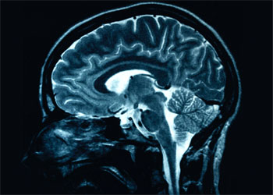
Schizophrenia: Introduction; Epidemiology; Aetiology; Pathology
Dr Nick Larsen
MBChB MSc MRCPsych
SpR in Forensic Psychotherapy

Slide 6
Introduction(1)
Severe mental illness, typically (but not invariably) manifesting as severe psychotic illness with early onset in early adulthood, characterised by bizarre delusions, auditory hallucinations, thought disorder, odd behaviour and progressive deterioration in personal, domestic, social and occupational competence, all occurring in clear consciousness.
Often a difficult clinical picture to hold in mind in its entirety
Acute vs chronic; positive vs negative symptoms; subtypes
Differential diagnoses
Management (especially antipsychotics) and prognosis

Slide 7
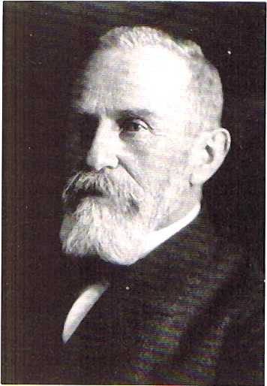
Introduction (2)
Eugen Bleuler (1857 – 1939)
Coined Schizophrenia
4 As:
Loosening of Associations
Flat Affect
Autism
Ambivalence

Slide 8
Introduction (3)
Kurt Schneider (1887-1967)
Attempted to operationalise the diagnosis by describing
“first-rank symptoms”:
Audible thoughts
3rd person hallucinations (voices arguing; running commentary)
Thought insertion
Thought withdrawal
Thought broadcast
Delusional perception
Somatic passivity
Made volition
Made impulse
Made affect
Second-rank symptoms:
Other disorders of perception,
sudden delusional ideas, perplexity,
mood changes, ....

Slide 9
Epidemiology (1)
Lifetime prevalence is about 1%
All countries and all cultures
Populations with increased prevalence: urban; lower socio-economic classes; prison populations; recent immigrants
Lifetime suicide risk: 10%
1 %

Slide 10
Epidemiology (2) Prevalence: M = F
 | Male | Female
Onset | Earlier | Later
First admission < age 25 | > Half | One third
Peak age of onset | 10 – 25 years | 25 – 35 years + Middle age (Bi modal)
Negative symptom Impairment | More likely | Less likely
Social functioning prior to disease onset | Worse | Better
General outcome | Worse | Better

Slide 11
Aetiology
Neurodevelopmental hypothesis: combination of environmental and genetic factors
“Nature +/- nurture”
Temporal – exposure to influenza in utero
Physical - obstetric complications; pro-psychotic drugs
Psychological and social factors
Genetic – 1st degree relatives have 10x increased risk for developing Schizophrenia than general population
Polygenic/multifactorial model

Slide 12
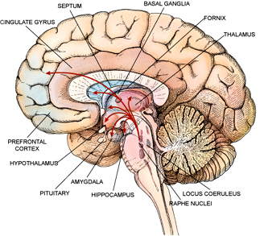
Pathology (1)
Neurostructural and neurofunctional changes:

Slide 13
Pathology (2)
Decreased brain weight and volume (especially reduced volume of the hippocampus, amygdala and the parahippocampal gyrus) (MRI studies)
Enlarged ventricles
Decreased activation of frontal lobe and increased activation of temporal lobe (functional neuroimaging studies)
Liddle et al – correlation of each of 3 syndromes of chronic Schizophrenia with specific pattern of regional cerebral blood flow
Prepulse inhibition disruption

Slide 14
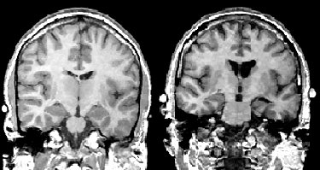
Pathology (3) - Neuroimaging
Reduced cortical volume
Smaller medial temporal lobes
NORMAL
Enlarged lateral and third ventricle
Reduced cortical grey matter
SCHIZOPHRENIA

Slide 15
Pathology (4)
Neurochemistry
Multiple neurotransmitters have been implicated in aetiological theories of Schizophrenia:
Dopamine
Serotonin
Excitatory amino acids (glutamate and aspartate)
Also, phospholipid membrane hypothesis

Slide 16
Pathology (5)
Dopamine hypothesis:
SZ due to excess dopaminergic activity
Amphetamines and levodopa increase dopamine and cause positive symptoms in non-schizophrenics
All effective antipsychotic medications are dopamine D2 receptor antagonists
Serotonin hypothesis:
SZ due to excess serotonergic activity
LSD and psilocybin (5HT receptor antagonists) cause positive symptoms in non-schizophrenics
Newer antipsychotics are potent 5HT receptor antagonists

Slide 17
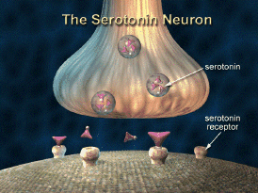
Pathology (6)
Antagonism at the serotonin 5-HT₂ receptor causes reduction in psychotic symptoms
Antipsychotics - SDA (Serotonin-Dopamine antagonists) eg: Clozapine, Risperidone and Sertindole have potent serotonin related activities

Slide 18
Pathology (7)
EAAs:
Insufficient EAAs or receptors (eg NMDA receptors) are implicated in SZ
Low CSF glutamate; decreased glutamate receptors in temporal lobes
Single dose of PCP (non-competitive NMDA receptor antagonist) causes positive and negative symptoms in non-schizophrenics
Phospholipid membrane hypothesis:
Abnormalities of phospholipid metabolism (neuronal membranes) implicated in SZ
Use of omega 3 fatty acids in SZ

Slide 19
Schizophrenia and Sex Hormones (1)
Organisational vs activational effects of sex hormones on brain
Sex differences in severity and age of onset of multiple psychiatric illnesses (e.g. Schizophrenia)
Putative relationship to: sexually dimorphic brain anatomy; differential birth injury rates; differential effects of androgens and estrogens; buffering of early marriage in females

Slide 20
Schizophrenia and Sex Hormones (2)
Activational mechanisms:
Sex hormone receptors in brain; regulation of neuronal function; focus in literature on estradiol.
Estrogens protective against psychosis
Correlation of fluctuating estrogen levels with severity of symptoms
Antenatal vs postpartum psychosis
Possible modulatory effects on neurotransmitter systems
Dopaminergic – neuroleptic-like effect (especially on positive symptoms)
Lindemar – biphasic effect (lingual dyskinesia in monkeys)

Slide 21
Schizophrenia and Sex Hormones (3)
Lindemar (cont.) -up-/down-regulation of dopaminergic systems, affecting receptor density and affinity
Effect of time course of administration
Serotonergic – e.g. prepulse inhibition studies
Sensorimotor gating deficiencies in schizophrenics
Estrogen protective, testosterone facilitative
Apoptosis in hypothalamic dopaminergic neurons (male mice, no estrogen) – putative sex-specific neurodegenerative processes
Variants in estrogen receptor alpha - association with Schizophrenia

Slide 22
Schizophrenia and Sex Hormones (4)
Organisational mechanisms:
Perinatal organisational effects of sex hormones on sexual differentiation
Relates to sex difference in age of onset?
Sex dimorphisms in midbrain dopaminergic circuitry
Crow – sexual selection theory
Therapeutic use of hormones
Conflicting results
Effect of estrogen augmentation on positive, not negative, symptoms
Initial effect, but reversed with longer administration
Lindemar case sudy

Slide 23
Small group discussion
2 – 3 groups
10 minutes per question
Discuss the literature provided and try to answer:
1. What do we know about sex hormones and the brain and how it might potentially explain the above?
2. Choose one particular theory in the provided literature to describe further
based on your current knowledge,
3. Can you think ways of researching such a theory in order to refine and test it?

