Slide 1
Sexual dimorphism and neuroprotection by sex steroids in common complex diseases: Parkinson’s disease as the prototype 28 January 2013 Professor Glenda Gillies
Imperial College London
BSc Endocrinology
Module 3

Slide 2
Objectives
To summarise epidemiological and clinical evidence for sex differences in the prevalence, manifestations and degenerative processes in PD
To evaluate a role for sex hormones in contributing to sex difference in PD: clinical studies; experimental PD (ovx/E2 in females; Cx/T/E2 in males)
To appreciate the difference between cell loss/survival of degenerating neurones versus compensatory mechanisms in surviving neurones as potential protective mechanisms targeted by sex steroid hormones
To assimilate clinical and experimental evidence that the NSDA pathway and associated circuitry is sexually dimorphic
To understand differences in potential modes of action of sex hormones of systemic and central origin

Slide 3
Gillies, G. E. McArthur, S. “Independent influences of sex steroids of systemic and central origin in a rat model of Parkinson’s disease: a contribution to sex-specific neuroprotection by estrogens” Hormones and Behavior. 57, (2010), 23-34.
Gillies, G. E. “Estrogen actions in the brain and the bases for differential actions in men and women: a case for sex-specific medicines”. Pharmacological Reviews 62 (2), (2010), 155-198.

Slide 4
Synopsis thus far
Observational/retrospective comparisons of menopausal women suggest that oestrogen is neuroprotective, neurotrophic and psychotrophic (AD, stroke, schizophrenia, PD)
Ovarian steroids, especially E2, are important factors in providing the female advantage for sex differences in disease susceptibility, a view strongly supported by clinical and pre-cliical studies.
But oestrogens have physiological important roles to play in males as well as females
Therefore, oestrogen-based therapies have potential for brain disorders that affect men and women, but which currently lack effective treatments
Rochira, V., et al (2002). Congenital estrogen deficiency in men: a new syndrome with different phenotypes; clinical and therapeutic implications in men. Mol Cell Endocrinol 193, 19-28.
Jones, M et al (2006) Of mice and men: the evolving phenotype of aromatase deficiency. TEM 17, 55-64.

Slide 5
Parkinson’s disease as a prototype

Slide 6
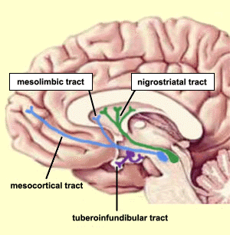
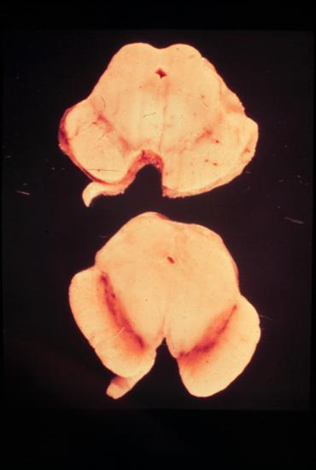
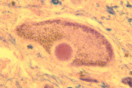
Specific neural circuitry
nigrostriatal dopaminergic system
Parkinson’s disease
SNc
Mask-like facial expression
Pill-rolling tremor
Flexion of trunk
Depigmentation in mid-brain in PD
*
*
Slow, shuffling movements
Inclusion of Lewy body in nigral neurone
substantia nigra pars compacta
Notes:
PD is a highly prevalent debilitating movement disorder.
The main pathological feature of PD is the loss of DA neurones in the SNc that project to the striatum, forming the NSDA pathway. This controls fine movements
Apart from a few % of cases that have genetic origins, we do not know the cause of PD, but it is a highly prevalent and deblitating movement disorder.
Disease symptoms appear to be less at times when E2 levels are highest
However, there are contradictions in the literature .....
but also in its symptoms, progression and responses to treatment

Slide 7
Parkinson’s Disease
tremor, rigidity, bradykinesia, problems of locomotion and balance (1º symptoms)
depression, anxiety, dementia and problems with sleep, speech and swallowing (2º symptoms)
the second most common neurological disorder; affects 1:500 in the dveloped world (3% > 65years)
degeneration of the dopaminergic neurones of the substantia nigra pars compacta (SNc)
Cause unknown (environmental & genetic + aging)
Distinct male:female difference in incidence of idiopathic PD; ratios range from 1.37 to 3.7

Slide 8
After aging, being male is the highest risk factor for developing Parkinson’s disease
Prevalence of idiopathic Parkinson's Disease,
London,1997
1800
Male
1200
Female
No. of cases
600
0
0-29
30-39
40-49
50-59
60-69
70-79
>79
Schrag et al. (2000) B.M.J. 321 21-22
Age (years)

Slide 9
Priorities in Parkinson’s disease research
Meissner WG et al (2011) Nat Rev Drug Discov 10: 377-93
Current therapies rely on dopamine replacement strategies
There is an urgent, unmet need for disease modifying agents
Progress requires an understanding of susceptibility factors that lead to disease
Being male is an important susceptibility factor after age, but this was not considered in the review
Sufficient pre-clinical evidence now suggests that sex differences should no longer be ignored

Slide 10
Factors contributing to sex bias in PD
genetic factors, including factors linked to the sex chromosomes
life-style, especially agri-toxins
sex hormones are considered by far to have the greatest influence on brain sex dimorphisms, whether in structure, function or disease susceptibility
Kaminsky, Z., et al. (2006). Complex disease, gender and epigenetics. Ann Med 38, 530-544.
What role for oestrogens or androgens?

Slide 11
Sex differences in the clinical profile - females present with a milder phenotype in early clinical stages; less frequent rigidity, but greater incidence of PD-associated depression Sex differences in treatment responses
Women are relatively protected from PD compared with men
Shulman L & Bhat V (2006) Expert Rev Neurother 6: 407-16

Slide 12
Epidemiological & clinical evidence suggest that oestrogens are neuroprotective in women
1. Menstrual cycle variations:
Sensorimotor function varies over the human menstrual cycle.
Observational studies suggest that parkinsonian symptoms in premenopausal patients worsen just prior to and during menses, when oestrogen levels are lowest

Slide 13
Epidemiological & clinical evidence suggest that oestrogens are neuroprotective in women
2. Retrospective observations with menopause and HRT
studies suggest that, in postmenopausal women, PD symptoms worsen after withdrawal of HRT
administration of oestradiol has been shown to reduce PD symptom severity in post-menopausal women.

Slide 14
Oestrogen and Parkinson’s Disease
#UPDRS Score
Without E-HRT
26.9 ± 15
Mean ± SD
* P < 0.05
With E-HRT
19.6 ± 11.5*
Saunders-Pullman et al. (1999) Neurology 52 1417-1421
# Unified Parkinson’s disease rating scale (UPDRS) disability score

Slide 15
2. Retrospective observations with menopause and HRT cont’d
oestradiol replacement therapy was associated with a reduced incidence of PD, a delayed onset of PD, and a better cognitive performance in women with PD, but not all studies are in agreement.
Prospective, double-blind studies have been contradictory, but used relatively small patient samples.
Tsang KL et al 2001 The use of oestrogen in the treatment of Parkinson’s disease. Parkinsonism and Related Disorders 8: 133-7.

Slide 16
Properly controlled, large scale prospective studies are needed Clinical studies do not permit investigations into the nature of oestrogen’s actions
They also do not provide clues as to potential hormonal influences in men.

Slide 17
Experimental models of PD

Slide 18
Questions that need to be addressed
Are sex differences in diseases recapitulated in experimental models of disease?
Could endocrine factors (sex steroid hormones) in males as well as females contribute to these diseases
If so, the strategies for harnessing endocrine therapies need to be sex-specific

Slide 19
Models of PD
Lesion models
Rodents
1-methyl-4-phenyl-1,2,3,6,-tetrahydropiridine (MPTP)
6-hydroxydopamine (6-OHDA)
Methamphetamine (MA)
Non-human primates (MPTP)
Mimic aspects of processes that may initiate or propagate neurodegenerative processes
Mitochondrial dysfunction
Excitotoxicity
Inflammation
Glial activation
Trophic factor deficiency
apoptosis
Oxidative stress

Slide 20
2. Transgenic models (may mimic hereditory forms of disease) with disruptions to genes for
Alpha synuclein
Parkin
Ubiquitin C-terminal hydrolase (UCHL-1)
Superoxide dismutase
Lacking studies on hormonal influences

Slide 21
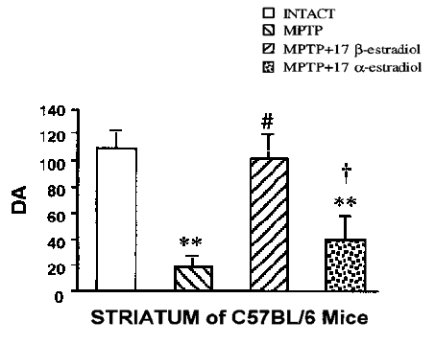
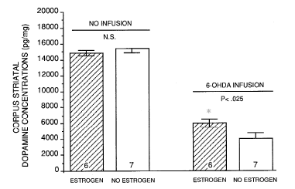
Oestrogen and the Nigrostriatal Dopamine Pathway
Oestrogen has been shown to be protective in a variety of models of dopaminergic toxicity.
MPTP in Ovx
mice
6-OHDA in Ovx
rats
Callier et al. (2000) Synapse 37 245-251
Dluzen (1997) Brain Res. 767 340-344

Slide 22
ERs in the NDSA Pathway
Relevance?
SNc
ERα Negative for mRNA and protein (adult rat)
ERβ Positive for mRNA and protein (adult rat)
Shughrue et al. (1997) J. Comp. Neurol. 388 507-525
Shughrue et al. (2001) J. Comp. Neurol. 436 64-81
Striatum
ERα Positive for mRNA (developing and adult mouse)
Küppers & Beyer (1998) Mol. Brain Res. 34 333-336
ERβ Positive for mRNA, Negative for protein (adult rat) Shughrue et al. (2001) J. Comp. Neurol. 436 64-81
Human studies are lacking

Slide 23
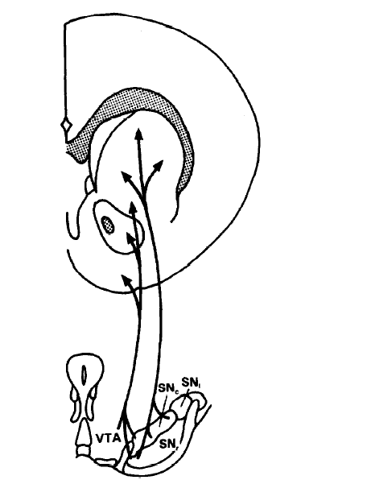
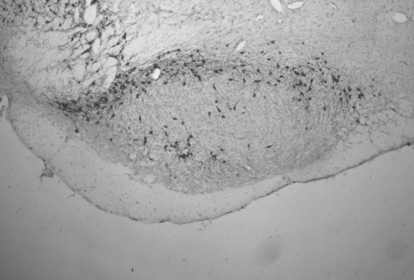
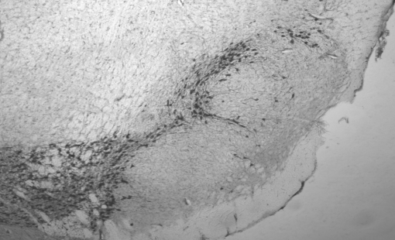
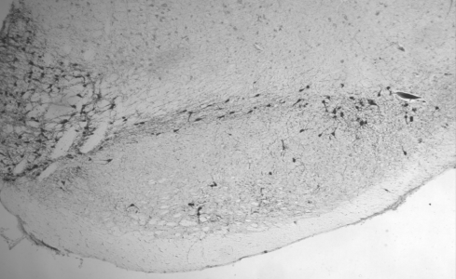
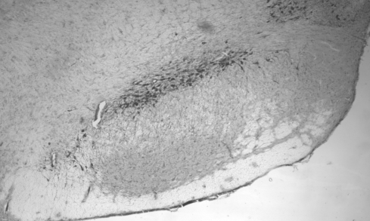
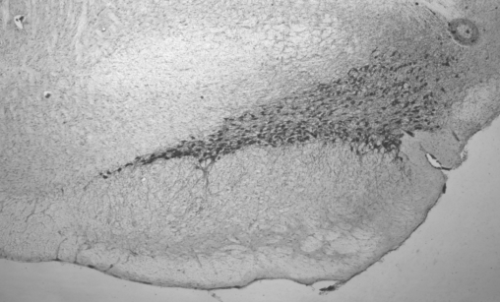
6-OHDA model reproduces
key features of PD
oxidative stress; cell loss
infiltration of reactive
microglia
excitotoxicity
increased iron deposition
in SNc
progressive in nature
DAT density
[¹²⁵I]RTI-121 binding
levels 1-4
HPLC
DA & metabolites
Striatum
6-OHDA Injection
into MFB
E
-6.0
D
-5.7
C
-5.4
SNc 20μm slices
TH ICC
B
-5.1
A -4.8 relative to bregma

Slide 24
Unilateral 6-OHDA lesions
DA cell number in SNc or DA content in striatum
Lesioned/non-lesioned x 100
Non-lesioned side (R)
Lesioned side (L)
Intact animal untreated
Vehicle into L MFB
6-OHDA into L MFB
Vehicle into L MFB
6-OHDA into L MFB

Slide 25
Experimental Parkinson’s disease
Sex differences are seen with mild/moderate lesions
Striatal DA content
% lesioned vs
unlesioned side
DA neurones in SNc
% lesioned vs
unlesioned side
120
DA levels
Striatum
†
†
80
*
*
*
6-OHDA Injection
40
**
SNc
**
**
**
0
Vehicle 1 6
Vehicle 1 6
mg 6-OHDA
Murray et al (2003) Neuroscience 116: 213-222
Notes:
Therefore, we used an experimental model of PD that mimics important aspects of the condition. 6-OHDA is a neurotoxin selective for DA neurones. It is injected into the MFB and
here are recognised familial Model mirrors sex differences in clinical PD

Slide 26
Prevailing levels of estrogen at the time of neurotoxic challenge with 6-OHDA appear to influence susceptibilty
Striatal content pmol/mg
control lesioned
3.0
*
DA
pmol E₂/ml
0
200
80
*
**
DOPAC
0
0
Pro
Di
20
HVA
0
Proestrus
Diestrus
Datla et al Neuroreport (2003) 14: 47-50

Slide 27
Manipulations of the adult sex steroid hormone environment
1
Sham operation + placebo pellet (Gdx control)
Bilateral gonadectomy plus
placebo pellet s.c. (hormone treatment control)
slow release pellet s.c. containing 17β-estradiol (E₂; 0.5 mg for replacement to physiological proestrus levels
slow release pellet containing 5α-dihydrotestosterone (DHT; 1.5 mg for replacement to physiological androgen levels)
2
3
4
1 week
Unilateral lesion with 1 μg 6-OHDA or vehicle infusion
2 weeks
Tissue collection

Slide 28
Adult sex hormones influence lesion size in pre-clinical experimental Parkinson’s disease
Females
Males
100
#
DA content
(% lesioned vs
unlesioned striatum)
80
*
*
*
*
60
40
20
0
Intact
Pro
Ovx
Ovx
+ DHT
Ovx
+ E2
intact
Cx
Cx
+ DHT
Cx
+ E2
Physiological levels of gonadal hormones (E2) are neuroprotective in females
... but in males gonadal hormones (T aromatized to E2) may worsen DA loss
Murray et al (2003) Neuroscience 116: 213-222
Datla et al (2003) Neuroreport 14: 47-50
Notes:
In further experiments we

Slide 29
Females: The neuroprotective effects of gonadal factors in the female are due primarily to physiological levels of circulating estrogen
Numerous studies using ovariectomised mice, rats, monkeys and marmosets exposed to MPTP, methamphetamine or 6-OHDA agree with our finding that estrogen has neuroprotective capacity in females

Slide 30
Males: gonadal factors are not protective and may even exacerbate striatal DA loss
Other Studies agree that Cx and hormone treatment are not protective
Estrogen has no neuroprotective effects against methamphetamine toxicity in male mice, but is neuroprotective in females
in male mice, striatal toxicity of methamphetamine and MPTP was unaffected by gonadectomy

Slide 31
Summary for experimental PD that models early- stage disease (<50% loss of striatal DA)
Detrimental effects of gonadal factors in the male NSDA system as well as protective effects in females contribute to sex differences in susceptibility to striatal injury
E2 has opposite effects on striatal DA loss in males (increased) and females (decreased)
In the absence of sex hormones male and female brains are not identical
Innate sex dimorphisms may be attributable to the established major contribution of the organizational effects of sex hormones
McArthur S. et al (2007) JNeurochem 100: 678-692; Gillies GE & McArthur S. (2010) Horm Behav 57: 23-34 ; Gillies GE & McArthur S.( 2010) Pharm Revs 62: 155-198
Notes:
To summarise, these studies showed that
1
2
From these observations it follows that....3. and, 4. given our prior knowledge, it is reasonable to suggest that

Slide 32
Implications
The detrimental effects of gonadal factors in the male NSDA system, as well as protective effects of ovarian factors in females contribute to sex differences in striatal susceptibility to injury.
The reported clinically beneficial effects of systemic oestrogen on the partially damaged NSDA system in females may not be universally adopted for males
Processes underlying degeneration appear to differ in males and females

Slide 33
Implications
The detrimental effects of gonadal factors in the male NSDA system, as well as protective effects of ovarian factors in females contribute to sex differences in striatal susceptibility to injury.
The reported clinically beneficial effects of systemic oestrogen on the partially damaged NSDA system in females may not be universally adopted for males
Processes underlying degeneration appear to differ in males and females

Slide 34
Neuroprotection at perikarya level?

Slide 35
In experimental PD that models early stage disease (<50% loss of striatal DA)...
DA levels
Striatum
Hormonal manipulations that affect DA levels in the injured striatum do NOT affect DA cell loss in the SNc
6-OHDA Injection
SNc
McArthur S. et al 2007 JNeurochem 100: 678-692
Gillies GE & McArthur S. 2010 Horm Behav 57: 23-34 and Pharm Revs 62: 155-198
Notes:
How can hormonal influences on striatal DA depletion occur independently of dopaminergic cell survival? A combination of results from our own and other labs support our hypothesis that

Slide 36
Dose and sex dependent loss of TH+ cells in SNc of adult male and female rats in response to 6-OHDA lesions
TH + cell numbers in intact SNc
**
200
*
*
Level A
120
100
100
†
%
survival
lesioned
vs
unlesioned
*
0
80
†
LEVELS A B C D E
*
**
60
40
**
**
males
**
females
20
0
vehicle 1 3 6 μg 6-OHDA
* Murray et al (2003) Neuroscience 116: 213-222

Slide 37
Intact (unlesioned) NSDA system: inherent male/female differences in the size of the normal SNc DA population are not hormonally mediated
male
female
140
Mean TH-IR
Cell Number
per 20µm section
120
100
80
60
40
20
0
Sham +
Placebo
GDX +
Placebo
GDX +
DHT
GDX +
E2
Significant main effect of gender (two-way ANOVA; p = 0.004); m > f (p<0.05)
No significant effect of treatment (two-way ANOVA; p = 0.832)
McArthur et al JNeurochem (2007) 100: 678-692

Slide 38
Hormonal manipulations fail to alter doapminergic neurone survival in the SNc
100
Females
TH-IR cell survival in the SNc after unilateral infusions of 6-OHDA
% lesioned
vs unlesioned side
50
0
100
Males
50
Level
0
A B C D E
A B C D E
A B C D E
A B C D E
McArthur et al JNeurochem
(2007) 100: 678-692
Sham +
Placebo
GDX +
Placebo
GDX +
DHT
GDX +
E2

Slide 39
Hormonal influences on 6-OHDA-induced striatal dopamine depletion are independent of effects on cell survival
How can this be reconciled?

Slide 40
Compensation vs neurone survival as a target for circulating sex steroid hormones in the partially injured NSDA pathway may explain this conundrum
In humans suffering from PD, surviving neurones and their associated circuitry have a remarkable capacity to compensate for cell loss
Increased TH expression & DA synthesis
Increased DA release per impulse
Reduced DAT
Preserves e.c. [DA] & striatal functionality
Overt symptoms appear only after loss of
60% of DA neurones
80% striatal DA

Slide 41
Compensation also occurs in experimental models of PD
In the 6-OHDA experimental model low doses of toxin create sub-maximal lesions of the NSDA system
This models early (pre-clinical stages of the disease) where < 50% of neurones are lost; compensatory plasticity will occur in the surviving (‘normal’) neurones
In normal female rodents (i.e. no NSDA lesions) Ovx reduces DA neurone activity, whereas E2 treatment stimulates activity via several processes
In male rats none of these parameters are affected by Cx or Cx +/- E2/T

Slide 42
Circulating oestradiol positively influences process involved in adaptive mechanisms in female, not male, rats.
Females
Ovx + E2
Males
Cx + E2/T
TH expression & DA synthesis
Striatal DAT levels & DA re-uptake
Basal & amphetamine-stimulated DA release in vivo
GABAergic (inhibitory tone by MSNs on striatal DA release
Effects of psychotropic drugs (stereotypy, addictive behaviours)

Slide 43
Circulating oestradiol positively influences process involved in adaptive mechanisms in female, not male, rats.
Nor-adrenergic transmission to the NSDA system from the LC influences NSDA activity and is known to affect its adaptive responses to injury
In female mice TH expression in the LC is up-regulated by circulating E2
In male mice TH expression in the LC is down-regulated by circulating T after conversion to E2
E2?
Female rats have improved recovery from 6-OHDA lesions compared with males, as observed from locomotor deficits discernable in specific tests.

Slide 44
synopsis
Prevailing endogenous sex hormone levels are not responsible for sex differences in DA cell loss in the SNc in experimental PD
Instead, hormonal influences on adaptive compensatory mechanisms within the surviving neurones appear to be the targets for circulating hormonal influences in models of early PD.
Hormonal mechanisms may render the female NSDA system more able to adapt to injury
However, the findings that E2 in the systemic circulation (E2 or T metabolized to E2) protects against striatal DA loss in females but not males suggests that the plastic compensatory responses to injury are sexually dimorphic.

Slide 45
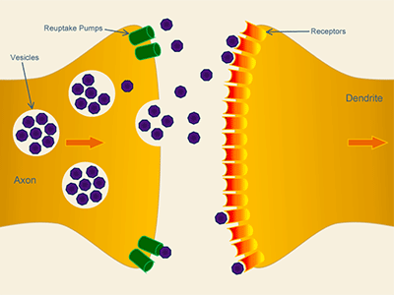
Compensatory mechanisms in surviving neurones in the damaged NSDA system
Adaptations in NSDA-associated circuitry
100
% SNc DA neurones
or striatal DA
Clinical signs & symptoms
50
0
Progression of disease
re-uptake
receptors
synthesis
release
Adaptations in striatal terminal
Notes:
Compensatory mechanisms are complicated and not fully understood. They may involve adaptations in the input pathways that regulate the NSDA pathway, and they also involve adaptations in the striatal nerve terminals

Slide 46
Compensatory mechanisms in striatal terminals of surviving neurones in the damaged NSDA system
Renders females more able to preserve striatal DA levels when lesions are small/moderate
re-uptake
Promoted by physiological levels of E2 in normal females, not males
receptors
synthesis
release
Pre-clinical studies:
sex differences in PD prevail for moderate lesion size
Potential to delay progression or onset of disease –
at least in females
100
% striatal DA
Clinical signs & symptoms
50
0
McArthur S. et al (2007) JNeurochem 100: 678-692
Gillies GE & McArthur S. (2010) Horm Behav 57: 23-34;
Gillies GE & McArthur S. (2010) Pharm Revs 62: 155-98
Progression of disease
Notes:
Together these findings could account for why physiological levels of oestrogens appear neuroprotective at the level of the striatal DA terminals, but not at the cell bodies in the SNc.
A disease modifying drug – at least in females. An important challenge would be to investigate whether the detrimental effects of testicular factors could be prevented

Slide 47
Effects of oestradiol on both the intact and partially injured NSDA are sexually dimorphic in rats.
Why?
Is there similar evidenc in humans?

Slide 48
Hypothesis (Analogy with sexual differentiation (defeminization) within hypothalamic circuitry). Sex differences in organization of the NSDA system and its regulatory input underlie sex-specific effects of oestrogens.
Although the NSDA system performs essentially the same functions in males and females, several lines of evidence suggest that the similarities are achieved by different means

Slide 49
Evidence for inherent sex differences in the NSDA system.

Slide 50
Sex differences are apparent in the shape of the rat and mouse SNc and the numbers and topographical organization of SNc dopaminergic neurones
male
female
Volume
x 10⁶
μm³
400
120
4 levels through rostrocaudal extent of SNc, separated by 300 µm, beginning at bregma
-4.8 (A),
-5.1 (B),
-5.4 (C), and
-5.7mm (D)
were analysed
300
+
80
+
+
200
+
40
100
0
male
female
0
B
D
A
B
D
A
C
C
Total
Level
10
+
+ p<0.05 for
males vs females
+
% cells per Level
50
TH-IR
cell count
x10³
8
40
6
30
McArthur et al
Neuropsychopharmacol (2007) 32, 1462-1476
+
+
4
20
2
10
Dewing, P et al. 2006 Current Biology 16: 415-20
0
0
male
female
A
B
C
D
A
B
C
D
Total
Level

Slide 51
Sex differences in the organization and neuronal activity of the NSDA system
TH-IR neuron number in SNc m > f
Murray HE et al 2003; McArthur et al 2007, JNC & NPP; Dewing P et al 2006
Striatal DA content m = f
Murray HE et al 2003; Ji & Dluzen 2008
Striatal DA nerve terminal & DAT density, m < f
Walker QD et al 2000
Locomotor activity, response to novelty f > m
Striatal DA release & behavioural responses f > m
to cocaine (locomotor activity) amphetamine
or apomorphine (stereotypy)
Extracellular DA levels in caudate nucleus intact m = f
Walker QD et al 2000; Robinson TE et al 1990 Gdx m f

Slide 52
NSDA transmission is sexually dimorphic and striatal functionality is preserved by a different balance of uptake and release in males and females
Sexually differentiated inputs to the NSDA system that are oestrogen-sensitive (at least in females) include the mesocortical DA pathway and the serotonergic system of the dorsal raphe.

Slide 53
Sexually
differentiated
input pathways
NSDA system
-
+
+
+/-
Aromatase?
Blood-Brain Barrier
Gonadal hormones in systemic circulation
E2
females
T/E2
males
E2
females
T/E2
males
Direct effects
Indirect effects

Slide 54
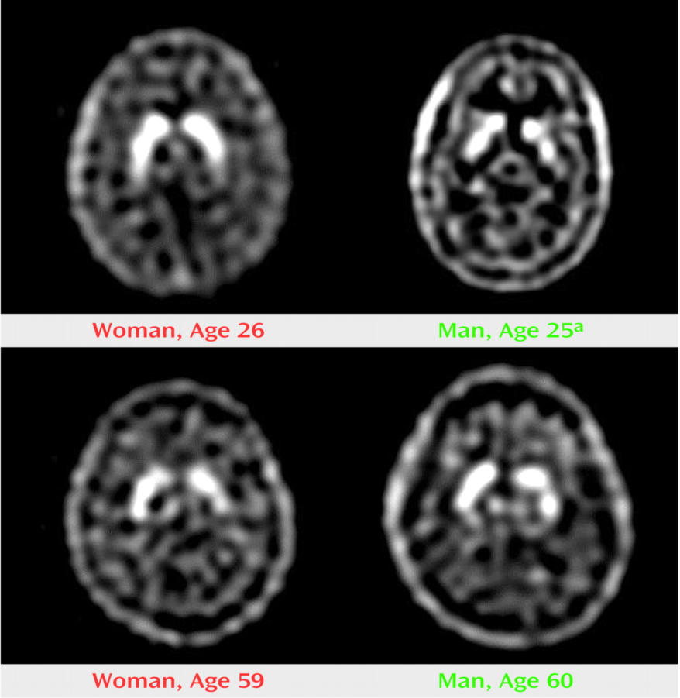
Supporting evidence for innate sex dimorphisms in the human NSDA pathway and associated circuitry
Same goal,
different strategies
Similar performance between the sexes does not necessitate the same neural mechanisms and information processing
Woman
(26 years)
Man
(25 years)
Similar extracellular levels of striatal DA levels are achieved by different DA neurone dynamics (balance of uptake and release) in males and females (humans & rodents)
Real-time in vivo neuroimaging
Motor & cognitive functions are differentially regulated by DA in men & women
There are sex differences in the ‘molecular’ signature of the NSDA pathway in normal and PD brains
Mozley L. et al. Am.J.Psychiatry, 2001, 158: 1492
Notes:
And here are some examples from several studies that supports the view that there are innate sex dimorphisms in the nigrostriatal pathway. Here, functional magnetic resonance imaging was used to assess striatal activity in subjects performing tests that largely rely on activation of the NSDA pathway and, although performance was similar in men and women, brain activity and, by implication, information processing, was different... And this is notably a recurring theme for other brain regions.

Slide 55
Sex dimorphisms in the healthy, human NSDA system Gillies & McArthur Hormones & Behavior 2010
SNc gene expression patterns (laser capture microdissection)
Women: Up-regulation of genes involved in signal transduction and neuronal maturation relative to males
Men: Up-regulation of genes implicated in PD pathogenesis (alpha-synuclein, PINK-1) relative to females
Cantuti-Castelvetri I et al 2007
In vivo imaging of basal striatal dopaminergic neurone dynamics
DAT density
women > men
DA precursor (FDOPA) uptake/accumulation
women > men
Striatal D2 receptor affinity
women < men
Lavalaye J 2000; Mozley LH, 2001
Kaasinen V et al 2001; Laakso A et al 2002; van Beilen M et al 2008
Pohjalainen, T et al 1998
In vivo imaging of while performing tasks targeting cognitive & motor functions associated with the NSDA activity
Extracelluar DA levels in caudate/putamen
Women > men
Correlates with executive and motor function in women, not men
Mozley LH, 2001
DA function differs in men and women in normal NSDA system.

Slide 56
Sex dimorphisms in PD molecular neuropathology
SNc gene expression patterns (laser capture microdissection; end stage surviving neurones, <24h post mortem)
Women: Alterations in genes with protein kinase activity, and genes involved in proteolysis and WNT signalling predominate
Men: Alterations in genes for proteins with protein- and copper-binding activities predominate
Cantuti-Castelvetri I et al 2007;
In vivo imaging dopaminergic neurone dynamics (FDOPA) in ‘early’, unmedictaed PD
> 50% reduction in accumulation of FDOPA (loss of DA) in putamen in men and women (90% postmenopausal)
FDOPA accumulation in frontal cortex increased to a greater extent in women (219%) than men (87%) compared with respective controls
Kaasinen V et al 2001
Underlying neurotransmitter function differs in men and women. Adaptive responses vs disease progression?
Women: Reduced incidence & prevalence at all ages; later onset. Tremor (mild DA loss), side effects of L-DOPA, postural impairment and depression are more prominent.
Men: Exhibit more parkinsonian motor features and sleep disturbances
Clinical features
Lyons KE et al 1998; Rojo A et al 2003; Utti RJ et al 2005; Scaglione C et al 2005; Haaxma CA, 2007.

Slide 57
Like the rodent NSDA system, the human NSDA system shows inherent sex dimorphisms in the underlying circuitry in health & disease
This indicates a need for a sex-specific approach to promoting human mental health and well-being

Slide 58
Translational implications
Is the clinical course of Parkinson’s disease affected by endogenous sex steroid hormones in humans?
In healthy human individuals performance on a striatal-mediated sequential movement task suggests that the effects of sex hormones on NSDA activity may be sexually dimorphic:
endogenous E2 promotes activity in females; males unaffected by T or E2 (Siegel et al 2008, Behav Neurosci 122: 955-62; Jennings et al 1988)
The reported clinical benefits of oestrogens in the female sex may not simply translate to the male sex, highlighting the importance of studies in both males and females
Notes:
As it is not possible to perform similar experiments in humans, we cannot be certain of the applicability of these findings to the clinical situations, but ......., suggesting that sex hormone effects on the activity of the healthy nigrostriatal activity appear sexually dimorphic in human as well as rodents. If the same proves true for the degenerating pathway, these studies indicate that..

Slide 59
Glial cells as both producers of and targets for oestrogens in the brain: potential neuroprotective mechanisms Glenda Gillies 30th Jan 2012
Imperial College London
BSc Endocrinology
Module 3

Slide 60
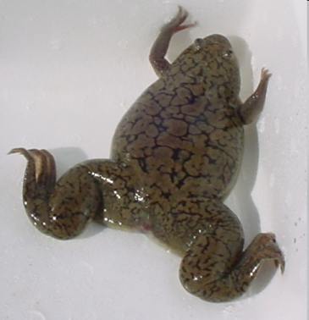
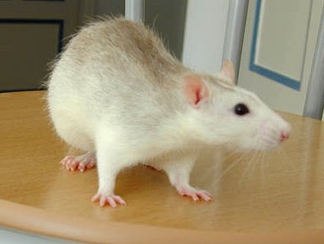
Glia
Glia are the second major class of cells in the nervous system
provide physical support and nutrients to neurones
Critically involved in brain homeostasis
The ratio of glial cells to neurones increases with brain complexity in different species:
2.5:1
10:1
1:1
8:1

Slide 61
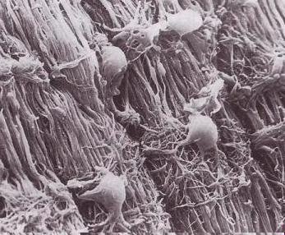
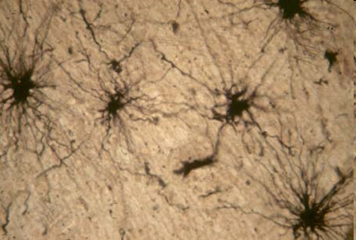
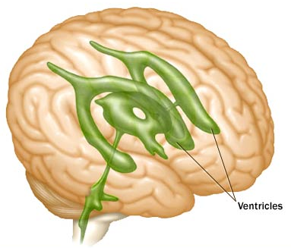
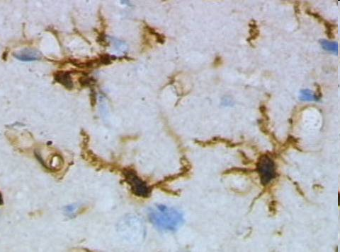
Glial Cells: four major glial cell types in the adult brain
Maintain myelination
Brain
homeostasis & repair;
Neurosteroidogenesis
when activated
Oligodendrocytes
Astrocytes
Ependymal cells
Microglia (12% of brain cells)
Barrier between
CSF & brain
parenchyma
Innate, immune
(macrophage-like)
cells in the brain

Slide 62
All types of brain injury are associated with a rapid activation of astrocytes and microglia – suggesting common signalling systems Marchetti et al. (2005) Brain Res Rev 48 129-408
Controlled activation
protective mechanisms to
control and repair injury –
anti-inflammatory molecules,
Aromatase up-regulation,
especially astrocytes
E2
Over-activation
Excessive production of toxic mediators
Cytokines, reactive oxygen/nitrogen species
(free radicals)
especially microglia

Slide 63
Brain aromatase
Neurosteroids, including oestrogens, are produced within the brain in both sexes
This adds a level of complexity to interpreting the role of systemic steroids in CNS function, and the relative contributions of steroids of systemic and central origin to brain health and disease remain to be fully established.

Slide 64
Aromatase protects against striatal DA loss in male rats after sub-maximal 6-OHDA-induced NSDA lesions
McArthur et al
J. Neurochem (2007) 10: 678

Slide 65
Different modes of action of systemically and centrally generated oestrogens that are relevant to unraveling their relative importance in brain physiopathology.
How can E2 of systemic and central origins have opposite effects on striatal susceptibility to injury in male rats?

Slide 66
Brain concentrations of E2 are independent of systemic levels and in males are 6-7 fold greater centrally
Aromatase
Sexually
differentiated
input pathways
NSDA system
-
Local E2
productions in
males and females
+
+
+/-
Aromatase?
Blood-Brain Barrier
Gonadal hormones in systemic circulation
E2
females
T/E2
males
E2
females
T/E2
males
Direct effects
Indirect effects

Slide 67
Neurosteroids are abundant in nigrostriatal regions in human post-mortem brains, with reports of altered levels in neurodegenerative conditions, including PD Bixo et al., 1997, Brain Res 764: 173-8; di Michele et al., 2003, Neurol Sci, 24: 172-3; Luchetti et al., 2010; Brain Pathol, 20: 945-51
Relevance to humans?

Slide 68
Targeting central steroid generation could be an effective way of preserving striatal DA loss in both sexes
Requires a better knowledge of control of tissue-specific aromatase expression, especially up-regulation in astrocytes
Enhanced delivery of substrates for E2 synthesis (DHEA/S)

Slide 69
Protective Mechanisms of Oestrogen
Oestrogen can exert specific protective mechanisms in specific pathways undergoing unique neurodegenerative processes e.g. Parkinson’s disease, Alzheimer’s disease (see previous lecture). Rodent studies suggest that these effects are sex-specific.
Oestrogens may regulate neuroinflammatory responses accompanying neurodegenerative processes

Slide 70
Protective Mechanisms of Oestrogen
Oestrogen can act through more general mechanisms to provide neuroprotection against damaging processes in the neurones themselves (direct action). These mechanisms may be common to many forms of injury (excitotoxic, ischaemic) and may operate in males and females. They include
regulation of apoptotic genes (see previous lecture)
regulation of antioxidant enzyme systems which remove potentially damaging organic peroxides.
direct antioxidant activity (protection against superoxide radicals)

Slide 71
The precise mechanisms of protection may also depend on the concentration and type of oestrogen (physiological vs pharmacological)

Slide 72
Validity of models of Parkinson’s disease - a progressive neurodegenerative disorder of unknown aetiology
Do the models genuinely look at neuroprotection?
Are the experiments designed to assess neuroprotection and disease progression?
Are they useful for studying disease that is well underway before clinical symptoms appear?
What value do they have in predicting results in humans?
Are the results equally relevant for males and females?

Slide 73
Committee to identify Neuroprotective Agents in Parkinson’s (CINAPS)
Current treatments for PD (eg DA agonists, levodopa) ameliorate symptoms, do not prevent disease progression and eventually result in dopaminergic-related complications (dyskinesias, motor fluctuations).
CINAPS selected 12 compounds for clinical trials as neuroprotective agents based on certain criteria (primary mechanism, consistency of preclinical data*, penetration of BBB, safety to tolerability ratio, efficacy in a relevant animal model) – one of which was oestrogen.
Ravina BM et al Neurology 2003; 60: 1234-1240
Bezard E The Lancet, Neurology 2003; 2 (7): 393
* Derived from E2-treated
Ovx female rodents &
non-human primates

Slide 74
Conclusion: The goal of understanding PD pathogenesis and improving treatments requires a better knowledge of the basis for sex differences in Parkinson’s disease
NIH mandated inclusion of women in human clinical trials in 1993
There is no equvialent mandate for pre-clinical research, where single sex studies of males outnumber those in females by 5.5:1
Yet, because of the potential neuroprotective effects of E2 in PD, most basic science studies begin with ovariectomized females, despite the evidence for greater susceptibility in the male sex (humans and rodents models)
Notes:
Therefore, I hope that you will agree that....
However, changing attitudes is a slow process. Until relatively recently it was not necessary to include women in clinical trials and more than *0% of basic neuroscience research is conducted in males only, but may be relevant for only 50% of the population.

Slide 75
END
Thank you

