Slide 1
Type 2 diabetes prevention: What the trials tell us about pathogenesis
Nick Oliver

Slide 2
Learning Objectives
Define abnormal glucose metabolism
Summarise the evidence for type 2 diabetes prevention with lifestyle
Summarise the evidence for type 2 diabetes prevention with pharmacology
Discuss the mechanism of type 2 diabetes prevention

Slide 3
Type 2 Diabetes Prevention
Abnormal glucose metabolism
Prevention of progression
  Lifestyle interventions
  Diabetes-specific pharmacological intervention
  Non-specific pharmacological intervention
Pathophysiology

Slide 4
Abnormal Glucose Metabolism
Impaired fasting glycaemia
  Fasting plasma glucose 6.1→7.0mmol/L
Impaired glucose tolerance
  Fasting glucose <7.0mmol/L
  2 hour glucose on OGTT 7.8→11.0mmol/L
Diabetes
  Fasting glucose ≥7.0mmol/L
  2 hour glucose ≥11.1mmol/L
  HbA1c > 6.5% (48mmol/mol)

Slide 5
Abnormal Glucose Metabolism
Spectrum of disease
Type 1 diabetes is a categorical divide
  Defined by risk of microvascular disease
Type 2 diabetes
Normal glucose tolerance
IFG/
IGT
Type 2 Diabetes

Slide 6
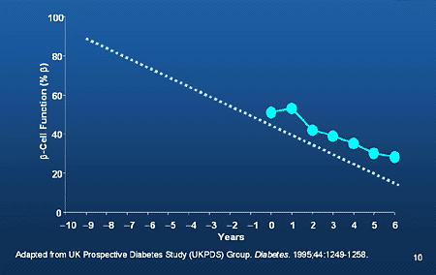
Physiology
Declining beta cell function

Slide 7
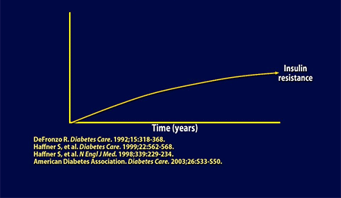
Physiology
Increasing insulin resistance

Slide 8
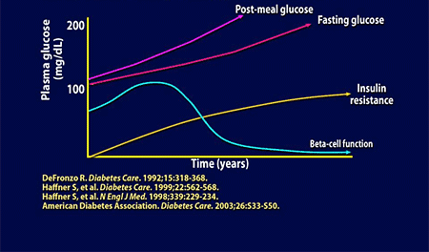
Physiology

Slide 9
Pathogenesis
Genetic factors
  Cannot be modified
  Complex polygenic inheritance of risk for diabetes
Non-genetic factors
  Modifiable
  Can they be modified to prevent type 2 diabetes?

Slide 10
Nurses’ Health Study
Background
  Nurses’ Health Study started in 1976
  121,700 nurses answered biennial questionnaire about their health
Data from those not previously diagnosed with diabetes assessed
N=89,941 women only

Slide 11
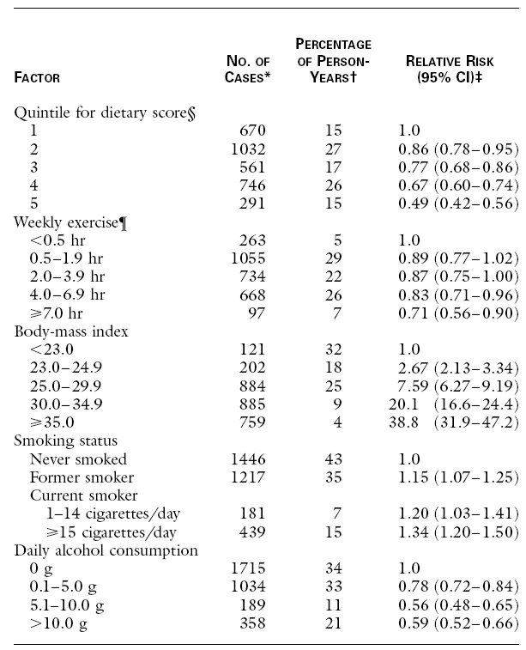
Nurses’ Health Study

Slide 12
Nurses’ Health Study

Slide 13
Nurses’ Health Study

Slide 14
Nurses’ Health Study

Slide 15
Nurses’ Health Study
Excess body fat single largest determinant of longitudinal type 2 diabetes risk
Supporting evidence that risk of type 2 diabetes is attributable to modifiable risk factors

Slide 16
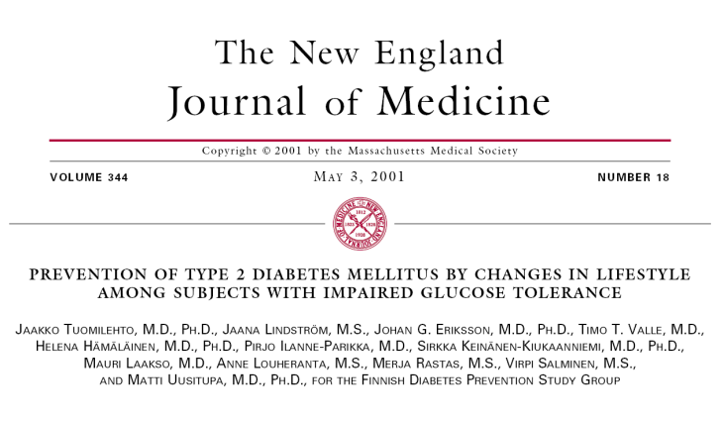
Finnish Study

Slide 17
Finnish Study
522 ‘middle aged’ overweight subjects
All had IGT
Randomised to
  Intensive lifestyle intervention
  Control group

Slide 18
Finnish Study
Intervention Arm
  Detailed individualised advice
  Goals
    Weight reduction of ≥5%
    Fat intake reduction to ≤30% of total Kcal intake
    Increase fibre to ≥15g/ 1000Kcal
    Moderate exercise ≥30 minutes per day
  Dietary advice
  3 day food diaries completed 4 times/year
  7 sessions with dietitian in 1st year, 4 per year thereafter
  Individualised exercise schedule
  Supervised circuit training

Slide 19
Finnish Study
Control group
  Oral and written diet and exercise information annually
Mean follow up 3.2 years

Slide 20
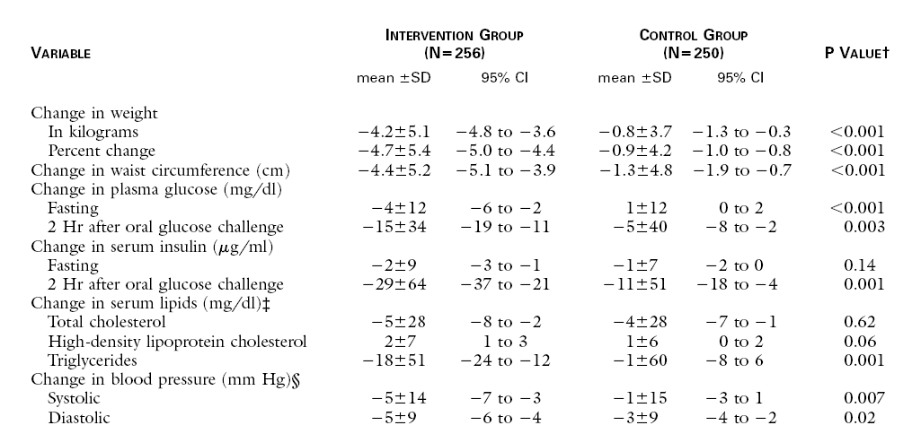
Finnish Study

Slide 21
Finnish Study

Slide 22
Finnish Study

Slide 23
Finnish Study

Slide 24
Finnish Study

Slide 25
Finnish Study

Slide 26
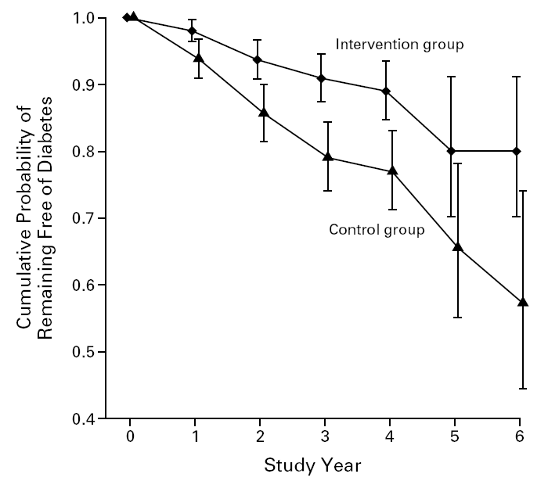
Finnish Study

Slide 27
Finnish Study
Intensive lifestyle intervention
  Reduced progression to type 2 diabetes by 58%
  Reduced weight
  Improved 2hr insulin response
  Reduced fasting and 2 hour glucose
  Reduced triglycerides
  Reduced blood pressure

Slide 28
Finnish Study
Intensive lifestyle intervention
  Reduced progression to type 2 diabetes
  Reduced weight
  Improved 2hr insulin response
  Reduced fasting and 2 hour glucose
  Reduced triglycerides
  Reduced blood pressure
All features of insulin resistance

Slide 29
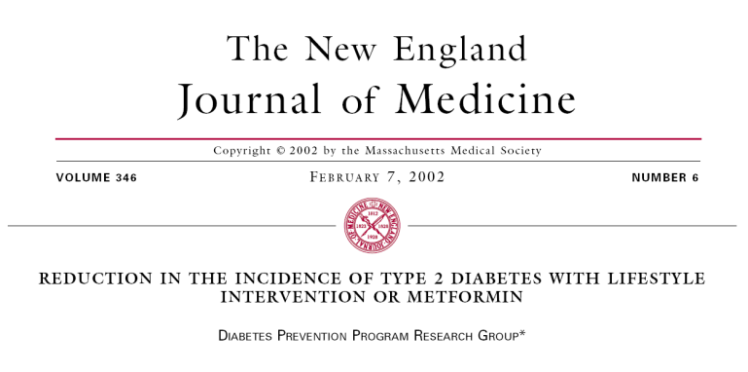
Diabetes Prevention Program

Slide 30
DPP
3234 Subjects with IFG/ IGT
Randomised to
  Metformin and standard lifestyle advice
  Intensive lifestyle intervention
  Standard lifestyle advice only
  (Troglitazone group)

Slide 31
DPP
Intensive lifestyle
  Target
    Weight reduction of ≥7%
    Moderate exercise for ≥150 minutes/ week
  Low calorie/ low fat diet
  16 lesson curriculum taught one to one over 24 weeks with subsequent monthly sessions

Slide 32
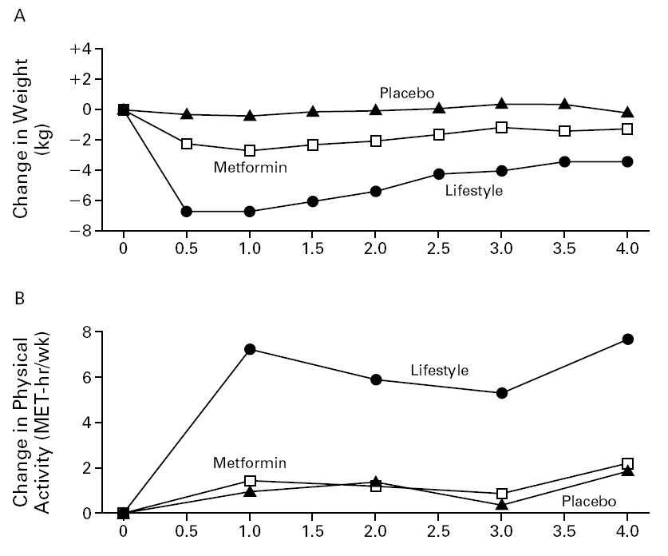
DPP

Slide 33
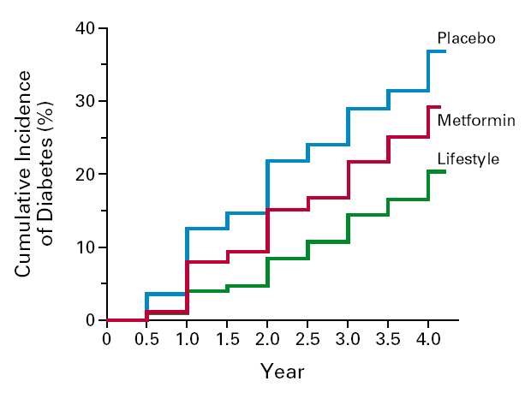
DPP
58% reduction in progression to T2DM in lifestyle group
31% reduction in metformin group

Slide 34
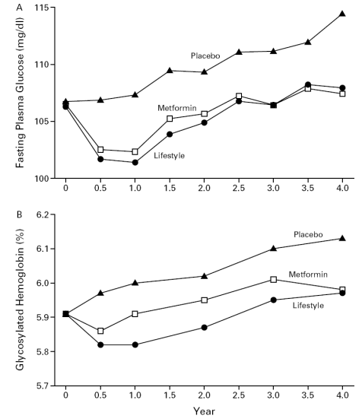
DPP

Slide 35
DPP
Intensive lifestyle intervention
  Reduced risk of progression to T2DM by 58%
  Reduced weight
  Reduces 2 hour glucose on OGTT

Slide 36
DPP
Intensive lifestyle intervention
  Reduced risk of progression to T2DM by 58%
  Reduced weight
  Reduces 2 hour glucose on OGTT
  Cost > $200m

Slide 37
DPP
Intensive lifestyle intervention
  Reduced risk of progression to T2DM by 58%
  Reduced weight
  Reduces 2 hour glucose on OGTT
  Cost > $200m
  Who Benefits?

Slide 38
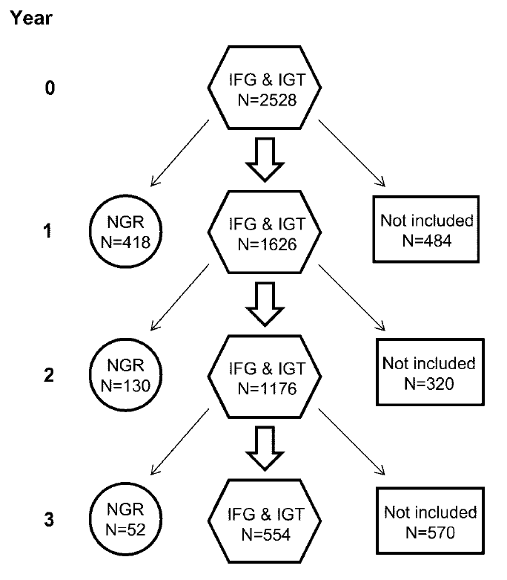
DPP

Slide 39
DPP

Slide 40
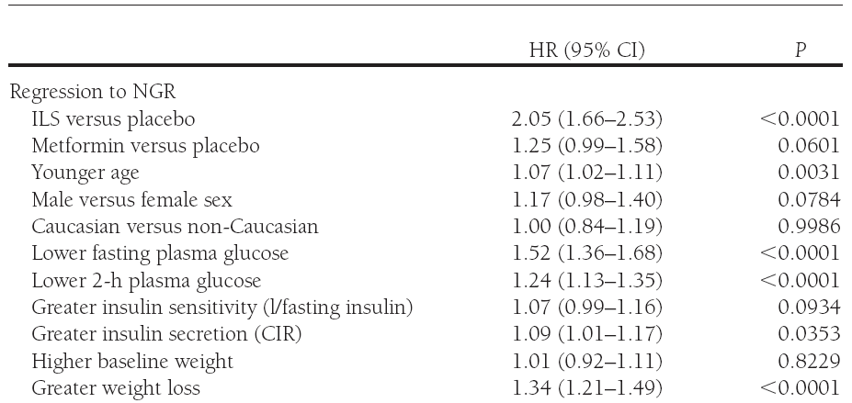
DPP

Slide 41
What about Troglitazone?
Troglitazone
  Thiazolidenedione class (Rosiglitazone, Pioglitazone)
  PPARγ agonist
  Nuclear receptor, alters gene transcription
  Glucose lowering
  Insulin sensitizing
  Withdrawn soon after release due to liver safety concerns

Slide 42
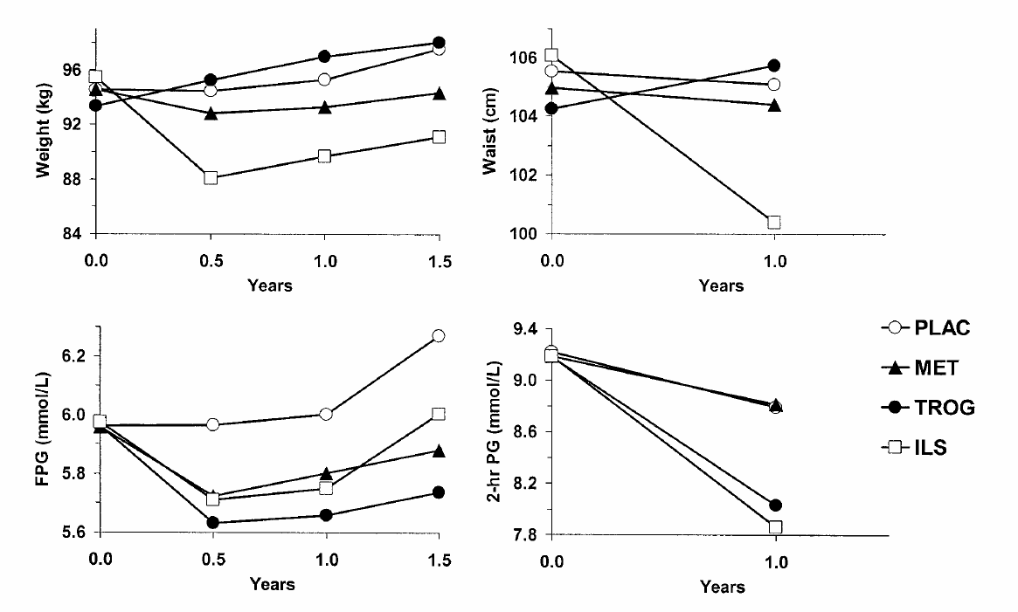
Troglitazone DPP
Only 0.9 years mean follow up (cf 2.8 years)

Slide 43
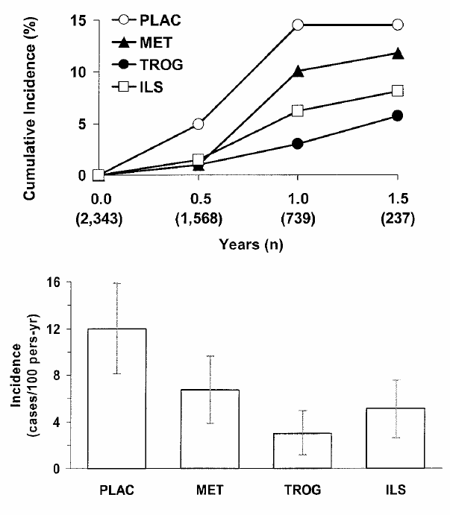
Troglitazone DPP

Slide 44
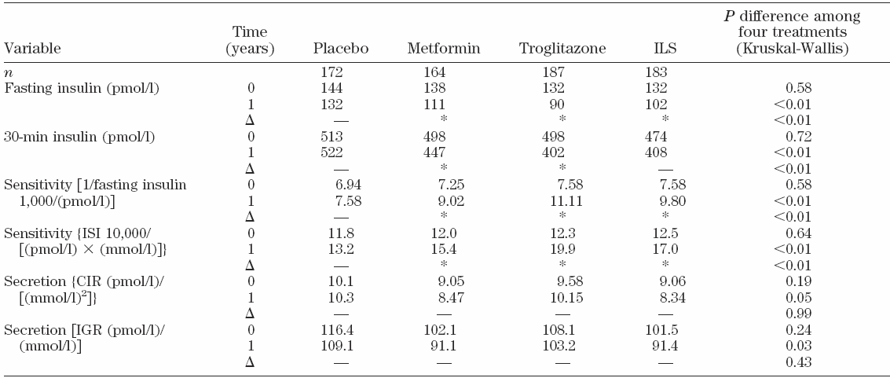
Troglitazone DPP

Slide 45
Troglitazone DPP

Slide 46
Troglitazone DPP

Slide 47
Troglitazone DPP

Slide 48
Troglitazone DPP

Slide 49
Troglitazone DPP
Troglitazone
  Reduces incidence of T2DM
  Improves measures of glycaemia
  Improves insulin sensitivity
  Despite weight gain
Troglitazone study confirms that intensive lifestyle intervention improves insulin sensitivity

Slide 50
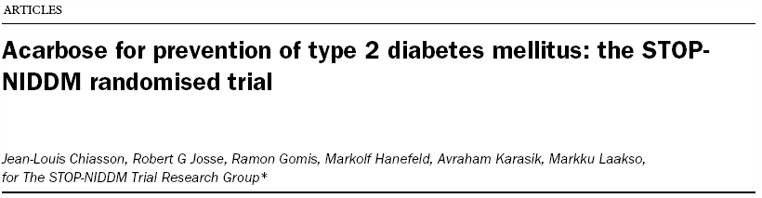
Acarbose

Slide 51
STOP-NIDDM
Acarbose
  α-glucosidase inhibitor
  Decreases post-prandial glucose
  Shown to increase insulin sensitivity
1368 subjects with IGT randomised to
  Acarbose treatment
  Placebo

Slide 52
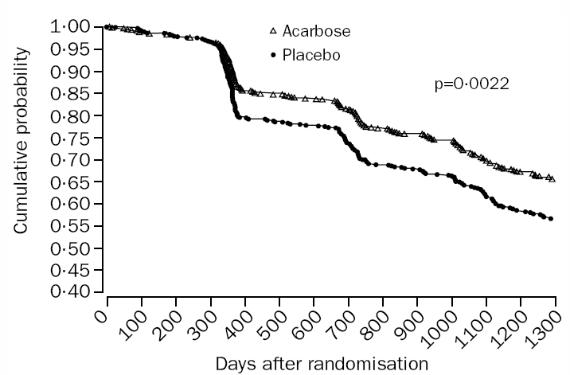
STOP-NIDDM
Mean follow up 3.3 years

Slide 53
STOP-NIDDM
Risk of progression to T2DM reduced by 25%
Change in first phase insulin and post-prandial
Are diabetes drugs preventing diabetes or simply masking the diagnosis?
  Metformin and troglitazone used in treatment with glucose lowering effect and insulin sensitizing
  Effect of drugs accounted for in statistics
  Acarbose not absorbed and does not affect monosaccharide absorption

Slide 54
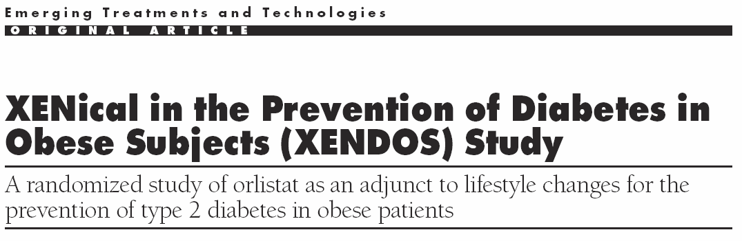
Non-Diabetes Drugs

Slide 55
XENDOS
Orlistat
  GI lipase inhibitor
  Not absorbed
  Weight loss agent
XENDOS
  3305 subjects, all obese
  21% had IGT
  Randomised to
    Lifestyle advice only
    Lifestyle plus Orlistat

Slide 56
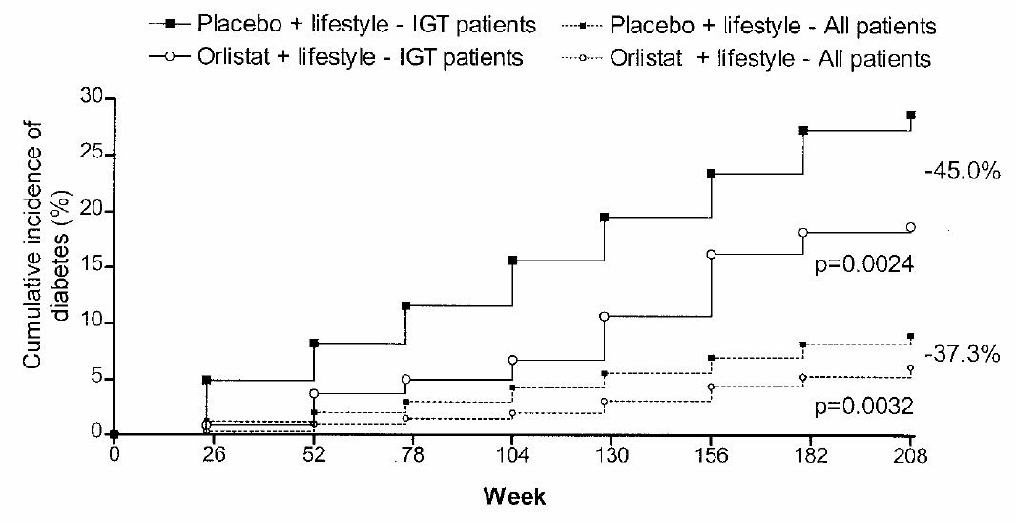
XENDOS

Slide 57
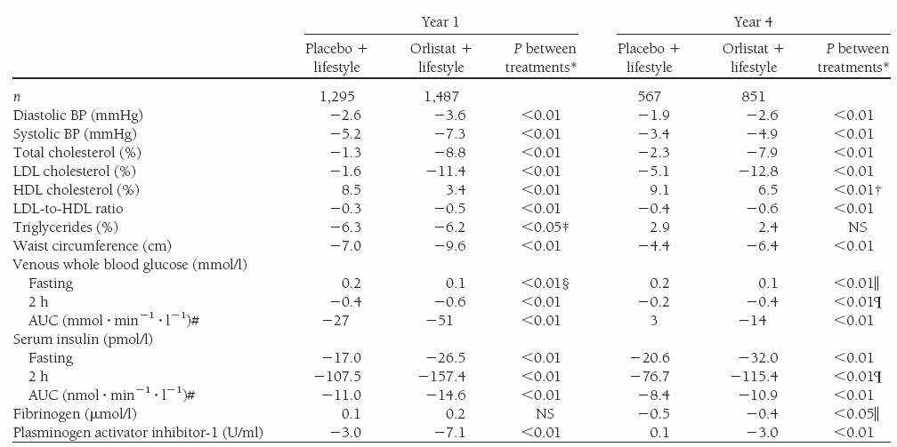
XENDOS

Slide 58
XENDOS
Orlistat
  Reduces risk of developing T2DM in obese subjects with normal and impaired glucose tolerance
  Improves
    BP
    Lipids
    2 hour glucose values
    Glucose AUC
    Fasting insulin and insulin response

Slide 59
Diabetes Prevention
Lifestyle intervention, diabetes-specific drugs and non-diabetes drug all prevent progression of glucose metabolic abnormality and improve the parameters of insulin resistance

Slide 60
Diabetes Prevention
Lifestyle intervention, diabetes-specific drugs and non-diabetes drug all prevent progression of glucose metabolic abnormality and improve the parameters of insulin resistance
HOW?

Slide 61
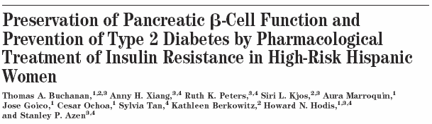
Back to Troglitazone

Slide 62
Troglitazone II
266 women with previous GDM randomised to
  Troglitazone
  Placebo
Median follow up 3 years

Slide 63
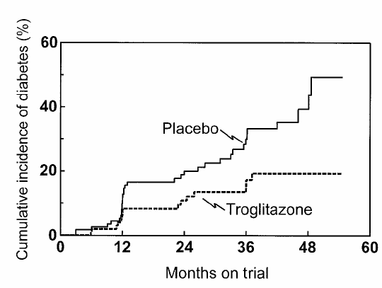
Troglitazone II

Slide 64
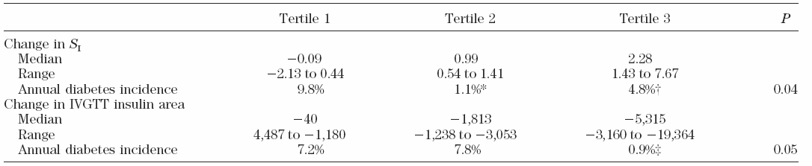
Troglitazone II
Protection from diabetes limited to the 2/3 of women with greatest increase in insulin sensitivity over the first 3 months
Therefore, need a large increase in insulin sensitivity to prevent T2DM

Slide 65
Troglitazone II
For insulin output, protection from diabetes was limited to 1/3 of women who had the greatest reduction from baseline in first 3 months

Slide 66
Troglitazone II
Insulin Secretion
Normal glucose metabolism
Diabetes
Insulin Sensitivity

Slide 67
Troglitazone II
Notes:
B is all the responders to Troglit
Responders are those 2/3 that had a large change in Si in the 1st 3 months.

Slide 68
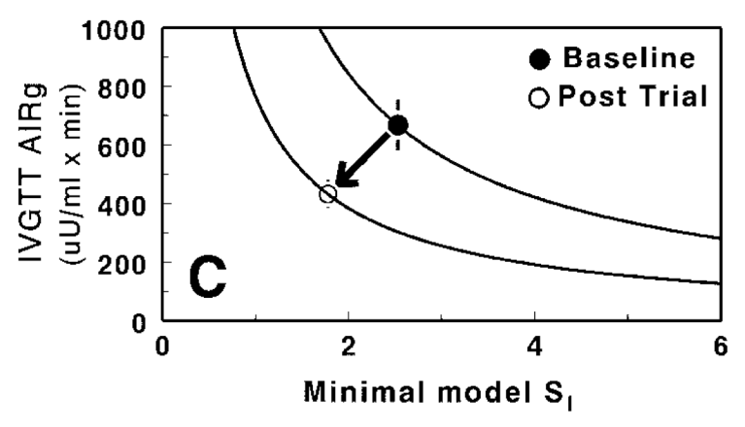
Troglitazone II

Slide 69
Troglitazone II
Insulin Secretion
Normal glucose metabolism
Diabetes
Insulin Sensitivity

Slide 70
Troglitazone II
Elucidated mechanism of diabetes prevention
  ‘Responders’ move the parabolic relationship between insulin secretion and insulin sensitivity
  Protection was related to reduction in endogenous insulin AND to preservation of beta cell compensation

Slide 71
DPP: Cui Bono?
Greater insulin secretion
Lowest FPG
Lowest 2hr Glucose
Lowest weight
Younger
Insulin Secretion
Normal glucose metabolism
Diabetes
Insulin Sensitivity

Slide 72
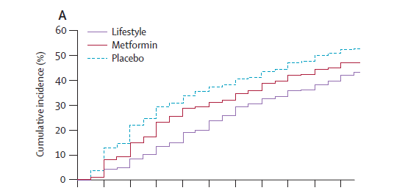
Does it Last?
10 year DPP follow up

Slide 73
Summary
Abnormal glucose metabolism is a spectrum of disease
Progression to type 2 diabetes may be prevented by lifestyle and pharmacology
Pharmacology may not be specifically targeted at glucose
Prevention of progression to type 2 diabetes is dependent on a change in insulin sensitivity

