Slide 1
Pancreatic development and diabetes
Gabriela da Silva Xavier
Imperial College London, Faculty of Medicine, Section of Cell Biology
email: g.dasilva-xavier@imperial.ac.uk

Slide 2
Introduction (1)
Why do we need to know this?

Slide 3
Introduction (2)
In this session we are going to consider…
Where does the pancreas come from?
What makes a β-cell a β-cell?
How do you make a β-cell?
Is it enough to be able to make β-cells?

Slide 4
Pancreatic islet

Slide 5
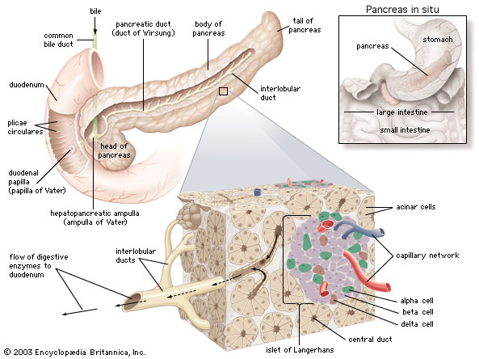
The pancreatic islet (1)
Insulin is made in β-cells in micro-organs called islets of Langerhans.
http://cache-media.britannica.com/eb-media/17/74317-004-9B143D52.jpg

Slide 6
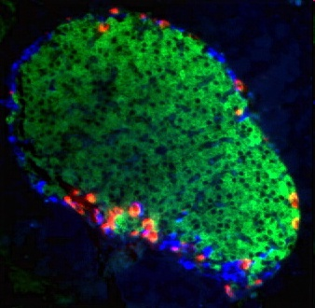
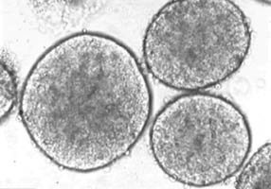
The pancreatic islet (2)
An islet of Langerhans, stained for glucagon, insulin, and somatostatin and pancreatic polypeptide.
Yun et al, 2005
100-500 μM
http://seungkimlab.stanford.edu/islet.html

Slide 7
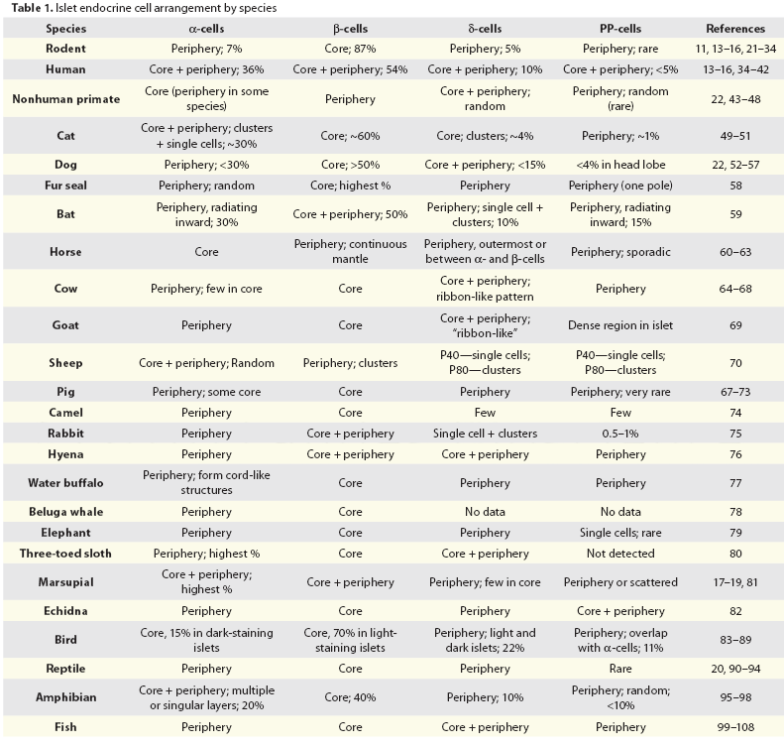
Steiner et al, 2010

Slide 8
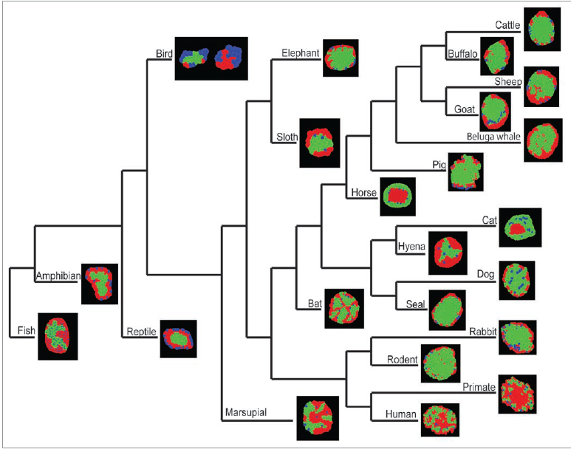
Steiner et al, 2010

Slide 9
What are the hallmarks of a pancreatic β-cell?

Slide 10
The pancreatic β cell (1)
Glucose
K⁺
Ca²⁺
GLUT2
KATP
L-Ca²⁺
IR
Glucose
Ca²⁺
(+) PI3 K
Glucokinase
Insulin
Glucose-6-phosphate
ATP
Cytosol
Nucleus
Gene expression

Slide 11
How do we get this?

Slide 12
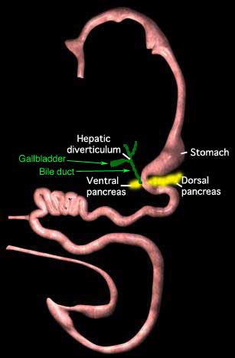
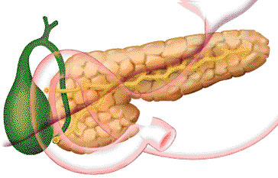
Day 26
Dorsal pancreatic bud
Day 27
Ventral pancreatic bud
Week 5
Stomach rotates, pancreatic buds come into contact
Week 6
Rudiments fuse, main ducts connect
Week 9
Tubules terminate into presumptive acini; presumptive islets form
Week 10
Alpha-cells
Week 11
Delta cells
Week 13
Beta-cells
Week s14-20
Acinar cells develop and expand
Week 17
Beta cells secrete insulin
Week 40-42
Birth
Development of the pancreas (1)
http://anatomy.med.umich.edu/modules/peritoneal_dev_module/peritoneal_07.html

Slide 13
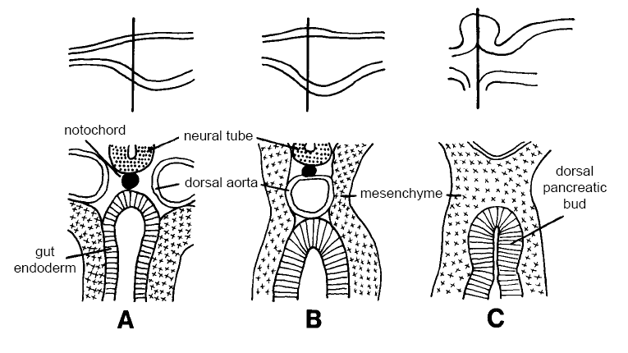
Development of the pancreas (2)
15 somite
20 somite
28somite
Slack, 1995

Slide 14
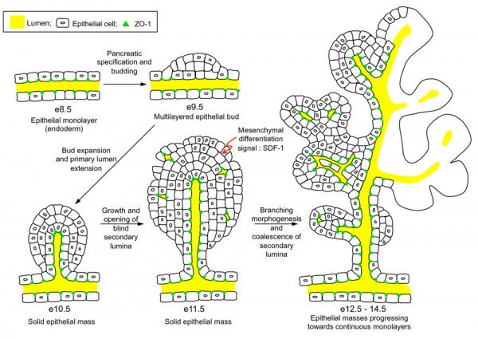
Hick et al, 2009

Slide 15
Development of the pancreas (3)
Notochord
Endothelial cells
Activins
FGFs (FGF2)
… regulation of Hedgehog signalling pathways
VEGF-A
N-Cadherin
Mesenchyme
WnT signalling
NOTCH signalling pathway
FGF 1, 7, 10*
Extracellular matrix/Basement membrane
Epithelia
Retinoids, glucagon, GLP-1, EGF
15 somite
20 somite
28somite

Slide 16
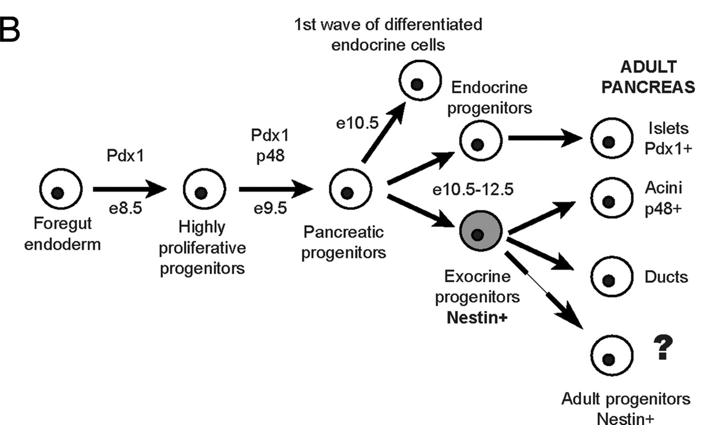
Stages of cell differentiation
Carrière et al, 2007

Slide 17
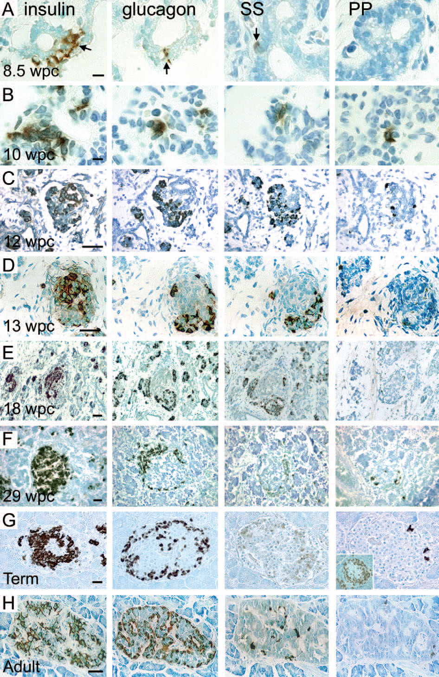
Piper et al, 2004

Slide 18
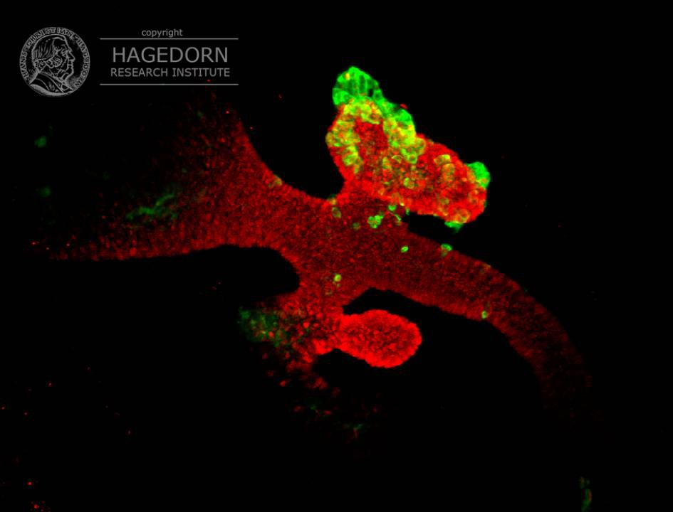
Glucagon
PDX-1
E10.5

Slide 19
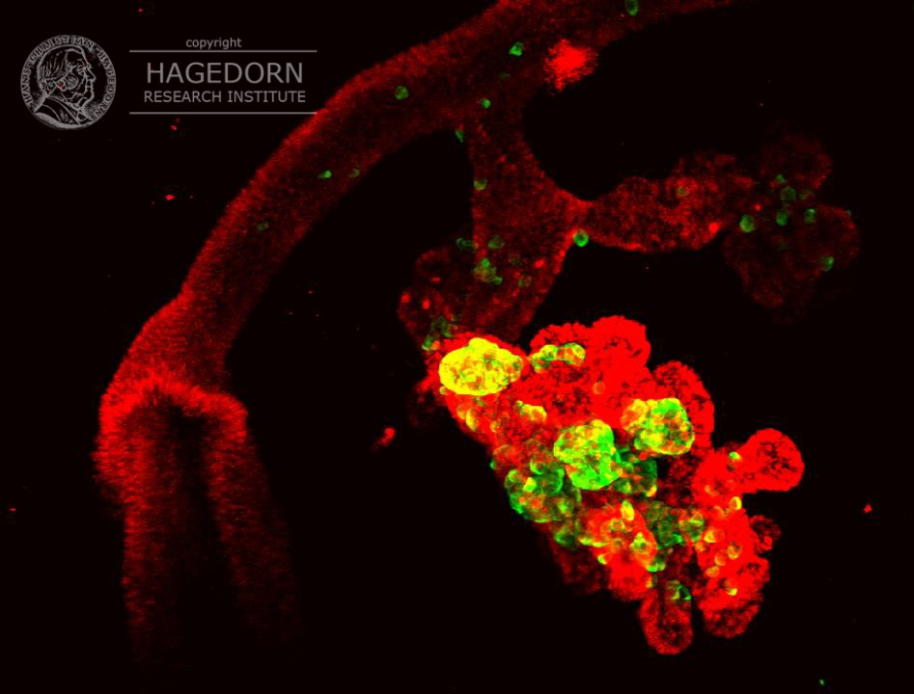
PDX-1
Glucagon
+ insulin
E12.5

Slide 20
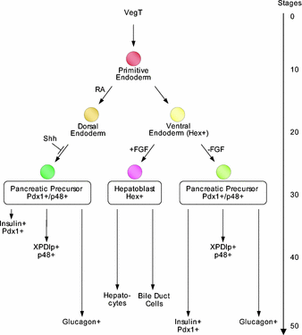
Development of the dorsal and ventral pancreas
Xenopus
Pieller and Chen, 2006

Slide 21
Transcriptional networks

Slide 22
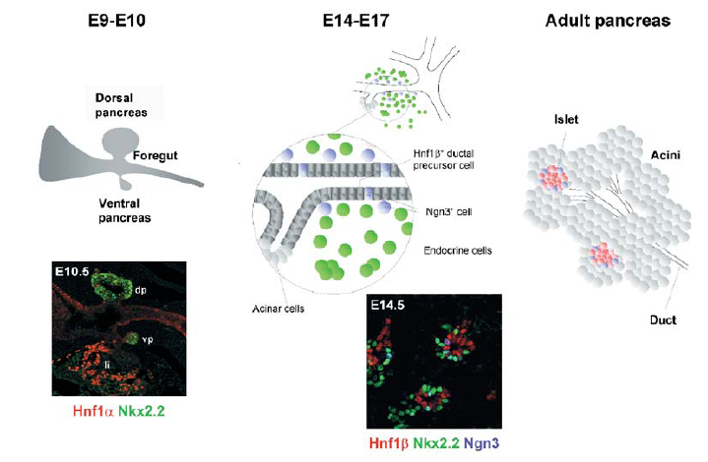
Transcription factors and cell differentiation (1)
Servitja and Ferrer, 2004

Slide 23
Where and when genes are expressed are important.

Slide 24
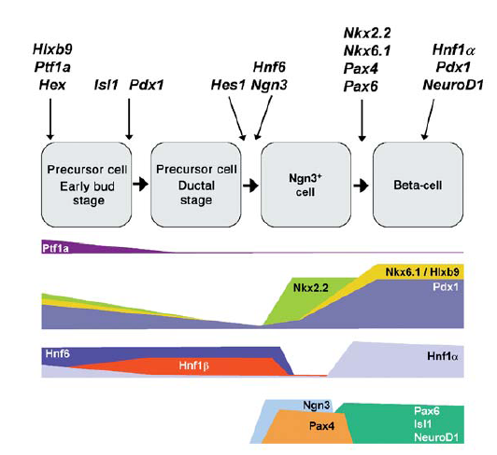
Transcription factors and cell differentiation (2)
Servitja and Ferrer, 2004

Slide 25
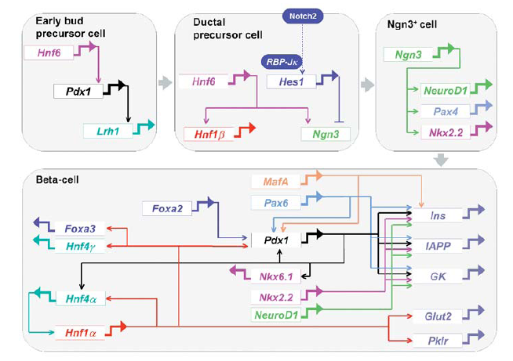
Transcription factors and cell differentiation (3)
Servitja and Ferrer, 2004

Slide 26
Transcription factors and cell differentiation (4)
Modified from Gromada et al, 2007

Slide 27
Genes and diabetes

Slide 28
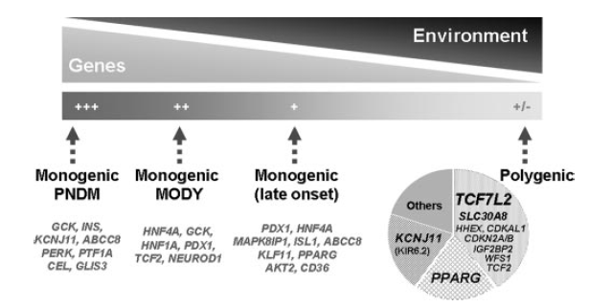
Transcription factors and cell differentiation (5)
Vaxillaire and Froguel, 2008

Slide 29
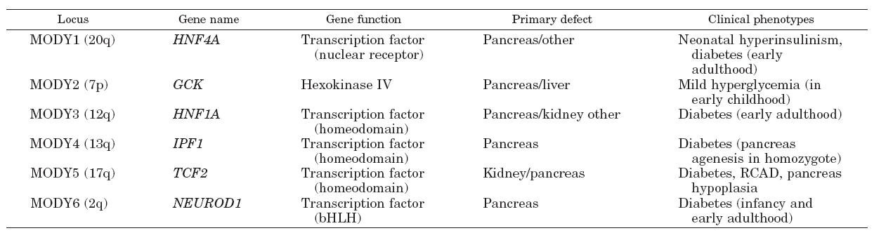
Transcription factors and cell differentiation (6)
PDX-1
HNF1b
Vaxillaire and Froguel, 2008
Servitja and Ferrer, 2004

Slide 30
So far…
… pancreatic β-cells in islets of Langerhans secrete insulin in response to glucose and regulate blood glucose,
… development of β-cells is regulated by a network of transcription factors,
… development of β-cells is regulated by intracellular signalling.

Slide 31
Cellular signalling (1)
Notochord
Endothelial cells
Activins
FGFs (FGF2)
… regulation of Hedgehog signalling pathways
VEGF-A
N-Cadherin
Mesenchyme
WnT signalling
NOTCH signalling pathway
FGF 1, 7, 10*
Extracellular matrix/Basement membrane
Epithelia
Retinoids, glucagon, GLP-1, EGF

Slide 32
Wnt signalling

Slide 33
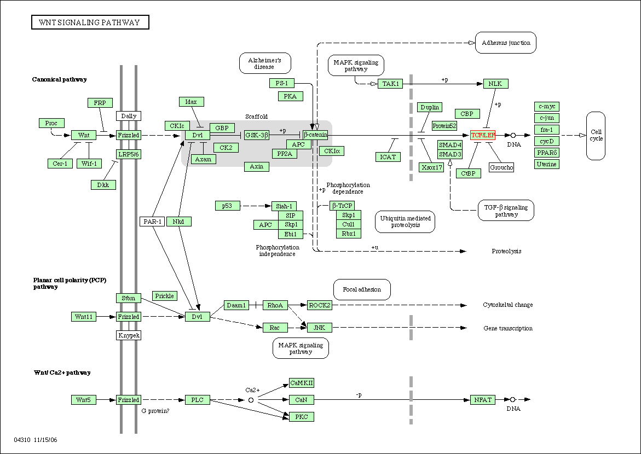
Cellular signalling (2)
***

Slide 34
Cellular signalling (3)
Defective Wnt signalling is asociated with decreased proliferation of epithelial progenitor cells and decrease in the number of islets.
The type 2 diabetes gene TCF7L2 is a downstream target of Wnt signalling
TCF7L2 has an effect on β-cell function and survival. Does TCF7L2 have an effect on islet number?

Slide 35
Cellular signalling (4)

Slide 36
Cellular signalling (5)
Control
TCF7L2
siRNA
TCF7L2
adenovirus
TCF7L2
siRNA + adenovirus
Da Silva Xavier et al, 2012

Slide 37
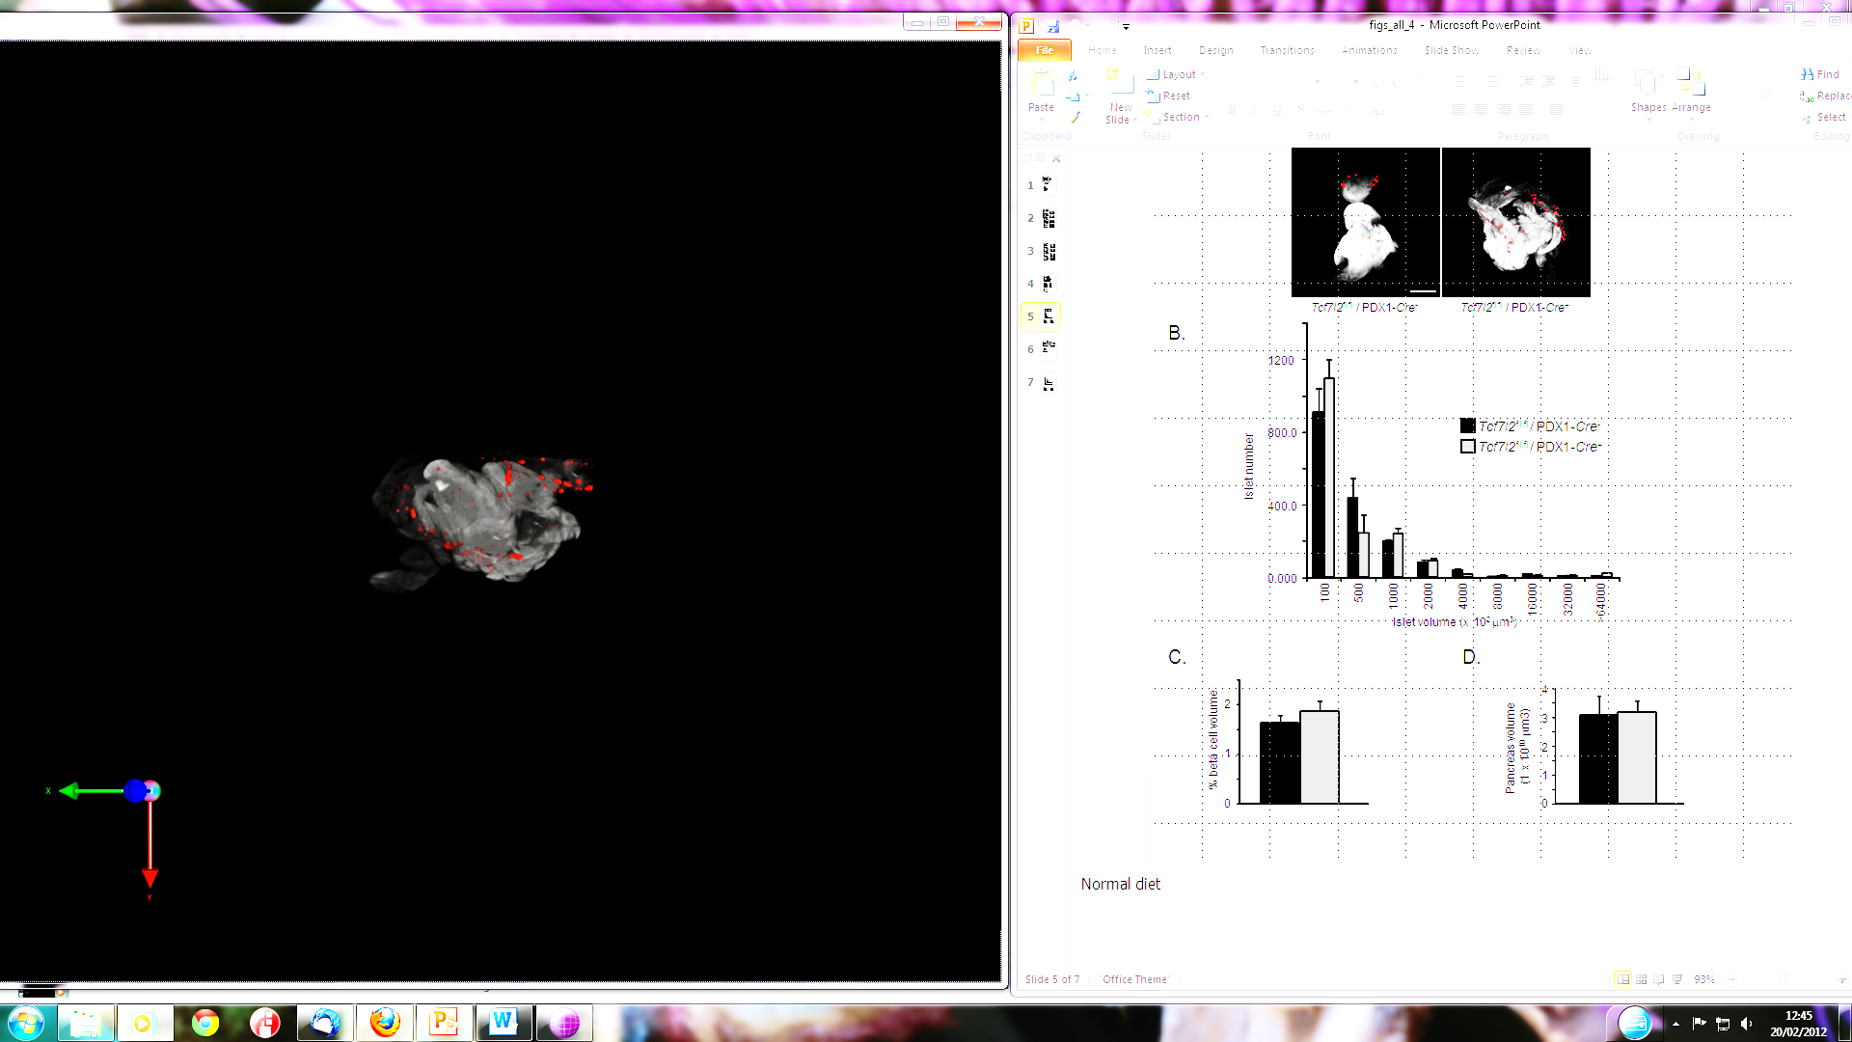
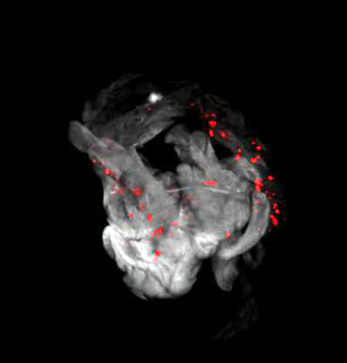
Wild-type
pTcf7l2
***
High fat diet
4000
1200
60
3000
50
40
800.0
Islet number
Islet number
2000
30
Islet number
20
*
10
400.0
1000
0
10000
15000
20000
25000
30000
35000
40000
45000
50000
55000
≥60000
Islet volume (x 10² μm³)
0.000
0
100
500
1000
2000
4000
8000
16000
32000
≤5000
10000
15000
20000
25000
30000
35000
40000
45000
50000
55000
>64000
≥60000
Islet volume (x 10² μm³)
Islet volume (x 10² μm³)
Da Silva Xavier et al, 2012

Slide 38
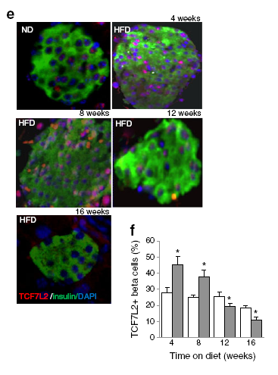
Shu et al, 2012

Slide 39
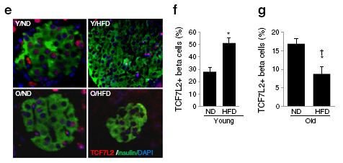
Shu et al, 2012

Slide 40
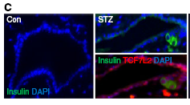
Shu et al, 2012

Slide 41
Talk about gene silencers and cell specification

Slide 42
Nutrient status

Slide 43
Maternal fuel environment and pancreatic development

Slide 44
Role of nutrients in cell differentiation (1)
Evidence that nutrients are involved in the development of the endocrine pancreas comes from a number of sources:
• The maternal diet is thought to be important to foetal islet development and glucose tolerance.
• Glucose is the principal energy substrate for the developing foetus.

Slide 45
Fuel sensing

Slide 46
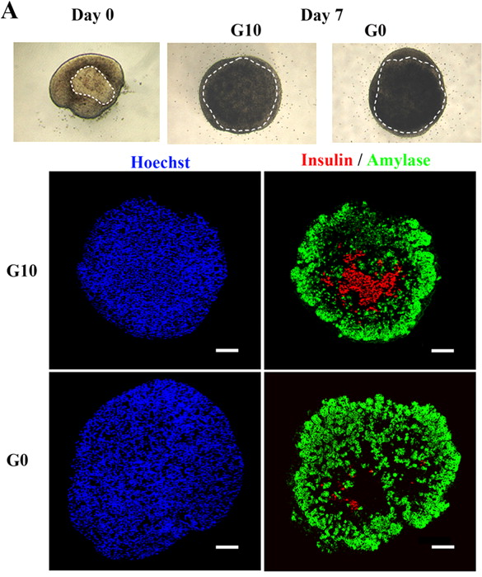
Role of nutrients in cell differentiation (2)
Guillemain et al 2008
• Showed that the number of insulin- and glucagon-positive cells in embryonic pancreatic explants was directly related to the glucose concentration in the culture media, possibly via its effects on the expression of the transcription factor, NeuroD1.

Slide 47
Transcription factors and cell differentiation (3)
Servitja and Ferrer, 2004

Slide 48
Stem cells

Slide 49
From ES cells to insulin producing cells
Has been shown that ES cells can give rise to cells expressing markers of the endocrine pancreas.
Insulin expressing cells have been derived but yield low and cellular properties do not mirror those of mature pancreatic β-cells
Adjust culture conditions e.g. addition of activin A, serum/growth factor deprivation, to optimise culture conditions.
ES cells that develop along a developmental pathway similar to in vivo- definitive endoderm, posterior foregut, pancreatic endoderm, progenitors of endocrine pancreas, hormone producing endocrine cells.
Can prevent streptozotocin induced diabetes in mice when implanted but cells still have a somewhat immature phenotype.

Slide 50
From adult stem cells to insulin producing cells
Stem cells- iPS cells
Adult cells (skin, blood) reprogrammed to induced pluripotent state.
Evidence that iPS cells can be programmed into β-cells.
Stem cells- adult stem cells
Mesenchymal stem cells from e.g. bone marrow source.
Proliferation and differentiation of endogenous adult pancreatic progenitor cells
Duct cells.
Artifical pancreas

Slide 51
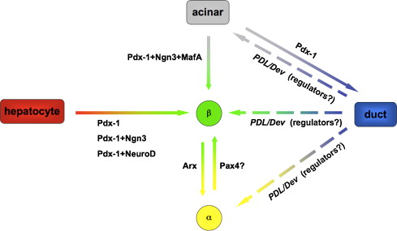
Plasticity and reprogramming?
Kordowich, et al 2010

Slide 52
Is it enough to make β-cells?

Slide 53
Glucagon (1).
Hormone secreted by pancreatic α-cells.
Where insulin is the hormone of the fed state, glucagon is the hormone of the fasted state.
Regulation of glucagon secretion has been reported to be regulated by glucose, insulin and zinc.
Regulation of glucagon secretion is dependent on ion channels that allow the flux of sodium, calcium and potassium ions.

Slide 54

Regulation of hormone secretion in pancreatic alpha & beta cells
Glucose
Beta cell
Glucose
Glucose
Alpha cell
GLP-1 receptor
K_{ATP}
Catecholamines receptor
[ATP]
[ATP]
Na_{v}
L-Ca²⁺
Catecholamines
GLP-1
[Ca²⁺]
Insulin, other factors
Insulin, other receptors
Glucagon
Somatostatin
GABA
Ashcroft, Biochem Soc Trans, 2006
Rutter et al, Biochem Soc Trans 2006
Braun and Rorsman, Diabetologia 2010
Kawamori et al, Cell Metabolism, 2009
Gromada et al, Endocr Rev, 2007

Slide 55
Glucagon (4).
Glucagon is important in protection against hypoglycaemia.
Major site of action is liver where glucagon stimulates gluconeogenesis and glycogenolysis.
Bihormonal hypothesis for pathophysiology of diabetes (Unger and Orci, 1975): insulin deficiency and relative excess of glucagon leads to increased hepatic output of glucose and, thus, hyperglycaemia.

Slide 56
Summary
β-cell therapy is a potential method for treating diabetes.
Understanding the developmental pathways of the endocrine pancreas gives insight into how β-cell therapy could be possible.

Slide 57
Thank you for your attention!
E- mail: g.dasilva-xavier@imperial.ac.uk

