Slide 1
Imperial College
London
Metabolism in obesity and type 2 diabetes mellitus
Ian F. Godsland, PhD
BSc Endocrinology, Module 2
i.godsland @ imperial.ac.uk

Slide 2
Obesity, T2DM and insulin resistance
obesity is a major risk factor for T2DM
obesity is a major cause of insulin resistance
insulin resistance is a major risk factor for T2DM
weight reduction can reduce glucose levels
in these relationships, what is happening at the metabolic level?
obesity
T2DM
insulin resistance

Slide 3
The Adipocyte
60 to 85% of the weight of white adipose tissue is lipid, with 90-99% of lipid as triglyceride
TRIGLYCERIDE
Obesity is associated with large, lipid-filled adipocytes
cytoplasm
nucleus
Notes:
Triglycerides are the most concentrated form of biological fuel available, making them ideal for energy storage

Slide 4
What is triglyceride?
glycerol
HO CH₂
palmitic acid
H₃C
COOH
HO CH
oleic acid
HO CH₂
H₃C
COOH
docosapentanoic acid
LIPOGENESIS
(esterification)
H₃C
COOH
example fatty acids
LIPOLYSIS
(hydrolysis)
triglyceride
H₃C
CO.
O CH₂
H₃C
CO.
O CH
H₃C
CO.
O CH₂

Slide 5
Serum triglyceride fatty acid content

Slide 6
lipogenesis
hormonal control of lipogenesis
lipolysis
hormonal control of lipolysis
lipogenesis and insulin resistance
lipolysis and insulin resistance
metabolic effects of adipose tissue

Slide 7
lipogenesis
hormonal control of lipogenesis
lipolysis
hormonal control of lipolysis
lipogenesis and insulin resistance
lipolysis and insulin resistance
metabolic effects of adipose tissue

Slide 8
Adipocyte lipogenesis - fatty acid delivery
GUT
chylomicron triglyceride
vascular endothelium
lipoprotein lipase
LIVER
VLDL triglyceride
glycerol
FFA
TRIGLYCERIDE
PLASMA
albumin free fatty acid

Slide 9
Adipocyte lipogenesis - triglycerides
glucose
glycolysis
glycerol-3- phosphate
lyso
phosphatidic acid
diacyl
glyceride
triacyl
glyceride
fatty acid binding proteins 4 and 5
G3P acyltransferase
GPAT
diacylglycerol acyltransferase
DGAT
TG
FFA-CoA
FFA-CoA
FFA-CoA
FFA
fatty acid oxidation
adipocyte fatty acid pool
Notes:
in the short term, fatty acid oxidation makes only relatively minor contribution to adipocyte fatty acid metabolism

Slide 10
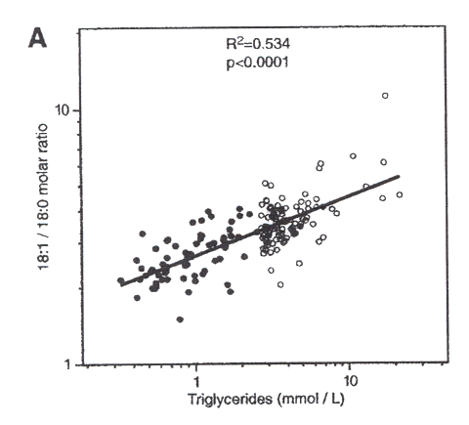
Lipogenesis – triglycerides and SCD
H₃C
COOH
H₃C
COOH
stearic acid (18:0)
stearoyl-CoA desaturase
(SCD – delta 9 desaturase)
oleic acid (18:1)
SCD gene expression is rate-limiting for triglyceride synthesis in adipocytes and hepatocytes
SCD over-expression in mice is associated with a 4-fold increase in SCD activity, a 1.8-fold increase in the 18:1/18:0 ratio and a 2-fold increase in triglyceride levels
in humans triglyceride levels correlate positively with the 18:1/18:0 ratio
Attie et al. J Lipid Res 2002;43:1899

Slide 11
Lipogenesis – fatty acid synthesis
transcription of genes promoting glycolysis, fatty acid synthesis and triglyceride synthesis
ChREBP
carbohydrate response element binding protein
ChREBP
PROMOTER RESPONSE ELEMENTS
SREBP-1c
sterol regulatory element binding protein 1c
SREBP-1c

Slide 12
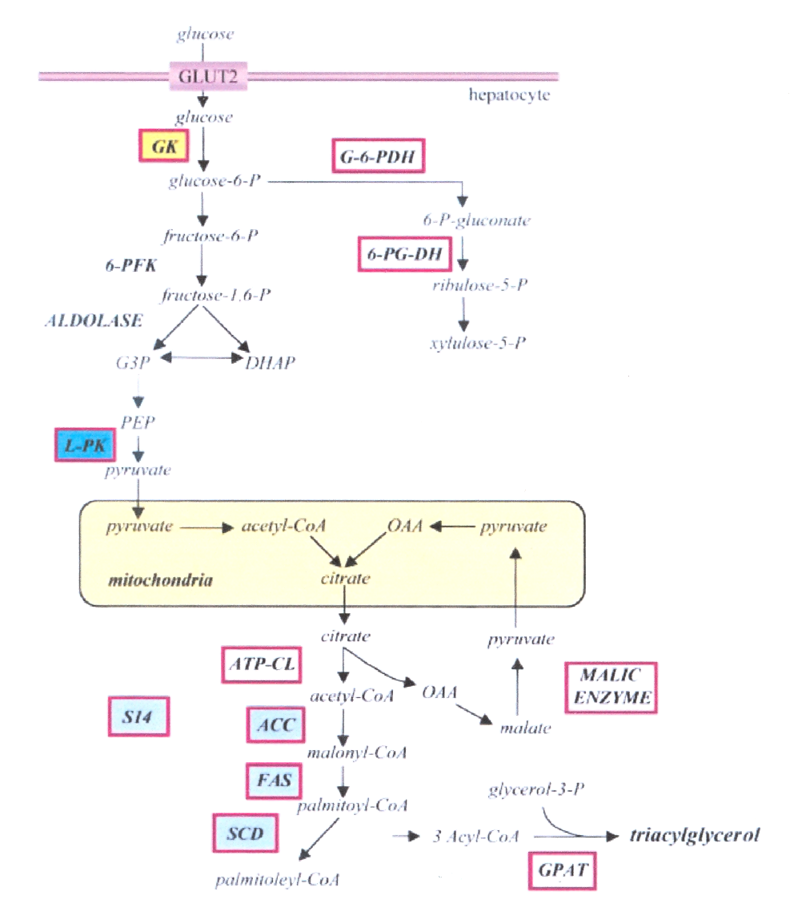
Lipogenesis – fatty acid synthesis
genes induced by SREBP-1c
SREBP-1c is the principal transcription factor controling fatty acid synthase (FAS) and acetyl-CoA carboxylase (ACC) transcription
Foufelle and Ferré
Biochem J 2002;366:377

Slide 13
lipogenesis
hormonal control of lipogenesis
lipolysis
hormonal control of lipolysis
lipogenesis and insulin resistance
lipolysis and insulin resistance
metabolic effects of adipose tissue

Slide 14
Control of fatty acid synthesis by insulin
insulin
ADIPOCYTE /
HEPATOCYTE
IR
Grb2
“...in normal humans, adipose tissue lipogenesis, although active, is quantitatively a minor pathway and is less responsive than hepatic lipogensis to acute or prolonged carbohydrate overfeeding.”
Diraison et al. J Lipid Res 2002;44:846
SOS
Shc
P
P
P
RAS
Raf
SREBP-1c
P
MEK
cytoplasm
P
ERK
SREBP-1c RESPONSE ELEMENTS
SREBP-1c
increased enzymes of fatty acid and triglyceride synthesis
nucleus

Slide 15
Control of hepatic fatty acid synthesis by insulin
insulin
via IRS-2, insulin promotes phosphorylation and nuclear exclusion of Foxo1
HEPATOCYTE
IR
PIP3
GLUT - 4
Grb2
IRS-2
SOS
RAS
SOS
P
P
Shc
P
P
Grb2
p85
Akt
PDK1
P
p110
PI3K
RAS
IRS-1
Raf
SREBP-1c
Foxo1
P
cytoplasm
P
MEK
P
ERK
Foxo1 RESPONSE ELEMENTS
SREBP-1c RESPONSE ELEMENTS
decreased enzymes of glycogenolysis and gluconeogenesis
SREBP-1c
increased enzymes of fatty acid and triglyceride synthesis
nucleus

Slide 16
Control of hepatic fatty acid metabolism by insulin
via IRS-1 and IRS-2, insulin promotes phosphorylation and nuclear exclusion of Foxa2
insulin
IR
HEPATOCYTE
PIP3
GLUT - 4
IRS-2
SOS
RAS
P
P
P
P
Grb2
p85
Akt
PDK1
p110
PI3K
IRS-1
Foxa2
P
cytoplasm
FoxA2 RESPONSE ELEMENTS
decreased transcription of enzymes of fatty acid oxidation, ketogenesis and VLDL export / increased enzymes of fatty acid synthesis
nucleus

Slide 17
Hormonal control of lipogenesis by insulin
insulin stimulates SREBP-1c action via the ras/MAPK pathway
insulin stimulates SREBP-1c action via nuclear exclusion of Foxo1
stimulation of SREBP-1c increases heptocyte and adipocyte lipogenesis
insulin suppresses hepatic fatty acid oxidation and VLDL export via Foxa2
suppression of hepatic fatty acid oxidation and VLDL export increases hepatic fatty acid storage
also >>

Slide 18
Hormonal control of lipogenesis by insulin
insulin stimulates LPL activity
stimulation of LPL activity increases VLDL lipolysis and adipocyte lipogenesis
insulin stimulates provision of glycerol phosphate
increased provision of glycerol phosphate increases adipocyte lipogenesis
insulin suppresses expression of VLDL apoCIII
suppression of apoCIII expression increases VLDL lipolysis and adipocyte lipogenesis
insulin promotes the synthesis and storage of fatty acids in insulin-sensitive tissues

Slide 19
lipogenesis
hormonal control of lipogenesis
lipolysis
hormonal control of lipolysis
lipogenesis and insulin resistance
lipolysis and insulin resistance
metabolic effects of adipose tissue

Slide 20
Adipocyte lipolysis
mono
glyceride
diacyl
glyceride
triacyl
glyceride
glycerol
hormone sensitive lipase
TG
FFA
FFA
FFA
FFA-CoA
FFA
fatty acid oxidation
adipocyte fatty acid pool

Slide 21
Hormonal control of lipolysis and oxidation
glucagon and catecholamines stimulate HSL activity (lipolysis increased)
glucagon stimulates fatty acid oxidation
insulin suppresses HSL activity (lipolysis reduced)
insulin suppresses fatty acid oxidation
insulin promotes lipid storage
Notes:
apolipoprotein CIII on VLDL inhibits LPL acivity, therefore suppression of apoCIII expression by insulin stimulates LPL activity.

Slide 22
Lipogenesis, lipolysis and insulin deficiency
glucagon and catecholamines stimulate lipolysis
lack of insulin lifts suppression of lipolysis
lack of insulin diminishes provision of glycerol phosphate and triglyceride synthesis
lack of insulin diminishes LPL activity
glucagon stimulates hepatic fatty acid oxidation
lack of insulin lifts suppression of hepatic fatty acid oxidation
ketone bodies, acetoacetate and beta-hydroxybutyrate, accumulate
insulin deficiency leads to mobilisation of fatty acids, fatty acid oxidation and ketosis

Slide 23
Lipogenesis, lipolysis and insulin resistance
in contrast to absolute insulin deficiency, insulin resistance combines elevated insulin concentrations with loss of insulin action
with regard to glucose metabolism, the increase in insulin concentrations normalises insulin action to maintain euglycaemia
how does the combination of the two opposing influences of insulin resistance and hyperinsulinaemia affect lipid metabolism?

Slide 24
lipogenesis
hormonal control of lipogenesis
lipolysis
hormonal control of lipolysis
lipogenesis and insulin resistance
lipolysis and insulin resistance
metabolic effects of adipose tissue

Slide 25
Hepatic lipogenesis and insulin resistance 1a
insulin
glucose
HEPATOCYTE
IR
PIP3
GLUT - 4
IRS-2
SOS
RAS
P
P
P
P
Grb2
p85
Akt
PDK1
P
p110
PI3K
IRS-1
cytoplasm
IRS-2 signalling is inhibited in insulin resistance; this promotes de-phosphorylation and nuclear translocation of Foxo1, increased hepatic gluconeogensis
Foxo1 RESPONSE ELEMENTS
Foxo1
increased enzymes of glycogenolysis and gluconeogenesis
nucleus
Notes:
Promotion of fat synthesis and storage by insulin is relatively unaffected in states of insulin resistance due to: 1) the differential sensitivities of FoxA2 and Foxo1 to insulin - nuclear exclusion of FoxA2 is unaffected whereas nuclear exclusion of Foxo1 is impaired - Foxo1 promotes transcription of genes for gluconeogenesis and glycogenolysis - compensatory hyperinsulinaemia overcomes this but at the expense of even more effective exclusion of FoxA2 and consequent lipid synthesis and storage; 2) stimulation of SREBP-1c via sustained MAP kinase signalling.

Slide 26
Hepatic lipogenesis and insulin resistance 1b
insulin
glucose
HEPATOCYTE
IR
PIP3
GLUT - 4
IRS-2
SOS
RAS
P
P
P
P
Grb2
p85
Akt
PDK1
P
p110
PI3K
IRS-1
cytoplasm
compensatory hyperinsulinaemia results in increased IRS-1 signalling, increased GLUT-4 activity and recovery towards normoglycaemia
Foxo1 RESPONSE ELEMENTS
Foxo1
increased enzymes of glycogenolysis and gluconeogenesis
nucleus

Slide 27
Hepatic lipogenesis and insulin resistance 2
Wolfrum et al. Nature 2004;432:1027
insulin
glucose
HEPATOCYTE
IR
PIP3
GLUT - 4
IRS-2
SOS
RAS
P
P
P
P
Grb2
p85
Akt
PDK1
P
p110
PI3K
IRS-1
Foxa2
P
cytoplasm
FoxA2 RESPONSE ELEMENTS
increased IRS-1 signalling enhances nuclear exlusion of Foxa2 and augments fatty acid and lipid retention and synthesis in the liver
decreased enzymes of fatty acid oxidation, ketogenesis and VLDL export / increased enzymes of fatty acid synthesis
nucleus

Slide 28
Hepatic lipogenesis and insulin resistance 3
insulin
glucose
HEPATOCYTE
IR
PIP3
GLUT - 4
Grb2
IRS-2
SOS
RAS
SOS
P
P
Shc
P
P
Grb2
p85
Akt
PDK1
P
p110
PI3K
RAS
IRS-1
Raf
SREBP-1c
cytoplasm
P
MEK
P
ERK
SREBP-1c RESPONSE ELEMENTS
Compensatory hyperinsulinaemia augments the action of SREBP-1c via the MAP kinase pathway, despite nuclear sequestration of Foxo1
SREBP-1c
increased enzymes of fatty acid and triglyceride synthesis
nucleus

Slide 29
Hepatic lipogenesis and insulin resistance 4
insulin
glucose
HEPATOCYTE
IR
PIP3
GLUT - 4
Grb2
IRS-2
SOS
RAS
SOS
P
P
Shc
P
P
Grb2
p85
Akt
PDK1
P
p110
PI3K
RAS
IRS-1
Raf
SREBP-1c
Foxa2
P
cytoplasm
P
MEK
P
ERK
FoxA2 RESPONSE ELEMENTS
Foxo1 RESPONSE ELEMENTS
SREBP-1c RESPONSE ELEMENTS
decreased enzymes of fatty acid oxidation, ketogenesis and VLDL export / increased enzymes of fatty acid synthesis
Foxo1
SREBP-1c
increased enzymes of glycogenolysis and gluconeogenesis
increased enzymes of fatty acid and triglyceride synthesis
nucleus

Slide 30
Hepatic lipogenesis and insulin resistance 5
nuclear exclusion of Foxa2 is unaffected by hepatic insulin resistance and augmented by the compensatory hyperinsulinaemia that develops
Foxa2-stimulation of fatty acid oxidation and suppression of fatty acid synthesis is decreased
compensatory hyperinsulinaemia augments fatty acid and triglyceride synthesis via SREBP-1c
fatty acid oxidation and ketogenesis are suppressed, fatty acid synthesis is increased
export of VLDL triglyceride from the liver is opposed (suppression of microsomal triglyceride transfer protein – MTP)
insulin resistance promotes hepatic lipid accumulation

Slide 31
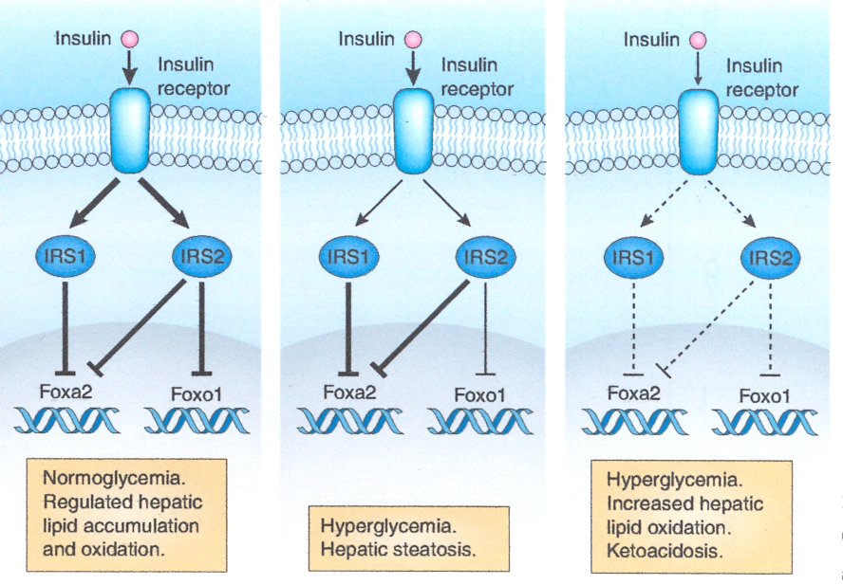
(IRS1, IRS2, Foxa2, Foxo1 and the liver – Summary)
NGT
IGT / T2DM
late T2DM

Slide 32
lipogenesis
hormonal control of lipogenesis
lipolysis
hormonal control of lipolysis
lipogenesis and insulin resistance
lipolysis and insulin resistance
metabolic effects of adipose tissue

Slide 33
Lipolysis and insulin resistance 1
100
percent maximum effect
suppression of lipolysis
stimulation of glucose elimination
50
0
10
20
30
40
50
60
70
90
100
110
120
insulin concentration (mU/l)

Slide 34
Lipolysis and insulin resistance 2
the hyperinsulinaemia of insulin resistance tends to suppress adipocyte HSL activity and lipolysis despite glucoregulatory insulin resistance
the hyperinsulinaemia of insulin resistance maintains provision of adipocyte G3P for triglyceride synthesis
insulin resistance promotes adipocyte lipid accumulation

Slide 35
Type 2 diabetes and metabolism
the relative hyperinsulinaemia of insulin resistance in early T2DM drives lipid accumulation in adipose tissue and the liver
the relative hypoinsulinaemia of late T2DM may result in lipid oxidation, weight loss and ketosis
what about obesity?

Slide 36
lipogenesis
hormonal control of lipogenesis
lipolysis
hormonal control of lipolysis
lipogenesis and insulin resistance
lipolysis and insulin resistance
metabolic effects of adipose tissue

Slide 37
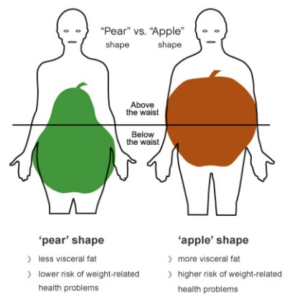
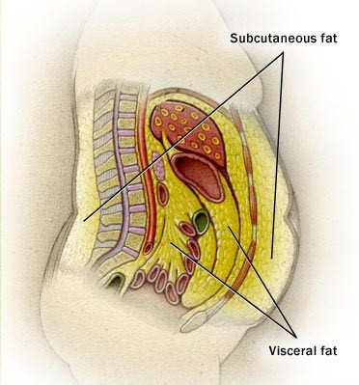
Regional body fat and metabolism
lower body fat: small adipocytes resistant to lipolytic stimuli
upper body, central, android visceral fat: large adipocytes increased in obesity
upper body, central, android visceral fat: sensitive to lipolytic stimuli, e.g. catecholamines
upper body, central, android visceral fat: increased sympathetic activity
upper body, central, android visceral fat: pro-inflammatory

Slide 38
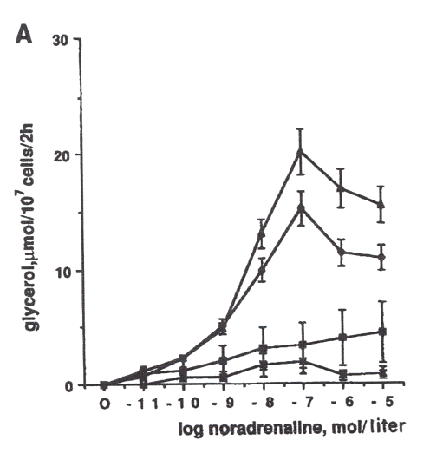
Regional body fat and catecholamines
Wahrenberg et al. J Clin Invest 1989;84:458
upper-body fat is more sensitive to lipolytic stimuli than lower-body fat
abdominal - female
abdominal - male
gluteal - female
gluteal - male

Slide 39
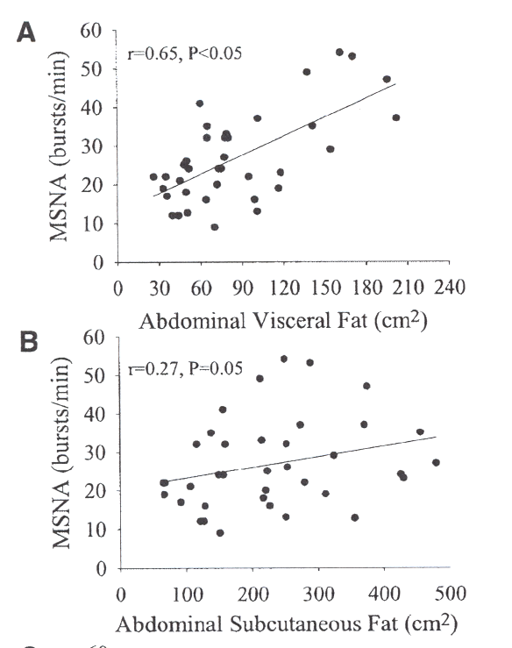
Regional body fat and sympathetic activity
Alvarez et al. Circulation 2002;106:2533
muscle sympathetic nerve activity increased more with increasing visceral fat than with increasing subcutaneous fat

Slide 40
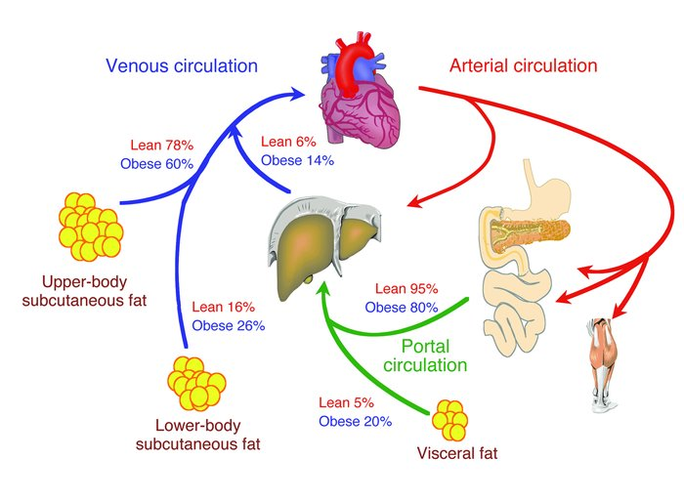
Regional body fat and fatty acid delivery
Klein J Clin Invest 2004;113:1530
visceral fat drains into the hepatic portal blood supply
high visceral fat mass exposes the liver to increased fatty acid flux
increased fatty acid flux to the liver increases hepatic triglyceride production and VLDL secretion

Slide 41
Regional body fat and inflammatory markers
pre-adipocytes act as ‘macrophage-like’ cells
human adipose tissue secretes adipocytokines
from adipose tissue from obese compared with non-obese humans there is increased release of: tumour necrosis factor-α, interleukin-6, monocyte chemotactic protein-1, transforming growth factor-β
macrophage numbers in adipose tissue increase in obesity
these effects are especially augmented by visceral fat
Calabrò et al. Internal Emerging Medicine 2009;4:25

Slide 42
Adipose tissue promotes insulin resistance
insulin
IR
P
P
PIP3
GLUT - 4
PDK1
serine phosphorylation
IRS
Grb2
SOS
RAS
P
P
Akt
P
p85
p110
PI3K
TNFα
JNK
TNF-alpha
fatty acids
CATECHOLAMINES

Slide 43
Visceral adipose tissue promotes insulin resistance
Visceral fat has a more marked adverse effect on factors that promote insulin resistance than other fat depots – a greater effect on insulin sensitivity would therefore be expected

Slide 44
...or does it?
Searched on “regional adiposity” or “visceral fat” and “insulin sensitivity” – selected studies in which visceral and subcutaneous fat were measured by CT or MRI
1995-2010: 22 studies
both abdominal subcutaneous and visceral fat appear to be strong independent correlates of insulin sensitivity
differentials one way or the other may appear according to age, gender, ethnicity, glycaemic status and obesity
insulin sensitivity in these studies was generally peripheral but in the few studies in which both were measured relationships with hepatic insulin sensitivity did not differ
visceral adiposity may, neverthelss, have stronger relationships with triglycerides and glucose tolerance

Slide 45
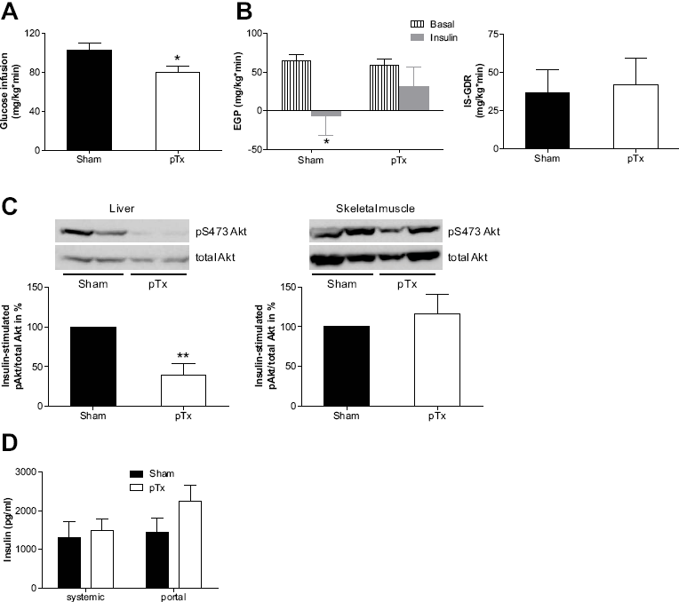
...or does it?
Rytka et al
“The portal theory supported by venous drainage-selective fat transplantation”
Diabetes 2010;60:56
abdominal fat mass in mice was artificially increased by fat depot transplantation
only portally draining transplants impaired insulin sensitivity and glucose tolerance
effects correlated with portal IL-6 and were not present in IL-6 KO mice

Slide 46
conclusions

Slide 47
Obesity, T2DM and insulin resistance
obesity is a major risk factor for T2DM
obesity is a major cause of insulin resistance
insulin resistance is a major risk factor for T2DM
weight reduction can reduce glucose levels
in these relationships, what is happening at the metabolic level?
obesity
T2DM
insulin resistance

Slide 48
Obesity, T2DM and insulin resistance
obesity is a major cause of hepatic and peripheral insulin resistance
compensatory hyperinsulinaemia promotes further lipid deposition in adipose tissue
compensatory hyperinsulinaemia promotes ectopic lipid accumulation in the liver which further promotes hepatic insulin resistance
obesity augments hepatic exposure to catecholamines, fatty acids and adipocytokines which further promotes hepatic insulin resistance
sustained hepatic insulin resistance, catecholamines, fatty acids, and cytokines all impair beta-cell function

