Slide 1
Imperial College
London
Clinical assessment of insulin secretion
Ian F. Godsland, PhD
BSc Endocrinology, Module 2
i.godsland @ imperial.ac.uk

Slide 2
WHY MEASURE INSULIN SECRETION?
Defective insulin secretion is critical in the development of Type 2 diabetes
Evaluation of changes in insulin secretion is critical in developing treatments for Type 2 diabetes

Slide 3
MEASUREMENT OF INSULIN SECRETION IN VIVO
Measurement of insulin secretion in vivo is difficult and complicated

Slide 4
INSULIN SECRETION FROM THE PANCREAS
1) insulin secretion occurs at an inaccessible site in the body
pancreatic secretion
venous sampling

Slide 5
INSULIN DISTRIBUTION THROUGHOUT THE BODY
2) insulin has a complex pattern of distribution throughout the body
pancreatic secretion
venous sampling
pancreatic secretion
PANCREAS
insulin
~50% uptake on
LIVER
first pass
venous sampling
receptor uptake
EXTRACELLULAR
VENOUS
FLUID
PLASMA
transendothelial
tissue
transport
renal
metabolism
excretion

Slide 6
THE INSULIN / GLUCOSE CLOSED FEEDBACK LOOP
3) insulin secretion depends on glucose levels, which depend on insulin secretion
GLUCOSE TURNOVER
PLASMA INSULIN
PLASMA GLUCOSE
INSULIN SECRETION
= complex systems

Slide 7
THE INSULIN SECRETION RESPONSE TO GLUCOSE
4) there is no direct, linear relationship between insulin secretion and a glucose stimulus
insulin secretion is phasic
the initial first phase burst of insulin release depends on the rate of rise of glucose
the prolonged second phase of insulin release depends on sustained glucose levels
repeated glucose stimulation potentiates net insulin release
each of these processes has its own sensitivity to glucose that contributes to glycaemic status

Slide 8
INFLUENCES ON INSULIN SECRETION
5) insulin secretion is susceptible to many different influences apart from glucose
insulin secretion is pulsatile
incretin hormones from the gut augment the sensitivity of insulin release to glucose
increased sympathetic tone suppresses insulin secretion
increased inflammatory tone suppresses insulin secretion

Slide 9
INSULIN SECRETION: QUANTIFICATION IN CLINICAL RESEARCH
surrogate
homeostasis model assessment
the insulinogenic index
IVGTT acute insulin response
IVGTT modelling: glucose C-peptide minimal model
IVGTT modelling: insulin C-peptide combined model
OG/MTT modelling: glucose C-peptide modelling
hyperglycaemic clamp
C-peptide deconvolution analysis
pancreatic

Slide 10
SIMPLE EVALUATIONS OF INSULIN SECRETION
EVALUATE INSULIN SECRETION USING VENOUS PLASMA INSULIN CONCENTRATIONS ALONE

Slide 11
HOMEOSTASIS MODEL ASSESSMENT
evaluates the basal beta cell response to basal glucose
ß = 200%
IR = 16
ß = 100%
80
Basal
IR = 8
ß = 50%
insulin
(µU/ml)
IR = 4
IR = 2
ß = 25%
IR = 1
IR = 0.5
ß = 12.5%
0
0
Basal glucose (mmol/l)
13
HOMA-B % beta cell function
(20 x FPI mU/l) / (FPG mmol/l – 3.5)

Slide 12
THE OGTT INSULINOGENIC INDEX
oral glucose tolerance test insulin profiles
200
obese
IGT
insulin
(mU/L)
healthy
150
100
50
0
0
30
60
90
120
150
180
0
30
60
90
120
150
180
0
30
60
90
120
150
180
minutes
the OGTT insulinogenic index:
30 minute insulin increment / 30 minute glucose increment

Slide 13
THE HYPERGLYCAEMIC CLAMP
15
glucose
(mg/dl)
10
5
50
insulin
(mU/L)
40
30
20
10
0
from: Groop et al. Diabetes 1987;36:1320

Slide 14
USING THE PLASMA INSULIN HALF-LIFE
insulin is eliminated from plasma very rapidly
the plasma insulin half-life is, on average, about 4 minutes
consequently an increase in plasma insulin concentrations due to increased secretion is immediately followed by a decrease
this means that increases in insulin secretion can be very clearly distinguished
enables evaluation of the pulsatility of insulin secretion
enables clear distinction of the first phase of insulin secretion following a glucose injection

Slide 15
EVALUATING INSULIN PULSATILITY
insulin µU/ml
6
Matthews. Diabetic Medicine 1996;13:S53
5
healthy
4
3
2
1
6
O'Rahilly et al. N Engl J Med 1988;318:1225
5
o
1 relative
4
3
2
1
Lang et al. Diabetes 1981;30:435
6
5
T2DM
4
3
2
1
0
10
20
30
40
50
60
minutes

Slide 16
EVALUATING PHASE 1 INSULIN SECRETION
intravenous glucose tolerance test insulin profiles
200
insulin
(mU/L)
healthy
obese
IGT
150
100
50
0
0
30
60
90
120
150
180
0
30
60
90
120
150
180
0
30
60
90
120
150
180
minutes
the IVGTT acute insulin response to glucose (AIRg):
incremental area under the insulin profile from 0 – 10 minutes

Slide 17
AIRg DECLINES WITH INCREASING FPG
Godsland et al. Diabetologia 2004;47:1157
mean AIRg by FPG in 533 men without diabetes
800
700
NG
IFG
AIRg
(mU/l.min)
600
500
400
300
200
100
0
fasting glucose
range (mmol/L)
<4.75
5.00
5.25
5.50
5.75
6.00
6.25
6.5-7.0
n 43 94 127 124 75 45 25 20
a decline in AIRg is the first readily-detectable sign of beta cell deterioration

Slide 18
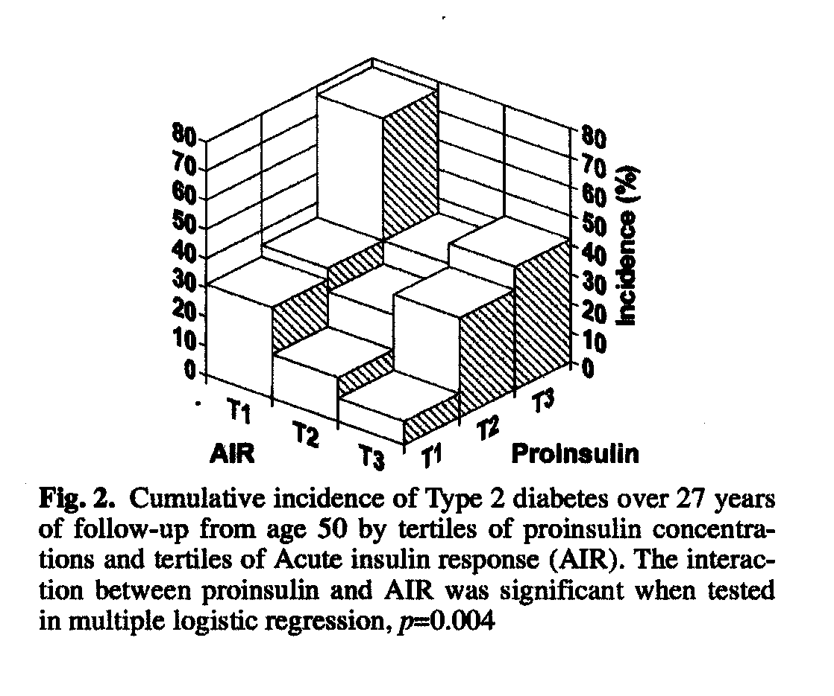
AIRg PREDICTS INCIDENT T2DM
Zethelius et al. Diabetologia 2003;46:20
development of T2DM over 27 years in 1306 men initially free of diabetes
only AIRg and fasting proinsulin were independent predictors of T2DM

Slide 19
COMPLEX EVALUATION OF INSULIN SECRETION
EVALUATE INSULIN SECRETION USING VENOUS PLASMA C-PEPTIDE CONCENTRATIONS AND MODELLING ANALYSIS

Slide 20
C-peptide
proinsulin
S
S
S
S
S
S
S
S
S
S
S
S
insulin
C-peptide

Slide 21
INSULIN DISTRIBUTION THROUGHOUT THE BODY
pancreatic secretion
PANCREAS
insulin
~50% uptake on
LIVER
first pass
venous sampling
receptor uptake
EXTRACELLULAR
VENOUS
FLUID
PLASMA
transendothelial
tissue
transport
renal
metabolism
excretion

Slide 22
C-PEPTIDE DISTRIBUTION THROUGHOUT THE BODY
PANCREAS
pancreatic secretion
C-peptide
venous sampling
EXTRACELLULAR
VENOUS
FLUID
PLASMA
renal
excretion

Slide 23
THE 2-COMPARTMENT MODEL OF C-PEPTIDE
S
t
dC
t
-k
C
S
-k
C
t
t
+k
Y
t
dt
t
21
01
12
dY
t
-k
Y
k
k
C
t
12
t
21
C
dt
21
Y
t
t
k
V
d
12
S
t
pancreatic insulin secretion rate at time, t
C
t
plasma C-peptide mass at time, t
k
01
V
d
C-peptide volume of distribution
Y
t
extracellular fluid C-peptide mass at time, t
k
rate constants
01,21,12

Slide 24
INSULIN SECRETION BY C-PEPTIDE DECONVOLUTION
the reference method for measuring insulin secretion
determine the C-peptide kinetic rate constants, k₀₁, k₁₂, k₂₁, and volume of distribution, V_{d}, for an individual volunteer
use the rate constants and volume of distribution, plus the equations of C-peptide kinetics to determine the insulin secretion profile that can give rise to any observed C-peptide profile in that individual volunteer

Slide 25
Insulin / C-peptide secretion by deconvolution (1)
Eaton et al J Clin Endocrinol Metab 1983;51:520
Polonsky et al J Clin Invest 1986;77:98
Hovorka & Jones Diabetes/Metab Rev 1994;10:91
For a given individual:
give a bolus C-peptide injection and measure C-peptide concentrations to derive a C-peptide decay profile
determine the rate constants and volume of distribution for that individual by predicting the observed C-peptide concentrations from the C-peptide distribution equations
Bolus C-peptide injection
7
k
: 0.043 min
-1
C-peptide
6
01
-1
5
k
: 0.028 min
(pmol/ml)
4
21
-1
3
k
12
: 0.047 min
2
V
1
d
: 7721ml
0

Slide 26
Insulin / C-peptide secretion by deconvolution (2)
For the same individual:
measure a C-peptide concentration profile (e.g. in basal state, following intravenous glucose, following a meal)
take the C-peptide distribution equations and the rate constants and volume of distribution from the C-peptide decay analysis for that individual
use these to determine the insulin secretion rate profile that can predict the observed C-peptide concentrations
= deconvolution

Slide 27
Insulin / C-peptide secretion by deconvolution (3)
Bolus C-peptide injection
7
k
: 0.043 min
-1
C-peptide
6
01
-1
5
k
: 0.028 min
(pmol/ml)
4
21
-1
3
k
12
: 0.047 min
2
V
1
d
: 7721ml
0
Intravenous glucose tolerance test
2.0
C-peptide
1.5
(pmol/ml)
1.0
0.5
0
Deconvolution analysis
insulin
14,000
secretion
12,000
10,000
(pmol/min)
8,000
6,000
4,000
2,000
0
0
30
60
90
120
150
180
(case: GOM)

Slide 28
SIMPLIFIED EVALUATION OF INSULIN SECRETION
EVALUATE INSULIN SECRETION USING VENOUS PLASMA C-PEPTIDE CONCENTRATIONS AND MODELLING ANALYSIS WITH SIMPLIFYING ASSUMPTIONS

Slide 29
POPULATION PARAMETER DECONVOLUTION
van Cauter et al. Diabetes 1992;41:368
200 bolus C-peptide decay profiles were analysed
rate constants and volumes of distribution were significantly related to an individual’s normal, obese or NIDDM status, and to age, gender, body surface area
regression analysis provided formulae with which values for these variables for a given individual could be used to calculate C-peptide rate constants and the volume of distribution for that individual

Slide 30
INSULIN SECRETION FROM A SINGLE IVGTT (1)
The glucose C-peptide minimal model
Cobelli & Pacini. Diabetes1988;37:223 (one compartment)
Caumo & Cobelli. Am J Physiol 1993;264:E829 (two compartment)
first phase secretion described by an instantaneous bolus output
second phase secretion given by the sensitivity of C-peptide secretion to glucose, multiplied by the increment in glucose above a threshold, multiplied by the time elapsed since commencement of the IVGTT
parameters determined by predicting the observed C-peptide concentration profile from the accompanying glucose concentrations
the two-compartment version incorporates estimation of C-peptide rate constants and volume of distribution and deconvolution analysis

Slide 31
INSULIN SECRETION FROM A SINGLE IVGTT (2)
The insulin C-peptide combined model
Volund et al Diabetes 1987;36:1195
Watanabe et al JCEM 1989;69:790 (one compartment)
Watanabe et al Am J Physiol 1998;274:E172 (two compartment)
plasma insulin and C-peptide concentration profiles derive from a single insulin / C-peptide secretion profile
the concentration profiles differ due to hepatic uptake of newly-secreted insulin, and differences in the plasma half-lives of insulin and C-peptide
use modelling analysis to determine the insulin secretion profile, fractional hepatic insulin uptake and insulin and C-peptide elimination constants that can simultaneously predict the observed plasma insulin and C-peptide concentration profile

Slide 32
INSULIN SECRETION FROM A SINGLE OGTT OR MTT
Hovorka et al. J Clin Endocrinol Metab 1998;83:744
Toffolo et al. Am J Physiol 2001;280:E2
Mari et al. Diabetes 2002; 51 suppl 1: S221
incorporate a component into the model that describes glucose absorption
incorporate static and dynamic components of insulin release
incorporate population parameter deconvolution estimates of C-peptide rate constants
many assumptions needed to make the modelling analysis practicable
current interest in in vivo evaluation of insulin secretion justifies exploration of these models

Slide 33
MEASUREMENT OF INSULIN SECRETION - SUMMARY
Very generally:
HOMA or OGTT indices for epidemiological investigations
IVGTT insulin (AIRg or model-derived measures) for small to large scale investigations with evaluation of both insulin sensitivity and secretion
OGTT and MTT model-derived measures may be of value but is still in the developmental stage
Bolus C-peptide injection / deconvolution analysis for small, intensive investigations involving a high degree of precision

