Slide 1
Imperial College
London
DEBATE
“The primary defect in Type 2 diabetes mellitus is insulin resistance”

Slide 2
Imperial College
London
“The primary defect in Type 2 diabetes mellitus is insulin resistance”
Insulin resistance is the cause
Ian F. Godsland, PhD
i.godsland@imperial.ac.uk

Slide 3
Insulin Resistance v Insulin Secretion
before diabetes develops...
which comes first ?

Slide 4
Insulin Resistance v Insulin Secretion
before diabetes develops...
which comes first ?
those at risk >>>

Slide 5
Normoglycaemic relatives of patients with T2DM are insulin resistant but not insulin deficient
Eriksson et al. New England Journal of Medicine 1989; 321: 337-343
glucose metabolism during euglycaemic, hyperinsulinaemic clamp
**
**
**
insulin concentrations at the start of a hyperglycaemic clamp
minutes

Slide 6
Insulin Resistance v Insulin Secretion
before diabetes develops...
which comes first ?
risk factors and mechanism >>>

Slide 7
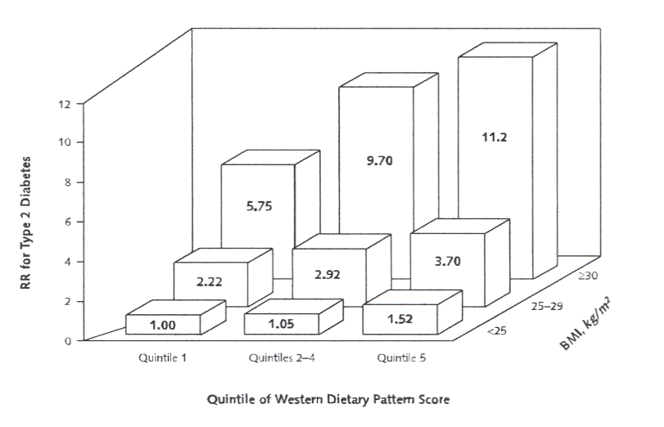
Diet, diabetes and fatty acids
van Dam et al Ann Intern Med 2002;136 :201
% OF ENERGY INTAKE
quintile 1 quintiles 2-4 quintile 5
total fat 26.4 32.1 37.2
saturated fat 8.5 11.0 13.3
linoleic acid 4.7 5.1 5.5

Slide 8
Fatty acids and insulin secretion: short and long-term
Paolisso et al.
Opposite effects of short- and long-term fatty acid infusion on insulin secretion in healthy subjects.
Diabetologia 1995;38:1295
12 healthy volunteers
IVGTT at 0, 6 and 24 hours of Intralipid
AIRg increased significantly at 6 h (p<0.01) and decreased significantly at 24 h (p<0.001)
at 6 h NEFA v AIRg r = +0.89
at 24 h NEFA v AIRg r = -0.87
AIRg

Slide 9
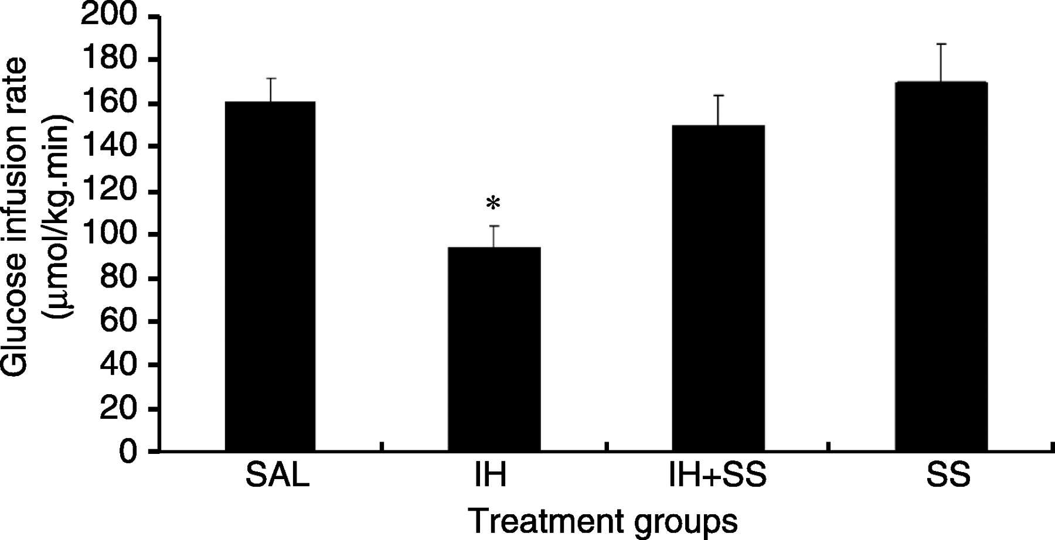
Fatty acids, cell signalling and insulin resistance
insulin
IR
P
P
Effects of saline (sal), fatty acids (IH) and salicylate (SS) on insulin sensitivity
Park et al. J Endocrinol 2007;195:323
serine phosphorylation
IRS
P
IKKβ
JNK
fatty acids stimulate IKKβ
IKKβ serine phosphorylates the insulin receptor
salicylate inhibits IKKβ and alleviates fatty acid-induced insulin resistance
fatty acids

Slide 10
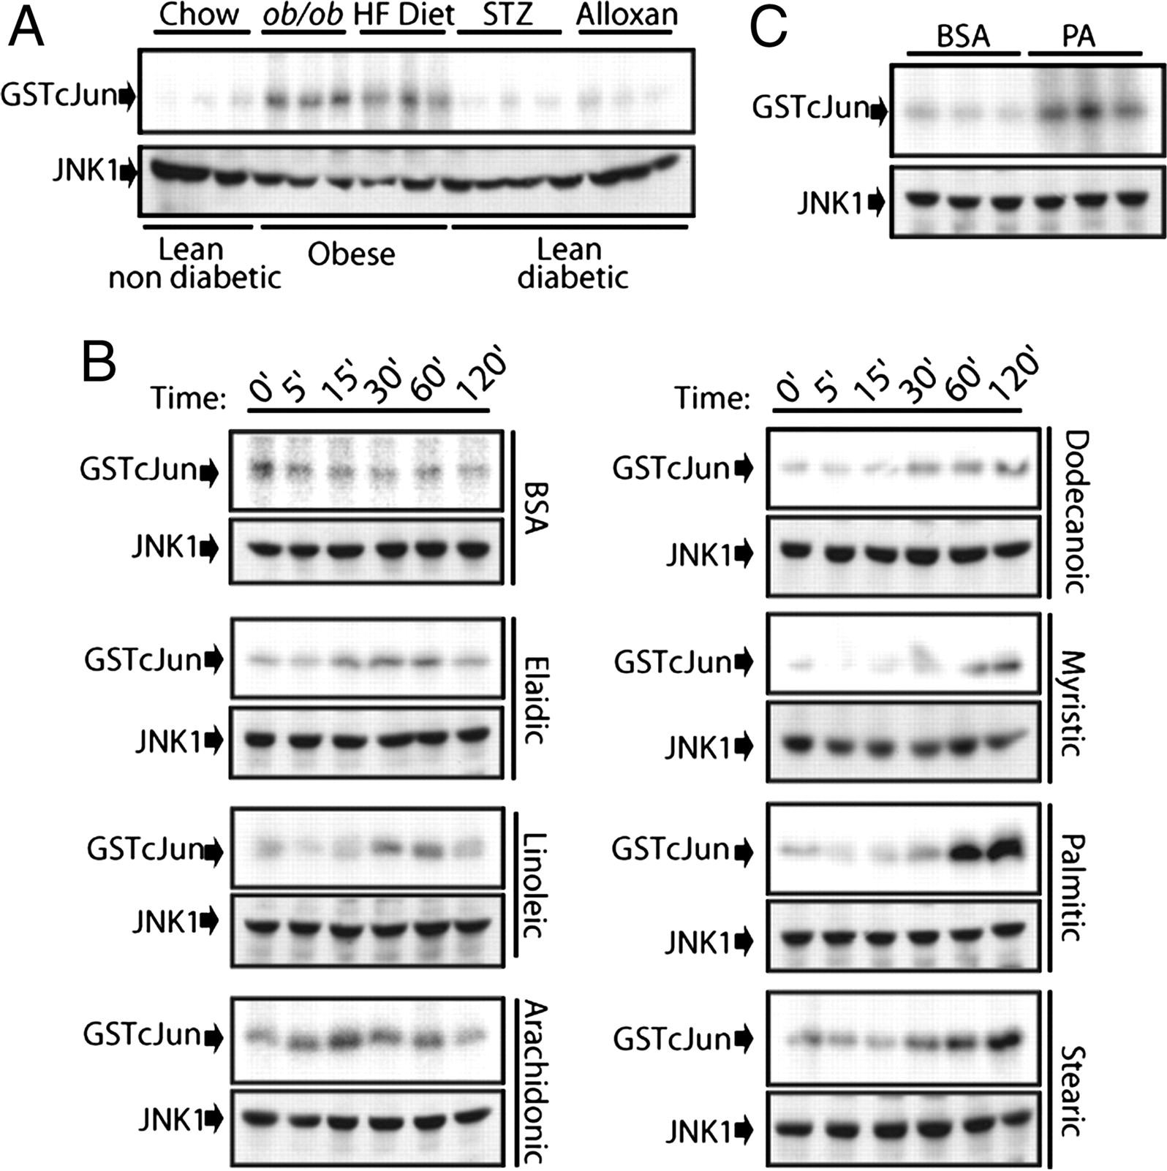
Fatty acids, JNK and insulin resistance
Solinas et al.
Saturated fatty acids inhibit induction of insulin gene transcription by JNK-mediated phosphorylation of insulin-receptor substrates.
PNAS 2006;103:16454
exposure to fatty acids resulted in activation of JNK (identified by binding to GSTcJUN)
this effect was seen with long-chain saturated fatty acids

Slide 11
Insulin Resistance v Insulin Secretion
before diabetes develops...
which comes first ?
changes accompanying the onset of T2DM >>>

Slide 12
The transition to impaired glucose homeostasis and diabetes during long-term follow up is accompanied by an increase in insulin resistance (1)
Laspa et al. Diabetic Medicine 2007;24:1269
5.8
fasting plasma glucose (mmol/l)
p<0.001
The HDDRISC study:
59 men who developed IGH/DM each compared with 2 age- and follow-up-matched controls who remained normoglycaemic
5.6
5.4
5.2
5.0
4.8
4.6
0
16
OGTT glucose AUC (mmol/l.min)
p=0.008
14
12
10
8
controls
cases
6
0
baseline
penultimate
index
-12
-10
-8
-6
-4
-2
0
years prior to developing IGH

Slide 13
The transition to impaired glucose homeostasis and diabetes during long-term follow up is accompanied by an increase in insulin resistance (2)
Laspa et al. Diabetic Medicine 2007;24:1269
insulinogenic index
1
0.8
The HDDRISC study:
59 men who developed IGH/DM each compared with 2 age- and follow-up-matched controls who remained normoglycaemic
0.6
0.4
0.2
0
8
ISI-Matsuda
p=0.001
7
6
5
4
controls
cases
3
0
penultimate
index
baseline
-12
-10
-8
-6
-4
-2
0
years prior to developing IGH

Slide 14
Insulin Resistance v Insulin Secretion
before diabetes develops...
which comes first ?
prediction of incident T2DM >>>

Slide 15
Low insulin sensitivity but not low beta cell function predicts T2DM over 25 years (1)
Lancet 1992; 340: 925-929
155 subjects, initially normoglycaemic, with family history of T2DM
IVGTT at baseline
Followed for 6-25 years
Minimal model of glucose disappearance – insulin sensitivity and glucose effectiveness
Minimal model of post-hepatic insulin delivery –phase 1 and 2 beta cell function

Slide 16
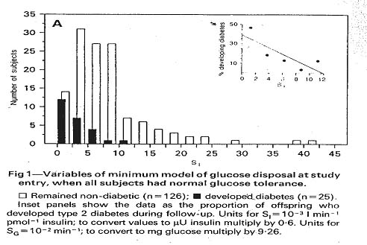
Low insulin sensitivity but not low beta cell function predicts T2DM over 25 years (2)
Martin et al. Lancet 1992; 340: 925-929
Those who developed diabetes began with very low insulin sensitivity

Slide 17
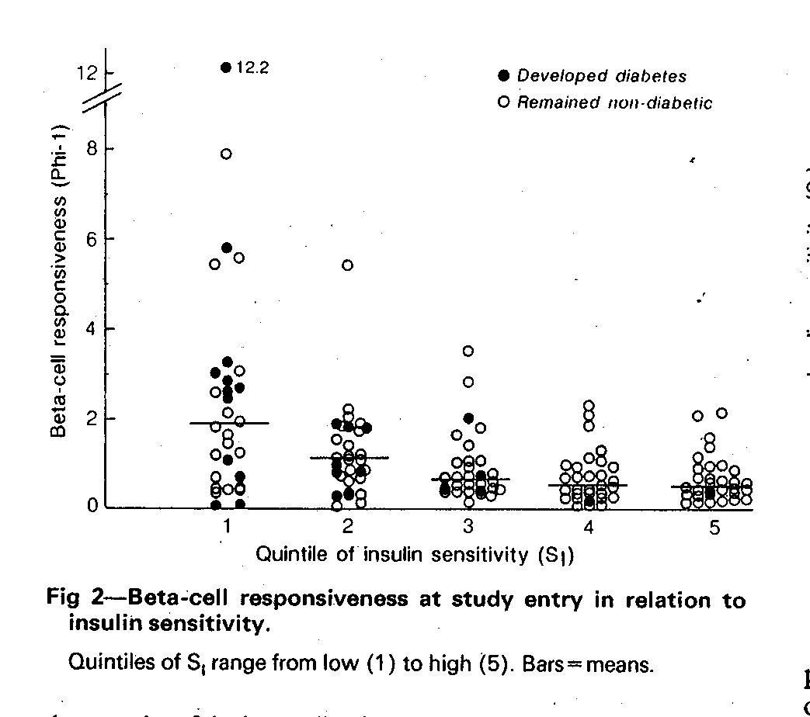
Low insulin sensitivity but not low beta cell function predicts T2DM over 25 years (3)
Martin et al. Lancet 1992; 340: 925-929
Those who developed diabetes did not have impaired beta cell function

Slide 18
before diabetes develops...
which comes first ?
insulin resistance!

