Slide 1
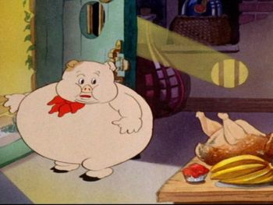
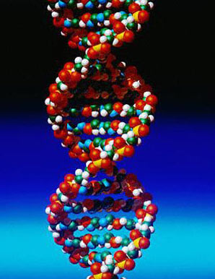
Genetics of obesity
Dr Gavin Bewick
Dept of Investigative Medicine

Slide 2
Learning objectives
By the end of this lecture you should be able to:
Discuss the evidence for genetic influences on obesity
Using named examples from both humans and animal models, describe how monogenic forms of obesity have been important in identifying the mechanisms involved in the regulation of appetite.
Describe the methods used for identification of susceptibility genes for obesity
Critically discuss the evidence for a role for FTO in the pathogenesis of obesity.

Slide 3
Obesity
“Isn’t it just all about people eating too much and not doing enough exercise?”

Slide 4
Why is the world’s population getting more obese?
Lifestyle?
Diet?
Genetics?

Slide 5
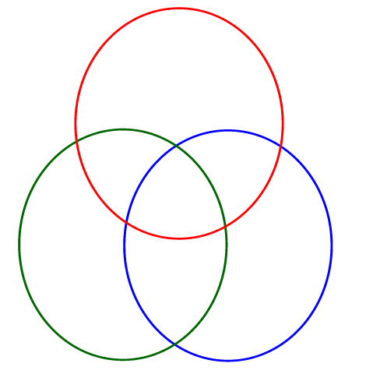
Why is the world’s population getting more obese?
DIET
GENES
LIFESTYLE

Slide 6
Weight is highly heritable
Estimates for the genetic contribution to body weight have been established through family studies, investigations of parent-off-spring relationships and twin studies.
Heritability estimates of 40-70%
This is only slightly less than that for height.

Slide 7
Evidence for genetics of common obesity
Twin studies
  Compare effects on monozygotic (identical) and dizygotic/ fraternal (non-identical) twins.
Adoption studies
  Adopted children more similar body weight to biological parents than adopted parents.

Slide 8
Twin studies
 | Men |  |  | Women
 | No. | BMI | Intra-pair Correlation | No. | BMI | Intra-pair Correlation
Monozygotic
Reared apart | 49 | 24.8 ± 2.4 | 0.70 | 44 | 24.2 ± 3.4 | 0.66
Reared together | 66 | 24.2 ± 2.9 | 0.74 | 88 | 23.7 ± 3.5 | 0.66
Dizygotic
Reared apart | 75 | 25.1 ± 3.0 | 0.15 | 143 | 24.9 ± 4.1 | 0.25
Reared together | 89 | 24.6 ± 2.7 | 0.33 | 119 | 23.9 ± 3.5 | 0.27
Stunkard et al NEJM 1990; 322:1483-7
Notes:
These observations have been observed numerous times in a number of different twin studies.

Slide 9
Twin studies

Slide 10
Why are we genetically predisposed to be obese?

Slide 11

The “thrifty gene” hypothesis
Genes that predispose to obesity would have had a selection advantage in populations that frequently experience starvation.
Neel 1962 Am J Hum Genet 14:352-353
Notes:
Such a genotype would be advantageous for primitive humans exposed to variation in food supply because it would allow them to efficiently deposit fat stores and hence survive any subsequent period of famine. In modern society however, with plentiful and continuous food, this thrifty genotype proves deleterious because it promotes efficient storage of fat, in preparation for a famine that never comes. People who possess these genes in today’s obesogenic environment might be those that over-react- not just becoming slightly overweight but extremely obese
There have been a number of arguments against this hypothesis – famines are relatively rare demographic events, occuring only about once every 100 years, probably originated during our transition to an agriculture-based society about 10,000 years ago
Mortaliity in post-reproductive adults is irrelevant for genetic selection and differential mortality in the very young is unlikely to be biased toward lean individuals because until recently obesity was virtually unheard of in this age group.

Slide 12
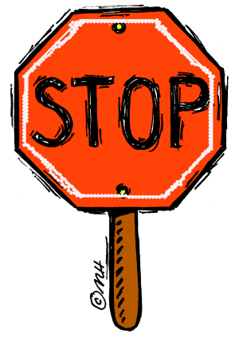
But.....
Famines are rare
Evidence from modern hunter gatherers – do not get fat in between famines.
No evidence fat people protected against famines.
Drifty gene hypothesis (John Speakman 2008)

Slide 13
Monogenic forms of obesity
Rare- 176 cases due to mutations in 11 genes
Often the most severe familial forms which present in childhood.
Often presenting in consanguineous families.
These forms of obesity have been important in furthering our understanding of how appetite is controlled.

Slide 14
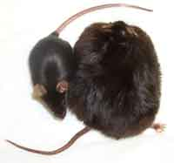
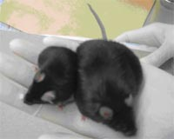
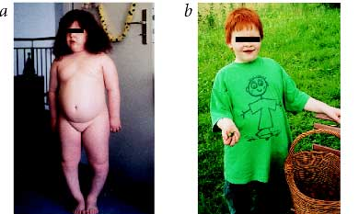
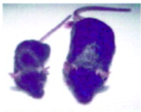
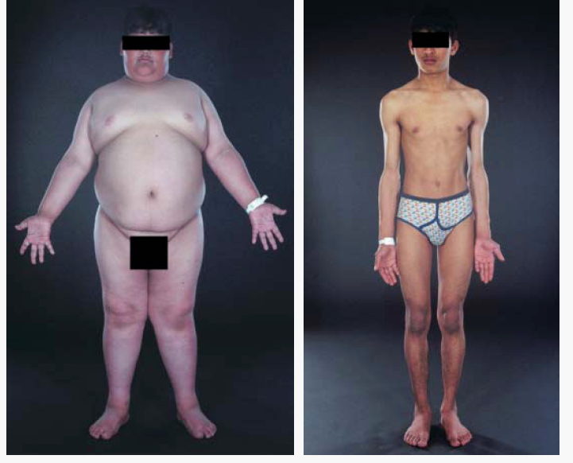
Monogenic forms of obesity
Ob/Ob
Ob/Rb
POMC
PC1
MC4R
Carboxypeptidase E (CPE)
Brain derived neurotrophic factor (BDNF)
TrkB

Slide 15
Syndromic forms of obesity
20 rare syndromes caused by discrete genetic defects or chromosomal abnormalities are characterised by obesity.
Most characterised by mental retardation.

Slide 16
Prader-Willi Syndrome
1 in 25000 births
Obesity
Hyperphagia
Muscular hypotonia
Mental retardation
Short stature
Hypogonadotropic hypogonadism

Slide 17
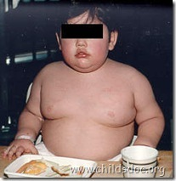
Prader-Willi Syndrome
Deletion at the chromosomal region 15q11.2-q12 most common cause.
Cause of hyperphagia unknown.

Slide 18
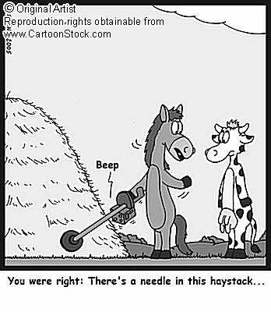
Finding Obesity Susceptibility Genes

Slide 19
Why is the world’s population getting more obese?
ENVIRONMENT
DIET
GENES
LIFESTYLE

Slide 20
Many common variants contribute to BMI and obesity each conferring only modest risk

Slide 21
Candidate gene approach
Relies on current understanding of biology and pathophysiology of obesity
Genetic variants at these loci tested for association at the population level

Slide 22
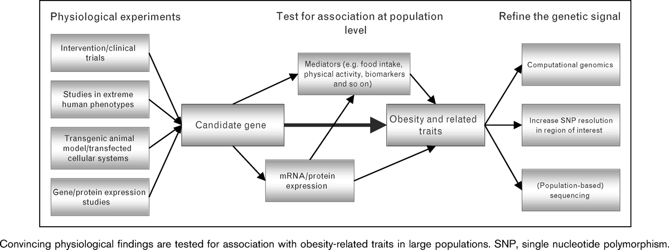
Candidate gene approach
Li and Loos; Current Opinion in Lipidology 2008,19:113-121

Slide 23
Candidate gene approach
Smaller the effect of genetic variant and the lower its minor allele frequency, the greater the sample size required to identify an association between this variant and obesity with sufficient power

Slide 24
The Human Obesity Gene Map
Project to review all markers, genes and mutations associated with obesity phenotypes.
There are 244 genes that when mutated or expressed as transgenes in the mouse result in phenotypes with altered body weight.
253 QTLs have been identified in humans from 61 genome-wide scans
426 findings of positive associations with 127 candidate genes
22 genes are supported by at least 5 positive studies
Notes:
A quantitative trait locus (QTL) is a region of DNA that is associated with a particular phenotypic trait - these QTLs are often found on different chromosomes. Knowing the number of QTLs that explains variation in the phenotypic trait tells us about the genetic architecture of a trait. It may tell us that plant height is controlled by many genes of small effect, or by a few genes of large effect.

Slide 25
The Human Obesity Gene Map
http://obesitygene.pbrc.edu/
The human obesity gene map: the 2005 update.
Rankinen T, Zuberi A, Chagnon YC, Weisnagel SJ, Argyropoulos G, Walts B, PÃ©russe L, Bouchard C.
Obesity (Silver Spring). 2006 Apr;14(4):529-644.

Slide 26
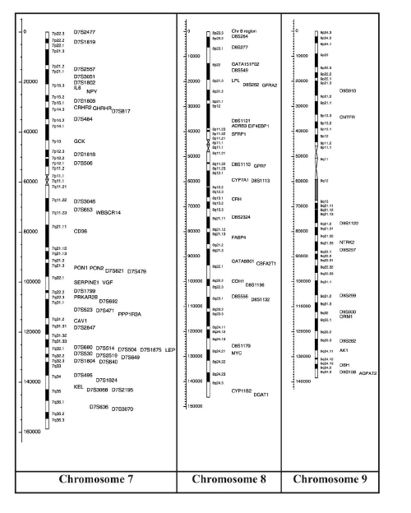
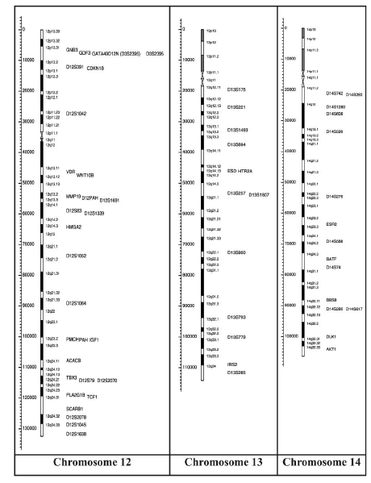
The Human Obesity Gene Map

Slide 27
Genome-wide association studies
Scanning the whole genome to identify genetic variations associated with disease.
Identified candidate genes in T1DM, T2DM, breast cancer, Crohn’s disease and multiple sclerosis.

Slide 28
Candidate gene approach
Li and Loos; Current Opinion in Lipidology 2008,19:113-121

Slide 29
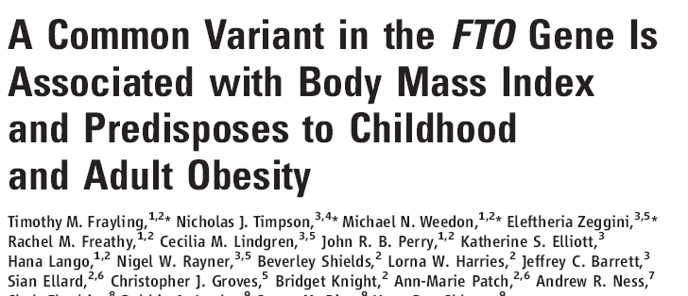

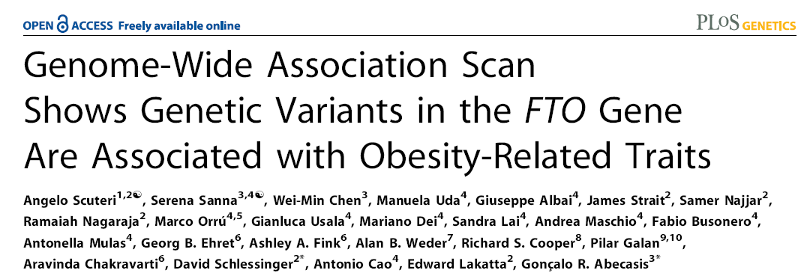

Slide 30
Identification of FTO as a candidate genes for obesity
Wellcome Trust Case Control Consortium (WTCCC) http://www.wtccc.org.uk/
Genome-wide association study for type 2 diabetes.
SNPs in the FTO gene region strongly associated with T2DM
Association abolished by adjustment for BMI
SNP association with T2DM risk is mediated through BMI
Frayling et al Science 316, 889 (2007)
Notes:
The Wellcome Trust Case Control Consortium (WTCCC) is a collaboration of 24 leading human geneticists, who will analyse thousands of DNA samples from patients suffering with different diseases to identify common genetic variations for each condition. It is hoped that by identifying these genetic signposts, researchers will be able to understand which people are most at risk, and also produce more effective treatments.
FTO gene – fat mass and obesity associated

Slide 31
FTO as a candidate gene for obesity
SNPs in the first intron of FTO associated with BMI and/or obesity.
16% of 38k population homozygous
Accounts for 1.18 – 1.32 fold increase in BMI =3kg for homozygous.
From 7 years upwards
Replicated in a number of studies
Not associated in African Americans or the Chinese

Slide 32
What is FTO?
FaT mass and Obesity associated
Originally cloned as result of identification of the fused-toes (Ft) mutant mouse
  1.6Mb deletion of mouse chr 8
  Homozygous mice are embryonic lethal
  Six genes deleted – poor model

Slide 33
Ft mutant mouse
Wild-type
Ft^{+/-}
Ft^{+/-}
Peters et al Mamm Genome 13, 186 (2002)
Notes:
The specific phenotype of the FT +/- mouse. Fore limb alterations: A typical fore limb of a hetereozygous FT +/- mouse is illustrated in A. A skeletal stain of a wild-type right fore limb is shown in B and compared to right fore limbs of Ft +/- mice

Slide 34
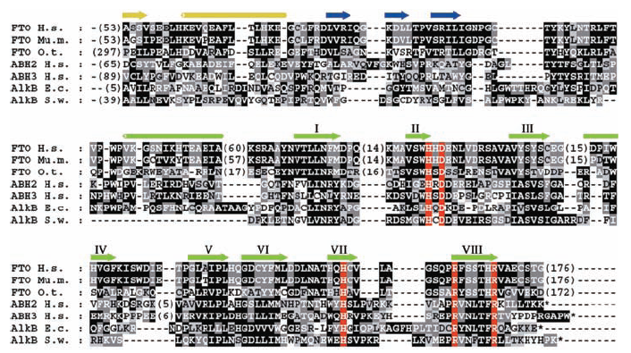
How did they determine the role of FTO?
Bioinformatics approach
Gerken et al Science 318, 1469 (2007)

Slide 35
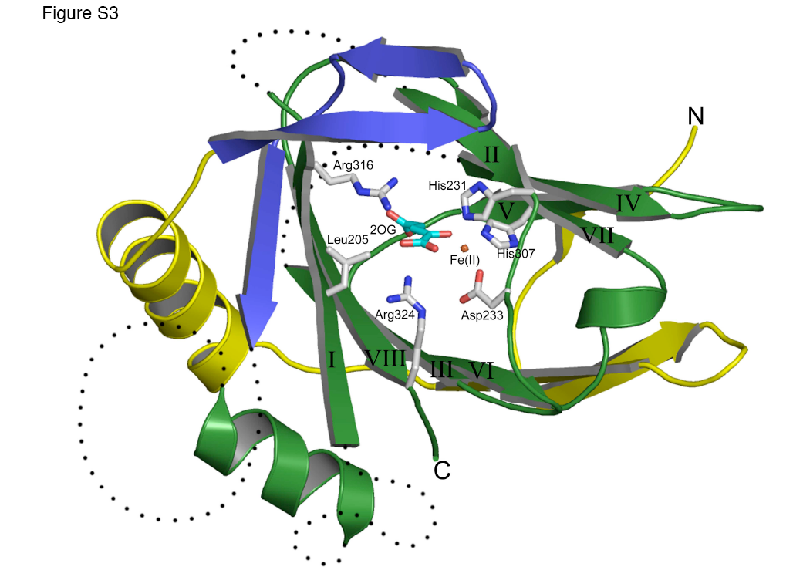
A role for FTO?
2-Oxoglutarate-Dependent Nucleic Acid Demethylase

Slide 36
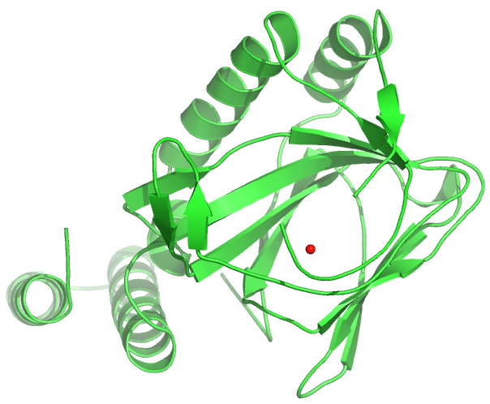
2OG-dependent nucleic acid demethylases
Member of the 2OG oxygenase family
Requires
  Fe²⁺ as a cofactor
  2-oxoglutarate and dioxygen as cosubstrates
Number of functions
  DNA repair
  Fatty acid metabolism
  Post-translational modifications
  Histone demethylation

Slide 37
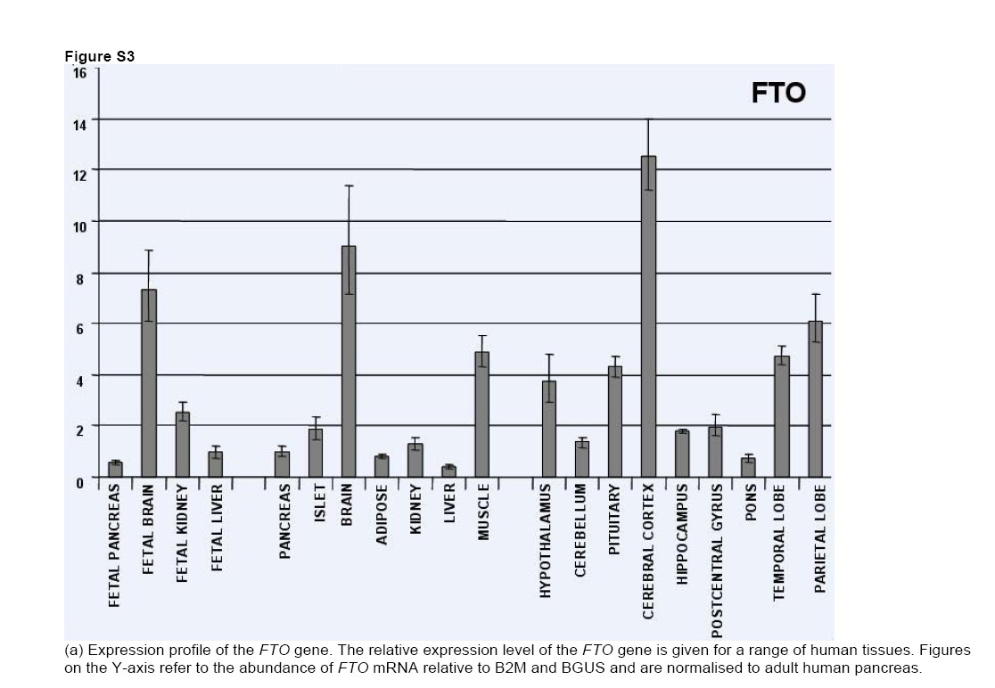
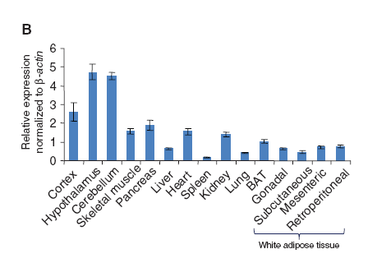
Human
Mouse
Frayling et al Science 316, 889 (2007)
Gerken et al Science 318, 1469 (2007)
Rat
Fredriksson R et al Endocrinology 149:2062-2071(2008)
Notes:
Expression profile of the FTO gene. The relative expression level of the FTO gene is given for a range of human tissues. Figures on the Y-axis refer to the abundance of FTO mRNA relative to B2M and BGUS and are normalised to adult human pancreas

Slide 38
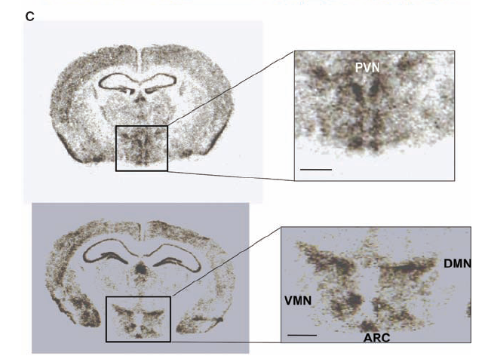
FTO expression in the hypothalamus
Gerken et al Science 318, 1469 (2007)

Slide 39
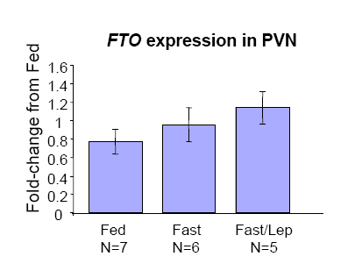
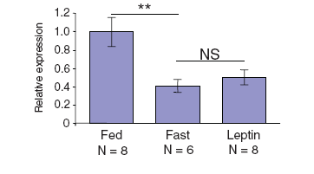
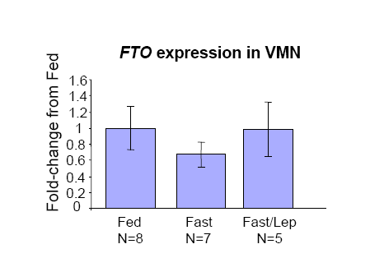
The nutritional regulation of FTO is nucleus specific in mice
Arcuate nucleus
Gerken et al Science 318, 1469 (2007)

Slide 40
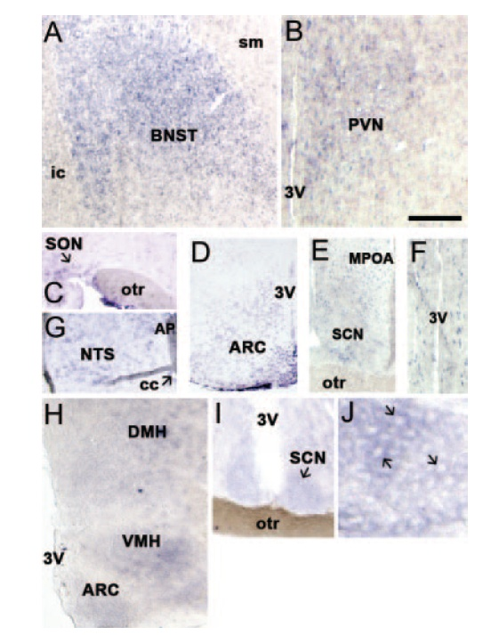
FTO expression in rat CNS
Fredriksson R et al Endocrinology 149:2062-2071(2008)

Slide 41
Hypothalamic FTO mRNA is altered by changes in nutritional status in rats
Fredriksson R et al Endocrinology 149:2062-2071(2008)

Slide 42
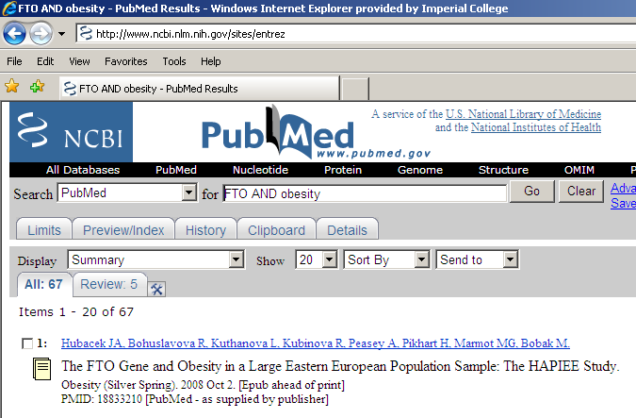
A gene for obesity?

Slide 43
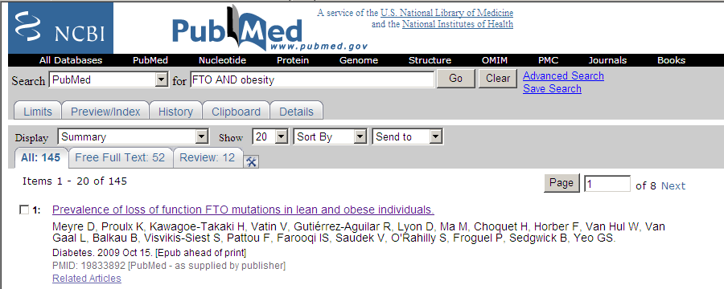
Publications to 2009
Loss of function Hets associated with both lean and obese.

Slide 44
Relevance to obesity?
Expressed in regions involved in the regulation of energy balance
Hypothalamic FTO mRNA changes in response to nutritional status.
Is it physiologically relevant?

Slide 45
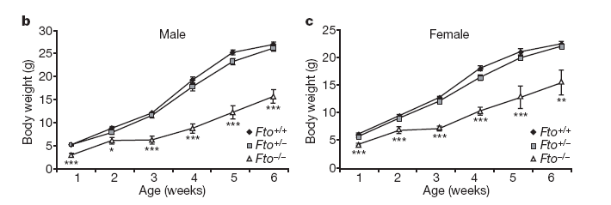
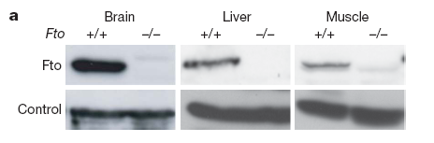
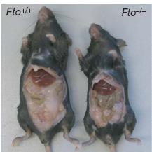
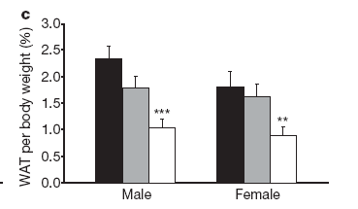
FTO knockout mouse #1
Fischer J et al 2009 Nature 458:894-9
Notes:
Generated by replacing exons 2 and 3 of the FTO gene with a neomycin resistance cassette. This also deletes part of intron 1 althuogh not the position equivalent to the BMI-assoicated SNPs in human FTO
Homozygous mutant mice are viable but postnatal death occurs more frequently. May be due to phenotypic disadvantages as the mortality rate is decreased by postponed weaning and a reduction in litter size.

Slide 46
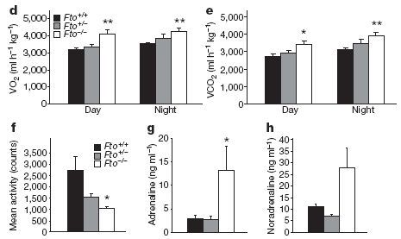
FTO knockout mouse #1

Slide 47
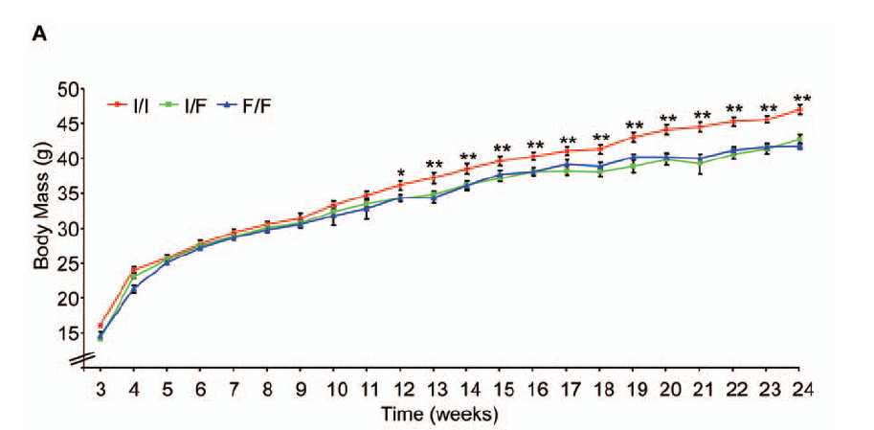
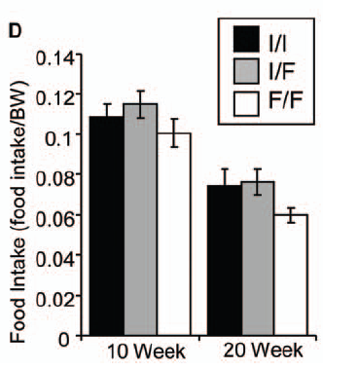
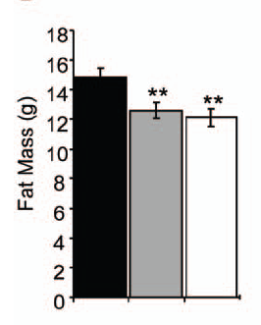
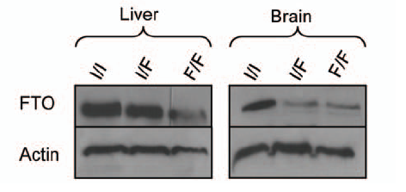
FTO knockout mouse #2
Church et al PLoS Genet 5(8): e1000599
Notes:
Used N-ethyl-N-nitrosourea mutagenesis to identify an FTO mutation that produces a partial loss of function – trying to make it more analogous to the human SNPs.
Mutation – an adenosine to thymidine mutation in exon 6 of FTO leading to substitution of a phenylalanine for isoleucine-367 in the C-terminal region of murine FTO.

Slide 48
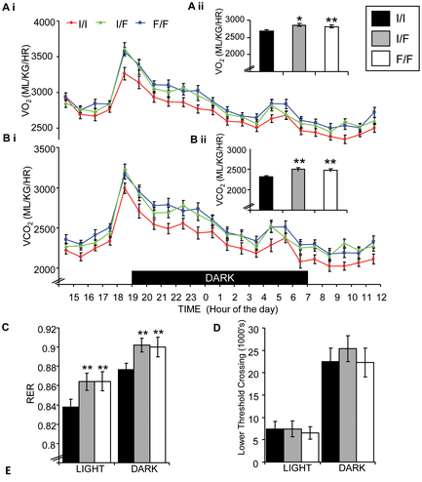

Slide 49
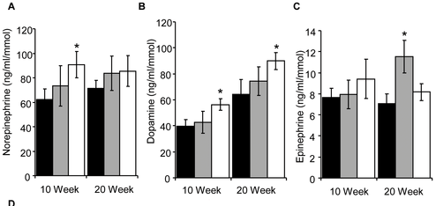
FTO knockout mouse #2

Slide 50

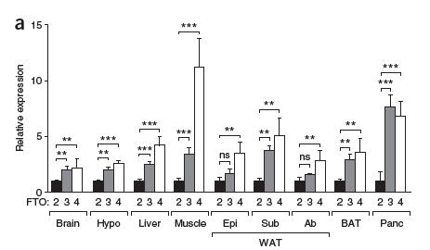
Overexpression of Fto leads to increased food intake and results in obesity
Chris Church1, Lee Moir1, Fiona McMurray1, Christophe Girard2, Gareth T Banks1, Lydia Teboul1, Sara Wells1, Jens C Brüning3, Patrick M Nolan1, Frances M Ashcroft2 & Roger D Cox1

Slide 51
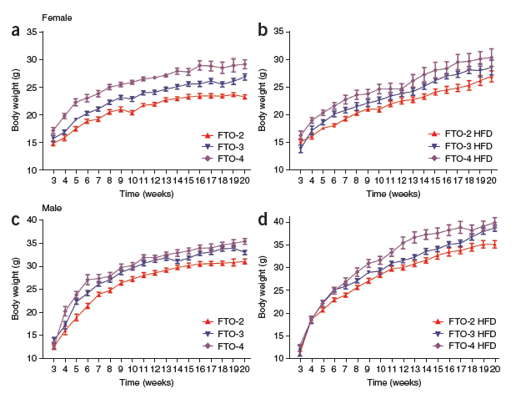
Overexpression of Fto leads to increased food intake and results in obesity

Slide 52
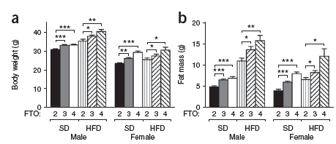
Overexpression of Fto leads to increased food intake and results in obesity

Slide 53
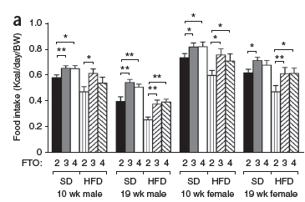
Overexpression of Fto leads to increased food intake and results in obesity

Slide 54
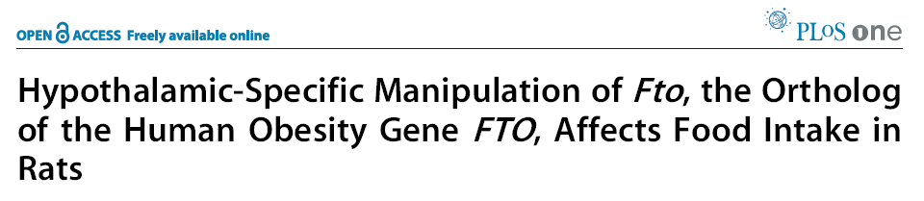
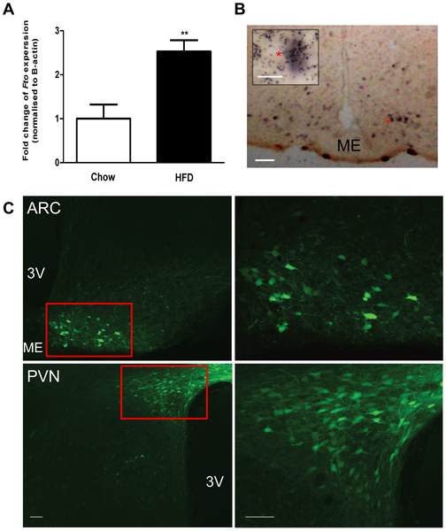
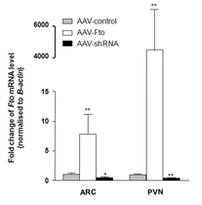

Slide 55
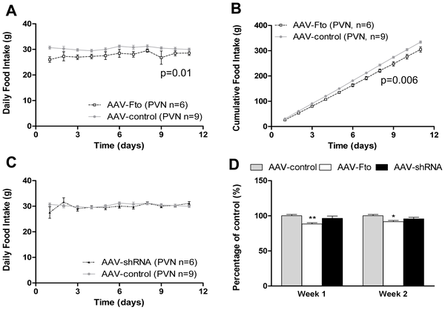

Slide 56
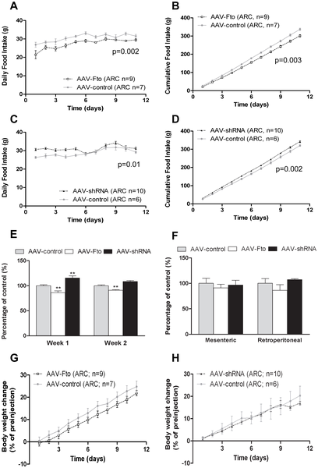

Slide 58
Unanswered questions
Is FTO the important gene?

Slide 59
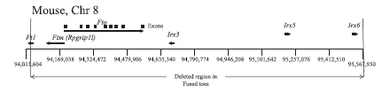
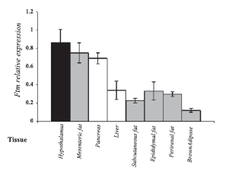
Ftm
Mouse
Stratigopoulos G et al Am J Physiol Regul Integr Comp Physiol 294: R1185-R1196 (2008)

Slide 60
Unanswered questions
Is FTO the important gene?
What role does a DNA demethylase enzyme that is ubiquitously expression play in the regulation of fat mass?
What are the other obesity-susceptibility loci?
How are they going to be found?

Slide 61


Slide 62
Summary
Obesity is a multifactorial disease.
High incidence of heritability in obesity.
Identification of genes involved in the rare monogenic forms of obesity is useful for understanding the mechanisms involved in the regulation of energy balance.

Slide 63
Summary cont.
A number of QTLs and genes have been identified.
As yet there is little known about a number of these candidate genes or their role in the development of obesity.
Identifying the physiological role of these gene products will help in the development of new strategies for the treatment and prevention of obesity.
FTO is the first candidate gene contributing to common obesity although its role remains unclear.

Slide 64
“Isn’t it just all about people eating too much and not doing enough exercise?”

