Slide 1
Imperial College
London
Fatty acids and regulation of intermediary metabolism
Ian F. Godsland, PhD
BSc Endocrinology, Module 2
i.godsland @ imperial.ac.uk

Slide 2
Fatty Acids as fuel
fatty acids can be oxidised and generate ATP by beta-oxidation in the mitochondrion
fatty acids are the primary oxidative fuel for liver, resting skeletal muscle, renal cortex and myocardium
adipose tissue is the primary source of fatty acids in the fasted state
in the fasted state fatty acid oxidation can account for 70% of body energy expenditure
fatty acid oxidation spares glucose for central nervous system requirements

Slide 3
Fatty Acids – a controling influence on metabolism
Fatty acids directly affect:
insulin sensitivity
insulin secretion
VLDL synthesis
LDL receptor levels
PPAR, HNF, RXR and LXR nuclear receptors
SREBP-1c activity
inflammation

Slide 4
Fatty Acids, insulin resistance and insulin secretion
compete with glucose as a metabolic fuel to cause insulin resistance
affect insulin sensitivity according to diet
modulate insulin sensitivity via membrane composition
affect insulin sensitivity by direct effects on intracellular signalling mechanisms
stimulate insulin secretion – short-term
suppress insulin secretion – long-term

Slide 5
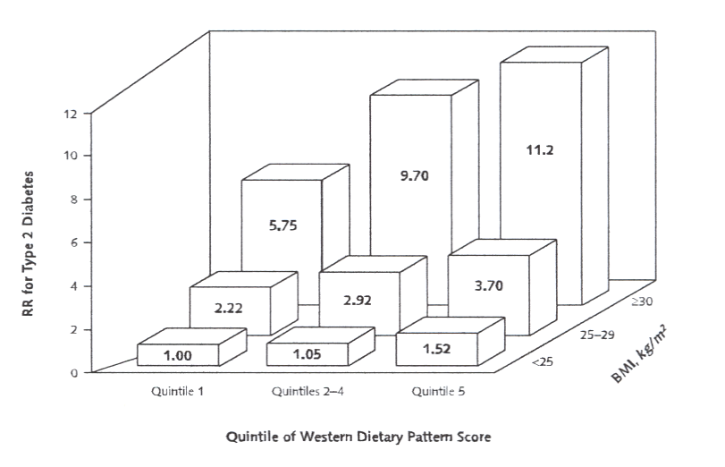
Diet, diabetes and fatty acids
van Dam et al Ann Intern Med 2002;136 :201
% OF ENERGY INTAKE
quintile 1 quintiles 2-4 quintile 5
total fat 26.4 32.1 37.2
saturated fat 8.5 11.0 13.3
linoleic acid 4.7 5.1 5.5

Slide 6
Saturated fatty acids
H₃C
COOH
C14
myristic
butter and animal fats
H₃C
COOH
C16
palmitic
butter, cheese, milk, meat
H₃C
COOH
C18
stearic
animal fats

Slide 7
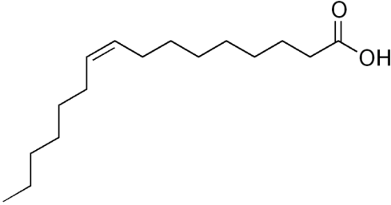
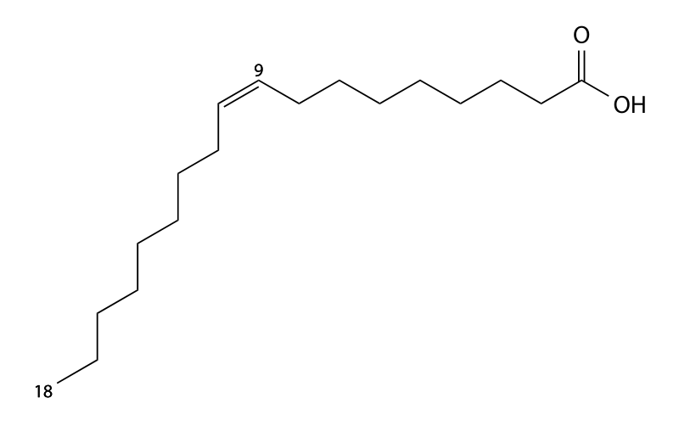
Mono-unsaturated fatty acids
H₃C
COOH
C16:1 n-7
palmitoleic
vegetable and marine oils and animal fats
H₃C
COOH
C18:1 n-9
oleic
olive, peanut, grape and sesame seed oils and animal fats
C16
C18
delta 9 desaturase
(stearoyl CoA desaturase)
C16:1 n-7
C18:1 n-9

Slide 8
n-6 poly-unsaturated fatty acids
H₃C
COOH
C18:2 n-6
linoleic
essential fatty acid
vegetable oils, especially safflower, sunflower and corn oil
Δ-6 desaturase
H₃C
COOH
C18:3 n-6
gamma linolenic
elongase
H₃C
COOH
C20:3 n-6
eicosatrienoic
Δ-5 desaturase
H₃C
COOH
C20:4 n-6
arachidonic
elongase
H₃C
COOH
C22:4 n-6
docosatetraenoic
Δ-4 desaturase
H₃C
COOH
C22:5 n-6
docosapentaenoic

Slide 9
n-3 poly-unsaturated fatty acids
H₃C
COOH
C18:3 n-3
alpha linolenic
essential fatty acid
seed oils, especially flax, rape and soya
Δ-6 desaturase
H₃C
COOH
C18:4 n-3
stearidonic
elongase
H₃C
COOH
C20:4 n-3
eicosatetraenoic
Δ-5 desaturase
H₃C
COOH
C20:5 n-3
eicosapentaenoic
elongase
fish oil
H₃C
COOH
C22:5 n-3
docosapentaenoic
Δ-4 desaturase
H₃C
COOH
C22:6 n-3
docosahexaenoic
fish oil

Slide 10
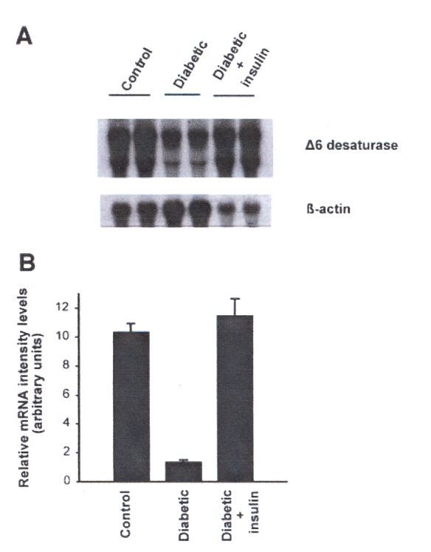
Δ-6 desaturase activity in diabetes
Rimoldi et al BBRC 2001;283:323
H₃C
COOH
C18:2 n-6
linoleic
Δ-6 desaturase
H₃C
COOH
C18:3 n-6
gamma linolenic
experimental evidence for improvements in neural and renal function with gamma linolenic acid supplementation in animal models of diabetes

Slide 11
Fatty acids in vivo
NON-ESTERIFIED FATTY ACIDS (NEFAs)
CHOLESTEROL
ESTER
H C
3
CH
CH
3
3
H C
COOH
CH
CH
3
3
3
H C
COOH
3
H C
COO
H C
COOH
3
3
CH .O.CO
CH
2
3
H C
COO.CH
TRIGLYCERIDE
3
CH .O.CO
CH
2
3
CH .O.CO
CH
2
3
H C
COO.CH
3
O
+
CH
3
CH .O
P
OCH .CH .N
CH
PHOSPHOLIPID
2
2
2
3
O
CH
3

Slide 12
Serum non-esterified fatty acid content

Slide 13
Serum triglyceride fatty acid content

Slide 14
Serum cholesterol ester fatty acid content

Slide 15
Serum phospholipid fatty acid content

Slide 16
Fatty acids and insulin resistance
The Glucose Fatty Acid Cycle - 1963
Randle et al Lancet 1963;i:785
High levels of fatty acids were known to:
induce insulin insensitivity
impair pyruvate oxidation
promote glucose storage in muscle
impair glucose tolerance
“We wish to propose that there are interactions between glucose and fatty acid metabolism in muscle and adipose tissue which take the form of a cycle and which are fundamental to the control of glucose and fatty acid concentrations, and of insulin sensitivity”

Slide 17
The glucose fatty acid cycle - intracellular
high glucose drives triglyceride accumulation
low glucose drives fatty acyl CoA accumulation
fatty acyl CoA accumulation drives fatty acid oxidation
glucose
glycerol-3-phosphate
fatty acyl CoA
triglyceride
glycerol
fatty acids

Slide 18
The glucose fatty acid cycle - intercellular
glucose
fatty acids
high glucose drives down fatty acid release
low fatty acids permit rapid glucose utilisation
glucose levels fall

Slide 19
The glucose fatty acid cycle - intercellular
glucose
fatty acids
low glucose permits fatty acid release
high fatty acids oppose glucose utilisation
glucose levels rise

Slide 20
Fatty acids and insulin resistance
Metabolic competition
glucose and fatty acids exert mutual feedback control to normalise their respective levels
fatty acids compete with glucose as a metabolic fuel
high fatty acid levels increase insulin resistance by opposing oxidation of glucose

Slide 21
Fatty acids and insulin resistance
Boden and Schulman. Eur J Clin Invest 2002;32 Suppl 3:14
Effects of continuous lipid infusion
glycogen synthesis
glucose uptake
glucose oxidation
3-4 hours
4-6 hours
1-3 hours
non-oxidative glucose metabolism

Slide 22
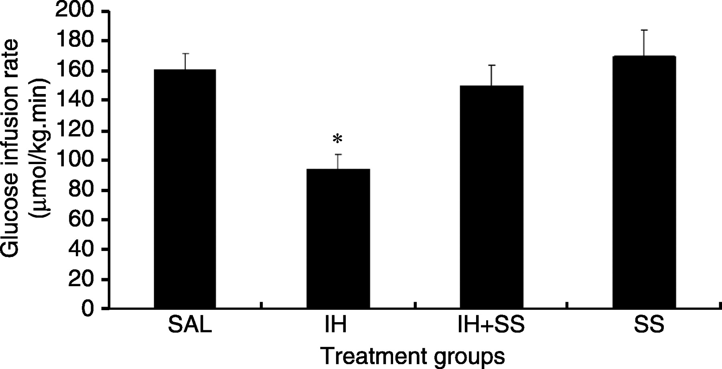
Fatty acids, cell signalling and insulin resistance
insulin
IR
P
P
Effects of saline (sal), fatty acids (IH) and salicylate (SS) on insulin sensitivity
Park et al. J Endocrinol 2007;195:323
serine phosphorylation
IRS
P
IKKβ
JNK
IKKβ – inhibitor of NF-κβ kinase - proinflammatory
salicylate partly acts as an anti-inflammatory agent by inhibiting IKKβ
fatty acids

Slide 23
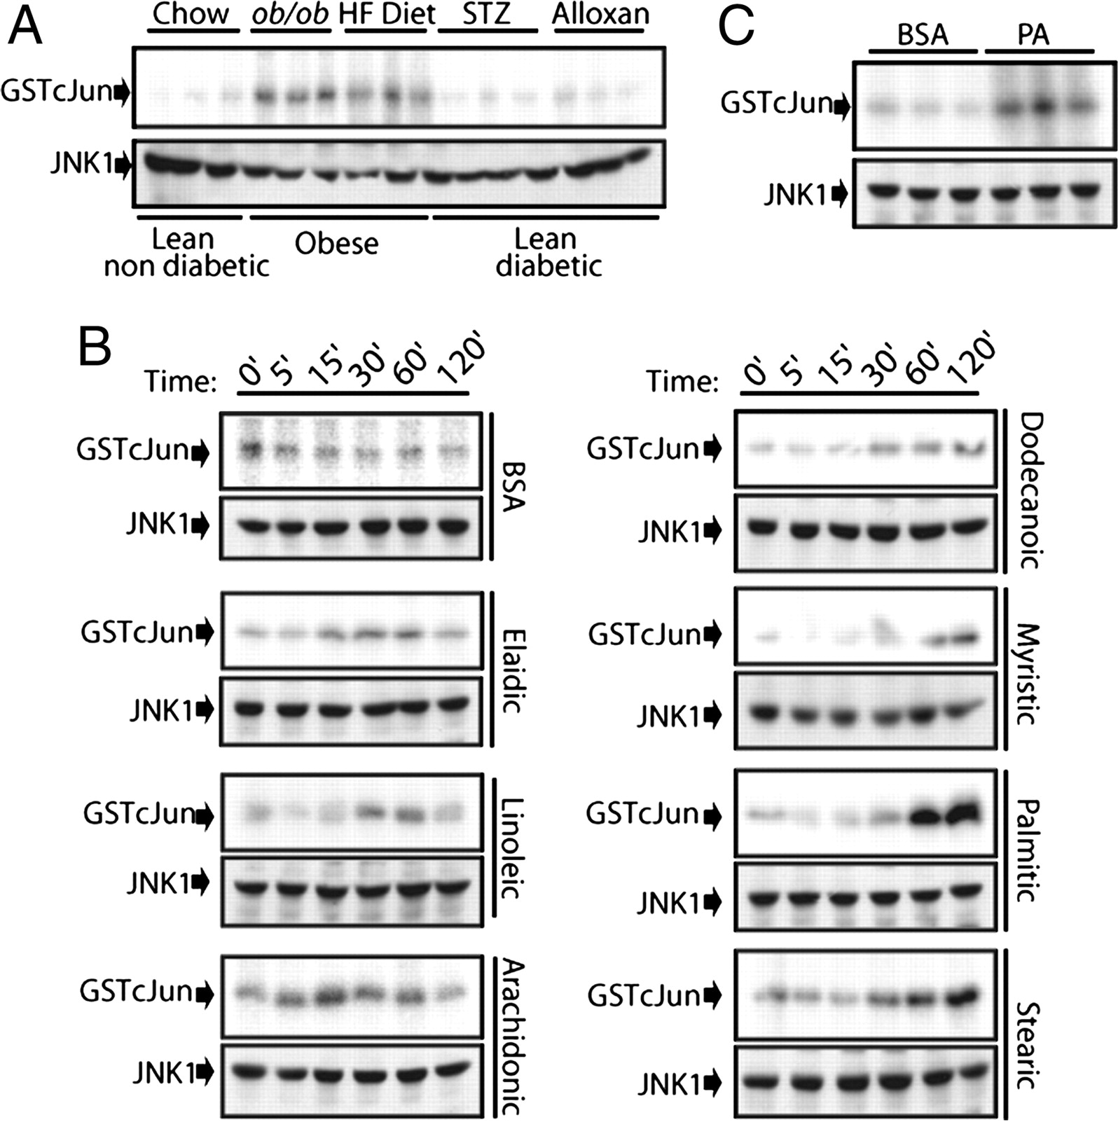
Fatty acids, JNK and insulin resistance
Solinas et al.
Saturated fatty acids inhibit induction of insulin gene transcription by JNK-mediated phosphorylation of insulin-receptor substrates.
PNAS 2006;103:16454
exposure to fatty acids resulted in activation of JNK (identified by binding to GSTcJUN)
this effect was only seen with long-chain saturated fatty acids

Slide 24
Fatty acids, cell signalling and insulin resistance
Mechanism by which fatty acids inhibit insulin activation of insulin receptor substrate-1 (IRS-1)-associated phosphatidylinositol 3-kinase activity in muscle
Yu et al. J Biol Chem 2002;277:50230
insulin
IR
P
P
peak availability of DAG coincided with peak activation of PKCθ
peak activation of PKCθ coincided with IRS-1 serine 307 phosphorylation
serine phosphorylation
IRS
P
PKCθ
diacylglycerols

Slide 25
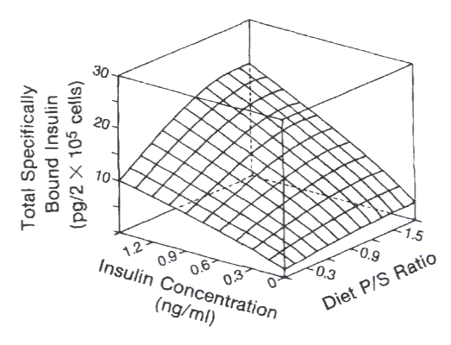
Dietary fatty acids and insulin resistance
Field et al.
Relationship between dietary fat, adipocyte membrane composition and insulin binding in the rat.
J Nutrition 1989;119:1483
rats fed one of 10 purified high fat diets for 6 weeks
polyunsaturated/saturated fat ratio varied from 0.14 to 1.80
increasing P/S ratio augmented the insulin concentration / adipocyte insulin binding dose response

Slide 26
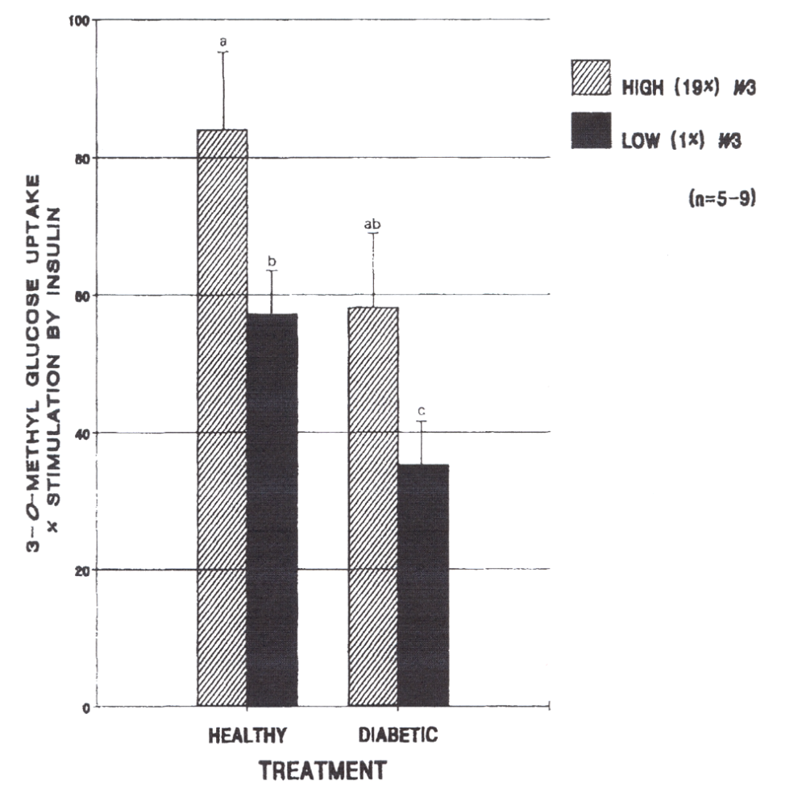
Dietary fatty acids and insulin resistance
Clandinin et al.
Dietary lipids influence insulin action.
Ann NY Acad Sci 1993;683:151
rats fed diets containing 1% or 19% omega-3 fatty acids
insulin-stimulated muscle glucose uptake measured
high omega-3 diet was associated with improved insulin sensitivity in both healthy and diabetic rats

Slide 27
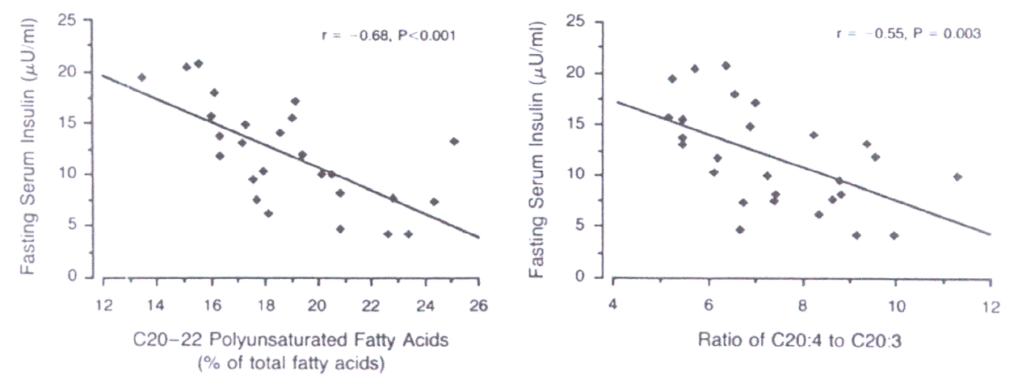
Fatty acids, membranes and insulin resistance
Borkman et al.
The relation between insulin sensitivity and the fatty-acid composition of skeletal-muscle phospholipids.
New England Journal of Medicine 1993;328:238
27 patients undergoing coronary artery surgery
fasting plasma insulin
fatty acid composition of skeletal muscle phospholipids

Slide 28
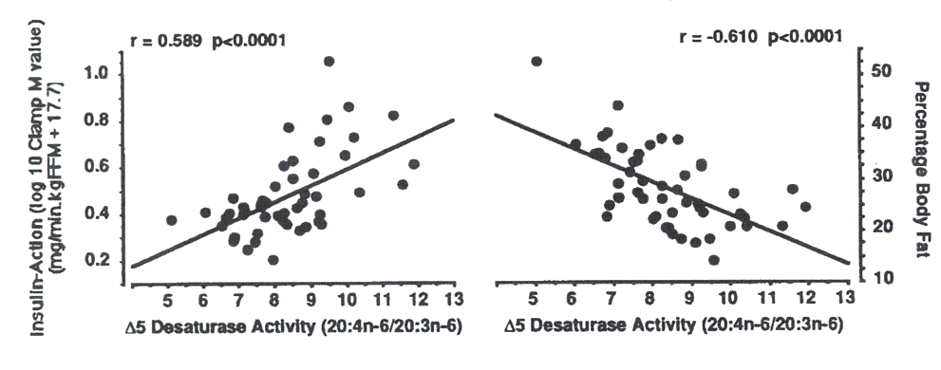
Fatty acids, membranes and insulin resistance
Pan et al.
Skeletal muscle membrane lipid composition is related to adiposity and insulin action.
Journal of Clinical Investigation 1995;96:2802
52 male Pima Indian volunteers
euglycaemic hyperinsulinaemic clamp
fatty acid composition of seletal muscle phospholipids

Slide 29
Fatty acids and insulin secretion
Effects of exposure of pancreatic islets to free fatty acids:
at low glucose concentrations, FFA stimulates insulin secretion
at high glucose levels, FFA suppresses insulin secretion
FFA can cause decreased insulin gene expression and proinsulin processing
prolonged exposure to FFA can cause beta cell death

Slide 30
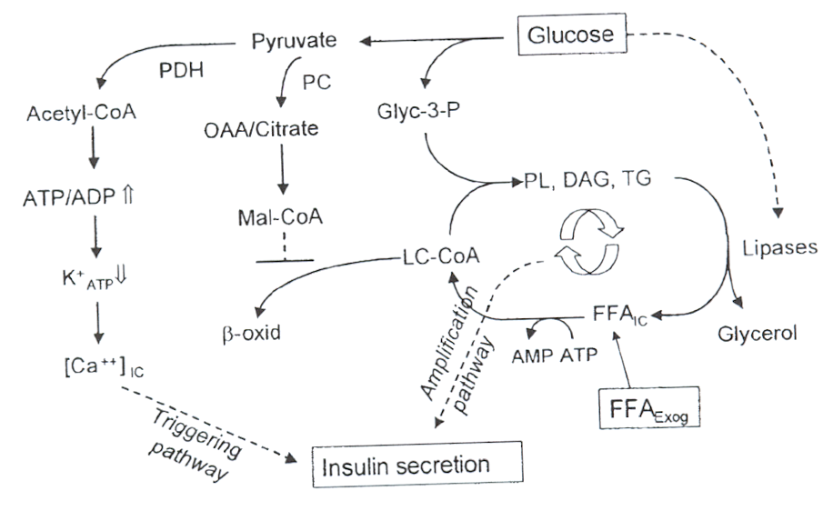
Lipid partitioning and increased insulin secretion
at high glucose concentrations malonyl-CoA levels increase
malonyl-CoA inhibits carnitine palmitoyl transferase-1 activity and therefore mitochondrial beta oxidation of fatty acids
fatty acids are diverted from oxidation towards acylation
diacyl glycerols and phospholipids accumulate and act to amplify insulin secretion

Slide 31
Fatty acids and insulin secretion: short and long-term
Paolisso et al.
Opposite effects of short- and long-term fatty acid infusion on insulin secretion in healthy subjects.
Diabetologia 1995;38:1295
12 healthy volunteers
IVGTT at 0, 6 and 24 hours of Intralipid
AIRg increased significantly at 6 h (p<0.01) and decreased significantly at 24 h (p<0.001)
at 6 h NEFA v AIRg r = +0.89
at 24 h NEFA v AIRg r = -0.87
AIRg

Slide 32
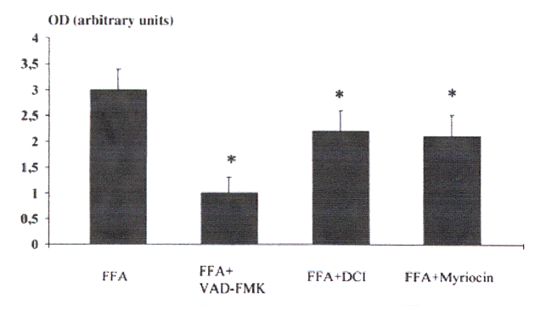
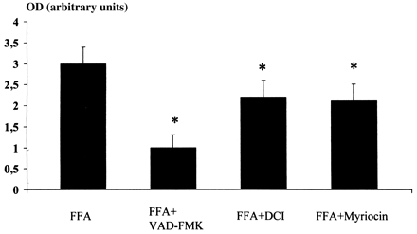
Fatty acids and beta-cell apoptosis
Lupi et al.
Prolonged exposure to free fatty acids has cytostatic and pro-apoptotic effects on human pancreatic islets: evidence that β-cell death Is caspase mediated, partially dependent on ceramide pathway, and Bcl-2 regulated .
Diabetes 2002;51:1437
apoptotic index
caspase inhibition
protease inhibition
ceramide inhibition

Slide 33
Glucolipotoxicity
at high glucose concentrations and high fatty acid concentrations, long-chain fatty acyl-CoAs accumulate in the cytoplasm
complex lipids, including diacyl glycerols, triglycerides, phospholipids and sphingolipids, accumulate in excess of signalling requirements
long-chain fatty acyl-CoAs promote reactive oxygen species formation, undergo peroxidation and induce an inflammatory response and promote beta cell apoptosis
high glucose levels alone appear to be insufficient to cause beta cell apoptosis – fatty acids must be present

Slide 34
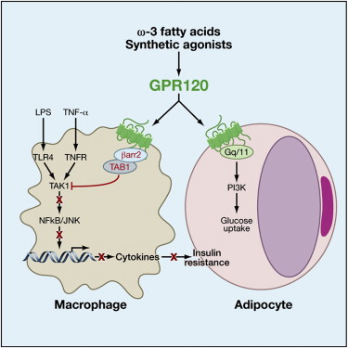
Anti-inflammatory and insulin-sensitising effects of omega-3 fatty acids
Oh da et al.
GPR120 is an omega-3 fatty acid receptor mediating potent anti-inflammatory and insulin-sensitizing effects .
Cell 2010;142:687
G protein-coupled receptor, GPR120, is a specific receptor for omega-3 fatty acids
GPR120 signalling suppressed inflammatory pathways in macrophages and improved insulin sensitivity in adipocytes

Slide 35
Conclusion
impaired fatty acid metabolism and elevated fatty acids play a key role in the induction of insulin resistance and beta-cell dysfunction

