Slide 1

Central regulation of energy expenditure (EE)
Dr Caroline Small

Slide 2
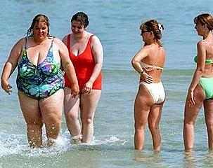
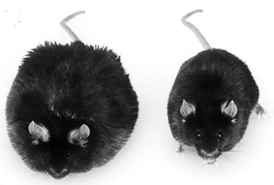
Disorders of
Energy Homeostasis

Slide 3
Body Weight Homeostasis
Food Intake
Energy Expend

Slide 4
Energy Expenditure
Principles of thermogenesis
Diet-induced thermogenesis and the role of the HPT axis
Interactions between the melanocortin system and the HPT axis

Slide 5
Learning Objectives
By the end of this lecture, you should be able to:
  Define the different types of EE
  Define obligatory & adaptive (facultative) thermogenesis
  Describe the mechanism for heat production in adaptive thermogenesis
  Describe how the HPT axis influences EE
  Describe how regulators of feeding: leptin, MC system & NPY can also alter EE
  Explain how Oxyntomodulin controls Energy expenditure

Slide 6
What is energy expenditure?
Basal (resting) metabolic rate
The thermic effects of food intake
The thermic cost of exercise

Slide 7
What is energy expenditure (EE)?
Basal metabolic rate = ~60-70% of daily EE
  Minimum energy requirement to maintain body’s functions
Thermic effects of food intake (10%)
  Energy used on digestion, absorption & storage of food
Thermic cost of activity
  Non-exercise & exercise

Slide 8
Thermogenesis
= production of heat to maintain body temperature in environments colder than the body
OBLIGATORY- accompanies all metabolic processes that maintain life
eg heart rate, breathing
ADAPTIVE - additional heat production in response to cold or overfeeding

Slide 9
Adaptive Thermogenesis
Can be RAPIDLY UP/DOWN regulated by the CNS
Important in THERMAL balance i.e. maintaining constant body temperature
Also important in ENERGY balance

Slide 10
ADAPTIVE THERMOGENESIS
COLD
HYPOTHALAMUS
OVER-
FEEDING
HEAT
PRODUCTION
Regardless of stimulus (cold/overfeeding)
- efferent neural pathways are the same

Slide 11
Diet-induced thermogenesis
Regulatory increase in energy expenditure which accompanies hyperphagia
Aim is to prevent or minimise the deposition of excess fat
In rodents – majority of excess energy dissipated as HEAT

Slide 12
Remember: energy balance
ENERGY INPUT:
Food intake
ENERGY OUTPUT:
Thermogenesis
Physical activity

Slide 13
Diet-induced thermogenesis
2
Increased diet-induced thermogenesis
1
Increased food intake

Slide 14
Q. Where does diet-induced thermogenesis (DIT) occur?
A. Brown adipose tissue (BAT)

Slide 15
BAT (Brown adipose tissue)
Interscapular, packed full of mitochondria
Regulated by sympathetic nervous system (has β adrenergic receptors) and thyroid hormones (has thyroid hormone receptors)
Human neonates & small mammals
Site of adaptive thermogenesis – ie heat production due to cold or over-eating

Slide 16
UCP-1 (uncoupling protein)
Heat producing ability of BAT depends on UCP-1
  How does this happen?
  ATP = energy storehouse of body
  Normally, breakdown of fats (β oxidation) and glucose (glycolysis) yields protons (H+) which are transported across inner mitochondrial membrane to produce ATP (oxidative phosphorylation)

Slide 17
Proton transport and ATP synthesis
Outer mitochondrial
membrane
H+
H+
H+
Transport of H+ across membrane creates an electrochemical gradient
Inner mitochondrial
membrane
H+
Mitochondrial matrix
Electron transfer chain
Breakdown of fats & glucose

Slide 18
Proton transport and ATP synthesis (ii)
H+ moves back into the mitochondria driving ATP synthase to generate ATP
(OXIDATIVE PHOSPHYORYLATION)
H+
ATP synthase
H+
Breakdown of fats & glucose
ATP
ADP

Slide 19
UCP-1 (uncoupling protein)
Organised in the inner membrane of BAT mitochondria
UCP-1 =
  directly transports H+ through the inner mitochondrial membrane
  this uncouples ATP synthase from the proton gradient across the inner mitochondrial membrane
  UCP collapses gradient in a controlled manner stopping ATP production
  Energy accumulated in the gradient dissipated as HEAT

Slide 20
How does UCP-1 in BAT generate heat?
H+
H+
UCP-1
Inner mitochondrial
membrane
HEAT
H+
x
ATP synthase
Breakdown of fats & glucose
ATP
ADP

Slide 21
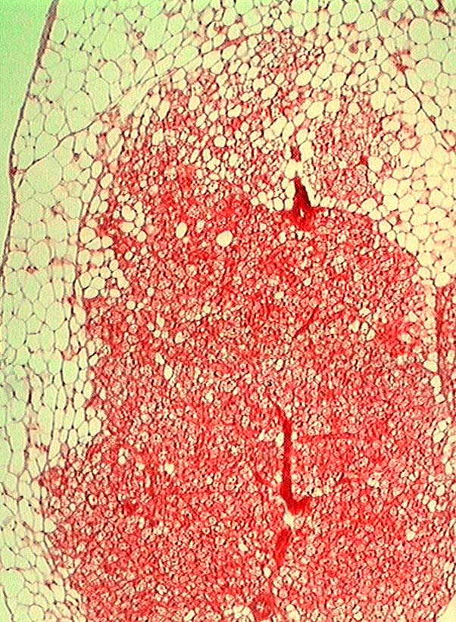
BAT
White fat
Brown fat

Slide 22
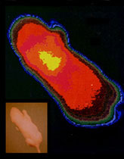
BAT: major site of thermogenesis

Slide 23
The Hypothalamic pituitary thyroid axis

Slide 24
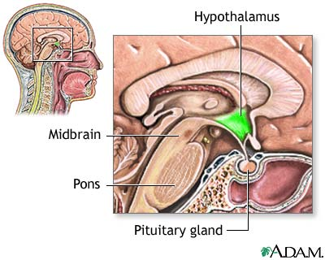
The Hypothalamus

Slide 25
The HPT axis
PVN
-
hypothalamus
TRH +
+
-
pituitary
TSH +
thyroid
T₄
T₃

Slide 26
HPT axis and EE
BMR increased in hyperthyroidism
BMR decreased in hypothyroidism
NEAT may contribute – ‘fidgety’ hyperthyroid patients
Thyroid hormones increase BAT UCP expression in rodents, increasing heat production via BAT (ie increasing adaptive thermogenesis)

Slide 27
Regulation of BAT
Sympathetic innervation – α- & β adrenergic Rs on BAT
Thyroid hormones – bind to thyroid receptors on BAT
SNS and thyroid hormones act synergistically to regulate BAT

Slide 28
The Deiodinases

Slide 29
Thyroid regulation of BAT
BAT contains D2 – converts T4 T3 (T3 = 10x more potent than T4)
For BAT to be most effective at producing heat - conversion of T4 to T3 within BAT is needed
D2 makes this conversion

Slide 30
Thyroid
hormones
via TRs
BAT
D2
T4 T3
UCP
SNS via β adrenergic receptors
HEAT

Slide 31
Thyroid
hormones
via TRs
BAT
D2
T4 T3
UCP
SNS via β adrenergic receptors
This is in response to COLD or OVER-EATING
HEAT

Slide 32
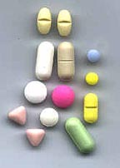
How might our knowledge of BAT & diet-induced thermogenesis be able to help with weight loss?

Slide 33
Neuropeptides that influence appetite can also affect the thyroid axis and hence energy balance

Slide 34
Anatomical relationship between melanocortin system & HPT axis
In the PVN, TRH neurones which control the HPT axis are innervated by α-MSH & AgRP neurones

Slide 35
EATING & ENERGY
EXPENDITURE
Paraventricular Nucleus
TRH
Higher
Centres
3rd Ventricle
Arcuate Nucleus
NPY/AgRP
aMSH/CART
Blood
Circulation
Ghrelin
Leptin
Gut Hormones

Slide 36
The HPT axis & Starvation
hypothalamus
-
TRH
+
-
pituitary
TSH
thyroid
T₄
T₃

Slide 37
Starvation
Falling body fat decreases leptin
Signals to brain to increase food intake (increase AgRP)
Signals to brain to conserve energy and decrease energy expenditure (decreased TRH)
AGRP – Increases food intake and decreases energy expenditure

Slide 38
Increase food intake
Decrease HPT axis
to conserve energy
STARVATION
Paraventricular Nucleus
TRH
Higher
Centres
+
-
3rd Ventricle
Arcuate Nucleus
NPY/AgRP +++
aMSH/CART
-
-
+
Blood
Circulation
Ghrelin
Leptin
Gut Hormones

Slide 39
Overfeeding
Increase in fat mass causes increase in Leptin
Signal to brain to decrease food intake
(increase in alpha MSH)
Increase energy expenditure to loose energy as heat
(increase TRH – activate EE)

Slide 40
EATING & ENERGY
EXPENDITURE
Paraventricular Nucleus
TRH
+
Higher
Centres
-
3rd Ventricle
Arcuate Nucleus
NPY/AgRP
aMSH/CART +++
+
Blood
Circulation
Ghrelin
Leptin
Gut Hormones

Slide 41
Why is it important for leptin & the melanocortin system to affect the HPT axis?

Slide 42
Benefits of Suppression in the HPT axis
Decreased energy stores
Reduced fat mass signalled by fall in leptin
Reduction in hypothalamic α-MSH & up-regulation in AgRP
Result = increased ‘drive to eat’
Suppression of HPT axis during starvation beneficial – conserves precious energy stores

Slide 43
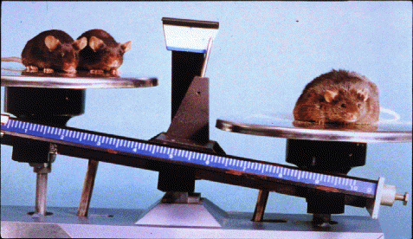
Leptin

Slide 44
Leptin
Produced by adipocytes – signals energy stores to CNS from periphery
Anorectic signal
Does it have any effects on EE?

Slide 45
Ob/Ob mice
Evidence suggests that ob/obs have lower metabolic rate
YOUNG ob/obs (ie same weight as wt controls)
  lower temperature
  (ie reduced thermogenesis)
  reduced motor activity (exercise & NEAT)
  gain excess weight without greater food intake

Slide 46
Leptin & EE
Ob/obs = reduced VO₂ even when compared to DIO weight-matched wt controls
Peripheral leptin injections for 10ds to ob/obs
  80% decrease in FI
  24% decrease in body weight
  50% INCREASE in VO₂ (EE)

Slide 47
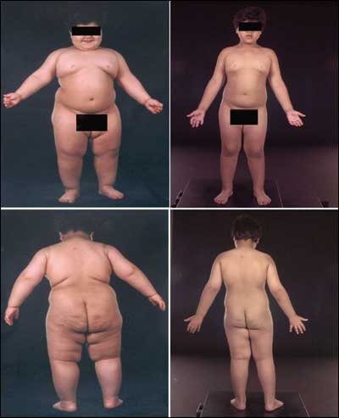
Leptin deficient humans
Given leptin treatment
Decreased food intake
Decreased body weight
NO change in BMR (but n = 2)

Slide 48
food intake
UP-regulated HPT axis
→ ? ⇑ EE
food intake
DOWN-regulated
HPT axis → ? ⇓ EE
3V
MC4-R activation
MC4-R activation
Arcuate
nucleus
Fed
Fasted
AgRP
POMC
AgRP
POMC
plasma
leptin
plasma
leptin

Slide 49
SUMMARY
Energy homeostasis – a balance between energy intake and energy output (EE)
Thermogenesis: adaptive = heat production in response to increased caloric intake – a mechanism to regulate body weight
Many regulators of food intake eg leptin, MC system, NPY– also influence EE, and this is, at least in part, via effects on the HPT axis

Slide 50
SUMMARY
Thyroid hormones can increase energy output by stimulating DIT in rodents

Slide 51
SUMMARY
Thyroid hormones can increase energy output by stimulating DIT in rodents
In rodents, thermogenesis occurs in BAT & needs UCP, sympathetic input & conversion of T4 to T3 by D2 within BAT

Slide 52
SUMMARY
Thyroid hormones can increase energy output by stimulating DIT in rodents
In rodents, thermogenesis occurs in BAT & needs UCP, sympathetic input & conversion of T4 to T3 by D2 within BAT
α-MSH & AgRP can influence body weight not only via food intake but also via effects on energy expenditure & the HPT axis

Slide 53
Hedonic regulation of energy balance
Opioids
GABA
Dopamine
Glutamate
Cannabinoids
Senses
Cognition
Learning
Energy
Intake
Reward
Tonic signals
Hypothalamus
Leptin
Episodic
signals
Insulin
Adipose tissue
Ghrelin
Enterostatin
Cholecystokinin
PP; PYY 3-36
oxyntomodulin
GLP-1
Energy expenditure
Gut
Notes:
If animals are to eat, they must experience some reward; if they are to select foods with a variety of nutrients, they must be rewarded by their selections. The systems that regulate reward are usually classified as ‘hedonic’ and are excluded from the homeostatic systems, presumably because unchecked hedonism can lead to obesity. Nevertheless, the hedonic system interacts with the homeostatic system. For example, leptin suppresses the responses of taste cells to sweet substances
A number of neurotransmitters have been implicated in the hedonic regulation of feeding: opioid agonists, GABA agonists, glutamate antagonists and cannabinoids all preferentially increase consumption of palatable foods (Saper et al. 2002), whilst the cannabinoid receptor-1 receptor antagonist rimonabant, which is in Phase III anti-obesity trials for obesity, selectively reduces intake of a sucrose solution in rats (Harrold & Williams 2003).
The nucleus accumbens, hippocampus and amygdala are some sites where these agents act to affect reward.

Slide 54
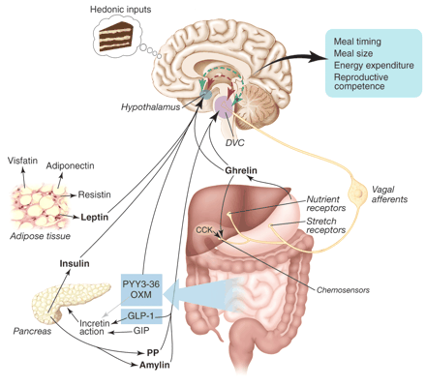
Appetite-regulating signals

Slide 55
WHY DO YOU FEEL LESS HUNGRY AFTER A MEAL?
Bulk in stomach? …… NO
Nutriments in circulation? … NO
Signal from the gut?
  Neural?
  Hormonal?

Slide 56
The Gut Hormones
Ghrelin
Pancreatic
Polypeptide
CCK
GLP1
Oxyntomodulin
PYY
GLP1
Oxyntomodulin
PYY

Slide 57
Analysis of food intake and energy expenditure following Oxyntomodulin

Slide 58
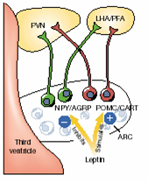
Peripheral signals of energy homeostasis
Hypothalamus
Brainstem
-
-
-
-
-
-
-
CCK
Vagus Nerve
Insulin
OXM
+
-
GLP-1
Adiponectin
Leptin
PYY
Ghrelin
PP
Adiposity signals
Gut Hormones

Slide 59
The major cleavage products of pre-proglucagon
Proglucagon
1
158
GRPP
Glucagon
GLP-1
GLP-2
Gut / brain
1
69
78
107/8
126
158
Glicentin
GLP-1
GLP-2
GRPP
OXM
1
30
33
69
Pancreas
1
30
33
61
72
158
GRPP
Glucagon
MPGF
GRPP
Glucagon
GLP-1
GLP-2
1
30
33
61
78
107/8
126
158

Slide 60
The sequence of oxyntomodulin
33
HIS
SER
ASP
SER
TYR
THR
N-Terminal
GLN
PHE
GLY
THR
SER
LYS
ARG
SER
TYR
C-Terminal Octapeptide
ARG
ASP
ALA
69
LEU
ALA
ILE
VAL
GLN
GLN
PHE
ASN
ASP
TRP
ASN
ARG
ARG
LYS
THR
ASN
LEU
MET
ASN

Slide 61
Oxyntomodulin
Released into plasma following meal ingestion in proportion to meal size
Levels peak at 2 hr post-meal
Hence may signal onset and amount of food ingestion to the brain

Slide 62
Peripheral OXM dose-response

Slide 63
Chronic peripheral administration
Body weight

Slide 64
Chronic peripheral administration
White adipose tissue
Brown adipose tissue

Slide 65
Oxyntomodulin Infusion: Protocol
Buffet Meal
OXM
-20 0 30 60 90 120 150 180 210
SALINE or
OXM 3.0 pmol/kg/min
SALINE
-20 0 30 60 90 120 150 180 210

Slide 66
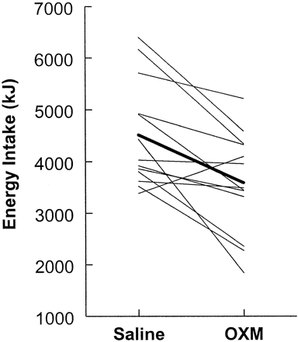
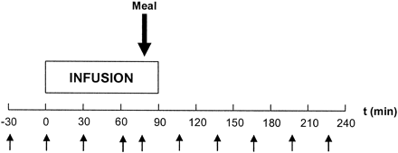
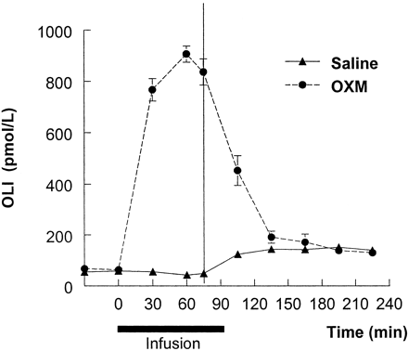
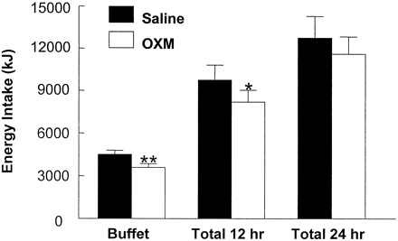
Human data: normal body-weight
A
C
B
D
Cohen et al. JCEM 2003

Slide 67
Subcutaneous Oxyntomodulin Reduces Body-Weight In Overweight Subjects: A Randomised Controlled Trial
Dietary and Exercise Advice
Study Meal
Study Meal
Study Meal
Pre-prandial saline injections
Randomised to pre-prandial saline or 400 nmol OXM injections
1 week
4 weeks
Subcutaneous injections 3 times a day, half an hour prior to meals.
Body weight, leptin and adiponectin compared before and after the 4 week study.

Slide 68
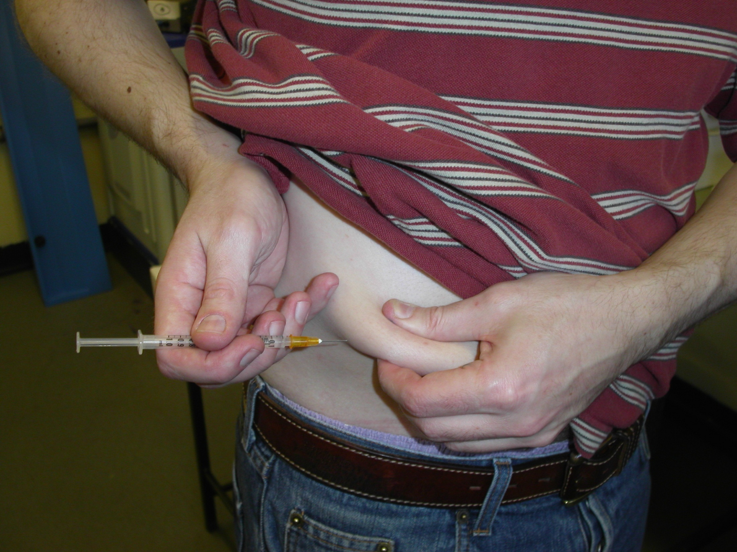

Slide 69
The effect of oxyntomodulin on body-weight
* p=0.03
** p=0.01

Slide 70
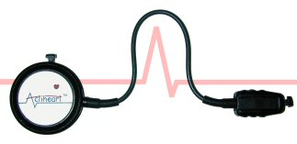
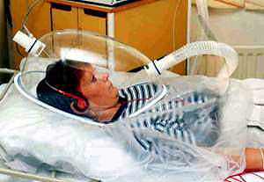
Subcutaneous administration to 15 obese volunteers:
Energy balance
Activity-related energy expenditure measured by Combined heart-rate and movement monitor
Intake
Expenditure
Resting energy expenditure measured by Indirect Calorimetry

Slide 71
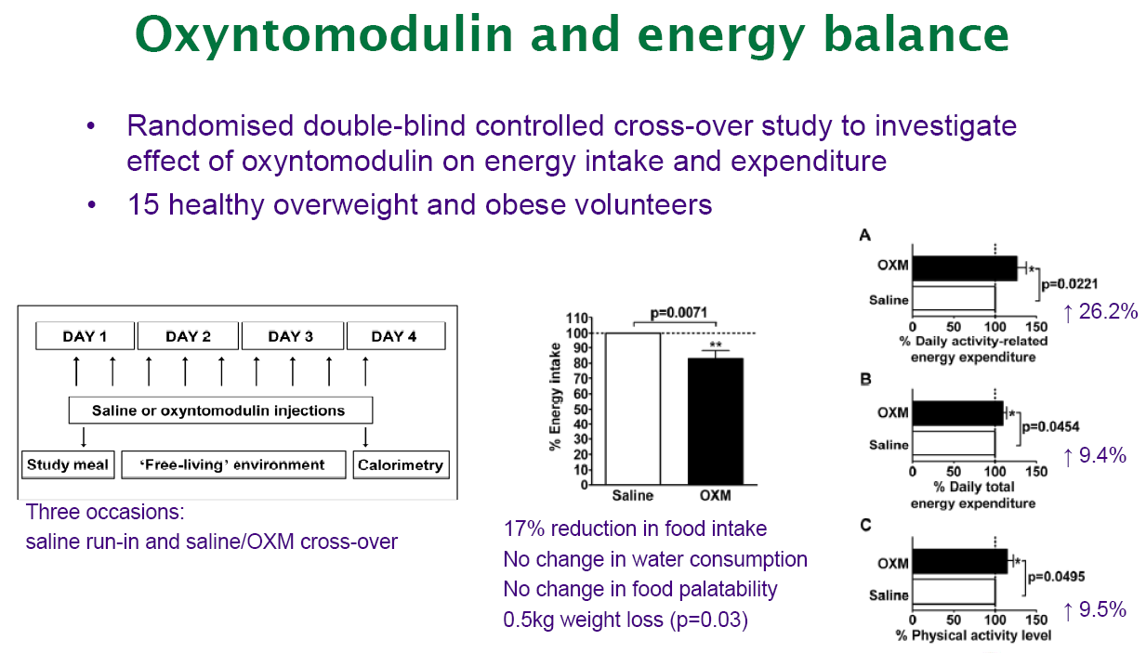
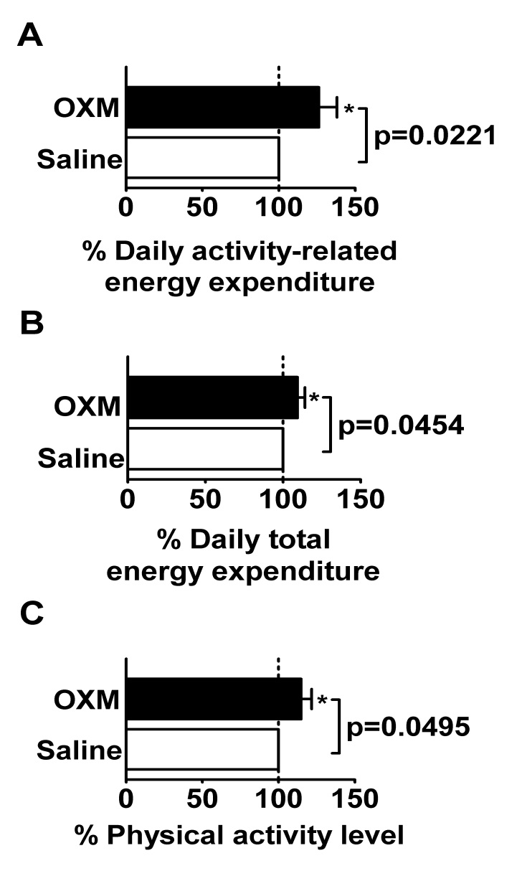
26%
P<0.02
9%
P<0.05
10%

Slide 72
Summary
Rodent studies suggest dual action on food intake and energy expenditure
Subcutaneous oxyntomodulin self-administered pre-prandially for 4 weeks reduced weight by 2.3 kg (2.4%)
26% increase in activity related energy expenditure
9% increase in total energy expenditure
Oxyntomodulin has a dual role resulting in weight loss

Slide 73
Notes:
73

Slide 74
Oxyntomodulin Analogue 23/36
Three Day Study SC in Rats, n = 8 per Group
Single SC Injection
Oxyntomodulin
Analogue Dose
3 Days
HOURS
Notes:
74

Slide 75
60 day study DIO rats
with pair feeding group
650
625
vehicle
600
Body
Weight
in
grams
575
550
525
500
pair fed
475
450
TKS1225 45nmol/kg
425
0
5
10
15
20
25
30
35
40
45
50
55
60
Days
Kind Permission Thiakis
Presented European Obesity Congress 2008

Slide 76
Summary
Importance of energy balance - food intake and energy expenditure
Hypothalamic neuropeptide control both intake and expenditure
Peripheral hormones alter hypothalamic neuropeptide
Oxyntomodulin has a dual role resulting in weight loss

Slide 77
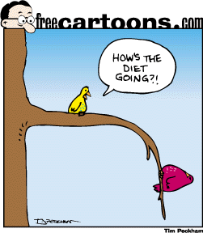

Acknowledgements
Steve Bloom
Niamh Martin
Carel Le Roux
Katie Wynne
Adrian Park
Mohammad Ghatei
Gary Frost
Karim Meeran
Sandra Ellis
Michael Patterson
Kevin Murphy
Alison Wren

Slide 78
What is energy expenditure (EE)?
Basal metabolic rate = ~60-70% of daily EE
  Minimum energy requirement to maintain body’s functions
Thermic effects of food intake (10%)
  Energy used on digestion, absorption & storage of food
Thermic cost of activity
  Non-exercise & exercise

Slide 79
Activity Thermogenesis
Exercise & non-exercise activity thermogenesis (NEAT)
NEAT = EE of all physical activities other than volitional ‘sport-like’ exercise
Can be associated with occupation & leisure time
What occupations are associated with more NEAT than others?

Slide 80
NEAT & obesity
Some researchers thinks that NEAT is important in obesity
Lean & obese volunteers fitted with microsensors to record postures & movements (matched for occupation)
LEAN exploit opportunities to WALK, OBESE find opportunities to SIT

Slide 81
Weight loss and food intake
Sham BW match Bypass
le Roux, Bueter, Lutz et al Gastroenterology 2009

Slide 82
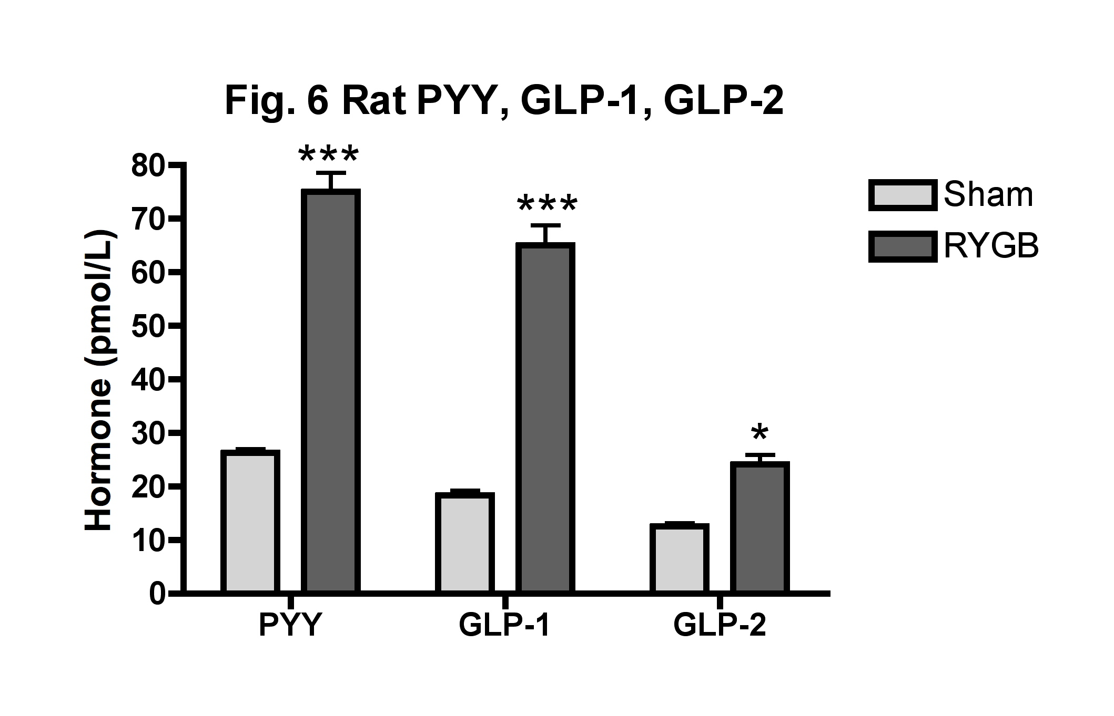
Post surgery response
le Roux, Aylwin et al Ann Surg 2009

Slide 83
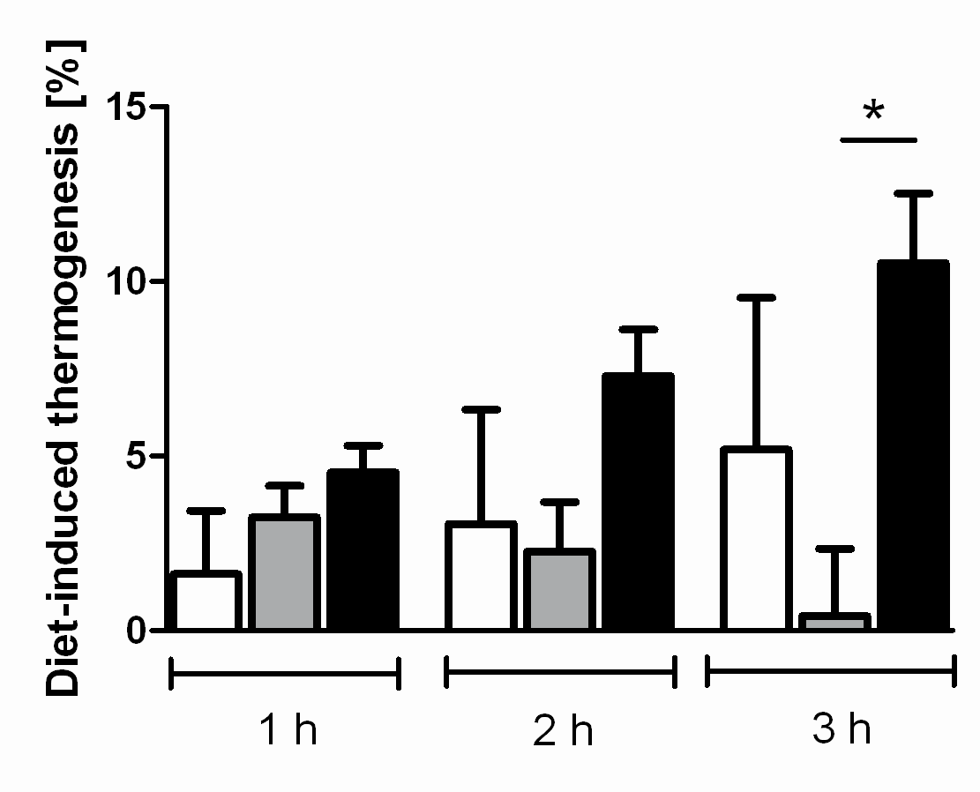
Energy expenditure and gastric bypass
le Roux, Bueter, Lutz et al Gastroenterology 2009

