Slide 1


Bariatric surgery
Dr Alexander Miras
MRC Clinical Research Fellow
Imperial Weight Centre - Charing Cross Hospital
Metabolic Imaging Group - Hammersmith Hospital

Slide 2
WHY DO WE EAT
Hunger
  Physiological (internal) drive to eat
  The feeling that prompts thought of food and motivates food consumption
  Influenced by nutrients in the bloodstream, eating patterns, climate, etc
  Controlled internally

Slide 3
WHY WE EAT
SATIETY
If the quest for food is successful the brain signals the body to stop eating (hunger is suppressed).

Slide 4
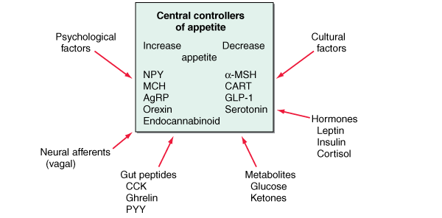
THE FACTORS THAT REGULATE APPETITE
PSYCHOLOGICAL
Factors
CULTURAL
Factors
HORMONES
Leptin
Insulin
Cortisol
NEURAL AFFERENTS
( Vagal )
GUT PEPTIDE
CCK
Ghrelin
PYY
METABOLITES
Glucose
Ketones

Slide 5
FACTORS THAT REGULATE QUANTITY OF FOOD INTAKE
Short term regulation
Concerned primarily with preventing over eating at each meal
Long term regulation
Concerned primarily with maintenance of normal quantities of energy stores in the body

Slide 6
Afferent factors in appetite regulation
Food Intake
Energy Expenditure
Leptin
GO
Vagus
CCK
Ghrelin
Insulin
PYY
GLP-1
OXM
Notes:
Hormones that control eating. Leptin and insulin (lower part of the figure) circulate in the blood at concentrations proportionate to body-fat mass. They decrease appetite by inhibiting neurons (centre) that produce the molecules NPY and AgRP, while stimulating melanocortin-producing
neurons in the arcuate-nucleus region of the hypothalamus, near the third ventricle of the brain. NPYand AgRP stimulate eating, and melanocortins inhibit eating, via other neurons (top). Activation of NPY/AgRP-expressing neurons inhibits melanocortin-producing neurons. The gastric hormone ghrelin stimulates appetite by activating the NPY/AgRP-expressing neurons. Batterham et al.1 have now shown that PYY3-36, released from the colon, inhibits these neurons and thereby decreases appetite for up to 12 hours. PYY3-36 works in part through the autoinhibitory NPY receptor Y2R.

Slide 7
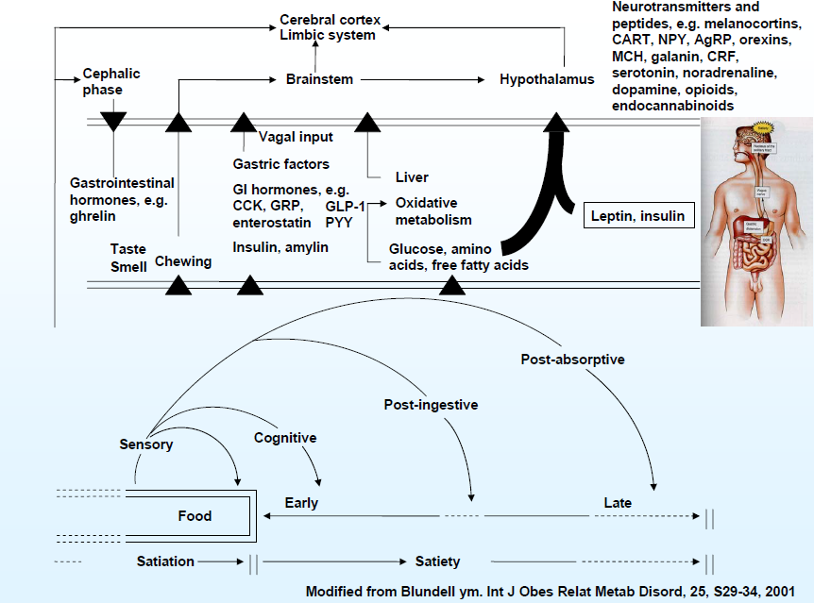
Factors operating during a meal

Slide 8
AETIOLOGY OF OBESITY
Genetic
Biochemical
Neurologic and
Physiologic
Environmental
Cultural and
Socio-economic
1. Adapted from Weighing the Options; 1995:52. 2. Clinical guidelines. National Heart, Lung, and Blood Institute
Web site. Available at: http://www.nhlbi.nih.gov/guidelines/obesity/ob_home.htm. Accessed March, 2001.
Notes:
Etiology of Obesity: Numerous Complex, Interrelated Factors ^{1,2}
Obesity is a complex, multifactorial disease involving many aspects of genetics, neuroscience, physiology, and biochemistry, as well as environmental, cultural, and socio-economic factors.
Obesity is a complex disease caused by the interaction of a number of factors.

Slide 9
Recidivism after volitional weight loss
Set point
BMI
Volitional / pharmacological weight loss
Reduced-obese state
40
Homeostatic response promotes weight regain
30
20
Time
Bray GA,JCEM, 2008; 93:S81-8.

Slide 10
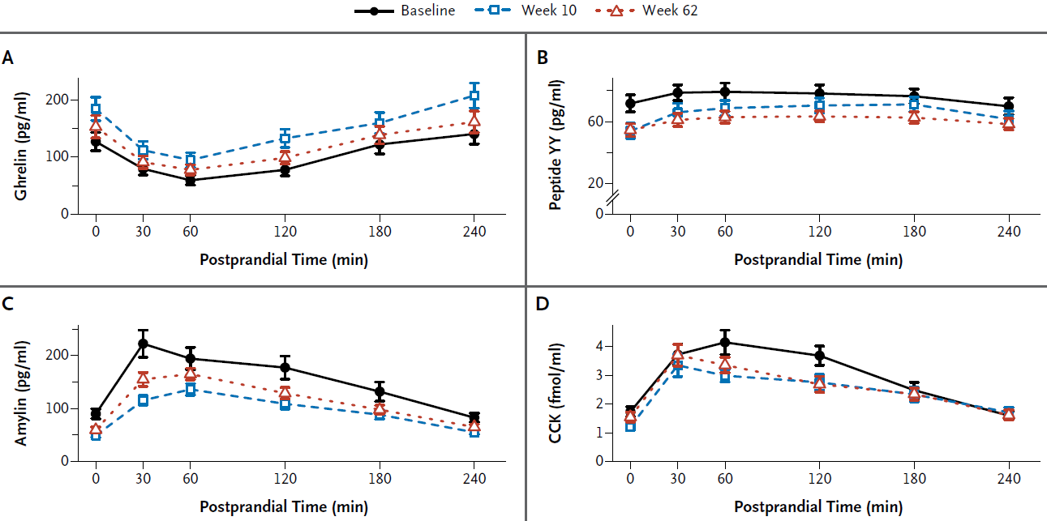
Hormonal changes on dieting (Sumithran NEJM 2011)

Slide 11
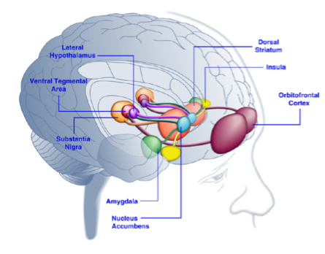
Brain Regions Activated in Response to
Palatable Food or Food-Associated Cues
Kenny et al. Neuron 69:664-679, 2011
Notes:
Caudate: learning and memory, responses to visual beauty
Amygdala: formation and storage of memories associated with emotional events, appetitive conditioning: more emotionally-arousing information increases amygdalar activity, and that activity correlates with memory retention
OFC: reward value, the expected reward value, and subjective pleasantness of foods
Anterior cingulate: ventral ACC is connected with amygdala, nucleus accumbens, hypothalamus, and anterior insula, and is involved in assessing the salience of emotion and motivational information
Nucleus accumbens: inputs from OFC, amygdala, and dopaminergic in the ventral tegmental area (VTA). Associated with addiction, reward motivation, drive, expectancy.

Slide 12
Calorie Intake vs PYY dose response
*
*
*
*
PYY
(pmol/L)
*
*
500 mL
900 mL
Test meal (kcal)
le Roux et al Endocrinology 2006

Slide 13
Genetic obesity
MC4 receptor deficiency
FTO gene mutations
Leptin deficiency

Slide 14
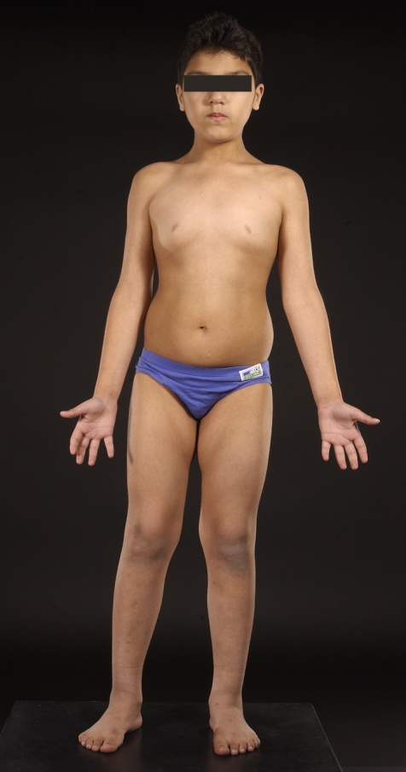
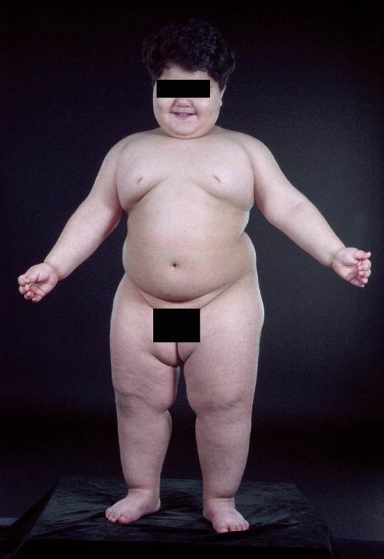
Response to leptin therapy in a child with congenital leptin deficiency
Males
Weight (kg)
50
45
40
35
Child B
30
98th centile
25
20
50th centile
15
2nd centile
10
5
0
1
2
3
4
5
6
7
Age (years)
Courtesy Prof Steve O’Rahilly

Slide 15
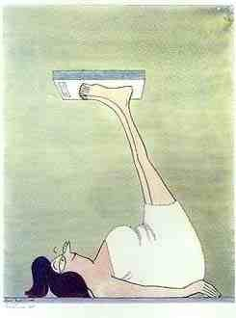
Pharmacotherapy

Slide 16
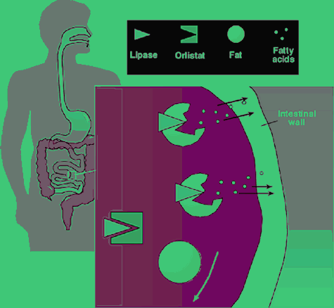
MECHANISM OF ACTION: ORLISTAT
Inhibition of lipases by orlistat blocks systemic absorption of dietary fat²
Unabsorbed fat is
excreted into faeces
(up to one-third of
ingested fat)²
1. Zhi et al. J Clin Pharmacol. 1995;35:1103-1108. 2. Zhi et al. Clin Pharmacol Ther. 1994;56:82-85.
Notes:
16
Mechanism of Action: Orlistat ^{1,2}
Gastric and pancreatic lipases are key enzymes involved in the hydrolysis of dietary fat (triglycerides) into free fatty acids and monoglycerides, which are then absorbed¹
Orlistat inhibits these lipases, thereby blocking systemic absorption of dietary fat²
Unabsorbed fat is excreted in faeces (up to one-third of ingested fat is eliminated)²

Slide 17
Orlistat over 4 years (completer data)
Week
0
26
52
78
104
130
156
182
208
0
–2
–4
–4.1 kg
–6
Change in bodyweight (kg)
–6.9 kg*
–8
–10
*p<0.001 vs placebo + lifestyle
–12
P
Placebo + lifestyle (n=564)
Xenical + lifestyle (n=850)
Adapted from Torgerson JS et al. Diabetes Care 2004; 27: 155–161
Notes:
Effect of Xenical on bodyweight after 4 years
For those patients who completed 4 years of treatment (52% of the orlistat patients and 34% of placebo patients initially randomised), weight loss was significantly greater with orlistat than placebo at year 1 (–11.4 kg vs –7.5 kg; p<0.001), and year 4 (–6.9 kg vs –4.1 kg; p<0.001).
Reference
Torgerson JS et al. Xenical in the prevention of diabetes in obese subjects (XENDOS) study. Diabetes Care. 2004; 27: 155-161.

Slide 18
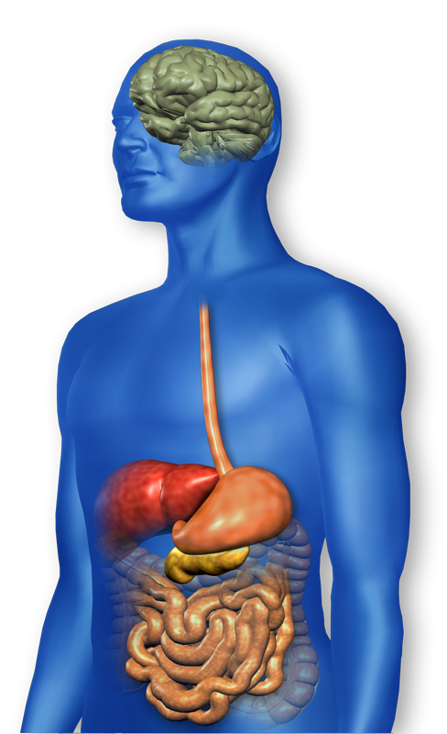
GLP-1 effects in humans
GLP-1 secreted upon the ingestion of food
5.Brain:
Promotes satiety and
reduces appetite^{4,5}
2.α-cell:
Suppresses postprandial
glucagon secretion¹
3.Liver:
reduces hepatic glucose output²
1.β-cell:
Enhances glucose-dependent insulin secretion in the pancreas¹
4.Stomach:
slows the rate of gastric emptying³
Adapted from ¹Nauck MA, et al. Diabetologia 1993;36:741–744; ²Larsson H, et al. Acta Physiol Scand 1997;160:413–422; ³Nauck MA, et al. Diabetologia 1996;39:1546–1553; ⁴Flint A, et al. J Clin Invest 1998;101:515–520; ⁵Zander et al. Lancet 2002;359:824–830.
Notes:
18
DISCUSSION
This diagram demonstrates the GLP-1 effects in humans and the role these effects play in normal physiology.
Upon the ingestion of food, plasma glucose levels increase postprandially.
GLP-1 is secreted from intestinal L cells and provides a stimulus to the β-cells to release insulin in a glucose-dependent manner. When plasma glucose levels return to normal, the action of GLP-1 decreases¹.
GLP-1 also suppresses glucagon levels that are inappropriately elevated in patients with type 2 diabetes¹. Lower glucagon levels leads to decreased hepatic glucose output².
In the stomach, GLP-1 slows the rate of gastric emptying, which reduces the rate at which meal-derived glucose appears in the circulation³.
In the brain, GLP-1 promotes satiety and reduces appetite, which leads to a feeling of fullness and a reduction in food intake^{4,5}.
All these actions help maintain overall glucose homeostasis.
¹Nauck MA, et al. Diabetologia 1993;36:741–744
²Larsson H, et al. Acta Physiol Scand 1997;160:413–422
³Nauck MA, et al. Diabetologia 1996;39:1546–1553
⁴Flint A, et al. J Clin Invest 1998;101:515–520
⁵Zander et al. Lancet 2002;359:824–830.

Slide 19
Open-label extension 82-week Exenatide continued to reduce weight
Baseline body weight
Placebo BD (N = 128)
Exenatide 5 µg BD (N = 128)
Exenatide 10 µg BD (N = 137)
98 kg
100 kg
100 kg
1
Placebo-controlled Trials
Open-label extension (all patients exenatide 10 µg BD)
0
-1
-2
Mean ∆ body weight (kg)
-3
-4
-5
0
10
20
30
40
50
60
70
80
90
Time (week)
82-wk completers; Mean (SE); Weight was a secondary endpoint
Adapted from Blonde L, et al. Poster presented at the American Diabetes Association Meeting 2005 (Abstract 477P)
Notes:
19
DISCUSSION
Shown here are data for 393 patients at Week 82, which includes 30 weeks of the placebo-controlled, double-blind studies and 52 weeks of open-label extension (OLE)¹.
Upon receiving exenatide, patients in the placebo cohort showed a similar decrease in body weight similar to that observed with exenatide treatment in the first 30 weeks.
Mean body weight reductions mediated by exenatide during the first 30 weeks (5 μg: -1.9 ± 0.3 kg; 10 μg: -2.7 ± 0.4 kg) were sustained and appeared to be progressive through 82 weeks (10 μg: -4.5 ± 0.5 kg)^{1.}
BACKGROUND (Blonde L, et al. 2006)
Mean weight change when viewed by quartiles ranged from a reduction of 11.9 kg in quartile 1 to a weight gain of 1.7 kg in quartile 4²
A 4.4 kg mean reduction in weight from baseline was observed in patients receiving 10 μg BD²
¹Blonde L, et al. Poster presented at the American Diabetes Association Meeting 2005 (Abstract 477P)
²Blonde L, et al. Diabetes Obes Metab 2006;8:436–47

Slide 20
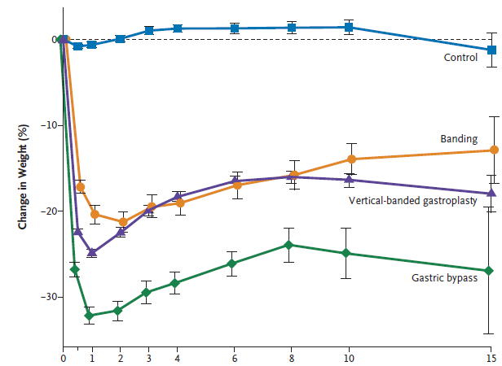
Long term weight loss maintenance
Sjöström, L. et al. N Engl J Med 2007

Slide 21
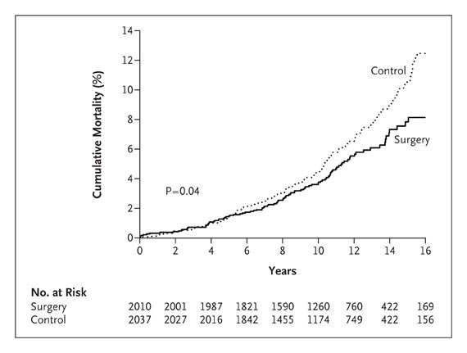
Mortality benefit
Diet/Drug induced weight loss NO mortality benefit (yet)
Sjostrom NEJM 2007

Slide 22
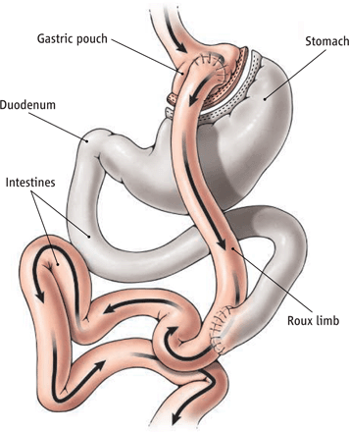
Gastric bypass - It’s five operations in one!
Small pouch
Bypassed stomach and duodenum
Altered bile flow
Distal jejunum in contact with food earlier
Vagal manipulation

Slide 23
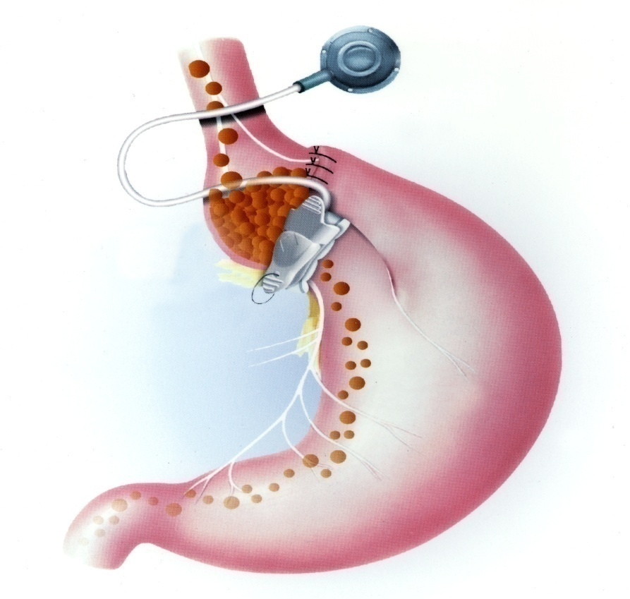
Adjustable Silastic Gastric Banding
Adjustable Lap Band
  <1 hr procedure
  1 day in-patient
  20% weight loss
  1:1000 Risk of Death
  High risk of re-operation
  Self-sabotage easier
  Reversible

Slide 24
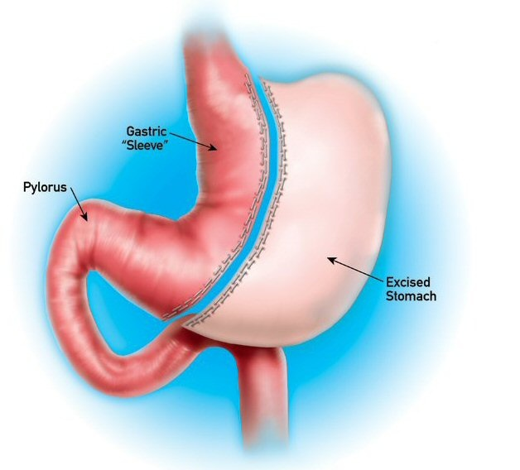
Sleeve gastrectomy
Laparoscopic
  1-2 hour procedure
  2-3 days in-patient
  25% weight loss
  1:300 Risk of Death
  1:10 complications
  1st choice for very obese

Slide 25
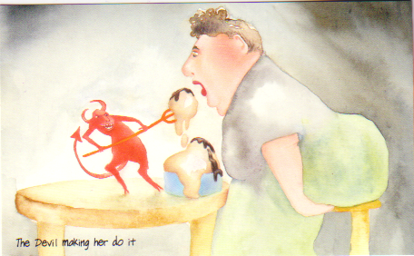
Physiology?

Slide 26
Decreasing adipocyte mass
Progressive weight loss
Decreased fasting leptin
Decreased fasting insulin

Slide 27
Visual analogue scores
le Roux, Borg et al 2006 Brit J Surg

Slide 28
PYY response after bariatric surgery
MEAL
PYY
pmol/L
Time point (min)
le Roux et al Ann Surg 2006

Slide 29
PYY response pre & post RYGB
***
***
PYY AUC
pmol/l/min
12
24
Months post-op
le Roux et al Ann Surg 2009

Slide 30
Postprandial and fasting GLP-1
le Roux, Pournaras et al Ann of Surg 2010

Slide 31
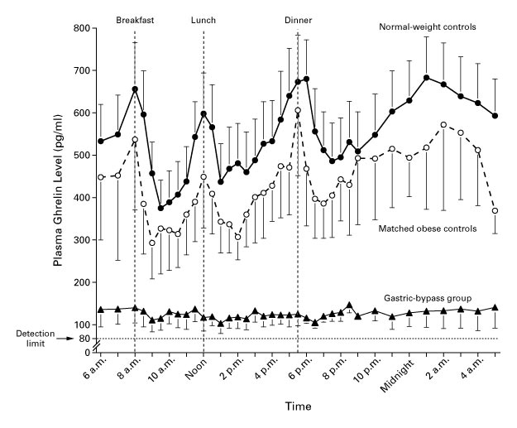
Ghrelin post meal
Cummings et al N Engl J Med. 2002

Slide 32
Dose response curve
LEAN
OBESE
Satiety
Physiological range
Bypass surgery
Meal Size

Slide 33
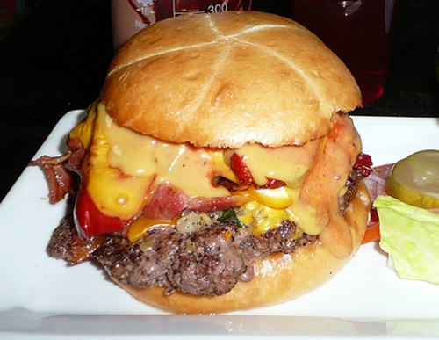

Clinic – Dietary Change
preoperative
postoperative
“I Don’t Enjoy Burgers Anymore” Syndrome
Paradoxical – as dietary weight loss increases preference for fatty food and sugars
Olbers Ann Surg 2006

Slide 34
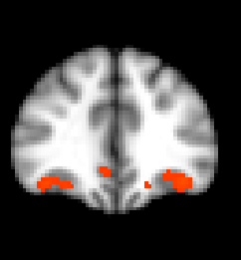
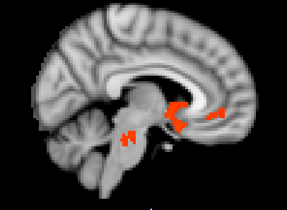
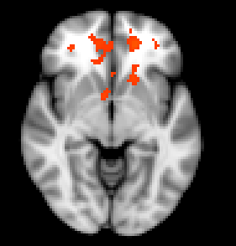
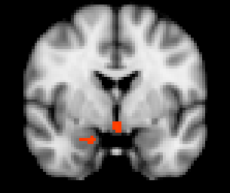
Less Activation to High-Calorie Foods in Gastric Bypass
R
y 36
x 6
Caudate
vACC
vACC
OFC
Ventral striatum
Medial frontal cortex
z -6
y -2
Ventral striatum
Amygdala
High-calorie food > Objects, Banding > Bypass, Bypass > Banding, adjusting age, gender, BMI
n=19-20, cluster threshold Z>2.1 , P<0.05

Slide 35
Mechanism facilitating weight maintenance
BMI
Leptin
Insulin
40
30
RYGB
20
↑ Gut hormones, ↑ energy expenditure, food choices
Time

Slide 36
Remission of Diabetes after bariatric surgery
Who would have thought it? An operation proves to be the most effective therapy for adult-onset diabetes mellitus
Pories WJ et al Ann Surgery (1995) 222:339-352

Slide 37
Improvement in diabetes
 | Complete resolution (%) | HbA_{1C} (%) Drop | FBG (mmol/l) Drop
Total population | 76.8 | 2.4 | 3.9
Gastric banding | 47.8 | 1.2 | 3.1
Gastric bypass | 83.8 | 3 | 3.4
Biliopancreatic Diversion | 97.9 |  | 5.8
Buchwald et al, JAMA 2004

Slide 38
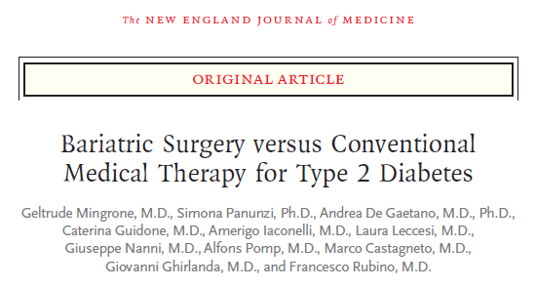
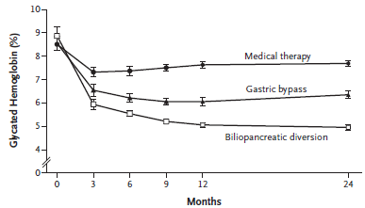
RCT – At last

Slide 39
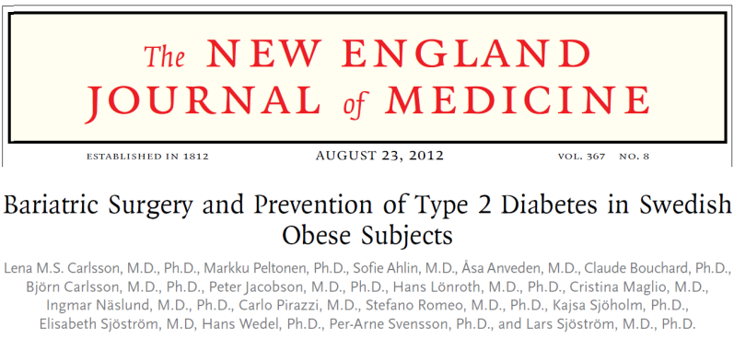
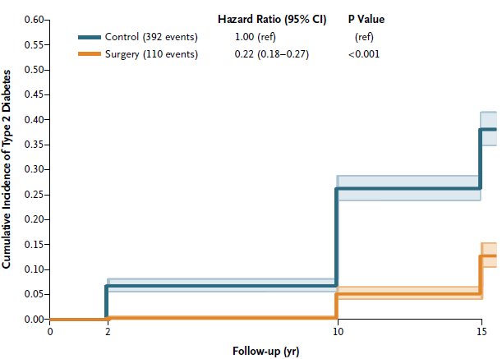
Prevention of diabetes – SOS study

Slide 40
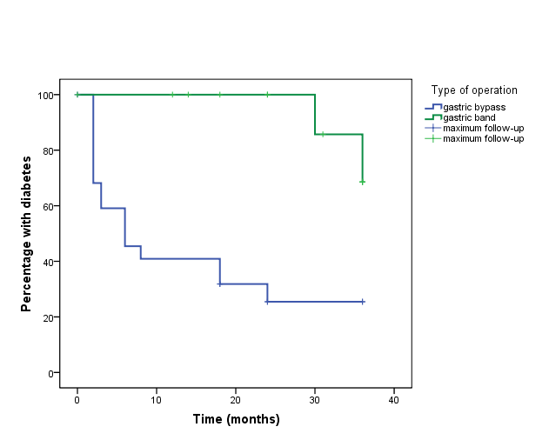
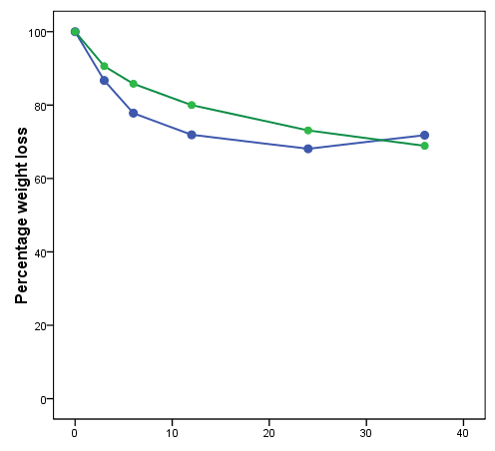
Diabetes “remission”
le Roux, Pournaras et al Ann of Surg 2010

Slide 41
POST-OP s/c SLIDING SCALE –first 24 hours...
OUT OF SURGERY

Slide 42
FIRST 24 HOURS....
Range glucose (5.1 – 12.4)
Mean glucose: 7.6
Total Actrapid used: 183 Units

Slide 43
POST-OP: DAY 2
4 hourly subcutaneous sliding scale discontinued at 7 am
Started on regime:
LEVEMIR 50 units S/C

Slide 44
Day 3: DISCHARGE
BM 8 am: 6.4
Discharged with no complications
Metformin 1 g bd
Levemir 50 units BD
Was injecting 465 units of insulin pre-operatively
(120 units BD of insulatard, 75 units novorapid TDS)

Slide 45
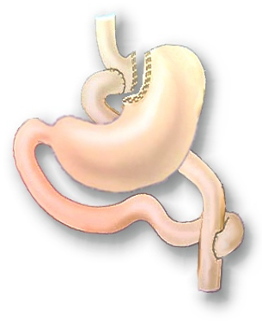
Hindgut – Distal Hypothesis
Early delivery of nutrients to the distal intestine enhances GLP 1 / OXM secretion

Slide 46
Postprandial and fasting GLP-1
le Roux, Pournaras et al Ann of Surg 2010

Slide 47
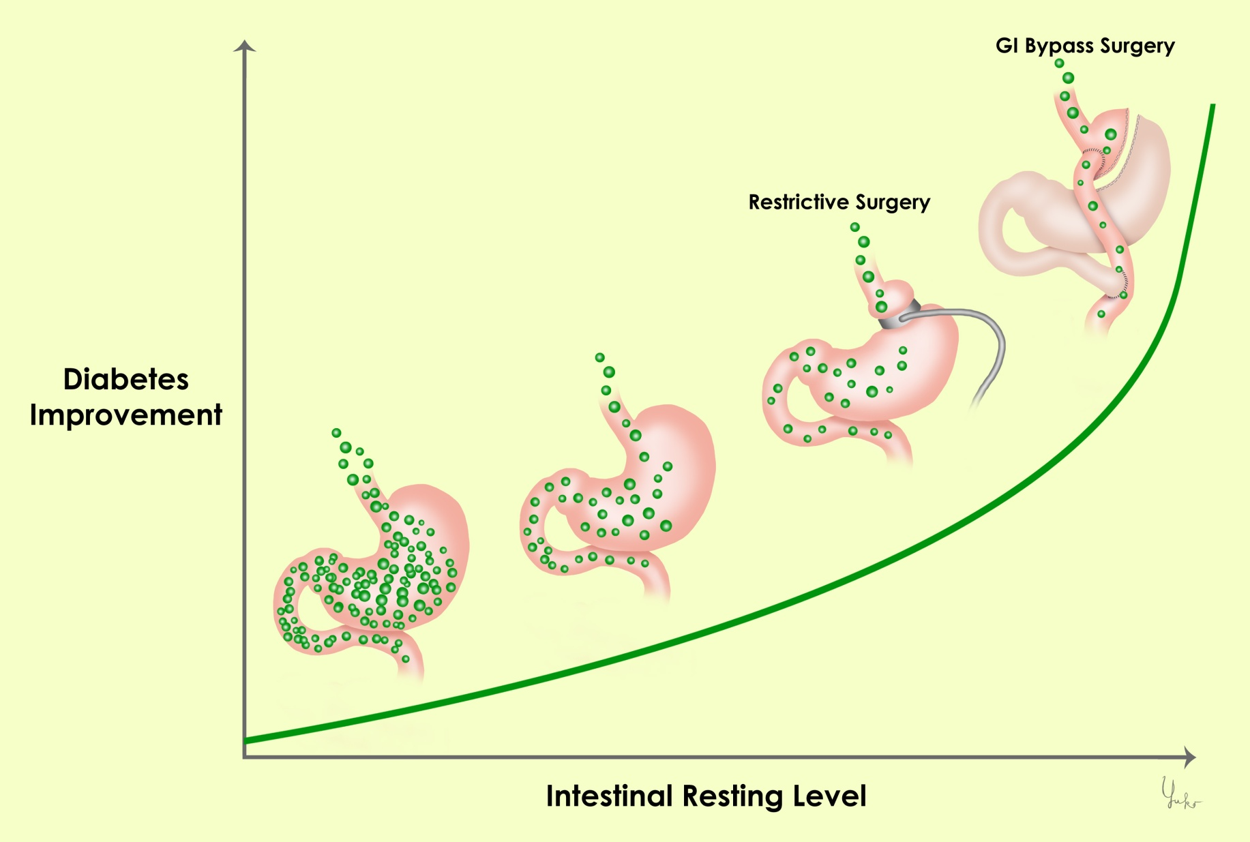
Foregut-Proximal Hypothesis
diet
Overeating
Food preservatives
Bugs?
Courtesy Prof Francesco Rubino
Notes:
47

Slide 48
HOMA-IR (even before weight loss)
le Roux, Pournaras et al Ann of Surg 2010

Slide 49
Bile acids and glucose metabolism
Stimulate GLP-1 production
bile acids
Improvement in insulin sensitivity
Increase energy expenditure

Slide 50
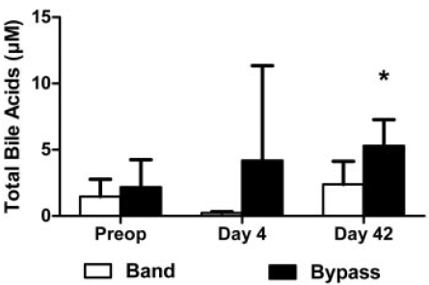
Bile acids after gastric bypass
# p<0.05 compared with gastric banding at same time point.
Pournaras et al, Endocrinology 2012

Slide 51
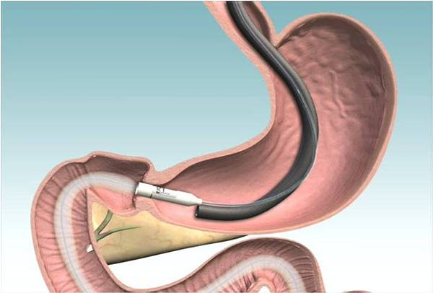

Endobarrier

Slide 52
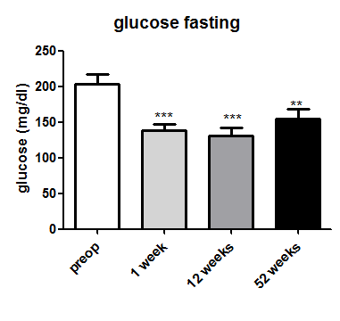
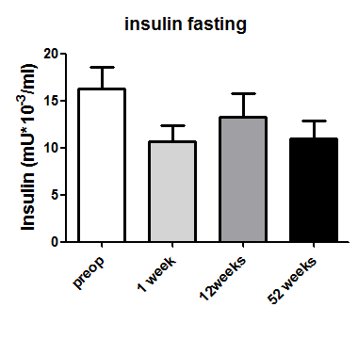
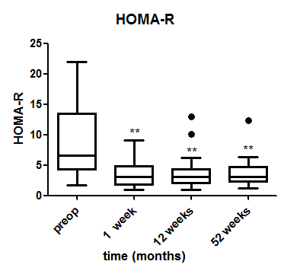
Metabolic effects

Slide 53
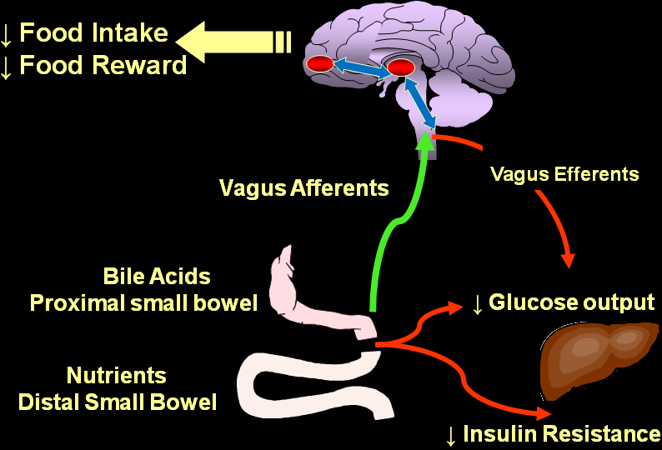
Potential mechanisms

Slide 54
Mechanisms of Diabetes improvement
Weight loss
Decreased Insulin Resistance
Increased Insulin production
Distal intestine incretin effect
Proximal intestine bypass

Slide 55
Hot topics in metabolic surgery
Lack of trials on its effects on complications
Preoperative management of glycaemia
Postoperative management of the patient
When to operate? What about hypos?
Lowering the random 35kg/m² cut-off

Slide 56
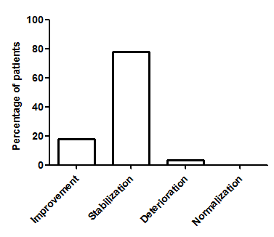
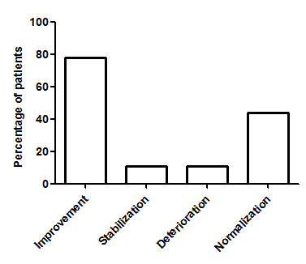
Microvascular complications
Retinopathy
Albuminuria
Miras et al, Diabetes Care in press

Slide 57


Acknowledgements
Imperial College London
  Dr Carel le Roux
  Mr Torsten Olbers
  Mr Florian Seyfried
  Dr Ling Ling Chuah
  Miss Sabrina Jackson
  Dr Christina Prechtl
Medical Research Council/CSC
  Prof Jimmy Bell
  Dr Tony Goldstone
  Dr Samantha Scholtz
  Dr Sarah Ali

