Slide 1


Ghrelin, PYY, PP and appetite
Dr Ben Field
Clinical Lecturer & Honorary Consultant in Diabetes & Endocrinology
Section of Investigative Medicine
Imperial College London

Slide 2
Learning objectives
Describe the structure, release pattern and biological actions of the gut hormones PYY, PP and ghrelin
Discuss the physiological relevance of the biological actions of these hormones
Critically discuss the evidence regarding the targeting of central circuits by these hormones
Discuss the potential for therapeutic use of these hormone signalling systems

Slide 3
Plan
Revision – CNS control of appetite
Gut hormones overview
  Peptide YY (PYY)
  Pancreatic Polypeptide (PP)
  Ghrelin

Slide 4
CNS control of appetite
Dorsal vagal complex

Slide 5
Gut hormones & appetite
Leptin
Hypothalamus
Brainstem
Vagus
Insulin
Amylin
PP
PYY₃₋₃₆
Oxyntomodulin
GLP-1
CCK
Ghrelin
Gastrin
Secretin
GIP
Motilin
Neurotensin
GLP-2
Notes:
5

Slide 6
Peptide YY
Amidated carboxy terminus
36
-NH₂
tyr
35
arg
34
gln
Alpha helix
22
33
arg
PP-fold
18
21
ala
25
29
asn
tyr
arg
asn
15
19
23
26
28
30
thr
glu
17
arg
ser
his
leu
leu
32
leu
20
leu
16
tyr
24
27
val
14
glu
tyr
pro
31
13
ser
2
12
5
pro
ala
10
8
pro
3
1
glu
pro
6
4
ile
tyr
9
7
lys
asp
gly
ala
glu
11
Amino terminus
Proline helix

Slide 7
Intestinal distribution of PYY (pmol/g)
fundus
<1.0
antrum
<1.0
duodenum
5.7 ± 0.9
jejunum
4.7 ± 1.0
sigmoid
colon
196 ± 34
ascending
colon
82 ± 9
ileum
84 ± 8
rectum
480 ± 66
Adrian et al, Gastroenterology 1985; 89:1070-7

Slide 8
PYY₁₋₃₆ effects
↑ ileal fluid & electrolyte absorption
↓ pancreatic & gastric secretion
↓ gallbladder contraction
↓ gastric emptying
peripheral vasoconstriction
↓ GFR
↓ plasma renin & aldosterone

Slide 9
PYY is a member of the PP-fold family
 | 1 | 2 | 3 | 4 | 5 | 6 | 7 | 8 | 9 | 10 | 11 | 12 | 13 | 14 | 15 | 16 | 17 | 18 | 19 | 20 | 21 | 22 | 23 | 24 | 25 | 26 | 27 | 28 | 29 | 30 | 31 | 32 | 33 | 34 | 35 | 36
PYY | Y | P | I | K | P | E | A | P | G | E | D | A | S | P | E | E | L | N | R | Y | Y | A | S | L | R | H | Y | L | N | L | V | T | R | Q | R | Y | NH₂
NPY | Y | P | S | K | P | D | N | P | G | E | D | A | P | A | E | D | M | A | R | Y | Y | S | A | L | R | H | Y | I | N | L | I | T | R | Q | R | Y | NH₂
PP | A | P | L | E | P | V | Y | P | G | D | N | A | T | P | E | Q | M | A | Q | Y | A | A | D | L | R | R | Y | I | N | M | L | T | R | P | R | Y | NH₂

Slide 10
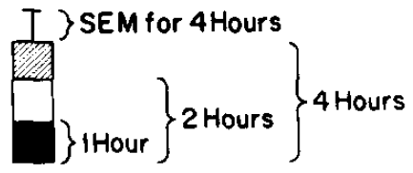
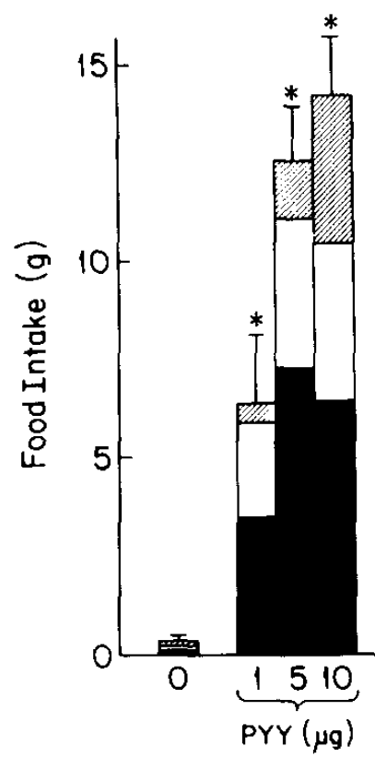
PYY₁₋₃₆ acts like NPY centrally…
saline control
intracerebroventricular PYY₁₋₃₆ satiated rats

Slide 11
… but PYY is secreted after meals…
Adrian et al, Gastroenterology 1985; 89:1070-7

Slide 12
… and elevated after ileal resection…
90
530 kcal breakfast
80
70
60
Ileal Resection
50
pmol/l PYY
40
Controls
30
20
10
0
-30
0
30
60
90
120
150
180
Minutes
Adrian & Bloom, Surgery 1987; 101:715-719

Slide 13
… and elevated after RYGB…
PYY
GLP-1
adapted from: le Roux et al, Ann Surg 2006; 243: 108-14
Notes:
13

Slide 14
… and is low in obesity…
500 ml meal
900 ml meal
Lean
Obese
Le Roux et al, Endocrinology 2006; 147:3-8
Notes:
14
14

Slide 15
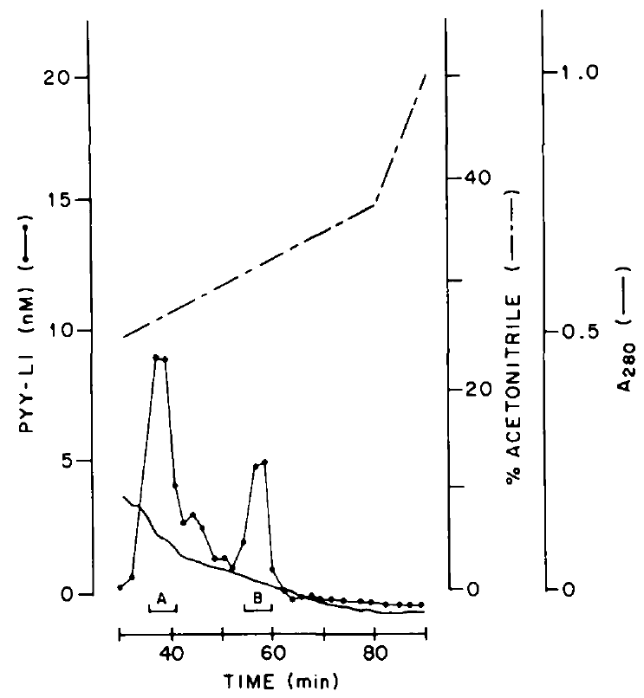
PYY exists in two forms: 1-36 & 3-36
PYY₃₋₃₆
PYY₁₋₃₆
Eberlein et al, Peptides 1989; 10: 797
Grandt et al, Regul Pept 1994; 51: 151
Notes:
15
15

Slide 16
PYY length confers receptor selectivity

Slide 17
PYY structure / function
 | 1 | 2 | 3 | 4 | 5 | 6 | 7 | 8 | 9 | 10 | 11 | 12 | 13 | 14 | 15 | 16 | 17 | 18 | 19 | 20 | 21 | 22 | 23 | 24 | 25 | 26 | 27 | 28 | 29 | 30 | 31 | 32 | 33 | 34 | 35 | 36
PYY | Y | P | I | K | P | E | A | P | G | E | D | A | S | P | E | E | L | N | R | Y | Y | A | S | L | R | H | Y | L | N | L | V | T | R | Q | R | Y | NH₂
NPY | Y | P | S | K | P | D | N | P | G | E | D | A | P | A | E | D | M | A | R | Y | Y | S | A | L | R | H | Y | I | N | L | I | T | R | Q | R | Y | NH₂
PP | A | P | L | E | P | V | Y | P | G | D | N | A | T | P | E | Q | M | A | Q | Y | A | A | D | L | R | R | Y | I | N | M | L | T | R | P | R | Y | NH₂
PYY₁₋₃₆ : non-selective Y receptor agonist
PYY₃₋₃₆ : Y2-selective agonist
NPY: non-selective Y receptor agonist
PP: Y4-selective agonist

Slide 18
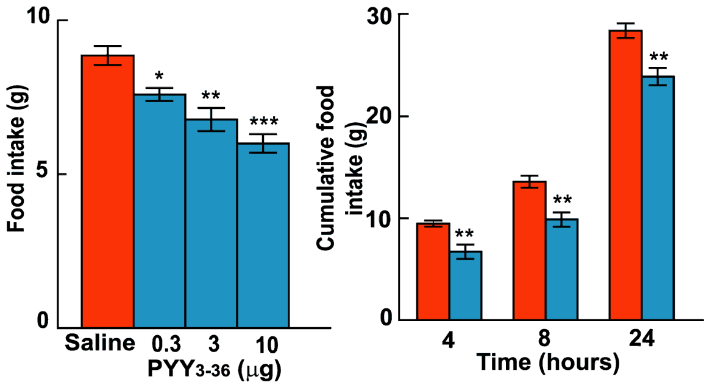
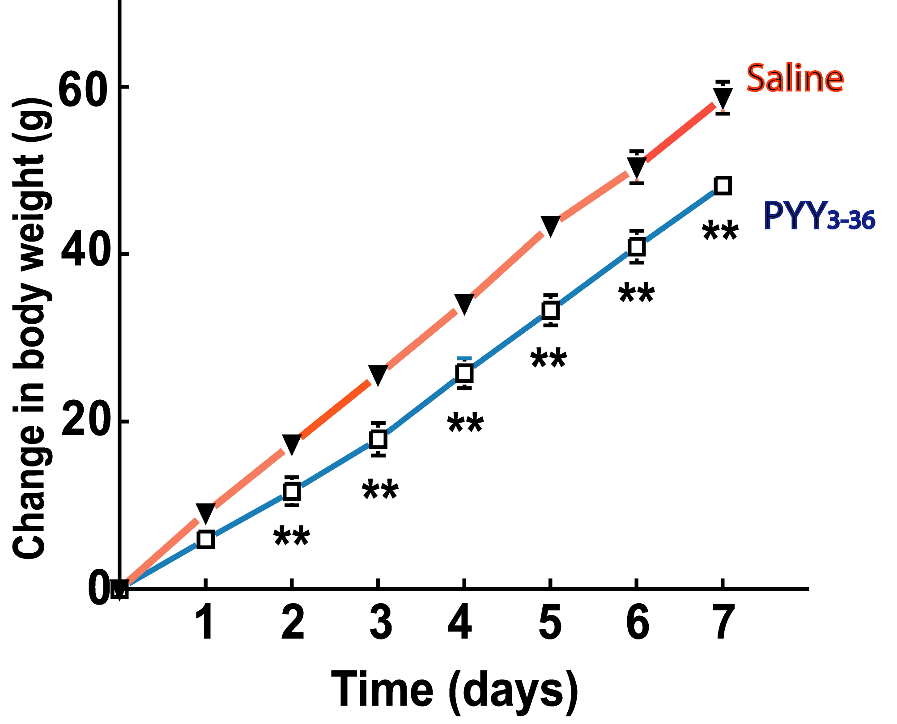
PYY₃₋₃₆ and satiety
intraperitoneal PYY₃₋₃₆ in fasted rats
repeated i.p. PYY₃₋₃₆ in rats
Batterham et al. Nature 2002; 418:650-4

Slide 19
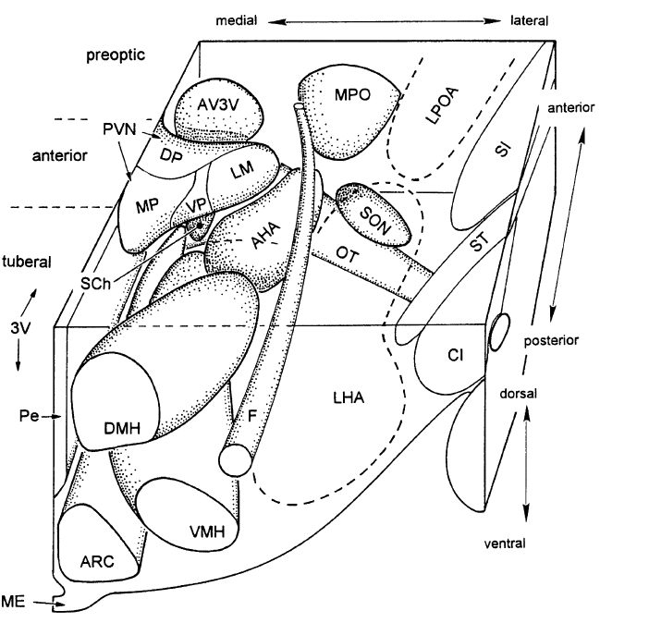
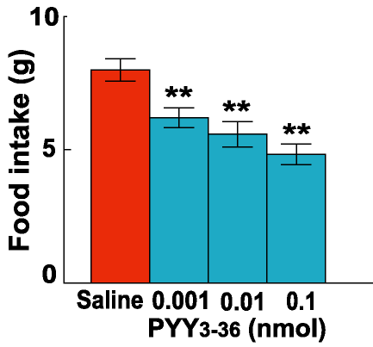
PYY₃₋₃₆ sites of action
intra-arcuate PYY₃₋₃₆
fasted rats
intra-arcuate Y2R antagonist blocks peripheral PYY₃₋₃₆
Batterham et al. Nature 2002; 418:650-4

Slide 20
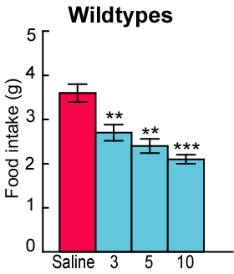
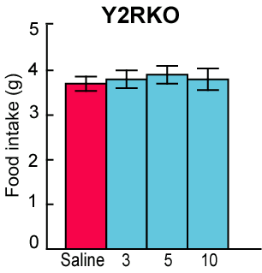
PYY₃₋₃₆ sites of action
Y2R knockout mice resistant to PYY₃₋₃₆
MC4R
Y1R/Y5R
a-MSH
AgRP
NPY
PVN
ARC
Y2R
GABA
Batterham et al. Nature 2002; 418:650-4
Notes:
20
20

Slide 21
PYY₃₋₃₆ sites of action
Hypothalamus
#
Brainstem
#
Abbott et al, Brain Research 2005; 1044: 127
Koda et al, Endocrinology 2005; 146: 2369
Vagus
Notes:
21

Slide 22
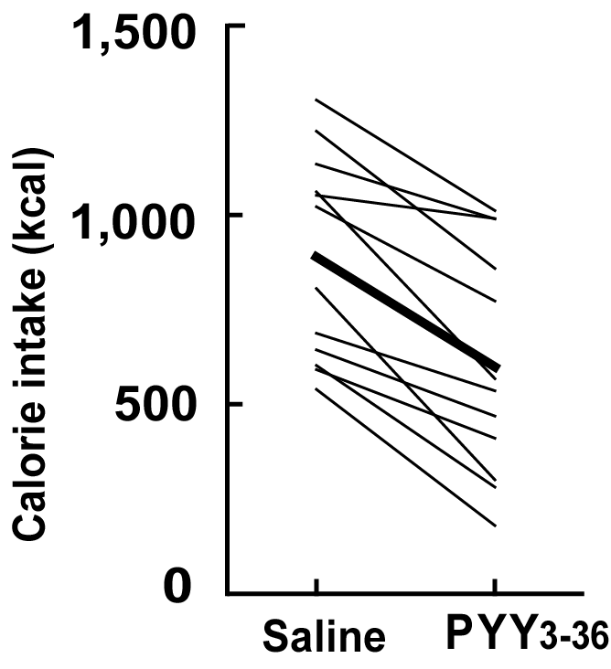
PYY₃₋₃₆ human infusion
obese volunteers
90 min i.v. infusion
free choice buffet
Batterham et al, N Engl J Med 2003; 349:941-8
Notes:
22
22

Slide 23
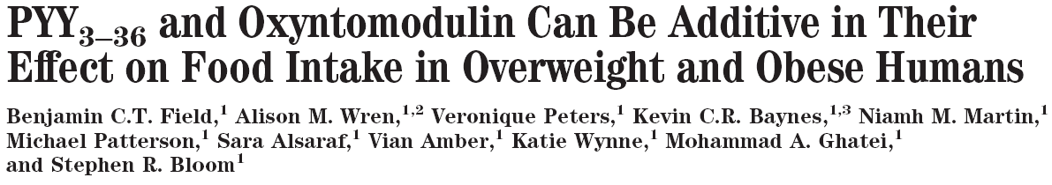
PYY + OXM have additive satiety effect
Simultaneous IV infusions in
obese human volunteers
PYY₃₋₃₆ 0.25 pmol/kg/min
Oxyntomodulin 1.5 pmol/kg/min
Notes:
23
23

Slide 24
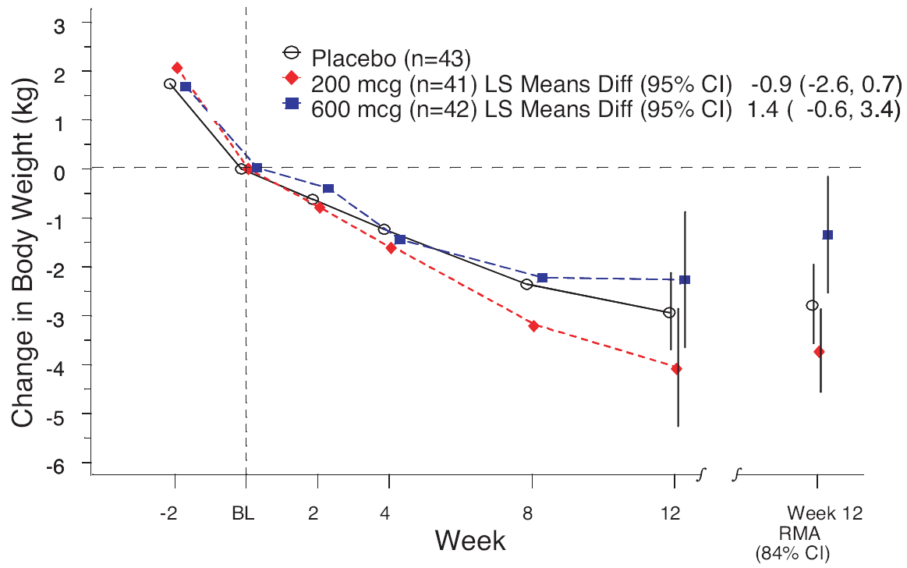
PYY₃₋₃₆ as a drug target?
Gantz et al, J Clin Endocrinol Metab 2007; 92:1754-7
Notes:
24
24

Slide 25
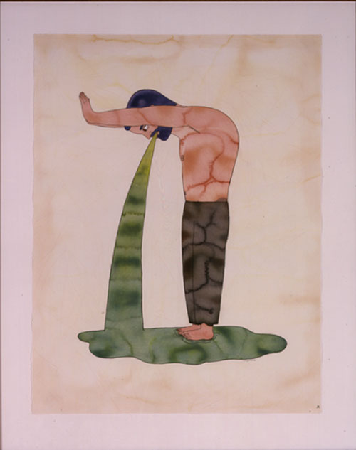
Is nausea the opposite of hunger?
Notes:
However, the trouble is that gut hormones are known to cause nausea and vomiting at high plasma levels.
The same is true of any anorectic substance, and this reflects the fact that satiety is a spectrum, with ravenous hunger at one end, and severe nausea at the other.

Slide 26
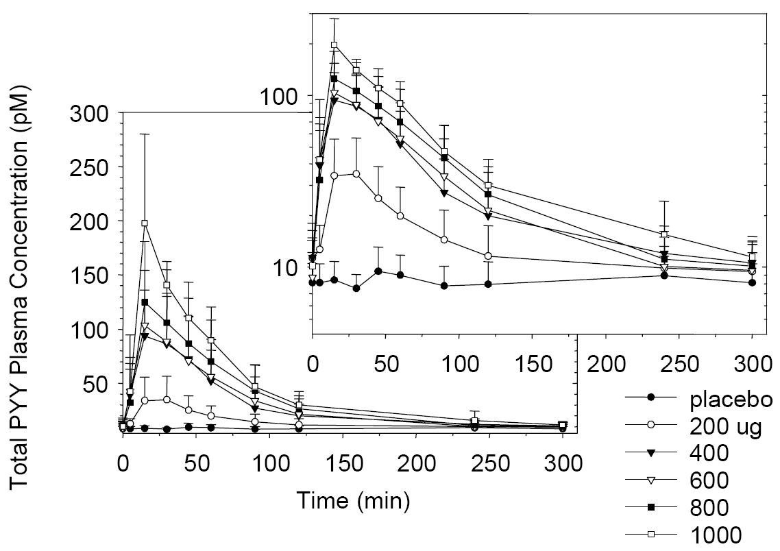
PYY₃₋₃₆ as a drug target?
Gantz et al, J Clin Endocrinol Metab 2007; 92:1754-7
Notes:
26
26

Slide 27
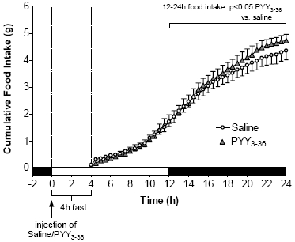
PYY₃₋₃₆ delayed orexigenic effect
previously ad libitum fed C57BL/6 mice
PYY₃₋₃₆
saline
fasted
Parkinson et al, Am J Physiol Endocrinol Metab 2008; 294:E698-708

Slide 28
PYY₃₋₃₆ as a drug target?
[Drug]
C_{max}
Nausea
Anorexigenic?
Orexigenic?
T_{max}
Time
Notes:
28
28
28

Slide 29
Long-acting analogue of PYY₃₋₃₆
acute food intake
fasted lean C57BL/6 mice
n = 8 per group
chronic weight loss
diet-induced obese C57BL/6 mice
n = 8 – 11 per group
saline
saline
PYY₃₋₃₆
PYY₃₋₃₆
Y analogue
Y analogue
unpublished data
Notes:
29
29
29

Slide 30
PYY₃₋₃₆ summary
Reduces appetite
Rapidly cleared from circulation
Rapid peak causes nausea & vomiting
Appetite overswing occurs

Slide 31
Pancreatic polypeptide
Notes:
31
31

Slide 32
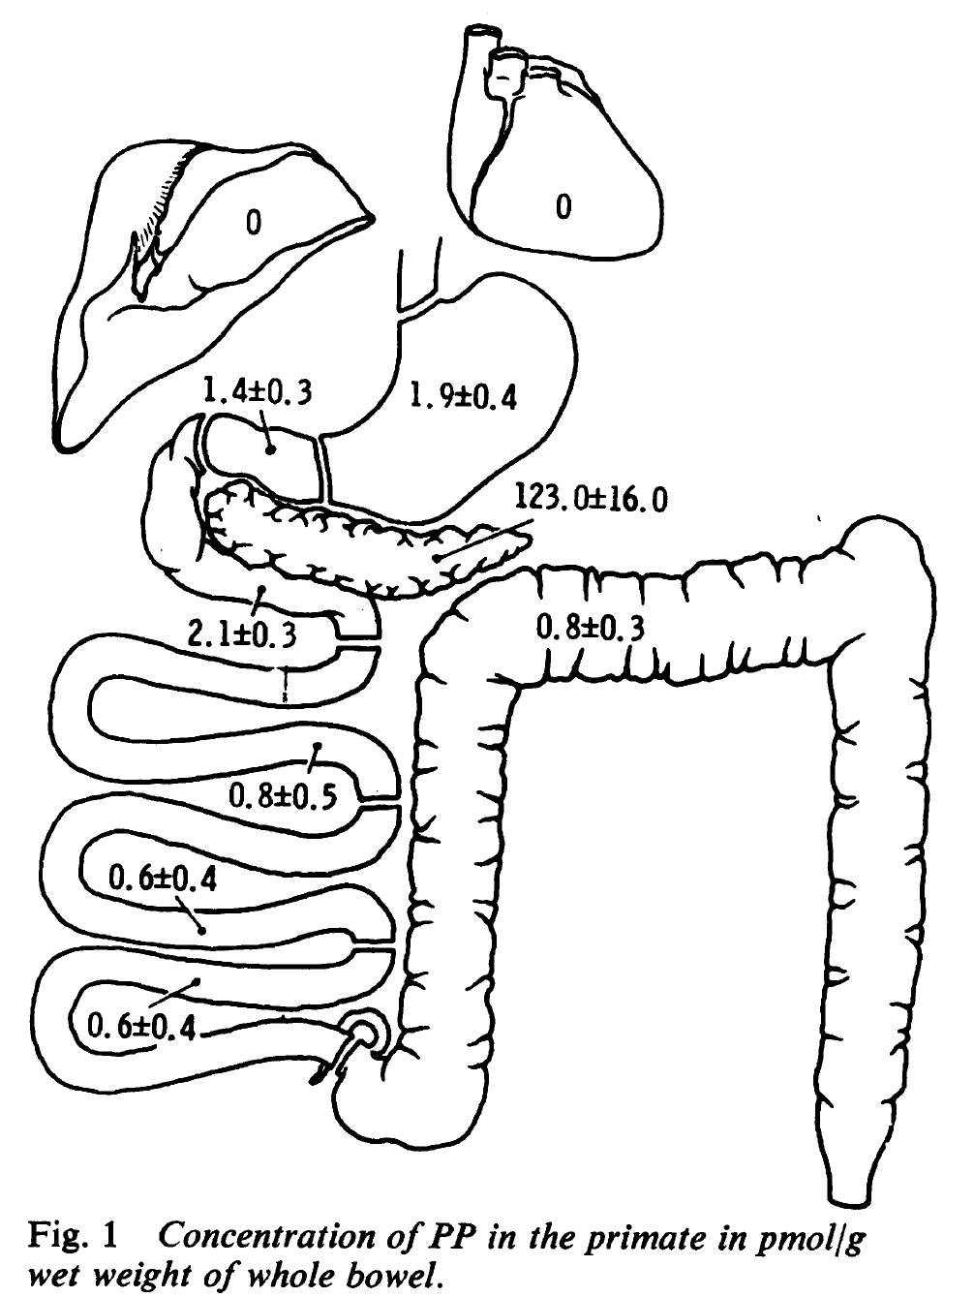
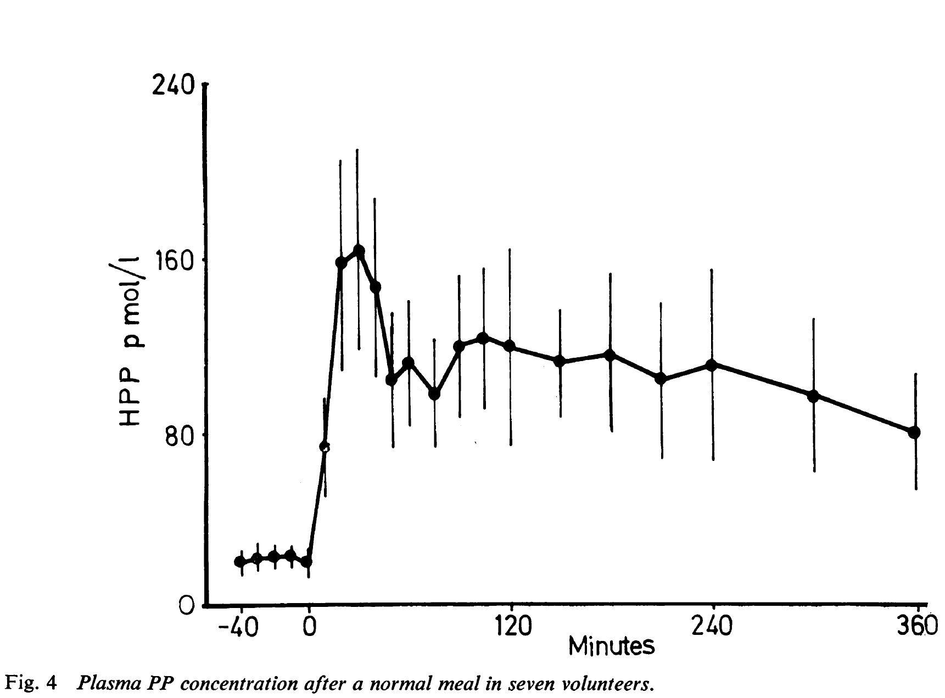
Released from PP islet cells after meals
Adrian et al, Gut 1976; 17:940-4

Slide 33
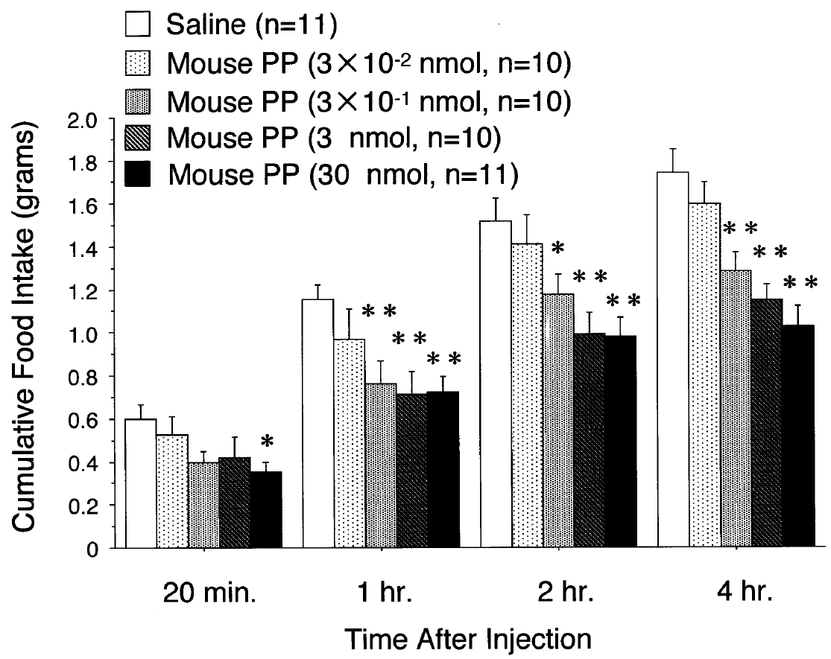
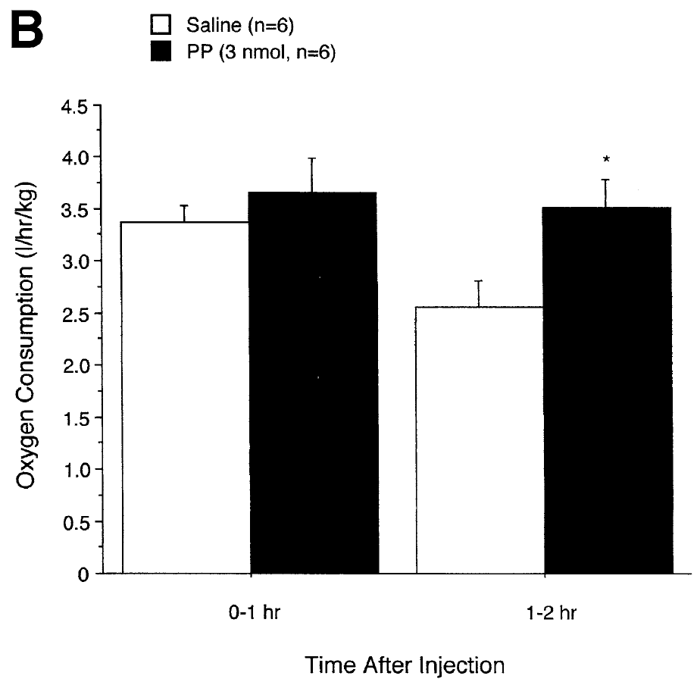
PP actions
↓ pancreatic exocrine secretion
↓ gallbladder contraction
↓ gastric acid secretion
↓ gastric emptying
↓ food intake
↑ energy expenditure
Asakawa et al, Gastroenterology 2003; 124: 1325

Slide 34
PP sites of action
Hypothalamus
Brainstem
#
Asakawa et al, Gastroenterology 2003; 124: 1325
Vagus
Notes:
34

Slide 35
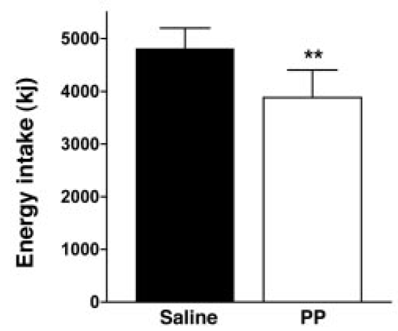
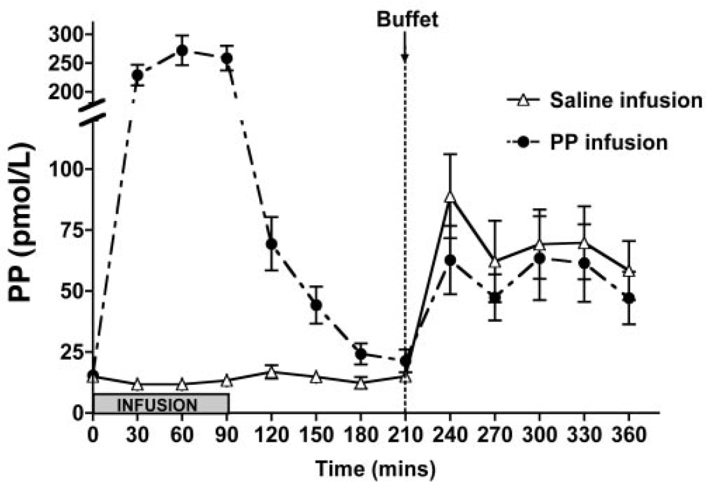
PP and human energy intake
PP IV infusion 10 pmol/kg/min for 90 mins
to lean human volunteers
Batterham et al, J Clin Endocrinol Metab 2003; 88:3989-92

Slide 36
PP as a drug target?
7TM / Prosidion / Imperial
Notes:
36
36

Slide 37
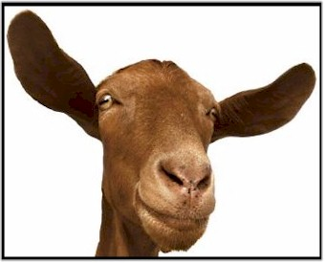
Ghrelin
28aa gastric hormone
Ghrelin O-acyltransferase
‘GOAT’
Yang et al. Cell 2008
Gutierrez et al. Proc. Natl. Acad. Sci 2008
O=C-(CH₂)₆ -CH₃
O
F
L
S
P
S
E
Human ghrelin
P
S
H
Q
R
G
Q
L
R
K
A
V
P
Q
K
P
Q
R
K
E
S
K
Notes:
37
37

Slide 38
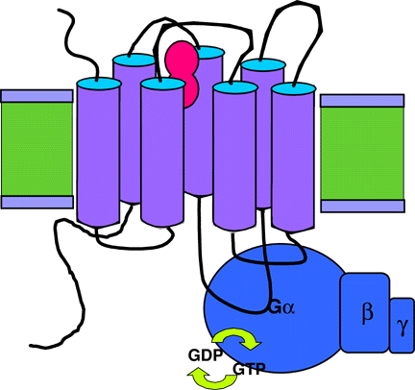
Ghrelin: agonist at the GHS-R1a
GH secretion
feeding
Notes:
38
38

Slide 39
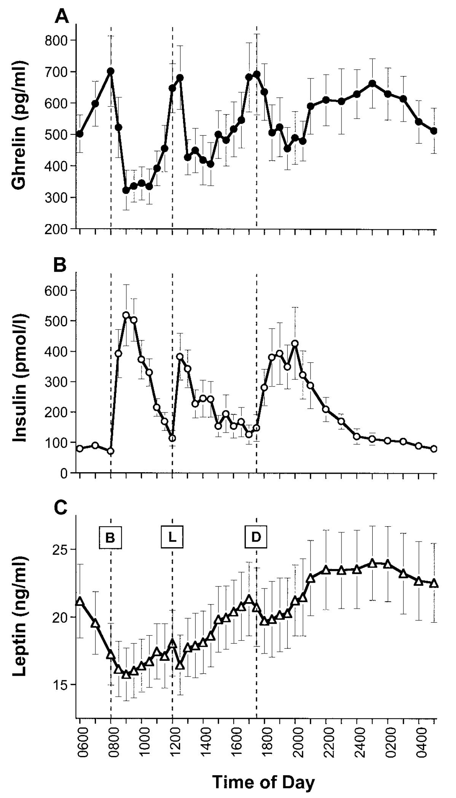
Ghrelin: agonist at the GHS-R1a
plasma level highest pre-meal
meal cue
GH secretagogue
↑ after weight loss
Cummings et al, Diabetes 2001; 50:1714-9
Notes:
39
39

Slide 40
Fasting plasma ghrelin concentration
Tschöp et al, Diabetes 2001 50:707-9

Slide 41
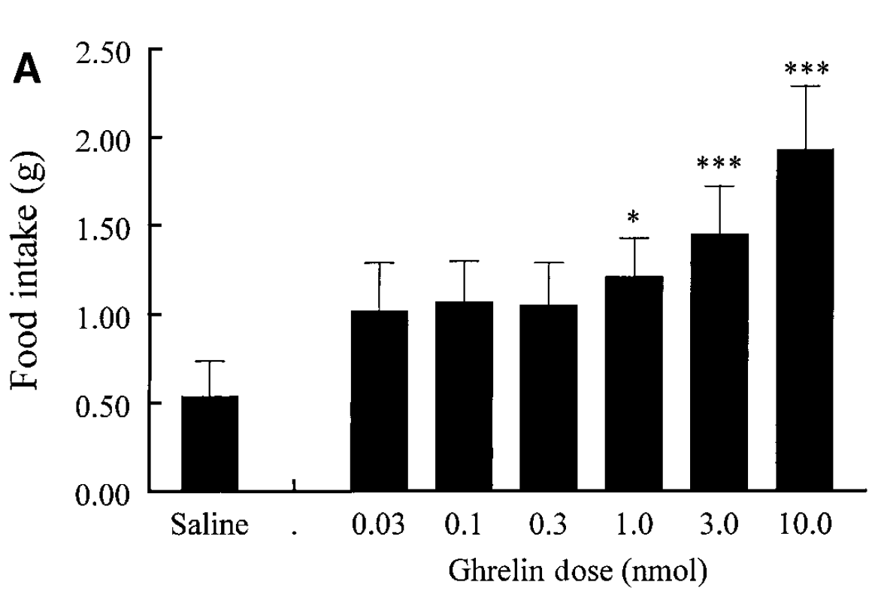
Ghrelin: site of orexigenic action
intraperitoneal injection in fasted rats
Wren et al, Diabetes 2001; 50:2540-7
Notes:
41
41

Slide 42
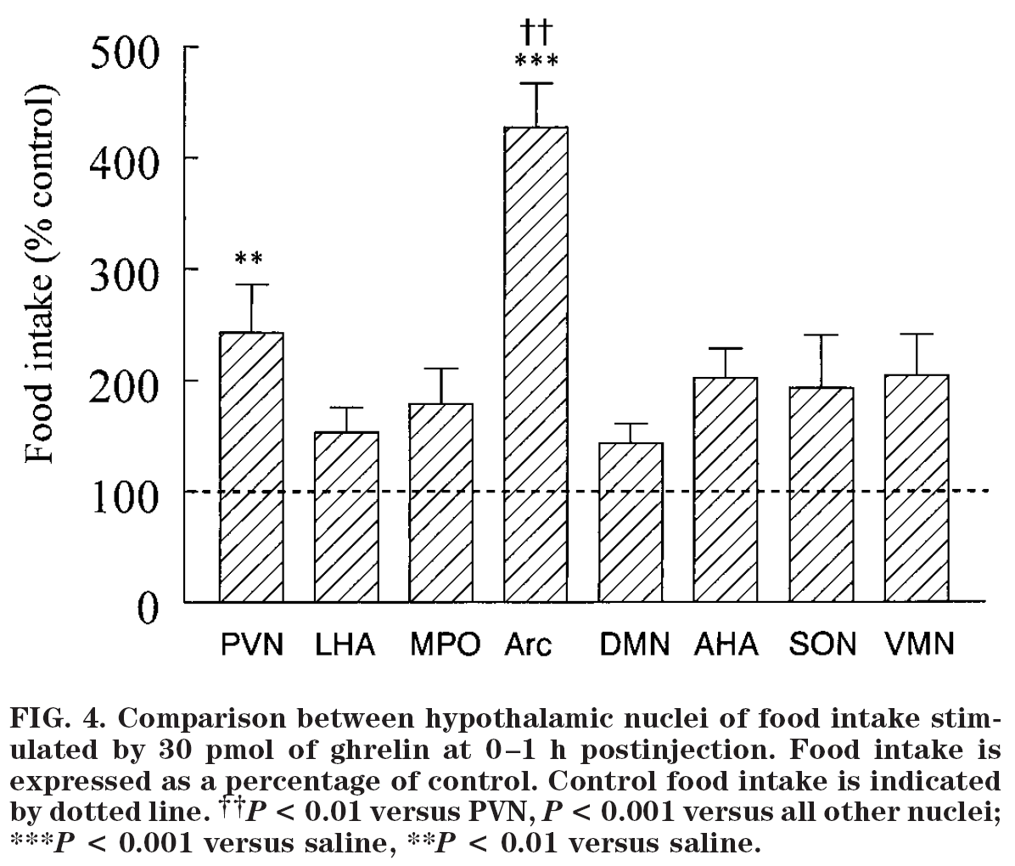
Ghrelin: site of orexigenic action
intra-nuclear cannulated rats
Wren et al, Diabetes 2001; 50:2540-7
Notes:
42
42

Slide 43
Ghrelin and human appetite
Ghrelin IV infusion 5.0 pmol/kg/min
Wren et al, J Clin Endocrinol Metab 2001 86:5992-5
Notes:
43
43

Slide 44
Energy intake after ghrelin infusion in
cancer patients with cachexia
Neary et al, J Clin Endocrinol Metab 2004 89:2832-6
Notes:
44
44

Slide 45
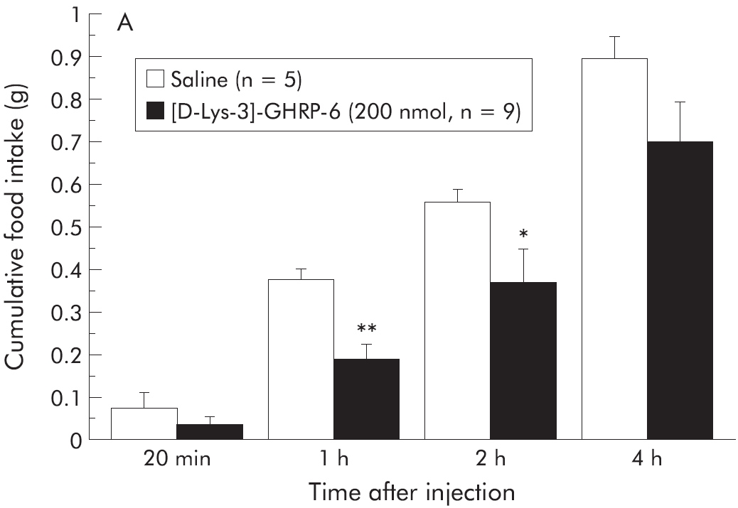
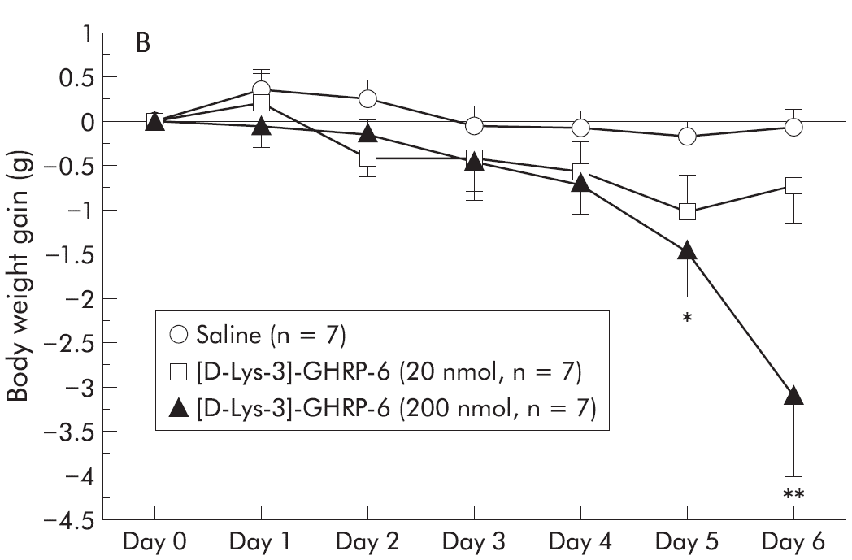
Effect of GHS-R1a peptide antagonist
Fasted ob/ob mice, acute IP injection
Repeated IP injection, ob/ob mice
Asakawa et al, Gut 2003; 52: 947
Notes:
45
45

Slide 46
GHS-R1a orally available antagonist
Bayer Research Center small molecule
lean rat
IPGTT
DIO mice
chronic
oral dose
10 mg/kg
DIO mice
chronic
oral dose
Esler et al, Endocrinology 2007 148:5175-85
Notes:
46
46

Slide 47
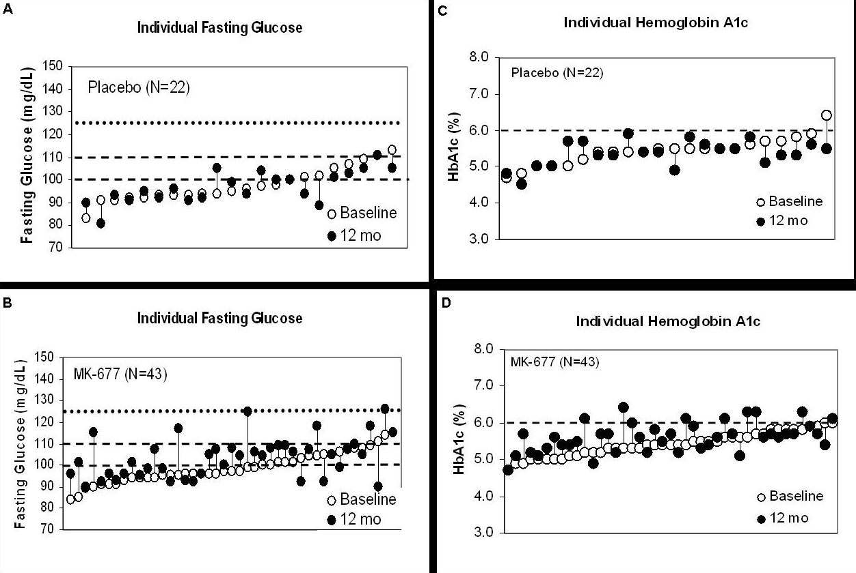
Ghrelin: the elixir of eternal youth?
Oral ghrelin mimetic phase 2 study
Placebo
Fasting glucose
HbA_{1c}
Drug
Nass et al, Ann Intern Med 2008 149:601-11
Notes:
47
47

Slide 48
Ghrelin summary
GHS-R1a antagonists synthesised
Cause weight loss
Off-target effects on GH axis
Future unclear

Slide 49
Summary
Describe the structure, release pattern and biological actions of the gut hormones PYY, PP and ghrelin
Discuss the physiological relevance of the biological actions of these hormones
Critically discuss the evidence regarding the targeting of central circuits by these hormones
Discuss the potential for therapeutic use of these hormone signalling systems

