Slide 1
General and clinical aspects of thyroid cancer
Mr Fausto Palazzo MS FRCS
Department of Endocrine Surgery
Hammersmith Hospital
BSc Reproductive and Developmental Sciences Nov 2010

Slide 2
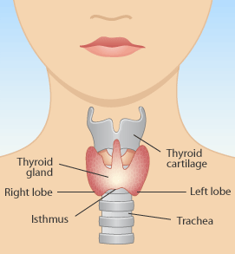
Thyroid Gland Anatomy

Slide 3
Thyroid Gland Anatomy

Slide 4
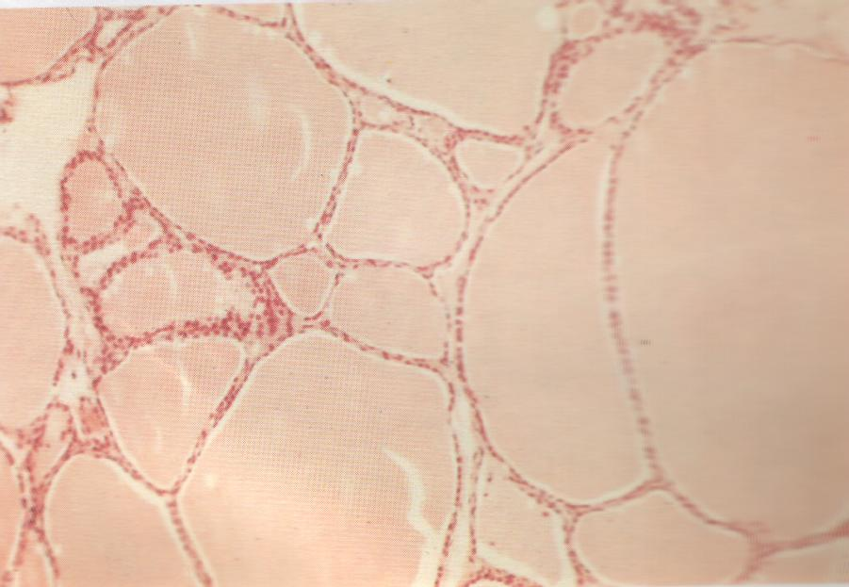
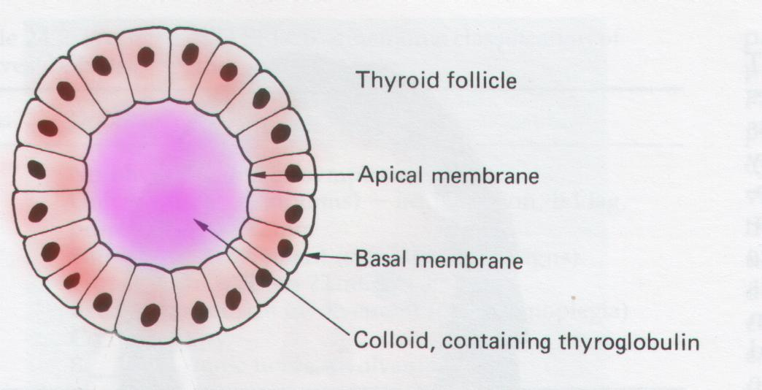
Thyroid Histology

Slide 5
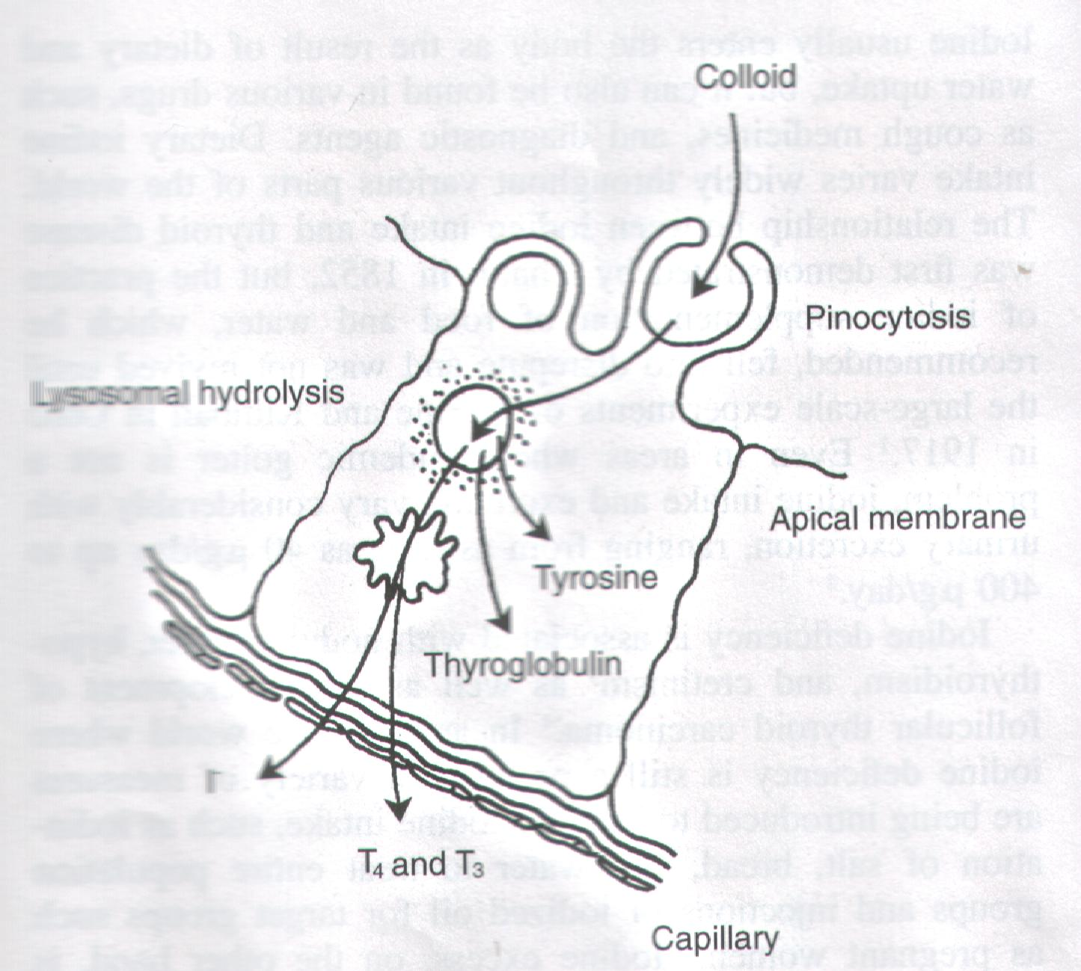
Thyroid Gland Physiology

Slide 6
Main Action of Thyroxine
Regulation of metabolic rate & calorific turnover

Slide 7
Thyroid Gland Physiology
Hypothalamus
Neg
TRH
Thyroid Releasing Hormone
(T3)
Peripheral
Conversion
Neg
Pituitary
Pos
TSH
Thyroid Stimulating
Hormone
T4
Pos
Thyroid

Slide 8
Thyroid Disease
Disorders of Function
Disorders of Growth (tumour)
Benign
Malignant – Thyroid cancer

Slide 9
Thyroid cancer Incidence/Age/Sex
2.0/100,000 (2.3F & 0.9M) & increasing
All ages
F>M (3:1)

Slide 10
Thyroid cancer - lifetime risk
Breast 1:9
Prostate 1:14
Lung 1:13
Colorectal 1:20
Oesophagus 1:75*
Pancreas 1: 96*
Thyroid 1:142
US National Institute of Health, www.cancer.gov

Slide 11
Types of 1^{ary} thyroid cancer
Follicular cells
Papillary thyroid cancer
+variants
Follicular & Hurtle cell thyroid cancer
+variants
Parafollicular (C) cells
Medullary thyroid cancer
Lymphocytes
Lymphoma

Slide 12
Risk factors
Ionized radiation
Family history of thyroid cancer
Solitary/Dominant nodule at extremes of age
Familial syndromes linked to PTC
Familial non-MTC
Gardener’s, FAP,
Diseases associated with MEN 2 (MTC)
Hashimoto’s thyroiditis (Lymphoma)
Ron et al. 1995 Radiat Res 141:259-277

Slide 13
Epidemiology
No particular geographical distribution once known risk factors removed
Eg. Bielorussia
Data distorted by lead time bias
USS neck

Slide 14
Presentation
Thyroid nodules in 4-7% of the population
< 5% malignant

Slide 15
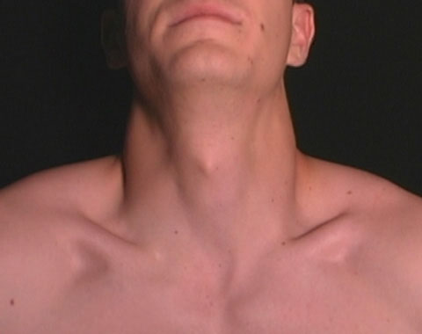
Clinical presentation – Triangles of the neck

Slide 16
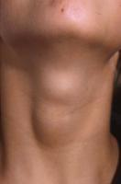
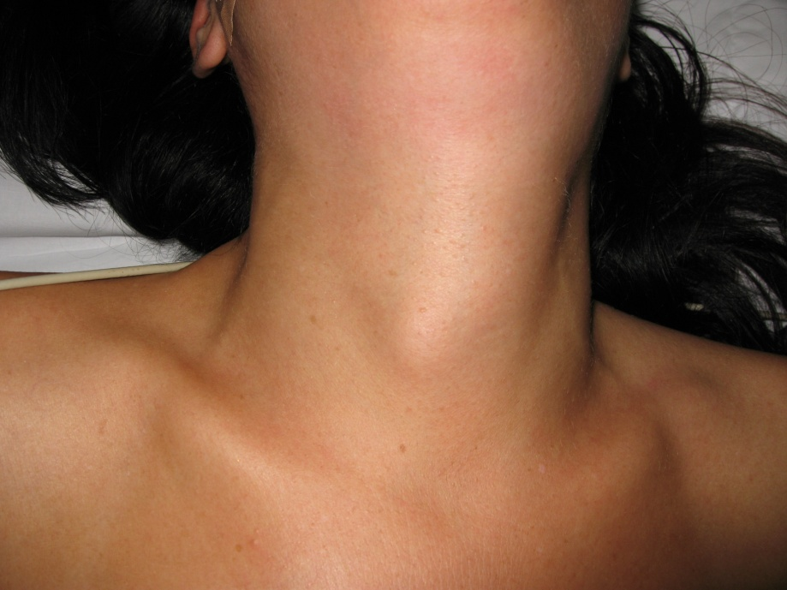
Clinical presentation
Solitary thyroid nodule
Dominant nodule in MNG

Slide 17
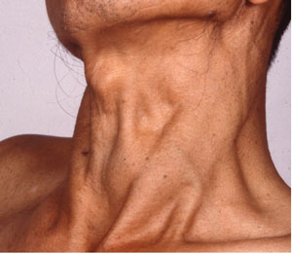
Thyroid nodule – presentations 1

Slide 18
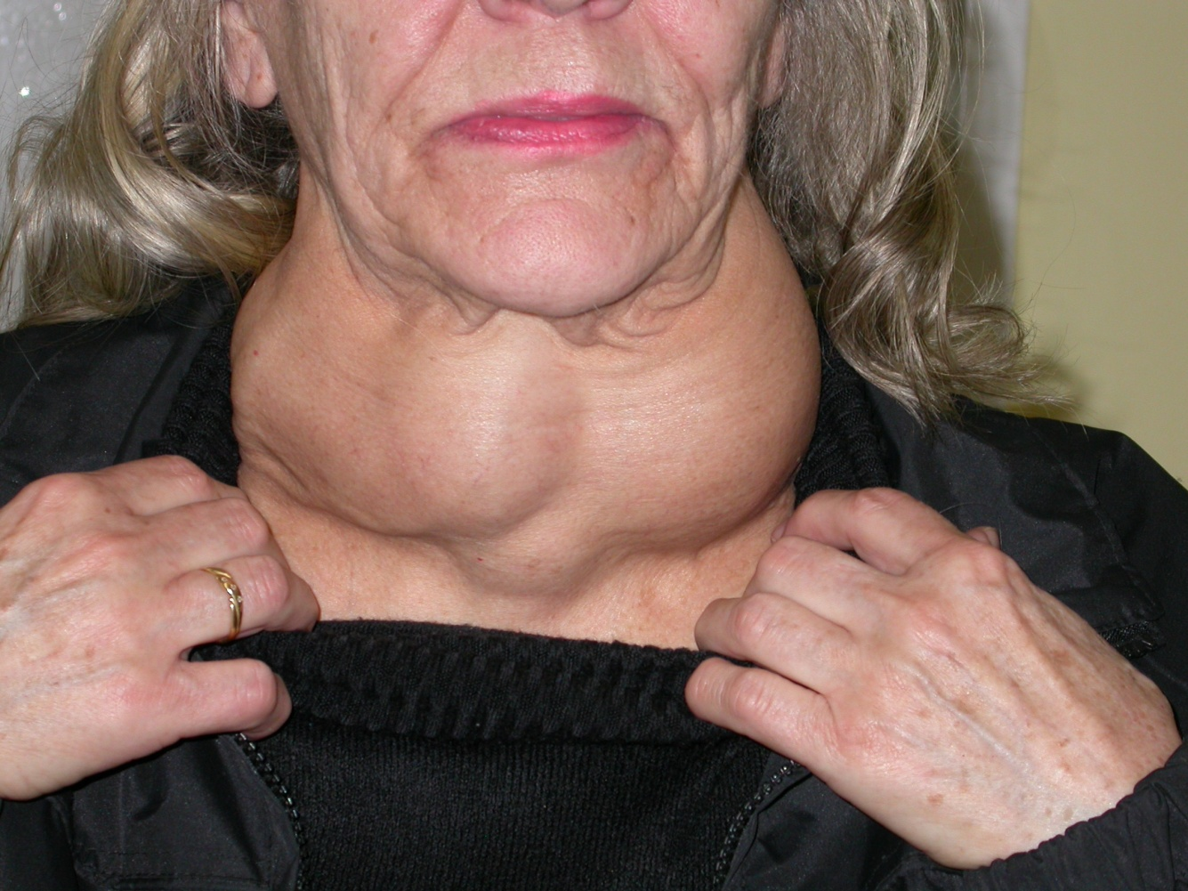
Thyroid nodule presentations 2

Slide 19
History
Age
Length history
Local symptoms
Hx irradiation?
FH
Thyroid cancer
Other thyroid disease
Other endocrine related disease

Slide 20
Examination
Solitary or dominant nodule?
Lump characteristics
Lymphadenopathy?

Slide 21
Investigations
TFTs
Autoimmune screen
Routine bloods
FBC
U&E
Calcium!

Slide 22
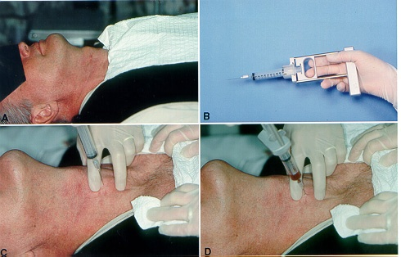
Investigations – FNA!

Slide 23
FNA
Score | Definition
ThyC1 | Non-diagnostic
ThyC2 | Non-neoplastic
ThyC3 | Atypical follicular neoplasm
ThyC4 | Suspicious for malignancy
ThyC5 | Diagnostic of malignancy
www.british-thyroid-association.org

Slide 24
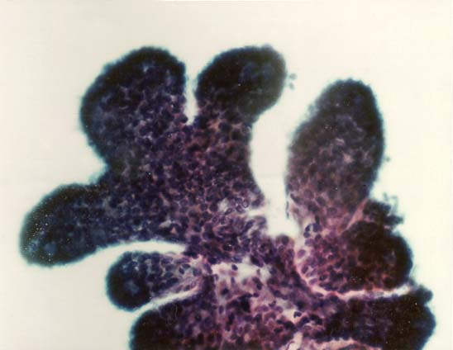
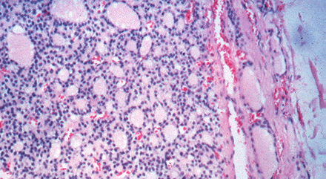
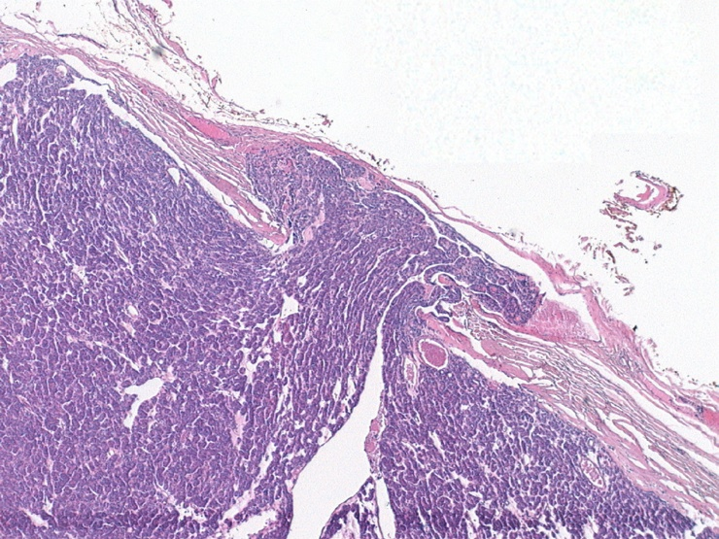
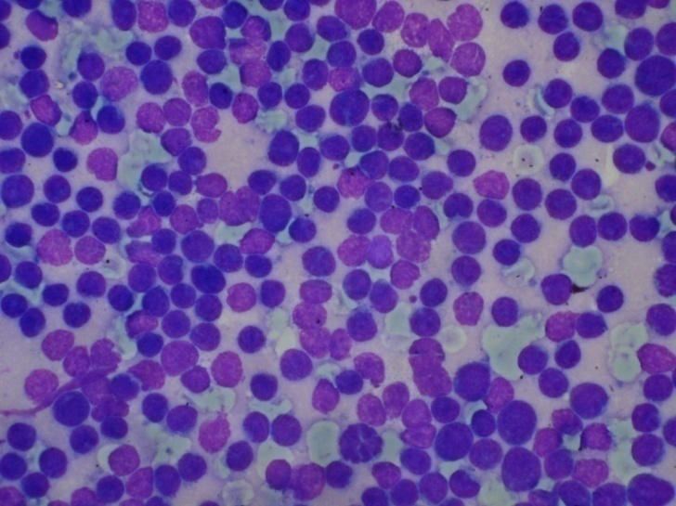
Follicular lesions/cancer
PTC
Thyroid lymphoma

Slide 25
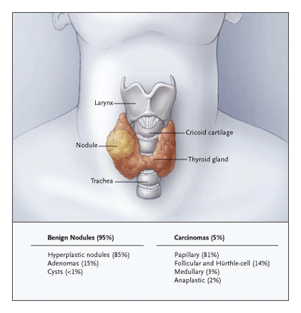

Slide 26
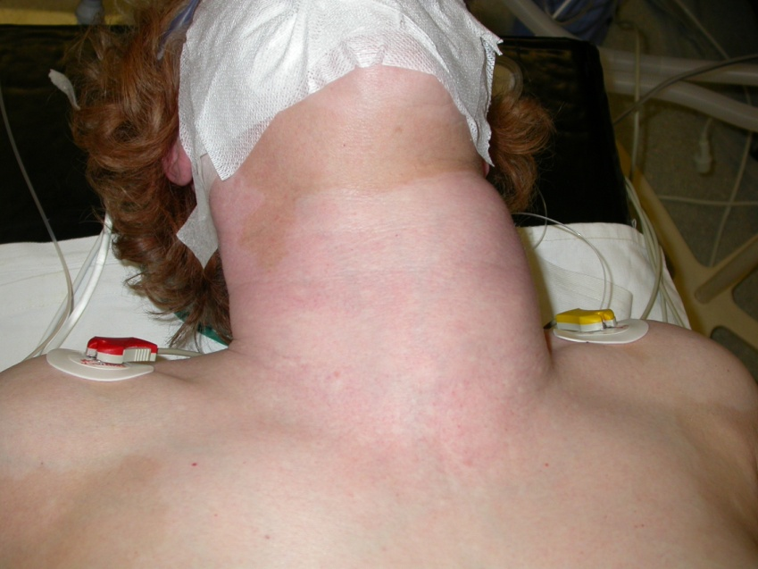
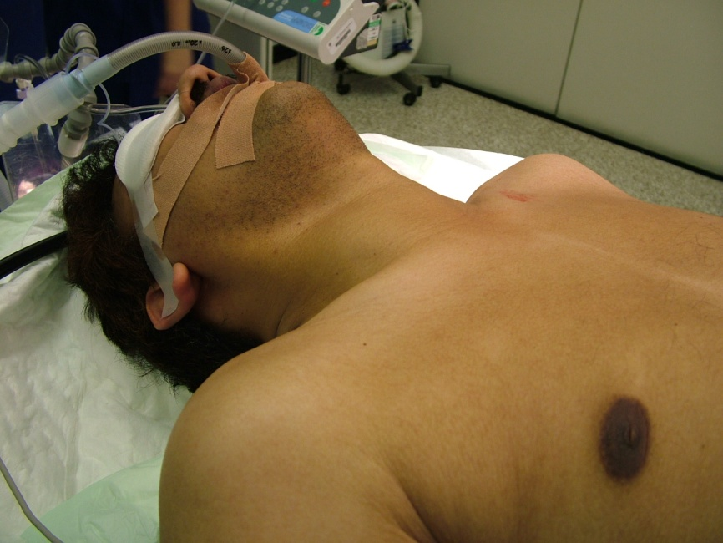
Treatment of thyroid cancer

Slide 27
Treatment of thyroid cancer
Ohio: median fu 15.7 years, 1355 patients, “Likelyhood of cancer death statistically reduced by surgery > lobectomy”
Chicago: mean fu 12 years, 269 patients
“total/near-total thyroidectomy is statistically associated with a reduced risk of death and reduced risk of local recurrence”
Mazzaferri & Jhiang, 1994, Am J Med 418-28
De Groot, 1990, J Clin Endocrinol Metab 414-24

Slide 28
Complications of thyroid surgery
Haemorrhage
Recurrent laryngeal nerve injury
Hypoparathyroidism
complications less likely
if surgeon performs >30 thyroidectomies per year

Slide 29
I¹³¹ Therapy
Cell specific targeted therapy
Destroys remnant & stray thyrocytes
Aids cancer patient follow-up
Whole body scanning
Thyroglobulin measurement

Slide 30
Recurrence in patients with stage II/III thyroid cancer with & without I¹³¹
No I¹³¹ ablation
Cumulative recurrence
Cumulative recurrence (%)
I¹³¹ ablation
Years since diagnosis
Years after initial therapy

Slide 31
I¹³¹ & Risk of death in PTC
No post-operative I¹³¹ increases the risk of death 2.7 fold
The administration of postoperative I¹³¹ ablation is an independent factor associated with improved survival

Slide 32
TSH Suppression
TSH suppression
Risk stratified
Relapse free survival longer in patients with constantly suppressed TSH (undetectable)
Pujol et al, J Clin Endocrinol Metab 1996;81:4318

Slide 33
Follow up
Lifelong
Annual thyroglobulin/calcitonin
Annual USS neck
Most likely recurrence within 10yrs in PTC/FTC

Slide 34
Prognosis thyroid cancer
Prognosis PTC & FTC
~80% 5 year survival
90% @10 years for under 65s
8-10% die of disease
Spread
Local recurrence up to 27%
Distant metastases up to 20%
Schlumberger N. Eng J Med 1998,297-306
Rossi et al.Surg Clin N. Am 2000, 2238-52

Slide 35
Thyroid cancer in UK
5 year age/sex matched survival (1985-89)
Iceland 89%
Sweden* 79%
Finland 77%
Denmark 78%
England 69%
USA ?90%
Eurocare II 1998, Eur J Cancer 2248-52
Mazzaferri, 1999, Thyroid 421-427

Slide 36
Poor prognostic factors
Extremes of age
Male gender
Poor histological differentiation
Delay in diagnosis
Tumour size
Adequacy in surgical treatment
?¹³¹I

Slide 37
Improving outcomes – Centralisation of care
Earlier diagnosis
More FNA
More appropriate surgery
Less complications
Vocal cord palsy
Hypoparathyroidism

Slide 38
Thank You
Questions?
Mr Fausto Palazzo MS FRCS
Department of Endocrine Surgery
Hammersmith Hospital

