Slide 1
Progesterone signaling in breast and endometrial cancer
Dr Laki Buluwela
Reader in Cancer Medicine
Department of Oncology
Department of Surgery and Cancer
l.buluwela@imperial.ac.uk

Slide 2
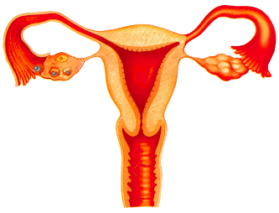
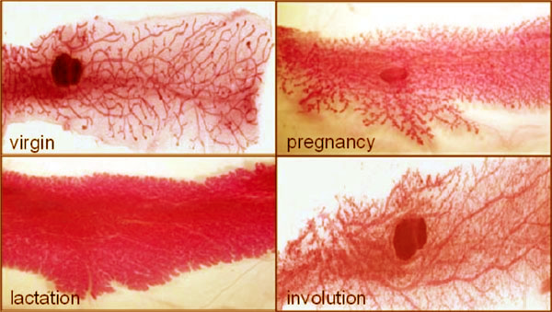


Progesterone : Essential for Pregnancy Maintenance
(Hence- PRO-GESTATION)
Breast
Breast epithelium
Proliferation, lobular alveolar development
Ovary
Uterus
Ovulation
Luteinization
Endometrium
Proliferation
Differentiation
Implantation
Myometrium quiescence
virgin
pregnancy
lactation
involution
Mouse mammary gland
Brain
Bone
Prevention of bone loss
Sexual behaviour
Notes:
Progesterone also known as P4 (pregn-4-ene-3,20-dione) is a C-21 steroid hormone. Progesterone is secreted by the ovary in the second two weeks of the menstrual cycle. About 20-25 mg of progesterone are produced per day during a woman's monthly cycle and up to 300-400 mg are produced daily during pregnancy.

Slide 3

PR-A* PR-A*AM
Genomic & non-genomic progesterone signalling
Classic (nuclear)
progesterone receptor
mPR
P4
c-Src
cAMP ↓
MAPK
Cascade
PKA
PR
CREB
AP-1
Basal Transcription-
Machinery
Coactivator
PRE

Slide 4
Progesterone receptor-
a ligand-activated transcription factor
Both Isoforms (PR-A, PR-B) are involved in reproductive functions
AF-3
AF-1
AF-2
knock-out:
Reduced mammary
ductal morphogenesis
DBD
LBD
PR-B
1
933
DNA-Binding
domain
Ligand Binding
domain
knock-out:
Severely impaired ovulation
Impared implantation
and decidualization
Infertility
165
933
DBD
LBD
PR-A
ID

Slide 5
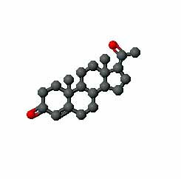
Cell-specific responses to progesterone
Relative expression of PR-A and PR-B
Relative expression of putative membrane receptors
Integration of genomic and non-genomic pathways
Convergence between progesterone and
other signalling pathways
Relative expression of co-activators & repressors
Interaction of PR with other transcription factors
Post-translational modification of the receptor

Slide 6
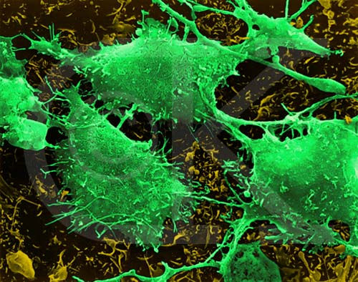
Progesterone
In the breast and breast cancer

Slide 7
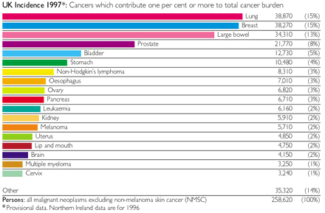
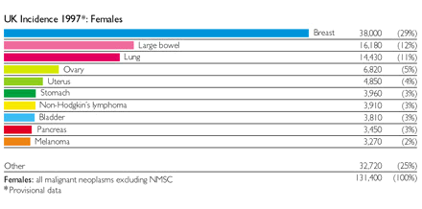
Breast Cancer - the Statistics
1997
38,270 (15%)
Breast cancer is the leading female cancer, accounting for almost 1 in 5 cancer deaths among women.
1 in 9 women in the UK and the USA develop the disease in their lifetime.
38,000 (29%)
Notes:
1.5 million women in the United States will be newly diagnosed with invasive cancer and that about 30% of them will ultimately die of the disease

Slide 8
Breast Cancer - the Statistics
48, 034
1997
38,270 (15%)
Breast cancer is the leading female cancer, accounting for almost 1 in 5 cancer deaths among women.
1 in 8 women in the UK and the USA will develop the disease in their lifetime.
Currently, 48,000 women develop breast cancer every year in the UK.
47, 693 (31%)
38,000 (29%)
Breast cancer incidence is rising.
  1979: 75 cases per 100, 000
  2000: 114 cases per 100, 000
  2008: 127 cases per 100, 000
Notes:
1.5 million women in the United States will be newly diagnosed with invasive cancer and that about 30% of them will ultimately die of the disease

Slide 9
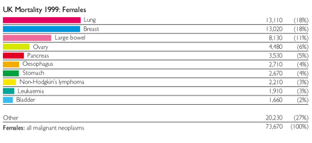
Breast Cancer - the Statistics
48, 034
Breast cancer mortality is falling.
  1989: 42 women per 100, 000 died
  2002: 30 women per 100, 000 died
  2008: 26 women per 100, 000 died
  A 38% fall in deaths (1989-2008).
1997
38,270 (15%)
47, 693 (31%)
38,000 (29%)
12, 047
1999
13,020 (18%)
Reason: Early Diagnosis, Chemo/Radiotherapies
Hormonal Therapies.
©Cancer Research UK
Notes:
1.5 million women in the United States will be newly diagnosed with invasive cancer and that about 30% of them will ultimately die of the disease

Slide 10
Breast Cancer Growth is Estrogen-Regulated
1889: Albert Schinzinger noted that atrophy of the breast follows cessation of ovarian function and proposed ovariectomy as a treatment for breast cancer
1896: George Beatson demonstrated that ovariectomy in pre-menopausal women resulted in disease regression and improved prognosis.
In 1923 Allen and Doisy identified the ovarian hormone “estrogen”. This was subsequently shown to stimulate breast cancer development and growth.
Important risk factors include lifetime of exposure to estrogens:
age of onset of menarche,
age to first full-term pregnancy,
some contraceptive pills,
some hormone-replacement therapies
Further studies have elucidated the mechanisms by which estrogen action is mediated

Slide 11
Estrogen Receptor
The estrogen Receptor is Activated upon binding estrogen,
Gene Expression is Induced by Binding to Specific DNA Sequences called estrogen Response Elements,
The estrogen-Induced Gene Products Increase Cell Proliferation, Resulting in Breast Cancer.
Some Important estrogen Regulated Genes;
Progesterone Receptor (PR)
Cyclin D1
c-myc
TGF-α
Notes:
Although estrogen was identified in the 1920s, estrogen receptors were not identified until the 1960s, with the demonstration that subcutaneous administration of radiolabelled estrogen in rats resulted in label retention in known estrogen target tissues (vagina, uterus), but absence from tissues not associated with estrogen action (e.g. muscle, kidney), and the subsequent purification of an estrogen binding protein from the rat uterus.

Slide 12
Breast Cancer: Targetting Oestrogen Signalling
Aromatase inhibitors
Gonadotrophins
(FSH + LH)
X
Oestrogens
Progesterone
Premenopausal
GNRH agonists
Ovary
Antiestrogens
X
LHRH
X
Prolactin
Growth hormone
hypothalamus
Pituitary gland
Corticosteroids
Progesterone
Pre/post-
menopausal
Adrenocorticotrophic
hormone
(ACTH)
Adrenal
glands
Androgens
X
Oestrogens
Peripheral conversion
Aromatase
inhibitors

Slide 13
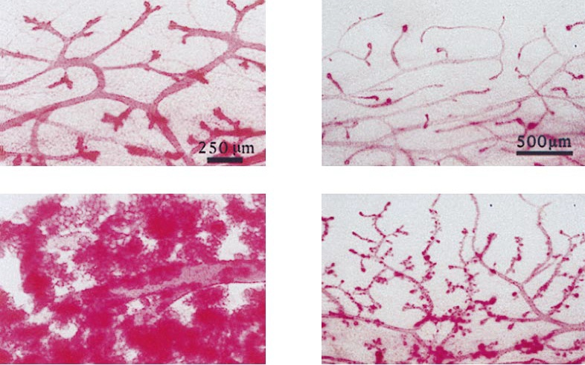
PR is required for side branching in Puberty and Alveologenesis in Pregnancy
Mammary epithelial cell transplants into the cleared mammary fat pad
Pregnant
Virgin
PR KO
WT
(Brisken et al,1998)

Slide 14
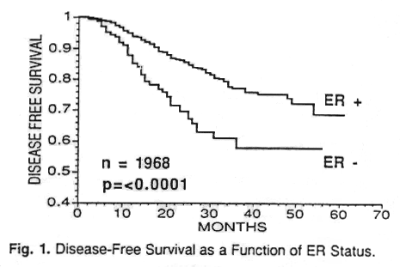
Estrogen Receptor in Breast Cancer
Table 2. ER and Endocrine Therapy in Advanced
Breast Cancer
Response Rate
(%)
ER+ PR+ 77
ER+ PR- 27
ER- PR+ 46
ER- PR- 11
ER +
ER -

Slide 15
Breast Cancer Classification and Therapies
Breast Cancer
70%
ERα-
ERα+
Basal-like
“Normal” like
HER2
Luminal B/C
Luminal A
Triple-negative BC
ER-/PR-/HER2-
Herceptin
Lapatinib
Hormone Therapy
Resistance
De novo Resistance
Acquired Resistance
Prof Simak Ali

Slide 16
Progestins in Breast Cancer
Progesterone is the dominant naturally occurring progestin
The poor absorption of progesterone has been overcome with some of the synthetic derivative progestins
Progestin response in the human breast is complex and influences both proliferation and differentiated function.
Progestins are used in the endocrine treatment of uterine and breast cancer with clinically proven antineoplastic properties.
Progestin therapy for metastatic breast cancer has been used principally as a second- or third-line therapy following selective estrogen receptor modulators and aromatase inhbitors
. The principal progestin used for metastatic breast cancer has been megestrol acetate

Slide 17
Progesterone
in endometrial cancer

Slide 18
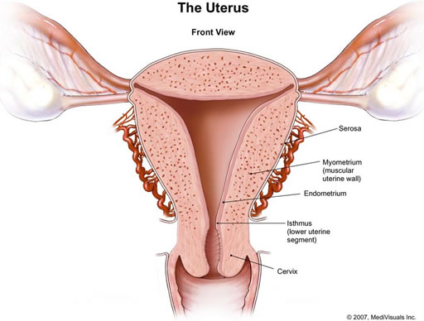
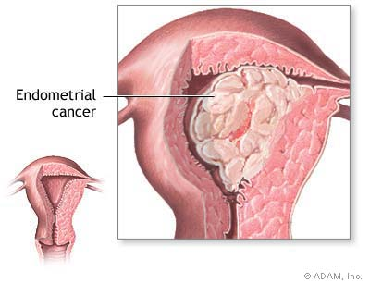
The Endometrium
The endometrium is the tissue that lines the uterine cavity and consists of a layer of columnar luminal epithelium supported by cellular stroma with tubular glands.
Endometrial cancer is a carcinoma arising from the columnar luminal epithelium.
Notes:
The luminal and glandular cells of the endometrium originate from the paramesonephric duct epithelium during development; the stroma originates from the mesenchyme surrounding the urogenital ridge. From the onset of puberty to menopause, the endometrium undergoes extensive remodeling in response to the ovarian steroid hormones estrogen and progesterone during each menstrual cycle in preparation for implanting an embryo. Estrogen promotes proliferation and growth of the endometrial lining while progesterone antagonizes estrogen-driven growth and promotes differentiation. Specifically, when progesterone levels are high during the luteal phase of the menstrual cycle, the glandular epithelium transforms from relatively inactive cells full of free ribosomes to very active polarized cells, containing giant mitochondrial profiles, intracellular deposits of glycogen/glycoprotein-rich material, and a complex intranuclear channel system. Morphologically, the glands become tortuous and have large lumens due to increased secretory activity. In parallel, the underlying stroma becomes very edematous as a result of increased capillary permeability, and the cells begin to appear large and polyhedral.

Slide 19
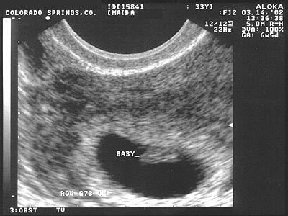

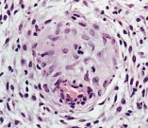

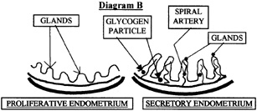
CYCLIC ENDOMETRIAL REMODELLING
‘Tipping point’
Ovulation
Phase:
menstrual
Proliferative
Secretory
+P4
Cycle day:
1
3
5
7
9
11
13
15
17
19
21
23
25
27
1
blastocyst
-P4
Implantation
window
Decidualization
Notes:
Estrogen promotes proliferation and growth of the endometrial lining while progesterone antagonizes estrogen-driven growth and promotes differentiation. Specifically, when progesterone levels are high during the luteal phase of the menstrual cycle, the glandular epithelium transforms from relatively inactive cells full of free ribosomes to very active polarized cells, containing giant mitochondrial profiles, intracellular deposits of glycogen/glycoprotein-rich material, and a complex intranuclear channel system. Morphologically, the glands become tortuous and have large lumens due to increased secretory activity. In parallel, the underlying stroma becomes very edematous as a result of increased capillary permeability, and the cells begin to appear large and polyhedral. This transformation process, termeddecidualization, begins in the stroma around the spiral arteries when progesterone levels are high during the midluteal phase and spreads to the upper two thirds of the endometrium. If embryo implantation occurs, the reaction is intensified and becomes the decidua of pregnancy. The decidualized Progesterone is central in the remodeling that occurs in the endometrium and acts on both the epithelial and stromal compartments.

Slide 20
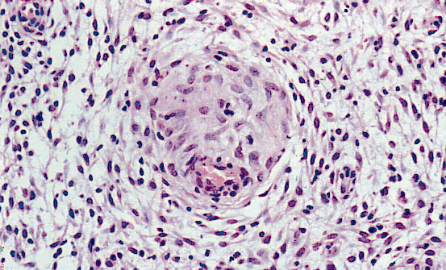
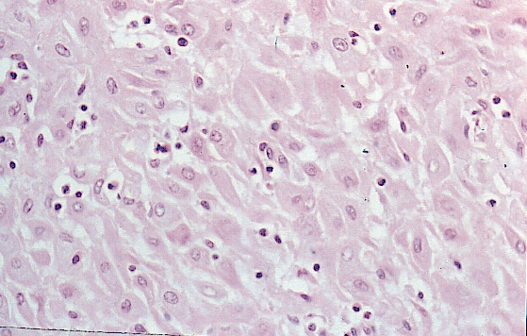
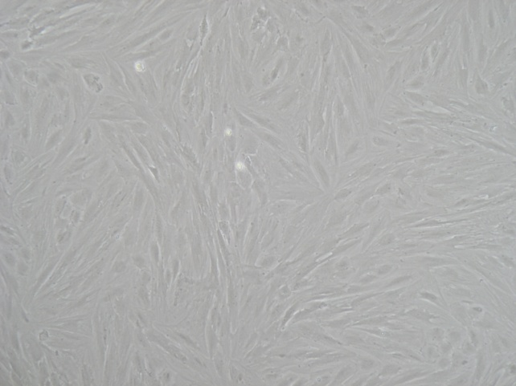
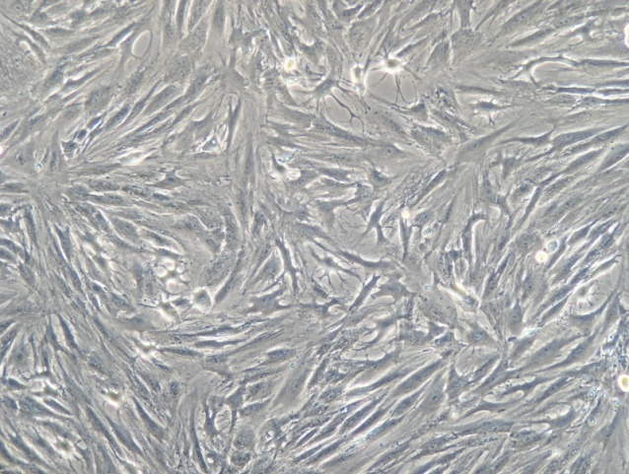
DECIDUALIZATION IN VIVO AND IN VITRO
P4
Immune modulation
Angiogenesis
Controlled invasion
Resistance to stress
haemostasis
Immune modulation
Angiogenesis
Controlled invasion
Resistance to stress
haemostasis
cAMP/P4

Slide 21
Endometrial Cancer
Most common gynecologic cancer
4th most common in women (US)
2nd most common in women (UK)
5th most common in women (worldwide)
Western developed > Southeast asia
35,000 new cases annually
5,000 death annually
Increased incidence seen from the 1970’s
  Increased use of menopausal estrogen therapy
Notes:
Endometrial Cancer
Strong evidence indicates that in the cycling endometrium, progesterone negatively regulates estrogen-driven growth. However, when there is either insufficient progesterone action or an excess in estrogen, this can result in endometrial pathologies such as endometrial hyperplasia or endometrial adenocarcinoma. Endometrial cancer is the most common gynecologic malignancy diagnosed in the United States. The American Cancer Society estimated 40,100 new cases of endometrial cancer to be diagnosed with ~7470 deaths in 2008. Approximately 80% of all endometrial carcinomas are the endometrioid type, which arise from endometrial glands. These tumors, also known as type 1 endometrial carcinomas, are associated with chronic exposure to estrogen and insufficient opposing progesterone. The reasons for this chronic unopposed estrogen exposure are multifactorial because high levels of estradiol and insufficient progesterone could arise from various conditions such as anovulation, polycystic ovarian syndrome, obesity, estrogen-only hormone replacement therapy, and prolonged tamoxifen use.^{[23-25]} Although more than half of these cancers are diagnosed in postmenopausal women from the ages of 55 to 74 uears, ~5% of women with this disease are diagnosed < 40 years of age, and 20 to 25% are diagnosed before menopause. This paradigm shift to younger ages will continue due to an increase in risk factors such as marked obesity, diabetes mellitus, and hypertension.

Slide 22
Endometrial Cancer – Risk Factors
Obesity
  Excess weight have 2 ~ 5 x greater risk
  Fat cells (adipocytes) produce estrogen
Diabetes Mellitus and Hypertension
  DM women have 2 x greater risk
Nulliparity
  Progesterone counterbalances estrogen
  Pregnancy lowers risk

Slide 23
Endometrial Cancer - Symptoms
Postmenopausal vaginal bleeding
Abnormal uterine bleeding
  Bleeding in between periods
  Heavier / longer lasting menstrual bleeding
Abnormal vaginal discharge / Pyometra
Pelvic or back pain
Pain on urination
Pain on sexual intercourse
Blood in stool or urine

Slide 24
Endometrial Cancer - Diagnosis
Endometrial sampling
  Dilation and curettage / Endometrial aspiration
Imaging
  TVS / CT scan / MRI
  Hysteroscopy + targeted biopsy
Tumor marker
  Ca 125 / 199

Slide 25
Endometrial Cancer
Type I endometrial carcinoma: this type represents 70–80% of all
endometrial cancers. Type I tumors are endometrioid in origin,
hormone-responsive, and prognosis is generally good. Mutations in
genes encoding PTEN, PI3K, KRAS, and beta-catenin and also
microsatellite instability are common. These tumors are associated with chronic exposure to estrogen and insufficient opposing progesterone.
Type II endometrial carcinoma: type II is an aggressive nonendometrioid
cancer with papillary serous or clear-cell morphology. Tumors are not hormone-responsive, outcome is generally poor, and recurrence is frequent. Loss of p53 and chromosomal instability characterise this tumor type.
Notes:
Endometrial Cancer
Strong evidence indicates that in the cycling endometrium, progesterone negatively regulates estrogen-driven growth. However, when there is either insufficient progesterone action or an excess in estrogen, this can result in endometrial pathologies such as endometrial hyperplasia or endometrial adenocarcinoma. Endometrial cancer is the most common gynecologic malignancy diagnosed in the United States. The American Cancer Society estimated 40,100 new cases of endometrial cancer to be diagnosed with ~7470 deaths in 2008. Approximately 80% of all endometrial carcinomas are the endometrioid type, which arise from endometrial glands. These tumors, also known as type 1 endometrial carcinomas, are associated with chronic exposure to estrogen and insufficient opposing progesterone. The reasons for this chronic unopposed estrogen exposure are multifactorial because high levels of estradiol and insufficient progesterone could arise from various conditions such as anovulation, polycystic ovarian syndrome, obesity, estrogen-only hormone replacement therapy, and prolonged tamoxifen use. Although more than half of these cancers are diagnosed in postmenopausal women from the ages of 55 to 74 years, ~5% of women with this disease are diagnosed < 40 years of age, and 20 to 25% are diagnosed before menopause. This paradigm shift to younger ages will continue due to an increase in risk factors such as marked obesity, diabetes mellitus, and hypertension.

Slide 26
Endometrial Cancer
Type I endometrial carcinoma: this type represents 70–80% of all
endometrial cancers. Type I tumors are endometrioid in origin,
hormone-responsive, and prognosis is generally good. Mutations in
genes encoding PTEN, PI3K, KRAS, and beta-catenin and also
microsatellite instability are common. These tumors are associated with chronic exposure to estrogen and insufficient opposing progesterone.
Type II endometrial carcinoma: type II is an aggressive nonendometrioid
cancer with papillary serous or clear-cell morphology. Tumors are not hormone-responsive, outcome is generally poor, and recurrence is frequent. Loss of p53 and chromosomal instability characterise this tumor type.
The reasons for chronic unopposed estrogen exposure are multifactorial because high levels of estradiol and insufficient progesterone can arise from various conditions such as anovulation, polycystic ovarian syndrome, obesity, estrogen-only hormone replacement therapy, and prolonged tamoxifen use.
Notes:
Endometrial Cancer
Strong evidence indicates that in the cycling endometrium, progesterone negatively regulates estrogen-driven growth. However, when there is either insufficient progesterone action or an excess in estrogen, this can result in endometrial pathologies such as endometrial hyperplasia or endometrial adenocarcinoma. Endometrial cancer is the most common gynecologic malignancy diagnosed in the United States. The American Cancer Society estimated 40,100 new cases of endometrial cancer to be diagnosed with ~7470 deaths in 2008. Approximately 80% of all endometrial carcinomas are the endometrioid type, which arise from endometrial glands. These tumors, also known as type 1 endometrial carcinomas, are associated with chronic exposure to estrogen and insufficient opposing progesterone. The reasons for this chronic unopposed estrogen exposure are multifactorial because high levels of estradiol and insufficient progesterone could arise from various conditions such as anovulation, polycystic ovarian syndrome, obesity, estrogen-only hormone replacement therapy, and prolonged tamoxifen use. Although more than half of these cancers are diagnosed in postmenopausal women from the ages of 55 to 74 years, ~5% of women with this disease are diagnosed < 40 years of age, and 20 to 25% are diagnosed before menopause. This paradigm shift to younger ages will continue due to an increase in risk factors such as marked obesity, diabetes mellitus, and hypertension.

Slide 27
Standard Treatment of Endometrial Neoplasia
The treatment for patients diagnosed with endometrial neoplasia is surgery, including total abdominal hysterectomy and bilateral oophorectomy with further staging depending on risk factors. This is true for both endometrial adenocarinoma and atypical endometrial hyperplasia.
Hysterectomy may not be an acceptable option for young women diagnosed with complex atypical hyperplasia and/or endometrial cancer prior to completing childbearing.
This may also be true for patients with multiple comorbidities who are poor surgical candidates. In this subset of patients with either complex atypical hyperplasia of the endometrium or clinical stage 1A low-grade uterine tumours, progesterone therapy may be an acceptable alternative for primary management.
The main purpose for treating simple or complex endometrial hyperplasia without atypia is for symptom control, with only a 1 to 3% risk of progression to actual cancer.
This is not the case with atypical endometrial hyperplasia, which if left untreated, will progress to carcinoma in ~30% of cases.
Notes:
Standard Treatment of Endometrial Neoplasia
The treatment for patients diagnosed with endometrial neoplasia is surgery, including total abdominal hysterectomy and bilateral oophorectomy with further staging depending on risk factors. This is true for both endometrial adenocarinoma and atypical endometrial hyperplasia. The main purpose for treating simple or complex endometrial hyperplasia without atypia is for symptom control, with only a 1 to 3% risk of progression to actual cancer. This is not the case with atypical endometrial hyperplasia, which if left untreated, will progress to carcinoma in ~30% of cases. Furthermore lies the possibility of missing underlying concurrent carcinoma, which is documented to be as high as 42% within uterine specimens.^{[26,27]}Hysterectomy may not be an acceptable option for young women diagnosed with complex atypical hyperplasia and/or endometrial cancer prior to completing childbearing. This may also be true for patients with multiple comorbidities who are poor surgical candidates. In this subset of patients with either complex atypical hyperplasia of endometrium or clinical stage 1A low-grade uterine tumors, progesterone therapy may be an acceptable alternative for primary management.

Slide 28
Progestin Therapy in Endometrial Hyperplasia
Consistently, studies have shown that progestins are effective for the treatment of endometrial hyperplasia.
Progestin therapy has an impact on endometrial cells as early as 10 weeks after initiation of treatment, but most recognize the need for a minimum of 3 months of progestin therapy before assessing for a response.
Reversal of endometrial hyperplasia by progestins is thought to occur through activation of PRs, resulting in stromal decidualization and subsequent thinning of the endometrial lining.
The doses and types of progestins for treating endometrial hyperplasia vary depending on presence of absence of atypia.
- Regression of hyperplasia without atypia to normal endometrium in 80 to 90% of patients when treated with either medroxyprogesterone acetate (MPA), 10 mg daily for 12 to 14 days each month, or micronized progesterone in vaginal cream, when treated for 3 to 6 months.
- Successful treatments for atypical hyperplasia include use of continuous oral megestrol acetate( 80 mg daily up to 160 mg per day), and oral MPA (600 mg daily).
Notes:
Progestin Therapy in Endometrial Hyperplasia
Consistently, studies have shown that progestins are effective for treatment of endometrial hyperplasia. Progestin therapy has an impact on the endometrial cells as early as 10 weeks after initiation of treatment, but most recognize the need for a minimum of 3 months of progestin therapy before assessing for a response. Reversal of endometrial hyperplasia by progestins is thought to occur through activation of PRs, resulting in stromal decidualization and subsequent thinning of the endometrial lining. The doses and types of progestins for treating endometrial hyperplasia vary depending on presence of absence of atypia. Studies have shown regression of hyperplasia without atypia to normal endometrium in 80 to 90% of patients when treated with either medroxyprogesterone acetate (MPA), 10 mg daily for 12 to 14 days each month, or micronized progesterone in vaginal cream, when treated for 3 to 6 months. In a larger prospective study from the United Kingdom (n = 105), patients with endometrial hyperplasia were treated with a levonorgestrel intrauterine device (LNG-IUD). A reported 90% (94 of 105) of patients had histologic regression after 2 years. Out of this group, only 67% (6 of 9) of patients had "atypical" endometrial hyperplasia with most (88 of 96) having hyperplasia without atypia. Other successful treatments demonstrated for atypical hyperplasia include use of continuous oral megestrol acetate, starting 80 mg daily up to 160 mg per day, and oral MPA, 600 mg daily. A reported 82% complete (14 of 17) and 18% partial response rate was found using the MPA regimen in a multicenter trial with only six recurrences found within 25- to 73-month follow-up. These studies demonstrate the relative efficacy of progestin therapy in endometrial hyperplasia with a significant number of cases resulting in complete response. As a precaution, follow-up biopsies are usually recommended.

Slide 29
Progestin Therapy in Endometrial Hyperplasia
In vitro studies using endometrial cancer cell lines have provided insight into the effect of progesterone directly on cancer cell behavior and the genes that are regulated.
In cell lines expressing PR, progesterone treatment:
can inhibit cell growth, invasion, and expression of cellular adhesion molecules
promote differentiation to a secretory phenotype and induce replicative senescence
Numerous genes have been implicated in the progestin-mediated responses observed in endometrial cancer cells. Regulation of genes such as cyclin D1, MMP-1, -2, -7 and -9, and Ets-1 in response to progestins have been found to mediate the inhibition of cell growth and invasiveness.
Progestins can increase FOXO1 protein levels in Ishikawa cells, specifically through PR-Band promote cell cycle arrest and apoptosis in these cells. Levels of FOXO1 protein are lower in a very high percentage of endometrial tumor tissues studied compared with normal tissues from cycling endometrium.
Notes:
In vitro studies using endometrial cancer cell lines have provided insight into the effect of progesterone directly on cancer cell behavior and the genes that are regulated. In cell lines expressing either endogenous or recombinant PR, progesterone treatment can inhibit cell growth, invasion, and expression of cellular adhesion molecules, as well as promote differentiation to a secretory phenotype and induce replicative senescence.^{[60-62]} Smid-Koopman et al demonstrated that in the presence of progesterone, PR-B expressing Ishikawa cells displayed almost complete inhibition of cell growth, and PR-A expressing Ishikawa cells only displayed 50% inhibition of cell growth. In an additional study by Hanekamp et al, it was demonstrated that PR-B expressing Ishikawa cells caused more tumor growth in mice than PR-A expressing Ishikawa cells and that tumor growth was inhibited after administration of MPA only in cells expressing PR-B.
Numerous genes have been implicated in the progestin-mediated responses observed in endometrial cancer cells. Regulation of genes such as cyclin D1, MMP-1, -2, -7 and -9, and Ets-1 in response to progestins have been implicated to mediate the inhibition of cell growth and invasiveness. Primary cells from endometrial tumors also respond to progestins by significantly reducing pro-MMP-9, pro-MMP-2, and MMP-2 release. Progestins have been shown to induce glycodelin expression in Ishikawa cells, which causes inhibition of G1/S progression and upregulation of CDKIs, thereby reducing cell proliferation. Overexpression of PR-A and PR-B in endometrial cancer cells resulted in a significant progesterone-dependent inhibition of expression of a cadre of cellular adhesion molecules, including fibronectin, integrin α3, integrin β1, integrin β3, and cadherin 6. ]Progestins can increase FOXO1 protein levels in Ishikawa cells, specifically through PR-B and promote cell cycle arrest and apoptosis in these cells. Interestingly, levels of FOXO1 protein are dramatically lower in 77% or 95.9% of endometrial tumor tissues studied compared with normal tissues from cycling endometrium. Shiozawa et al reported that p27 expression in hyperplastic epithelia was negligible before MPA treatment, whereas it was greatly increased after treatment. Watanabe et al demonstrated that it is through PR-B that p21 and p27 expression increases.[ Women with hyperplasia treated with either system MPA or a LNG-IUD exhibited increased apoptosis in the glandular cells with decreased expression of the antiapoptotic genes Bcl-2 and BAX.

Slide 30
Chemotherapy in Endometrial Hyperplasia
Chemotherapy
  No clear results on effectiveness
  Potentially most useful in metastatic cancer
  Not as important as surgery and radiation
  Only used in advanced or recurrent tumor after definitive treatment with surgery and radiation
Notes:
In vitro studies using endometrial cancer cell lines have provided insight into the effect of progesterone directly on cancer cell behavior and the genes that are regulated. In cell lines expressing either endogenous or recombinant PR, progesterone treatment can inhibit cell growth, invasion, and expression of cellular adhesion molecules, as well as promote differentiation to a secretory phenotype and induce replicative senescence.^{[60-62]} Smid-Koopman et al demonstrated that in the presence of progesterone, PR-B expressing Ishikawa cells displayed almost complete inhibition of cell growth, and PR-A expressing Ishikawa cells only displayed 50% inhibition of cell growth. In an additional study by Hanekamp et al, it was demonstrated that PR-B expressing Ishikawa cells caused more tumor growth in mice than PR-A expressing Ishikawa cells and that tumor growth was inhibited after administration of MPA only in cells expressing PR-B.
Numerous genes have been implicated in the progestin-mediated responses observed in endometrial cancer cells. Regulation of genes such as cyclin D1, MMP-1, -2, -7 and -9, and Ets-1 in response to progestins have been implicated to mediate the inhibition of cell growth and invasiveness. Primary cells from endometrial tumors also respond to progestins by significantly reducing pro-MMP-9, pro-MMP-2, and MMP-2 release. Progestins have been shown to induce glycodelin expression in Ishikawa cells, which causes inhibition of G1/S progression and upregulation of CDKIs, thereby reducing cell proliferation. Overexpression of PR-A and PR-B in endometrial cancer cells resulted in a significant progesterone-dependent inhibition of expression of a cadre of cellular adhesion molecules, including fibronectin, integrin α3, integrin β1, integrin β3, and cadherin 6. ]Progestins can increase FOXO1 protein levels in Ishikawa cells, specifically through PR-B and promote cell cycle arrest and apoptosis in these cells. Interestingly, levels of FOXO1 protein are dramatically lower in 77% or 95.9% of endometrial tumor tissues studied compared with normal tissues from cycling endometrium. Shiozawa et al reported that p27 expression in hyperplastic epithelia was negligible before MPA treatment, whereas it was greatly increased after treatment. Watanabe et al demonstrated that it is through PR-B that p21 and p27 expression increases.[ Women with hyperplasia treated with either system MPA or a LNG-IUD exhibited increased apoptosis in the glandular cells with decreased expression of the antiapoptotic genes Bcl-2 and BAX.

Slide 31
Disease Recurrence
Likely in women with advanced disease
Within 3 years of original diagnosis
Hormone therapy can be considered
Use of chemotherapy is being evaluated
External beam pelvic radiation or brachytherapy
Notes:
In vitro studies using endometrial cancer cell lines have provided insight into the effect of progesterone directly on cancer cell behavior and the genes that are regulated. In cell lines expressing either endogenous or recombinant PR, progesterone treatment can inhibit cell growth, invasion, and expression of cellular adhesion molecules, as well as promote differentiation to a secretory phenotype and induce replicative senescence.^{[60-62]} Smid-Koopman et al demonstrated that in the presence of progesterone, PR-B expressing Ishikawa cells displayed almost complete inhibition of cell growth, and PR-A expressing Ishikawa cells only displayed 50% inhibition of cell growth. In an additional study by Hanekamp et al, it was demonstrated that PR-B expressing Ishikawa cells caused more tumor growth in mice than PR-A expressing Ishikawa cells and that tumor growth was inhibited after administration of MPA only in cells expressing PR-B.
Numerous genes have been implicated in the progestin-mediated responses observed in endometrial cancer cells. Regulation of genes such as cyclin D1, MMP-1, -2, -7 and -9, and Ets-1 in response to progestins have been implicated to mediate the inhibition of cell growth and invasiveness. Primary cells from endometrial tumors also respond to progestins by significantly reducing pro-MMP-9, pro-MMP-2, and MMP-2 release. Progestins have been shown to induce glycodelin expression in Ishikawa cells, which causes inhibition of G1/S progression and upregulation of CDKIs, thereby reducing cell proliferation. Overexpression of PR-A and PR-B in endometrial cancer cells resulted in a significant progesterone-dependent inhibition of expression of a cadre of cellular adhesion molecules, including fibronectin, integrin α3, integrin β1, integrin β3, and cadherin 6. ]Progestins can increase FOXO1 protein levels in Ishikawa cells, specifically through PR-B and promote cell cycle arrest and apoptosis in these cells. Interestingly, levels of FOXO1 protein are dramatically lower in 77% or 95.9% of endometrial tumor tissues studied compared with normal tissues from cycling endometrium. Shiozawa et al reported that p27 expression in hyperplastic epithelia was negligible before MPA treatment, whereas it was greatly increased after treatment. Watanabe et al demonstrated that it is through PR-B that p21 and p27 expression increases.[ Women with hyperplasia treated with either system MPA or a LNG-IUD exhibited increased apoptosis in the glandular cells with decreased expression of the antiapoptotic genes Bcl-2 and BAX.

Slide 32
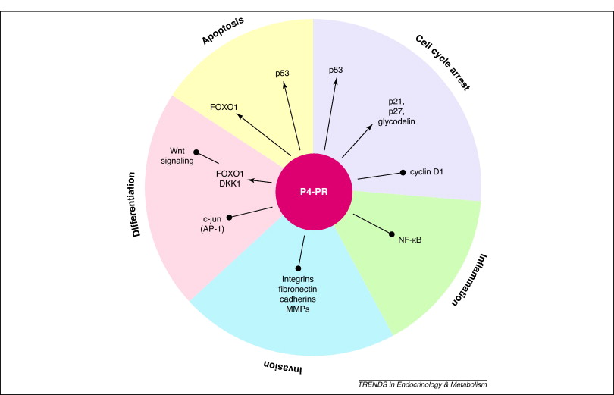
Progesterone web of influence. Through genomic and non-genomic regulation, progesterone acts as a tumor suppressor to promote () apoptosis, differentiation, and cell cycle arrest, and to inhibit () inflammation and invasion.

Slide 33
LEARNING OBJECTIVES
To understand the mechanisms that underpin the cell-responses to progesterone signalling in the mammary gland and endometrium
To understand how the progesterone receptor is a target for breast cancer cells treatment
To understand how progesterone is used in the treatment of endometrial cancer
http://www.cancer.gov/cancertopics/pdq/treatment/endometrial/HealthProfessional/page1
http://info.cancerresearchuk.org/cancerstats/types/uterus/symptomsandtreatment/

Slide 34
X
=Transcriptional partners of PR
Bone fide transcription factors
Capable of physically interacting with liganded or unliganded PR
Engages in transcriptional cross-talk with PR
Expression or activation is confined to differentiating endometrium
Gene ablation results in a reproductive phenotype
X
=C/EBPβ : inflammation, differentiation, metabolism…..
X
=FOXO1 (FKHR): cell cycle regulation, apoptosis,
oxidative stress, metabolism,
glucose homeostasis….
X
=STAT5: differentiation
X
=Hoxa10, PIASy, p53……

