Slide 1
Phaeochromocytomas and tumour markers
Dr Radha Ramachandran
Specialist Registrar Chemical Pathology and Metabolic Medicine

Slide 2
Paragangliomas
Parasympathetic paragangliomas
extra adrenal paragangliomas
Sympathetic paragangliomas (chromaffin cells)
Adrenal – phaeochromocytomas
Extra adrenal – paragangliomas

Slide 3
Paraganglia
Cells derived from the neuroectoderm
Parasympathetic - non-chromaffin cells –– hormonally inactive
Sympathetic - chromaffin cells –– hormonally active

Slide 4
Parasympathetic paraganglia
Lee K Y et al. AJR 2006;187:492-504

Slide 5
Parasympathetic paraganglia

Slide 6
Sympathetic paraganglia - the adrenal gland

Slide 7
Sympathetic paraganglia - the adrenal gland

Slide 8
Extra-adrenal sympathetic paraganglia
Lee K Y et al. AJR 2006;187:492-504

Slide 9
Paragangliomas
Tumours arising from paraganglia
Paragangliomas from sympathetic paraganglia – hormonally active
Paragangliomas from parasympathetic paraganglia – not hormonally active

Slide 10
Paragangliomas
Parasympathetic paragangliomas
extra adrenal paragangliomas
Sympathetic paragangliomas (chromaffin cells)
Adrenal – phaeochromocytomas
Extra adrenal – paragangliomas

Slide 11
Pheochromocytoma/paraganglioma in hypertensives
Rare tumours – incidence – 2 to 8 per million per year
May be present in between 0.1% to 1% of patients presenting to hypertension clinic
5% of adrenal incidentalomas
Diagnosis important since potentially fatal and eminently treatable
Prognosis significantly better for localised disease

Slide 12
Sympathetic paragangliomas- clinical features
Hormonally active tumours
Secrete catecholamines
Symptoms secondary to catecholamine excess

Slide 13
Sympathetic paragangliomas- clinical features
M. Mannelli et al. / Best Practice & Research Clinical Endocrinology & Metabolism 26 (2012) 507–515

Slide 14
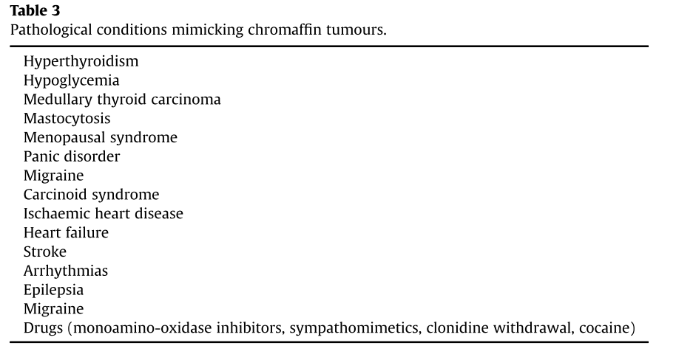
Sympathetic paragangliomas- clinical features
M. Mannelli et al. / Best Practice & Research Clinical Endocrinology & Metabolism 26 (2012) 507–515

Slide 15
Parasympathetic paragangliomas – clinical features
Hormonally inactive
Present as a mass
Compression symptoms
Incidental finding on imaging

Slide 16
Paragangliomas
Sporadic (2/3 of the tumours)
Part of an endocrine tumour syndrome – multiple endocrine neoplasia type 2
Familial – where it is inherited as the only trait

Slide 17
Diagnostic markers
Circulating
Imaging
Histological

Slide 18
Diagnostic markers – circulating
Catecholamines
Tyrosine
Only within the adrenal gland
L-dopa
PNMT
Dopamine
Nor-adrenaline
Adrenaline
COMT
3-Methoxytyramine
Nor-metanephrine
Metanephrine

Slide 19
Diagnostic markers – circulating - catecholamines
Plasma catecholamines – adrenaline, nor-adrenaline and dopamine
May be measured as plasma catecholamine levels or 24 hour urinary catecholamine levels
Release of catecholamines by tumours not constant
Other causes of sympathetic-adrenal stimulation may give false positive results
Catecholamines are unstable and therefore sample processing needs to be very rigorous

Slide 20
Diagnostic markers – circulating
Catecholamines
Tyrosine
Mainly within the adrenal gland
L-dopa
PNMT
Dopamine
Nor-adrenaline
Adrenaline
COMT
3-Methoxytyramine
Nor-metanephrine
Metanephrine

Slide 21
Diagnostic markers – circulating - metanephrines
May be measured as plasma free metanephrine levels or 24 hour urinary fractionated metanephrine levels
Release of metanephrines by tumours remains more or less constant
Since sympathetic nerves do not have COMT, levels much less likely to rise due to other causes of sympathetic-adrenal stimulation
More stable than catecholamines

Slide 22
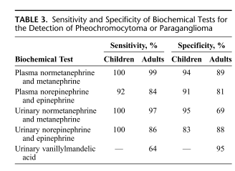
Diagnostic markers – circulating
Pancreas & Volume 39, Number 6, August 2010

Slide 23
Diagnostic markers – circulating – granular proteins
M. Mannelli et al. / Best Practice & Research Clinical Endocrinology & Metabolism 26 (2012) 507–515

Slide 24
Diagnostic markers – circulating – granular proteins

Slide 25
Diagnostic markers - Imaging
Q J Nucl Med Mol Imaging 2008 Dec;52(4):419-29

Slide 26
Diagnostic markers - Imaging
J Clin Endocrinol Metab, November 2012, 97(11)

Slide 27
Diagnostic markers - histology

Slide 28
Diagnostic markers - histology

Slide 29
Diagnostic markers - histology

Slide 30
Prognostic markers
No definite prognostic markers available that can accurately differentiate malignant from benign disease
Presence of metastasis is the only confirmatory sign of malignant disease
Circulating
Histology
Genetic

Slide 31
Prognostic markers
Histology
Genetic
Circulating

Slide 32
Prognostic markers- histology
Am J Surg Pathol, Vol. 26, No. 5, 2002

Slide 33
Prognostic markers – histology – Ki67

Slide 34
Prognostic markers - genetic
MEN
VHL
Loss of function mutations in the genes coding for succinate dehydrogenase enzyme

Slide 35
Prognostic markers - genetic
Sungwoo Lee et al CANCER CELL : AUGUST 2005 · VOL. 8

Slide 36
Prognostic markers- genetic
Succinate dehydrogenase enzyme

Slide 37
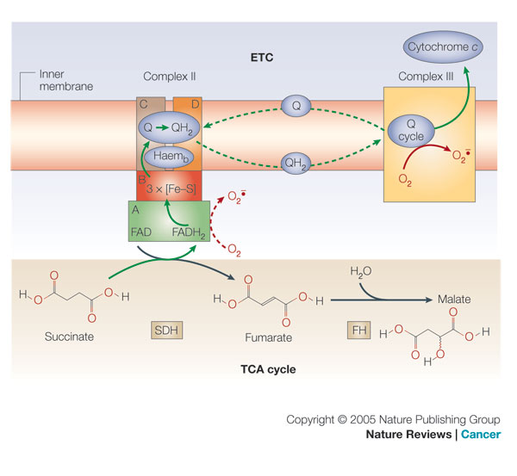
Prognostic markers - genetic

Slide 38
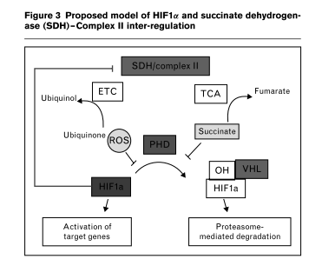
Prognostic markers - genetic
Current Opinion in Oncology 2006, 18:1–8

Slide 39
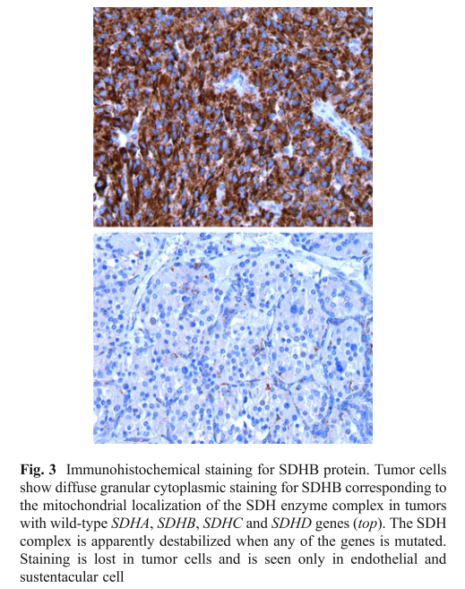
Prognostic markers - genetic
Endocr Pathol (2012) 23:4–14

Slide 40
Prognostic markers - biochemical

Slide 41
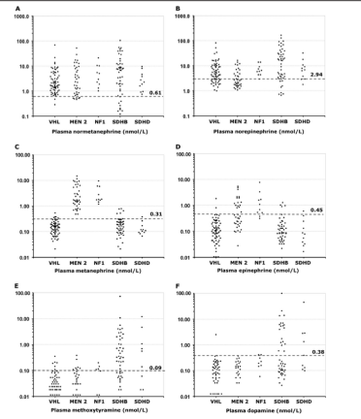
Clinical Chemistry 57:3 (2011)

Slide 42
Prognostic markers
Endocr Pathol (2012) 23:4–14

