Slide 1
Is the increased prevalence of cancer in diabetes due to the disease or the therapy?
Stephen Robinson MD FRCP
Notes:
Thanks, talk to graphs emphasize

Slide 2
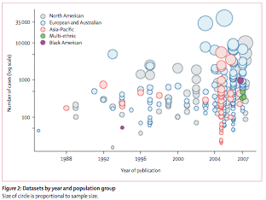
Renehan 2008 Lancet 371:569

Slide 3
The epidemiology of BMI, diabetes and cancer
BMI
Diabetes
Type of cancer

Slide 4
BMI and cancer incidence 221 datasets; 282,137 incident cause, 5kg/m² BMI
MEN
WOMEN
Oesophageal 1.52 p<0.0001
Colon 1.24 p<0.0001
Renal 1.24 p<0.0001
Endometrial 1.59 p<0.0001
Gallbladder 1.59 p<0.04
Oesophageal 1.51 p<0.0001
Stronger association in men,
Common and less common malignancies
Renehan 2008 Lancet 371:569

Slide 5
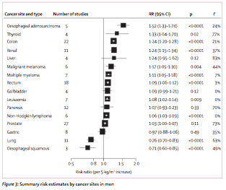
Renehan 2008 Lancet 371:569

Slide 6
Diabetes Mellitus and risk of breast cancer meta-analysis
20 studies, n=2.5million
Case (population and hospital) and cohort studies
Most T2DM
Larson 2007 IJCancer 121:856

Slide 7
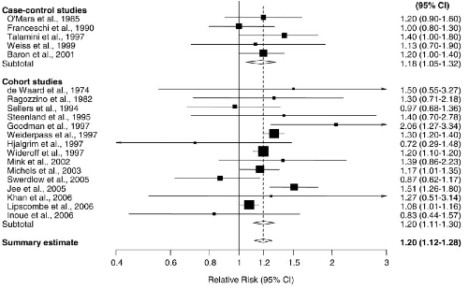
Larson 2007 IJCancer 121:856

Slide 8
Diabetes Mellitus and risk of breast cancer meta-analysis
Cancer RR 1.20 [1.12-1.28]
Breast cancer mortality v non-dm 1.24 [0.95-1.62] NS
Larson 2007 IJCancer 121:856

Slide 9
Diabetes Mellitus and risk of colorectal cancer meta-analysis
15 studies, n=2.5million
Case (population and hospital) and cohort studies
Most not clear T1 or T2DM
Larson 2005 J Natl Cancer Inst 97:1679

Slide 10
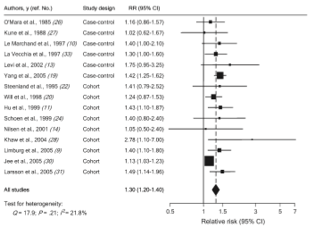
Larson 2005 J Natl Cancer Inst 97:1679

Slide 11
Diabetes Mellitus and risk of colorectal cancer meta-analysis
Cancer RR=1.30 [1.2-1.4]; P_{heterogeneity} = 0.21
No difference sex and cancer subtype
Was associated cancer mortality but P_{het}=0.04
Larson 2005 J Natl Cancer Inst 97:1679

Slide 12
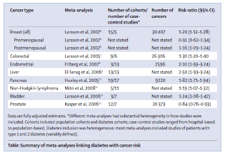
Renehan 2010 375:2201

Slide 13
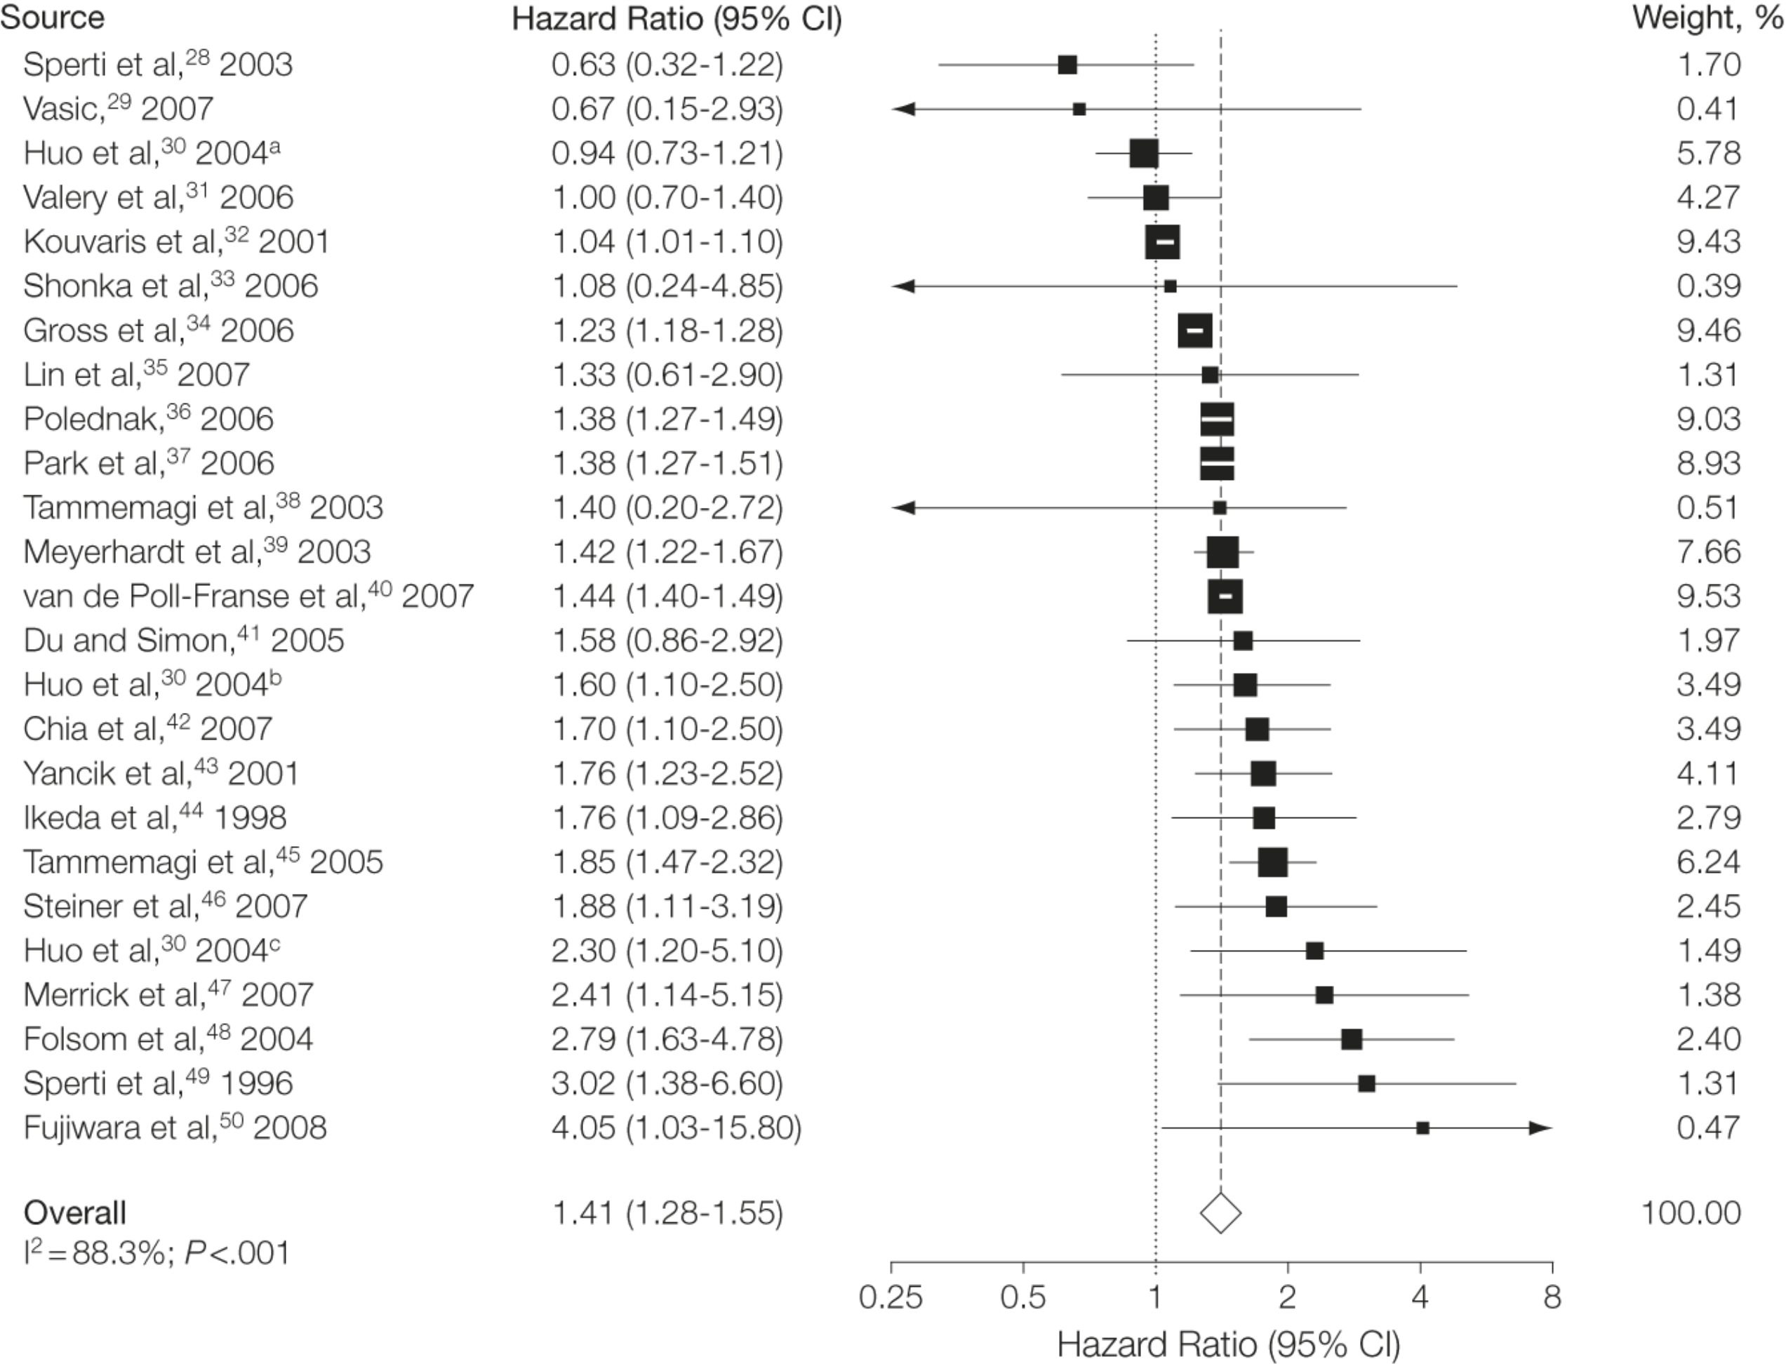
From: Long-term All-Cause Mortality in Cancer Patients With Preexisting Diabetes Mellitus;
A Systematic Review and Meta-analysis
JAMA. 2008;300(23):2754-2764. doi:10.1001/jama.2008.824
Figure Legend:
The 23 studies provided 25 estimates. Weights are from random-effects analysis. Data markers are proportional to study sample sizes. CI indicates confidence interval. ªPatients who had no resection, Childs Pugh B. ^{b}Patients who had no resection, Childs Pugh A. ^{c}Patients undergoing surgical resection.
Date of download: 5/28/2012
Copyright © 2012 American Medical Association. All rights reserved.

Slide 14
Long term mortality in cancer patients with diabetes mellitus
48 titles
Cancer mortality 1.41 [1.28-1.55]
Endometrium 1.76
Colorectum 1.32
Patients diagnosed with cancer who have pre-existing diabetes are at increased risk of all cause mortality
2008 Barone JAMA 300:2754

Slide 15
Diabetes therapy and cancer diagnosis and prognosis
Excess insulin
Glargine
Metformin

Slide 16
Risk of malignancies in patients with diabetes treated with human insulin analogues
Cohort study of malignant neoplasms and mortality
German statutory health insurance, treated human insulin, aspart, lispro or glargine
N=127,031, mean 1.63 years
Adjust age, sex, other agents
Hemkens 2009 Diabetologia

Slide 17
Risk of malignancies in patients with diabetes treated with human insulin analogues
Dose dependent increase cancer risk with glargine v human insulin; all p<0.0001
1.09 [1.00-1.19] 10 iu
1.19 [1.10-1.30] 15 iu
1.31 [1.20-1.42] 30 iu
No increase for aspart or lispro
Hemkens 2009 Diabetologia

Slide 18
Risk of malignancy prescribed insulin glargine
 | Comparator | Adjusted HR | Author
Randomised trial | Human Insulin | 0.63 (0.36-1.09) | Rosenstock | 2009
German database | Human Insulin | 0.86 (0.79-0.94) | Hemkens | 2009
UK THIN database | Human Insulin | 0.81 (0.59-1.11) | Currie | 2009
Swedish database | Other Insulin | 1.07 (0.91-1.27) | Jonasson | 2009
Swedish database | Other Insulin | 1.02 (0.77-1.36) | SDRN | 2009

Slide 19
Insulin glargine and malignancy; an unwarranted alarm
No excess risk
Reverse causality; cancer causes change to diabetes treatment
One randomised trial; n=1017, 4.2yrs,
20 glargine v 31 human insulin
Pococok Lancet 2009 374:511-3

Slide 20
Insulin glargine and malignancy; an unwarranted alarm
Hemkens found lower incidence malignancy in those treated with glargine.
Correction for dose based on weight led to claim of increased cancer risk
Allocation before start, removed if changed dose
Insulin dose calculated as mean
Pococok Lancet 2009 374:511-3

Slide 21
Insulin glargine and malignancy; an unwarranted alarm
Specific cancer need exploration
Jonasson study found breast cancer 1.99 (1.31-3.03) glargine cf other insulin not in glargine used in combination treatment
but NOT predefined tumour site
Pococok Lancet 2009 374:511-3

Slide 22
Basal insulin and outcomes in dysglycaemia
12,537 age 63.5, IFG, IGT, T2DM, 6.2yr
CV outcomes and cancer
Any cancer 1.00 (0.88-1.13) p=0.97
Death from cancer 0.94 (0.77-1.15) p=0.52
Glargine has neutral effect on cancer
ORIGIN 2012 NEJM June11

Slide 23
New users of metformin are at low risk of incidental cancer
Record linkage databases Tayside
4085 users and comparators
7.3% metformin, 11.6% controls
OR 0.46 [0.40-0.53]
Corrected 0.63 [0.53-0.75]
Libby DC 2009 32;1620

Slide 24
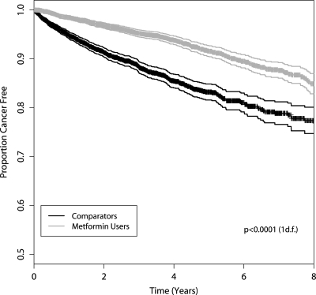
Libby DC 2009 32;1620

Slide 25
Metformin and pathologic complete responses to neoadjuvant chemotherapy in diabetic patients with breast cancer
68 DM metformin; 87 DM; 2,374 non-DM
Pathologic complete response
Jiralespong 2009 JClinOnc 27:3297

Slide 26
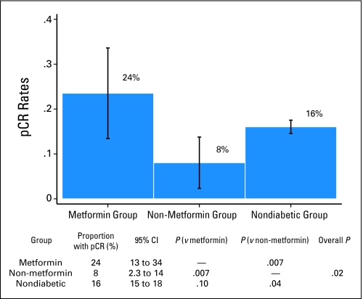
Jiralespong 2009 JClinOnc 27:3297

Slide 27
The influence of glucose lowering therapies on cancer risk T2DM
Retrospective cohort study, t2DM>40
62,809 GP practices
Colorectal, pancreatic cancer
Currie 2009 Diabetologia

Slide 28
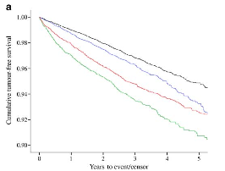
The influence of glucose lowering
therapies on cancer risk T2DM
Metformin
Metformin/Sulphonylurea
Insulin
Sulphonylurea
Currie 2009 Diabetologia

Slide 29
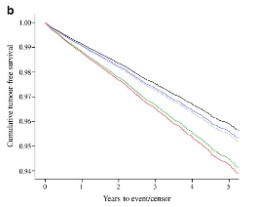
The influence of glucose lowering
therapies on cancer risk T2DM
Adjusted for age, smoking, prior cancer
Metformin
Metformin/Sulphonylurea
None
Sulphonylurea
Insulin
Currie 2009 Diabetologia

Slide 30
The influence of glucose lowering therapies on cancer risk T2DM
Metformin lowest risk 1.00
Met + Sulph 1.08
Sulph 1.36
Insulin 1.42
Metformin added to insulin cf no metformin 0.54
Currie 2009 Diabetologia

Slide 31
Glucose lowering agents and cancer mortality rates in T2DM
Canada, n=10,309, 5.4 years
4% died of cancer
Metformin 0,80 [0.65-0.98] cf Sulph
Insulin 2.22 [0.99-5.00] <3 insulin dispens/yr
Insulin 6.40 [4.69-8.73] >12/yr
Bowker 2010 Diabetologia

Slide 32
Metformin and cancer occurrence in insulin treated T2DM
112 cases v 370 controls
Adjust co-morbidity and total insulin dose
Metformin 0.46 [0.25-0.85] p<0.014
Sulph 0.75 [0.39-1.45] p<0.4
Monami 2011 Diabetes Care 34:129

Slide 33
Lower risk of cancer in patients on metformin
Netherlands 2.5million patients
v sulphonylurea prescriptions
0.90 [0.88-0.91]
Ruiter DC 2012 35:119

Slide 34
The putative mechanisms of the association of diabetes and cancer
Hyperinsulinaemia
Insulin resistance
IGF-1 receptor
Insulin receptor type

Slide 35
Hyperinsulinaemia
How can excess insulin cause effect in one pathway if there is insulin resistance
The different post receptor pathways the metabolic and the mitogenic

Slide 36
Compensatory Hyperinsulinaemia
Insulin
Insulin receptor
Shc
IRS
Grb2
Insulin Resistance
Sos
ras
PI3K-Akt pathway
MAPK pathway
Metabolic actions
Growth, proliferation
In vitro studies: mitogen, anti-apoptosis
Notes:
Insulin stimulates cell-cycle progression

Slide 37
IR-A and IR-B
IR-A Increased expression in cancer cells
Belfiore 2009 ER 30:586

Slide 38
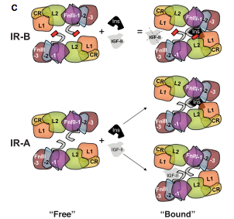
Belfiore 2009 ER 30:586

Slide 39
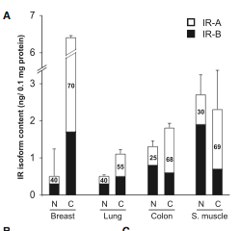
Frasca 1999 MCB 19:3278

Slide 40
In Vitro metabolic and mitogenic signaling of insulin glargine and its metabolites
Glargine binding to insulin IR isoforms A and B similar
Increased affinity IGF1 receptor
Sommerfeld 2010PLoS One 4:5(3):e9540

Slide 41
The future
Johnson 2012 Diabetologia 55:1607
Renehan 2012 Diabetologia 55:1619

Slide 42
Insulin resistance and hyperinsulinaemia main hypothesis but temporal relationship needs investigation
IR present for diabetes>obese
In those developing malignancy IR-A receptor may be associated with more rapid progression in IR states and/or therapeutic agents

Slide 43
Modifiable risk factors cluster in low socioeconomic class. Important to account for smoking, obesity poor diet physical inactivity.
Prospective/randomised therapy difficult

Slide 44
Potential mechanisms precede onset and diagnosis of T2DM. Several time scales need investigation; age, DM duration, obesity and therapies.
Temporal relationships difficult to investigate prior to DM diagnosis

Slide 45
DM/Cancer relationship varies for cancer sites Do some cancers, pancreas liver, induce onset of diabetes
Metabolic tissue cancers have particular relationship

Slide 46
Glucose lowering therapy and cancer
Indirect effects through glucose or insulin
Direct effects on cellular growth
Confounding by indication
Total and cumulative therapy
Lagged exposure

Slide 47
Breast and cervical cancer screening lower in diabetic population, colorectal inconsistent
More cancers diagnosed as individuals addressed health
Cancer screening in diabetes

Slide 48
Breast cancer more advanced in diabetes at diagnosis
Reason unknown

Slide 49
Clinicians modify anti-cancer therapies in patients with diabetes Increase in treatment related adverse effects Increased short term mortality especially surgery
Cancer mortality affected by diabetes

Slide 50
Conclusions diabetes and cancer
Diabetes and obesity associated cancer diagnosis and mortality
Glargine association now seems less likely
Metformin associated improved outcome in diabetes
Mechanisms may relate to insulin resistance and increased mitogenic effect of insulin

