Slide 1
The TSH receptor as a paradigm for G-protein coupled receptors in endocrinology
“7TM-Receptors”
Duncan Bassett
Molecular Endocrinology Group, Imperial College London

Slide 2



Studies of G-protein-coupled receptors

Slide 3
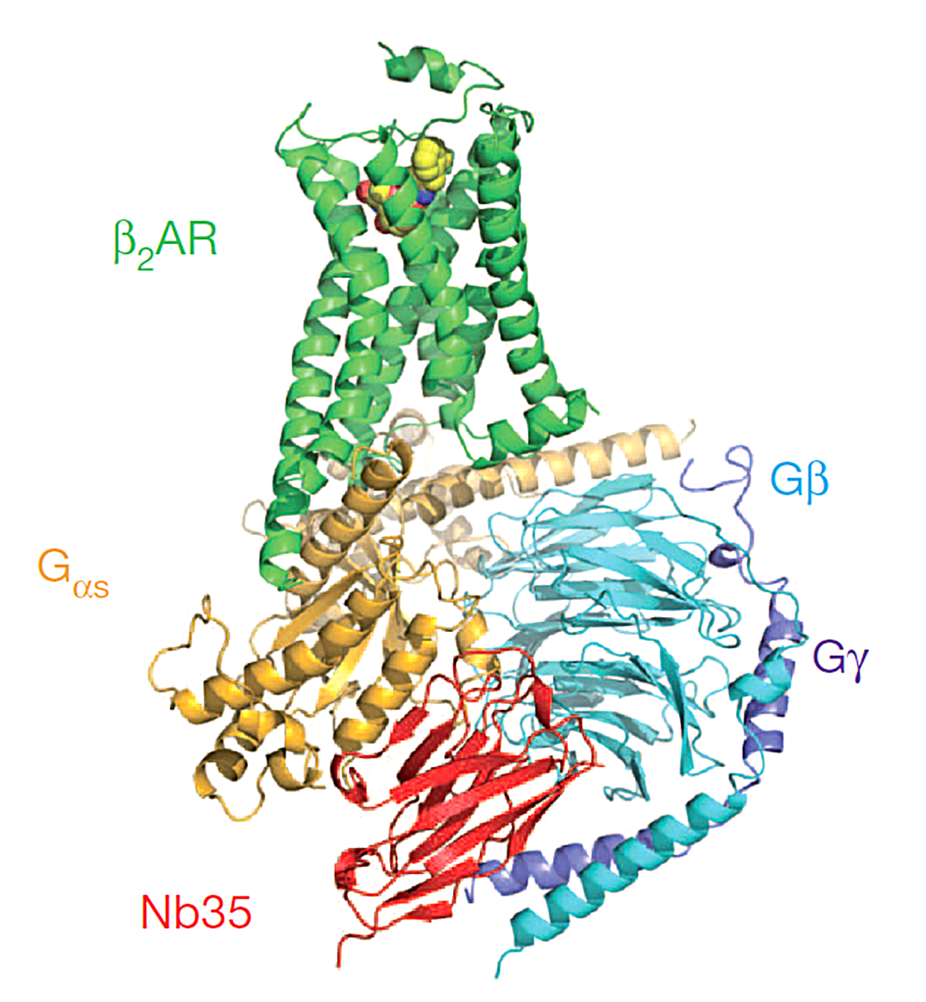
The Active Ternary Complex
“Bunch of roses” model
(Rasmussen SGF et al. 2011 Nature 477:549-556)

Slide 4
G-protein coupled receptors
Glycoprotein hormone receptors (TSHR)
Role of TSHR in endocrine physiology
Role of TSHR in endocrine pathology

Slide 5
G-protein coupled receptors
Glycoprotein hormone receptors (TSHR)
Role of TSHR in endocrine physiology
Role of TSHR in endocrine pathology

Slide 6
G-protein coupled receptors (7TMRs)
G protein coupled receptors are divided into 5 sub families
Transduce light, Ca²⁺, odorants, amino acids, nucleotides, peptides, proteins
Ligands bind at different locations in the receptor
50% of all medicines act through G protein coupled receptors
Notes:
2000 GPCR >1% genome 1000 oderent pheromone receptors

Slide 7
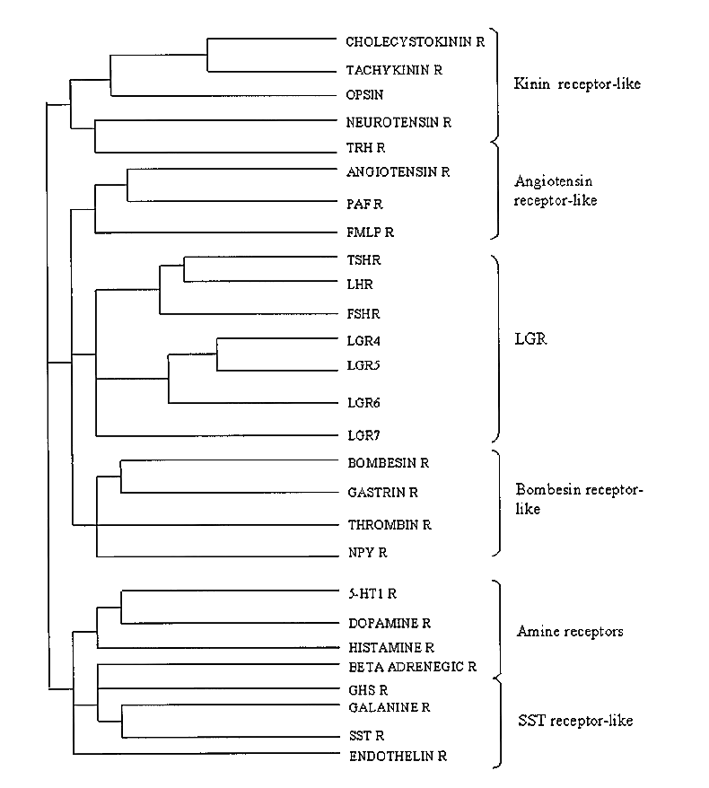
Glycoprotein hormone receptors
(Subfamily 1c)
(LH/CG)/FSH/TSH (9-10xLRRs)
Orphan (14xLRRs)
Relaxins (9xLRRs)
Characteristically GpHRs have a large N-terminal ectodomain 350-400αα containing leucine rich repeats (LRRs)
Hsu SYT 2003 TEM 14: 303-309

Slide 8
G-protein coupled receptors
Glycoprotein hormone receptors (TSHR)
Role of TSHR in endocrine physiology
Role of TSHR in endocrine pathology

Slide 9
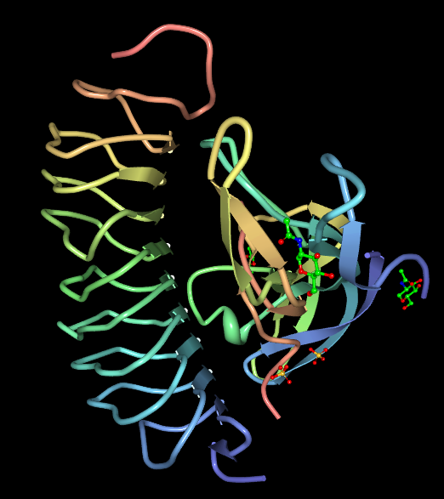
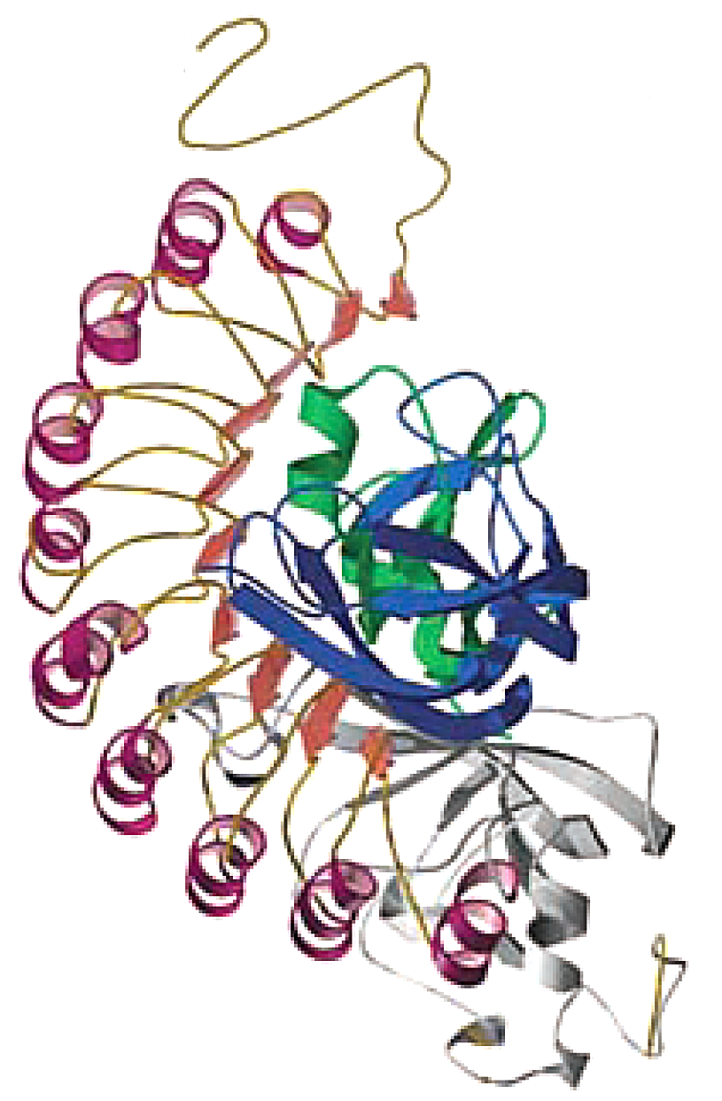
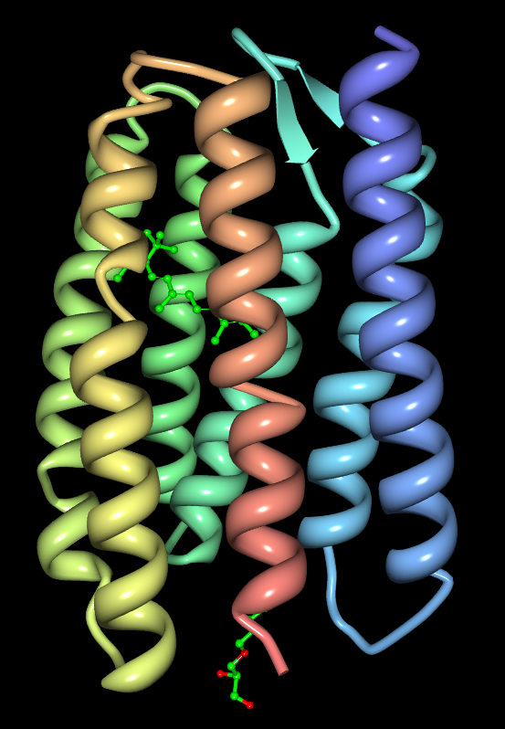
Thyroid stimulating hormone receptor
Ectodomain
FSH/FSHR
TSHR expression
Thyroid, thymus, pituitary, testis, kidney, brain, heart, bone, fat and lymphocytes
9x Leucine rich repeat ectodomain
LRRs are a 20-30αα motif of β-strand and α-helix
40% homology between TSHR, LH/CGR and FSHR
Cystein rich flanking hinge region
Heptahelical serpentine domain
70% homology between TSHR, LH/CGR and FSHR
Serpentine-
domain (7TM)
Rhodopsin
Luecke H 2001 Science 293:1449, Fan QR Nature 2005 433:269, Davies T 2005 JCI 115:1972

Slide 10
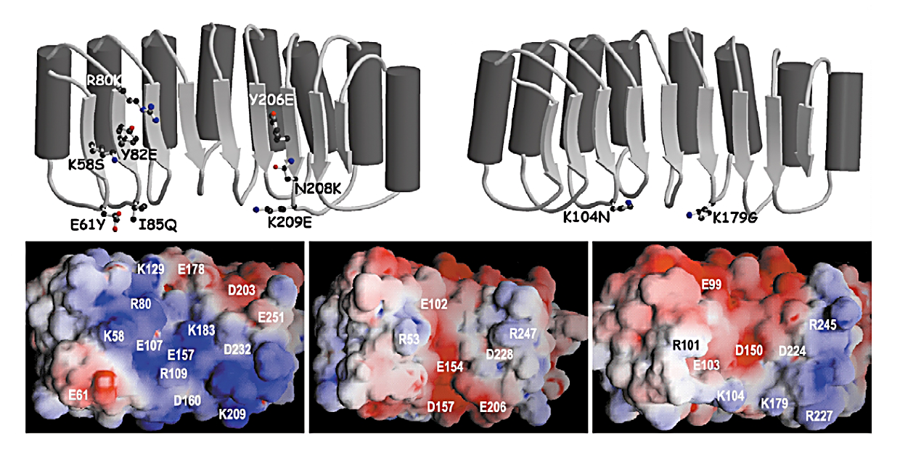
GpHR ectodomain specificity
TSHR
FSHR
acidic
groove
TSHR
LH/CGR
FSHR
Electrostatic potential over the accessible β-strand concave surface
Vassart G 2004 Trends Biochem Sci 29:119

Slide 11
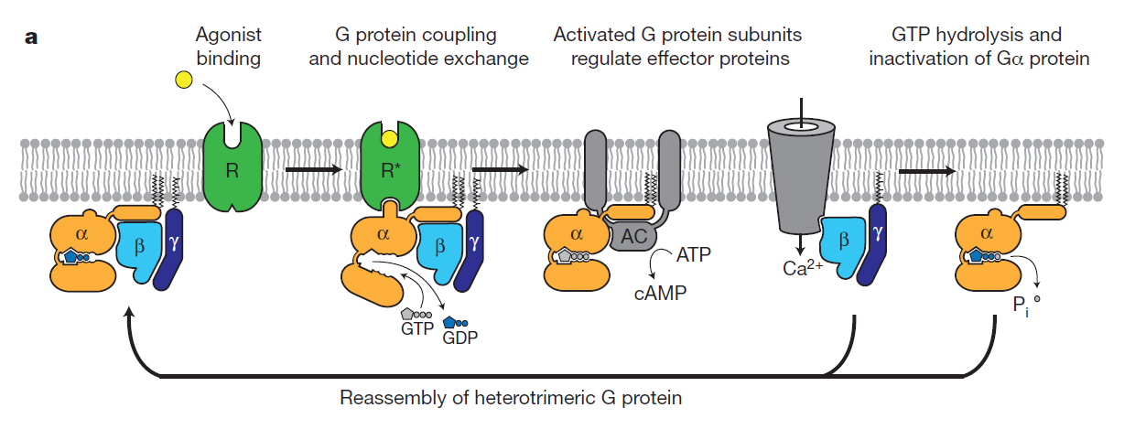
Mechanism of GPCR signalling
“TM6 and the bunch of roses model”
(Rasmussen SGF et al. 2011 Nature 477:549-556)

Slide 12
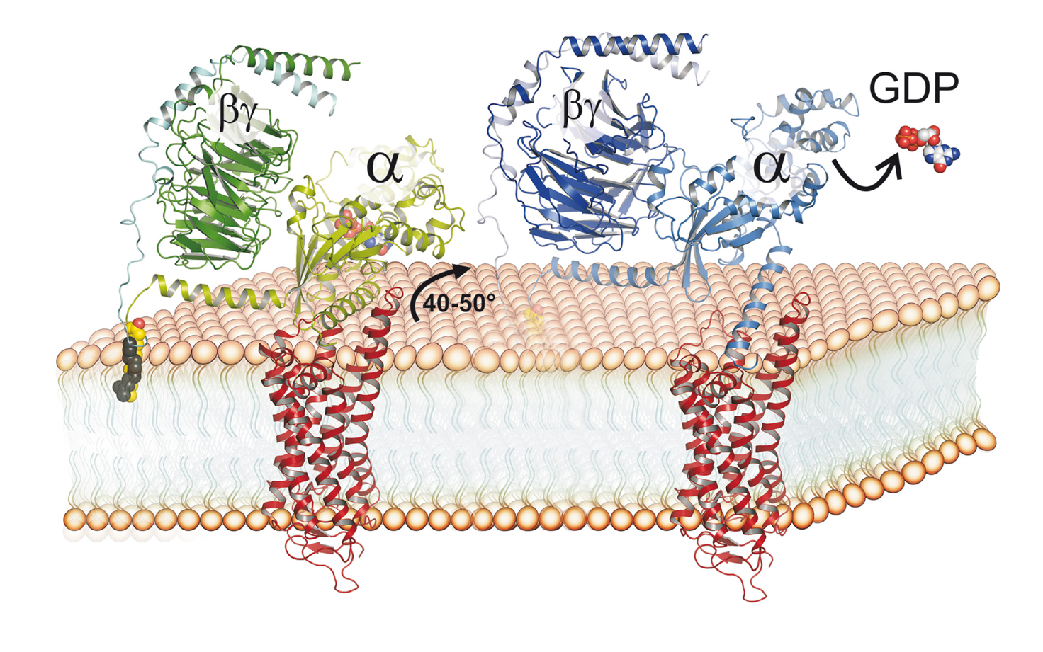
Activation of Gsα
Cytoplasm
No ligand
Ligand
Extracellar
Receptor activation result in exchange of GDP for GTP
α-subunit-GTP then dissociates from receptor and βγ dimer
α-subunit-GTP then activates adeylyl cyclase
Scheerer P 2009 PNAS 106:10660

Slide 13
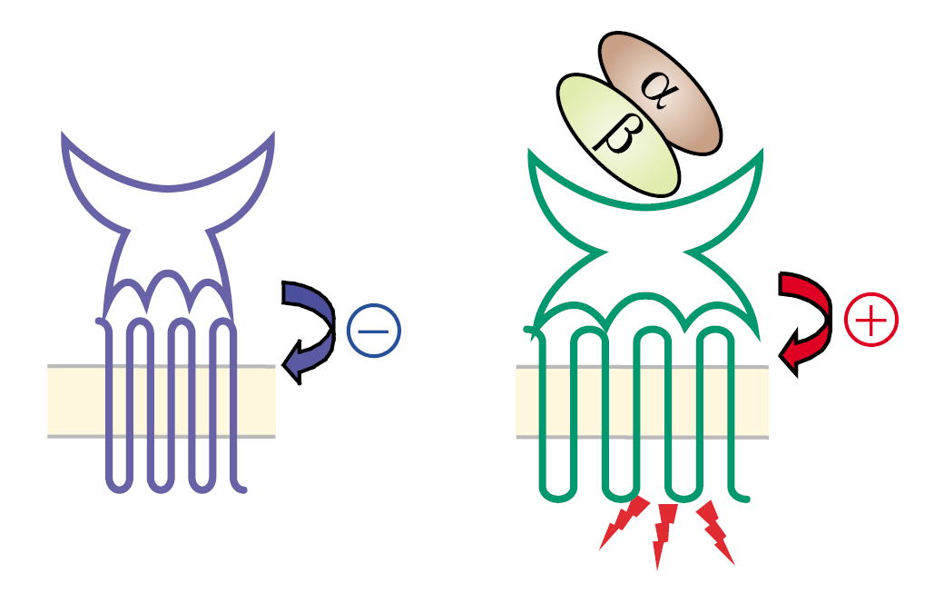
TSHR silencing and activation
TSHR
TSH
A
B
γ
γ
α
β
α
β
GDP
GTP
TSHR has a bipartite structure
LRR ectodomain mediates ligand specificity (A-subunit)
Ectodomain transmits signal to serpentine domain (B-subunit)
Serpentine domain mediates signal transduction to Gs/Gq
B-subunit heptahelical domain has constitutive activity (noisy)
Unliganded A-subunit mediates receptor silencing
Ligand binding switches the ectodomain from tethered inverse agonist to full agonist of the serpentine domain

Slide 14
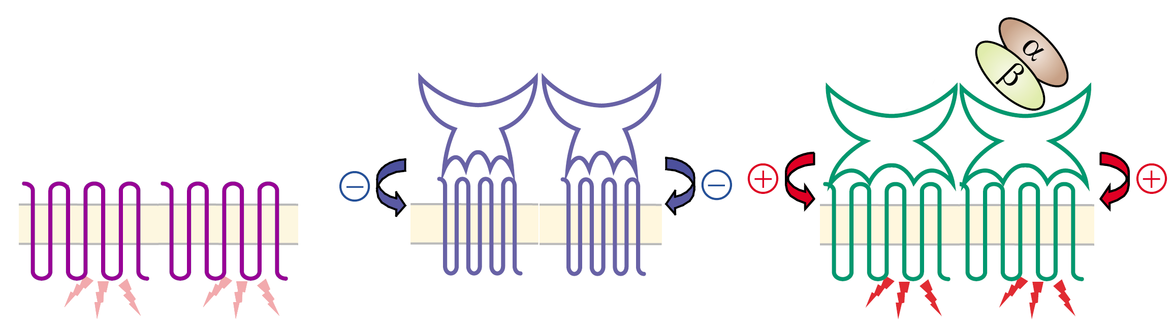
TSHR functional dimerisation
α-subunit
shedding
TSHR
TSH
Gsα
Gsα
TSHR is a dimer in the plasma membrane
Interaction between serpentine domains (TM5 and TM6)
Probably acts as a single functional unit
Strong negative cooperativity of hormone binding
Allows responses over wider range of TSH concentration
The TSHR may also heterodimerise with other GpHRs
Uriza E 2005 EMBO J 24:1954

Slide 15
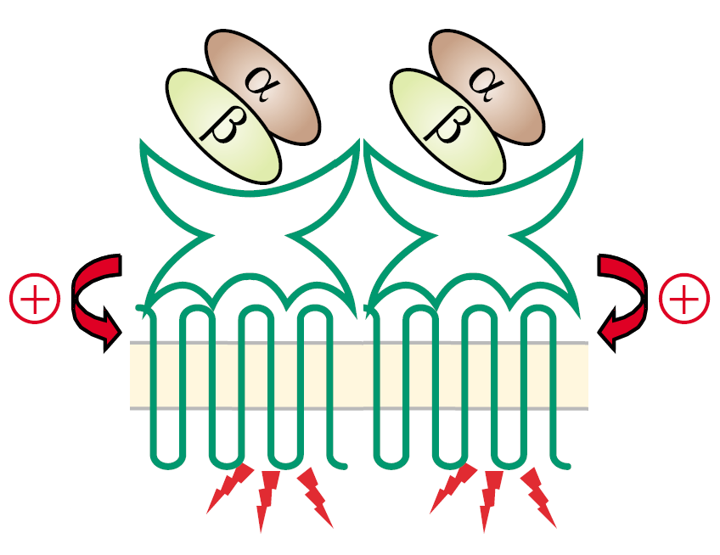
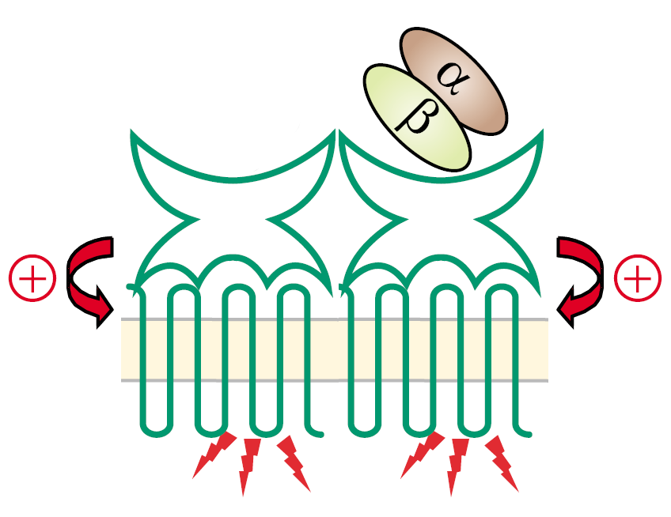
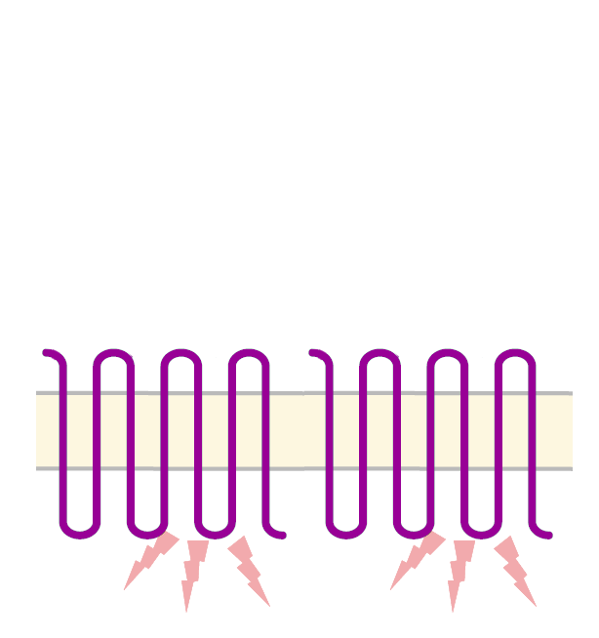
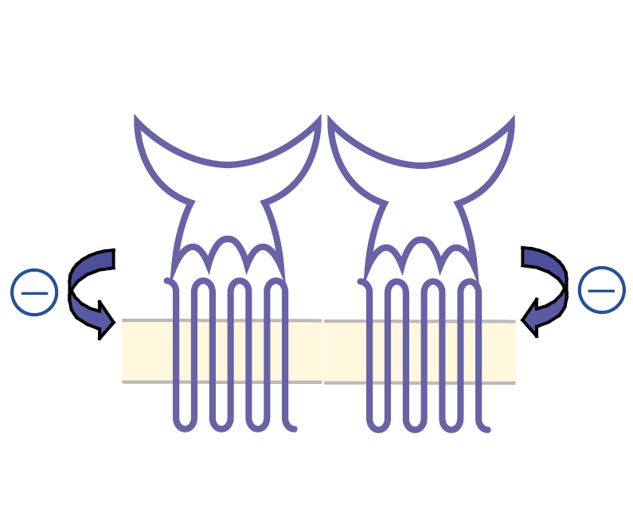
Full agonists and inverse agonists
GPCRs are molecular rheostats
Rosenbaum DM et al 2009 Nature 459:356

Slide 16
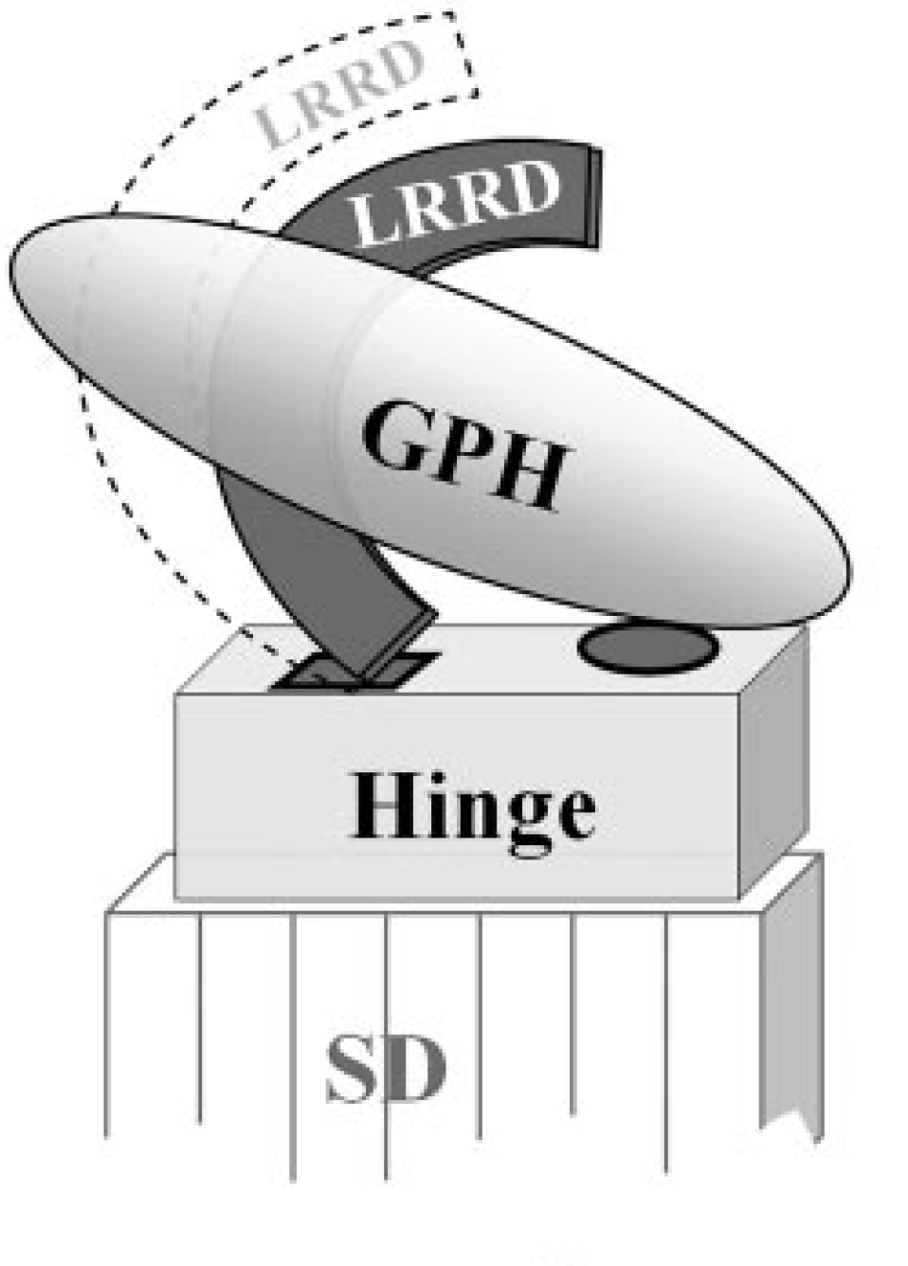
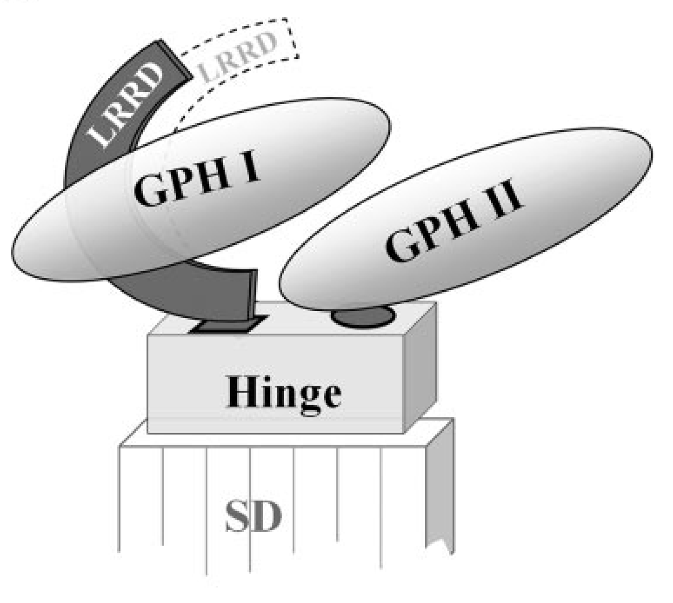
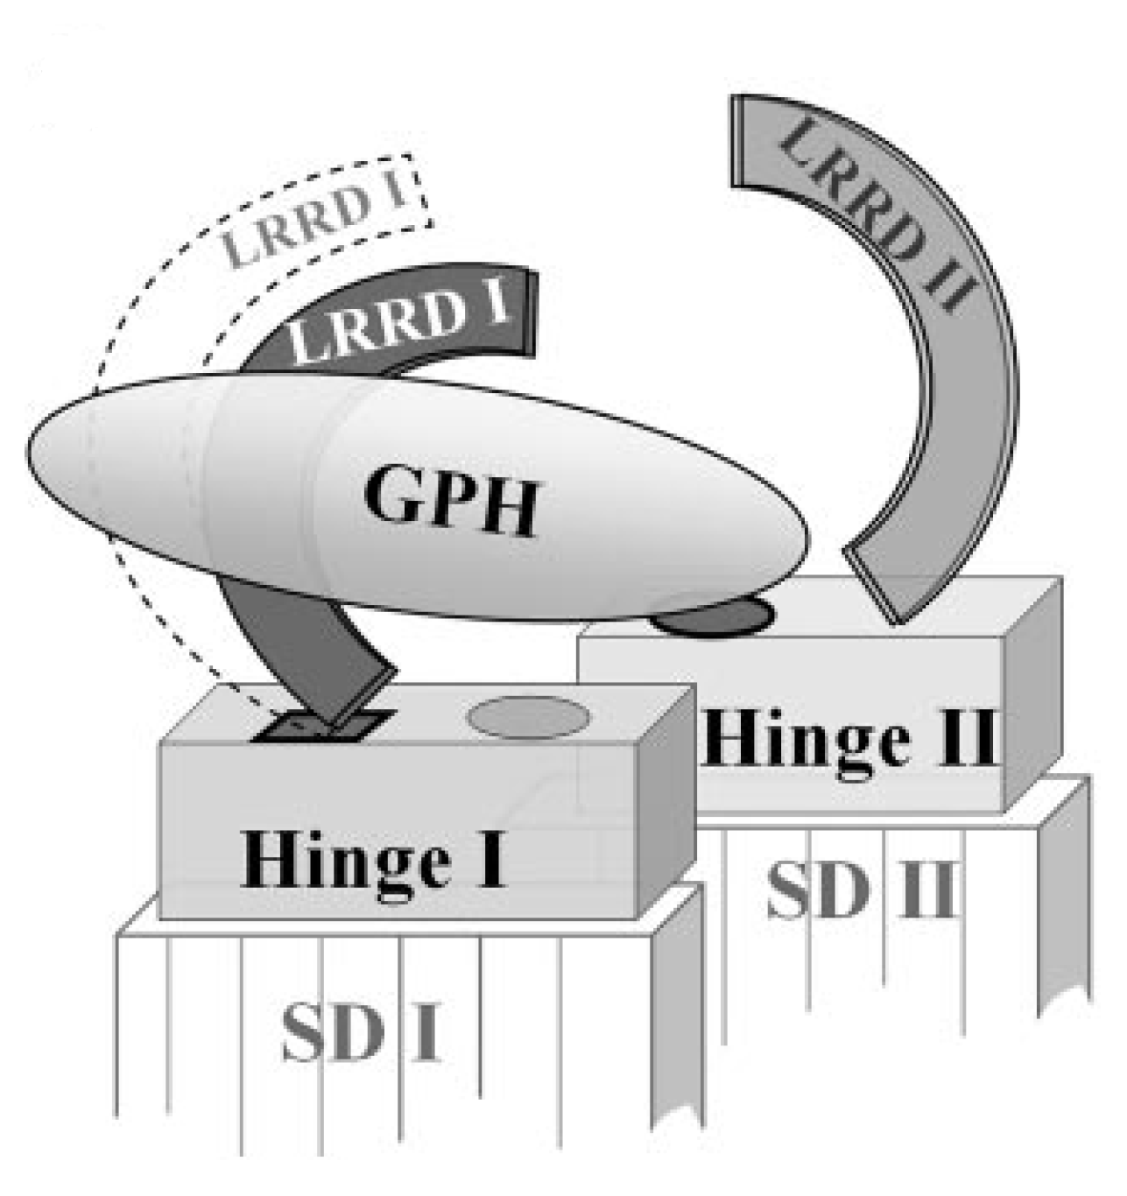
TSH/TSHR binding and signalling
TSH binding to LRRD exposes a second binding site in the hinge region of TSHR which conducts the signal to the 3 extra cellular loops
Binding of 1x TSH to 1x TSHR
Binding of 2x TSH to 1x TSHR
Binding of 1x TSH to TSHR dimer
Kleinau G et al 2009 Endo Reviews 30:133

Slide 17
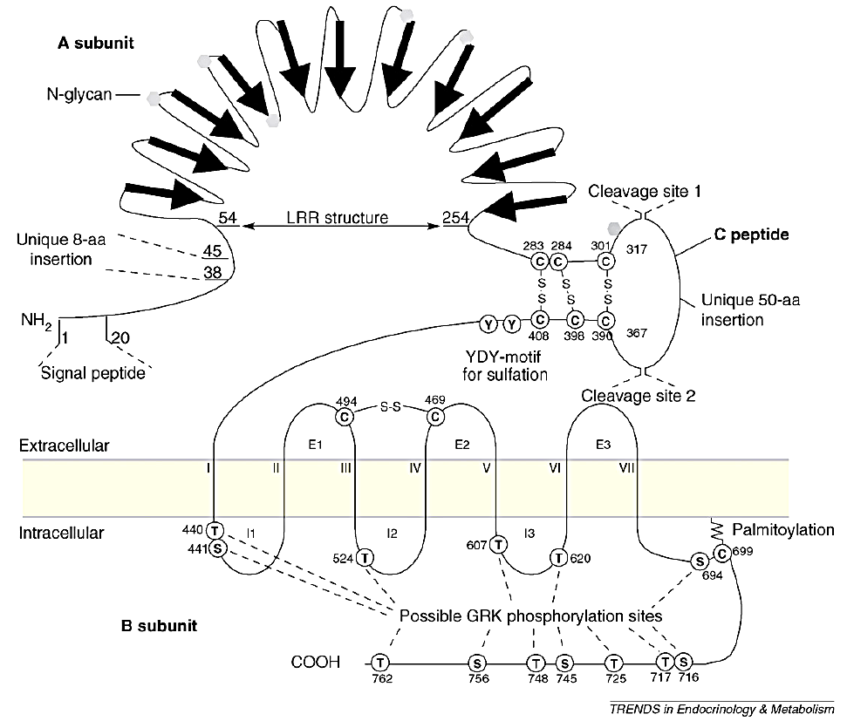
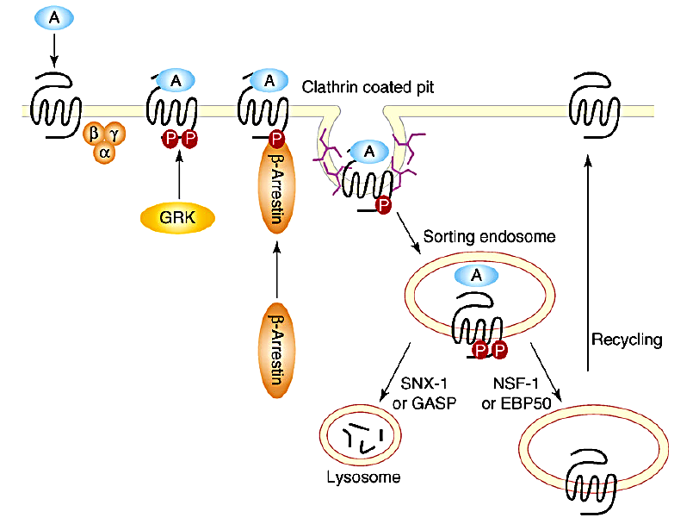
TSHR post-translational modification
Protein folding, trafficking, ligand binding and signalling
TSH
TSH
TSH
TSH
90%
TSH
Disulphide bonds Folding and tetramerization
Cleavage Activation? α-subunit shedding, 3:1 excess of β-subunit
Oligomerisation Mediated by β-subunit heptahelical domain
Palminolation Formation of a 4th ICL (cell surface expression and lipid raft entry)
Sulphation High affinity binding requires sulphated tyrosine in β-subunit
Glycosilation Folding, surface expression, effective TSH binding (40% mol wt)
Sialylation Increase and prolong cell surface expression
Phosphorylation GRKs: agonist dependent phosphorylation and desensitization
Kursawe R 2007 TEM 18:199

Slide 18
G-protein coupled receptors
Glycoprotein hormone receptors (TSHR)
Role of TSHR in endocrine physiology
Role of TSHR in endocrine pathology

Slide 19
TSHR in endocrine physiology
The thyrotropin receptor plays a pre-eminent role in thyroid physiology and disease

Slide 20
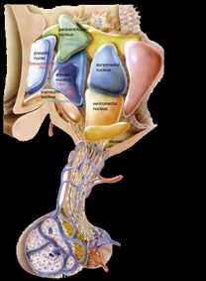
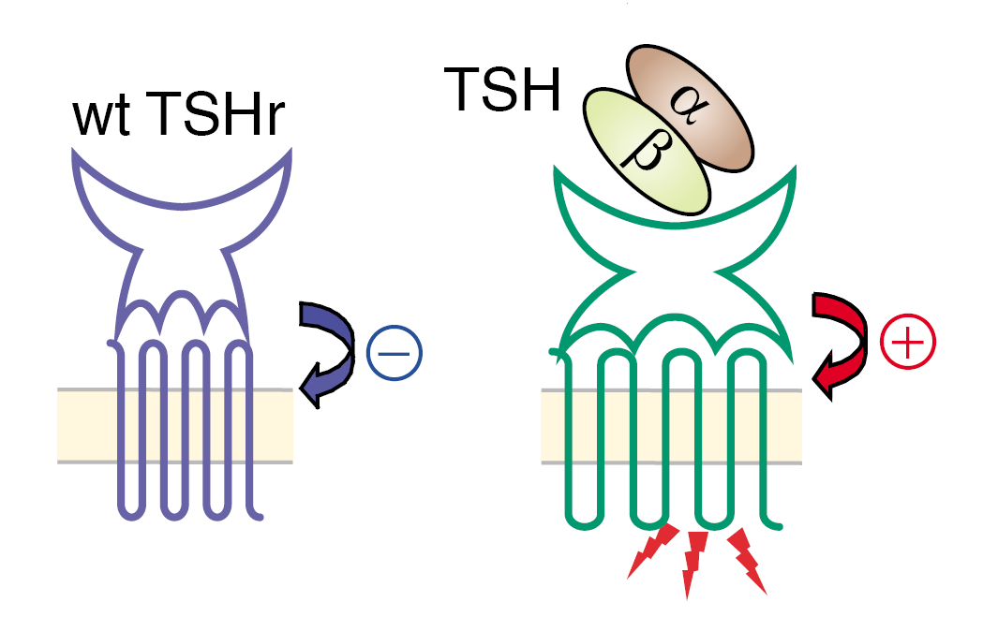
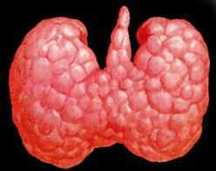
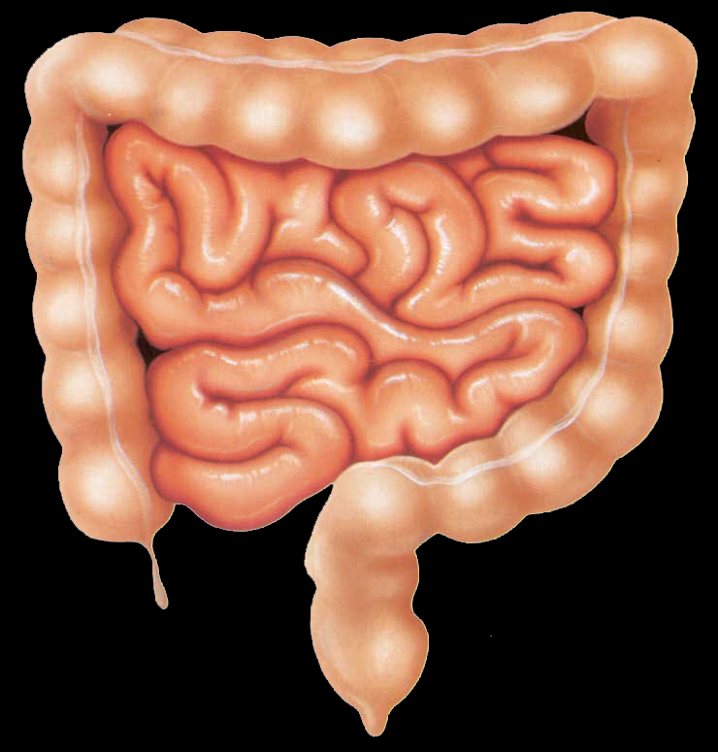
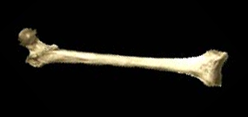
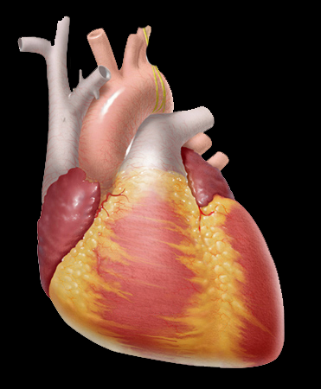
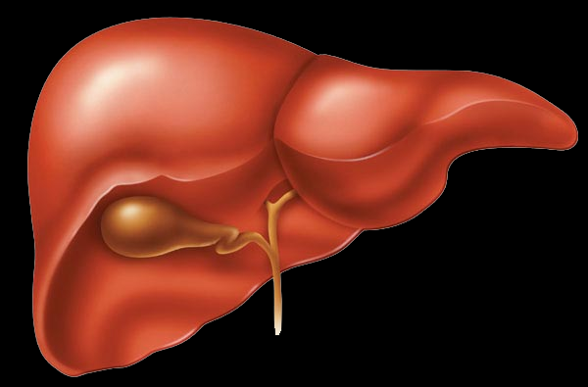
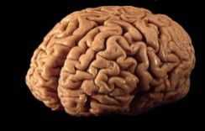
Hypothalamic-pituitary-thyroid axis
TRH
Hypothalamus
+
Pituitary
TSH
Thyroid
T₄ T₃
Target organs
Notes:
a series of genetically modified mice
However as these are global knockout or knockin models it is important
to also consider the effects of such mutations on the hypothalamic pituitary thyroid axis when analysing the skeletal phenotype……

Slide 21
TSHR and thyroid development
Not required for early organogenesis and migration
Not required for follicle formation
Expressed from 12 weeks of gestation
Essential for terminal thyroid maturation and growth
Hyt/Hyt (TSHR^{P556K}) and TSHR^{-/-} mice
Congenital hypothyroidism, thyroid hypoplasia

Slide 22
TSH/TSHR and thyroid function
Thyroid follicular cell proliferation and differentiation
Mitogenic effect of TSH mediated by cAMP
Thyroid hormone synthesis (TPO, NIS) via cAMP
Transcriptional and post-transcriptional
Induces TSHR expression by cAMP at low concentration

Slide 23
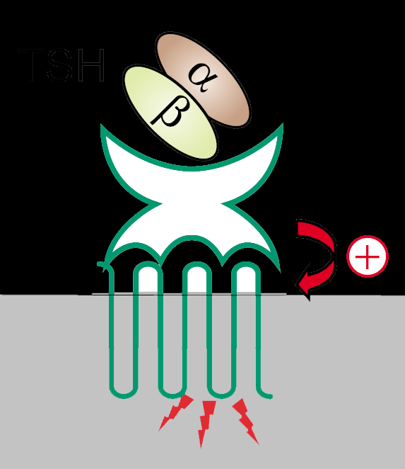
TSHR secondary messenger pathways
Thyroid Follicular Cell
S
PLC
Gq
Gs
AC
Gi
cAMP is the predominate secondary messenger
Gα_{s}/AC/cAMP/PKA regulates transcription of
Sodium-iodide symporter (NIS)
Thyroid peroxidase (TPO)
Thyroglobulin (Tg)
Gα_{q}/PLC/PKC/Ca²⁺ regulates
Iodine efflux
Thyroglobulin iodination
H₂O₂ generation
PIP2
ATP
cAMP
DAG
PKA
PKC
IP3
STAT3
CREB
NIS,TPO,Tg
↑H₂O₂ Generation
↑Iodine efflux
↑Iodination
↑Differentiation
↑Growth
↑Synthesis
Follicular Lumen
Kopp P 2001 CMLS 58:1301; Davies T 2002 JCI 110:161

Slide 24
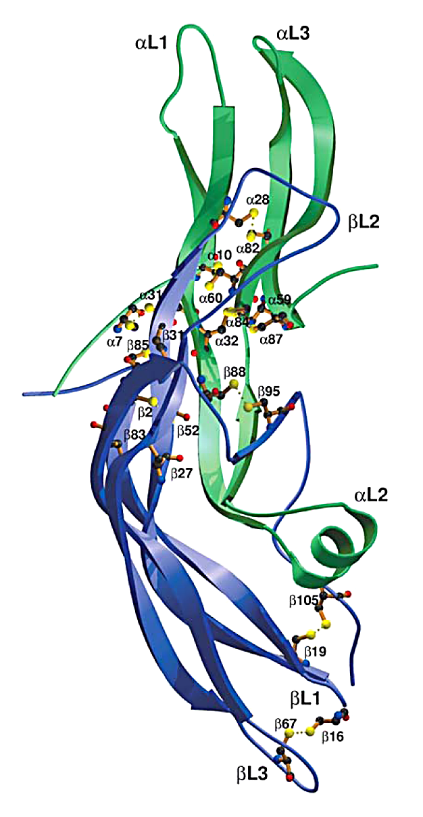
TSHR ligands
Thyrotropin (TSH)
Heterodimeric glycoprotein hormone family
Common α-subunit
Unique β-subunit (TSHβ, FSHβ, LHβ and hCGβ)
Thyroid stimulating hormone (TSH)
Common 42αα α-subunit
Specific β-subunit 41% identity to hCG
intrachain disulphide bonds form cysteine knot motif
Thyrostimulin
Glycoprotein-α2 (GPA2) diverse expression
Glycoprotein- β5 (GPB5) pituitary, brain
IHC: Pituitary, brain, adrenal, pancreas, duodenum, testis
α2β5 heterodimer activates TSHR and cAMP
10x higher affinity than TSH (physiological role unknown)
Human chorionic gonadotropin (hCG)
Promiscuous activation of TSHR during pregnancy
α
β
Glinoer G 1997 Endo Rev 18:404; Nakabayashi K 2002 JCI 109:1145; Miguel RN 2004 Thyroid 12: 991

Slide 25
G-protein coupled receptors
Glycoprotein hormone receptors (TSHR)
Role of TSHR in endocrine physiology
Role of TSHR in endocrine pathology

Slide 26
TSHR in endocrine pathology
Germline inactivating mutations
TSH resistance (AR) (congenital hypothyroidism)
Germline activating mutations
Non-autoimmune familial hyperthyroidism (AD)
Somatic activating mutations
Toxic thyroid adenomas
TSHR antibodies
Graves’ Disease (TSHR stimulating antibodies)
Autoimmune hypothyroidism (TSHR blocking antibodies)
Promiscuous activation by hCG
Gestational hyperthyroidism
Trophoblastic tumour induced hyperthyroidsm
Gα_{s} mutations
Pseudohypoparathyroidism and hypothyroidism
Toxic thyroid adenomas

Slide 27
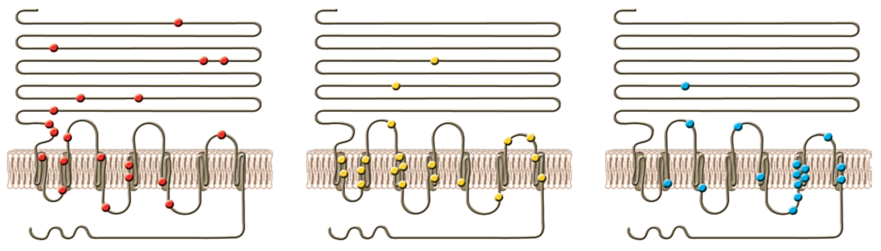
Mutations of the TSHR
Germline inactivating
widely scattered
Germline activating
Predominantly in TMD
Somatic
Activating
Predominantly in TMD
Davies T 2005 JCI 115:1972

Slide 28
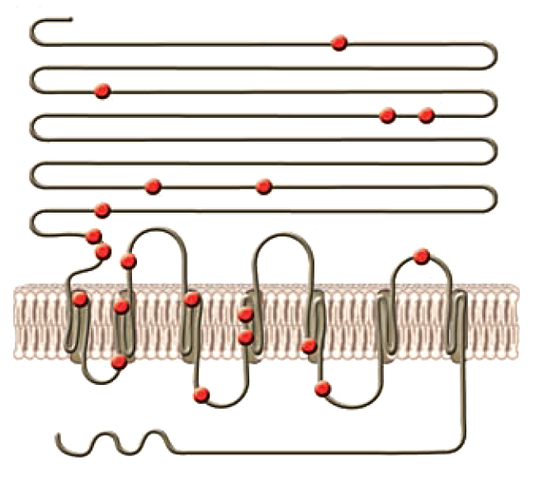
Germline TSHR inactivating mutations
Congenital hypothyroidism (AR)
Homozygous or compound heterozygous TSHR mutations
  Mutations scattered throughout the receptor
  Usually result in reduced cell surface expression
Compensated partial TSH resistance (AD/AR)
Heterozygous TSHR mutations
May be dominant negative interference due to dimerisation
Hyt/Hyt mouse TSHR P556L in TMD IV
No surface expression, thyroid hypoplasia, severe hypothyroidism
TSHR^{-/-} mouse
Thyroid hypoplasia and severe hypothyroidism

Slide 29
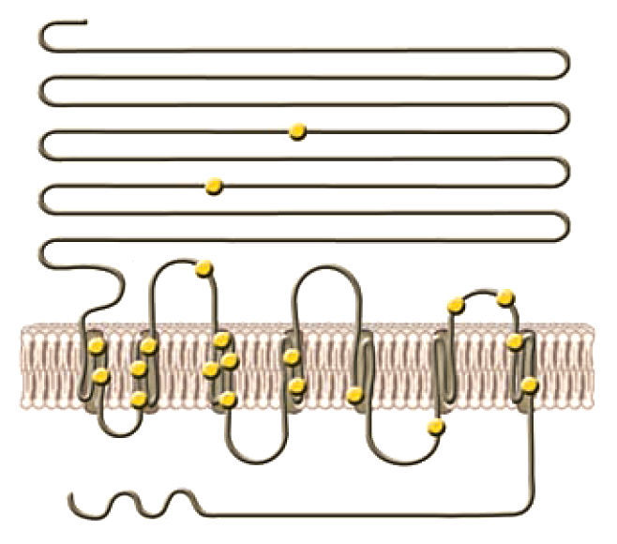
Germline TSHR activating mutations
Non-autoimmune familial hyperthyroidism (AD)
  Rare condition diffuse goiter and thyrotoxicosis
  Age of onset may vary
  Heterozygous gain of function mutations often in exon 10
  Rx anti thyroid drug and thyroidectomy after age 5
  May also occur sporadically
  The common transient form of congenital hyperthyroidism is due to placental transfer of TSHR stimulating antibodies
Duprez 1994 Nat Genet 7:396

Slide 30
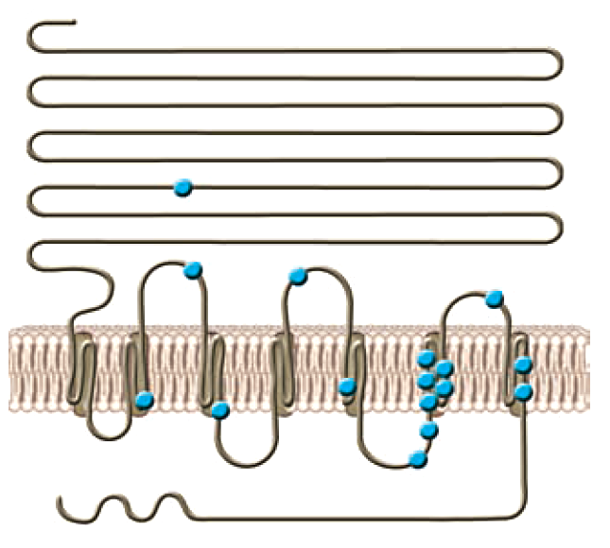
Somatic TSHR activating mutations
Thyroid nodules
50% of population in iodine deficient areas have thyroid
nodules due to prolonged TSH stimulation
5-10% are autonomous nodules (“hot” nodules)
Result in hyperthyroidism
60% have constitutively activating mutations of TSHR
most commonly in serpine TMD
Mutation induces clonal expansion and nodule formation
Treatment is with radioactive iodine (¹³¹I)
Kron K 2002 Mol Gen Metab 75:202

Slide 31
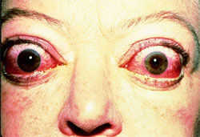
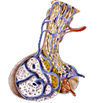
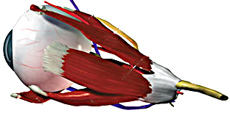
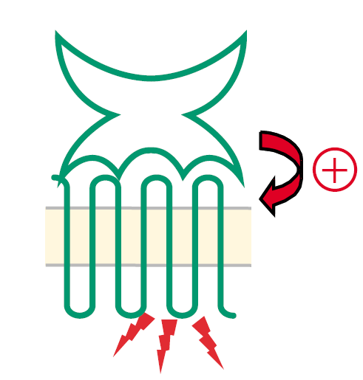
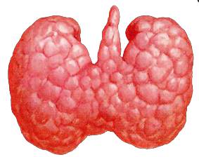
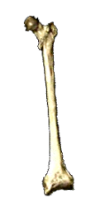
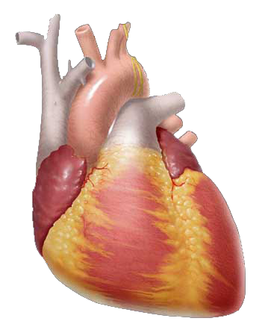
TSHR autoimmunity
Graves’ Disease
TSHR antibodies
Graves’ disease
Autoimmune hyperthyroidism
Opthalmopathy
TSHR stimulating antibodies (ectodomain)
Stimulates growth and hormone secretion
Shedding of α-subunit may be antigenic
Genetic component DZ twins 35% concordant
(HLA DRβ1, CTLA4, PTNP22, CD40 and Tg)
Transient congenital hyperthyroidism
Treated with anti-thyroid medication or ¹³¹I
Atrophic Hasimoto’s disease
Autoimmune hypothyroidism
TSHR blocking antibodies in 15% (ectodomain)
Transient congenital hypothyroidism
Pituitary
↓TSH
Eye
TSHR
Thyroid
↑T4/T3
Heart
Bone

Slide 32
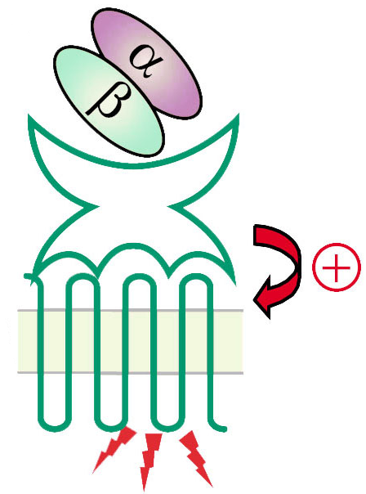
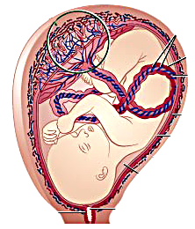
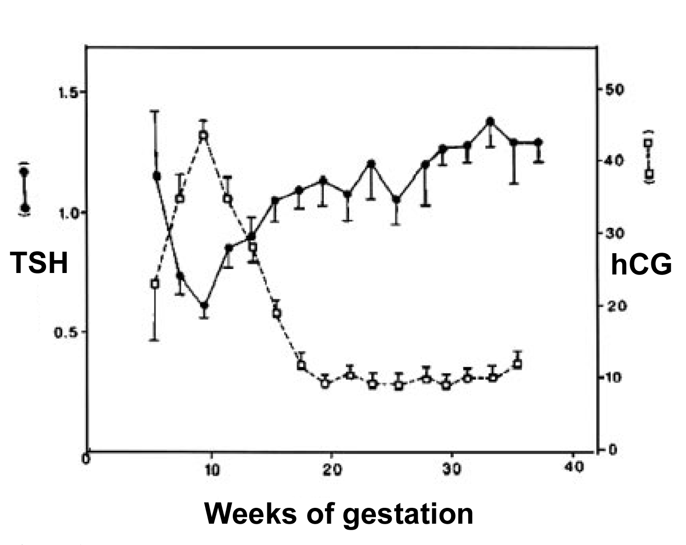
hCG induced hyperthyroidism
Pituitary
↓TSH
Promiscuous activation of TSHR by hCG
hCG in μmol/l range activates WT TSHR
1st trimester gestational hyperthyroidism
Inverse relationship between TSH and hCG
hCG is μmol/l (TSH/FSH/LH are pmol/l)
Occurs in 4% of pregnancies (twins)
(hyperemesis gravidarium)
Trophoblastic tumours
(Choriocarcinoma/Hydatidiform mole)
Familial gestational hyperthyroidism
K183R mutations of TSHR ectodomain
increase TSHR sensitivity to hCG but still
1000x less sensitive than LH/CGR
No change in TSH sensitivity
Symptoms
Hyperemesis, hyperthyroidism throughout preganancy, multiple miscarriages
↑ ↑ ↑ hCG
TSHR
Thyroid
↑T4/T3
Placenta
Rodien P 1998 NEJM 339:1823; Glinoer G 1997 Endo Rev 18:404

Slide 33
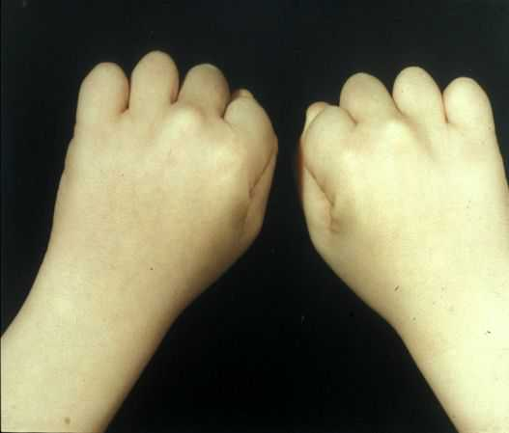
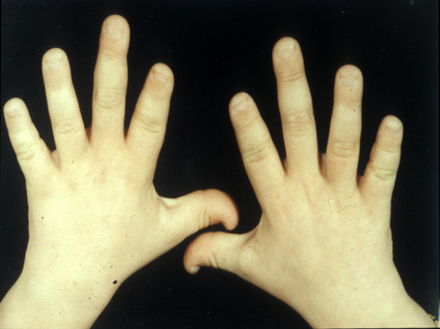
Gα_{s} mutations and thyroid pathology
Resistance to PTH, TSH, FSH and LH
Pseudohypoparathyroidism type 1a (PHP1a)
Albrights hereditary osteodystrophy
Germline inactivating mutations of Gα_{s}
TSH cannot stimulate cAMP response
Often TSH resistance occurs later than PTH
Treatment is T4 replacement
Autonomous thyroid nodules (“hot” nodules)
Somatic gain of function mutations in Gα_{s}
Results in hyperthyroidism
3% of toxic nodules have mutations of Gα_{s}
Mutations frequently inhibit GTP hydrolysis
Persistent activation of TSHR signalling pathway and elevated cAMP
Treatment with ¹³¹I
Kron K 2002 Mol Gen Metab 75:202

Slide 34
GPCR Summary
GPCRs are the oldest signal transduction molecules
Most diverse of all membrane receptors (2000 members)
GpHRs
LRR ectodomain mediates ligand specificity
Serpine TMD mediates signal transduction to G proteins
TMD is inherently noisy
Unliganded ectodomain acts as inverse agonist to suppress TMD
Liganded ectodomain as a full agonist of TMD
GpHR dimerisation
Negative cooperativity extends range of ligand concentration
GpHRs multiple post-translational modifications are essential for
Folding, activation, ligand affinity, oligomerisation, cell surface
expression and desensitisation
GpHRs ligands
Heterodimeric glycoproteins common α-subunit, diverse β-subunit

Slide 35
TSHR Summary
Has a critical role in thyroid physiology and pathology
Essential role in the
Hypothalamic-pituitary-thyroid axis
Thyroid growth and hormone synthesis
Not essential for thyroid organogenesis or migration
Signals predominantly via cAMP but also PLC
Inactivating mutation
Spectrum TSH resistance to severe congenital hypothyroidism
Gain of function mutations usually effect the TMD
Familial hyperthyroidism and sporadic toxic adenomas
Antibodies to TSHR ectodomain
Graves’ Disease and autoimmune hypothyroidism
TSHR in other tissues and the alternative ligand thyrostimulin
Physiological roles remains uncertain

