Slide 1
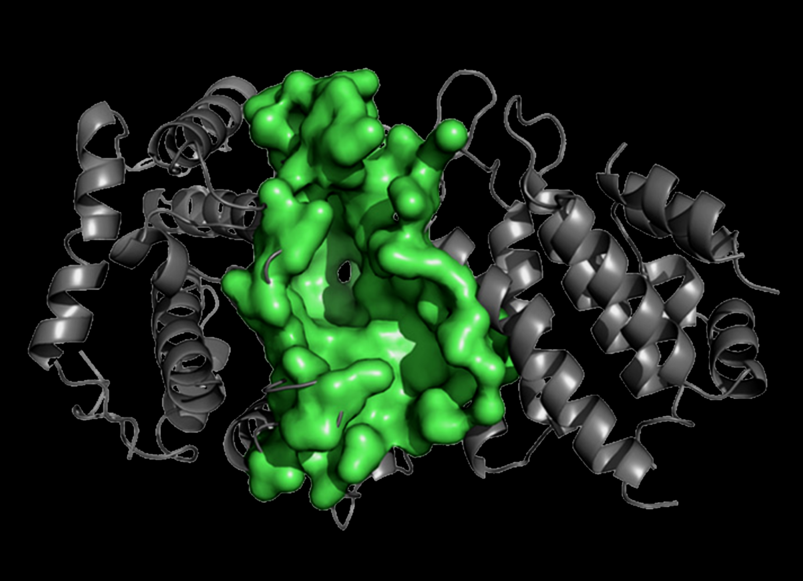
The Multiple Endocrine Neoplasias and the success of positional cloning?
Duncan Bassett
Molecular Endocrinology Group, Imperial College London

Slide 2
MEN1 and MEN2 Rare autosomal dominant familial cancer syndromes
Prevalence 1 per 100,000
Presentation 5 to 81 years
MEN1
Parathyroid tumours
Pancreatic islet cell tumours (NETs)
Anterior pituitary tumours
Adrenal cortical tumours
Gut, thymic, bronchial carcinoids (NETs)
Angiofibromas, lipoma
collaginomas, meningiomas
Isolated familial syndromes
Hyperparathyroidism
Prolactinomas/Acromegaly
Carcinoids
Prevalence 1 per 500,000
High penetrance 6/12 to 40 years
MEN 2A (60%)
Medullary thyroid carcinoma
Phaeochromocytoma
Parathyroid hyperplasia
MEN 2B (5%)
Medullary thyroid carcinoma
Phaeochromocytoma
Marfanoid habitus
Mucosal neuromas
Ganglioneuromatosis/megacolon
Isolated familial syndromes (35%)
Familial MTC
Familial Phaeo

Slide 3
Complex Multiple Endocrine Neoplasias
MEN4 Parathyroid tumours
(CDKN1B) Pituitary tumours
McCune Albright Thyroid nodular hyperplasia (TTX)
(GNAS1) Adrenal hyperplasia (Cushing's)
Somatotrophinomas (Acromegaly)
Hyperprolactinaemia
Neurofibromatosis I Phaeochromocytoma
(Neurofibromin) Hyperparathyroidism
Carcinoids (NETs)
(Medullary thyroid carcinoma)
Von Hippel-Lindau Phaeochromocytoma
(VHL) Pancreatic Islet cell tumour
Carney’s Complex Thyroid tumours
(PRKAR1A) Parathyroid tumours
Adrenal tumours
Pituitary tumours
Familial isolated pituitary adenomas (FIPA)
(AIP) Somatotrophinomas, prolactinomas
Somatolactotrophinomas, Non-functional

Slide 4
Multiple Endocrine Neoplasia Type 1

Slide 5
Multiple Endocrine Neoplasia Type 1
Parathyroid (94%)
Pancreas (40%)
43%
26%
2%
11%
14%
1%
3%
Pituitary (29%)
Associated tumours
Carcinoid 4%
Adrenocortical 5%
Phaeochromocytoma 0.5%
Cutaneous tumours
Angiofibromas 88%
Collaginomas 72%
Lipomata 30%
(Jensen RT 2008 Cancer 113:1807-1843; Verges B 2002 JCEM 87:457-465)

Slide 6
1⁰ Hyperparathyroidism
1⁰ Hyperparathyroidism (95%)
Frequently the first presenting feature
Differs from sporadic disease
Early age of presentation peak 20-25 years
Multiple gland hyperplasia rather than adenoma
High recurrence rate (50% by 10 years)
Presentation
Hypercalcaemia
Polyuria, polydipsia, nephrocalcinosis, renal stones
Abdominal pain, N/V, constipation
Dyspepsia, peptic ulceration, pancreatitis
Osteofibrosacystica
Psychiatric disturbance

Slide 7
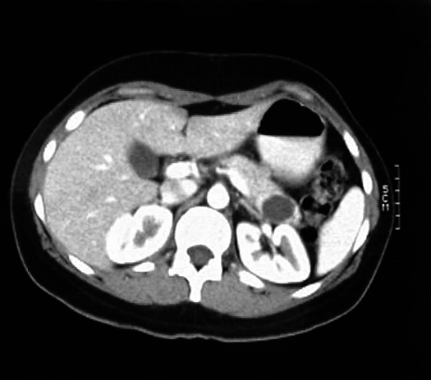
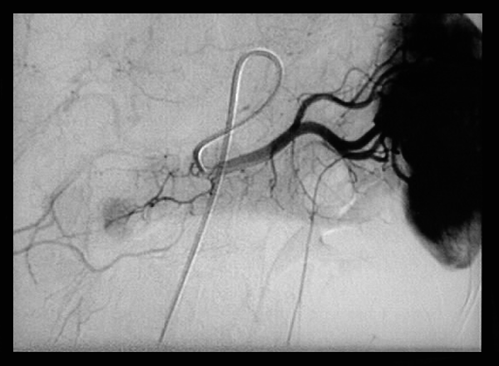
Pancreatic endocrine tumours Single/multiple, benign/malignant, functional/non-functional
CT scan
Angiography
Pancreatic neuroendocrine tumours NETs (50-100%)
Non-functional (PPomas) asymptomatic can metastasize if >4cm (80-100%)
Gastrinoma (ZE) Peptic ulceration, diarrhoea and steatorrhoea (48%)
Co-secreting Mixed symptoms (22%)
Insulinoma Hypoglycaemic symptoms, Hunger, Wt gain (14%)
Glucagonoma NME, DM, Wt loss, diarrhoea, DVT/PE (5%)
VIPoma Severe watery diarrhoea (2%)
Somatostatinomas (Rare)
(Jensen RT 2008 Cancer 113:1807-1843)

Slide 8
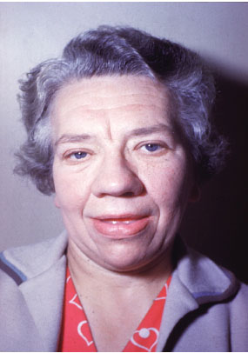
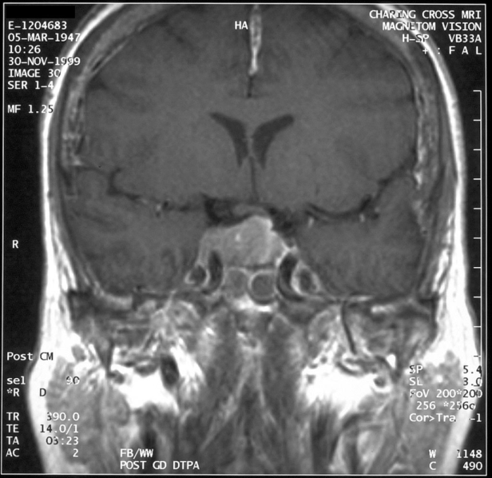
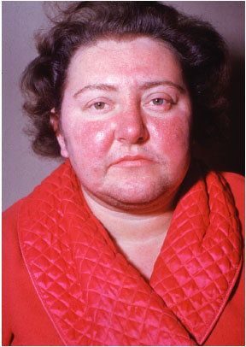
Anterior pituitary tumours
Acromegaly
Cushing’s
Pituitary Adenomas (40%)
Mean age of onset 40 years (5-83)
Initial lesion in 17% and more frequent in females
More aggressive than sporadic disease
85% macroadenomas and 37% invasive

Slide 9
Clinical features of pituitary adenomas
Lactotrophinomas (Prolactinomas) (Prolactin producing 63% )
Menstrual irregularity, galactorrhoea, reduced libido,
impotence, infertility
Somatotrophinomas (Acromegaly) (GH producing 23%)
Headache, sweating, ↑soft tissue, ↑hands and feet, prognathism,
nerve compression, cutaneous fibromas, acanthosis nigricans,
HT, LVH, cardiomyopathy, arrhythmias, colonic malignancy
ACTHomas (Cushings disease) (ACTH producing 4%)
Hirsuitism, centripedal obesity, buffalo hump, purple striae, HT,
glucose intolerance, proximal myopathy, infertility, psychiatric problems
Non Functional tumours (15%)
Headache, bitemporal hemianopia, hypopituitarism, cranial nerve palsies menstrual irregularity, galactorrhoea, reduced libido, impotence, infertility
Co-secreatory (9%)

Slide 10
Other MEN1 associated tumours
Adrenocortical (20-50%)
Clinically silent adrenal adenomas or hyperplasia
<10% functional (Conns/Cushing’s)
Rarely carcinomas
Carcinoid Syndrome (NETs) (15%)
70% foregut (gastric 70%), thymic (15%), and bronchial (15%)
Flushing, palpitations, wheezing, diarrhoea, tricuspid insufficiency and pulmonary stenosis

Slide 11
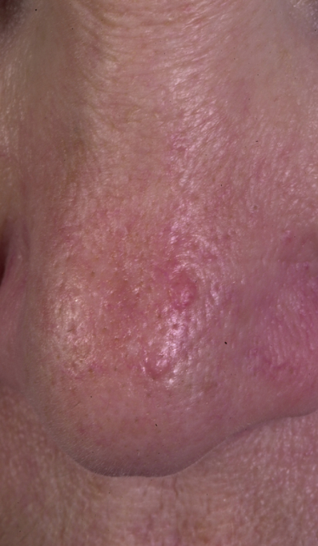
Dermatological features of MEN1
Benign lesions no treatment required
Multiple facial angiofibromas
(5- 88%)
Hypopigmented collagenomas
(0-72%)
Lipomas
(3-34%)

Slide 12
2012 Clinical practice guidelines
Management by specialist MDT
Endocrinologist, gastroenterologist, oncologist, endocrine surgeon, specialist histopathologist, interventional radiologist and clinical geneticist
Genetic testing
Index case (2x MEN1 associated tumours)
Screen 1st degree relatives at earliest opportunity (before biochemical testing)
Tumour Annually 3 yearly Management
1⁰HPT Ca, PTH Parathyroidectomy (Cinacalcet)
Pancreatic NET Glu, Gut hormones Surgery/PPI/SS analogues
MRI/Endo US (Surgery if NF >1cm)
Pituitary PRL, IGF-1 MRI Combined PFT
Dopamine agonist, SS analogues
Transsphenoidal hypophsectomy
Thymic/bronchial Chest MRI Gastroscopy Surgical resection
Carcinoids Endo US Radio/Chemotherapy
SS-scintigraphy
Adrenal MRI Biochemical evaluation if >1cm
Surgery is functional (10%)
(Surgery if NF>4cm)
(Thakker RV et al (2012) JCEM 97:2990-3011)

Slide 13
MEN1 is caused by loss of function mutations in a tumour suppressor gene that encodes MENIN

Slide 14
The MEN1 gene
Chr 11
Located at chromosome 11q13
10 exons
2.8Kb mRNA transcript
610 amino acids protein Menin
6 alternative splice variants (5’ UTR)
Menin is a tumour suppressor gene
MEN1 is caused by Menin loss of function mutations
75% predict truncated or absent protein
Rapid proteasome-degradation of mutant Menin
Tumour specific loss of the normal MEN1 allele (LOH)
“Knudsons two hit hypothesis”
Over-expression of Menin in Ras-transformed cell lines reverts the transformed phenotype

Slide 15
Tumour suppressor genes and tumour formation
Normal Individual
MEN1 mutant gene carrier
Susceptible cell
with 2 functional
MEN1 alleles
Susceptible cell
with 1 functional
MEN1 allele
MEN1
MEN1
Mutant
MEN1
MEN1
Sporadic mutation with loss of 11q
Susceptible cell
with 1 functional
MEN1 allele
Susceptible cell
no functional
MEN1 alleles
MEN1
Mutant
MEN1
No tumour
Tumours show
LOH
Tumour formation

Slide 16
Mutation are scattered throughout MEN1 gene
459 different germ line mutations identified
75% predict a truncated or absent protein
No hot spots, scattered throughout coding region
Nonsense 23%
Frameshift deletion/inertion 41%
Large deletions 1%
In frame deletion/insertion 6%
Missense 20%
10% occur de novo
5-10% of patients do not have mutations in coding region
(Thakker RV 2010 Best Pract Clin Endo Metab 24:355; Human Gene Mutation Database Cardiff)

Slide 17
The MENIN protein
0
100
200
300
400
500
600
NLS1
NLSa
NLS2
2
3
4
5
6
7
8
9
10
MENIN is a 67kDa protein, 3x NLS and binds DNA
Nuclear localisation but cytoplasmic in dividing cells
No homology or functional motifs
Conserved from man to molluscs
Drosophila 70% identity
Expressed from earliest stages of embryogenesis
Expressed ubiquitously in all adult tissues
Expression inversely correlated with proliferation (cell cycle)
Expression varies with the cell type
Menin negatively regulates its own expression
Somatostatin induces Menin expression
Multiple protein interactions have been identified
Precise cellular function of Menin remains uncertain
The pattern of MENIN expression cannot explain the endocrine nature of associated tumours

Slide 18
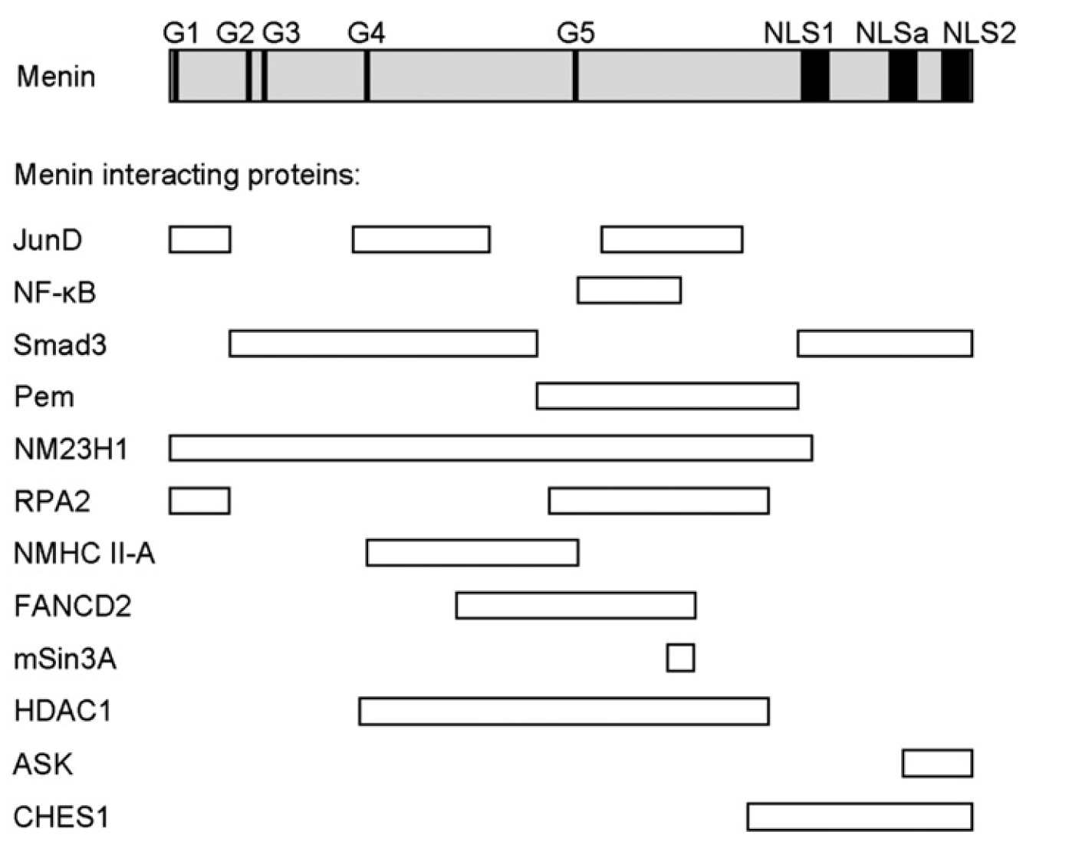
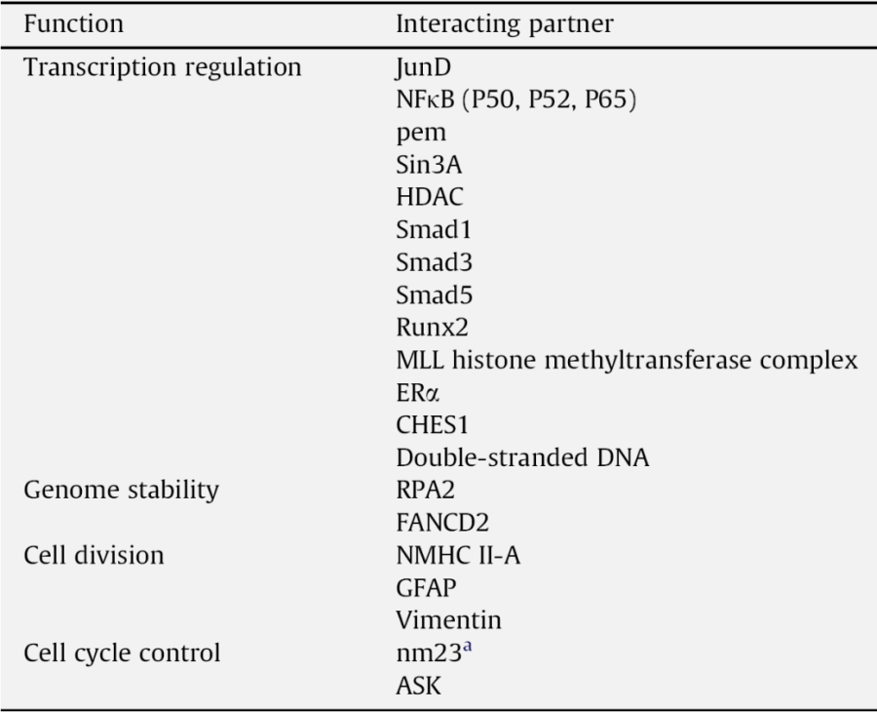
MENIN interactions and function
Two hybrid screening, co-immunoprecipitation and GST-pull-down studies
(Chandrasekharappa SC 2003 J Int Med 253:606 ;Thakker RV 2010 Best Pract Clin Endo Metab 24:355)

Slide 19
Transcriptional regulation by Menin
Interacts with JunD and C-Jun to suppresses transcription
JunD/mSin3A/HDAC histone deacetylase recruitment
Binds NFκB (p50, p52 and p65) suppressing transcriptional activation
Inhibits TGFβ and BMP-2 signally by binding Smad3 and Smad1/5
Menin is component of MLL histone methyltransferase complex
Activates gene transcription by H3-K4-timethylation
Menin binds and act as co-activator for ERα, VDR and PPARγ
Menin binds β-catenin
Effects β-catenin cellular location and Wnt signalling
“Menin may act as an adapter protein regulating many molecular
complexes involved in tumorigenesis, proliferation, differentiation,
apoptosis, growth factor and stress responses, DNA repair and
epigenetic modification”
(Balogh K 2010 Mol Cell Endo 326:80; Thakker RV 2010 Best Pract Clin Endo Metab 24:355)

Slide 20
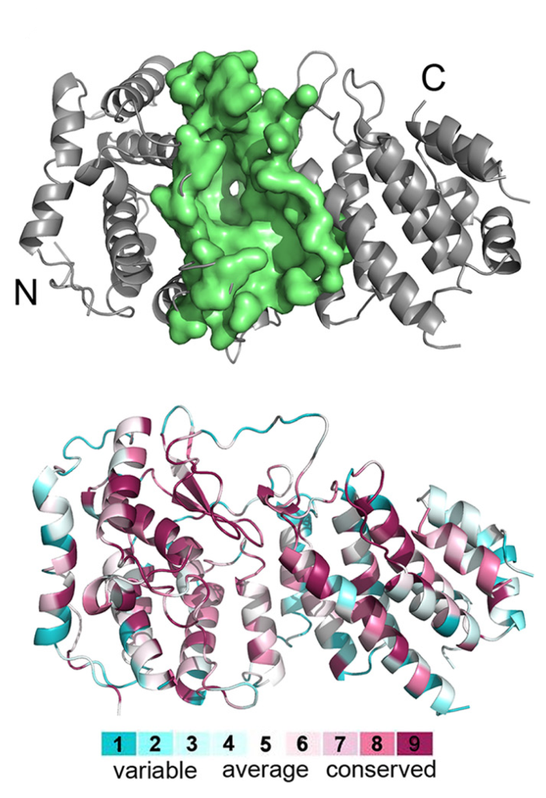
Mixed lineage leukaemia histone methyltransferase complex
Menin MLL binding pocket
Menin is key component of MLL-HMT complex
Trimethylation (H3-K4-me₃)
Epigenetic transcriptional regulation
Paf/Rtf
MLL
HMT
Menin
Elongation
Pol II
Ser 5-P
Persistent
H3-K4-me₃
Menin dependent MLL-HMT activity regulates
CDK inhibitor expression (p18 and p27)
Sea anemone menin
(Ng HH 2003 Mol Cell 11:709; Hughes CM 2004 Mol Cell 13:587; Murai MJ 2011 JBC 286:31742)

Slide 21
Importance of CDK inhibitors p27^{Kip} and p18^{ink4c}
p27^{Kip} and p18^{ink4c} double KO mice (3 month old) (Franklin Ds 2000 MCB 20:6147)
Parathyroid and pituitary adenomas, Islet cell and duodenal hyperplasia
Thyroid c-cell hyperplasia and Phaeochromocytomas
MenX rats: spontaneously occurring AR disorder (Pellegata 2006 NS PNAS 103:15559)
Homozygous frameshift mutation of p27^{Kip} (8nt duplication exon 2) Parathyroid adenomas, pancreatic islet cell hyperpasia,
Thyroid C-cell hyperplasia,
Bilateral phaeochromocytomas and paragangliomas
Analysis of CDKN1B/p27 in MEN1 mutation negative families
2% heterozygous for germline mutations of CDKN1B (5 identified “MEN4”)
Parathyroid, pituitary (GH and ACTH), pancreatic (Gastrinomas and NF)
Adrenal tumours and renal angiomyolipoma
Small cell cervical carcinoma (show LOH)
p27^{Kip} and p18^{ink4c} have key roles in preventing neoplasia in endocrine tissues
There regulation by MLL-HMT may help explain the phenotype of MEN1
(103:15558; Georgitsi M JCEM 2007 92:3321; Agawarl SK JCEM 94:1826)

Slide 22
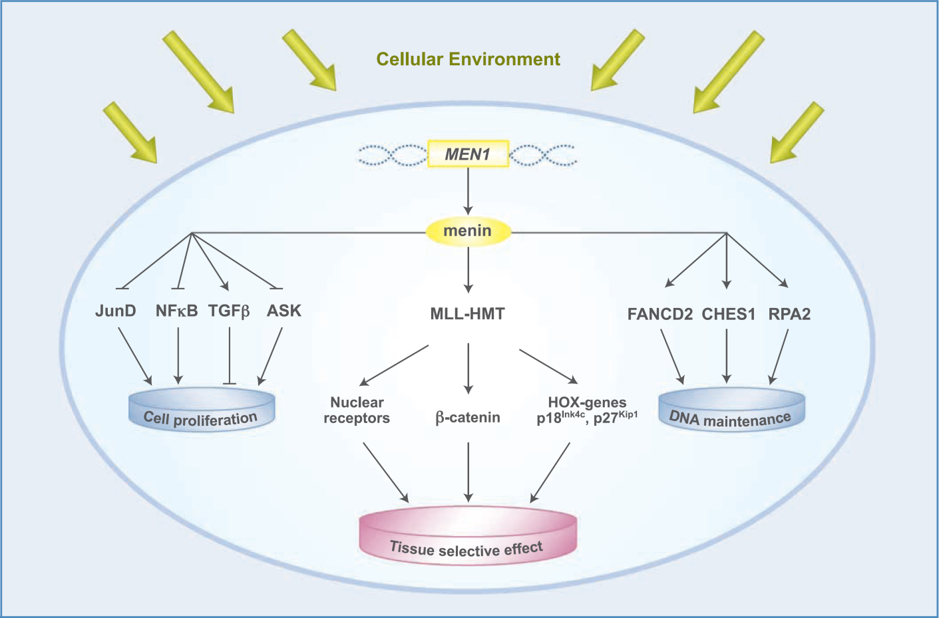
Summary of MENIN’s function
The pattern of tumorigenesis in MEN1 is likely to be a consequence of the specific inability of endocrine cells to compensate for the loss of Menin
(Gracanin A 2009 Cancer Res 69:6371-6374)

Slide 23
Animal models of MEN1 Global Men1 knockout mice
Men1^{(-/-)} die in utero E11.5-13.5
Craniofacial, neural, cardiac and hepatic abnormalities
Men1^{(+/-)} (deletion of exon 3-8) (Crabtree JS 2001 PNAS 98:1118)
Parathyroid, pancreatic (Ins), pituitary (Prl) and adrenocortical tumours
LOH in tumours
Hyperplasia is nonclonal in some tissues (islet cells)
Men1^{(+/-)} (deletion of exon 3) (Bertolino P 2003 Mol Endo 17:1880)
Parathyroid, pancreatic (Ins/Gast/Glu), pituitary (Prl/GH) and adrenal
Thyroid, Leydig, ovarian and mammary tumours
Men1^{(+/-)} (deletion of exon 1 and 2)
(Loffler KA 2007 Int J Cancer 120:259; Harding B 2009 Endo Related Cancer 16:1313)
Parathyroid, pancreatic, pituitary tumours
Thyroid, adrenal and gonadal tumours
Endocrine tissues in humans and mice have different abilities to compensate for the loss of menin

Slide 24
Animal models of MEN1 Tissue specific Men1 knockout mice
β cell specific deletion of Men1 by E11.5 (Men1^{(ΔRip/ΔRip)} mice)
Normal islet cell architecture
100% islet hyperplasia at 2 months
88% insulinomas at 8 months
Loss of one Men1 allele leads to hyperplasia, 2 alleles to atypical hyperplasia but further somatic events are required for adenoma formation
Hepatocyte specific deletion of Men1 (Men1^{(ΔAlb/ΔAlb)} mice)
Normal livers no tumours
89% and 63% reduction CDK inhibitors p18^{Ink4c} and p27^{Kip1} respectively
Tamoxifen inducible deletion (Cre-ER x Men1^{flox/flox})
Pancreatic hyperplasia and islet enlargement within 14d
Decreased expression of CDK inhibitors p18^{Ink4c} and p27^{Kip1}
Increased cellular proliferation
(Crabtree JS MCB 2003 98:1118, Bertolino P Can Res 2003 4836,
Scacheri PC Mam Gen 15:872, Schnepp RW Can Res 2006 66:5707)

Slide 25
Genotype phenotype correlation and genetic testing in MEN1

Slide 26
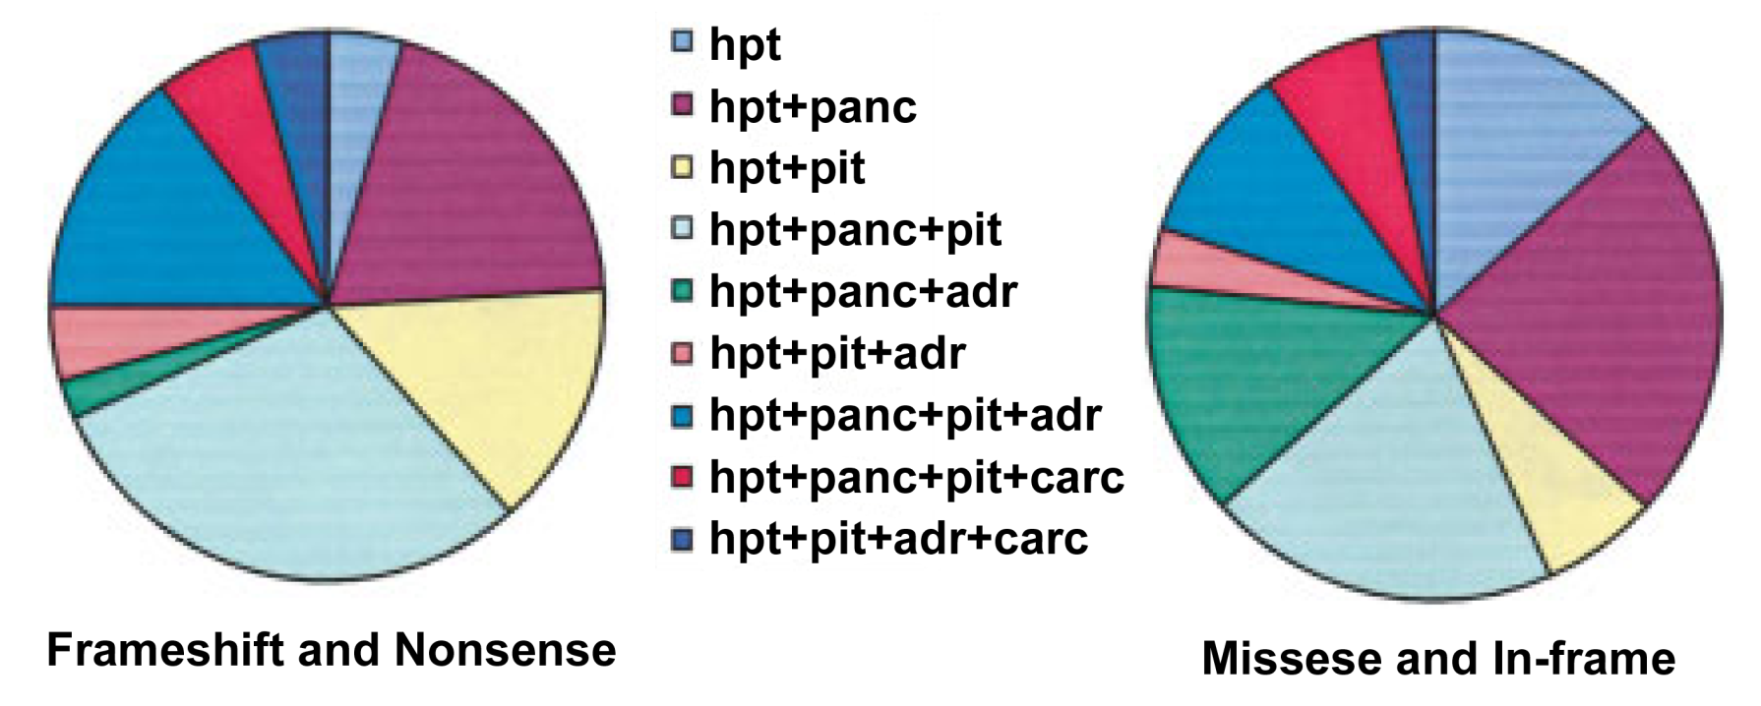
Genotype phenotype correlation in MEN1
There is no evidence of a phenotype genotype correlation in MEN1
Wide phenotypic variation within families
Menin is a tumour suppressor
Mutations are scattered with no hot spots
75% of mutations predict absent or truncated protein
Mutant Menin proteins are rapidly degraded
(Wautot V 2002 Hum Mut 20:35)

Slide 27
Genetic testing in MEN1 Should be performed in an accredited laboratory (Exeter, Oxford & Cambridge)
Genetic testing should be offered to
Index cases (2 of 3 main MEN1 tumours)
1st degree relative of known mutant gene carrier (as early as possible)
Suspicious/atypical cases with
2 or more MEN1 related tumours
Multiple/recurrent parathyroid tumours (<30y) or familial 1⁰HPT
Gastrinoma or multiple pancreatic NETs
MEN1 mutation screening is by direct sequencing
Screening MEN1 exons 2 to 10 £350
Dosage analysis (MLPA) Multiplex ligation-dependent probe amplification £100
Known MEN1 mutation in family member £100
If no MEN1 mutation identified and likely to be familial
Linkage analysis £245
(CDKN1B (MEN4); AIP (FIPA); CDC73 (HPT-JT); CaSR (FHH))
(Thakker RV et al 2012 JCEM 97:2990-3011;Brandi ML 2001 JCEM 86:5658; Ozawa A 2007JCEM 92:1948)

Slide 28
Genetic testing for MEN1
Probability of identifying a germline MEN1 mutation
75-95% of familial MEN1 probands 1% sporadic HPT
30-45% of sporadic MEN1 5% sporadic gastrinoma
10% of familial 1⁰HPT probands 1% sporadic prolactinama
1% familial pituitary tumours 1% sporadic carcinoid
Benefits of MEN1 genetic screening
Confirms the diagnosis in the proband
Targets biochemical screening to mutant gene carriers
Prevents unnecessary screening of unaffected family members
MEN1 genetic screening DOES NOT
Prevent cancer
Predict phenotype
Alter clinical management
(Thakker RV et al 2012 JCEM 97:2990-3011; Ellard S 2005 Clin Endo 62:169; Ozawa A 2007JCEM 92:1948)

Slide 29
Genetic testing algorithm for MEN1
(Thakker RV et al 2012 JCEM 97:2990-3011)

Slide 30
MEN1 Summary
MENIN is a tumour suppressor
MEN1 due to inactivating mutations throughout the coding region
Many cellular functions have now been ascribed to MENIN
Transcriptional regulation
Chromatin modification
Cell cycle control
Genome stability, DNA replication and repair
Apoptosis regulation
No phenotype genotype correlation in MEN1
Genetic testing confirms diagnosis and identifies mutant gene carriers
Target deletion in mice suggest
Menin induces expression of cell cycle inhibitors p18 and p27
Susceptible tissues
Are unable to compensate for reduced P18 and P27 levels
Menin haploinsufficiency predisposes to hyperplasia
Menin loss leads to atypical hyperplasia
Additional somatic events required for tumour formation

Slide 31
Multiple Endocrine Neoplasia Type 2

Slide 32
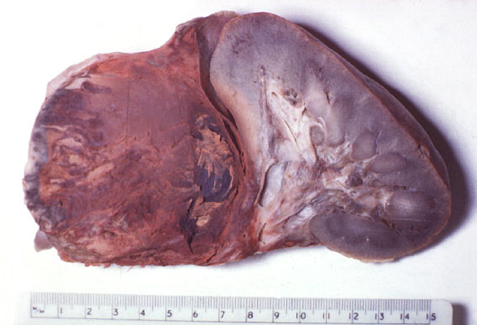
MEN2A and FMTC
MEN2 AD disease, high penetrance, prevalence >1/500,000
MTC
Phaeochromocytoma
CLA
MEN 2A (60%) Medullary thyroid carcinoma 90-100%
(5-10% de novo) Phaeochromocytoma 50%
Parathyroid hyperplasia 20-30%
MEN2A with Hirschsprungs (25 families)
MEN2A with cutaneous lichen amyloidosis (30 families)
FMTC (35%) Medullary thyroid carcinoma
(5-10% denovo) (Requires >10 carriers and multiple >50years old)

Slide 33
Multiple Endocrine Neoplasia Type 2A (Sipples Syndrome)
C-cell hyperplasia or MTC (100% by 30 years)
Thyroid nodule or mass uni/bilateral, diarrhoea in late stages
First presenting feature of MEN2
Phaeochromocytoma (20-50% uni or bilateral)
Sweating, anxiety, palpitations, HT, headaches, stroke,
Glucose intolerance
Often occurs 10y after MTC
Parathyroid hyperplasia/adenomas (5-20%)
Symptoms as in MEN1 but less aggressive
Frequently late onset

Slide 34
MEN2B only 5% of MEN2 and 50% Denovo
Marfanoid habitus
Mucosal neuromas
Medullary thyroid carcinoma (100%)
More aggressive than in MEN 2A, < 2y
Total thyroidectomy at the earliest age <1y
Phaeochromocytoma (50%)
As for MEN2A
Mucosal neuromas (>90%)
Tongue, lips and sub conjunctival and GI tract
Marfanoid habitus, pes cavus, scoliosis (>90%)
Pectus excavatum, slipped femoral epiphysis
GI ganglioneuromatosis / megacolon
Diarrhoea, colic, colonic obstruction and dilation

Slide 35
Biochemical Screening in MEN2
Iidentify family members with mutation
Clinical screening from the age of 1 to 2 years for life
Tumour Age Start Annual
MTC Prophylactic thyroidectomy
MTC 1 to 2 Calcitonin, Pentagastrin
Phaeochromocytoma 8-20y 3x Urinary catacholamines
1⁰HPT 8-20y Ca, PTH, VitD
Rapid further investigation of any abnormality

Slide 36
MEN2 is caused by gain-of-function mutations in the RET proto-oncogene
(REarranged during Transfection)

Slide 37
The RET proto-oncogene
Chr 10
Trans-membrane tyrosine kinase receptor
Restricted expression in cells derived from the neural crest
Chromosome 10
21 exons (1072-1114 amino acids)
3’ alternative splicing (RET9, RET43 and RET51)
Expression during embryogenesis
Developing excretory system
Peripheral nervous system
CNS neurons
C-cells of the thyroid
Essential function
Development enteric nervous system
Kidney organogenesis
Spermatogenesis

Slide 38
RET mutation and tumour formation
Normal Individual
Mutant gene carrier
Susceptible cell
with “gain-of-function”
mutation in one
RET allele
Susceptible cell
with 2 normal
RET alleles
RET
RET
Mutant
RET
RET
Normal proliferation differentiation and survival
Abnormal proliferation differentiation and survival
The pattern of RET expression can explain the endocrine nature of associated tumours

Slide 39
Receptor for the glial cell-derived neurotrophic factor family of ligands (GFLs)
RET
(Receptor)
GFRα
(Co-receptors)
GFLs
(Ligands)
Ligands
GFLs: GDNF, neurturin, artemin, persephin
Co-receptor
GDNF receptor-α family (GFRα1 – GFRα4)
GDNF GFRα1
Neurturin GFRα2
Artemin GFRα3
Persephin GFRα4
Receptor tyrosine kinase
RET
Cadherin
Cysteine
Tyrosine kinase
Differentiation Proliferation Survival Motility Apoptosis
(Plaza-Menacho I 2006 Trends Genet 22:627-636)

Slide 40
RET codons mutated in MEN2
Exon 5
321
515
531
532
533
600
603
606
609
611
618
620
630
631
633
634
649
666
95% of patients have RET mutations
138 different germ line mutations
Two hot spots
Cysteine rich domain
Tyrosine kinase domain
Mutations
95% missense mutations
5% in frame deletion/insertion
MEN2A and FMTC
5-10% de novo
MEN2B
50% de novo
Exon 8
NH₂
1
2
3
Cadherin like
4
Exon 10
5
6
7
8
9
Cysteine rich
Exon 11
10
11
Transmembrane
768
776
790
791
804
819
833
844
866
883
891
912
918
12
Exon 13
13
14
Tyrosine kinase
15
Exon 14
16
17
18
19
Exon 15
20
COOH
21
Exon 16
(Pacini F 2010 Clin Oncology 22:475-485; MEN2 mutation database, University of Utah)

Slide 41
Frequency of codon involvement in MEN2
MEN2A
MEN2B
Cysteine rich
TK
(Machens A 2003 NEJM 349:1517-1525)

Slide 42
Mechanism of gain-of-function mutations
Wild type RET
Cysteine rich domain
(MEN2A, FMTC)
TK domain
(MEN2A, FMTC, MEN2B)
GFLs
Covalent
dimerization
Ligand dependent
signalling
Ligand independent
constitutive activation
Altered TK activity and
substrate specificity
(Plaza-Menacho I 2006 Trends Genet 22:627-636)

Slide 43
Strong genotype phenotype correlation in MEN2
321
NH₂
1
515
531
532
533
600
603
606
609
611
618
620
630
631
633
634
649
666
2
3
MEN2A or FMTC
533
C609
C611
C618
C620
C630
633
C634
649
666
768
790
791
804
891
FMTC?
321
515
531
532
600
603
606
631
635
777
V804M+V778I
819
833
844
866
912
MEN 2B
A883F
V804M+E805K
V804M+Y806C
V804M+S904C
M918T
Cadherin like
4
5
6
7
Cysteine rich
8
9
10
80%
Transmembrane
11
768
777
790
791
804
819
833
844
866
883
891
912
918
12
13
14
Tyrosine kinase
15
16
17
18
19
95%
20
COOH
21

Slide 44
Animal models of MEN2
Mouse models of MEN2A
Transgenic rCGRP/CT promoter driven RET9-C634R (Michiels FM PNAS 1997 94:3330)
Multifocal bilateral MTC (similar to MEN2)
From 3 weeks of age to 14 months (variable penetrance)
Transgenic hCALC promoter driven RET51-C634R (Reynolds L 2001 Oncogene 20:3986)
MTC by 6 months, PTC and abnormal thyroid development
MTC frequency increased with time and background dependent
Mouse models of MEN2B
Transgenic hCALC promoter driven RET9-M919T (Acton DS 2000 Oncogene 19:3121)
C-cell hyperplasia from 8 months
Bilateral MTC from 20 months (variable penetrance and latency)
RET M919T knock-in mouse (Smith-Hicks CL 2000 EMBO 19:612)
RET(+/M919T) only CCH and pheochromocytoma at 12 months
RET(M919T/M919T) more severe CCH and male infertility
Genetic background, RET dosage and RET isoform effect tumours Additional oncogenic events are required for tumorigenesis

Slide 45
Genetic testing in MEN2 and Genotype phenotype correlation

Slide 46
Genetic testing in MEN2 and MTC (Exeter, Oxford and Cambridge)
Genetic testing should be offered in all patents with MEN2 and MTC
Index case and then all 1st degree relatives (<5y)
RET mutation screening is by direct exon sequencing
MEN2A/FMTC (exons 5,8,10,11,13,14,15 and 16) £245
MEN2B (exons 15 and 16) £105
Known RET mutation in family member £100
If no common RET mutation and likely to be familial
Sequence all 21 exons £600
(BTA/RCP 2007 Management of medullary thyroid cancer 41-48)
(Kloos RT 2009 ATA MTC Management Guidelines. Thyroid 19:565-612)

Slide 47
RET genetic testing
Probability of identifying a germline RET mutation
95% MEN2A and MEN2B
88% of FMTC
1-7% apparently sporadic MTC cases
Benefits of RET genetic testing
Distinguish sporadic from familial MTC
Early diagnosis of carrier state
Guides timing of prophylactic thyroidectormy
Directs surveillance for Phaeo, PHPT
PREVENTS CANCER
(BTA/RCP 2007 Management of medullary thyroid cancer 41-48)
(Kloos RT 2009 ATA MTC Management Guidelines. Thyroid 19:565-612)

Slide 48
A codon based approach risk stratification in MEN2

Slide 49
Risk stratification for MTC American Thyroid Association risk levels (2009)
NH₂
321
MEN2A/FMTC
533
609
611
618
620
630
633
634
649
666
768
790
791
804
891
FMTC?
321
515
531
532
600
603
606
631
635
777
819
833
844
866
912
MEN 2B
A883F
M918T
515
531
532
533
600
603
606
609
611
618
620
630
631
633
634
649
666
Level D: TTx ASAP but within the first year
Level C: TTx before 5 years
Level B: TTx by 5 years but may
be delayed if normal U/S and CT
768
777
790
791
804
819
833
844
866
883
891
912
918
Level A: TTx may be delayed if
normal U/S and CT<40pg/ml
in vitro transforming ability
Mutant codon: (768, V804M, 891):(609, 611, 618, 620):(630):(A883F): 634 : 918
Transforming ability: 1x 2x 3x 7x 9x 10x
COOH
(Kloos RT 2009 thyroid 19:565-612)

Slide 50
Youngest age of MTC and LN metastasis
A
B
C
A
D
Cysteine rich
TK

Slide 51
RET Cys634 and Val804 mutations
age of MTC and LN metastasis
634 (ATA risk level C)
804 (ATA risk level A)
Prophylactic thyroidectomy before 5 years
May delay thyroidectomy if
US normal and Ct <40
MTC
(n=129)
LN mets
(n=17)
MTC
(n=27)
LN mets
(n=18)

Slide 52
Risk stratification for phaeochromocytoma
B
C
B
D
?
2009 ATA recommendation for phaeochromocytoma screening
Level D 883 and 918 Annual screening from 8 years of age
Level C 634 Annual screening from 8 years of age
Level B 630 Annual screening from 8y
Others Annual screening from 20 years
Level A Periodical screening from 20 years
(Kloos RT 2009 thyroid 19:565)

Slide 53
Risk stratification for hyperparathyroidism
100%
RET 634 mutations
80%
60%
Cumulative risk of HPT
40%
20%
0%
0
20
40
60
80
Age
2009 ATA recommendation for 1⁰HPT screening
Level D 883 and 918 Screening not required in MEN2B
Level C 634 Most frequently associated with 1⁰HPT
Annual screening from 8y
Level B 630 Annual screening from 8y
Others Annual screening from 20 years
Level A Periodical screening from 20 years
(Kloos RT 2009 thyroid 19:565)

Slide 54
Limitations of a codon based approach to risk
Timing of thyroidectomy by mutant codon
Earliest reported incidence of MTC?
Average age at which MTC occurs?
Earliest reported incidence of metastasis?
Average age at which metastasis occurs?
Role of annual US and calcitonin measurement?
Limitations of codon based approaches
Influence of genetic background and modifier genes
MEN2A and FMTC families have the same mutations
Phenotype of RET mutant mice is background dependent
Variation within families less than between families
Additional stochastic events are required for tumour progression
Lack of sufficient clinical data for many rare mutations
Early thyroidectomy in a specialist centre has low risk of complications and cures cancer

Slide 55
MEN2 Summary
RET is a proto-oncogene and a receptor tyrosine kinase
Signalling via MAPK, AKT, JNK, PKC and JAK/STAT pathways
Roles in differentiation, proliferation, survival, motility and apoptosis
Expression pattern explains clinical phenotype
MEN2 caused by gain-of-function mutations
Mutations hotspots in cystine rich and TK domains
Strong phenotype genotype correlation
In vivo and in vitro
Genetic screening
Confirms diagnosis and identify mutant gene carriers
Guides clinical management and PREVENTS CANCER
Target mutation in mice suggest that
Phenotype is depends on genetic background
Phenotype dependent on RET isoform and gene dosage
Additional somatic events required for tumour formation

Slide 56
Contrasting molecular genetics in MEN1 and MEN2
Multiple Endocrine Neoplasia Type 1 (MENIN)
Loss-of-function mutations in a tumour suppressor gene
Further loss of the normal allele in tumours
Highly conserved protein with no known homology
Ubiquitously expressed but its function remains uncertain
No phenotype genotype correlation
Genetic screening
Confirms the diagnosis in the proband
Targets screening to mutant gene carriers
Does not prevent cancer
Multiple Endocrine Neoplasia Type 2 (RET)
Gain-of-function mutations in a proto-oncogene
Role as tyrosine kinase receptor already well established
Expression pattern consistent with clinical phenotype
Strong phenotype genotype correlation
Genetic screening
Confirms diagnosis and identifies mutant gene carriers
Directs clinical management and prevents cancer

