Slide 1
Endo BSc – a survival guide
Graham & Shiv
Endo BSc course reps 2011-12

Slide 2
Endo… good choice!
Exciting subject
One of the less intense BScs
Highly social
Good teaching
Brilliant choice of projects
What more could you ask for?!!!

Slide 3
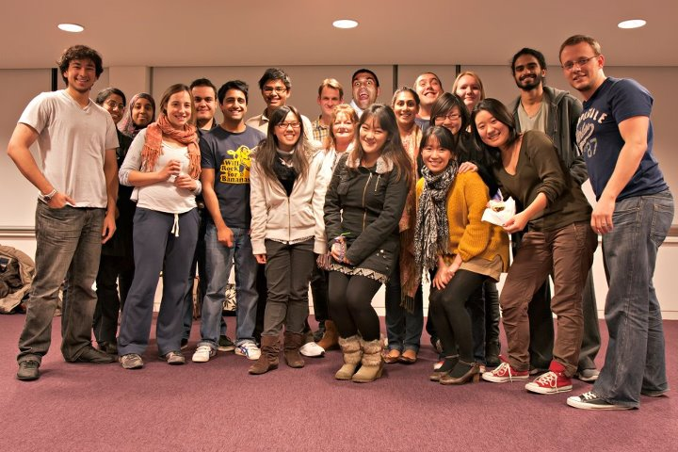

Slide 4
Content
Part A, B & C overview
ICA
Lectures
Exams
Project
Feel free to ask questions throughout!

Slide 5
Weighting
Part A = 0% (abstract may count towards project choice)
Part B = 60%
3 modules, each 20%
Module 1 exam = 14%
Module 1 ICA = 2 x 3%
Same for Modules 2 & 3
Part C = 40%

Slide 6
Part A (Intro course)
Gentle introduction to the course
Get familiar with RefWorks – learn how to use it now!
Endo social – we expect to be invited
Abstract

Slide 7
Abstract
Read the sample paper and abstract
Literally summarising the paper – nothing new!
Make it clear and concise!
4 sections: background/intro; methods; results; discussion/conclusions
Deadline: midnight Tuesday 2nd October

Slide 8
Part B
3 taught modules (2 before Xmas, 1 after)
2 week study leave
Exams

Slide 9
Part C
Project or specialist course
Should have chosen which by now
Project choices later in the year

Slide 10
ICAs
Critical appraisal
Essay

Slide 11
Critical appraisal
Need to read paper once to get a gist, and 2nd time to critique
Highlight important bits and annotate
Get together in pairs/groups to discuss
Read around the references of the paper
Follow the mark scheme
Word limit is tight!

Slide 12
Essay
Plan!
Start with PubMed search
Find reviews, and select references from this
20-40 references – import into RefWorks!
Give yourself enough time! It always takes a lot longer than you think (approx. 2 weeks)
Create bibliography and backup as you’re going along

Slide 13
Lectures
Module leaders’ lectures
Extra reading
Arrange tutorials for unclear lectures
Make notes in the lectures, esp. for graphs and figures
Slides aren’t enough on their own for revision

Slide 14
Exams
3 sections:
A: essay
B: data interpretation/critical appraisal
C: SAQs

Slide 15
Revision
Xmas hols – useful for consolidation for Modules 1 & 2
2 week study leave after Module 3
Pace yourself from Xmas
Module 3: need to keep on top of while you’re going along, esp. ICAs
You will all be fine!

Slide 16
Project
40%!
Lab vs. clinical vs. library
Very independent
5000 words over 10 weeks (vs. 2500 words for ICA essay)
Start reading early
Draft write-up early
Meet your supervisor regularly

Slide 17
Specialist course mini-project
DAL, medical humanities, history of medicine
Courseworks + mini-project
Mini-project very similar to ICAs
Your choice of title – choose something you’re interested in!
Only 5 weeks to do mini-project – use time wisely

Slide 18
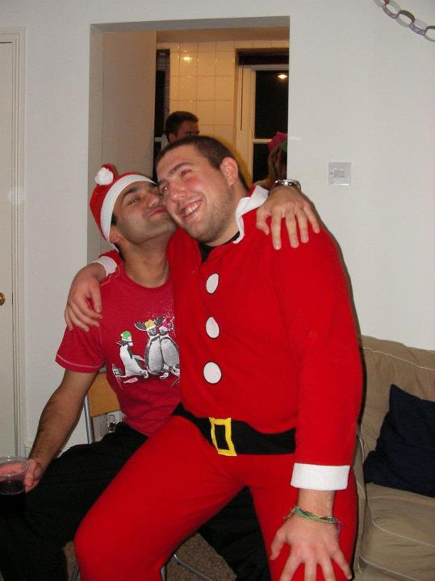
Any questions?

Slide 19
If you need a hand…
Graham: graham.hantman08@imperial.ac.uk
Shiv: shiv.vohra08@imperial.ac.uk

