Slide 1
Database search skills and RefWorks
BSc Endocrinology/BSc Reproductive & Developmental Sciences
24/25 September 2012
Michael Gainsford
Notes:
Introduction

Slide 2
Outline & Aims
Library resources – a brief refresher
Literature searching
Search strategies
Databases
OVIDSP (Medline) – advanced features
Full text articles
Manage references using Refworks
Notes:
The areas I will be covering today include a brief refresher on the some key library resource and how to access them. We will then look at literature searching which involves building an effective search strategy and carrying out advanced searches on databases such as at OVIDSP, an interface for a number of databases including Medline and Embase, among others.

Slide 3
Library Resources

Slide 4
Library resources
Notes:
Subject resources:
Databases
Medical websites
E-journals
Research support etc

Slide 5
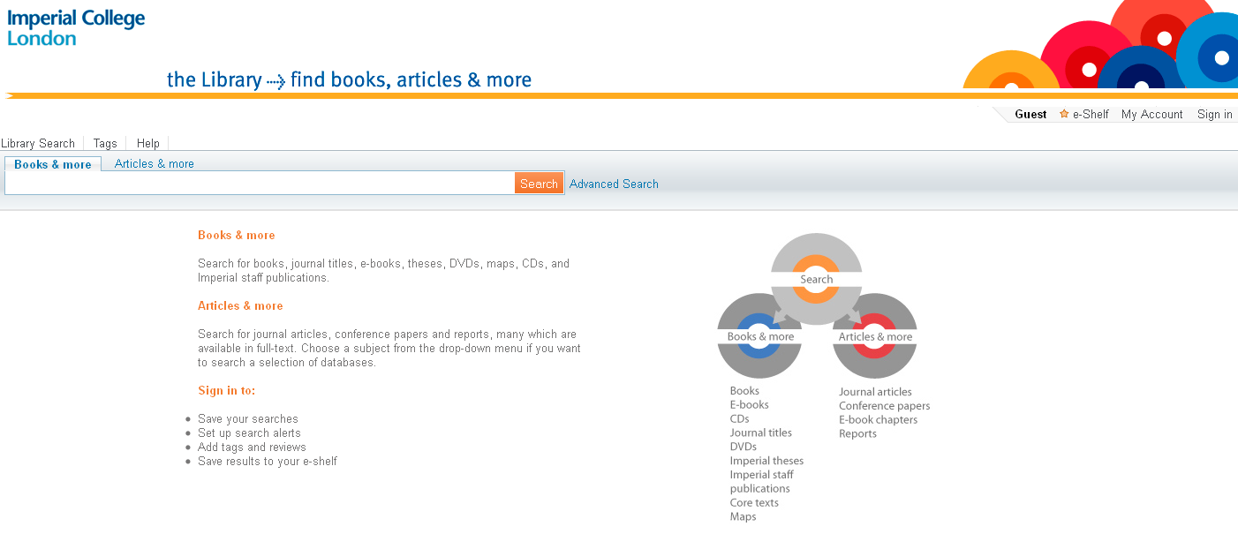
Library search

Slide 6
Imperial Mobile App
www.imperial.ac.uk/imperialmobile
Can use to check PC availability in the Central Library

Slide 7
Literature Searching
Notes:
BSc projects

Slide 8
Databases
Provide a way of searching across a large number of journals to find relevant articles.
Contain collections of indexed references to journal articles.
Contain bibliographic information and abstracts of journal articles.

Slide 9
Choosing a database
Core databases
Medline - Accessible via the database hosts - PubMed and OvidSP
Embase - Accessible via the database host - OvidSP
Web of Science
Cochrane Database of Systematic Reviews
Notes:
The most frequently used medical database is Medline which is available via various different interfaces.
Free via PubMed interface (via the US National Library of Medicine), as Pubmed is free you can get access to Medline throughout your career.
Also via Ovid.
Medline is a bibliographic database that lets you search millions of article references and abstracts in the fields of medicine, health care, and preclinical sciences. Has a slight American bias.
The Ovid interface also provides access to other databases; such as Embase. Embase covers more European journals and is especially strong on drugs and therapeutics.
We will focus on Medline today but I will first give you an overview of some the other databases out there.
Web of knowledge allows you to search through a number of general databases that cover science and humanities.
It allows you to do citation searching, so you can see how many times and where a particular article has been cited.
Provides access to journal citation reports, allowing you to find ‘journal impact factors’ where you can see which journals are most influential in a particular subject area.
You can access ‘Web of Science’ via WoK, where you can search for journal articles and the proceedings of worldwide conferences.
The Cochrane Library, a free Evidence Based medicine resource that provides access to systematic reviews carried out by the Cochrane Collaboration (who are seen as the ‘Gold standard’). Cochrane also contains the worlds largest searchable register of randomised control trials – demo and review groups.

Slide 10
Cochrane Library Review Groups
Notes:
Medicine context:
Links to Cochrane Library
About us – Cochrane Library Review Groups

Slide 11
Search strategies
Create a comprehensive search strategy
Clearly define your search concepts
Identify relevant keywords
Combine your keywords together to retrieve relevant papers
Notes:
BSc projects

Slide 12
Planning your search
Before you start Searching…….
Make sure you have:
Asked a focused, answerable question
Broken your search down into its key concepts

Slide 13
Ask a focused, answerable question
How effective is exercise?
How effective is physical training for interstitial lung disease?
How effective is magnesium sulfate?
How effective is inhaled magnesium sulfate in the treatment of acute asthma?

Slide 14
Planning your search
Break it down into separate keywords / subjects
Concept 1
Self-Monitoring
Concept 2
Blood glucose
Concept 3
Diabetes
Is self-monitoring effective for blood glucose control in patients with diabetes?

Slide 15
Choosing your search terms
There are 2 ways to go about searching a
database…..
Using free text word terms
Using subject headings

Slide 16
Text word searching
Do not recognise sentences like search engines such as Google.
Databases look for the appearance of single key words

Slide 17
Synonyms and additional terms
Look out for spelling differences (e.g. British / US)
Plurals
Coronary Heart Disease OR Coronary Heart Diseases
Pregnancy OR Pregnant OR Pregnancies etc
Synonyms
Primary Prevention OR Preventive Medicine

Slide 18
Search techniques
The term ‘AND’ will narrow your search
Concept 1
Self-monitoring
Concept 2
Blood glucose
Concept 3
Diabetes
AND
AND
Items containing all words will now be searched for. Using ‘and’ will usually result in fewer but more relevant hits.
Notes:
Link keywords together in your database search.
Boolean terms (logic), AND, OR (sometimes NOT) link different concepts together.
Use AND to find articles about each concept. AND will narrow your search by looking only for articles which include all of the terms.
So this search will find only articles which include self-monitoring, blood glucose and diabetes.

Slide 19
Search techniques
The term ‘OR’ will broaden a search
Concept 1
Self-monitoring
OR
Self-care
Concept 2
Blood glucose
OR
Blood sugar
Concept 3
Diabetes
OR
Type 2 Diabetes
AND
AND
Items containing either word will now be searched for. Remember to Use all variations or synonyms of a word to be comprehensive.
Notes:
Use OR to expand each concept by adding additional keywords; synonyms, plurals and spelling differences.
E.g. A synonym of self-monitoring is self-care (or self-administration). A synonym of concept 2 could be glucose (on it’s own), blood sugar or Hexoses/Monosaccharides.
Obviously you could think of more. You expand a search using ‘OR’ – this broadens your search increasing your results.
DEMO here

Slide 20
Search techniques
Truncation symbol (usually $ or *) e.g. Allerg* finds allergic, allergy, allergies etc
Wild cards e.g. ? Organi?ation
Notes:
Truncation lets you search for any words starting with a particular word stem.
Different databases may use slightly different symbols.
Wild cards will let you search for a missing letter or letters in the middle of a word (alternative spellings e.g. American).
Some databases, like Pubmed, will do a lot of this for you automatically, but it’s useful to bear this in mind as sometimes it will help you to increase your results.
Also useful for databases available through Ovid.

Slide 21
Adjacent words
You can use terms such as adj
Prolonged adj2 antibiotic$1 = (adj2 would find articles containing your search words up to two words apart) e.g.
Prolonged antibiotic use
Prolonged use of antibiotics
Prolonged treatment with antibiotics

Slide 22
Subject Headings
Notes:
Subject Headings:
Most databases have a thesaurus of terms for the subjects covered by the database. Indexers go through each article in the database and decide what subjects it covers, they then match or assign the article subject headings from the fixed thesaurus.

Slide 23
Subject Headings
MeSH (Medical subject Headings) OR Thesaurus
(Name varies across databases)
Controlled vocabulary: articles indexed regardless of author’s terminology
Time delay while article are indexed
Notes:
MeSH = Medical Subject Headings are a particular set of controlled vocabulary to index articles. The big advantage is that you don’t have to second guess what terminology an author has used.
Articles get indexed by individuals and it can take a few months before that happens. In the meantime the article can be searched for by using keywords. Be aware of this as you don’t want to miss out on relevant articles. A combination of text word and subject searching is best.
Sometimes there will not be an appropriate subject heading for your search and you will have to use a text word search instead, you can’t be sure you have covered everything if you rely solely on a subject heading search – how thorough you are depends on what/why you’re searching and how essential it is that you don’t miss anything.

Slide 24
Subject Headings
Mapping a term to a subject heading
Database finds relevant subject heading required
Notes:
Explode or Focus an indexed term (demo)
Or continue with a keyword search
‘Scope’ explains the coverage of the indexed term

Slide 25
Subject Headings
Searching the Database Thesaurus
In Pubmed, known as MeSH database.
Notes:
The subject headings sit in a tree going from larger to smaller headings so you can see that Diabetes Type 2 is a subset of Diabetes Mellitus but Diabetes Mellitus sits below Metabolic Diseases and Nutritional and Metabolic Diseases.
Search through the relevant subject ‘trees’. Expanding and collapsing various terms.
The further down the tree, the narrower the results (hits).

Slide 26
Subject headings
Using subheadings
Use specific subheadings to narrow search further
Notes:
Subheadings do some of the work for you

Slide 27
Subject Headings
Subject headings attached to a relevant article.

Slide 28
Text words vs. Subject headings
Use text-words when:
There is no appropriate subject heading
The database does not have a thesaurus
If you are looking for very recent material (it takes time to index new and recently added articles)
Things to remember:
Text words likely to retrieve irrelevant results
Use all variations or synonyms of a word to be comprehensive

Slide 29
Combine Methods
For a comprehensive search use a combination of both methods
Searching a database is not an exact science.
Try different search combinations to get a good set of results.
Useful search tip
To find relevant subject headings, conduct a basic text-word search first, check records of relevant articles for the subject headings used.

Slide 30
Search history
Combine previous searches using search history

Slide 31
Setting Limits
Publication year
Publication / article type
Age group
Gender
Language
Notes:
Setting limits – narrow your results and focus your search but be cautious
The options to set limits vary from database to database
Age group - e.g. young adults or infants
Article type - review article or clinical trial.
Language - most articles have an English abstract so you may want to look at these.
Year – Select a year range (i.e. Look at just the most recent research)

Slide 32
Searching OvidSP - Medline
The Medline database includes over 22 million citations for biomedical articles. It also includes links to many sites providing full-text articles.
Access OvidSP via the library website: www.imperial.ac.uk/library
Notes:
Pubmed is a freely available database so you can access it by just typing in pubmed.gov but if you access it via the library webpage it will recognise that you are an Imperial student and include the SFX link so you can access full text articles from journals that are paid for by Imperial. If you don’t do this it will only provide links to articles that are available free to anyone.
When searching it’s usually best to search for each concept in your search separately and then combine them. I’m going to show you about combining sets.
Access article called Blood glucose control using an artificial pancreas reduces the workload of ICU nurses to show SFX button

Slide 33
Search Questions
Try the sample searches on the handout, or try your own search.

Slide 34
Reference management software package
Save and organise your references
Web based – available wherever you are
Create citations and a bibliography from saved references

Slide 35
Accessing RefWorks
#1-Go to the library homepage: http://www3.imperial.ac.uk/library
#2-Select Reference Management under the ‘Find Out About’ column
#3-Once you’re on the Reference Management page, select RefWorks from the column on the right
#4-Select Log in to RefWorks at the bottom of the RefWorks page
Notes:
Demo & Workbook

Slide 36
Support
Hammersmith
Michael Gainsford m.gainsford@imperial.ac.uk Tel: + 44 (0)20 8383 2186
Royal Brompton/Central
Andrew Regan
a.regan@imperial.ac.uk
Tel: +44 (0)20 7594 8150
St Mary's
Jackie Cousins j.cousins@imperial.ac.uk Tel: +44 (0)20 7594 3691
Liaison Librarians, Medicine:
Charing Cross
Kate Perris
k.perris@imperial.ac.uk
Tel: +44 (0)20 7594 0756
Chelsea & Westminster
James Lockley
j.lockley@imperial.ac.uk
Tel: +44 (0)20 3315 8109

