Slide 1
BSc in Cardiovascular Science
Bruno Rojas
Department of Nuclear Medicine
Royal Brompton Hospital
Radiation
Protection

Slide 2
Talk Outline
Origin of Ionising Radiation
production of Gamma rays
productions of X-rays
Protection against ionising radiation
detrimental effects
dose limits
risks to foetus
principles of radiation protection

Slide 3
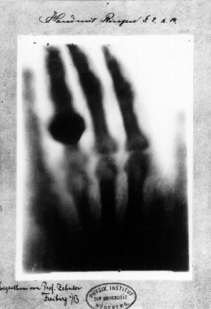
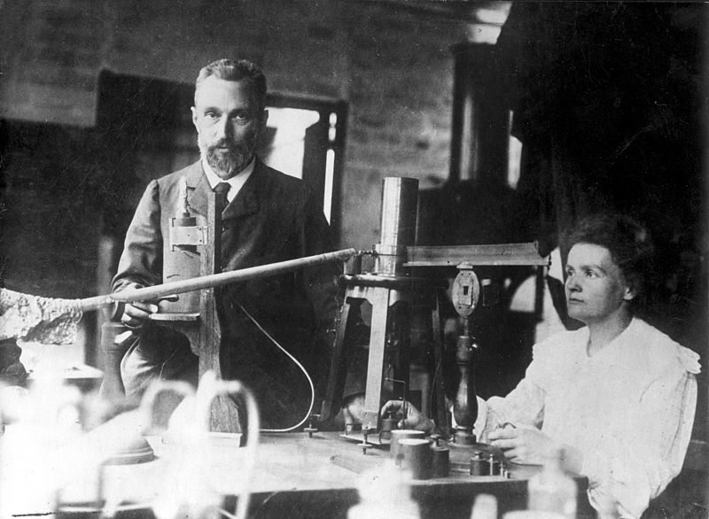
Discovery of ‘Radiation’
X-rays
Radioactivity
1895
1896

Slide 4
THE ORIGIN OF IONISING RADIATION
Radiation is energy that travels through space or matter
Two types important in diagnostic imaging
electromagnetic
particulate

Slide 5
ELECTROMAGNETIC RADIATION
No mass
Unaffected by either electrical or magnetic fields
Has a constant speed in a given medium
Does not require matter for propagation

Slide 6
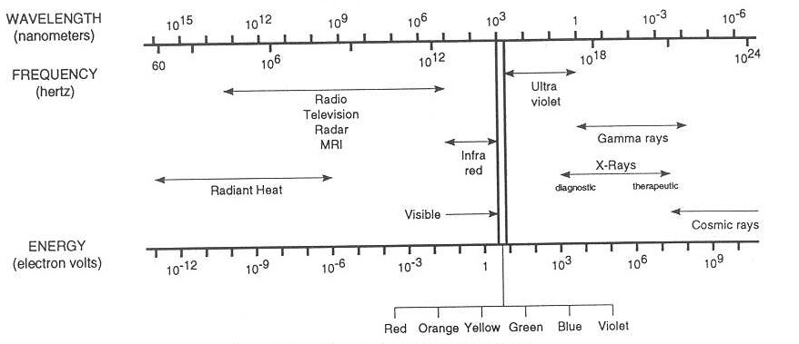
ELECTROMAGNETIC RADIATION
Characterised by wavelength (λ), frequency (ν), energy per photon (E)
Electromagnetic spectrum:

Slide 7
ELECTROMAGNETIC RADIATION
EM radiation behaves like waves and/or particles
Wave characteristics
c = λν
Particle characteristics
where E is energy of the photon/quanta
h is Planck’s constant
E = hν = hc/λ

Slide 8
ELECTROMAGNETIC RADIATION
On the EM spectrum, radiation of frequency higher than visible light carries sufficient energy to remove bound electrons from atomic shells
Results in ionised atoms and molecules…
…IONISING RADIATION

Slide 9
PARTICULATE RADIATION
Protons - in nuclei of all atoms
Electrons - in orbits surrounding atomic nucleus
Beta particles – e⁻ (electrons) emitted by nuclei of radioactive atoms
Positrons – e⁺, emitted from nuclei
Alpha particles - 2 protons and 2 neutrons

Slide 10
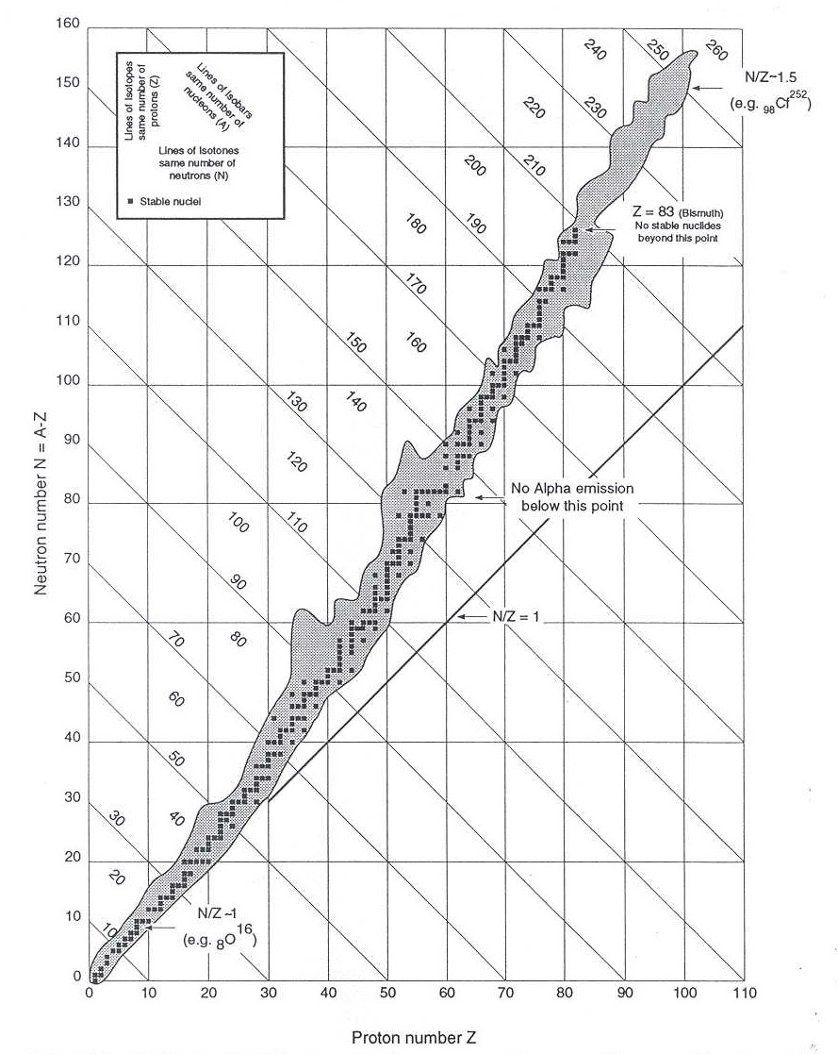
NUCLEAR STABILITY
Only certain combinations of neutrons and protons in nucleus are stable
Two kinds of instability:
neutron excess
neutron deficiency
Unstable nuclei have excess internal energy
Unstable nuclei are radioactive
Particulate emission to achieve stability

Slide 11
RADIOACTIVE DECAY - Gamma ray production
Parent nuclide decays to daughter
Daughter nucleus usually in an excited state
Excited state decays to lower (more stable) energy state
EM wave emitted - gamma radiation

Slide 12
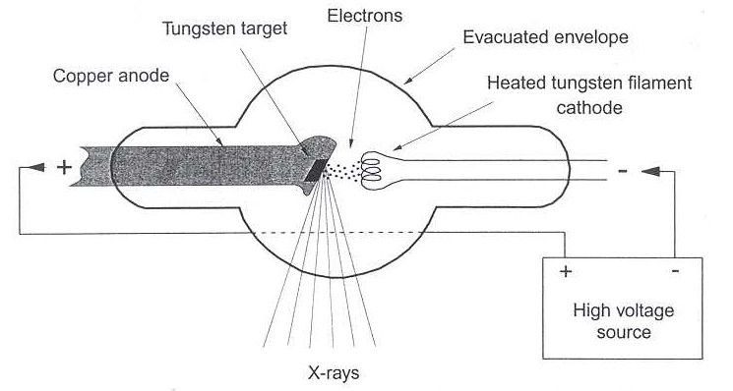
X-RAYS
Can be produced using an x-ray tube:

Slide 13
X-RAYS
Incident e⁻ fired into close proximity of large electric field of nuclei in target
e⁻ decelerated, resulting in loss of KE
Lost KE released as EM radiation – x-rays
x–rays produced by conversion of electron KE into EM radiation
gamma radiation produced as EM wave emitted from nucleus of atom

Slide 14
PROTECTION AGAINST IONISING RADIATION

Slide 15
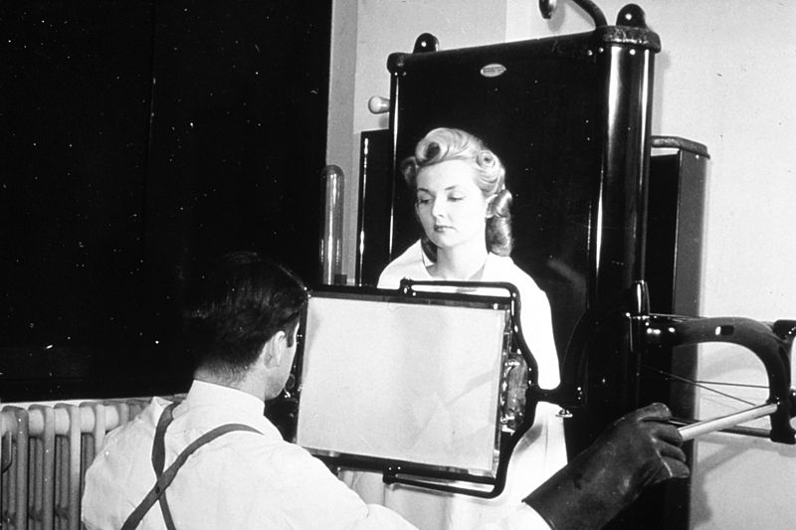
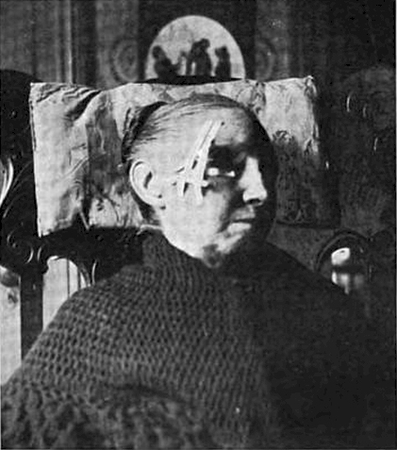
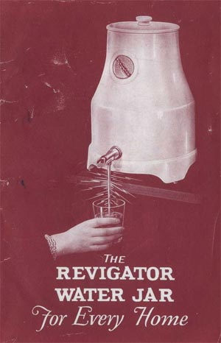
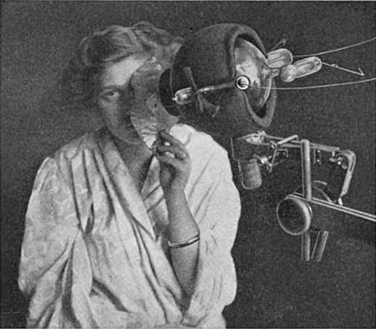
Early healthcare uses
X-rays
Radioactivity
Imaging
Radium therapy/ Brachytherapy
Röntgentherapy/ Radiotherapy
Quackery

Slide 16
Early healthcare ‘misuses’
Early 1900’s – no understanding of radiation ‘dose’, limited evidence of harms
X-rays:
No filtration – large skin dose to patient
No shielding – staff received large doses
Radioactivity
Discovered Radium/Radon in spa’s
Purified Radium for domestic use, huge public demand

Slide 17
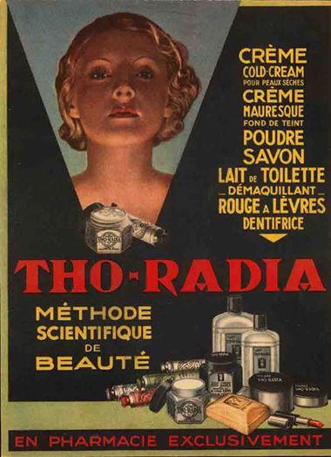
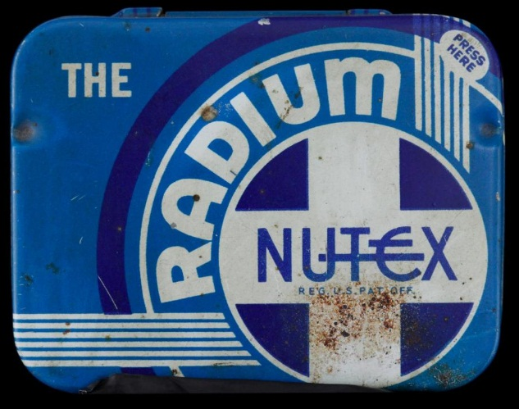
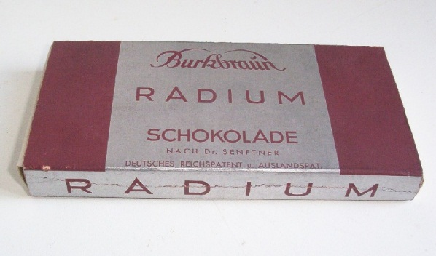
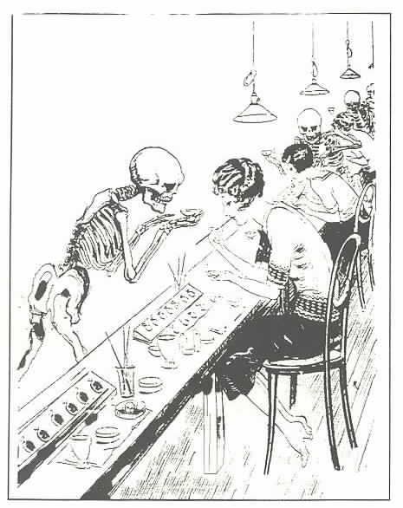
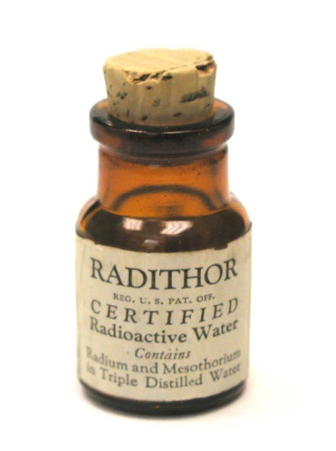
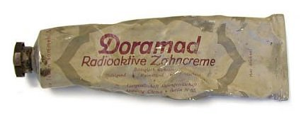
Give them what they want
Esthetic
Domestic
Health

Slide 18
Radiation Protection in Diagnostic Imaging
Ionising radiation - enough energy to dislodge e⁻
Human cells impaired - die, genetic effects, cancer
Use of radiation strictly controlled
ICRP consists of specialists in radiation effects
ICRP (60) 1990 recommendations incorporated in legislation
ICRP (103) 2007 recommendations are published, yet to be incorporated

Slide 19
Detrimental Effects of Radiation
Basically two types -
Deterministic effects: Threshold value; under - no effect; above - severity proportional to dose received
Stochastic effects: No threshold; risk increases with dose received

Slide 20
Deterministic Effects
Examples:
erythema
Cataracts
radiation sickness
necrosis
Effect
Radiation dose

Slide 21
Stochastic effects
Examples :
cancer
genetic effects
Risk
?
Radiation dose

Slide 22
ALARA
“All doses should be kept As Low As Reasonably Achievable, social and economic factors taken into account”

Slide 23
Radiation Dosimetry
Absorbed Dose, Gray (1 Gy=1 J/kg)
Effective Dose, Sievert (Sv)
adjusted for - radiation type - irradiated organ(s)
to give whole body dose
Effective dose allows comparison of exposures from different means

Slide 24
Weighting Factors
Radiation Weighting Factors
photons (all energies) 1
Electrons/beta (all energies) 1
protons 5
alpha particles 20
Tissue Weighting Factors
skin 0.01
lung 0.12
reproductive organs 0.20

Slide 25
Dose Limits for staff and public
Prevent deterministic effects
Limit (reduce) stochastic effects (mainly cancer) to acceptable levels
Level of acceptability differs for radiation workers and members of the public

Slide 26
Dose Limits - Factors considered
Perceived acceptable mortality risks
Workers:
mortality risk of 1/100 is unacceptable
mortality risk of 1/1 000 perhaps acceptable
Public:
public hazard with mortality risk of 1/100 000 perhaps acceptable
Age at exposure

Slide 27
Mortality Risks
Activities carrying a 1 in 10,000 risk of death:
Whole body exposure to 2 mSv ionising radiation
Smoking 150 cigarettes
Travelling 5000 miles by car
Travelling 25,000 miles by passenger aircraft
Effective doses of some typical medical procedures:
Chest x-ray 0.02-0.05 mSv
Nuclear Medicine ^{99m}Tc bone scan 3 mSv
Abdominal CT 4 mSv
¹⁸F FDG PET scan 10 mSv

Slide 28
Cancer Risk
Chance for fatal cancer (general)
= 5% per Sv exposure
= 1 in 20 per Sv exposure
= 1 in 20,000 per mSv

Slide 29
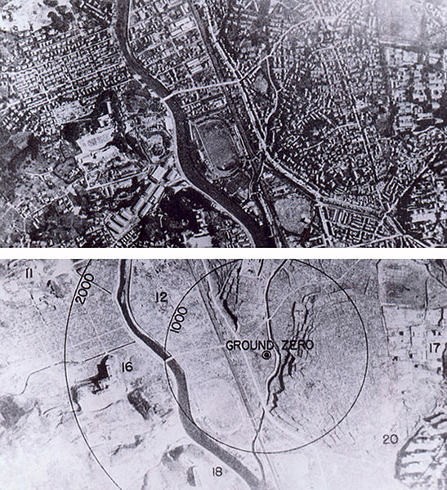
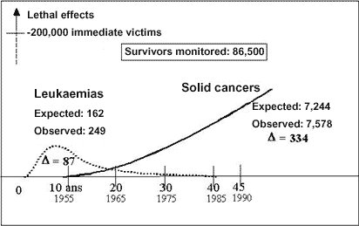
Evidence of risk
Hibakusha of Hiroshima and Nagasaki
Chernobyl liquidators
Uranium Miners

Slide 30
Annual Dose Limits*
Workers:
Effective dose (whole body) - 20 mSv per year
Equivalent doses lens of eye - 150 mSv per year (soon 20mSv)
1cm² skin - 500 mSv per year
extremities – 500 mSv per year
Public:
Effective dose (whole body) - 1 mSv per year
Equivalent doses lens of eye - 15 mSv per year
1cm² skin - 50 mSv per year
extremities – 50 mSv per year
*Taken from The Ionising Radiation Regulations 1999 (and ICRP 2011 Statement on tissue reactions)

Slide 31
Effective doses from typical examinations
Category | Examination | Effective Dose, mSv
Simple x-ray | Chest | 0.05
Simple x-ray | Skull | 0.15
Simple x-ray | Abdomen or pelvis | 1
Complex x-ray | IVU | 3.5
Complex x-ray | Barium meal | 3
Complex x-ray | Barium enema | 7
CT | Spiral CT abdomen | 4
Nuclear Medicine | Tc-99m bone scan | 3
Nuclear Medicine | Tc-99m MPI cardiac | 10

Slide 32
Radiation Risk to Foetus
Radiation exposure may cause detrimental effects such as:
death of foetus
abnormalities/malformation of limbs and organs
mental retardation
cancer and genetic effects
New guidance ‘Protection of Pregnant Patients during Diagnostic Medical Exposures to Ionising Radiation’
http://www.hpa.org.uk/web/HPAwebFile/HPAweb_C/1238230848746

Slide 33
Radiation Risk to the Foetus
For typical range of fetal dose given in diagnostic medicine (much less than 100mGy threshold)- no risk of causing fetal death, malformation, growth retardation of impairment of mental development
Main concern- childhood cancer induction (stochastic effect with no threshold)

Slide 34
Radiation Risk to the Foetus- Cancer Induction
Fetal dose is grouped into bands- to cover the wide range of dose due to equipment variation and the uncertainties in the risk estimates
Baseline risk of childhood cancer is 1 in 500
The excess absolute risk factor for incidence of childhood cancer is ~1 in 10,000 per mGy
Fetal dose of ~25mGy will lead to double the risk of childhood cancer

Slide 35
Radiation Risk to the Foetus
Exam | Typical fetal dose range (mGy) | Risk of childhood cancer per exam
Xray skull | 0.001-0.01 | <1 in 1,000,000
Xray chest | 0.001-0.01 | <1 in 1,000,000
Xray CT pulmonary angiogram | 0.01-0.1 | 1 in 1,000,000 to 1 in 100,000
Xray abdomen | 0.1-1.0 | 1 in 100,000 to 1 in 10,000
^{99m}Tc renal scan (DMSA, MAG3) | 0.1-1.0 | 1 in 100,000 to 1 in 10,000
Xray barium enema | 1.0-10 | 1 in 10,000 to 1 in 1,000
99mTc bone scan | 1.0-10 | 1 in 10,000 to 1 in 1,000
Xray CT pelvis | 10-50 | 1 in 1,000 to 1 in 200
18F PET/CT whole body | 10-50 | 1 in 1,000 to 1 in 200

Slide 36
Advice regarding Termination of Pregnancy – Diagnostic Procedures
For majority of diagnostic exposures to a pregnant woman (fetal dose up to 1mGy) associated risks in childhood are deemed acceptable when compared to natural risk
For typical exposures (fetal dose 1-50 mGy) care should be taken in justification process and these exams should be avoided if without causing detrimental effects on health
Termination of pregnancy unlikely to be justified even following higher dose procedures (e.g. pelvic CT)

Slide 37
Normal Pregnancy Risks
spontaneous abortion 15%
important abnormalities 3%
significant mental retardation 0.5%
genetic illness 8-10%
cancer 0.1%

Slide 38
Principles of Radiation Protection
TIME
DISTANCE
SHIELDING

Slide 39
Principles of Radiation Protection
Time
Exposure time is directly proportional to effective dose
All work resulting in radiation exposure must be completed as quickly as possible

Slide 40
Principles of Radiation Protection
Distance – the exposure rate, X, of radiation is inversely proportional to the square of the distance from its origin
Always keep as far as possible from radiation

Slide 41
Principles of Radiation Protection
2m
1m
dose
¼ dose

Slide 42
Principles of Radiation Protection
Shielding
To protect from radiation, when one must be close to the source, a shield of appropriate material may be used. The thickness, d, can be calculated from
X_{d} = X₀e^{-μd}
where X₀ is the exposure rate at origin, X_{d} the exposure rate desired and μ is the attenuation coefficient of the shielding material
Always use shielding when advised

Slide 43
Summary
There are risks associated with radiation exposure
Deterministic effects (burns etc)
Stochastic effects (cancer)
Staff and public doses must be kept below the dose limits and ALARP
Patient doses must be clinically justified

