Slide 1


Imaging in heart failure
S Richard Underwood
Professor of Cardiac Imaging
Royal Brompton Hospital &
Imperial College London, UK

Slide 2
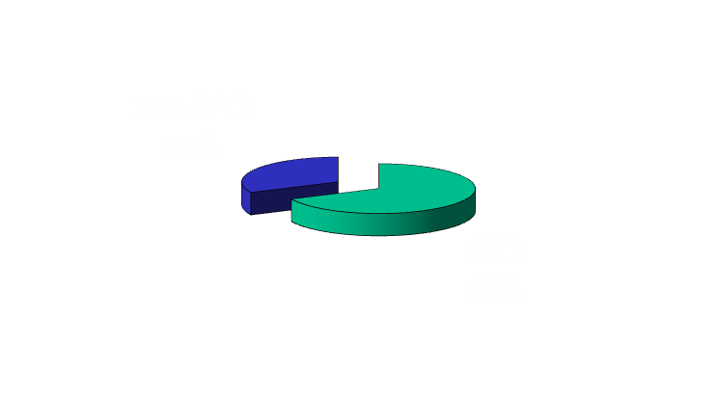
What is heart failure?
Cardiac output that is insufficient to meet the needs of the body
  Myocardial dysfunction IHD, CM
  Volume overload AR, MR
  Obstruction AS, HCM
  Diastolic dysfunction constriction
  Mechanical problems LV aneurysm
  Rhythm disturbance AF
  High output shunts

Slide 3
Demographics of heart failure
Prevalence
  3% age 65-74
  6% age 75-84
  15% age >84
  900,000 heart failure
  900,000 asymptomatic LV dysfunction
Average age at presentation 76
2% of NHS bed occupancy
Cost to NHS £716M or 1.8% of budget

Slide 4
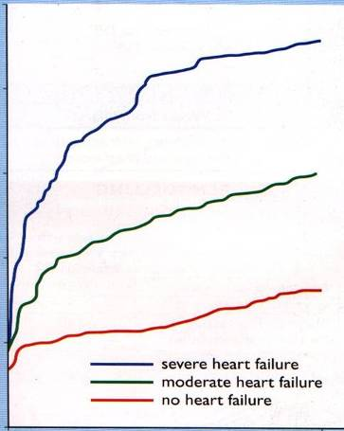
Heart failure mortality
50
Mortality
= CA colon
> CA breast, prostate
40
30
Mortality %
20
10
0
0
1 year

Slide 5
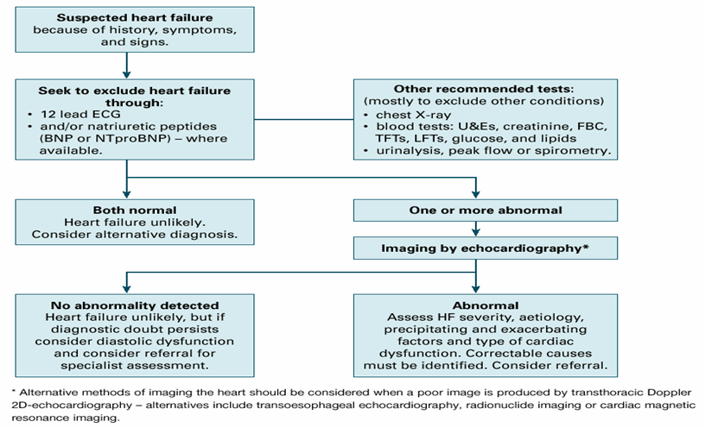
Diagnosis of Heart Failure
NICE guideline

Slide 6

Imaging the Failing heart
viability
echo
perfusion
nuclear
function
X-ray CT
fibrosis
coronaries
MRI

Slide 7
Structure of session
What is hibernating myocardium?
How can it be detected?
Case examples
Imaging and ischaemic LV dysfunction

Slide 8
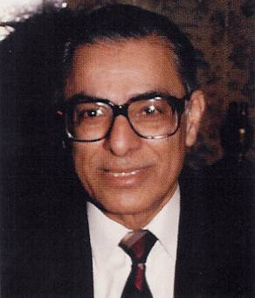

SH Rahimtoola
University of Southern California

Slide 9
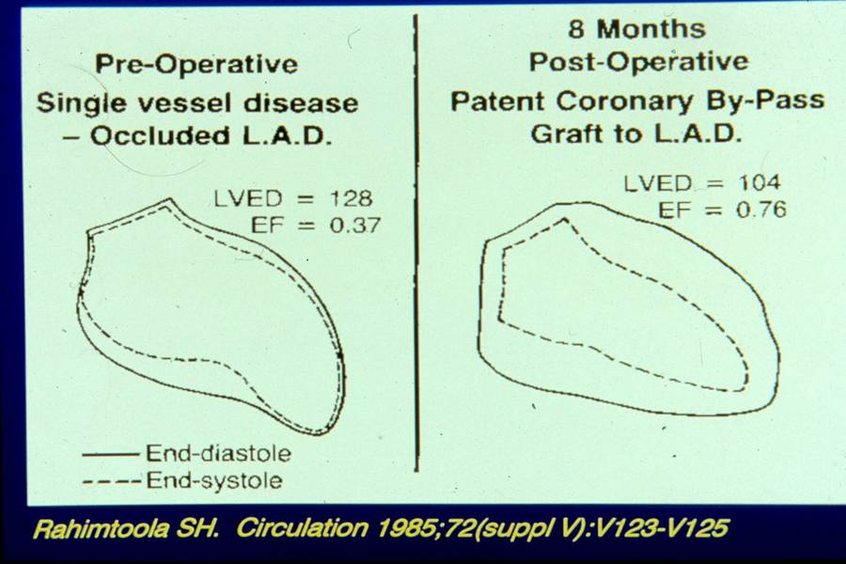

Slide 10
Clinical Definitions
Viable
Hibernating
Stunned
alive
alive
- reduced resting function (chronic)
- recovery after revascularisation
- alive
- reduced resting function (acute)
- spontaneous recovery

Slide 11
Viable Myocardium
Normal
Reversible ischaemic
Partial thickness infarction
Partial thickness infarction + ischaemia
Hibernating
Stunned
Myopathic

Slide 12
Viable Myocardium – A Continuum
Normal uptake
Mild reduction
Moderate reduction
Severe reduction
Absent uptake

Slide 13
Proposed Mechanisms of Hibernation
chronic reduction of resting perfusion
  rematch oxygen supply and demand
repetitive stunning
mixture

Slide 14
Myocardial Perfusion in Hibernation
Marinho N, et al. Circulation 1996; 93: 737-44
30 patients, LVEF < 35%, MBF by H₂¹⁵O
P = ns

Slide 15
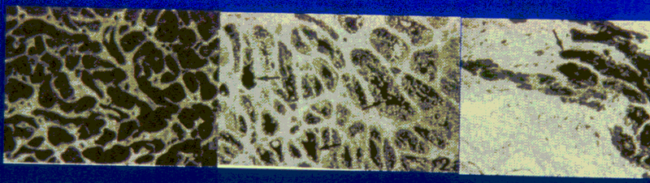
Light microscopy
Maes A, et al. Circulation 1994; 90:735-45
Normal function
Abnormal function
PET mismatch
Preservation of myocytes
Accumulation of glycogen
Abnormal function
PET match
Loss of myocytes
Extensive connective tissue

Slide 16
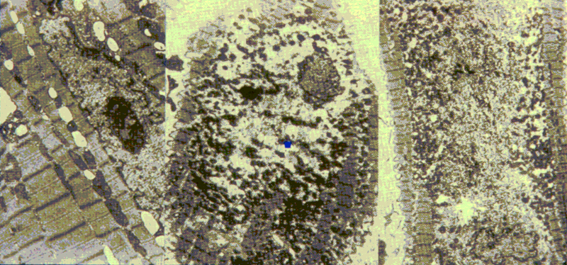
Increasing loss of contractile material
Flameng W, et al. Am Heart J 1981; 102: 846-56

Slide 17
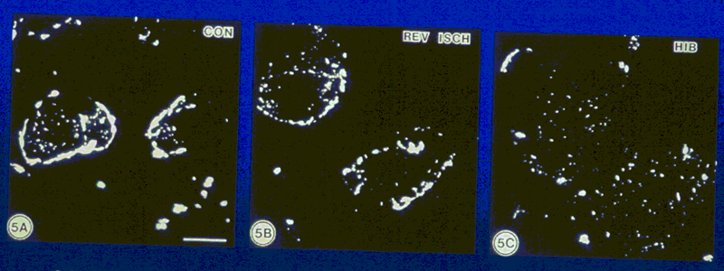
Gap junction distribution
Kaprielian RR, et al. Circulation 1998: 97: 651-60
Connexin-43 immunocytochemistry
normal
ischaemic
hibernating

Slide 18
Summary
Hibernating myocardium is
viable myocardium
akinetic myocardium
an ischaemic syndrome
improves function after revascularisation
initially repetitive stunning (functional hibernation)
later structural changes (structural hibernation)

Slide 19
Structure of session
What is hibernating myocardium?
How can it be detected?
Case examples
Imaging and ischaemic LV dysfunction

Slide 20
Radionuclide imaging
Ventricular function
Myocardial perfusion = hibernation
Myocardial viability
Myocardial metabolism
Neuroendocrine function

Slide 21
Surrogate definition
Hibernating myocardium is:
viable
akinetic
susceptible to ischaemia

Slide 22
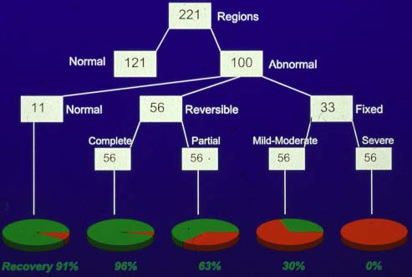
Hibernation – the need for ischaemia
Pre-op thickening
Thallium pattern
Post-op thickening
Kitsiou AN . . . Dilsizian V. Circulation 1998; 98: 501-8

Slide 23
Surrogate definition
Hibernating myocardium is:
viable
akinetic
susceptible to ischaemia

Slide 24
Signals of Viability
nuclear
  thallium membrane function
  technetium-99m membrane and/or mitochondrial function
  FDG glucose metabolism
  fatty acids fatty acid metabolism
echocardiography or cine MRI
  myocardial thickness/motion/thickening
  recruitment of myocardial motion/thickening
  deterioration of myocardial motion/thickening
contrast MRI
  absence of late enhancement

Slide 25


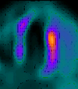
Radionuclide Techniques
Positron emitting
  Dedicated PET FDG + NH₃
  Hybrid FDG + MIBI/Tf
  Gamma camera FDG ± MIBI/Tf
  Others palmitate, acetate, Rb, H₂O
Single photon
  High energy FDG ± MIBI/Tf
  Conventional Tl/MIBI/Tf
  GSPECT MIBI/Tf
  Others fatty acids, MIBG
FDG PET
FDG GCPET
Tf SPECT

Slide 26
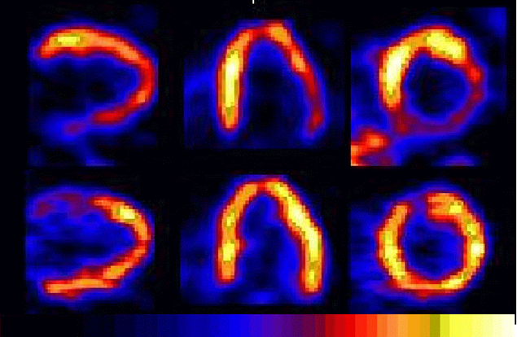
Perfusion – metabolism mismatch
¹³N ammonia
¹⁸F 2-fluorodeoxyglucose
Courtesy Markus Schwaiger

Slide 27
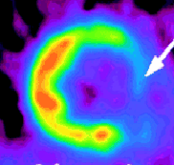
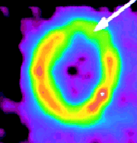
Quantification of metabolism
0.45 μmol/g/min
0.14 μmol/g/min
Pagano D, et al. J Thorac Cardiovasc Surg 1998; 115: 791-9
35 patients, Mean LVEF 35%, viability threshold 0.25 μmol/g/min
Sensitivity 89%, specificity 75% for recovery of function after CABG

Slide 28


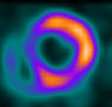

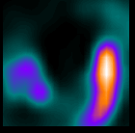


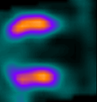
Gamma camera PET
Male age 76
Two previous infarctions
Heart failure NYHA III
Two vessel coronary disease
LVEF 21%
SA
HLA
VLA
¹⁸FDG PET
FDG gcPET
^{99m}Tc-SPECT
Notes:
Patient RW

Slide 29
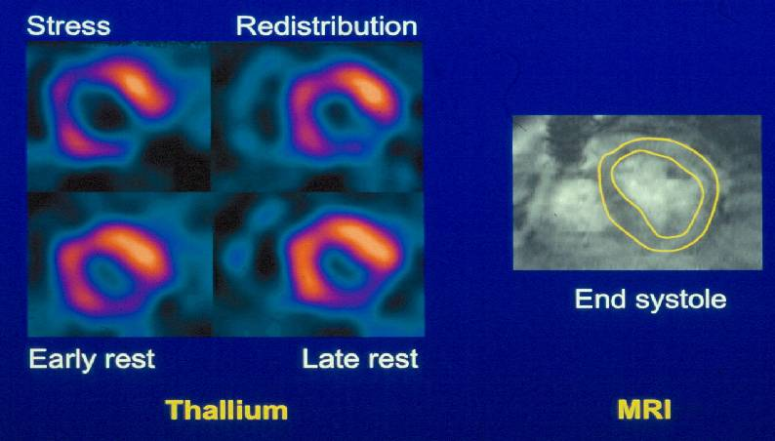
Hibernation

Slide 30
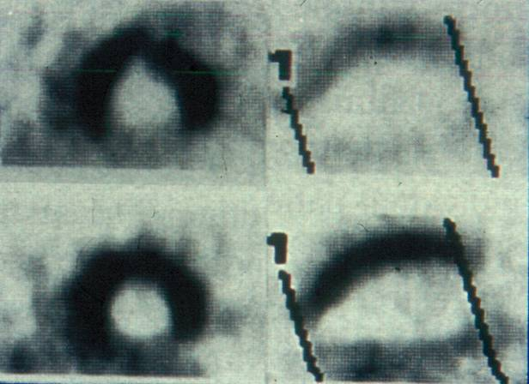
Nitrates and Viability
MIBI
Rest
Nitrate
Bisi G et al. JACC 1994; 24: 1282-9

Slide 31
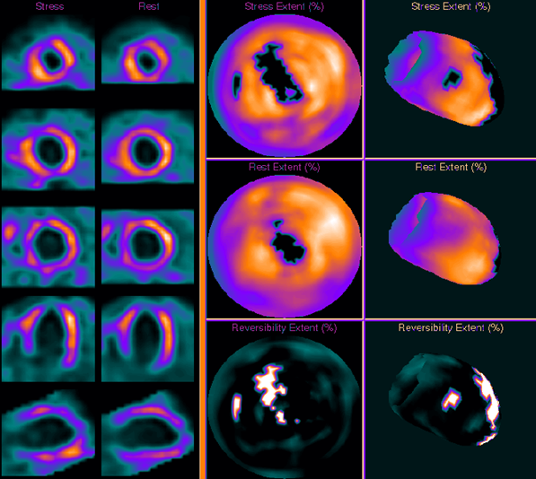
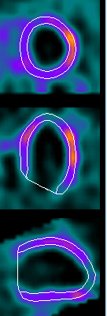
Two Segment Hibernation
Stress
Stress
LVEDV 332ml
LVEF 19%
Rest
Rest
G-rest
Stress
Rest
Reversibility
Reversibility

Slide 32
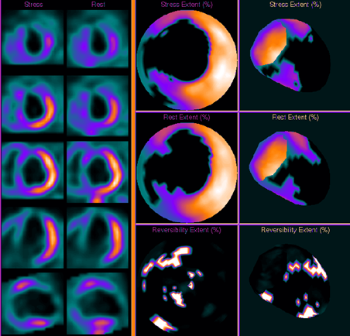
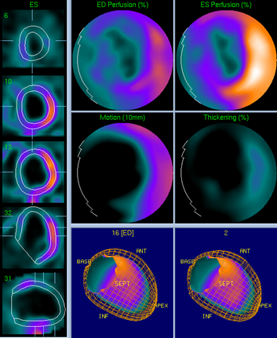
Full Thickness Infarction
Stress
Rest
G-Rest

Slide 33
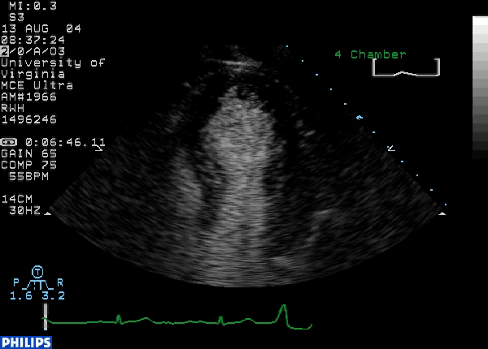
Echocardiography
Confirms systolic dysfunction
Assesses diastolic function
Excludes secondary causes
Suggests IHD if regional abnormalities

Slide 34
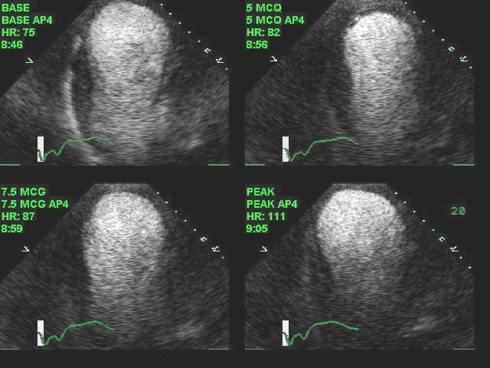
Dobutamine echo
Apical four chamber - biphasic response
Notes:
JACC 2005; 45: 1739. View Video 4A - Apical four-chamber (4A) and two-chamber (4B) views with intravenous contrast for left ventricular opacification recorded in a patient with a large anterior apical myocardial infarction and chronic left ventricular dysfunction. Note in the apical four-chamber view the large apical aneurysm and relatively preserved function in the basal half of the septum and lateral wall. At a dose of 5µg/kg/min there is augmentation of function of all segments, except the very apex, with a reduction in diastolic and systolic cavity areas. At 7.5µg/kg/min worsening of wall motion started to occur in the apical segments and basal lateral wall with progressive increase in the diastolic and systolic volumes. Wall motion in the basal septum appears relatively preserved. At the peak dose of dobutamine (20µg/kg/min), note the deterioration in function in basal and apical segments compared to that seen at the 5µg dose. This is a classic biphasic response implying extensive viable myocardium likely to have recovery of function following revascularization. The area that did not demonstrate any change or viability by dobutamine is the apical segment only. In the apical two-chamber view (Video 4B) a similar biphasic response is noted involving the inferior and anterior segments, sparing the apex. More obvious cavity dilation at peak dobutamine is noted when comparing the low dose dobutamine to peak dose.

Slide 35
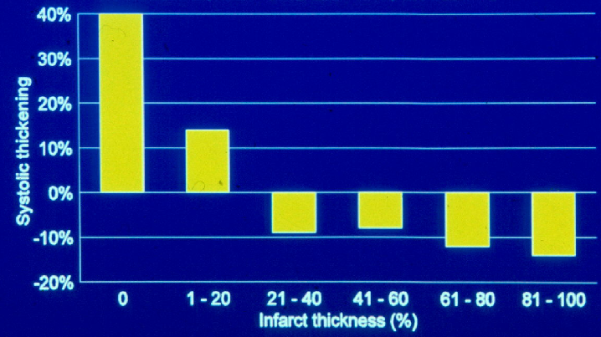
Myocardial Thickening and Infarction
Lieberman AL, et al. Circulation 1981; 63: 739-46
13 dogs, 48hr after coronary occlusion, cross sectional echocardiography

Slide 36
Biphasic response to dobutamine
24 hour hibernation in pigs
Chen et al. Circ 1995; 92: 756-66

Slide 37
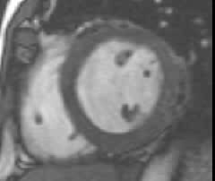
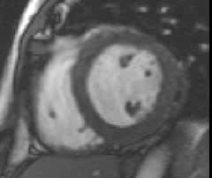
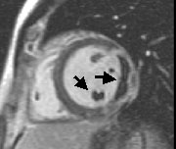
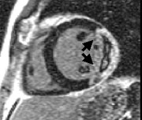
Dobutamine and contrast MRI
Rest
Dob 10µg
Early Gd
Late Gd

Slide 38
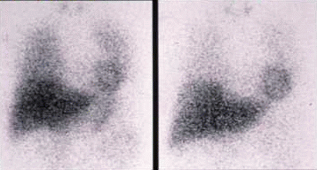
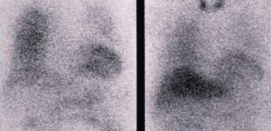
¹²³I-MIBG
normal
heart failure
NYHA III
Fukuyama et al
15 min
4 hour

Slide 39
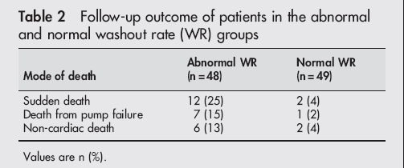
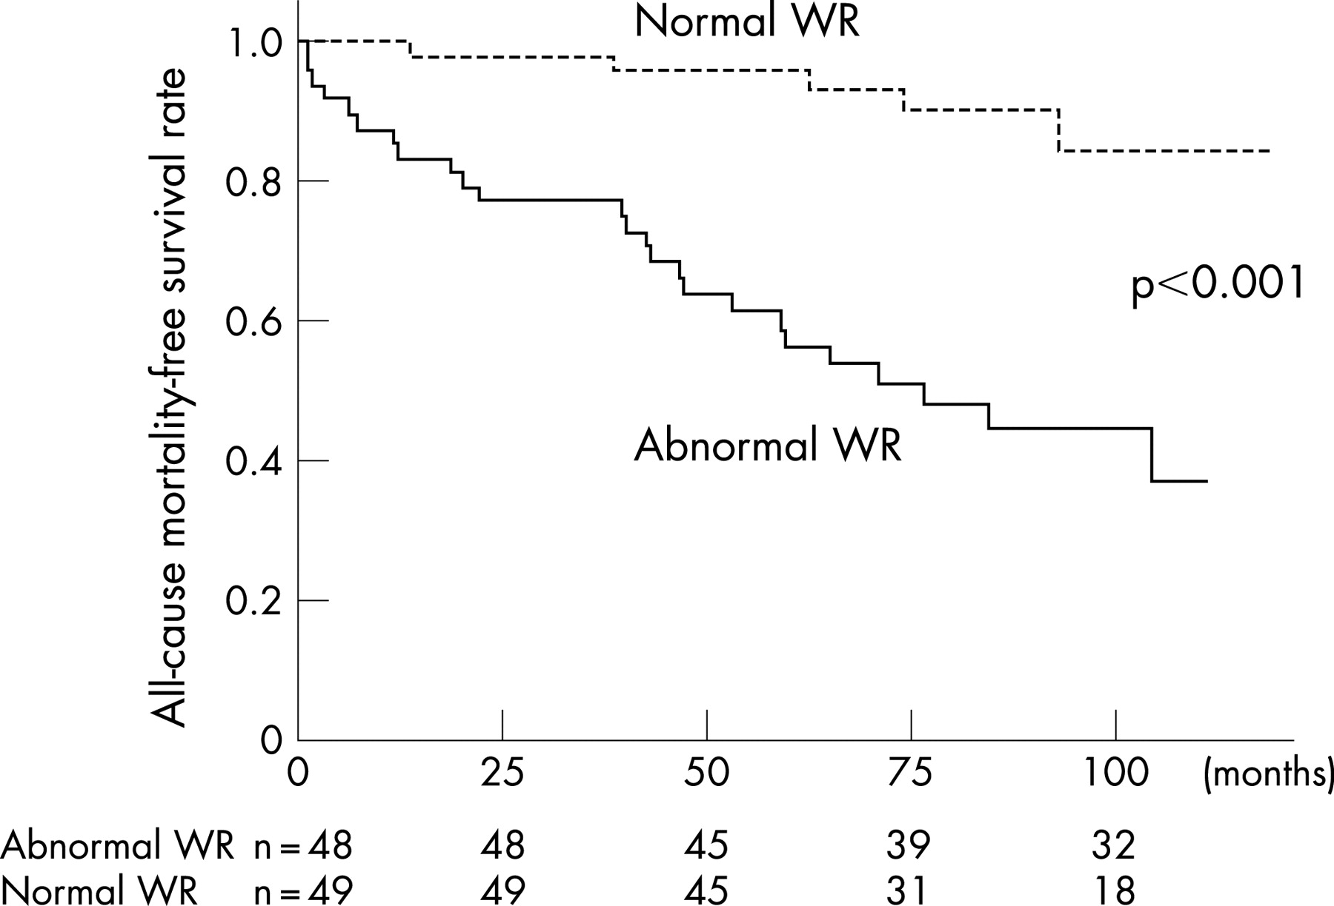
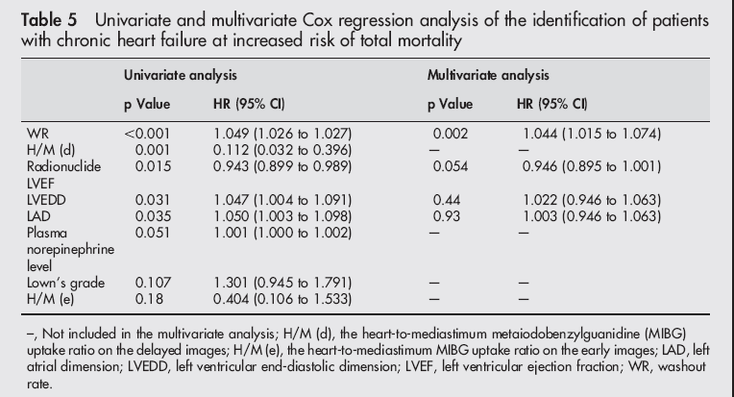
mIBG washout to predict mortality
Kioka H, et al. Heart 2007; 93: 1213-8
97 patients, IHD + DCM, LVEF 29%, NYHA 2.1
Notes:
Prediction of sudden death in patients with mild-to-moderate chronic heart failure by using cardiac iodine-123 metaiodobenzylguanidine imaging
Hidetaka Kioka¹, Takahisa Yamada¹, Takanao Mine¹, Takashi Morita¹, Yasumasa Tsukamoto¹, Shunsuke Tamaki¹, Masaharu Masuda¹, Keiji Okuda¹, Masatsugu Hori², Masatake Fukunami¹
Objective: To evaluate the usefulness of cardiac iodine-123 (¹²³I) metaiodobenzylguanidine (MIBG) imaging as a predictor of sudden death in patients with chronic heart failure (CHF).
Design and setting: Prospective cohort study in a tertiary referral centre.
Patients: 97 outpatients with CHF with a radionuclide left ventricular ejection fraction <40% (mean (SD) 29% (7.5%)).
Interventions: At study entry, cardiac I-123 MIBG imaging was performed. The cardiac MIBG heart-to-mediastinum ratio (H/M) and washout rate (WR) were obtained from MIBG imaging.
Main outcome measures: Patients were assigned to two groups based upon 27% of WR, which was the mean (2SD) control WR. 48 of 97 patients with CHF had abnormal WR (27%), whereas the remaining 49 patients had normal WR (<27%). All the study patients were then followed up.
Results: During the mean (SD) follow-up period of 65 (29) months, 12 (25%) patients in the abnormal WR group and 2 (4%) patients in the normal WR group died suddenly. Kaplan–Meier analysis revealed that sudden death was more often observed in patients with abnormal WR than those with normal WR (p = 0.001). On Cox regression analysis, MIBG WR, H/M on the delayed image and H/M on the early image were significantly associated with sudden death.
Conclusion: Cardiac MIBG imaging would be useful for predicting sudden death in patients with CHF.

Slide 40
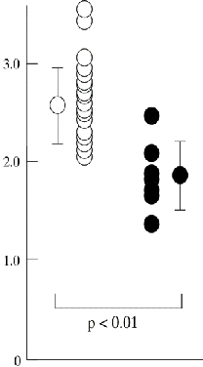
Beta blockade in DCM
Kakuchi H, et al. Heart 1999; 81: 148-52
27 patients with DCM
Response to metoprolol at 3 months
MIBG uptake
response
deterioration

Slide 41
Structure of session
What is hibernating myocardium?
How can it be detected?
Case examples
Imaging and ischaemic LV dysfunction

Slide 42
Case history KS
79 yr old male, hypertension, previously fit
6 month history of angina
recent admission with chest pain at rest (MI excluded)
coronary angiography
  dilated LV with EF 15%
  LAD stenosis of uncertain significance
  LCx normal
  RCA 90% stenosis

Slide 43
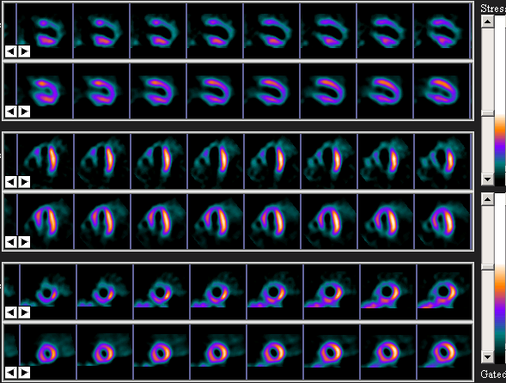
Images Mr KS
Technetium, 1 day stress-rest nitrate

Slide 44
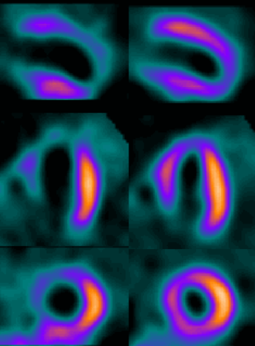
Question KS
To assess for possible hibernation:
rest-redistribution thallium
NH₃-FDG PET or SPECT
dobutamine echo
gated SPECT
rest + dobutamine MRI
Technetium
Stress
Rest (nitrate)

Slide 45
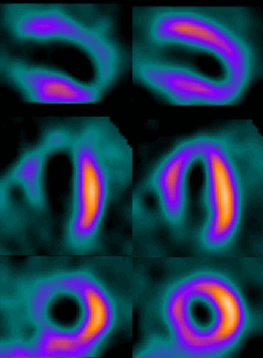
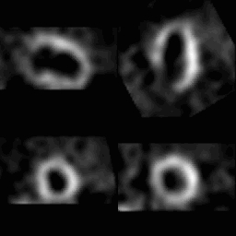
Further imaging KS
Technetium
Stress
Rest
Gated rest

Slide 46
SR, male age 79, LBBB
Jan 1998 initial presentation with severe LVF (ventilated)
Apr 1998 Angiogram
severe global LV dysfunction, no MR
LAD: mod proximal stenosis
LCx: severe stenosis at origin of OM1
RCA: irregular but not obstructed
Jul 1998 SPECT

Slide 47
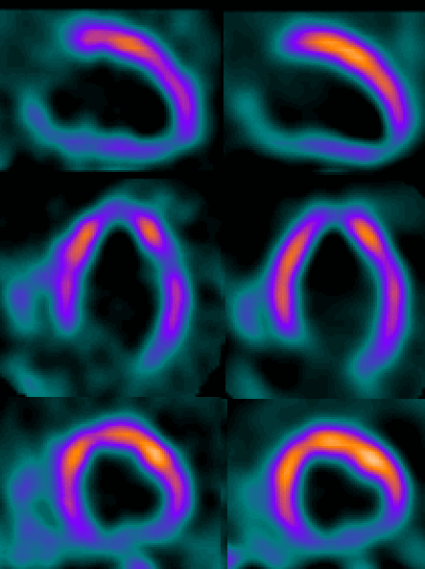
Technetium
SR, male age 79, LBBB
Jan 1998
initial presentation with severe LVF
Apr 1998 Angiogram
severe global LV dysfunction, no MR
LAD: mod proximal stenosis
LCx: severe stenosis at origin of OM1
RCA: irregular but not obstructed
Jul 1998 SPECT
Stress
Nitrate rest

Slide 48
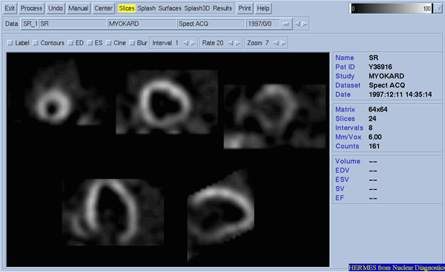
Technetium
Stress
Nitrate rest

Slide 49
Structure of session
What is hibernating myocardium?
How can it be detected?
Case examples
Imaging and ischaemic LV dysfunction

Slide 50
Detection of Hibernating Myocardium
Gunning MG, et al. Nucl Med Commun 1999; 30: 209-14

Slide 51
Predicting Hibernation from Viability
100%
Echocardiography
90
Nuclear
80
Positive predictive accuracy
70
60
50
50
60
70
80
90
100%
Negative predictive accuracy
Bax JJ, et al. Curr Prob Cardiol 2001; 26: 141-88
Direct comparison of viability in 11 studies, 325 patients

Slide 52
Discrepancies –echo and MPS
Echo less sensitive
Early onset of ischaemia
De-differentiation (loss of contractile protein)
Nuclear less specific
Partial thickness infarction
Inadequate mechanical advantage
Dual pathology (cardiomyopathy)

Slide 53
Is low specificity a problem?
choose suitable uptake threshold for clinically significant viability
recovery of function may be delayed
other clinical features more important than recovery of segmental function

Slide 54
Timing of recovery
Bax JJ, et al. Circ 2001; 104: 1314-8
Pre-op
3
3 months
14 months
2
Wall motion abnormality
1
0
stunning
hibernation
transmural
non-transmural

Slide 55
Changes after Revascularisation
Gunning MG et al. Eur J Cardiothoracic Surgery 1997; 11: 1105-12
47 patients, mean LVEF 23%
 | Improve | No change | Deteriorate
Wall motion
Revasc | 60 | 24 | 9
Medical | 6 | 36 | 11
NYHA class
Revasc | 17 | 1 | 1
Medical | 2 | 10 | 1
Angina class
Revasc | 18 | 4 | 1
Medical | 2 | 11 | 1

Slide 56
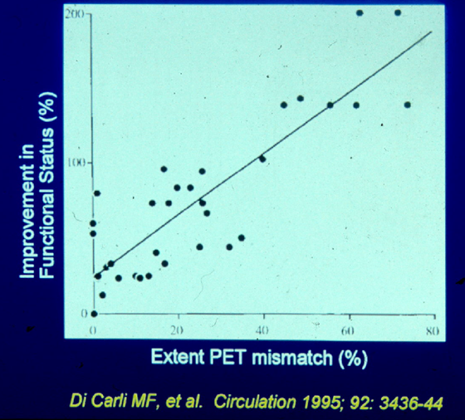
Improvement in Symptoms

Slide 57
Viability/Hibernation and Mortality
Bax JJ, et al. Curr Prob Cardiol 2001; 26: 141-88
Pooled data from 7 PET, 4 SPECT, 7 echo studies

Slide 58
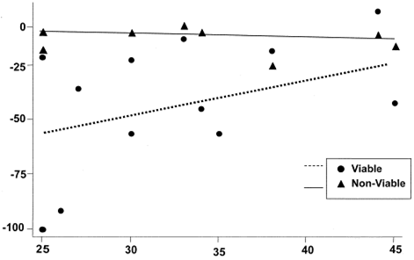
Mortality reduction with revascularisation
Allman K, et al. JACC 2002; 39: 1151-8
Percent change
Pre-operative LVEF %

Slide 59

Imaging techniques for the assessment of patients with chronic ischaemic heart failure
Report of a Study Group of the ESC
SR Underwood (co-chair), JJ Bax (co-chair), J vom Dahl,
MY Henein, J Knuuti, AC van Rossum, ER Schwarz,
JL Vanoverschelde, EE van der Wall, W Wijns
European Heart Journal 2004; 25: 815-36

Slide 60
N
CAD likely?
Y
Main symptom?
angina
Another algorithm
LV dysfunction?
CAD likely?
Main symptom?
dyspnoea
LV function
rest echo, or
rest MRI, or
gated MPS
Viability
rest MPS, or
PET, or
stress echo (low dose), or
contrast MRI
Perfusion reserve
stress MPS, or
stress echo (high dose), or
stress MRI (high dose)
No heart failure
normal
abnormal
viable
non-viable
Transmural scar
akinetic
non-viable
no ischaemia
Intramural scar
hypo- or akinetic
viable
no ischaemia
Hibernation
akinetic
viable
ischaemia
Ischaemia
normo- or hypokinetic
viable
ischaemia
consider PET
angiogram if not done
Medical therapy or transplant
Medical therapy and revascularise if feasible

Slide 61

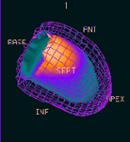

Patient with ischaemic heart failure
Echo or CMR first for resting function
GSPECT second for viability, ischaemia and function
  if nonviable: end
  if viable, akinetic, ischaemic: CAG
If hibernation and LVEF<20%
  stress CMR or echo

