Slide 1


Principles of Radionuclide Imaging
S Richard Underwood
MD FRCP FRCR FESC FACC FASNC
Professor of Cardiac Imaging
Imperial College London
and Royal Brompton Hospital

Slide 2
Cardiac Imaging
 | Resolution | Speed | Contrast
X-ray | < 1mm | < 10ms | Low*
US | 1 – 3mm | 1 – 100ms | Moderate*
NM | 8 – 12mm | 5 – 10min | High
MR | 1mm | 30s – 5min | High
 | Anatomy | Function | Perfusion | Metabolism
X-ray | 4 | 4 | 1 | 0
US | 4 | 4 | 1 | 0
NM | 2 | 4 | 4 | 5
MR | 5 | 4 | 2 | 2

Slide 3
Common abbreviations
RNI | Radionuclide imaging
MPI | Myocardial perfusion imaging
*MPS | *Myocardial perfusion scintigraphy
MUGA | Multi-gated acquisition
*RNV | *Radionuclide ventriculogram
RNA | Radionuclide angiocardiography
SPE(C)T | Single photon emission (computed) tomography
PET | Positron emission tomography
*C(X)T | *Computed (X-ray) tomography
*CMR | *Cardiovascular magnetic resonance
MRI | Magnetic resonance imaging
MRS | Magnetic resonance spectroscopy

Slide 4
Principles of Radionuclide Imaging
Properties of gamma rays
The gamma camera
Radiopharmaceuticals
Stress testing (seminar)
Acquiring images
Interpreting images
Radionuclide ventriculography

Slide 5
The Electro-Magnetic Spectrum

Slide 6
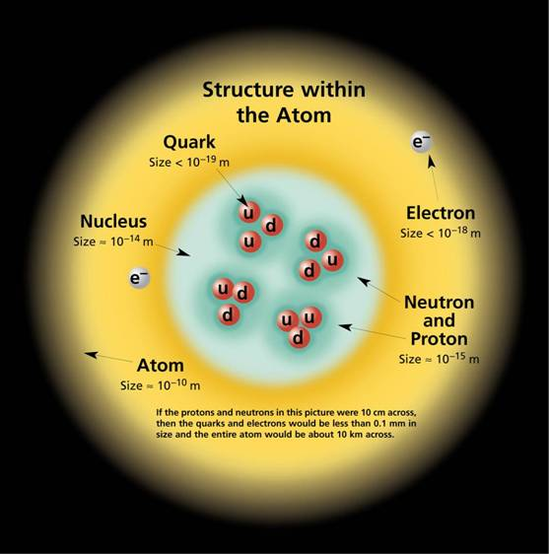
Atomic structure

Slide 7
Chemistry revision
Atomic number = protons
  defines an element
Atomic weight = protons + neutrons
  Defines an isotope or nuclide

Slide 8
Radionuclides
Unstable isotopes or nuclides are called radioisotopes or radionuclides
Nuclear transitions lead to stable isotopes by several mechanisms, one of which leads to emission of a gamma ray
Electron transitions lead to emission of an X-ray

Slide 9
Radioactive decay
Exponential decay is characterised by half-life
(the time for half of the radioactive nuclei in a sample to decay)
²³⁸U 4.5 x 10⁹ years
¹⁴C 5730 years
²²⁶Ra 1600 years
¹³¹I 8 days
²⁰¹Tl 72 hours
^{99m}Tc 6 hours
¹⁸F 2 hours
¹⁵O 2 minutes
Radioactivity
Time

Slide 10
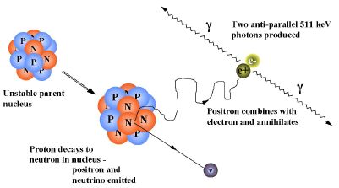
Positron emission

Slide 11
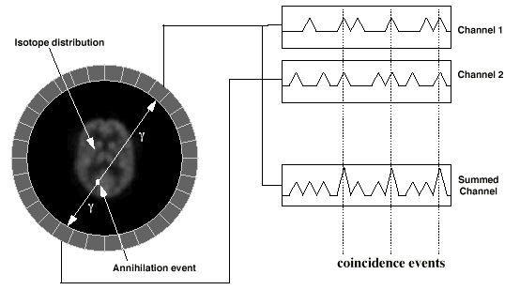
Coincidence detection

Slide 12
Principles of Radionuclide Imaging
Properties of gamma rays
The gamma camera
Radiopharmaceuticals
Stress testing (seminar)
Acquiring images
Interpreting images
Radionuclide ventriculography

Slide 13
The Gamma Camera
Gamma rays are emitted from the radiopharmaceutical injected into the patient
Gamma rays pass through a collimator and strike a sodium iodide crystal, a scintillator which emits light when struck by gamma rays
Photomultiplier tubes convert the light to an electrical signal which is used to produce the image

Slide 14
Gamma Camera
Discriminator
X coordinate pulse
ADC
Processor
Y coordinate pulse
energy
window
VDU
Unblank
pulse
Z Pulse
Lead shielding
positioning and summing circuits
Photomultiplier
tubes
NaI (Tl) detector
patient
Collimator

Slide 15
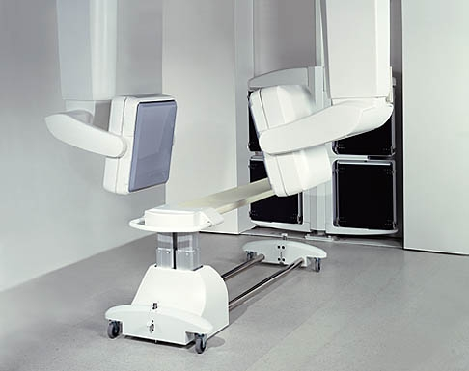
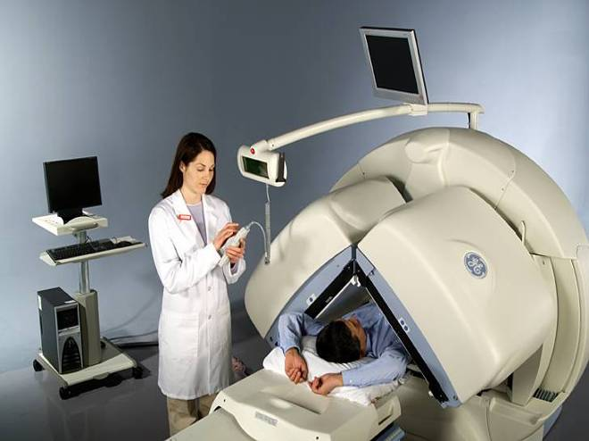
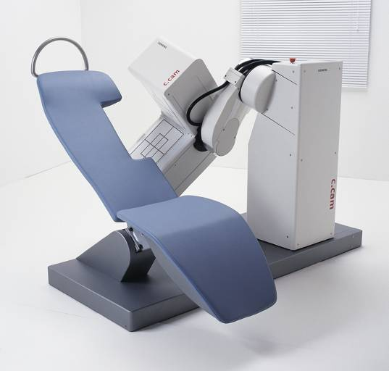

Slide 16
Principles of Radionuclide Imaging
Properties of gamma rays
The gamma camera
Radiopharmaceuticals
Stress testing (seminar)
Acquiring images
Interpreting images
Radionuclide ventriculography

Slide 17
Radiopharmaceuticals in Nuclear Cardiology
Single photon emitters
^{99m}Tc | erythrocytes, albumin | ventriculography
 | pyrophosphates | acute infarction
 | annexin-V | apoptosis
 | microspheres, MIBI, tetrofosmin | perfusion
²⁰¹Tl | ionic | perfusion
^{195m}Au | ionic | angiocardiography
¹¹¹In | platelets | thrombus
 | white cells | infection
 | anti-myosin antibody | acute infarction, transplant rejection
⁶⁷Ga | citrate | inflammation
⁸¹Kr | gos or solution | pulmonary ventilation, right ventriculography
¹³¹I | meta-iodo-benzylguanidine | sympathetic innervation
Positron emitters
¹¹C | microspheres | perfusion
 | pyruvate, lactate, lactate, acetate, ß-methyl fatty acids, palmitate | metabolism
¹³N | ammonia | perfusion
 | glutamate | metabolism
¹⁵O | water | perfusion
¹⁸F | 2-fluoro-deoxyglucose | metabolism

Slide 18
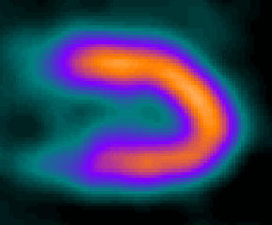
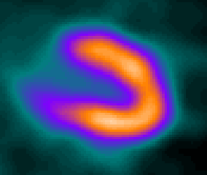
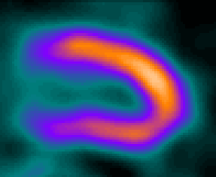
Myocardial perfusion tracers
Thallium
MIBI
Tetrofosmin

Slide 19
Technetium-99m Generator
Mother radionuclide
  Molybdenum-99 on an ion exchange column
  Half-life 66 hours
Daughter radionuclide
  Technetium-99m
  Eluted from column with saline
  Half life 6 hours
  140keV gamma emission

Slide 20
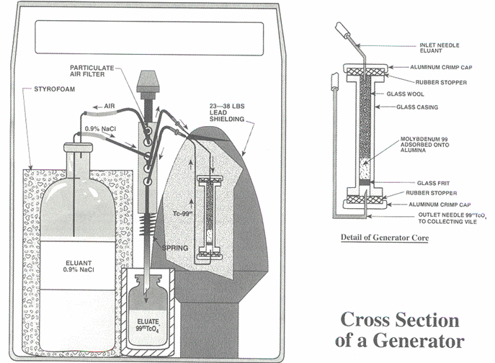
Technetium-99m generator

Slide 21
Radionuclide properties
Thallium-201
Cyclotron produced
79keV X-ray (88%)
135keV + 167keV γ-rays (12%)
Half life 72 hours
Typical effective dose 18mSv
Technetium-99m
Generator produced
140keV γ emission
Half life 6 hours
Typical effective dose 10mSv

Slide 22
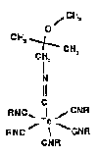
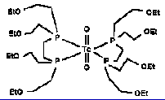
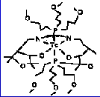
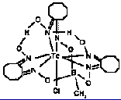

^{99m}Tc perfusion tracers
MIBI
tetrofosmin
furifosmin
+
+
+
teboroxime
NOET

Slide 23
Physiological properties
Thallium
  Part passive into negative intracellular potential
  Part active via Na⁺/K⁺ ATPase dependent pump
  Free exchange with extracellular thallium
  Renal excretion
MIBI
  Passive into negative intracellular potential
  Fixed in mitochondria
  Hepato-biliary excretion
Tetrofosmin
  Passive into negative intracellular potential
  Fixed in cytosol
  Hepato-biliary excretion

Slide 24
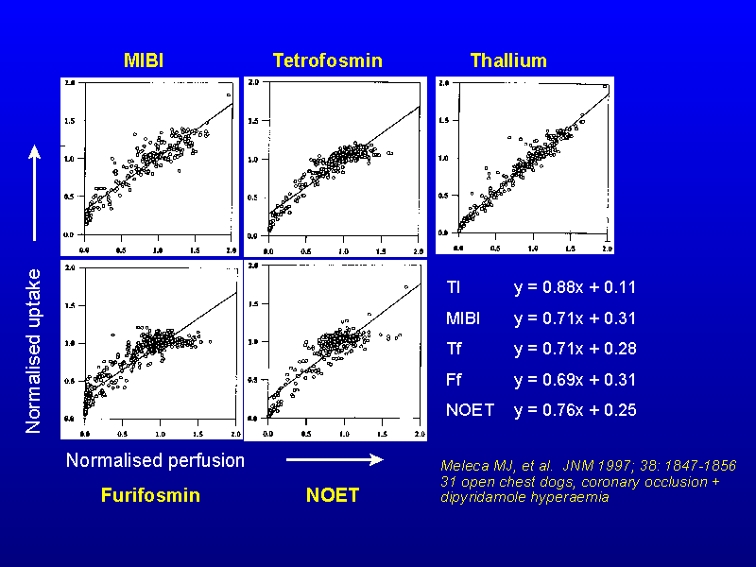

Slide 25
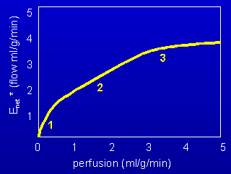
Implications of non-linear uptake
1 Intercept above zero
  Overestimation of reduced perfusion
  Reduced defect contrast
  Overestimation of viability
2 Reduced slope
  Reduced extraction and low counts
  Reduced defect contrast
3 Early plateau
  Underestimation of hyperperfusion
  Reduced defect contrast

Slide 26
Properties of tracers
 | Thallium | MIBI | Tetrofosmin
Extraction (max) | 0.80 | 0.39 | 0.30
Extraction (5 min) | 0.60 | 0.41 | 0.30
Cell injury reduces uptake | ++++ | ++++ | ++++
Redistribution | yes | minimal | no
Measure of hyperaemia | +++ | ++ | ++
After Leppo JA

Slide 27
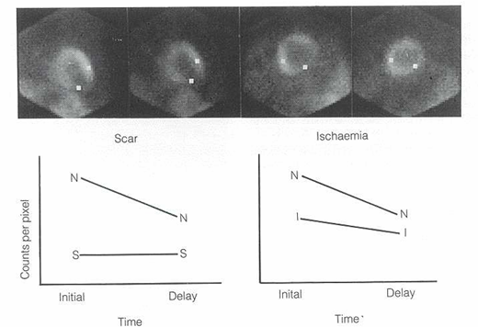
Thallium redistribution

Slide 28
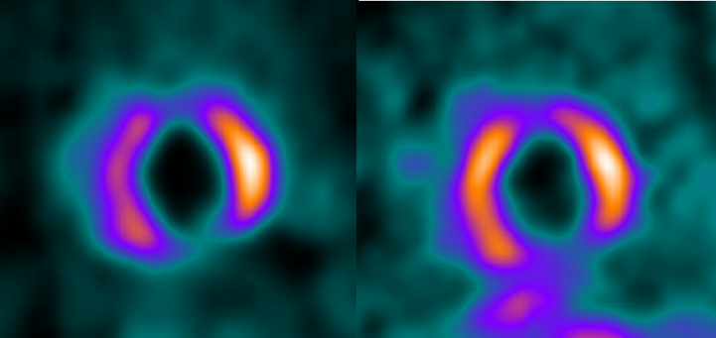
Patterns of uptake
Thallium-201
stress
redistribution

Slide 29
Principles of Radionuclide Imaging
Properties of gamma rays
The gamma camera
Radiopharmaceuticals
Stress testing (seminar)
Acquiring images
Interpreting images
Radionuclide ventriculography

Slide 30
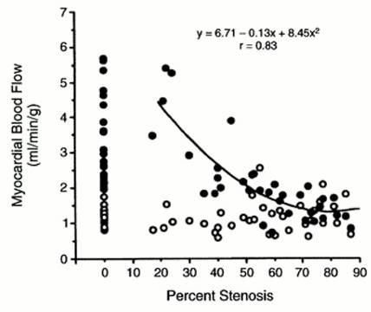
Myocardial perfusion reserve
Uren NG et al. NEJM 1994; 330: 1782-8
35 CAD, 21 controls, adenosine stress, ¹⁵O-water PET

Slide 31
Cardiovascular stress
Exercise
  Dynamic
  Isometric
Other
  Pacing
  Cold pressor
Vasodilators
  Adenosine
  Dipyridamole
  Regadenoson
Inotropes
  Dobutamine

Slide 32
Principles of Radionuclide Imaging
Properties of gamma rays
The gamma camera
Radiopharmaceuticals
Stress testing (seminar)
Acquiring images
Interpreting images
Radionuclide ventriculography

Slide 33
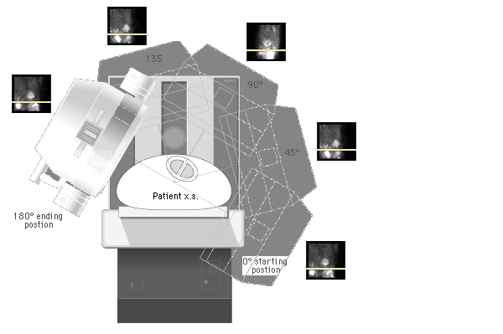
Emission tomography
Notes:
During SPECT image acquisition for myocardial perfusion imaging, 1 or 2 detectors or heads rotate around the long axis of the patient, acquiring planar images in a step-and-shoot fashion.

Slide 34

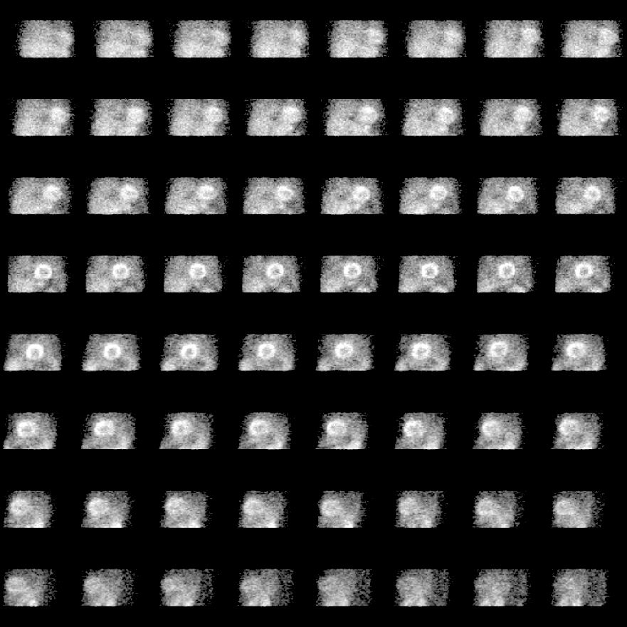
Projection images
Projection images
“raw data”

Slide 35

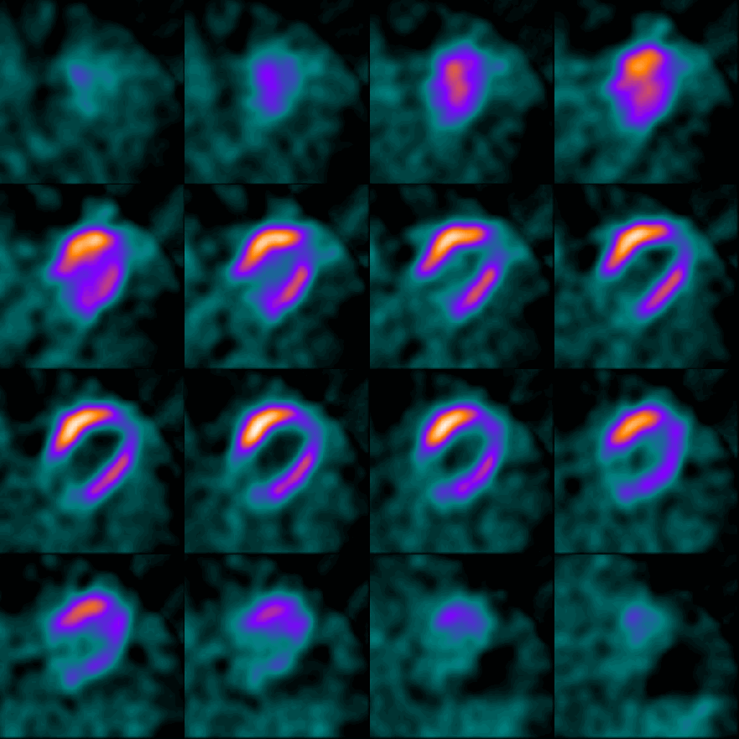
Transverse Tomograms
Anterior
Cranial
Right
Left
Caudal
Posterior

Slide 36
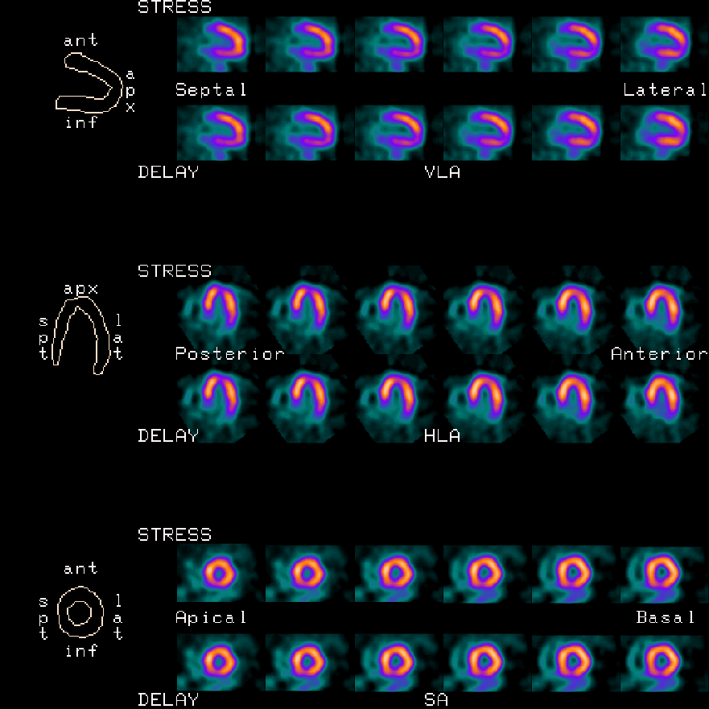
Full study Display

Slide 37
Triangulation
LAD
LAD
LAD
LAD
LCx
LAD
LCx
LAD
LCx
RCA
RCA
RCA

Slide 38
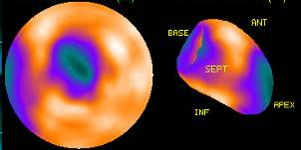
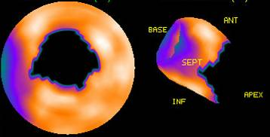
Quantification
Anterior
Septum
Lat
Inferior
Polar plot
3D display

Slide 39
Segmental models
9 segments
17 segments

Slide 40

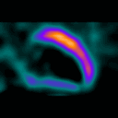
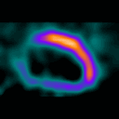
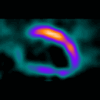
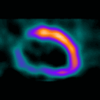
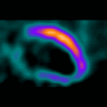
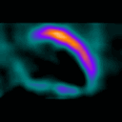
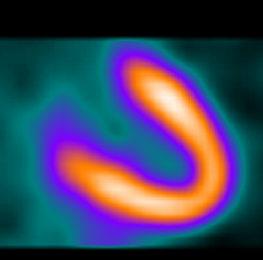
ECG gated acquisition
ED
Gated image
function
ES
ED
Summed image
perfusion

Slide 41
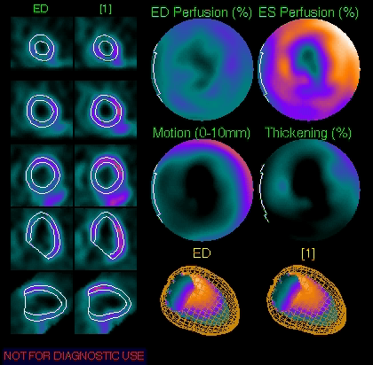
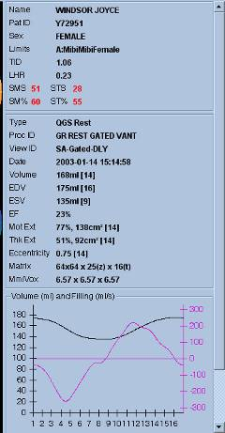
Quantification

Slide 42
Imaging protocols
Thallium Stress – redistribution
  Stress – redistribution – reinjection
  Stress – reinjection
  Stress – reinjection – 24 hour imaging
  Rest
  Rest – redistribution
Technetium Two day
  One day, stress – rest
  One day, rest – stress
Dual isotope Rest thallium – stress technetium
  Others
Adjuncts Nitrate
  Fatty meal

Slide 43
Thallium protocol
Tl 80MBq
Tl 40MBq
5 min
4 hr
5 hr
Stress
Stress image
Redistribution image
Reinjection image

Slide 44
Thallium protocol
Tl 80MBq
Tl 40MBq
5 min
1 hr
Stress
Stress image
Reinjection image

Slide 45
One day technetium protocols
Tc 250MBq
Tc 750MBq
Stress-rest
1 hr
4 hr
5 hr
Stress
Stress image
Rest image
Tc 250MBq
Tc 750MBq
1 hr
5 hr
Rest-stress
Stress
Rest image
Stress image

Slide 46
Technetium protocols
 | Advantages | Disadvantages
Two day | no image contamination ECG gating of stress and rest | often impractical
One day stress-rest | high contrast stress images ideal for diagnosis single injection if normal ECG gating of rest images | low count stress images
One day Rest-stress | high contrast rest images ideal for viability | low count rest images ECG gating of stress images only higher radiation if normal

Slide 47
Dual isotope protocol
Advantages | Disadvantages
Thallium for viability and technetium for ECG gating Shorter for patient | Thallium needs redistribution ± nitrate for viability No less camera time Highest radiation exposure (contravenes ALARA) Normal patients have full procedure Comparison of different tracers Expensive

Slide 48
Principles of Radionuclide Imaging
Properties of gamma rays
The gamma camera
Radiopharmaceuticals
Stress testing (seminar)
Acquiring images
Interpreting images
Radionuclide ventriculography

Slide 49
Inducible Perfusion Abnormality
Stress
Rest

Slide 50
Inducible and Fixed Abnormalities
Stress
Rest
Short Axis Thallium

Slide 51
Site of Perfusion Defect

Slide 52
Extent of Perfusion Defect

Slide 53
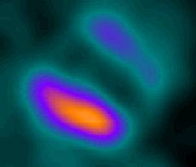
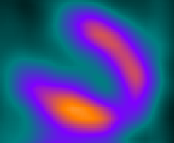
Image interpretation
Stress
2
Score
The basal anterior wall shows:
Partial thickness infarction
Mild ischaemia
Moderate ischaemia
Severe ischaemia
Reverse redistribution
1
4
0
4
4
4
4
2
4
Rest

Slide 54
Radionuclide ventriculography
Labelling of autologous erythrocytes with technetium-99m
ECG gating is used to acquire 16 to 32 frames through the cardiac cycle
Imaging of first-pass of tracer through heart and/or after blood-pool equilibrium
First-pass good for RV function and L → R shunting
Equilibrium good for LV function, systolic and diastolic

Slide 55
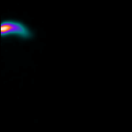
First pass RNV

Slide 56
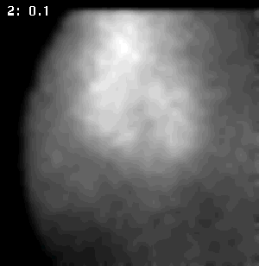
Equilibrium RNV
ED
RV
LV
ES
ED

Slide 57
Quantification

Slide 58
Principles of Radionuclide Imaging
Properties of gamma rays
The gamma camera
Radiopharmaceuticals
Stress testing (seminar)
Acquiring images
Interpreting images
Radionuclide ventriculography

