Slide 1


Role of CT imaging for cardiac disease and applications of multi-detector CT
4 Jan 2013
Dr Ed Nicol MD MBA MRCP RAF
Consultant Cardiologist
Honorary Senior Clinical Lecturer

Slide 2
Scope
Cardiac Imaging – Challenges
Coronary Artery Calcium Scoring
Coronary CT Angiography
Stents and Grafts
LV and RV Function
Valve Assessment
Extended Protocols
Summary

Slide 3
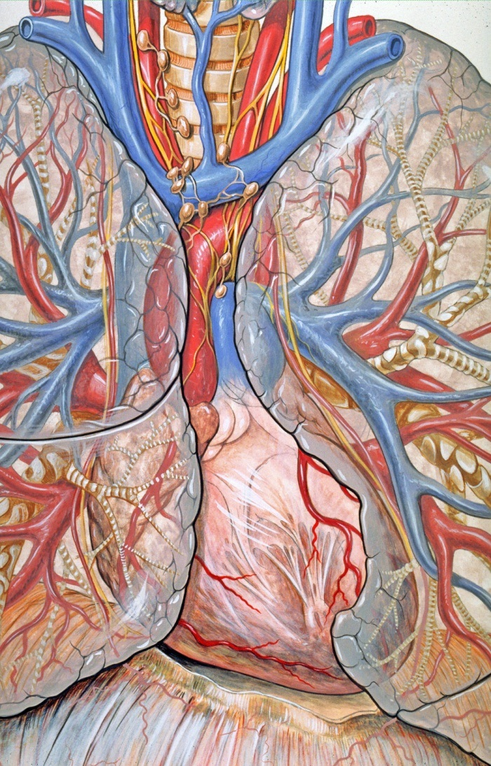
Cardiac imaging - Challenges
Complex 3-D structures
Complex motion
Small structures must be resolved
(0.5 – 4mm)
Significant inter-patient variation in anatomy

Slide 4
Options
Appropriate test is determined by clinical question
  Do we want to assess
    Anatomy?
    Function?
    Viability?
Appropriate tests might include:
  Echocardiography
  Cardiac MRI (CMR)
  Myocardial Perfusion Scintigraphy
  Cardiac Multi-detector Computed tomography (MDCT)
  Invasive coronary angiography

Slide 5
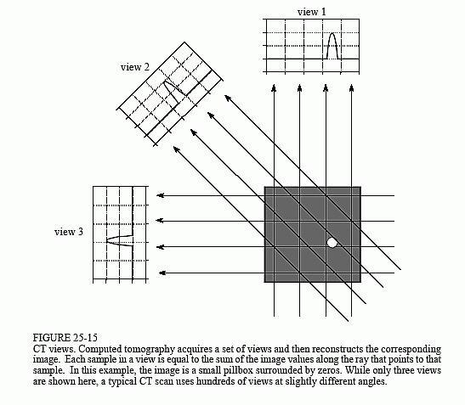
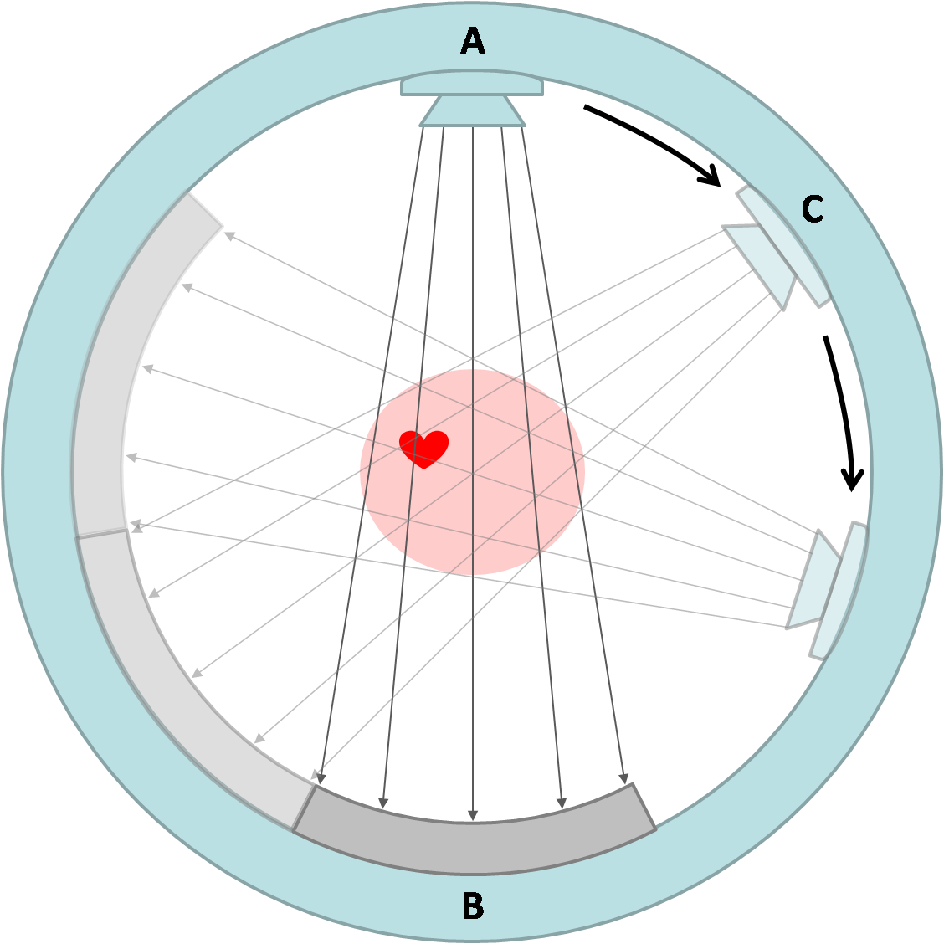
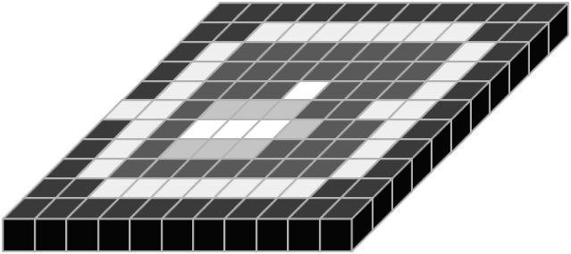
What is computed tomography?
Notes:
5

Slide 6
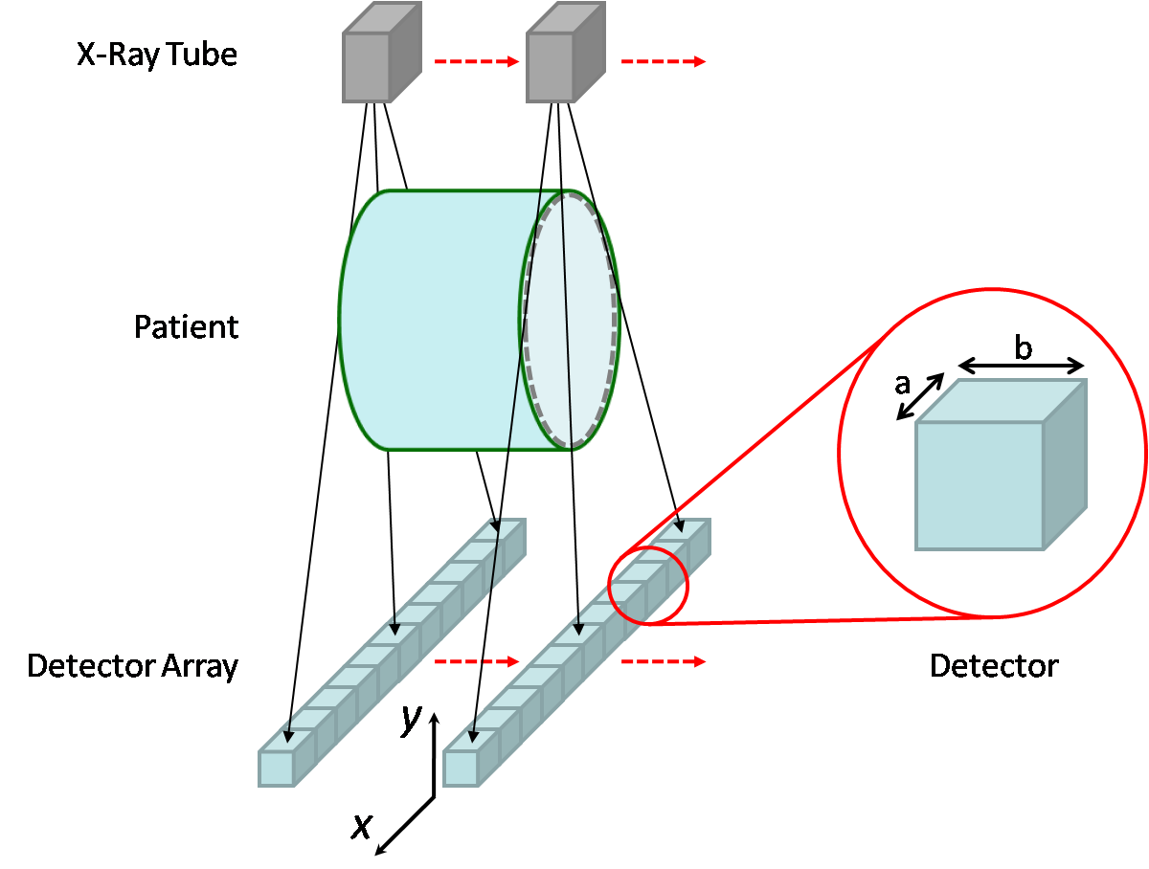
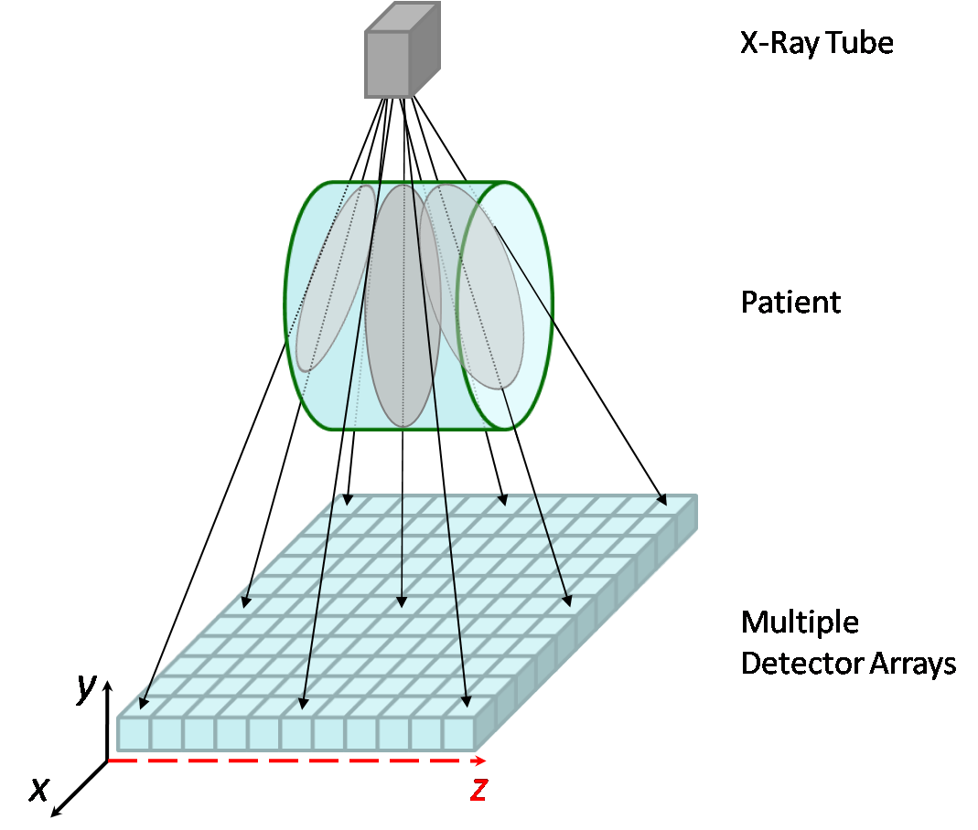
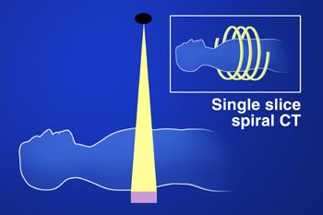
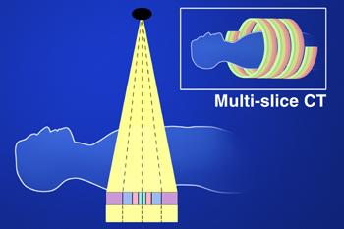
Single vs. Multi-detector CT

Slide 7
Cardiac CT Revolution
EBCT – temporal resolution 100ms
- Spatial resolution (1.0mm)^{3*}
4 MDCT (1998) - 250ms, (1.0mm)³
16 MDCT (2002)- 250ms, (0.7mm)³
64 -320 MDCT (2004-7) – 125-165ms, (0.4mm)³
64 DSCT (2007)- 83ms, (0.4mm)³
64 Dual Energy DSCT
* No ability to retrospectively ECG-gate study

Slide 8
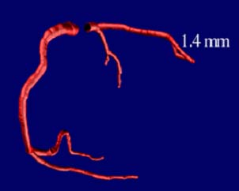
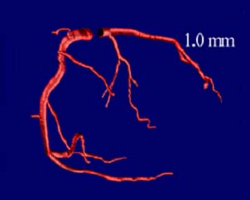
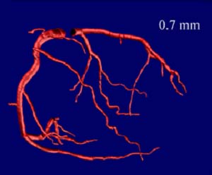
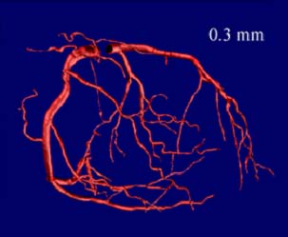
Spatial resolution
2-slice MDCT
4-slice MDCT
16-slice MDCT
64-slice MDCT

Slide 9
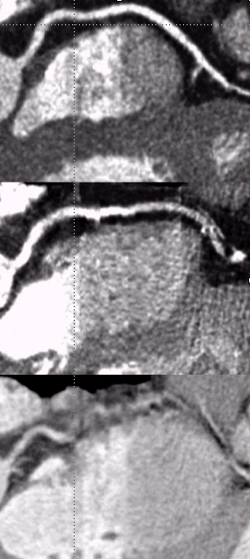
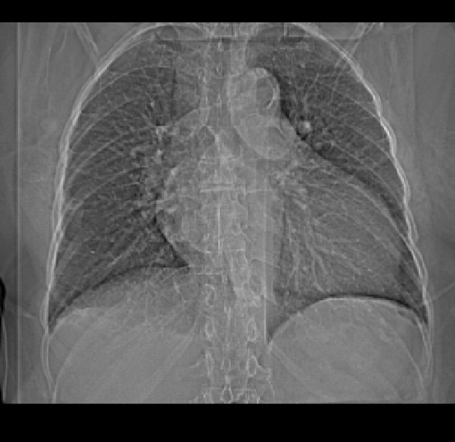
Temporal Resolution and its relationship to heart rate (64-MDCT)
64-MDCT
HR 49
Rot.=330ms
165msec
HR 67
5-10 s
HR 82
330 ms Gantry Rotation Time = half scan segment = temporal resolution of 165 ms
Flohr TG, Herz, 2003

Slide 10
Temporal Resolution and its relationship to heart rate (64-DSCT)
64-DSCT
HR 100+
Rot.=330ms
83msec
5-10 s
330 ms Gantry Rotation Time = 1/4 scan segment = temporal resolution of 83 ms
Adapted from Flohr TG, Herz, 2003

Slide 11
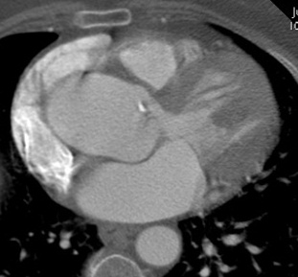
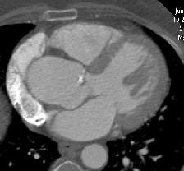
ECG Gating I
R
100%
R
Step 10%
25%
65%
95%
~ Systole
~ End-Diastole
Notes:
11

Slide 12
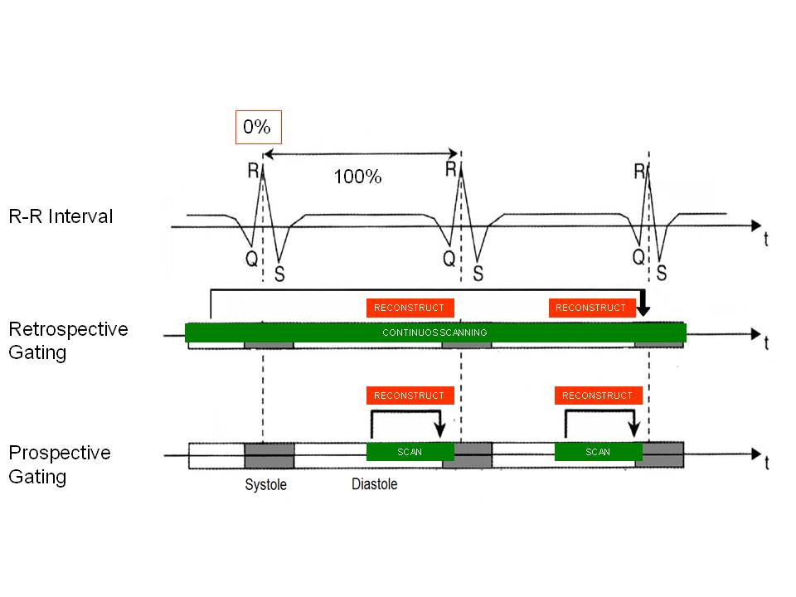
ECG Gating II

Slide 13
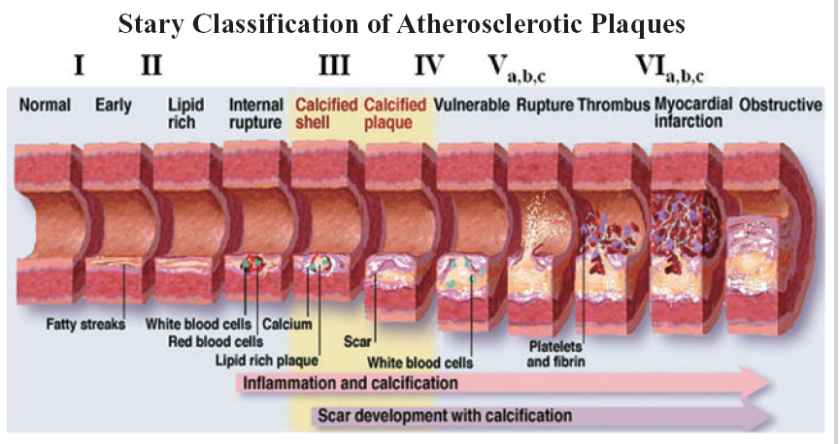
Spectrum of Coronary Artery Disease
CT
MPS
Notes:
13

Slide 14
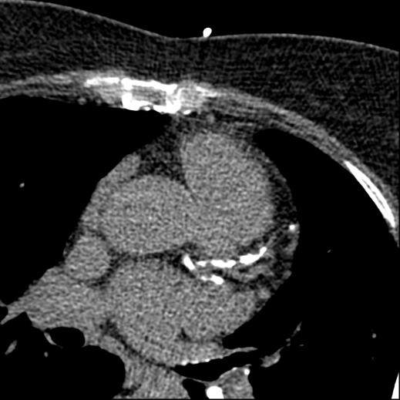

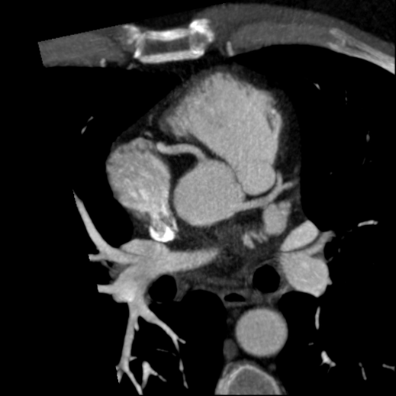
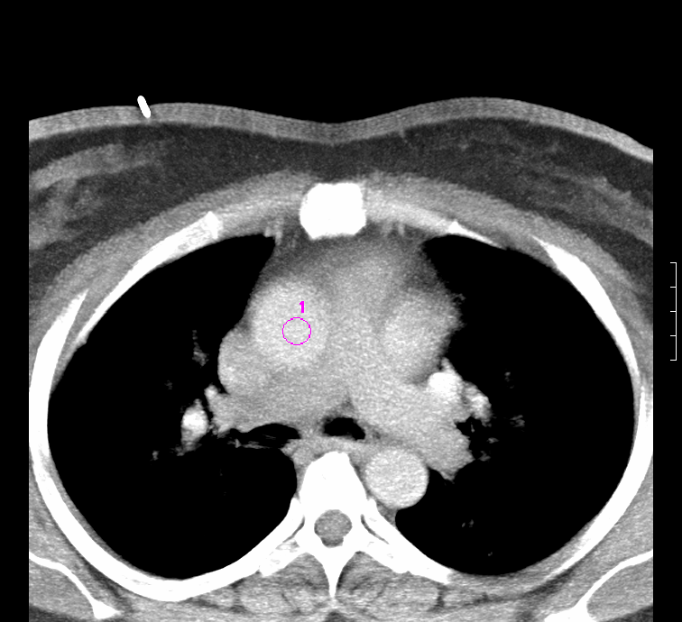
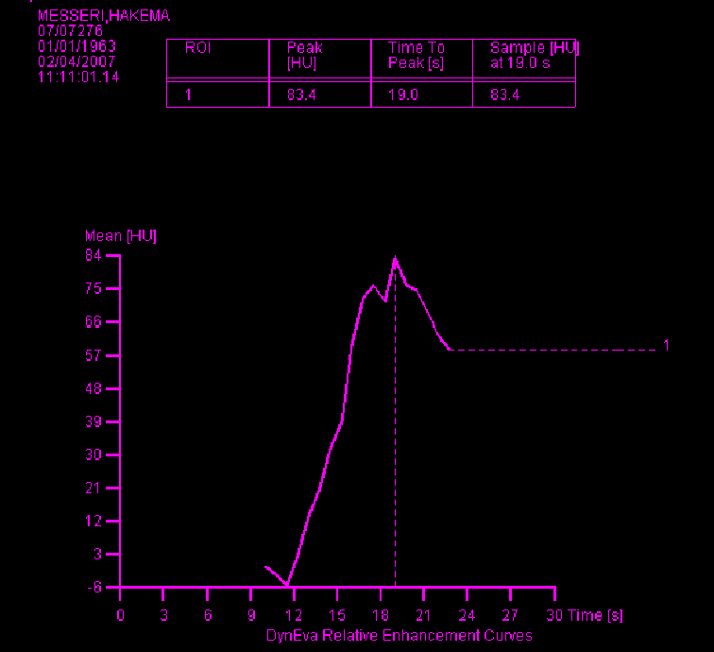
MDCT coronary angiography
2. Coronary calcium scan
1. Scout
4. Main CT coronary angiogram
3. Test bolus/tracking

Slide 15
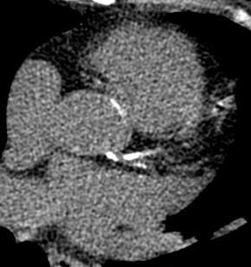
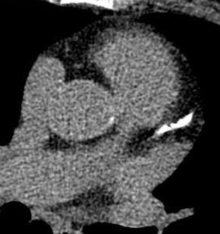
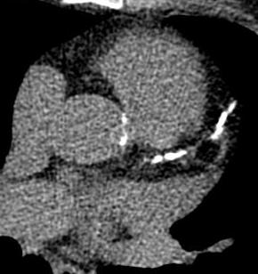
Coronary Artery Calcium Scoring
Left Coronary Artery Main Stem
Proximal Left Anterior Descending Artery
Mid Left Anterior Descending Artery

Slide 16
Coronary Calcium and Likelihood of Significant Stenosis
Total Score | Diagnosis | Clinical Interpretation
0 | No identifiable atherosclerotic plaque. Very low cardio-vascular disease risk. | A ‘negative’ examination. Greater than 97% chance for absence of coronary artery disease.
1-10 | Minimal plaque burden. | ‘Significant’ coronary artery disease very unlikely.
11-100 | Mild plaque burden. | Likely mild or minimal coronary stenosis.
101-400 | Moderate plaque burden. | Moderate non-obstructive coronary artery disease highly likely.
Over 400 | Extensive plaque burden. | High likelihood of at least one ‘significant’ coronary stenosis.
Notes:
16

Slide 17
Coronary Calcium Scoring
10,377 asymptomatic subjects, mean follow-up 5 years
Calcium score independent predictor and incremental to risk factors
12.3
6.2
3.6
2.7
2.5
2
2
1
DM
Smoke
HTN
CCS <10
101-400
>1000
10-100
401-1000
Shaw LJ. Radiology 2003; 228: 826
Notes:
17
17

Slide 18
Limitations of Coronary Calcium Scoring
Measure of global atheroma burden
  Cannot predict the location of discrete stenoses, only the likelihood of having at least one somewhere
Although calcium predicts risk in populations, it does not necessarily indicate individual vulnerability
The majority of data concerning coronary calcium scoring has come from predominantly male, asymptomatic populations
Notes:
18

Slide 19
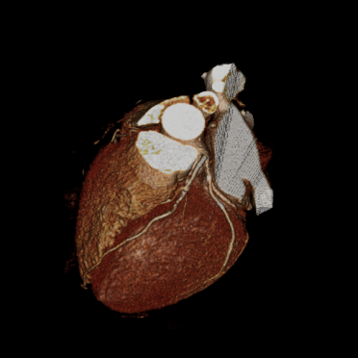

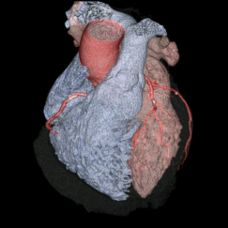
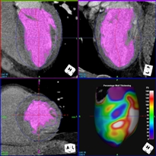
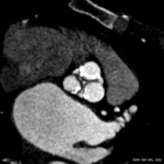

The MDCT Angiography dataset

Slide 20
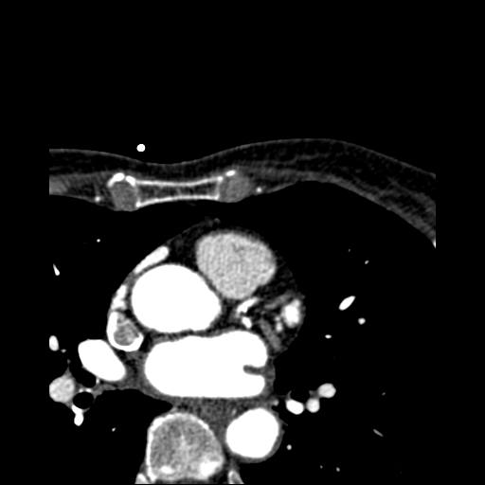
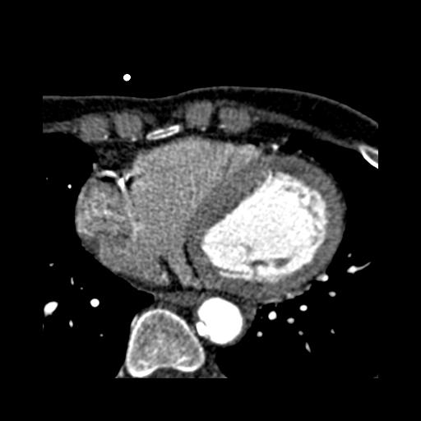
Reconstruction algorithms
Axial images (select best phase)

Slide 21
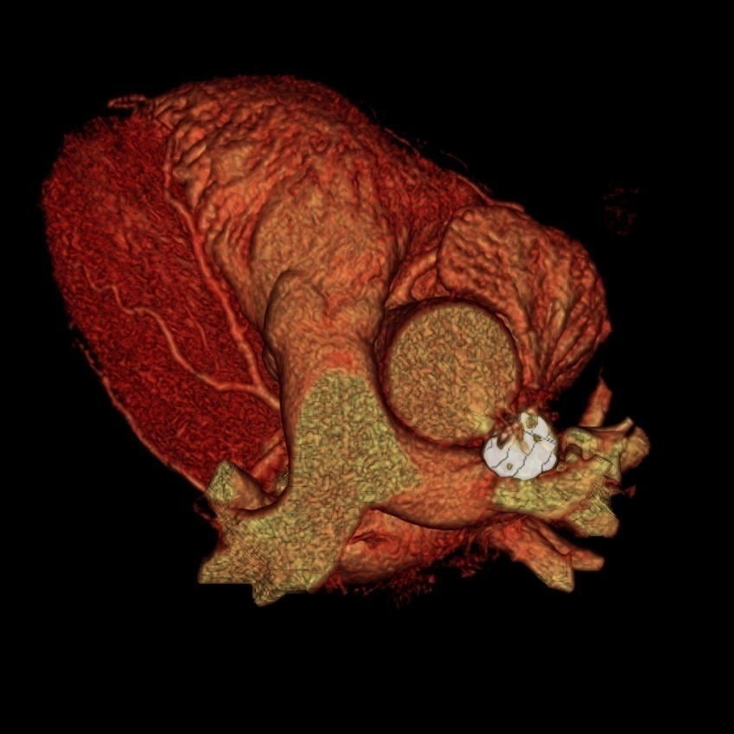
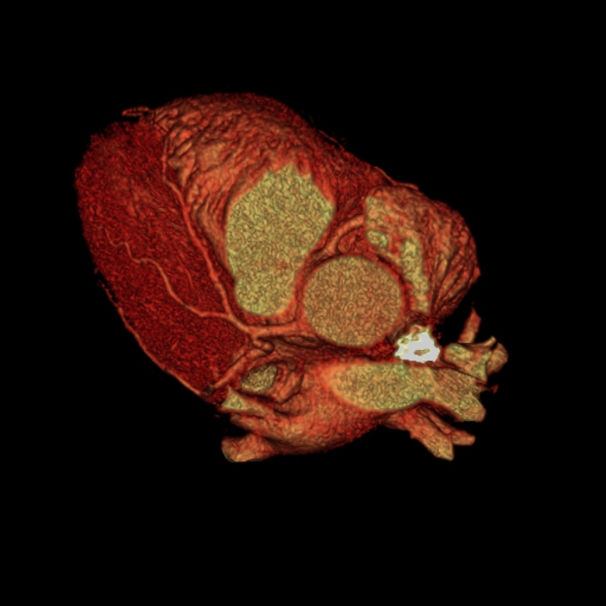
Reconstruction algorithms
Semi-automated to volume rendered
  Crop and select coronary vessels

Slide 22
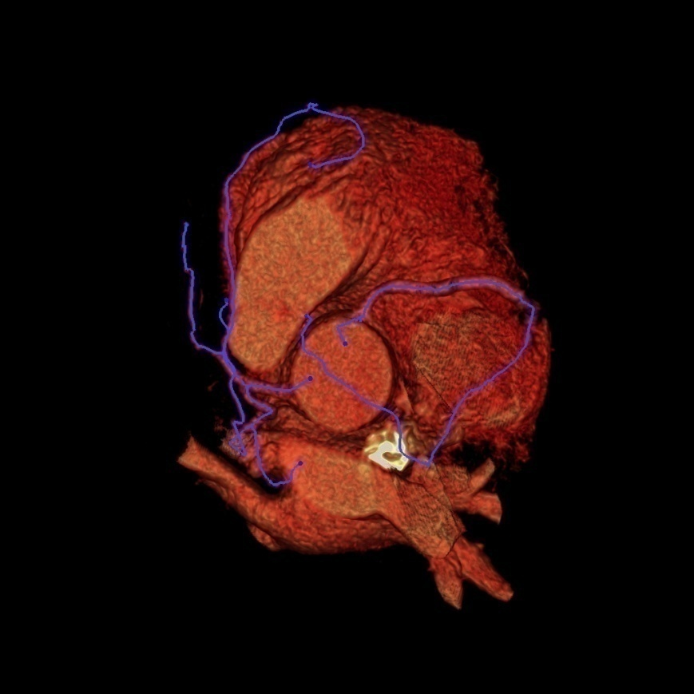
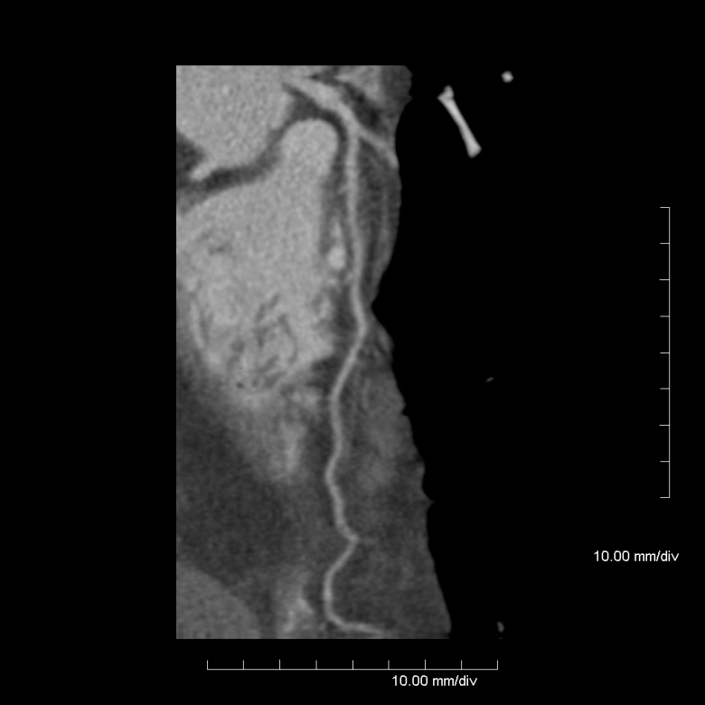
Reconstruction algorithms
Multi-planar reformats (MPR) - assessment

Slide 23
The MDCT Angiography dataset
Coronary lumenography and anatomy
Cardiac morphology
Ventriculography (left)
Valve assessment
First pass perfusion
All in the same 5-10 second breath-hold study
*No additional radiation burden

Slide 24
The MDCT Angiography dataset
Coronary lumenography and anatomy
Cardiac morphology
Ventriculography (left)
Valve assessment
First pass perfusion

Slide 25
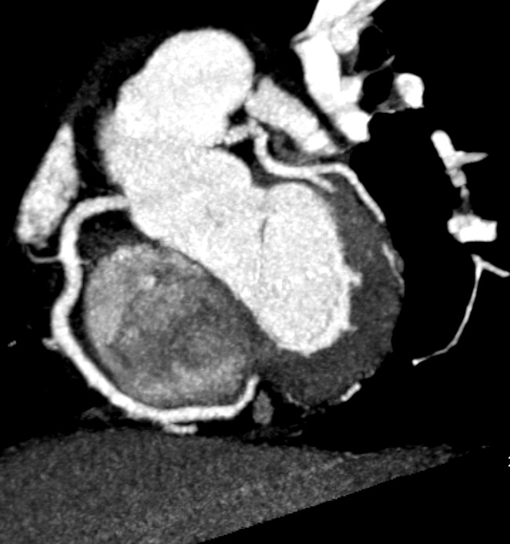
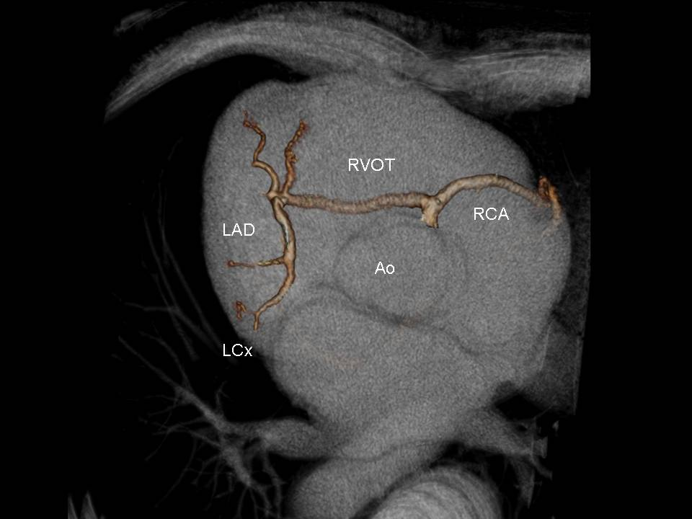
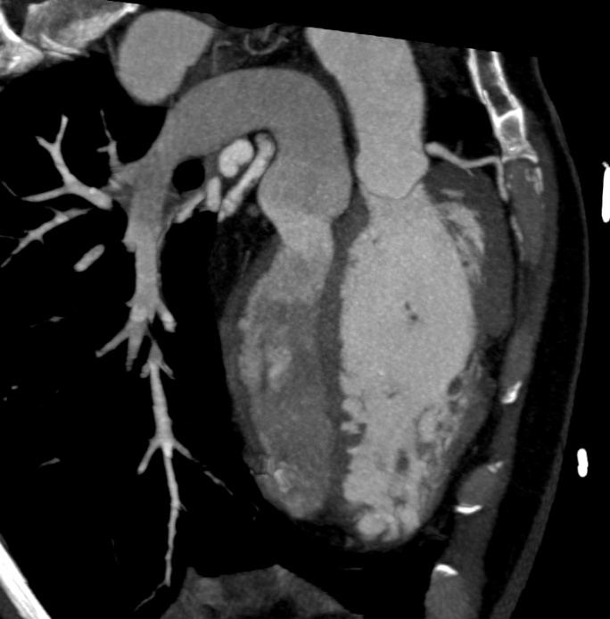
Nicol E D, Lyne J, Rubens M et al. J Nucl Cardiol 2007;14(5):715-8
Nicol E D, Gatzoulis M A, Padley SP et al. Clin Radiol 2007:62(6):518-27.

Slide 26

Image Interpretation I
Axial Images
  Raw data
  2-D
  Good road map
  Good for initial assessment of optimal phase
RVOT
RCA
LCA
Ao

Slide 27
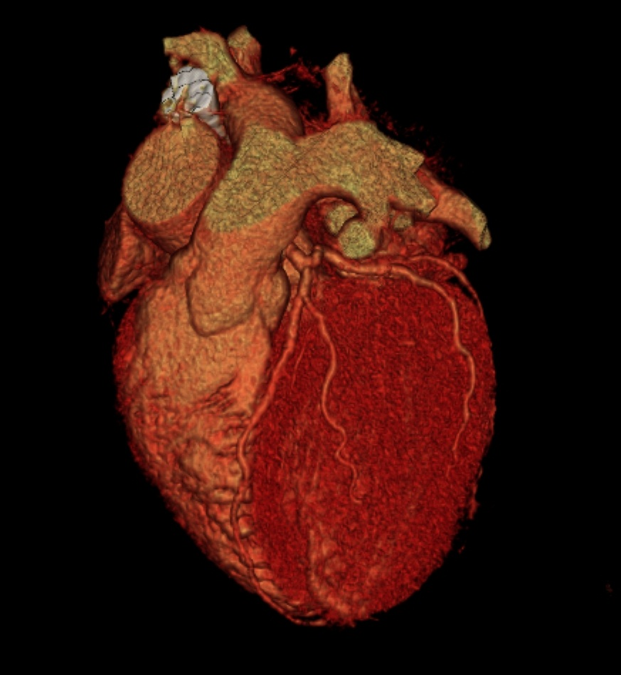
Image Interpretation II
Volume-Rendered Images
  Intuitive, coloured images, allows assessment of whole 3-D structures
  Good for communication of anatomy to non-radiologists
  Can “grow” coronary tree

Slide 28
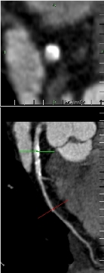
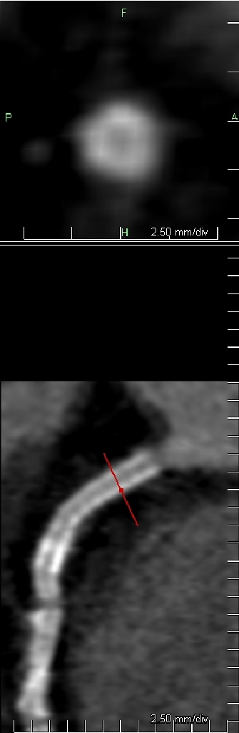
Image Interpretation III
Curved multi-planar reconstruction (MPR)
  Interactive, semi-automated oblique or curved vessels plotted from axial, sagittal or coronal images to show vessel in its entirety
  360° rotations enables visualisation of eccentric and circumferential stenoses
  Accurate quantification of stenosis

Slide 29
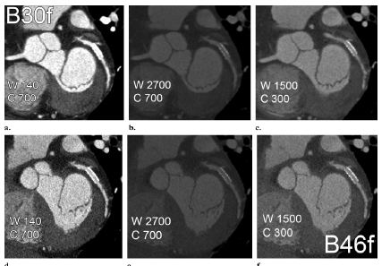
Windowing
Pugliese et al. Radiographics 2006;26:887-904

Slide 30
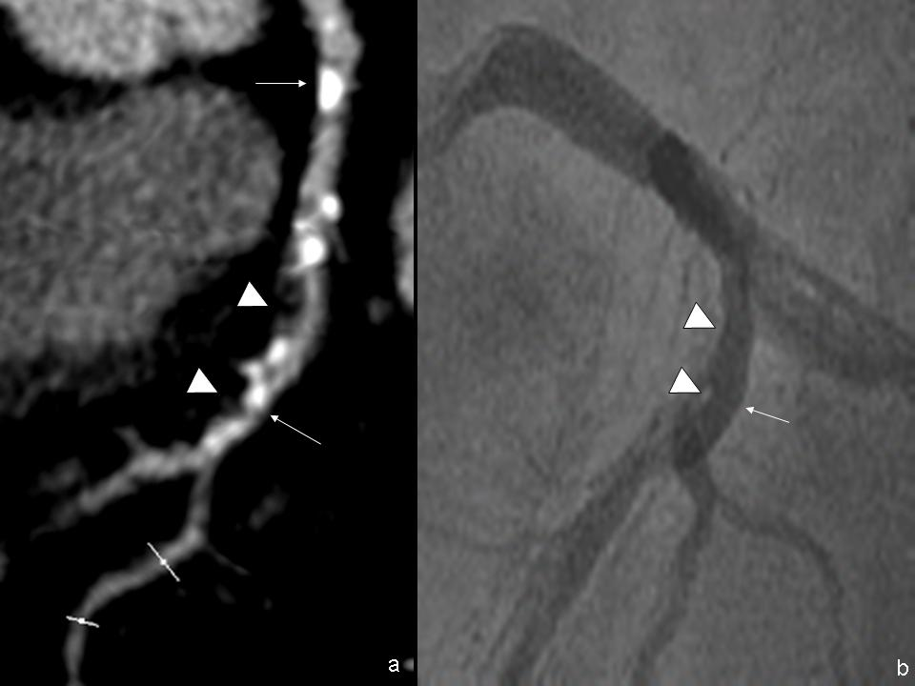
Plaque morphology
Calcified
Fibrous
(soft)
Mixed
Nicol E. MIMS Cardiovascular 2006;1(2):50

Slide 31
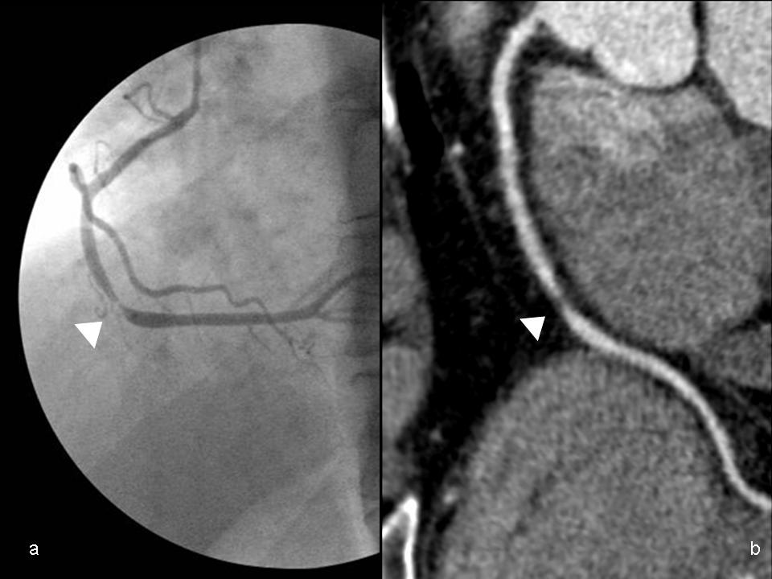
Nicol E. MIMS Cardiovascular 2006;1(2):50-51

Slide 32
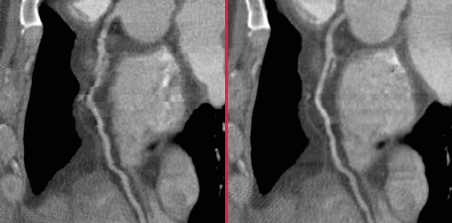
ECG Gating III
70 %
80 %

Slide 33
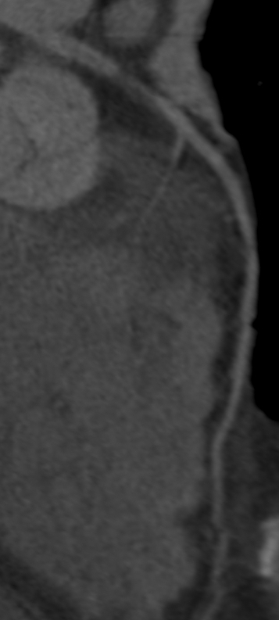
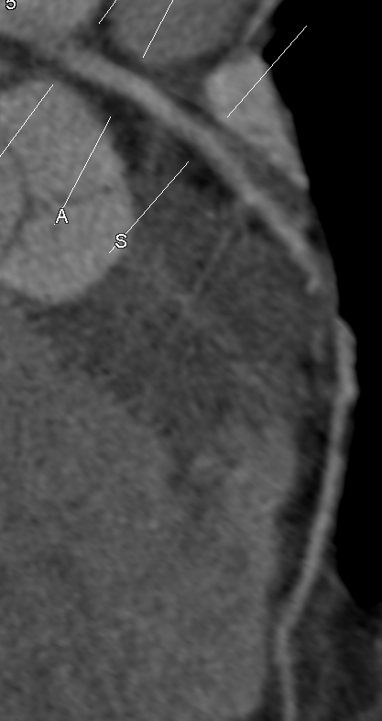
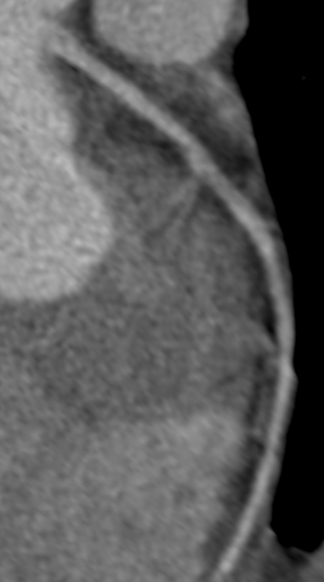
ECG Gating IV
65%
55%
95%

Slide 34

MDCT vs. ICA
Conventional angiography – 0.2mm³ spatial resolution, 20ms temporal resolution
  Able to distinguish between lesions to within 10% at any heart rate
MDCT coronary angiography – 0.4mm³
  Able only to distinguish lesions within 30-50% (i.e. why studies use > 50% as positive)
  With heart rate limitations

Slide 35
Results
Stenosis Detection: 64-slice CT vs. QCA
 |  | Year | Pts | Eval % | Sens % | Spec % | Ppv % | Npv %
Mollet | Circulation | 05 | 51 | 100 | 99 | 95 | 76 | 100
Raff | JACC | 05 | 70 | 88 | 86 | 95 | 66 | 98
Leber | JACC | 05 | 59 | 93 | 73 | 97 | - | -
Pugliese | Eur Radiol | 06 | 35 | 100 | 99 | 96 | 78 | 99
Schuijf | Am J Cardiol | 06 | 60 | 99 | 85 | 98 | 82 | 99
Nikolaou | AJR | 06 | 68 | 94 | 82 | 95 | 95 | 97
Ropers | Am J Cardiol | 06 | 84 | 96 | 93 | 97 | 56 | 100
Scheffel | Eur Radiol | 06 | 30 | 99 | 96 | 98 | 86 | 99
Muhlenbruh | Eur Radiol | 07 | 51 | 95 | 87 | 95 | 75 | 98

Slide 36
Multi-centre Data
291 symptomatic patients, median age 59
Referred for diagnostic invasive coronary angiography
Significant stenosis if ≥50%
Prevalence of significant stenosis 56%
 | Sens | Spec | PPV | NPV
Patient | 85 | 90 | 91 | 83
Vessel | 75 | 93 | 82 | 89
Miller et al. CORE 64 (NEJM 2008)

Slide 37
Multi-centre Data
360 patients (aged 50-70) with angina
Referred for diagnostic invasive coronary angiography
Significant stenosis if ≥50%
Prevalence of significant stenosis 68%
 | Sens | Spec | PPV | NPV
Patient | 99 | 64 | 86 | 97
Segment | 88 | 90 | 47 | 99
Meijboom et al. JACC 2008

Slide 38
The Effect of Pre-Test Probability
254 symptomatic patients  CTA and QCA
Divided into high (>70%), intermediate (30-70%) and low (<30%) likelihoods of CAD
Stenosis significant if >50%
 | Low |  | Intermediate |  | High
 | CT+ | CT- | CT+ | CT- | CT+ | CT-
Pre-Test Prob | 13 |  | 53 |  | 87
Post-Test Prob | 68 | 0 | 88 | 0 | 96 | 17
Meijboom et al. JACC 2007

Slide 39
Stenosis severity and functional significance
In the presence of a mild to moderate coronary artery stenosis, coronary blood flow (CBF) is maintained by compensatory vasodilatory regulation
Resting CBF remains constant until epicardial luminal narrowing exceeds 85%-90% diameter
During exercise or pharmacological stimulation both CBF and CFR usually increase when the lesion involves less than 50% of the luminal diameter
Both parameters show a variable response for stenoses of intermediate severity (50%-70%) and a progressive reduction as stenosis severity increases above 70% of the luminal diameter

Slide 40
CTA vs. MPS
52 patients referred for MPS
Low to intermediate CAD likelihood
Comparisons at >50% and >70% stenosis for the detection of inducible ischaemia
 | Sens | Spec | PPV | NPV
CTA >50% | 100 | 84 | 50 | 100
CTA >70% | 86 | 98 | 86 | 98
Nicol et al. JNC 2008

Slide 41
Detection of 70% Stenosis is possible and reduces unnecessary ICA referrals but the literature and clinical practice continues to use 50%

Slide 42
Stent Assessment
Affected by
  Strut thickness
  Stent coverage
  Stent deployment

Slide 43
Windowing
Pugliese et al. Radiographics 2006;26:887-904

Slide 44
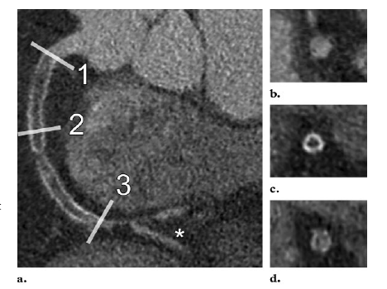
Stent Assessment
Pugliese et al. Radiographics 2006;26:887-904

Slide 45
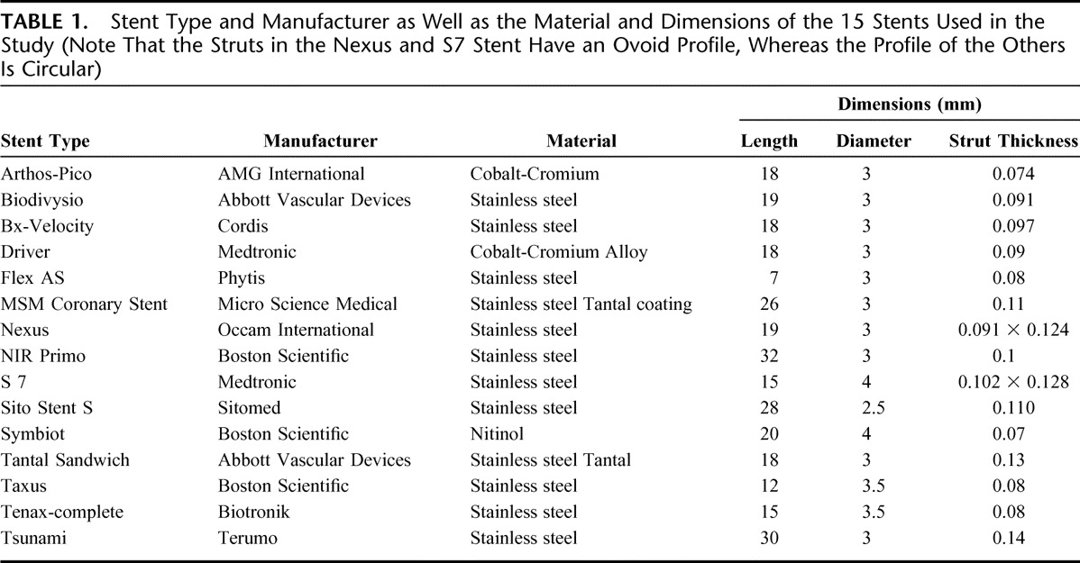
In conclusion, we can state that the increase of spatial resolution with 64-slice CT results in superior visualization of the stent lumen and in-stent stenosis as compared with 16-slice CT, especially when the stent is orientated parallel to the x-ray beam. Nevertheless blooming artefacts caused by the metallic stent struts remain an important problem obscuring about one third of the vessel lumen on average.
Siefarth et al. Invest Radiol. 2006 Jan;41(1):22-7.

Slide 46

Iterative Reconstruction Technology

Slide 47


Graft Assessment

Slide 48


Slide 49



Emergency Cardiac CT
CT Aortogram
CT Aortogram + CTPA (Double rule out)
CT Aortogram + CTCA (Double rule out)
CT Aortogram + CTPA + CTCA (Triple rule out)

Slide 50
The MDCT Angiography dataset
Coronary lumenography and anatomy
Cardiac morphology
Ventriculography (left)
Valve assessment
First pass perfusion

Slide 51




Time Volume Analysis
Ability to perform 4D imaging
Multiple (8-16) phases reconstructed
Functional assessment of the left ventricle

Slide 52
Ventriculography
LV Function (EDV/ESV/SV)
Regional Wall Motion
Systolic wall thickening
LV mass

Slide 53
Radiation Dose
Diagnostic Angiography 2-6mSv
PCI 5-40mSv
Thallium (1 day) MPS 18mSv
Thallium (2 day) 27mSv
Technetium MPS 10mSv
CTCA (retrospective gating) 6-18mSv*
CTCA (prospective gating) 2-4 mSv
*2-4 mSv on 320MDCT single beat

Slide 54
Acknowledgements
Dr Mike Rubens
Dr Simon Padley
Mrs Nina Arcuri
Miss Sally Copperthwaite
Dr Carl Schultz
Dr Jim Stirrup
Professor Richard Underwood
Professor Michael Gatzoulis
Professor Tim Evans
Prof Stefan Neubauer
Royal Air Force Medical Service

Slide 55
Questions
?

