Slide 1
Cardiovascular magnetic resonance: basic principles and applications - an overview
Dr Sanjay Prasad MD MRCP
Consultant Cardiologist
Royal Brompton Hospital, London
National Heart & Lung Institute, Imperial College London

Slide 2
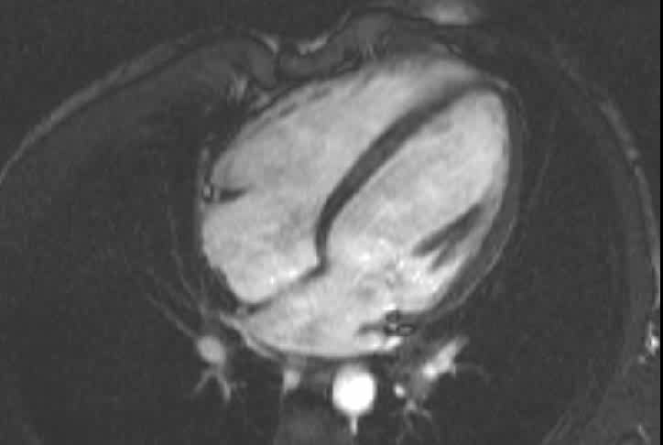
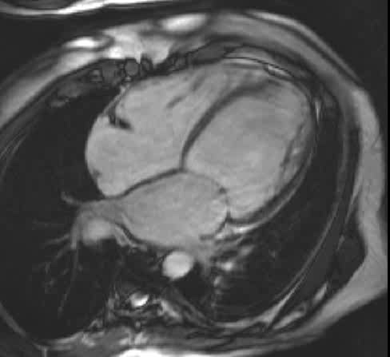
Assessment of Function

Slide 3
Overview
Basic Principles
Physics
Hardware
Range of sequences
Applications
Pitfalls
Safety concerns –devices/ contrast agents

Slide 4
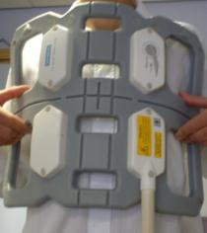
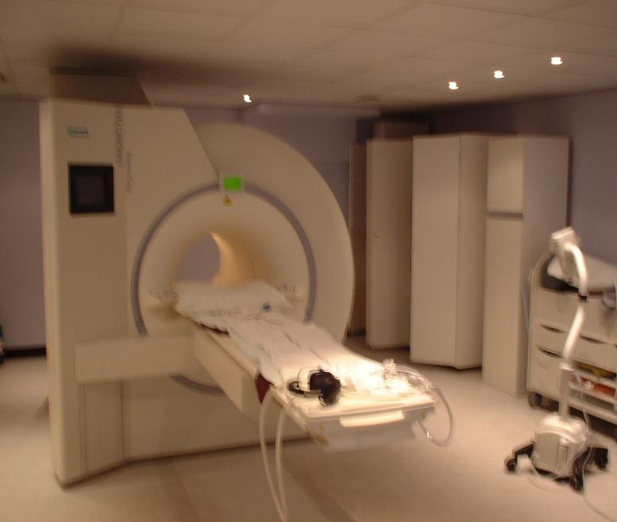
What is CMR
Siemens sonata 1.5T (Bo)
Liquid helium, superconducting coil, far less energy wastage, continuous uniform fled within ~ 50cm sphere at centre of bore
2 x 2 x 1.5m
Require fast, high strength gradients for switching during acquisition, for CMR.

Slide 5
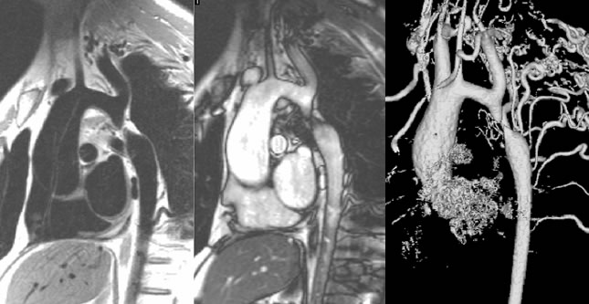
CMR of Coarctation of the Aorta
Babu-Narayan SV, Kilner. pJ, Gatzoulis MA>. Curr Cardiol Rep. 2003

Slide 6
Overview
Basic Principles
Physics
Hardware
Range of sequences
Applications
Pitfalls
Safety concerns –devices/ contrast agents

Slide 7
What is MRI ?
Magnetic resonance imaging (MRI) uses the body’s natural magnetic properties to produce detailed images from any part of the body.
For imaging purposes the hydrogen nucleus (a single proton) is used because of its abundance in water and fat.

Slide 8
MR
Freedom from ionising radiation
Acquisition in any plane without the need for reformatting
Versatility of available physiological information
Clinical validation

Slide 9
Overview
Basic Principles
Physics
Hardware
Range of sequences
Applications
Pitfalls
Safety concerns –devices/ contrast agents

Slide 10
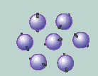
Physics
Proton can be likened to the
planet earth, spinning on its axis, with a north-south pole.
Behaves like a small bar magnet.
Under normal circumstances, these hydrogen proton “bar magnets” spin in the body with their axes
randomly aligned.

Slide 11
Outside Magnetic Field
The body contains many millions of ¹H nuclei or protons in water and fat based tissues
10⁻¹⁴ m

Slide 12
Outside Magnetic Field
Each one is a tiny spinning charged particle which produces a magnetic moment
10⁻¹⁴ m
Randomly orientated

Slide 13
Physics
When additional energy (in the form of a radiowave) is added to the magnetic field, the magnetic vector is deflected.
The radio wave frequency (RF) that causes the hydrogen nuclei to resonate is dependent on the strength of the magnetic field.

Slide 14
Inside Magnetic Field
Nuclei precess around the direction of the magnetic field at the resonant frequency
B₀
MAGNET

Slide 15
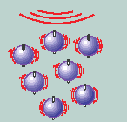
Physics
When the body is placed in a strong magnetic field, such as an MRI scanner, the protons’ axes all line up.
This uniform alignment creates a magnetic vector oriented along the axis of the MRI scanner.
MRI scanners come in different field strengths, usually between 0.5 and 2.0 tesla.

Slide 16
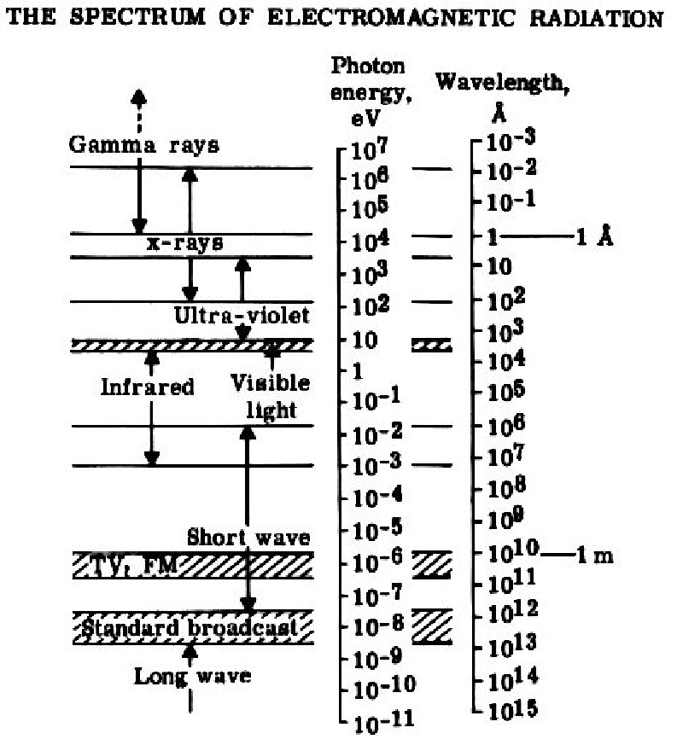

Slide 17
Physics
Most diseases manifest themselves by an
increase in water content, so MRI is a sensitive test for the detection of disease.

Slide 18
Hydrogen Nucleus
Main active nucleus used in MR
Single proton (atomic number 1)
Used for MR:-
    Abundant in the human body (fat and water)
    Solitary proton so has a large magnetic moment

Slide 19
Resonance and Signal Generation
Energy transition that occurs when an object is subjected to a frequency the same as its own
In MR resonance is induced by applying a radiofrequency (RF) pulse (excitation pulse)
    At the same frequency as the precessing hydrogen nuclei
    Or at 90° to magnetic field (B_{o}).

Slide 20
Resonance
Hydrogen nuclei will resonante whereas other active nuclei do not because their gyromagnetic ratios are different to Hydrogen and so have different precessional frequency
Result
-energy absorption
-phase coherence

Slide 21
Contrast
Difference in tissue characteristics
Fat – H atoms linked to Carbon
  Large molecules
  High inertia
  Low inherent energy
Water – small molecules with little inertia
  High rate of molecular motion
Differences in image contrast as different relaxation rates in each tissue

Slide 22
Relaxation
Withdrawal of RF eneregy:-
  T1 recovery – exchange of energy from nuclei to their surrounding environment or lattice
  Fat has a high T1 signal
T2 Decay
  Exchange of energy from one nucleus to another
  High in fluids, lower in fat.

Slide 23
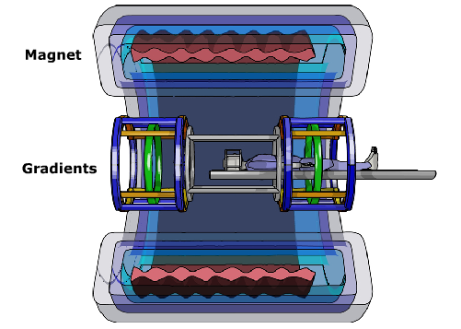
Basic image generation
Different components of an MR system
Superconducting magnet → ALWAYS ON
Gradient coils
  Alter the magnetic field
  Responsible for the noise (rapid switching / current)
RF generator
  Energy to deflect the magnetisation
RF detector coils
  Within the table
  Surface coils
  Detect signal

Slide 24
Basic image generation
H⁺ protons → tiny magnets → align with external magnetic field → spin (precess) at a frequency proportional to the magnetic field
‘LARMOR’ frequency f α Field strength
f ≈ 64MHz at 1.5T
→ important for RESONANCE

Slide 25
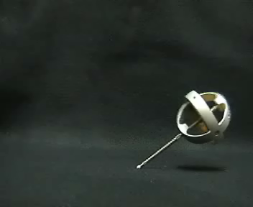
Basic image generation
Spinning protons → like tiny gyroscopes… 2 distinct properties:
Frequency
  cycles per second of spin
Phase
  orientation of net magnetisation vector
  IN PHASE = phase coherence OUT OF PHASE
  eg. If 2 protons start at the same position but one has a higher frequency, then they rotate at difference speeds and a difference in phase accumulates
Notes:
Due to the difference in resonant frequency between water and fat, the protons may be misregistered by the Fourier transform.
Where fat and water appear together, this may be represented by a bright or a dark band at the fat/water interface.

Slide 26
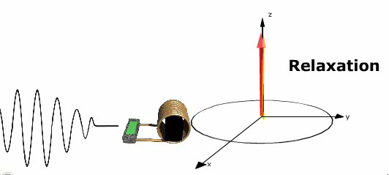
Basic image generation
RF energy → deflects net magnetisation temporarily
THEN… magnetisation returns to initial direction → ‘relaxation’ → relaxation generates signal → image
Different tissue have different relaxation properties
Main magnetic field

Slide 27
MR in a nutshell
Patient in magnetic field → protons align
Magnetisation disturbed by brief RF excitation pulse
Magnetisation allowed to return to equilibrium
  Relaxation → signal received
LOCALISATION of signals requires magnetic field gradients
Repeated many times (~128 – 256) to generate data needed
Data collected in a data space “k-space”
  k space is the collected data
  Fourier transform → creates image
∫
∞
‘k’ comes from the Fourier equation – k = 1/wavelength H(k_{x},k_{y}) = h(x,y) cos(k_{x}x + k_{y}y)dx dy
-∞

Slide 28

Basic image generation
RF → tips magnetisation into transverse plane
Magnetisation recovers into the longitudinal plane
  Two independent processes involved
T1 recovery
T2 decay

Slide 29

Basic image generation
T1 recovery Recovery of longitudinal magnetisation

Slide 30

Basic image generation
T2 decay Decay of transverse magnetisation → SIGNAL

Slide 31
Basic image generation
T2 fast ~10-100ms
T1 slower ~500-1500ms
Different tissues have different T1/T2 → images look different
Can manipulate image
sequence to bring out
desired contrast
ie. Tissues short / Fluids long
Gadolinium chelates
  Shorten T1 → High signal
 | T1 (ms) | T2 (ms)
Fat | 250 | 60
Myocardium | 800 | 30
Liver | 575 | 50
Arterial blood | 1200 | 250
CSF | 2000 | 1000
T1
T2

Slide 32
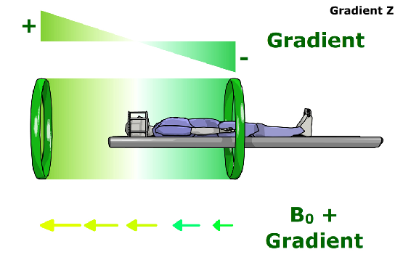
Basic image generation
SPATIAL LOCALISATION
  Need to identify the origin of a signal → image
GRADIENTS → Vary the magnetic field
  Frequency of protons varies linearly along the gradient
SLICE-SELECT
  Gradient in ‘z’ direction
  Precessional frequency varies along ‘z’ direction
  RF pulse of a certain frequency excites ONLY the protons at that frequency → slice ‘selected’
THICKNESS α
RF pulse bandwidth
Gradient field strength

Slide 33
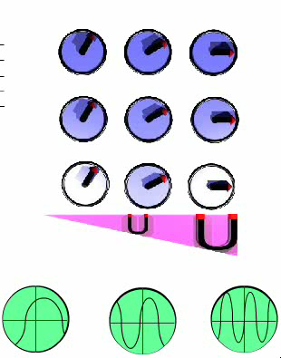
Basic image generation
After the slice has been selected…
  Need to know ‘x’ and ‘y’ coordinates
X-DIRECTION
  Gradient is applied → alters the frequency of the protons
  Different frequencies read out
  ‘FREQUENCY ENCODING’ or ‘READOUT’ gradient

Slide 34

Basic image generation
After the slice has been selected…
  Need to know ‘x’ and ‘y’ coordinates
Y-DIRECTION
  Another gradient is applied for a short time
  This changes the frequency of the protons… hence they accumulate a phase shift
  Stronger gradient → greater phase shift
  ‘PHASE ENCODING’ needs to be repeated many times

Slide 35
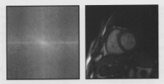
Basic image generation
All this data is acquired and stored
  ‘k-space’
To generate a full image
  Needs to be repeated multiple times
  Different ‘PHASE-ENCODING’ gradients

Slide 36
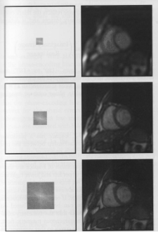
K-space

Slide 37
Speed and Turbo factors
Cardiovascular MRI demands fast imaging
Methods for speeding up acquisition needed
  MULTIPLE lines of data (echoes) per RF pulse
    SPIN ECHO → Use multiple 180º pulses
      Echo train length – ‘TURBO factor’ / TSE
    GRADIENT ECHO → Use multiple gradient reversals
      Echo planar imaging (EPI)
      Reduce the TR (repetition time)
  Reduce amount of data acquired
    Lower N_{PE} - Rectangular Field of View
    Lower N_{PE} – Lower spatial resolution
    Partial Fourier techniques – eg. HASTE
  PARALLEL IMAGING
    Use information from multiple coil elements – SENSE / SMASH

Slide 38
CMR: Advantages
a wide range of soft tissue contrast provides the potential for the characterization of myocardial tissue.
Contrast among tissues depends on:-
proton (hydrogen nuclei) density
magnetic relaxation times of the protons
magnetic susceptibility effects.

Slide 39
Magnetic Fields
Magnetic lines of flux
Number of lines per unit area =magnetic flux density
Units for measuring strength are
      Gauss
      Kilogauss
      Tesla

Slide 40
Magnetic Field Strength
1 Tesla =10,000 Gauss
Earth -0.5 Gauss
Scanner -15,000-30,000 Gauss (1.5-3 T)

Slide 41
Overview
Basic Principles
Physics
Hardware
Range of sequences
Applications
Pitfalls
Safety concerns –devices/ contrast agents

Slide 42
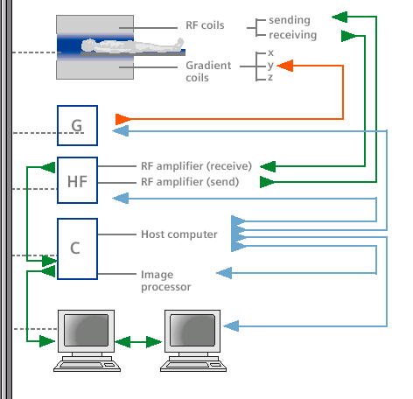
Important MR System Components
RF Transmitter

Slide 43
What is CMR
Siemens sonata 1.5T (Bo)
Liquid helium, superconducting coil, far less energy wastage, continuous uniform fled within ~ 50cm sphere at centre of bore
2 x 2 x 1.5m
Require fast, high strength gradients for switching during acquisition, for CMR.

Slide 44
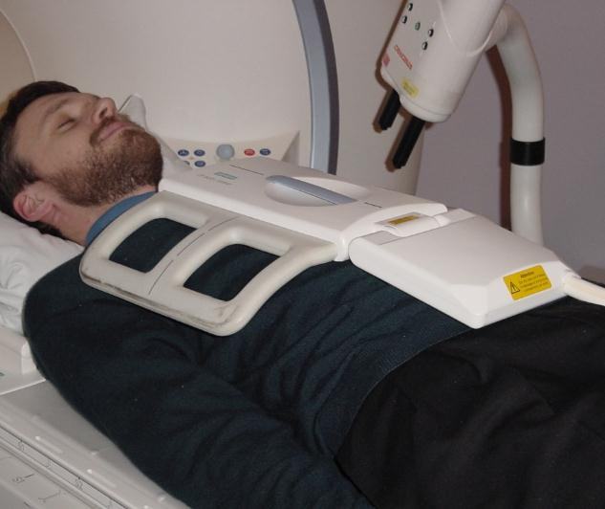
Surface receiver coils
Coil used to receive the signal from the cardiac region

Slide 45
1.5 vs 3T
SNR
Cost
Sequences

Slide 46
Overview
Basic Principles
Physics
Hardware
Range of sequences
Applications
Pitfalls
Safety concerns –devices/ contrast agents

Slide 47
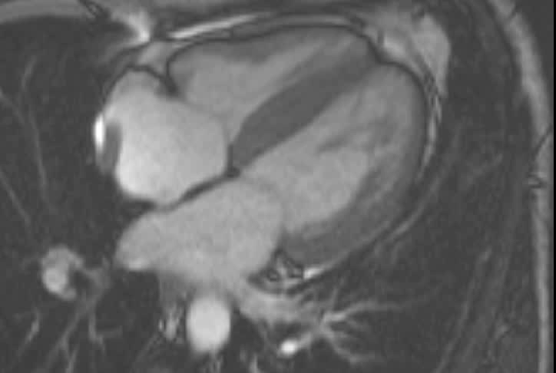
Evaluation
Function
Tagging
Diastolic function

Slide 48
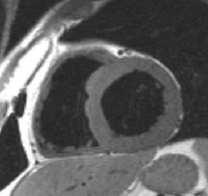
Myocardial Tissue Characterisation
Fat characterisation
    -ARVC
    T1-weighted spin-echo

Slide 49
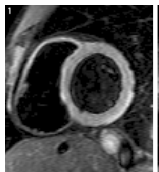
Myocardial Tissue Characterisation
Inflammation
  Myocarditis
  Sarcoidosis
  Recent infarct
T2-weighted spin-echo

Slide 50
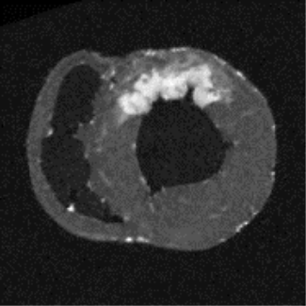
Myocardial Tissue Characterisation
Scar Tissue and Fibrosis
  Infarction
  IHD vs non-IHD Cardiomyopathy
  HCM
        Delayed Contrast-Enhancement

Slide 51
GADOLINIUM-DTPA
Paramagnetic contrast agent
Reduces T1 relaxation time where taken up
Uptake into extracellular water and if cell membrane injured
Scar from infarction /fibrous tissue

Slide 52
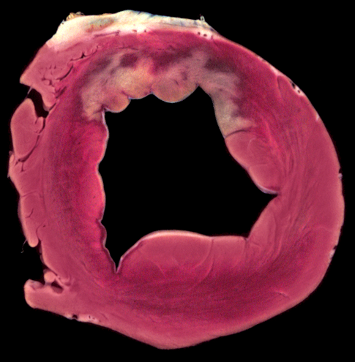
Contrast Enhancement in Infarction
Ex-vivo comparison of TTC and Gd-enhanced MR
TTC
MRI
R Judd, Northwestern University, Chicago

Slide 53
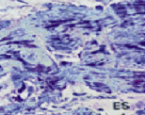
Healthy Myocardium
LM myocardium: Red stain for glycogen

Slide 54
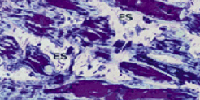
Background: Scar Tissue
LM myocardium: Red stain for glycogen, in myolytic cytosol

Slide 55
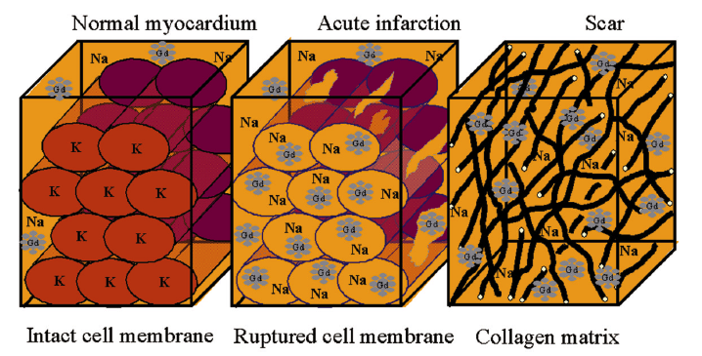
Late Enhancement

Slide 56
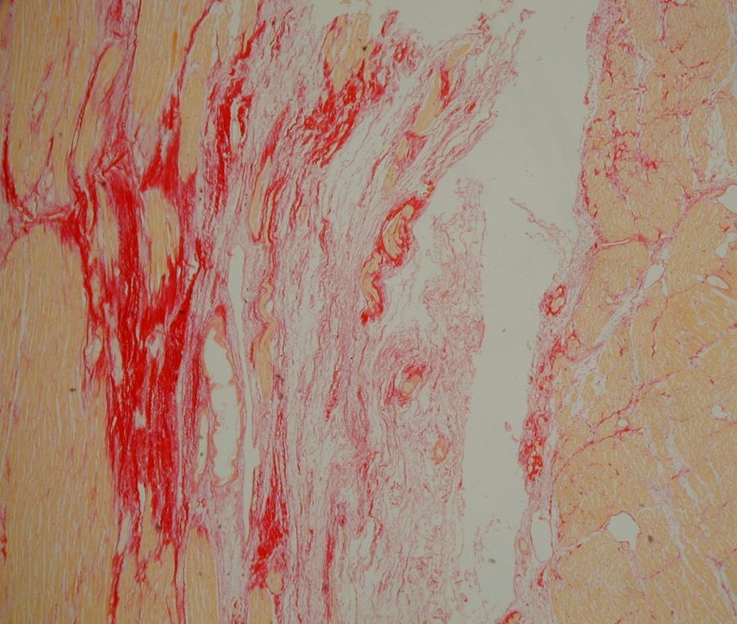
Fibrosis

Slide 57
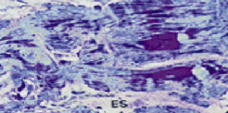
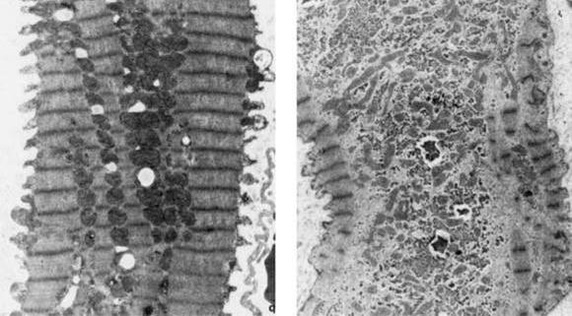
Normal
Scar
Electron-micrograph, Bonow et al

Slide 58
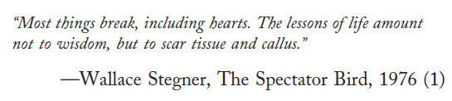
Where Are We?

Slide 59
Kinetics of gadolinium: 3 time periods
[Gd]
1
2
3
1:First pass
2: Early
3: Late
Blood pool
Normal
Isch
Infarcted
Microvascular obs.
<10s
1-3min
10-20 min
t

Slide 60
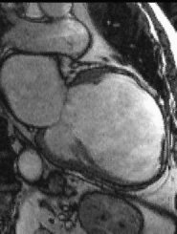
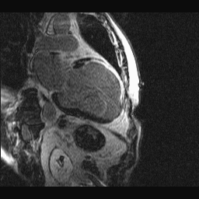
Viability - Transmural MI
Kim R, Judd R. Northwestern University, Chicago

Slide 61
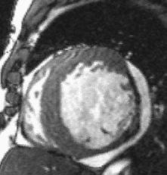
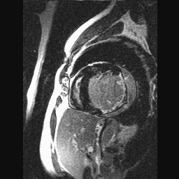
Viability
Kim R, Judd R. Northwestern University, Chicago

Slide 62
Overview
Basic Principles
Physics
Hardware
Range of sequences
Applications
Pitfalls
Safety concerns –devices/ contrast agents

Slide 63
CMR - Applications
Function
Anatomy
Perfusion
Flow
Viability
Angiography

Slide 64
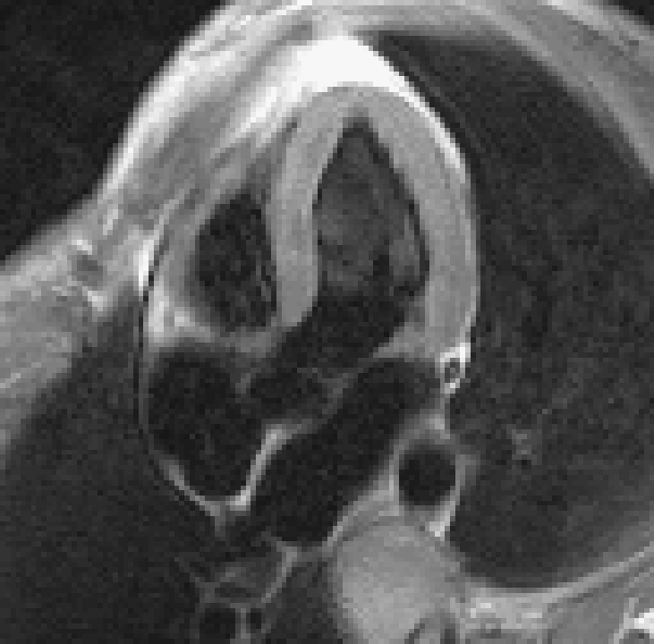
CMR Quantification
Apex
9
8
7
6
5
4
3
2
Base
1

Slide 65
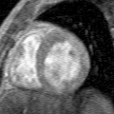
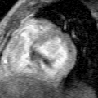
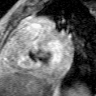
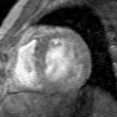
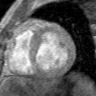
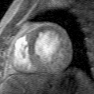
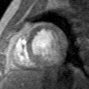
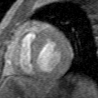
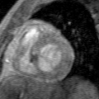
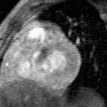
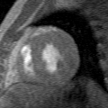
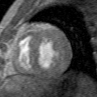
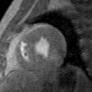
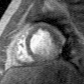
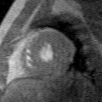
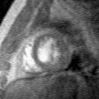





3D Assessment of Ventricular Function
ED
ES

Slide 66
Assessment of LV function
Multiplanar
No geometrical assumptions
Not limited by poor echo-window

Slide 67

Early Detection of CAD
The Glagov Phenomenon
Glagov NEJM 1987; 316: 1371-5

Slide 68


Spiral Coronary Wall CMR
Hu B, Meyer C. Stanford University

Slide 69
Eccentric Plaque in LAD
X-ray angiogram
LAD
RVOT
LV
LAD
RV
Fayad ZA Circulation 2000
Notes:
• X-ray angiogram from a 76 year-old male patient showing high-grade stenosis in the proximal left anterior descending coronary artery (LAD) (arrows, left panel). The in vivo cross-sectional black blood MR images of the LAD shows shows a large eccentric plaque with heterogeneous signal intensity (maximum thickness ~6mm). The heterogeneity may be due to the composition of the plaque.
• MR imaging is performed with a fast spin echo sequence with short ESP and long ETL imaging. Blood flow in the coronary artery lumen is suppressed with the velocity-selective inversion preparatory pulses and fat surrounding the coronaries is suppressed with an optimized chemical shift pulse. The slice thickness is 4 mm and the spatial resolution is 450 µm. LV represents left ventricle; RV represents right ventricle; RVOT represents right ventricular outflow tract.

Slide 70


3T Coronary CMR
LAD
PA
LCx
RCA
Ao
Ao
LV
LMS
RV
Matthias Stuber, Beth Israel, Boston

Slide 71
Overview
Basic Principles
Physics
Hardware
Range of sequences
Applications
Pitfalls
Safety concerns –devices/ contrast agents

Slide 72

Wrong TI

Slide 73

Late Enhancement: Scanning too Early

Slide 74
Overview
Basic Principles
Physics
Hardware
Range of sequences
Applications
Pitfalls
Safety concerns –devices/ contrast agents

Slide 75
Safety
1.5 vs 3T
All stents are fine
All mechanical valves are fine at 3 months
Pacemakers
  No longer absolute but only under very tight conditions

Slide 76
Contrast Agents
Evidence for nephrogenic systemic fibrosis
Incidence very low
Only seen in patients w ESRF (GFR<30)
Not seen w newer generation agents

Slide 77


Slide 78


Slide 79
Conclusion
Wide range of applications
High resolution images
In-vivo tissue characterisation
Detailed information in 30 mins

Slide 80

MR & CFD
Carotid bifurcation wall shear
Y. Xu et al., Imperial College

