Slide 1
Diagnosis and prognosis in coronary artery disease
S Richard Underwood
MD FRCP FRCR FESC FACC
Professor of Cardiac Imaging
Imperial College London &
Royal Brompton Hospital, London, UK

Slide 2
The Medical Process
history and examination
investigations
diagnosis
further investigations
management
treatment
outcome

Slide 3
The history and diagnosis
89%
Non-cardiac chest pain
Atypical angina
Typical angina
50%
16%
Diamond & Forrester
NEJM 1979;300:1350
Percent coronary disease

Slide 4
Pre-test likelihood of CAD

Slide 5
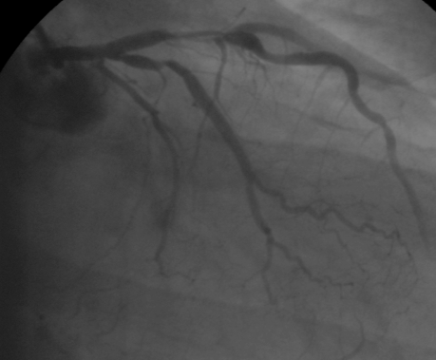
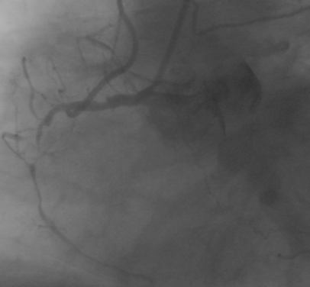
Atypical chest pain
Stress
Rest

Slide 6
The ischaemic cascade
hypoperfusion
metabolic alterations
diastolic dysfunction
Myocardial perfusion
systolic dysfunction
ECG-Changes
angina
Signs of ischaemia

Slide 7
Inducible Perfusion Abnormality
Stress
Rest

Slide 8
Detection of CAD

Slide 9
Detection of CAD
100%
92
89
87
87
90
89
81
84
80%
77
68
60%
40%
20%
0%
Sensitivity
Specificity
Ex ECG (150 studies)
Stress echo (14 studies)
Thallium SPECT (6 studies)
MIBI SPECT(3 studies)
Tetrofosmin SPECT
Adapted from Beller GA

Slide 10
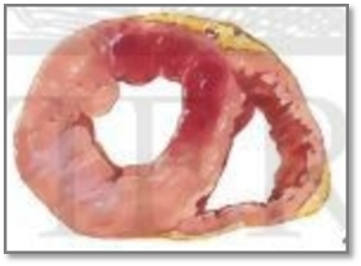
Chest pain of recent onset
Assessment and investigation of recent onset chest pain or discomfort of suspected cardiac origin
NICE guidance March 2010
http://www.nice.org.uk/cg95

Slide 11
Features of angina
Constricting discomfort in the chest, neck, shoulders, jaw or arms
Precipitated by physical exertion or psychological stress
Relieved by rest of GTN within 5 minutes
Three features = typical angina
Two features = atypical angina
One feature = non-anginal chest pain

Slide 12
Diagnosis of angina
Clinical assessment alone
Clinical assessment with obstructive CAD on anatomical testing
Clinical assessment with myocardial ischaemia on functional testing

Slide 13
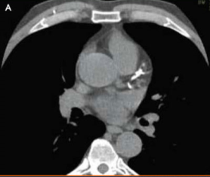
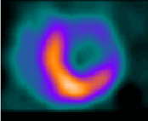
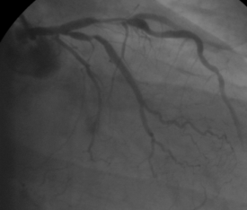
First line diagnostic investigations
Likelihood <30%
Coronary calcium imaging
CTA if CAC 1-400
Functional imaging if CAC >400
Likelihood 30-60%
Functional imaging
Likelihood >60%
ICA, if clinically appropriate and revasc considered
Functional imaging, if ICA not appropriate
March 2010. http://guidance.nice.org.uk/CG95

Slide 14
Diagnosis of CAD
Underwood SR, et al. EJNM 2004; 31; 261-91
Kapur A, et al. EJNM 2002; 29; 1608-16

Slide 15
Special circumstances in MPS
LBBB, bifascicular block, and paced rhythm
adenosine
chronic lung disease with pulmonary hypertension
false defects with dobutamine
early after percutaneous coronary intervention
?false defects in first 2-6 weeks
balanced three vessel disease
very rare
dilated cardiomyopathy
reversible defects possible

Slide 16
Artefact
low count
attenuation
diaphragm
inferior
breast
motion
reconstruction
“apical thinning”
cold inferior wall

Slide 17
low count
upward creep
breast
motion
breast
diaphragm

Slide 18
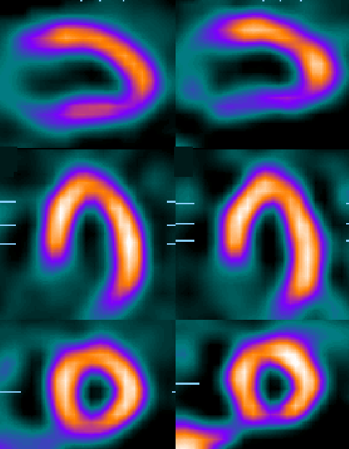
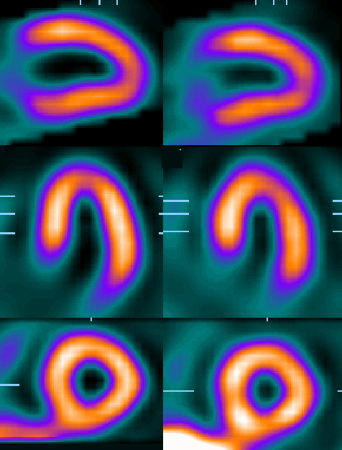
Stress
Rest
Stress
Rest
Conventional, backprojection
Attenuation and scatter correction,
iterative reconstruction

Slide 19
Clinical Indications for Perfusion Imaging
Diagnosis
abnormal resting ECG
unable to exercise
female
intermediate likelihood of CAD after ex-ECG
Management
confirmation of ischaemia
prognosis
culprit lesion
viable and jeopardised myocardium
hibernating myocardium

Slide 20
Health Economics Jargon
cost minimisation
cost effectiveness
cost utility
cost benefit

Slide 21
Monetary Issues
cost
reflects actual consumption of resources
can be difficult to quantify
most relevant for the Minister of Health in a state funded system
price
reflects the state of the market
easy to quantify
most relevant when “fee for item of service”

Slide 22
Global costs
Rest ECG £ 20
Exercise ECG £ 70
Echocardiogram (rest) £ 100
Myocardial perfusion imaging £ 220
Coronary angiography £ 1100
PTCA £ 2500
CABG £ 4500
Hospital bed £ 300

Slide 23
Two year costs (CAD absent)
P < 0.0001
P < 0.001
P < 0.05
EMPIRE study. Eur Heart J 1999; 20: 157-66

Slide 24
Bayes’ Theorem

Slide 25
Invasive procedures and outcomes
Yusuf S et al. Oasis registry. Lancet 1998; 352: 507-14
7987 patients with UA or suspected MI without ST elevation. 95 hospitals, 6 countries, follow-up 6 months
0.001
ns
0.001
ns
ns
ns

Slide 26
Outcome after infarction
Boden WE et al. VANQWISH study. NEJM 1998; 338: 1785-92
920 patients with acute non-Q MI. Randomised to invasive and conservative management. Mean follow-up 23m

Slide 27
Cost effectiveness of MPS
Where are the savings?
patient without CAD discharged without angiography
patient with CAD managed medically without angiography
avoid morbidity of angiography
revascularisation targeted more effectively at high risk patients with most to gain

Slide 28
“Thallium-201 imaging has important prognostic value in a wide spectrum of patients with coronary artery disease (refs 5-49)”
Kenneth A Brown
Prognostic value of thallium-201 myocardial perfusion imaging. A diagnostic tool comes of age
Circulation 1991; 83: 363-81

Slide 29
Prognostic value of MPS
asymptomatic volunteers
asymptomatic patients with abnormal sECG
investigation of suspected CAD
known CAD with stable angina
after infarction
after stabilisation of UA
after revascularisation
before non-cardiac surgery
Underwood SR, et al. EJNM 2004; 31; 261-91
29 studies , 20963 patients, mean follow-up 28m
Notes:
29
SR Underwood, Diagnosis and Prognosis in CAD

Slide 30
Prognosis and normal MPS
Author Stress n F/U (m) † or MI/yr %
Brown Ex 100 46 0.8
Staniloff Ex 374 12 0.5
Iskandrian Ex 402 13 1.1
Gill Ex 192 91 0.8
Kaul Ex 39 64 0.5
Fleg Ex 352 55 0.9
Wahl Ex 455 14 0.8
Pamelia Ex 345 34 1.1
Wackers Ex 344 22 1.0
Heo Ex 519 27 0.5
Bairey Ex 144 12 2.1
Koss Ex 309 36 0.5
Younis Dip 36 24 0
Hendel Dip 172 21 1.7
Younis Dip 14 12 0
Strateman Pace 85 19 2.2
Weighted mean 3,573 28m 0.9%
From Brown KA. Circulation 1991; 83: 363-81

Slide 31
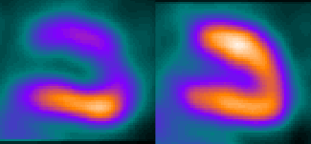
Prognostic indicators in MPS
reversible perfusion defects
extent
depth
transient LV dilation
increased lung uptake
LVEF (gated SPECT)

Slide 32
Prognosis
Nine segments

Slide 33
Normal myocardial perfusion
The likelihood of coronary events is <1%/yr for at least 2 years

Slide 34
Inducible Perfusion Abnormality
Stress
Rest
Ischaemia affecting 2 of 9 segments
The likelihood of coronary events is 5% per year

Slide 35
Inducible perfusion abnormality
Ischaemia affecting 5 of 9 segments
The likelihood of coronary events is 20%/yr

Slide 36
Cardiac death in known CAD
Bodenheimer et al. Am J Cardiol 1994; 74: 1196-200
896 patients with known CAD

Slide 37
Prognosis after MI
Gibson RS. Circ 1983; 68: 321-36
140 patients, mean F/U 15 ± 12m (terminated at revascularisation)

Slide 38
Prognostic value after ACS
P < 0.001
Heller GV, et al. J Am Coll Cardiol 1998; 31: 1011-7

Slide 39
Risk after myocardial infarction
Mahmarian JJ, et al. J Am Coll Cardiol 1995;25:1333-40

Slide 40
GSPECT and prognosis
Sharir T . . . Berman D. J Nucl Med 2001; 42: 831-7
2686 patients, mean follow-up 20m, revascularisation excluded

Slide 41
GSPECT and prognosis
Sharir T . . . Berman D. J Nucl Med 2001; 42: 831-7
2686 patients, mean follow-up 20m, revascularisation excluded

Slide 42
GSPECT and prognosis
Sharir T . . . Berman D. J Nucl Med 2001; 42: 831-7
2686 patients, mean follow-up 20m, revascularisation excluded

Slide 43
Why does MPS have prognostic value?
ischaemic events are related primarily to disturbances of coronary function
likelihood of coronary thrombosis related to overall ischaemic burden and severity of individual coronary stenoses
BUT remember that prognosis relates to populations rather than individuals

