Slide 1


Vascular tone and NO
Dr Adrian Chester
Imperial College London
Heart Science Centre
Harefield Hospital
Harefield, Middlesex
a.chester@imperial.ac.uk

Slide 2
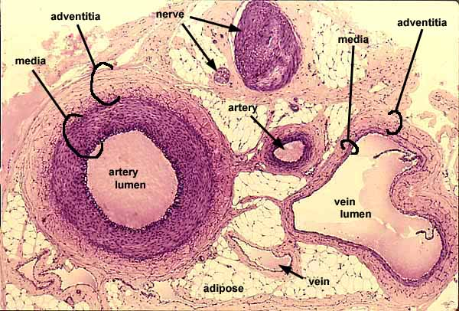
Arterial & Venous Structure

Slide 3
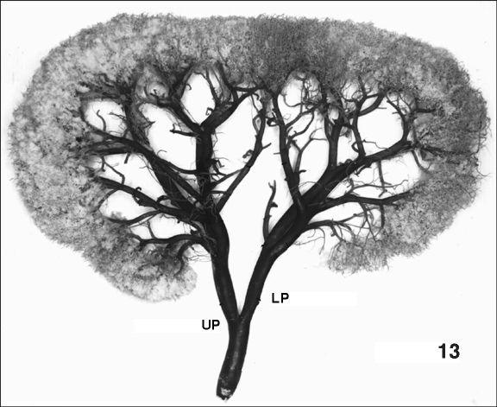

The Vascular Tree

Slide 4
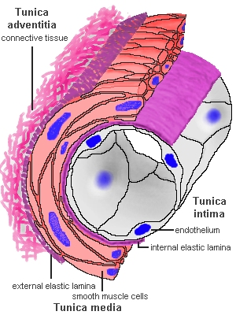
Vascular Cells

Slide 5
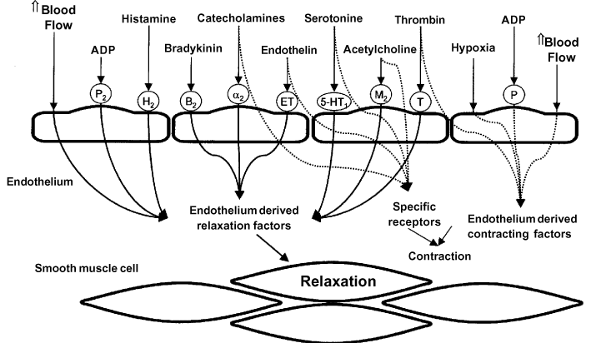
Stimuli for NO Release

Slide 6
Endothelium-dependent vasodilatation
With Endothelium
Acetylcholine
PE
Without Endothelium
Acetylcholine
PE

Slide 7
Control of Vascular Tone
NO, PGI₂
ET-1, TXA₂
Vasodilatation
Vasoconstriction

Slide 8
Control of Vascular Tone
ET-1, TXA₂
NO, PGI₂
Vasodilatation
Vasoconstriction

Slide 9
Synthesis and Action of NO
Acetylcholine
5-HT
Thrombin
Bradykinin
Sheer stress
Calmodulin
NADPH
BH₄
Ca²⁺
L-Citrulline
e NOS
Endothelial Cell
L-Arginine
NO
GC⁺
Vascular Smooth Muscle cell
GTP
cGMP
Relaxation

Slide 10
Nitric Oxide
Nitric oxide is generated from arginine by the action of nitric oxide synthase (NOS). NO has a half-life of only a few seconds in vivo .
NO reacts with iron in the active site of the enzyme guanylyl cyclase (GC), stimulating it to produce the intracellular mediator cyclic GMP (cGMP).
NO may also be involved in the regulation of protein activity through S-nitrosylation.
NO reacts with oxygen and water to form nitrates and nitrites.
NO toxicity is linked to its ability to combine with superoxide anions (O²⁻) to form peroxynitrite (ONOO⁻), an oxidizing free radical that can cause DNA fragmentation and lipid oxidation.

Slide 11
History of NO
Chemically characterised by Joseph Priestly in 1772
Toxicity determined by Sir Humphry Davy
In 1867 it was noted that amylnitrite lowers blood pressure
During WW1 filling nitroglycerine into cannons was seen to lower blood pressure
Use of nitroglycerine pills against angina pectoris

Slide 12
NO Synthases
3 isoforms
  NOS I, NOS II & NOS III
  nNOS, iNOS, eNOS
All contain heme as active centre
Active as homodimers
All require cofactors
  NADPH
  6 (R)-5,6,7,8 tetrahydrobiopterine
  FAD
  FMN
  calmodulin

Slide 13
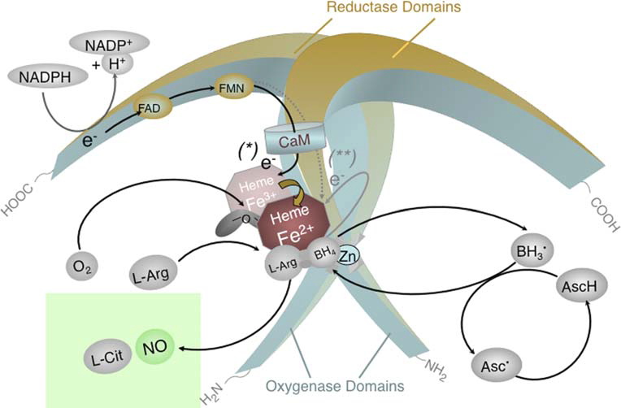
eNOS
Homodimeric enzyme; each subunit consists of a reductase domain and an oxygenase domain. NADPH donates electrons for NOS; The enzyme contains a zinc (Zn) thiolate cluster. This site is of major importance for the binding of the cofactor (6R-)5,6,7,8-tetrahydrobiopterin (BH4) and the substrate L-arginine (L-Arg). Electron transfer from the reductase domain (*) enables NOS ferric (Fe3+) heme to bind O2 and form a ferrous (Fe2+)-dioxy species. This species may receive a second electron preferentially from BH4 (or alternatively from the reductase domain) (**). This activates oxygen and allows the catalysis of L-arginine hydroxylation. The oxidized species formed from BH4 is trihydrobiopterin radical (BH3·) The BH3· radical (or radical cation) can be recycled to BH4 by eNOS itself (using an electron supplied by the flavins) or by L-ascorbic acid (which is present in cells in millimolar concentrations). BH4 is likely to also play a redox role in the second reaction cycle, i.e., the conversion of Nw-hydroxy-L-arginine to NO. AscH ascorbic acid, Asc ascorbate radical
Förstermann U 2006

Slide 14
NOS I
  NOS (neuronal), ncNOS (neuronal consitutive), bNOS (brain)
Constitutively expressed
  Present in epithelial and vascular smooth muscle and skeletal muscle cells
Regulation of activity
  Requires Ca²⁺ for calmodulin binding
  Ca²⁺, ser/try phosphorylation
NOS II
  iNOS (inducible), mNOS (macrophage)
Inducible expression in:
  Macrophages, glial cells, hepatocytes, endothelium, epithilium, cardiac myocytes, vascular smooth muscle cells
Regulation of activity
  Induced by inflammatory cytokines, LPS
  Does not requires Ca²⁺ for calmodulin binding
  NO inhibition (negative feedback)

Slide 15
NOS III
  eNOS (endothelial), ecNOS (endothelial constitutive)
Constitutively expressed in:
  Endothelium, epithelium, cardiac myocytes, hippocampus
Regulation of activity
  Requires Ca²⁺ for calmodulin binding
  ser/try phosphorylation
  Modulation of expression

Slide 16
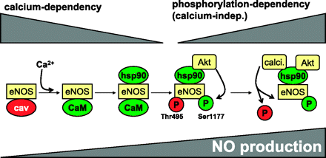
Calcium- and phosphorylation-dependent activation of eNOS
  Mediated by an increase in endothelial NO synthase (eNOS) protein activity
  Occurs within seconds and implicates cytosolic calcium and eNOS protein phophorylations
In basal conditions, caveolin maintains eNOS in its inactivated state
Increase in intracellular calcium in response to agonist stimulation leads to the disruption of the caveolin/eNOS
Role for interaction by calcium-bound calmodulin. Hsp90 consecutively binds eNOS
Favors the recruitment of Akt, which in turn phosphorylates eNOS on serine-1177.
The phosphatase calcineurin is similarly recruited in the eNOS vicinity via hsp90 binding;
subsequent dephosphorylation of eNOS on threonine-495 also contributes to maintain NO release

Slide 17
NO in blood vessels
Flow induced vasodilatation
  fundamental to its action, response to increased sheer stress
Regulate inflammatory cell attachment and platelet aggregation
Vasodilation in the skin due to temperature change
  Thermoregulation
Penile erection
  Flow mediated dilation of the corpus cavernosus

Slide 18
Effect of NO on target tissue
Relaxation via cGMP
  At lower concentrations of NO (eNOS/nNOS)
  Binding of NO to heme of guanylate cyclase
  Increase in guanosine-3’,5’ monophasphate (cGMP)
  Activation of cGMP-dependent kinases (G-kinase)
Net reduction in [Ca²⁺]i

Slide 19
Stimuli for NO Release

Slide 20
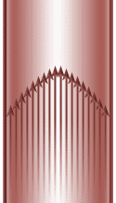
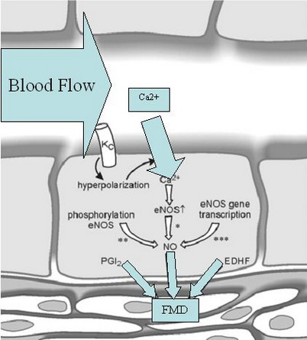
Physiological Stmilus for NO Release

Slide 21
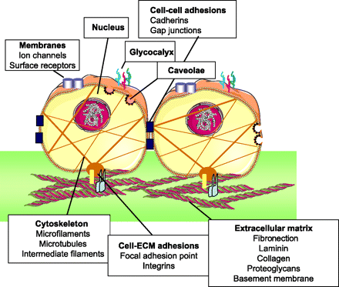
Endothelial Componets Involved in Response to Shear Stress
J.-L. Balligand, O. Feron, and C. Dessy eNOS Activation by Physical Forces: From Short-Term Regulation of Contraction to Chronic Remodeling of Cardiovascular Tissues. Physiol Rev, April 1, 2009; 89(2): 481 - 534

Slide 22
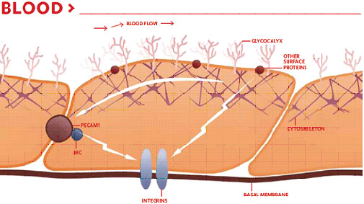
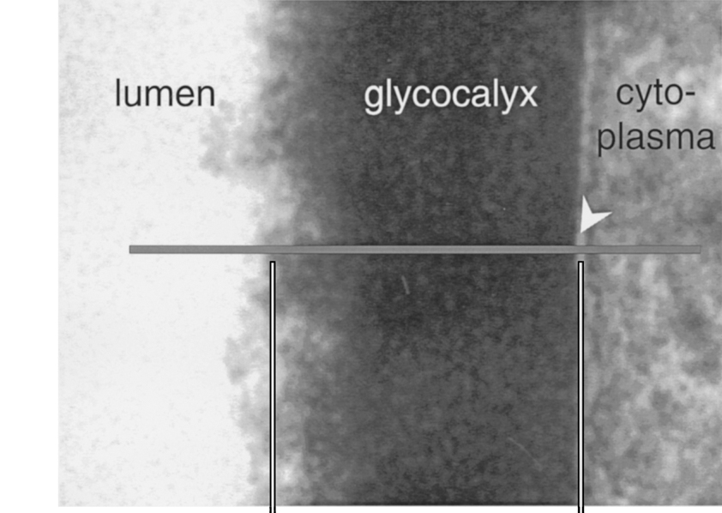
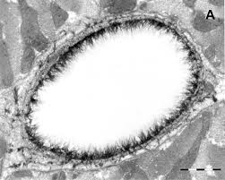
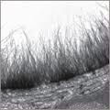
The Glycocalyx
Heparan Sulfate
Sialic Acid
Chrondroitin Sulphate
Hyaluronic Acid

Slide 23
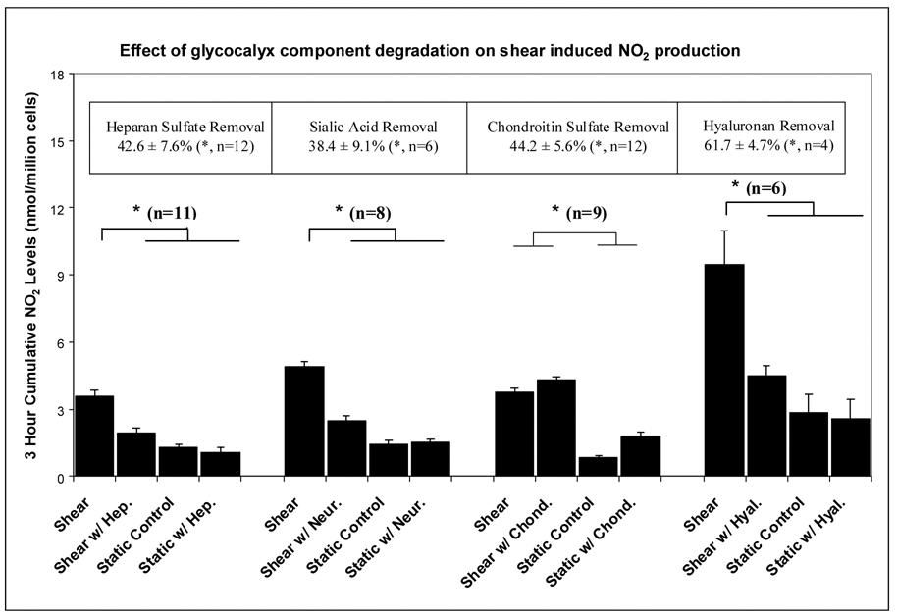
Effect of the Glycocalyx on Flow Induced NO Production
Pahakis et al. Biochem Biophys Res Commun. 2007 March 30; 355(1): 228–233

Slide 24
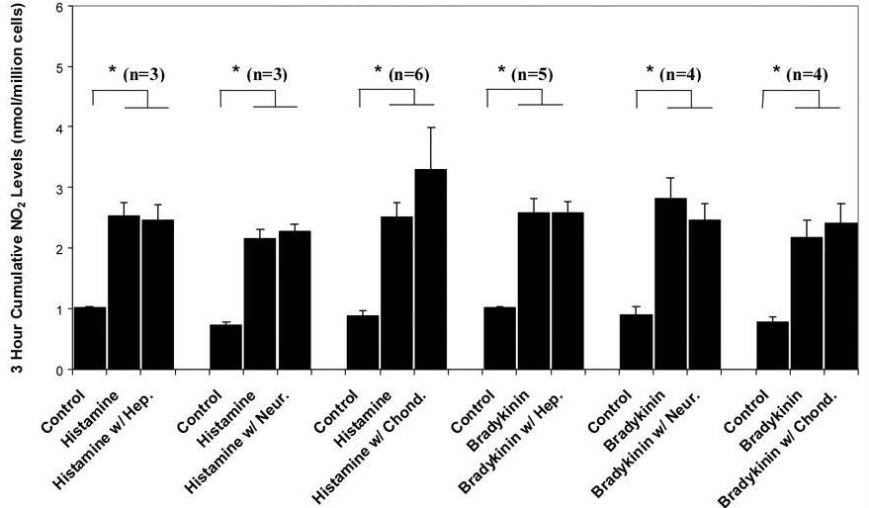
No Effect of the Glycocalyx on Agonist Induced NO Production
Pahakis et al. Biochem Biophys Res Commun. 2007 March 30; 355(1): 228–233

Slide 25
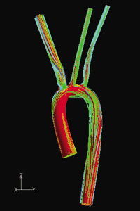
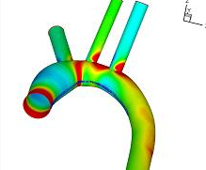
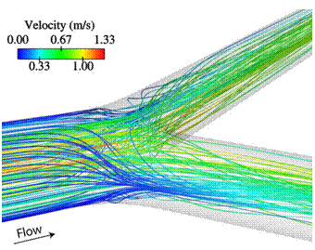
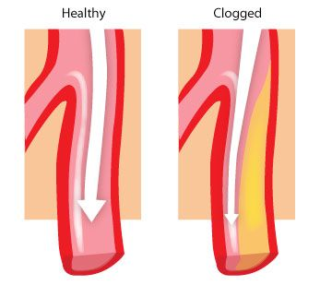
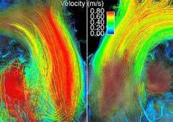
Flow Patterns in the Aorta

Slide 26
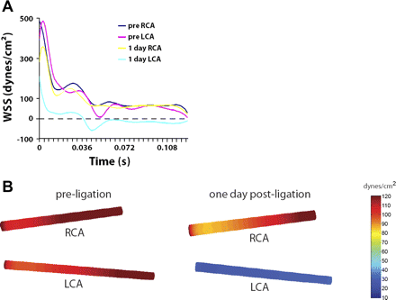
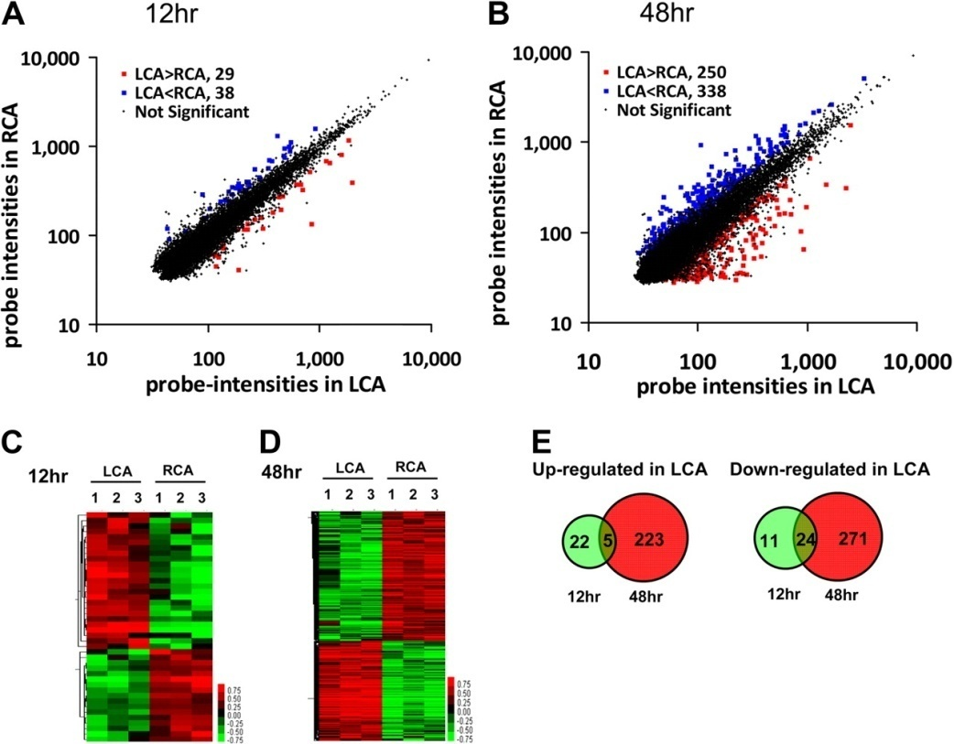
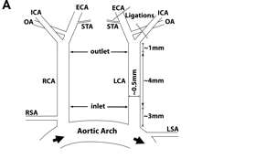
Gene Expression in response to flow
Ligation model
Gene Expression
62 (27 up-regulated and 35 down-regulated) genes at 12 hours
523 (228 up-regulated and 295 down-regulated) genes at 48 hours
Ni, C.-W. et al. Blood 2010;116:e66-e73

Slide 27
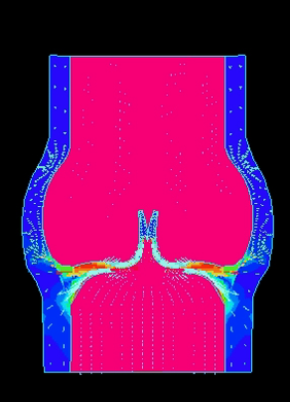
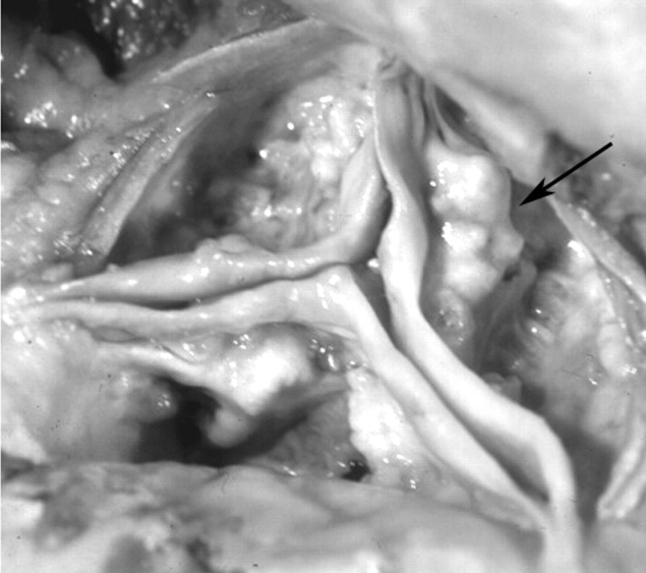
Flow in the Aortic Valve
VALVE OPEN
High shear, laminar flow
VALVE CLOSED
Low shear, disrupted flow
Lower Expression of anti-Calcification Genes on Aortic Side | Higher Expression of pro-calcification genes on Aortic Side

Slide 28
Pathophysiology of NO
Atherosclerosis
  Endothelial damage, loss of vasodilation, increase clot formation, increased cell attachment
Angina pectoris
  Lack of eNOS induced vasodilatation
Inflammation
- Loss of NOS inhibition of cell attachment
Impotence
  Lack of NOS induced vasodilation
Stroke
  Vascular spasm due to decreased NOS
Septic shock
  iNOS induction, eradication of inflection, vasodilation

Slide 29
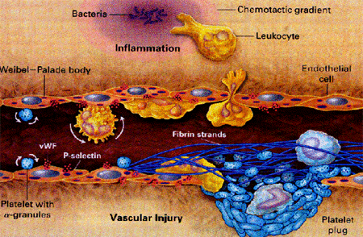
Vascular Injury
Endothelial Damage & Reduced expression of NO
Role of NO?
Role of reactive oxygen species (increased oxygen stress)

Slide 30
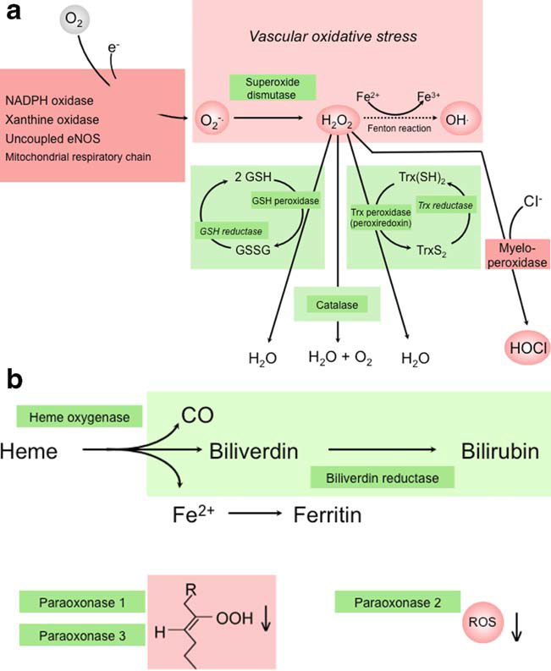
Control of Oxidative Stress
eNOS
H₂0₂ detoxified by thioredoxin (Trx), glutathione peroxidase
and catalase

Slide 31
Mechanisms of Un-coupling of NOS
Cardiovascular Risk Factors and Vascular Disease Are Associated With Increased Levels of Reactive Oxygen Species
  NADPH oxidases (NOX) in the vascular wall, thereby enhancing the production of reactive oxygen species (ROS).
Uncoupled eNOS Contributes to Endothelial Dysfunction
  NOS uncoupling has also been seen in patients with endothelial dysfunction
  Possible role for NOX in the phenomenon of eNOS uncoupling
Potential Role of L-Arginine
  Thus, a relative l-arginine deficiency in the vicinity of eNOS caused by excessive arginase activity
Potential Role of ADMA
  endogenous eNOS inhibitor asymmetric dimethyl-l-arginine (ADMA)
  Elevated ADMA may inhibit NO synthesis by eNOS
Role of BH₄ in eNOS Uncoupling
  Thus, oxidation of BH₄ may be the common cause of eNOS dysfunction in vascular pathophysiology

Slide 32
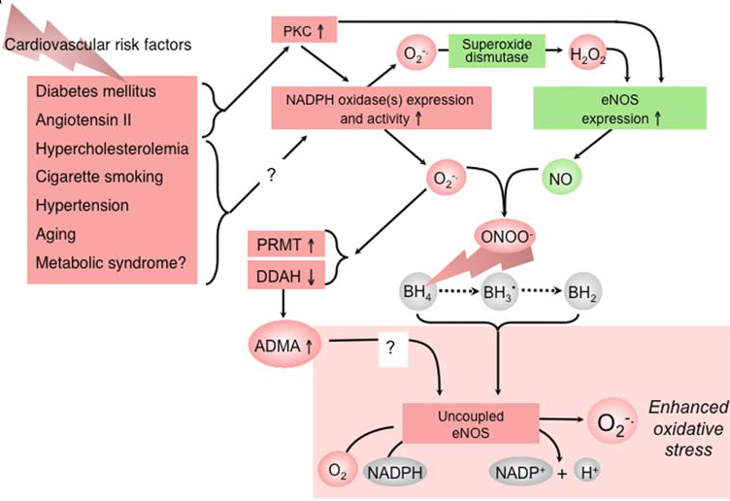
Un-coupled NOS
·NO (nitric oxide) + O₂^{·−} (super oxide) → ONOO⁻ (peroxynitrite)
Förstermann U 2006 & 2010

Slide 33
Key Points
Control of Vascular tone is a balance between opposing stimuli (vasodilators v’s vasoconstrictors)
Endothelium is an important source of vasoactive agents including nitric oxide
NO is synthesised by 3 enzymes, each having a specialised function, one of which (eNOS) is present in the endothelium
The flow of blood over the endothelium is an important physiological stimuli for NO release
Regions of low flow are associated with vascular disease – atherosclerosis
Risk factors for vascular disease stimulate reactive oxygen species (ROS) and increase oxidant stress
NO may react to ROS to generate peroxynitrite (ONOO-), an oxidizing free radical that can cause DNA fragmentation and lipid oxidation.

Slide 34

J.-L. Balligand, O. Feron, and C. Dessy eNOS Activation by Physical Forces: From Short-Term Regulation of Contraction to Chronic Remodeling of Cardiovascular Tissues. Physiol Rev, April 1, 2009; 89(2): 481 – 534
Chatzizisis YS, Coskun AU, Jonas M, Edelman ER, Feldman CL, Stone PH. Role of endothelial shear stress in the natural history of coronary atherosclerosis and vascular remodeling: molecular, cellular, and vascular behavior. J Am Coll Cardiol. 2007 Jun 26;49:2379-93.
Yang Z, Ming XF. Recent advances in understanding endothelial dysfunction in atherosclerosis. Clin Med Res. 2006 Mar;4:53-65.
Ni, C.-W. et al. Discovery of novel mechanosensitive genes in vivo using mouse carotid artery endothelium exposed to disturbed flow. Blood 2010;116:e66-e73
Förstermann U , Münzel T Circulation 2006;113:1708-1714
Förstermann U. Nitric oxide and oxidative stress in vascular disease. Pflugers Arch. 2010;459(6):923-39.

