Slide 1
Regulation of vascular function by Rho GTPases
Beata Wojciak-Stothard
Department of Experimental Medicine and Toxicology
Imperial College London

Slide 2
Lecture plan
Rho GTPases in the regulation of vascular function
(a) general information:
- classification, structure and subcellular localisation
- mechanism of activation
- basic biological processes regulated by Rho GTPases
- methods used in studies on Rho GTPases
(b) examples of processes regulated by Rho GTPases
- contractility
- endothelial barrier function
- motility/angiogenesis
- NADPH production of nitric oxide
- leukocyte adhesion and transmigration
- cell cycle control (proliferation)
(c) Rho GTPases in vascular diseases
Work in our laboratory: regulation of endothelial function in
pulmonary hypertension (PH).
The effects of oxygen deprivation (hypoxia) and nitric oxide deficiency on
Rho GTPases signalling – implications on angiogenesis and barrier function.
4. Summary

Slide 3
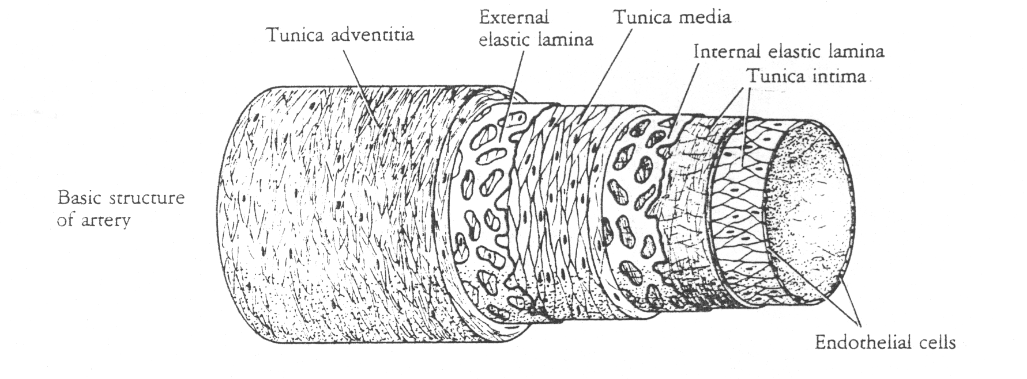
Basic structure of artery
ENDOTHELIAL CELLS

Slide 4
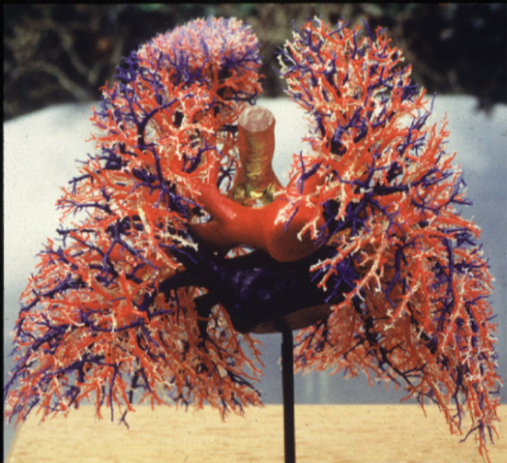
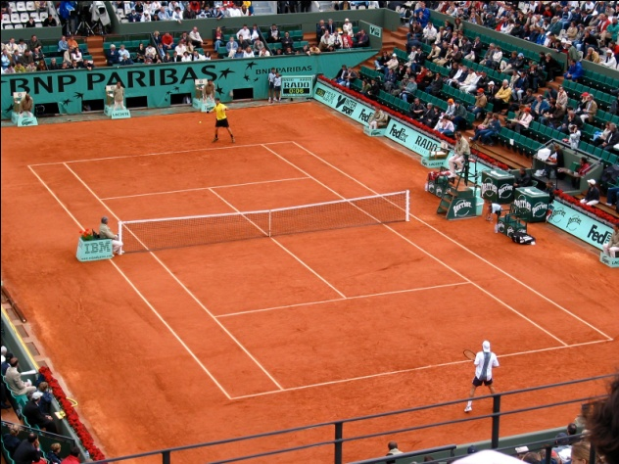
Pulmonary endothelium

Slide 5
Endothelium –definition. The endothelium is the layer of thin, flat cells that lines the interior surface of blood vessels, forming an interface between circulating blood in the lumen and the rest of the vessel wall. Endothelial cells line the entire circulatory system, from the heart to the smallest capillary. In small blood vessels and capillaries, endothelial cells are often the only cell-type present.
Endothelial function: In response to changes in environmental factors such as oxygen tension, blood flow, circulating cytokines, and growth factors, the pulmonary endothelium synthesizes and/or extracts many vasoactive mediators such as endothelin-1, norepinephrine, angiotensin 1, thromboxane, prostacyclin (PGI2), and the endothelial-derived relaxing factor nitric oxide (NO).
Using a complex language of chemical messages, the endothelium translates information about environmental changes to the underlying smooth muscle cells, to control their reactivity and regulate vascular tone.
The endothelial layer also acts as a barrier, regulating the exchange of fluids and nutrients between blood components and the surrounding tissues.
In inflammatory conditions the endothelium regulates trafficking of blood cells to the sites of injury.
The endothelium regulates formation of new blood vessel formation (angiogenesis and vasculogenesis).

Slide 6
Physical factors
Humoral factors
Inflammatory mediators
Acetylcholine
Bradykinin
Shear stress
Stretch Hypoxia
Histamine Thrombin TNFα
Paracellular permeability
adhesion
antithrombotic
neutrophils
sepsis
NO
caveolin
PGI₂
selectins
ICAM,VCAM
Transcytosis
Endothelium
PAF
vWF
NO
PGI₂
ET-1 TxA
PECAM
Fluid
myofilaments
Intercellular space
Matrix
dilatation
SMC
constriction
Barrier Function
Vascular tone
Host defence

Slide 7
Rho GTPases
in the regulation of vascular
structure and function

Slide 8
RAS SUPERFAMILY
RAS
RHO
RAB
ARF
RAN
RAD
Rho (A, B, C)
Rac (1, 2, 3)
Signalling
Cell survival
Cell growth
control
CDC42/G25K
Intracellular
Vesicle
formation
Nuclear import
Spindle
formation
angiogenesis
Chp
TC10
Intracellular
Vesicle
targetting
RhoG
RhoD
RhoE/Rnd (1,2,3)
TTF
Rho (Ras homology)
Rho GTPases – family of 20 small G proteins
Rho GTPases belong to the Ras superfamily of proteins:
70% homology with Ras and 85% homology with each other
The best known: RhoA, Rac1 and Cdc42
cytoskeletal
organization
cell migration
polarity
cell cycle

Slide 9
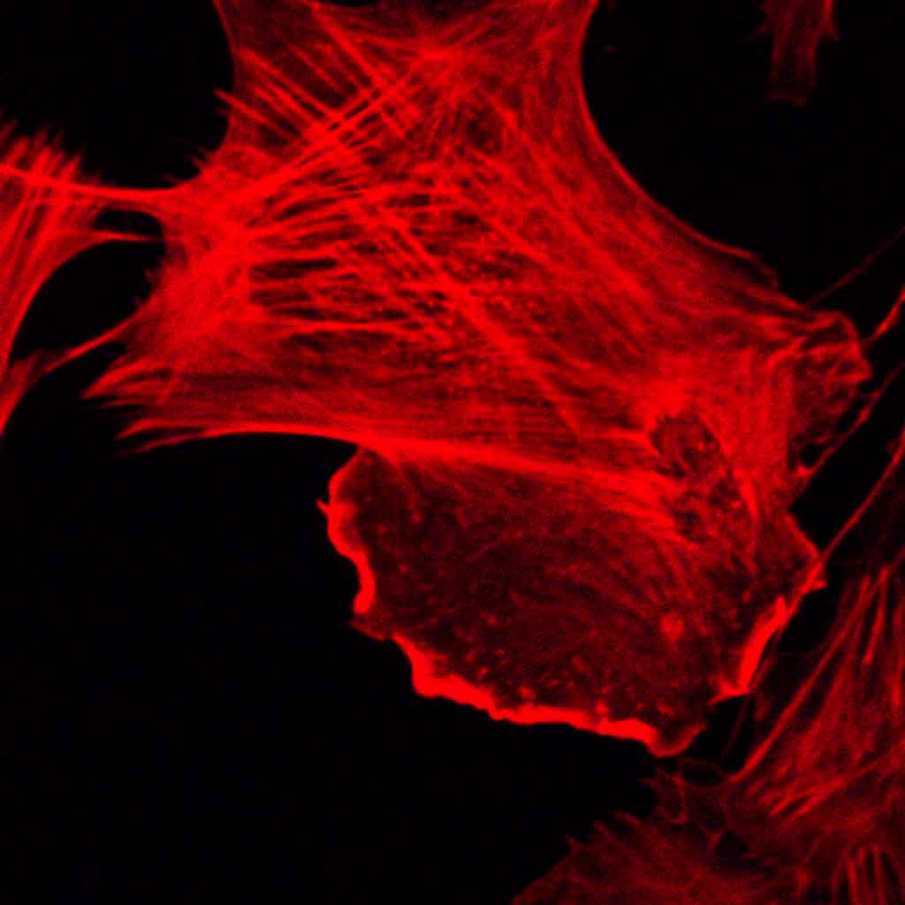
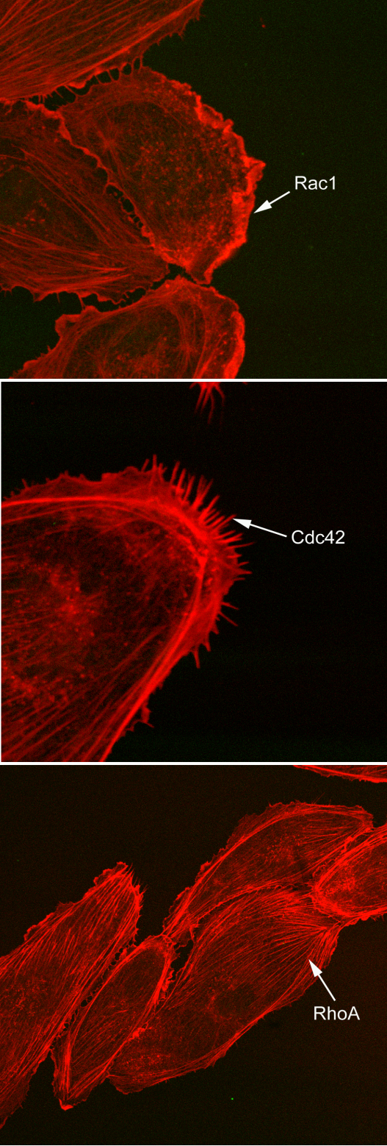
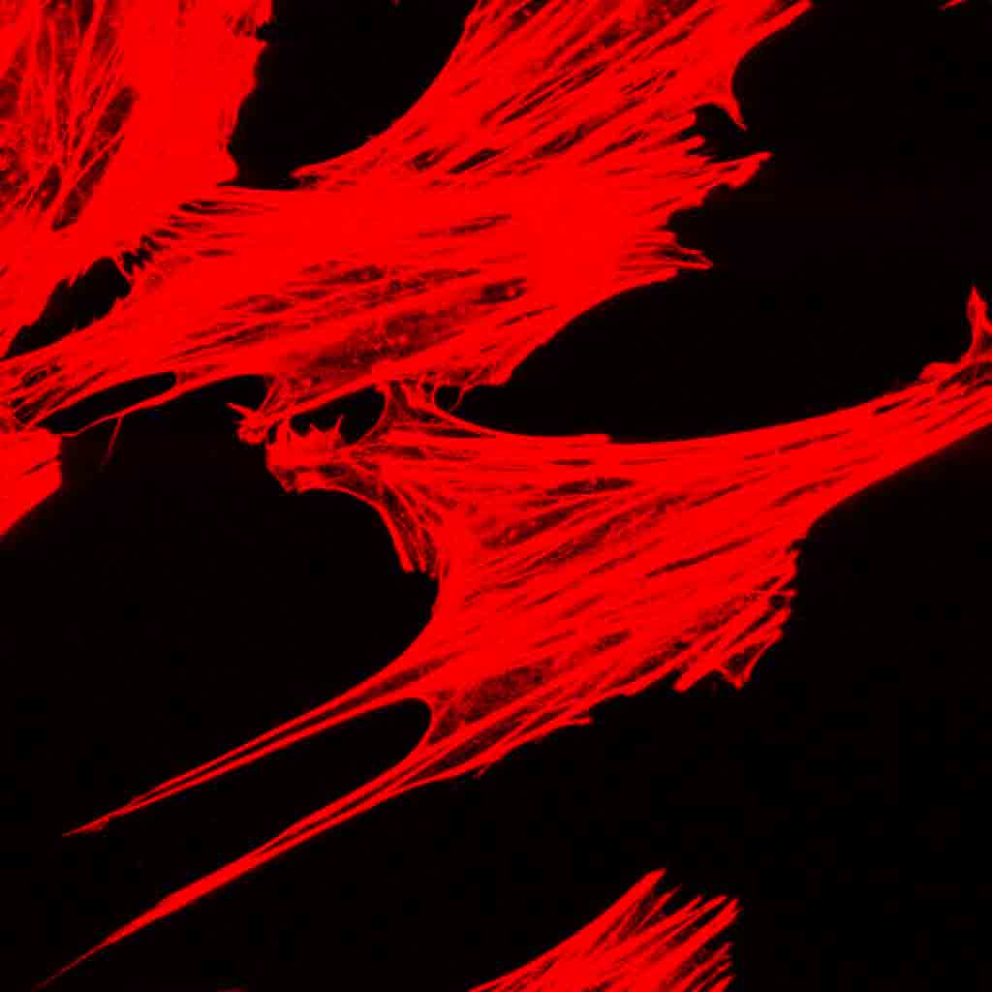
Rac1 - ruffling, lamellipodia,
focal complexes
SPREADING
lamellipodium
ACTIN DYNAMICS
Cdc42 – filopodia, focal complexes
SPREADING, NAVIGATION
filopodia
Cell migration
Contraction
Cell adhesion
Cell shape
RhoA - stress fibres, focal adhesions
CONTRACTION
stress fibres

Slide 10
Signal
e.g. G protein coupled receptor agonists, growth factors
e.g. thrombin, thromboxane A2, endothelin,
carbachol, angiotensin II, alpha-adrenergic agonists,
sphingolipids, mechanical stress
receptor
Cell membrane
Rho
GDI
GEF
Rho
Rho
GAP
GTP
P
GDP
Rho GTPases act as molecular switches: GDP-bound are inactive, GTP-bound are active
They are ctivated by receptor tyrosine kinases, G protein coupled receptors, adhesion molecules, integrins, cytokines.
Their activity is regulated by 3 groups of proteins: exchange of GDP for GTP is regulated by guanine nucleotide exchange factors (GEFs) and GTP hydrolysis is catalysed by GTPase-activating proteins (GAPs). Inactive Rho GTPases remain in cytosol complexed with GDP dissociation inhibitors (GDIs).
Rho GTPases are isoprenylated (geranyl-geranylated and farnesylated) and this is required for membrane localisation and activation. Membrane-bound Rho GTPases interact with
downstream targets.
Some Rho GTPases can be directly phosphorylated and this phosphorylation affects stability of complexes with GDI
downstream targets
Response
e.g. stress fibre formation

Slide 11

Tools used in studies on Rho GTPases activation.
GTP-loading assays (Pulldown assays).
The levels of activated GTP-bound Rho, Rac, and Cdc42 can be measured in ‘‘pulldown assays.’’ In these assays,
cell lysates are incubated with Sepharose beads with derivatized recombinant domains of target proteins of Rho,
Rac, and Cdc42 (p21-activated kinase [PAK] CRIB for Rac/Cdc42, WASp-CRIB for Cdc42, rhoteckin Rho-binding
domain for Rho). As these domains only bind GTP-loaded Rho proteins, the active proteins are being literally
‘‘pulled down’’ by the beads.
GST
GST
GST
WASH
+
GST
GST
GST
Sepharose beads
with derivatised Rho-binding
domain (binds only active,
GTP-RhoA)
Cell lysate
GTP-RhoA
Electrophoresis, Western blotting
Rho-binding
domain
Glutathione-Sepharose
GST- glutathione-S-transferase

Slide 12
The use of inhibitors/activators of Rho GTPases
The use of inhibitors helped to elucidate the physiological importance of Rho GTPases.
Statins inhibit cholesterol synthesis by inhibiting the rate-limiting enzyme in its pathway, HMG CoA reductase. They also inhibit synthesis of isoprenoids, the intermediates of the cholesterol synthesis, important for the formation of lipid attachments required for the activation and membrane localisation of Rho GTPases
More specific inhibition /activation : mutant proteins, introduced into cells by microinjection or expressed following plasmid transfection or infection with viral constructs. Created by a single amino acid substitution, dominant- negative mutants compete with endogenous GTPases for binding to cellular exchange factors (GEFs), while constitutively activated forms remain predominantly in the GTP-bound, active form
Use of knockout mice, cell- and tissue-specific knockouts
Bacterial toxins. Example: C3 exoenzyme ADP-ribosyl transferase from Clostridium botulinum, specifically inactivates Rho by ADP-ribosylation that impairs its activation by GEFs. Clostridium difficile toxins A and B inactivate all Rho family proteins by glucosylating the nucleotide binding site. Salmonella typhimurium SptP, acts as GAP protein for Rho family members. Other toxins such as cytotoxic necrotising factor from E.coli and the dermonecrotising toxin of Pertussis bacteria, activate Rho GTPases .
Bacterial toxins and other proteins of interest can be introduced into the cells by cell-penetrating peptides (CPPs) derived from the TAT protein from HIV virus (TAT peptide) or Drosophila Antennapedia peptide, with less damage than the conventional techniques .
The Rho kinase inhibitors include the pyridine derivative Y-27632, the closely related compound Y-32885 and fasudil with its derivatives: HA-1077 and H-1152. Y-27632 was originally developed as a smooth muscle relaxant and was shown to inhibit stress fibre formation in fibroblasts, endothelial contraction and thrombin-induced DNA synthesis in rat aortic SMC .

Slide 13
Rho GTPases regulate several fundamental cellular processes important in the regulation of vascular function

Slide 14
Rho GTPases
NADPH oxidase activity
Nitric oxide synthase expression
Cell migration
Cell-cell adhesion
cell cycle
endothelial permeability
ROS production
proliferation
leukocyte adhesion
NO production
DNA damage
Pro-inflammatory
Inhibit NO
Vasorelaxant
anti-inflammatory
Anti-proliferative
Angiogenesis
Inflammation
SMC hypertrophy
Pulmonary Hypertension COPD, Obstructive Sleep Apnoea, PPHN, Stroke,
Myocardial Infarction, Reperfusion Injury , Coronary Artery Spasm, Effort Angina, Atherosclerosis, Cancer

Slide 15
Rho GTPases in the regulation of vascular function:
examples of signalling pathways
RhoA/Rho kinase pathway in the regulation of endothelial and smooth muscle cell
contractility
(important in the regulation of vascular tone, barrier function and cell
movement/angiogenesis)
Balance between RhoA and Rac1 important in the maintenance of endothelial
barrier function
Regulation of reactive oxygen species production
(Rac1 in the NADPH oxidase activity)
Coordinated activity of RhoA, Rac1 and Cdc42 regulates cell movement
Cell cycle control –regulation of cell proliferation

Slide 16
RhoA increases actomyosin contractility
Ca²⁺
RhoA
NOS expression (Nitric Oxide Synthase)
Production of vasorelaxant
NO inhibited
Calmodulin-Ca²⁺
Rho kinase (RoK)
MLC kinase
MLC phosphatase
actin+myosin interaction
MLC-P
MLC
dissociated actin+myosin
contraction
Endothelial permeability
Vascular smooth muscle contraction
(calcium sensitization)
MLC – myosin light chain

Slide 17
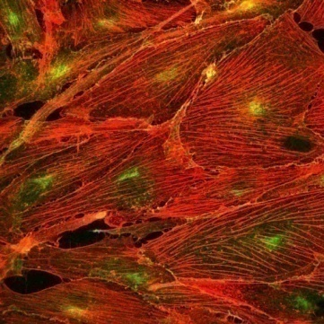
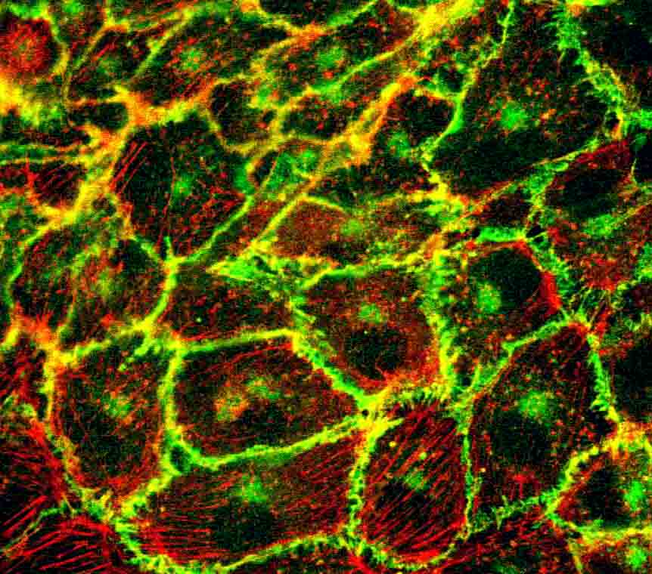
Endothelial permeability
1. Breakdown of endothelial integrity is a consequence of increased centripetal tension
created by increased actomyosin contractility and decreased intercellular adhesion
(tethering forces).
2. RhoA and Rac1 have opposing effects on endothelial permability
Activation of RhoA increases actomyosin contractility, while activation of Rac1
increases tethering forces.
Activated cells
Control cells
F-actin associated with
junctions
Stress fibres
Leaky endothelium
Tight endothelium
Thrombin,
histamine,
TNF-α,
hypoxia
Rho
Rac
Actomyosin contractility
Tethering forces (adhesion)
Barrier dysfunction
Barrier integrity

Slide 18
Rho proteins in response to vasoactive factors
Vasoactive agents | Sources in vivo | Rho proteins involved | Barrier function
Thrombin | Activated platelets | Rho/Rho kinase activated, Rac1 inhibited
Histamine | Mast cells | Rho, Rac
Sphingosine -1 phosphate (S1P) | Activated platelets | Rac
TNF-α | Activated leukocytes, endothelium | Rho, Rac, Cdc42
Endothelin-1 | Endothelium | RhoA/Rho kinase
VEGF | Endothelium | Rho, Rac, Cdc42
Hepatocyte growth factor (HGF) | Several cell types | Rac
Lypopolysaccharide (LPS) | Gram-negative bacteria | Rho/Rho kinase
Lysophosphatidic acid (LPA), oxLDL | Activated platelets | Rho
crosslinking adhesion molecules ICAM-1, VCAM-1) | Leukocyte adhesion | Rho
Ref: Wojciak-Stothard and Ridley Vasc Pharmacol 39 (2003) 187-199

Slide 19
Cell movement
Coordinated activation of Rac1, Cdc42 and RhoA is required for cell movement.
Ref. Wheeler and Ridley Exp Cell Res 301 (2004) 43-49; Ridley AJ. Rho GTPases and cell migration. J Cell Sci. 2001; 114(Pt 15):2713
Rac1 is essential for lamellipodia formation (forward protrusion).
2. Cdc42 is essential for filopodia formation and maintaining cell polarity (reorientation of the Golgi apparatus in the direction of movement)
Rac1 and Cdc42 are required for the formation of small adhesions
“ focal complexes”, associated with the expanding cell front.
4. RhoA is required for maintaining cell adhesion during cell movement. It induces
maturation of focal contacts into larger attachments called “focal adhesions” and is required for their turnover (detachment at the cell rear). RhoA/Rho kinase -induced contractility at the cell rear is required for cell detachment.
Forward expansion
Lamellipodium - Rac
Stress fibres,
contractility - RhoA
Directional sensing
Filopodia – Cdc42
New adhesions “focal contacts “– Rac1, Cdc42
detachment of FA - RhoA
Focal adhesions (FA) - RhoA

Slide 20
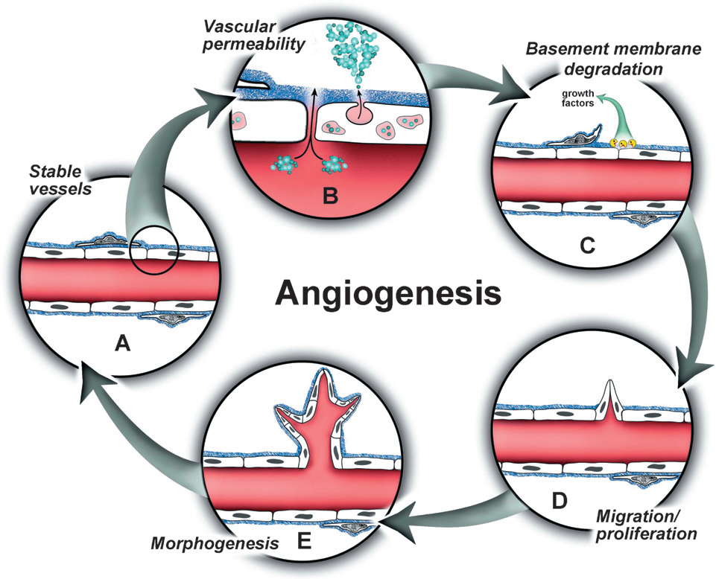
Ref. Bryan and d’Amore Cell.Mol.Life.Sci 64 (2007) 2053-2065

Slide 21
Rho GTPases regulate angiogenesis and vasculogenesis.
Rac 1 plays a central role in endothelial cell migration, tubulogenesis,
adhesion and permeability in response to vascular endothelial growth factor (VEGF).
Rac1-deficient cells are unable to migrate in response to VEGF
Endothelial-specific excision of Rac1 results in embryonic lethality in mid-gestation,
defective development of major blood vessels and complete lack of small vessel branching
Ref: Tan et al. FASEB J.22 p. 2008
Vav2-deficient and Vav3-deficient mice (lacking GEFs for Rac1) show several cardiovascular abnormalities. Vav2-null mice display tachycardia, hypertension, and
defects in the heart, arterial walls and kidneys. Vav3-deficient mice exhibit tachycardia, systemic arterial hypertension and extensive cardiovascular remodeling. This is a combined effect of defect in the Rho protein signaling and alterations in the nervous regulation of cardiovascular functions (hyperactivity of sympathetic neurons and high catecholamine levels)
RhoA and Rac1 are highly expressed in several types of cancer (promote proliferation and metastasis)
Lazer G, Katzav S. Cell Signal. 2011 Jun;23(6):969-79. Epub 2010 Oct 30. Review
Ref: Loirand G, Scalbert E, Bril A, Pacaud P. Curr Opin Pharmacol. 2008 Apr;8(2):174-80. Epub 2008 Jan 28. Review.

Slide 22
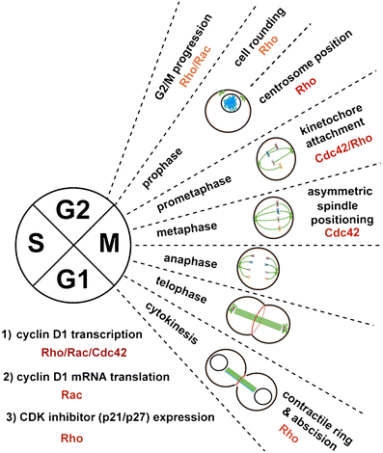
Rho GTPases in the regulation of cell cycle
- Regulation of endothelial and SMC
proliferation
e.g. Activation of RhoA reduces levels of cell
cycle inhibitors and induces translocation of kinase ERK,
important in regulation of cell cycle progression
Rac1 and Cdc42 also promote G1/S transition
Hall A. Cancer Metastasis Rev (2009) 28:5-14

Slide 23
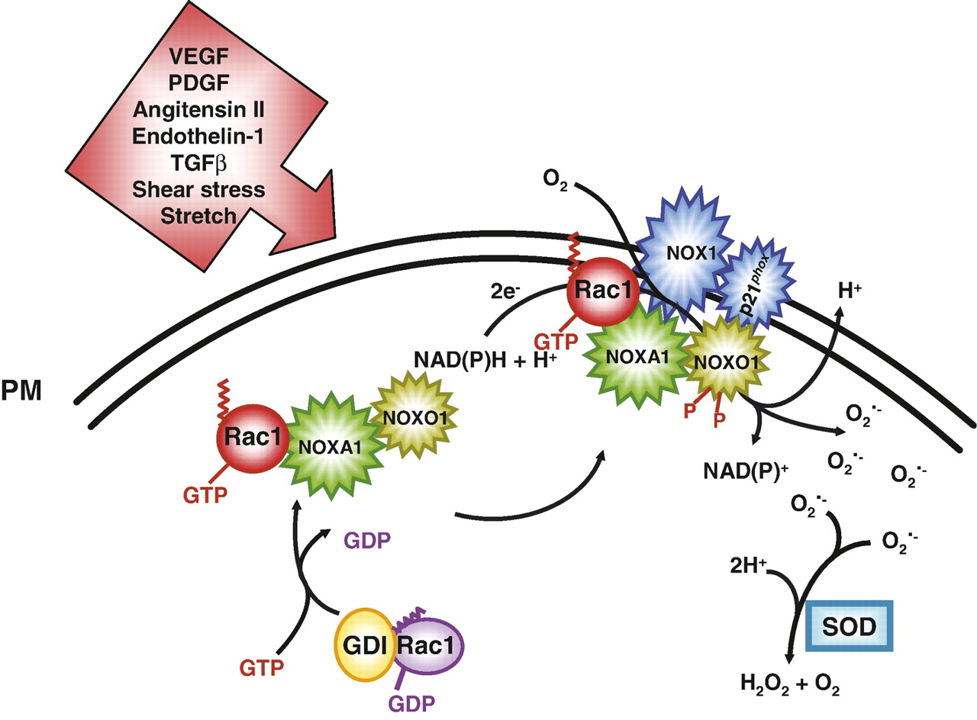
Rac1 is required for the assembly of NAD(P)H oxidase and
Reactive Oxygen Species (ROS generation) in non-phagocytic cells
Active NADPH oxidase
Reactive
Oxygen
Species (ROS)
NADPH + 2O₂ ↔ NADP⁺ + 2O₂^{°-} + H⁺
Moldovan, L. et al. Cardiovasc Res 2006 71:236-246;
doi:10.1016/j.cardiores.2006.05.003

Slide 24
ROS (O₂ ^{.-}, H₂O₂, HO.) impair endothelial function, inactivate endothelial NO,
promote expression of pro-inflammatory genes. This contributes to development of
hypertension, atherosclerosis and other vascular disorders.
Activation of Rac1 by mechanical stress, angiotensin II and PDGF leads to
ROS production in VSMCs, medial hypertrophy and endothelial senescence
(Ref. Rolfe et al. Atherosclerosis 183 (2005) 1-16.

Slide 25
Rho GTPases in Cardiovascular Diseases

Slide 26
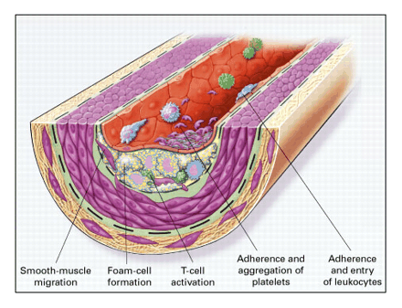
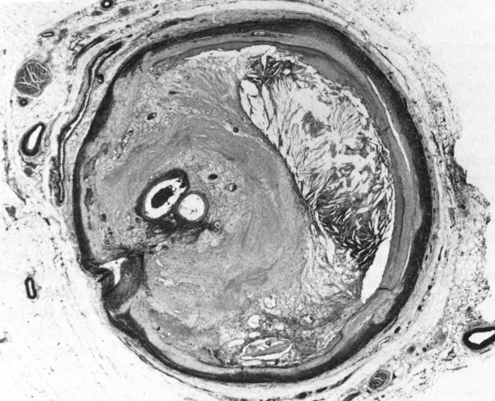
Atherosclerosis
Atherosclerosis is a disease of the arterial wall in which the layer thickens, causing narrowing of the channel and thus, impairing blood flow.
It is caused by excessive inflammatory-fibroproliferative response to numerous different forms of vascular insult. Principle cause of myocardial infarction (heart attack), stroke and gangrene of the extremities.
RhoA implicated in several processs leading to development of atherosclerosis:
Endothelial damage caused by oxLDL, shear stress and pro-inflammatory agents.
RhoA activation results in increased in permeability, increased adhesiveness of
leukocytes and platelets.
2. Leukocyte infiltration
3. SMC proliferation and migration, matrix production
4. Platelet aggregation
Coronary artery with advanced atherosclerosis

Slide 27
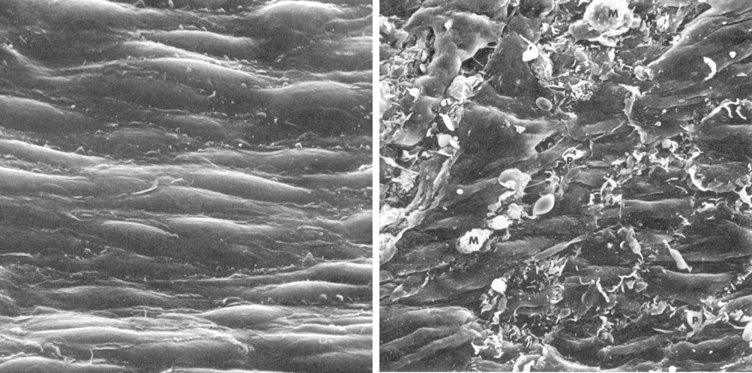
normal , resting endothelium
endothelium activated by mechanical stress (branching points)
RhoA activated –
loss of junctions,
monocyte adhesion
From: Pathology of Atherosclerosis by N.Woolf, 1982

Slide 28
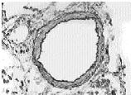
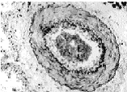
Hypertension
Hallmark of hypertension – increased peripheral vascular resistance as a consequence
of vascular contractility and remodelling
Evidence from animal models and patients – increased expression levels and activity of
RhoA result in increased contractility and increased proliferation and migration of vascular
smooth muscle cells , resulting in vascular remodelling.
Example – pulmonary hypertension (PH)
RhoA
Rho kinase
normal intrapulmonary artery
PH pulmonary artery – increase in wall thickness, increased contractility

Slide 29
RECEPTOR ANTAGONISTS
e.g. ET-1 receptor antagonist Bosentan
e.g. thrombin, endothelin-1, angiotensin II, alpha-adrenergic agonists, sphingolipids,
SIGNAL
SHEAR STRESS HYPOXIA
receptor
Cell membrane
STATINS
RhoA
active
GDI
GEF
PROSTANOIDS
e.g. Iloprost
RhoA
RhoA
inactive
GAP
GTP
cAMP
PKA
RHO KINASE INHIBITORS
Fasudil
Hydroxyfasudil
Y-27632
P
GDP
Rho kinase
PKG
VSMC
contractility
growth
differentiation
Endothelial permeability
NO
cGMP
ADMA
PDE5
DDAH
PDE5
INHIBITORS
e.g. Sildenafil

Slide 30
Work in our laboratory
Endothelial cell dysfunction in pulmonary
hypertension

Slide 31
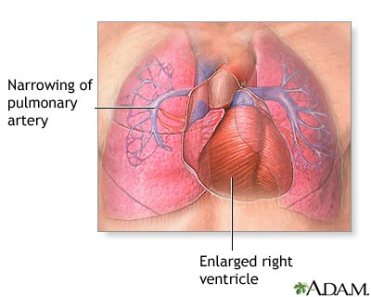
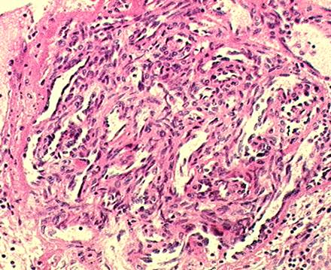
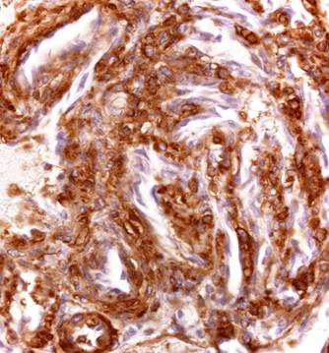
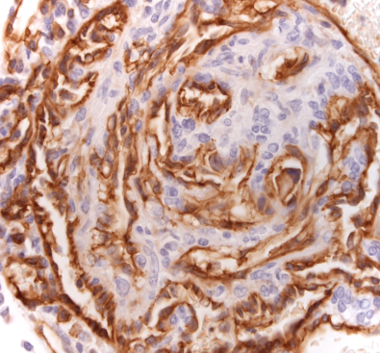
PH
narrowing
of pulmonary
artery
Intima/Endothelium
NO production
PGI2
Vasocontrictors ET1, TXA2
Permeability
Inflammatory cell migration
Proliferation/angiogenesis
enlarged right ventricle
Plexiform lesions

Slide 32
Hypoxia (oxygen deprivation) and shortage of vasorelaxant nitric oxide lead to PH
HYPOXIA
eNOS INHIBITION
Rho GTPases
ENDOTHELIAL DYSFUNCTION
BARRIER FUNCTION
ANGIOGENESIS
PH

Slide 33
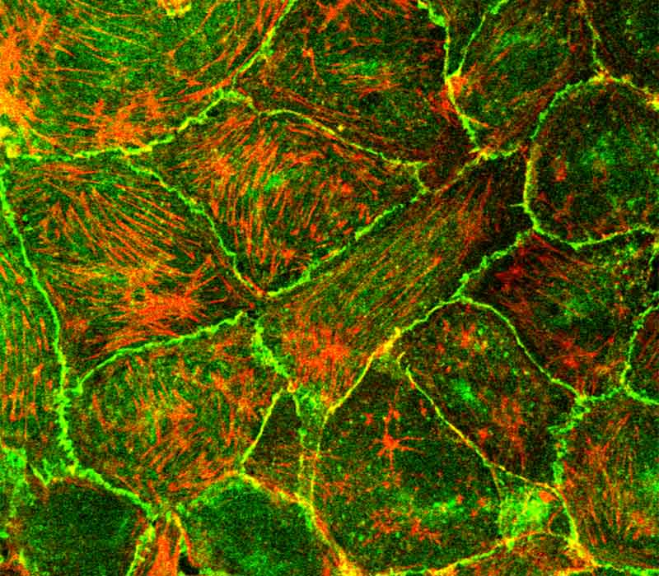
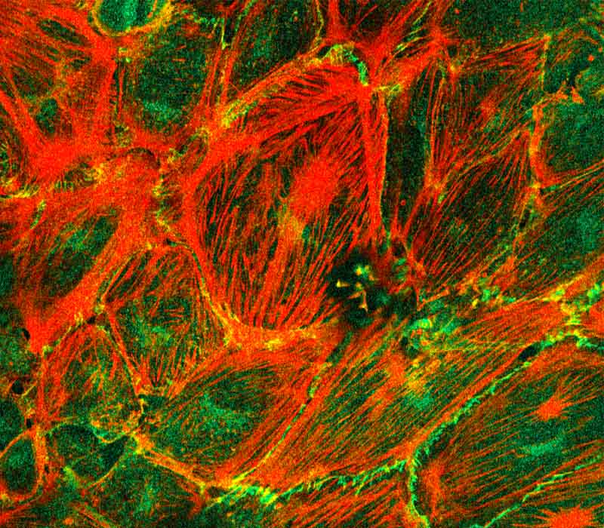
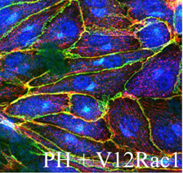
Hypoxia induces dysregulation of Rho GTPases activity in pulmonary endothelium
leading to decrease in barrier function
HYPOXIA
Rac1
RhoA
Sustained remodelling of the endothelial actin cytoskeleton
Barrier changes
Transcriptional activation HIF-1alpha, NFkB
Return to the NORMAL
phenotype
NORMAL
HYPERTENSIVE
N19RhoA
Y-27632
C3 transferase
Mutant Rho GTPases
Wojciak-Stothard Am J Physiol Lung Cell Mol
Physiol 288:749-760, 2005
Wojciak-Stothard et al. AmJPhysiol Lung Cell Mol Physiol
290:L1173-L1182, 2006

Slide 34
Nitric oxide inhibitors and Rho GTPases
Asymmetric dimethylarginine
Pulmonary Hypertension
Chronic renal disease
Hypertension
Atherosclerosis
Heart Failure
Coronary artery disease
Preeclampsia
Diabetes
Stroke
Hypercholesterolaemia
Hyperhomocysteinaemia
ADMA
L-arginine
NO
NOS
PRMT
PROTEOLYSIS
Citrulline
impairs angiogenesis
and blood vessel repair
DDAH
ADMA
Dimethylarginine
dimethylaminohydrolases
L-NMMA

Slide 35
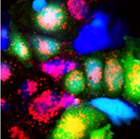
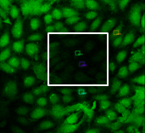
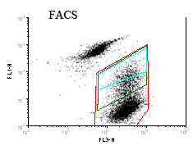
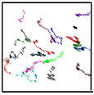
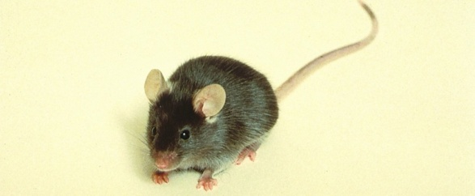
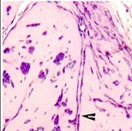
The effects of ADMA on Rho GTPases and endothelium
ADMA
DDAH
NO
Cell-cell
communication
Rac1
RhoA
FRAP
endothelial cell motility
and guidance
Barrier function
Endothelial cell growth
Vascular tone
Transwell assay
Vascular healing
Angiogenesis
Wojciak-Stothard et al. Mol Biol Cell. 2009
20(1):33-42.
Wojciak-Stothard et al. J. Cell Sci (2007)120:929

Slide 36
RhoB as a drug target in PH

Slide 37
Pulmonary Hypertension – is it only RhoA?
normal intrapulmonary artery
PH pulmonary artery –
increase in wall thickness
Remodelling
Contraction
RhoA
RhoB?

Slide 38
RhoA & RhoB - COMPARISON
1. RhoA and RhoB are highly conserved, 85% identical to each other
2. Similar intracellular effectors (in vitro binding assays)
3. Different post-translational modification/intracellular localization
RhoA RhoB
geranylgeranylated, geranylgeranylated
carboxymethylated FARNESYLATED
phosphorylated on Ser188 carboxymethylated
membrane, cytoplasm membrane, endosomes
4. RhoA constitutively expressed, RhoB inducible

Slide 39
RhoB gene expression, protein expression and activity
increase in hypoxia

Slide 40
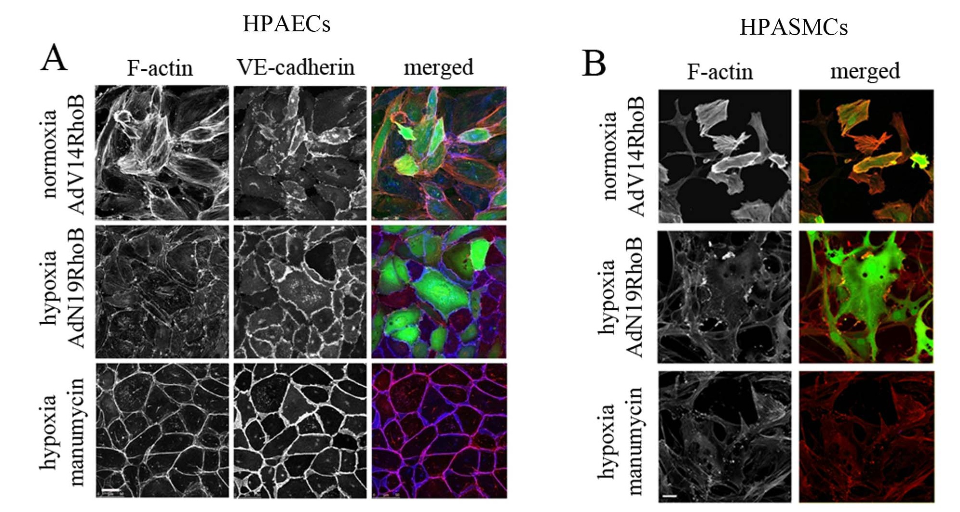
HPAECs – RhoB activation induces cell rounding and loss of VE-cadherin
Wu Yixing –MSc project
Wojciak-Stothard et al. Circ Res. 2012 May 25;110(11):1423-34.

Slide 41
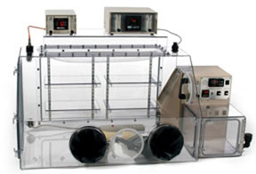

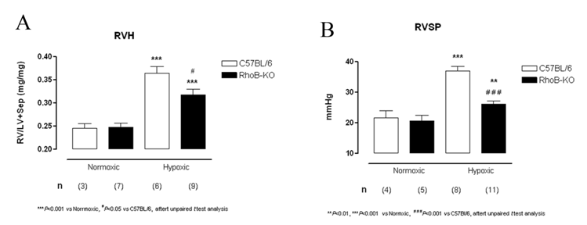
Pulmonary Hypertension is attenuated in RhoB -/- mice
RhoB -/- mice
10% oxygen, 2 weeks

Slide 42
RhoB – proposed
signalling pathway
HYPOXIA
RhoA
RhoB
Rho kinase
mDia
MLC phosphorylation
Actin polymerization
Cell proliferation
stress fibre formation
contractility
Endothelial permeability
SMC contraction
SMC and endothelial proliferation
PH
mDia – mammalian homolog of
Drosophila diaphanous,
regulates actin nucleation and polymerisation

Slide 43
New work:
Farnesyltransferase inhibitors - new drug targets in PH?
Designing fluorescent probes for measurement of protein
farnesylation/geranylgeranylation
in response to drugs (eg. statins)

Slide 44

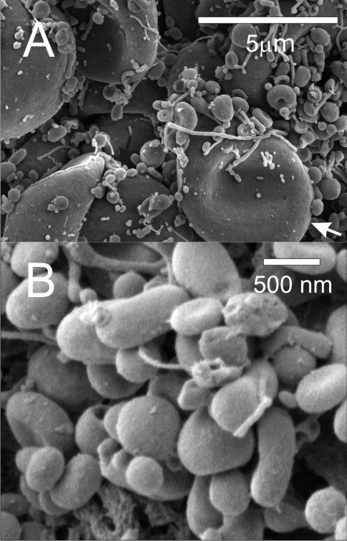
Endothelium-derived microvesicles – role in PH
Cell activation:
Hypoxia, oxidative stress,
inflammation
Rho kinase activation
membrane blebbing
Microvesicles
Carrying microRNA,
DNA fragments,
pro-inflammatory
membrane receptors
Angiogenesis, endothelial proliferation,
leukocyte adhesion, barrier function
PH
Image from: Sustar et al. Lipids in Health and Disease 2011;10:47

Slide 45
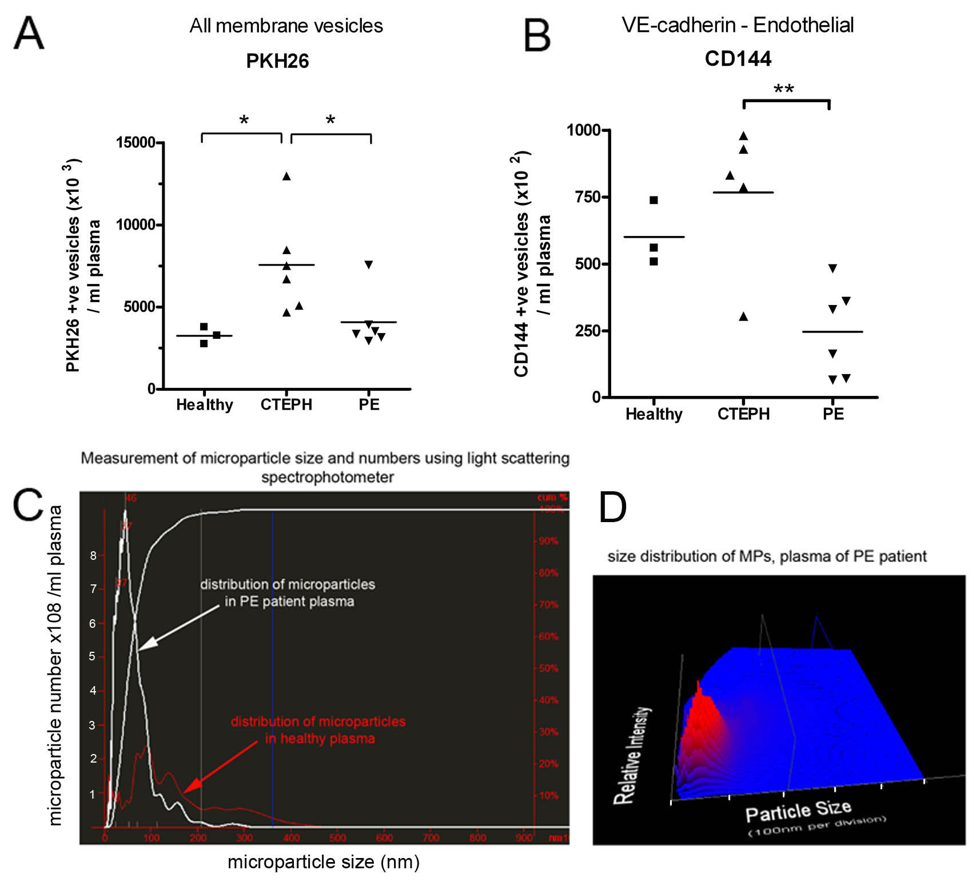
Patients with chronic thromboembolic PH (CTEPH) show increased plasma levels
of endothelial MPs
Dogukan Dagalan –MSc project

Slide 46
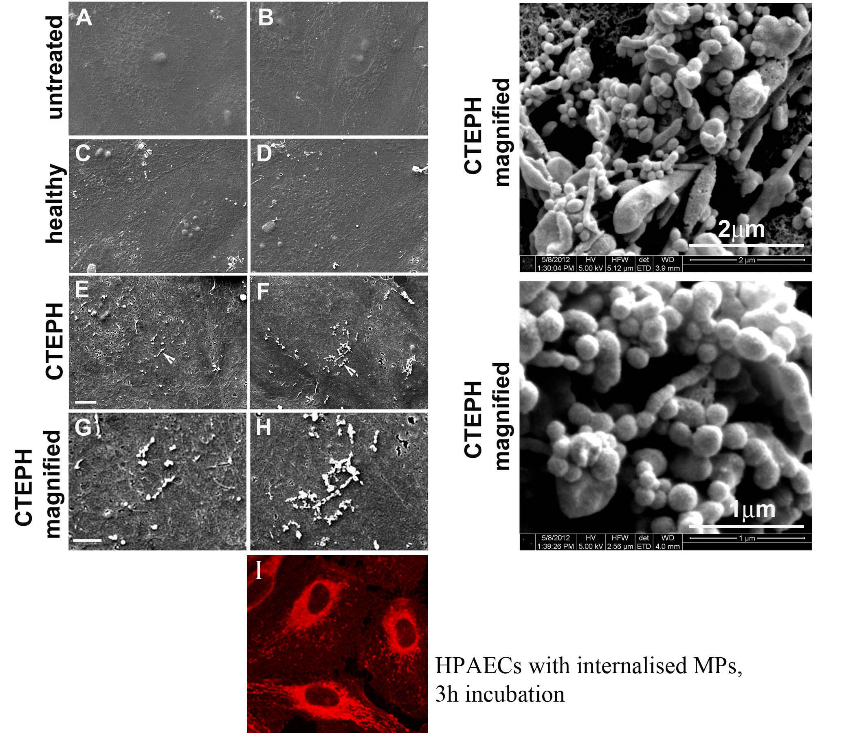
Dogukan Dagalan –MSc project

Slide 47
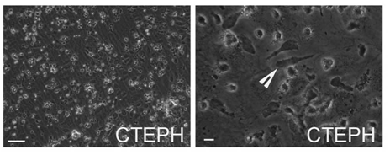
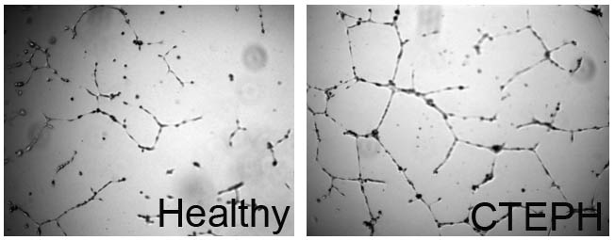
CTEPH MPs
Pro-angiogenic
Pro-inflammatory

Slide 48
SUMMARY
Rho GTPases link surface receptors to organisation of the actin cytoskeleton
Rho GTPases are involved in the regulation of endothelial barrier function,
inflammation, platelet activation, thrombosis, oxidative stress, proliferation,
smooth muscle and endothelial cell migration,
differentiation and therefore control almost every aspect of vascular homeostasis
Dysregulation of Rho GTPases is associated with development of atherosclerosis,
hypertension, angiogenic and hypertrophic disorders and vascular developmental
abnormalities.
Hypoxia and NO deprivation lead to dysregulation of RhoA and Rac1 activity resulting in increased endothelial leakage, abnormal angiogenesis and inhibition of gap junctional communication, contributing to PH

Slide 49
Recommended reading
Mammalian Rho GTPases: new insights into their functions from in vivo studies.
Heasman SJ, Ridley AJ.
Nat Rev Mol Cell Biol. 2008 Sep;9(9):690-701. Review
Rho GTPases in pulmonary vascular dysfunction.
Storck EM, Wojciak-Stothard B.
Vascul Pharmacol. 2012 Sep 13. pii: S1537-1891(12)00187-5
The role of Rho protein signaling in hypertension.
Loirand G, Pacaud P.
Nat Rev Cardiol. 2010 Nov;7(11):637-47. Review
Rho GTPases in cancer cell biology.
Vega FM, Ridley AJ.
FEBS Lett. 2008 Jun 18;582(14):2093-101. Epub 2008 May 5. Review
Role of GTPases in control of microvascular permeability.
Spindler V, Schlegel N, Waschke J.
Cardiovasc Res. 2010 Jul 15;87(2):243-53. Epub 2010 Mar 17. Review
The VEGF/Rho GTPase signalling pathway: a promising target for anti-angiogenic/anti-invasion therapy.
van der Meel R, Symons MH, Kudernatsch R, Kok RJ, Schiffelers RM, Storm G, Gallagher WM, Byrne AT.
Drug Discov Today. 2011 Mar;16(5-6):219-28. Epub 2011 Jan 22. Review
Bacterial protein toxins that modify host regulatory GTPases.
Aktories K.
Nat Rev Microbiol. 2011 Jun 16;9(7):487-98. doi: 10.1038/nrmicro2592. Review
Driving Rho GTPase activity in endothelial cells regulates barrier integrity.
Beckers CM, van Hinsbergh VW, van Nieuw Amerongen GP.
Thromb Haemost. 2010 Jan;103(1):40-55. Epub 2009 Sep 30. Review
The DDAH/ADMA pathway in the control of endothelial cell migration and angiogenesis.
Fiedler LR, Wojciak-Stothard B.
Biochem Soc Trans. 2009 Dec;37(Pt 6):1243-7. Review
Role of Rho GTPases and their regulators in cancer progression.
Rathinam R, Berrier A, Alahari SK.
Front Biosci. 2011 Jun 1;17:2561-71. Review

