Slide 1

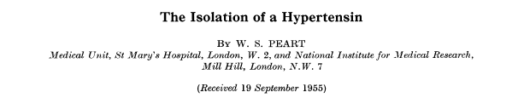
http://www.brookes.ac.uk/lifesci/medical/synopses/peart.html!
The renin-angiotensin system – physiology
Inhibitors of the RAA system and treatment of CVD
10/2011 © AD Hughes

Slide 2
RAS
Angiotensinogen
PRR
Renin
Prorenin
M6PR
ACE2
Ang I (1 - 10)
Bradykinin
Ang (1 – 9)
Chymase
ACE
ACE
Ang II (1 - 8)
fragments
ACE
ACE2
B₁
Ang (1 – 7)
Ang III (2 - 8)
B₂
AT₁
ACE
Mas
Ang IV (3 - 8)
AT₂
Ang (1 – 5)
AT₄

Slide 3
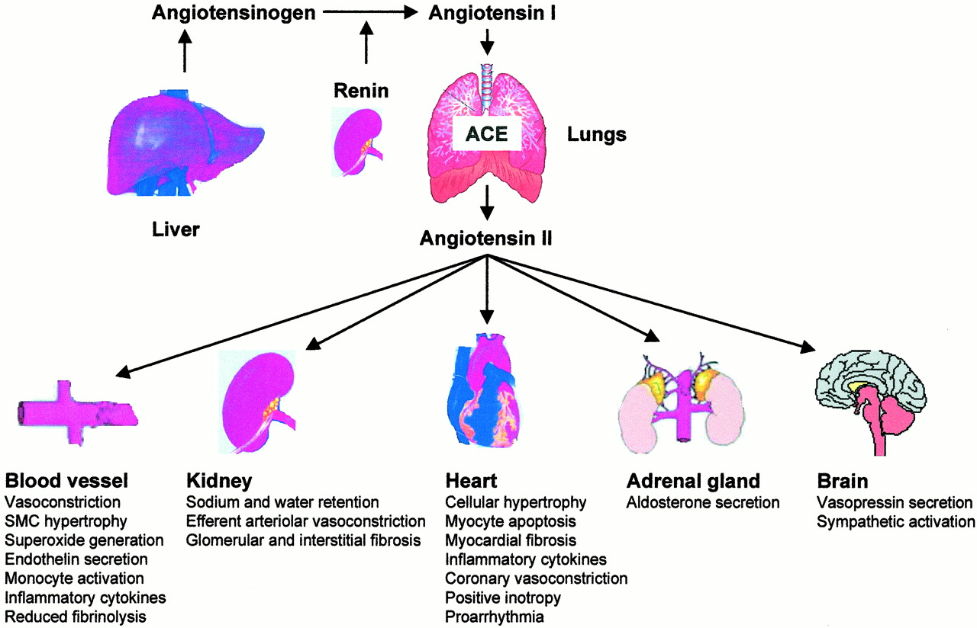
Classical RAS system

Slide 4
Evidence for local RAS
Classically plasma renin was thought to account for conversion of angiotensinogen to angiotensin I, but blood pressure correlates poorly with plasma renin activity
Action of Ang II requires levels that rarely if ever occur in circulating blood
Venous blood levels of Ang II exceed those expected on the basis of arterial blood levels
mRNA and protein for renin and angiotensinogen are present in a number of tissues (including heart and vasculature)
Local tissue production of Ang II is probably an important component of the systemic RAS

Slide 5
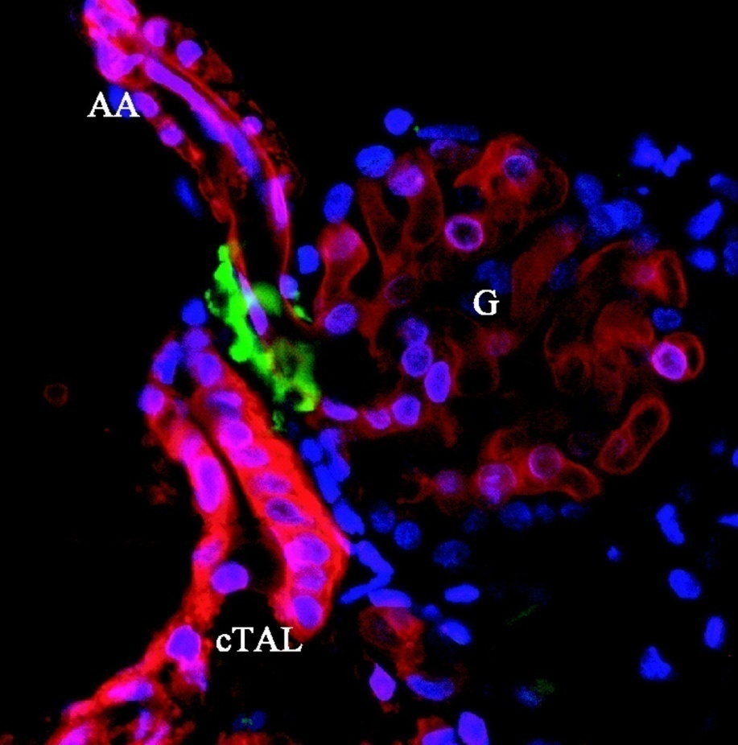
Renin
Aspartic protease with only one known substrate, angiotensinogen.
Produced by juxtaglomerular granular cells
Exists in pro-, active and inactive form
Prorenin the inactive precursor circulates in plasma at 100-fold higher concentrations and can be activated by proteolysis (enzymes , low pH and low temperatures).
renin
Peti-Peterdi Am J Physiol Renal Physiol 288: F1079-F1083, 2005

Slide 6
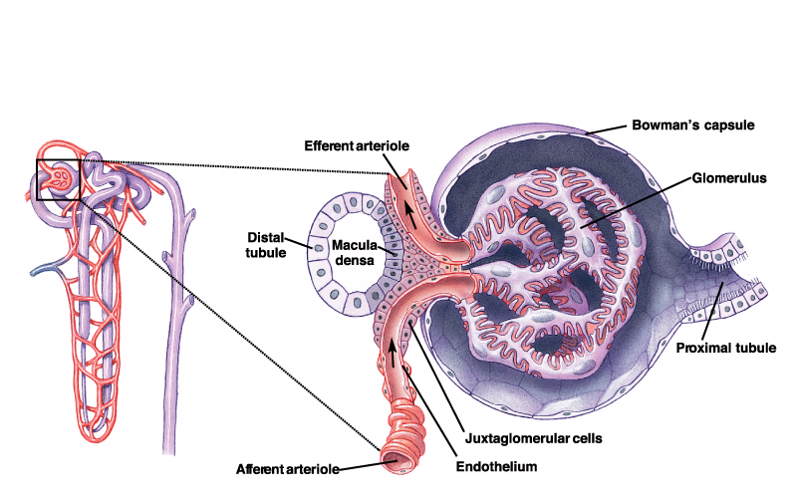
Regulation of renin release by the kidney
Diuretics (↑)
Na⁺ reabsorbtion
at Macula Densa
Adenosine (-)
Renin
Prostaglandins (+)
NSAID (↓)
ACEI (↑)
Systemic
BP (+)
ARB (↑)
Ang II (-)
β₁-adrenoceptors
on JGA (+)
Pressure in pre-glomerular
vessels (+)
Beta blockers (↓)

Slide 7
(Pro)renin receptors
Prorenin is usually enzymatically inactive unless activated by cleavage
Prorenin (and renin) can bind to two distinct receptors
    (pro)renin receptors (ATP6AP2)
    mannose-6-phosphate receptors (M6P/IGF2)
Prorenin receptors (PRR) are structurally homologous to vacuolar H⁺ATP-ase (ATP6AP2) but the role of this protein in responses to prorenin is unclear.
Binding of prorenin to PRR causes
  enzymatic activation of prorenin allowing conversion of angiotensinogen to angiotensin I without cleavage of prorenin
  induces intracellular signalling via MAP kinase pathways.
Physiological role of PRR unknown

Slide 8
The ever increasing family of angiotensin receptors
Type | Ligand | Signals | Distribution | Function
AT₁ | Ang II | Heterotrimeric G protein, Ca²⁺, IP₃ | Widespread, (kidneys, blood vessels etc.) | Salt & water homeostasis, blood pressure
AT₂ | Ang II | Heterotrimeric G protein? Tyrosine phosphatase? | Largely foetal, adult adrenal, ovaries, brain, endothelium? | Apoptosis? Growth regulation? Blood flow?
Mas | Ang (1-7) | Heterotrimeric G protein | Kidney, heart | Blood flow, Renal Na absorbtion
AT₄ | Ang III, Ang 3-8 (AKA Ang IV), LVV-hemorphin-7 (LVV-H7) | ? (not G protein) insulin-regulated aminopeptidase (IRAP)? | Brain, heart, adrenal, kidney, blood vessels? | Blood flow? Renal Na absorbtion? Memory?

Slide 9
AT₂ receptor
Functional antagonist of AT₁ receptors in some circumstances
  Mediates vasodilation in some blood vessels via bradykinin, endothelial NO and cGMP
  Inhibits renin release by a direct action on JG cells and may protect kidneys from ischaemic damage
  Inhibits growth of cardiac myocytes and perivascular fibrosis in Ang II-infused mice
  Experiments with selective AT₂ agonist also indicate a role in CNS function and inflammation
Reviewed in Carey RM Hypertension 2005; 45:840-844.

Slide 10
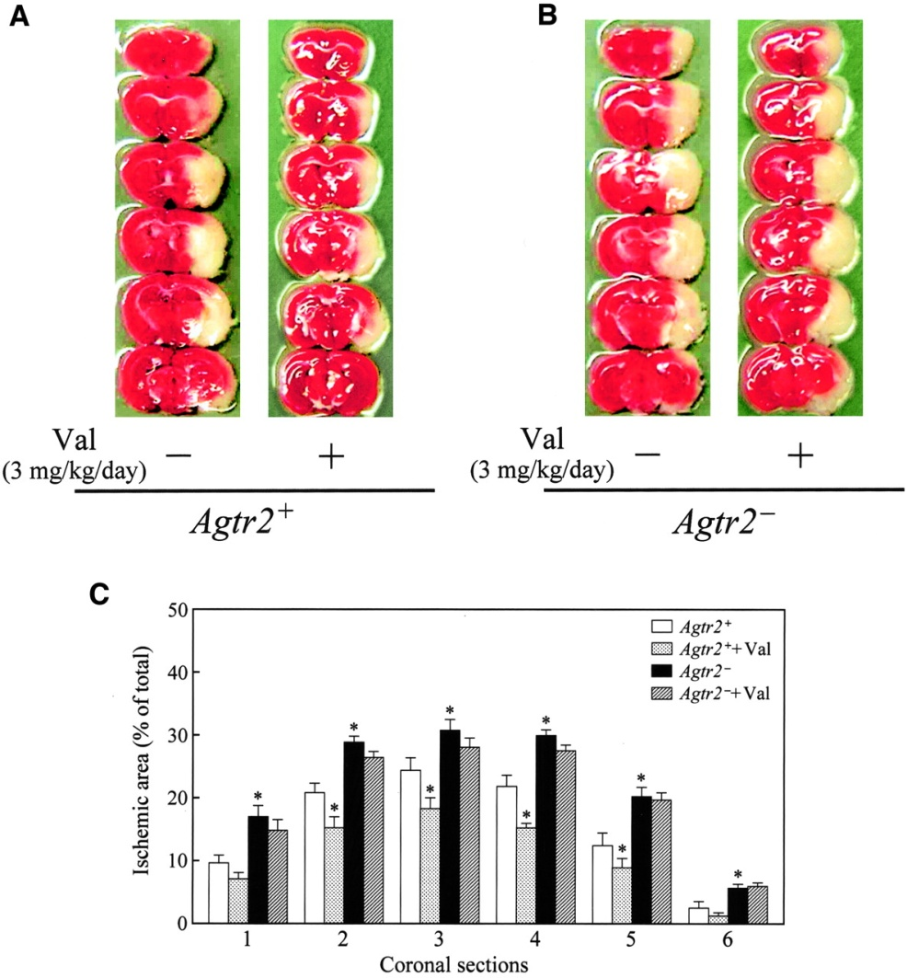
AT₂ receptors – a novel target in stroke?
Focal ischemic area of mouse brain 24 hours after MCA occlusion in angiotensin II type 2 (AT2) receptor-deficient mice
Iwai, M. et al. Circulation 2004;110:843-848

Slide 11
Ang 1-7
Mainly produced by the action of ACE2
Acts as MAS receptor
Functional antagonist of AT₁ receptors in some circumstances
  Vasodilation via bradykinin, prostanoids and endothelial NO
  Inhibits smooth muscle growth in vitro
  Increases diuresis and natriuresis via a tubular action
Ferrario et al., Am J Physiol E-pub July 29, 2005

Slide 12
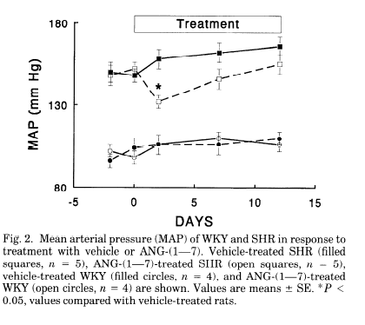
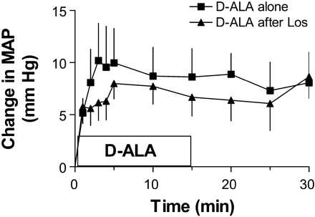
Ang 1-7 and blood pressure
Benter et al., ., Am J Physiol 1995; 38: H313-H319 Nakamura et al., Am J Physiol 2003; 284: R164-R173

Slide 13
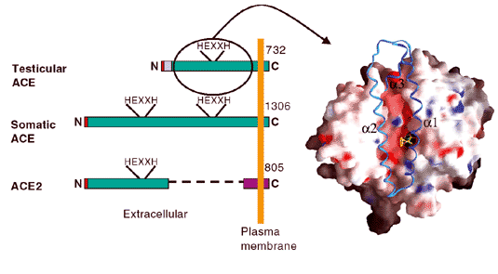
ACE2
Carboxypeptidase with 40% identity to ACE.
Converts Ang I to Ang 1-7 and metabolises various peptides including neurotensin, kinetensin, dynoprhin A but not bradykinin.
Expressed in heart, kidney, endothelium, smooth muscle and testis.
Not inhibited by classical ACE inhibitors
Expression upregulated by inhibition of AT₁ receptorsA
Acts as a receptors for SARS
Hooper NM Turner AJ Nature Structural Biology 2003;10:155-157
Notes:
ACE2 overexpression causes cardiac conduction disturbances and sudden death in mice

Slide 14
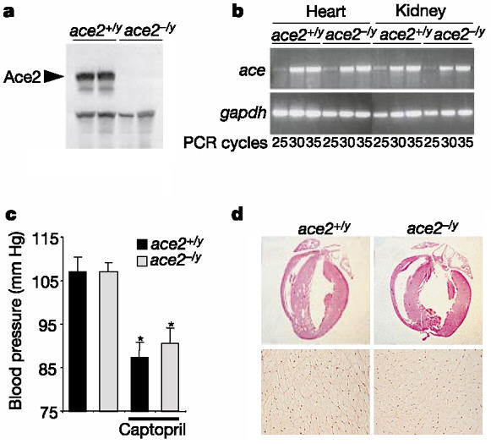
ACE2 and the heart
ACE2-deficient mice show enlarged left and right ventricles but the overall heart size is comparable between both genotypes and there is no evidence for cardiac hypertrophy macroscopically or in isolated cardiomyocytes. The bottom panels show an absence of interstitial fibrosis in ace2^{-/y} mice.
Crackower: Nature, 2002; 417: 822-828

Slide 15
Angiotensin and pathology
Angiotensin II
Insulin
resistance
Pro-inflammatory
/ pro-thrombogenic
effects
Hypertension
Metabolic syndrome
dyslipidemia
diabetes
Atherosclerosis

Slide 16
Applications of RAS inhibitors
ACE Inhibitors | Angiotensin Receptor Antagonists | Renin Inhibitors | Aldosterone antagonists
Hypertension Myocardial infarction Heart failure Diabetic nephropathy | Hypertension Heart failure Diabetic nephropathy | Hypertension | Hypertension Hypokalemia Heart failure Ascites
Vasopeptidase inhibitors (adverse effect profile) are not in clinical use.

Slide 17
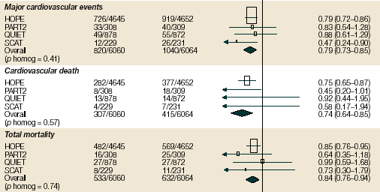
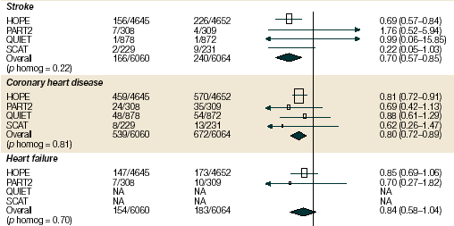
ACEI and CVD

Slide 18
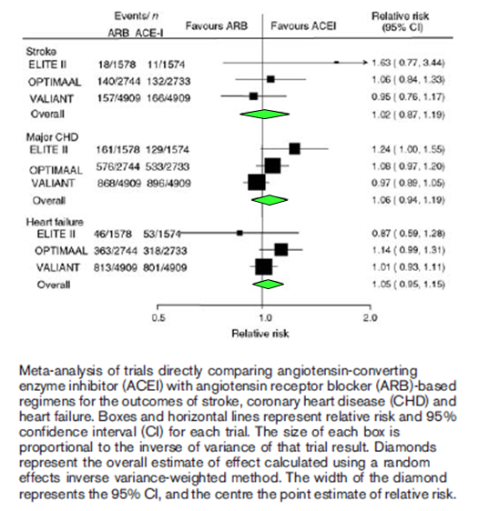
Are ACEI and ARB alike?
BPLTTC J Hypertens 2007; 25:951–958

Slide 19
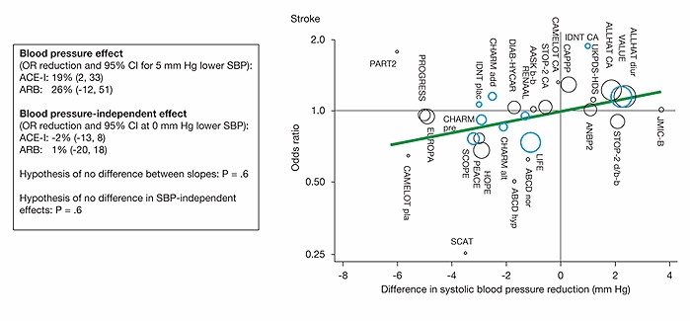
ACEI and ARB on stroke
ARB (blue ); ACEI (black)
BPLTTC J Hypertens 2007; 25:951–958

Slide 20
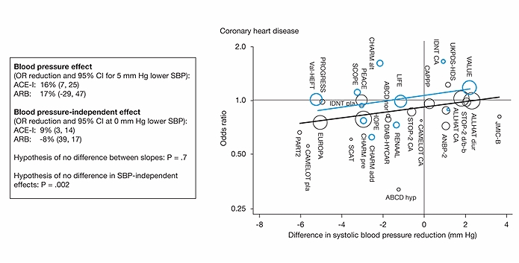
ACEI and ARB on CHD
ARB (blue ); ACEI (black)
BPLTTC J Hypertens 2007; 25:951–958

Slide 21
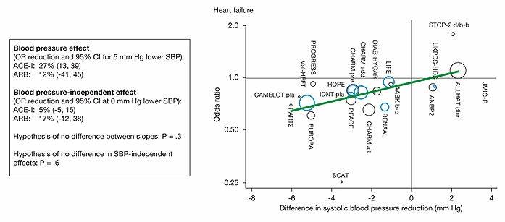
ACEI and ARB on heart failure
ARB (blue ); ACEI (black)
BPLTTC J Hypertens 2007; 25:951–958

Slide 22
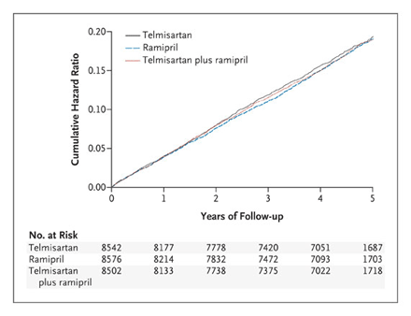
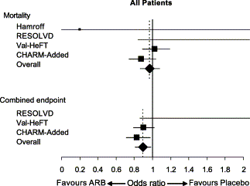
ACEI + ARB combination
Heart Failure
(Dimopoulos et al., 2003)
Combination therapy causes a marked increase in adverse effects, symptomatic hypotension, worsening renal function, and hyperkalemia (Phillips et al., 2007).
ONTARGET: High risk CVD individuals. Combination therapy resulted in lower BP (2.4/1.4 mmHg vs. ramipril alone), no event benefit but increased adverse effects (Yusuf et al., 2008),

Slide 23
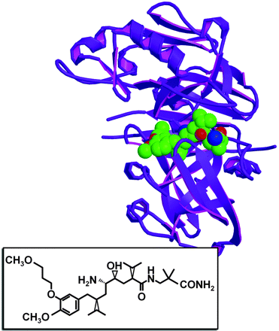
Renin inhibition
Aliskiren (released UK Sept 2007) is the first effective oral renin inhibitor
Binds to the renin S1/S3 pocket and another sub-pocket of the enzyme (S3 to hydrophobic core)
Lowers BP in mild-moderate hypertension with a safety and tolerability profile comparable to that of irbesartan
Expensive, role uncertain
Reviewed in Muller & Luft Clin J Am Soc Nephrol 1: 221-228, 2006

Slide 24
Conclusions
Inhibitors of RAS are effective, well tolerated agents useful in hypertension, ± type II DM, heart failure and in people at high risk of CVD
ARB a useful alternative in patients who cannot tolerate ACEI
ACEI + ARB combination of dubious value.

Slide 25
Further reading
Mentz RJ, Bakris GL, Waeber B, McMurray JJ, Gheorghiade M, Ruilope LM, Maggioni AP, Swedberg K, Piña IL, Fiuzat M, O'Connor CM, Zannad F, Pitt B. The past, present and future of renin-angiotensin aldosterone system inhibition. Int J Cardiol. 2012 Oct 30. pii: S0167-5273(12)01381-2. doi: 10.1016/j.ijcard.2012.10.007. [Epub ahead of print]
Santos RA, Ferreira AJ, Verano-Braga T, Bader M. Angiotensin-converting enzyme 2, Angiotensin-(1-7) and Mas: new players of the Renin Angiotensin System. J Endocrinol. 2012 Oct 23. [Epub ahead of print]
Steckelings UM, Unger T. Angiotensin II type 2 receptor agonists--where should they be applied? Expert Opin Investig Drugs. 2012 Jun;21(6):763-6. Epub 2012 Apr 21.
Paul M, Poyan Mehr A, Kreutz R. Physiology of local renin-angiotensin systems. Physiol Rev. 2006 Jul;86(3):747-803.
Persson PB. Renin: origin, secretion and synthesis. J Physiol. 2003 Nov 1;552(Pt 3):667-71. Epub 2003 Aug 29.

Slide 26
Additional slides

Slide 27
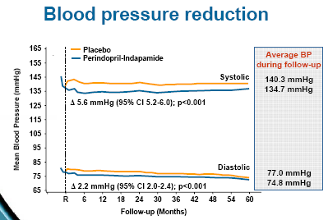
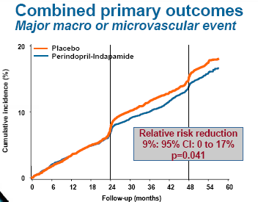
ACEI and DM
Patients with type 2 diabetes randomised to perindopril + indapamide vs. placebo, in addition to current therapy irrespective of BP
(www.advance-trial.com accessed October 2008)

