Slide 1
Pharmacogenetics

Slide 2

The Voltaire Challenge
Doctors put drugs of which they know little
into bodies of which they know less
for diseases of which they know nothing at all.
1694-1778

Slide 3
Nomenclature
P h a r m a c o g e n o m i c s is
P h a r m a c o g e n e t i c s
..with two single nucleotide polymorphisms
Notes:
Refers to genetic differences in metabolic pathways which can affect individual responses to drugs, both in terms of therapeutic effect as well as adverse effects

Slide 4
Pharmacogenetics refers to genetic differences in metabolic pathways which can affect individual responses to drugs, both in terms of therapeutic effect as well as adverse effects
Pharmacogenetics is generally regarded as the study or clinical testing of genetic variation that gives rise to differing responses to drugs
Pharmacogenomics is the broader application of genomic technologies to new drug discovery

Slide 5
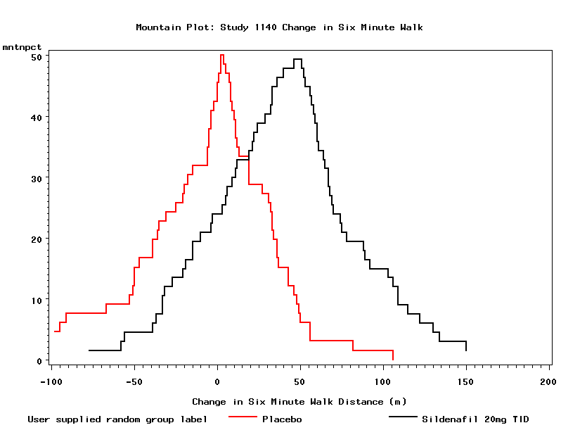
Variablility in response to a PAH drug
Placebo
Drug

Slide 6
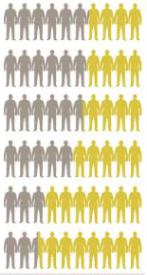
Response rate to drugs for different diseases
Anti-depressant drugs 38%
Asthma drugs 40%
Diabetes drugs 43%
Arthritis drugs 50%
Alzheimer’s drugs 73%
Cancer drugs 75%
Spear et al Clinical Trends in Mol Med 2001

Slide 7
Glaxo Chief: Our Drugs Do Not Work on Most Patients
by Steve Connor
A senior executive with Britain's biggest drugs company has admitted that most prescription medicines do not work on most people who take them.
Published on Monday, December 8, 2003 by the lndependent/UK

Slide 8
Factors That Influence Medicine Response
Genetic differences
between patients
Compliance
Interactions
with other
drugs
Patient Response to Drug
Diagnosis
Dose
Notes:
There are so many factors that influence how a person responds to a medicine;
first, there must be a correct diagnosis of the disease
the appropriate dose of the medicine must be prescribed
we, as the patients, must follow our doctor’s instructions when we take the medicine prescribed
there may be interactions between the medicine we were prescribed for our disease with other medicines we might be taking. Other medicines, vitamins, herbal preparations are we taking might change the way our medicine reacts in our body. (An example of this is certain antibiotics reduce the effectiveness of oral birth control).
And, as if the rest of these weren’t enough, there may be Genetic differences between different patients that allow the medicine to work better for some than for others.

Slide 9
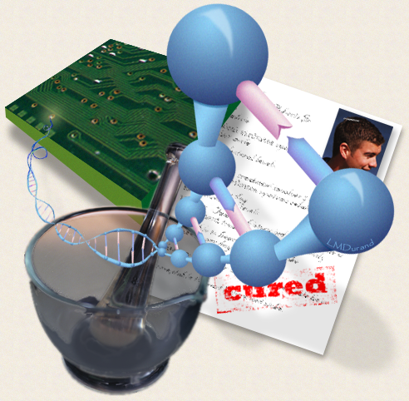
Pharmacogenomics
“Drugs by Design?”
“In the very near future, primary care physicians will routinely perform genetic tests before writing a prescription because (they will) want to identify the poor responders.”
  F. Collins
  (AAFP Annual Meeting, 1998)

Slide 10
Objectives
To understand the principles underlying the
use of genetic information to inform prescribing
To appreciate the present state-of-the-art and
be aware of the hurdles to implementing
pharmacogenetics/genomics in clinical practice

Slide 11
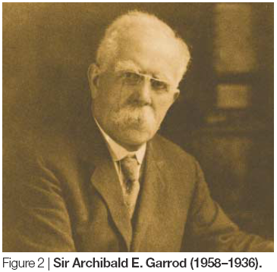
Historical Background
In his 1908 Croonian
Lecture he coined
the phrase
“Chemical
Individuality”
Sir Archibald Garrod 1858-1936

Slide 12
Historical Background
Synder describes
Phenylthiocarbamide (PTC)
taste blindness
Genetic determination
of isoniazid acetylation
recognised
Human Genome
published
Genetic polymorphism of
debrisoquine/sparteine
metabolism described
Primaquine haemolysis
with G6PD deficiency
1932 1955 1957 1959 1960 1975 1980 2003
“Pharmacogenetics”
coined
Thiopurine-methyltransferase
polymorphism reported
Succinylcholine apnoea
and serum cholinesterase
deficiency

Slide 13
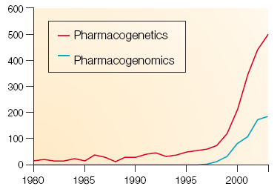
Increasing interest in genetics and medicines
Number of papers per year

Slide 14
Genetic variation can influence
patient response at two levels
Drug
Absorption
Distribution
Pharmacokinetics
Drug metabolism
Blood levels achieved
Drug target
Pharmacodynamics
Intermediate
pathways
Response
Notes:
These biochemical factors which influence a patient’s response to a product are subject to the genetic variation mention before.

Slide 15
Genetic variation can influence
patient response at two levels
Drug
Absorption
Distribution
Pharmacokinetics
Drug metabolism
Blood levels achieved
Drug target
Pharmacodynamics
Intermediate
pathways
Response
Notes:
These biochemical factors which influence a patient’s response to a product are subject to the genetic variation mention before.

Slide 16
Genetic variation can influence
drug metabolism

Slide 17
Poor drug metabolisers can be exposed to increased blood levels
Normal metabolism
Slow metabolism
Toxicity
Drug plasma
concentration
Efficacy
Time after drug administration

Slide 18
When is genetic variation in drug metabolism important?
When the drug has a steep dose-response curve
When the therapeutic window is narrow
When the drug is metabolised mainly by one enzyme

Slide 19
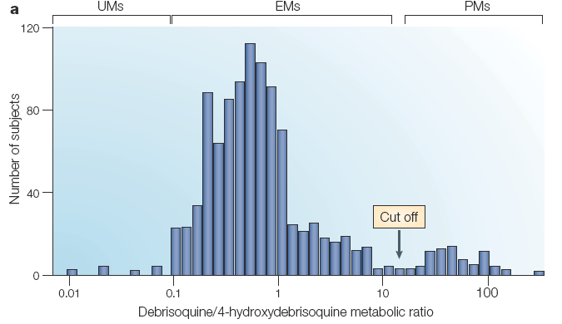
Population distribution of metaboliser status
Notes:
Figure 3 | Classic pharmacogenetic traits: polymorphisms in cytochrome P450 2D6. a | Cytochrome P450 2D6 (CYP2D6)
pharmacogenetics determined using the ratio of debrisoquine to its metabolite, 4-hydroxydebrisoquine, in 1,011 Swedish subjects.
This population sample included a group of ‘poor metabolizers’ (PMs), a large group of ‘extensive metabolizers’ (EMs) and a small
number of ‘ultra-rapid metabolizers’ (UMs). The box labelled ‘cut off’ indicates the cut off between data for subjects with ‘poor’
metabolism as a result of decreased or absent CYP2D6 activity and subjects with ‘extensive’ metabolism. b | Roche AmpliChip
P450 Array. The photograph shows a device that can be used to determine genotypes for alleles of selected CYP genes —
including CYP2D6. The authors have used the Roche device only for purposes of illustration; it does not imply endorsement of this
particular technology. Part a modified with permission from REF. 20 © American Society for Clinical Pharmacology and Therapeutics
(1992). Part b used with the permission of Roche Diagnostics.

Slide 20
Worldwide distribution of poor drug metabolisers (CYP2D6)
3%
6%
0.5%
9%
7%
6%
10%
1%
0%
1%
7%
4%
2%
2%

Slide 21
Some drugs cleared by CYP2D6
ß-Adrenergic antagonists
e.g.metoprolol, bufuralol, propranolol
Neuroleptics
e.g. haloperidol, perphenazine
Anti-depressants
e.g. imipramine, amitriptyline, nortriptyline, paroxetine
Anti-arrhythmics
e.g. flecainide, encainide
Miscellaneous drugs
e.g. dextromethorphan, debrisoquine, sparteine, codeine

Slide 22
CYP2D6 phenotype reduces effectiveness of codeine analgesia
Peak pain
Discomfort
10
EM
PM
20
EM
PM
8
16
Change in mm
on VAS
Change in mm
on VAS
6
12
4
8
2
4
0
0
P
C
M
P
C
M
P
C
M
P
C
M
P=placebo; C=codeine; M=morphine

Slide 23
Poor metaboliser status can
work both ways
Poor metaboliser
Prodrug eg codeine
activated by 2D6
Risk lack
of effect
Active drugs
inactivated by
metabolism
Risk of toxicity

Slide 24
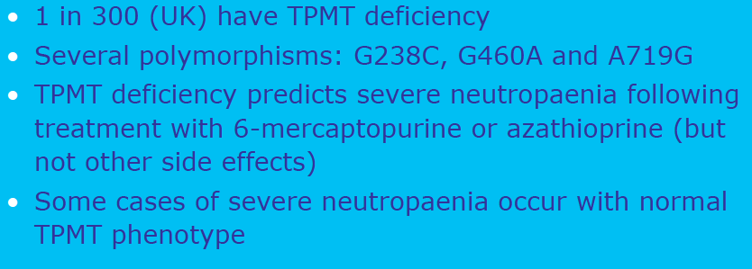
Thiopurine S-methyltransferase (TPMT) deficiency
Metabolic anomaly that increases the risk of adverse drug effects (especially hematopoietic toxicity - leukopenia, neutropenia, anemia, thrombocytopenia, pancytopenia) in patients treated with thiopurine drugs widely used in the treatment of acute leukemia, autoimmune disorders (e.g., Crohn's disease, rheumatoid arthritis), and organ transplant recipients.

Slide 25
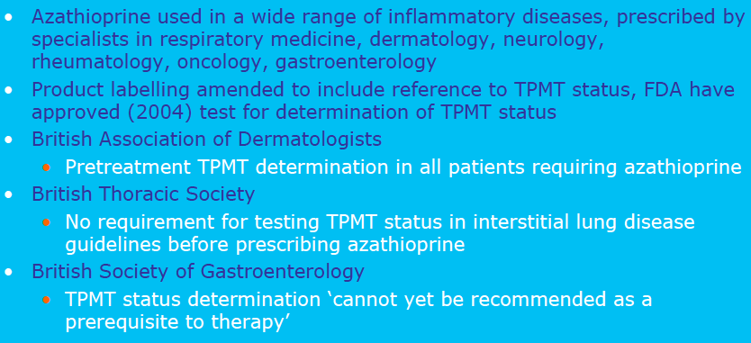
TPMT deficiency

Slide 26
Association of UGT1A1 genotype with drug toxicity
UDP glucuronosyltransferase 1A1 (UGT1A1) is an enzyme of the glucuronidation pathway that transforms small lipophilic molecules (steroids, bilirubin, hormones, and drugs), into water-soluble, excretable metabolites.
UDP glucuronosyltransferase 1A1 (UGT1A1*28) genotype influences the risk of severe drug related toxicity (neutropenia) of the chemotherapy agents irinotecan.
The US FDA-approved label of irinotecan has been recently revised to include UGT1A1 genotype among potential risk factors for toxicity, it is expected that UGT1A1 genotyping will be increasingly used in patients undergoing irinotecan treatment.
Notes:
These are patients who, by virtue of a genetic polymorphism, have a lower than normal capacity to metabolize SN-38, the active metabolite of irinotecan.

Slide 27
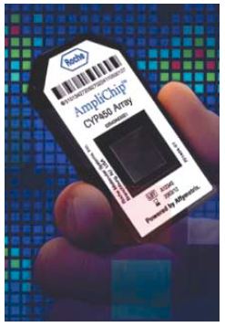
Genes on a chip

Slide 28
Genetic variation can influence
patient response at two levels
Drug
Absorption
Distribution
Pharmacokinetics
Drug metabolism
Blood levels achieved
Drug target
Pharmacodynamics
Intermediate
pathways
Response
Notes:
These biochemical factors which influence a patient’s response to a product are subject to the genetic variation mention before.

Slide 29
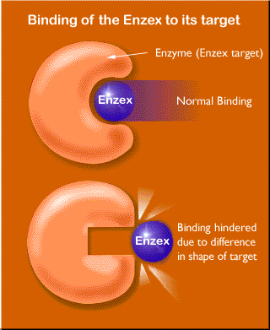
Genetic variation can affect
drug targets
Genetic variation in drug target

Slide 30
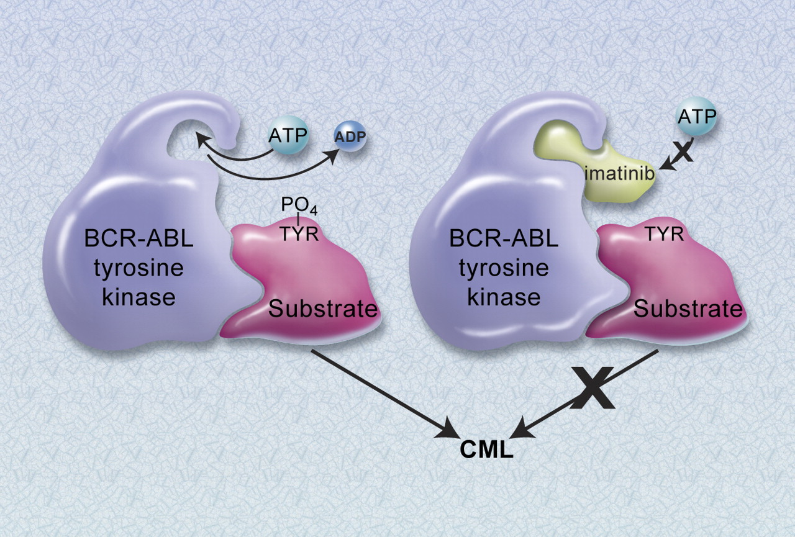
Imatinib (Gleevec): designer drug

Slide 31
Genomics can be used identify good responder subgroups in cancer
Breast cancer – Herceptin
Patients who respond best are those with tumours that overexpress the ERBB2 (also known as HER2/neu) gene
Genetic assays to select responder vs. non-responder patients

Slide 32
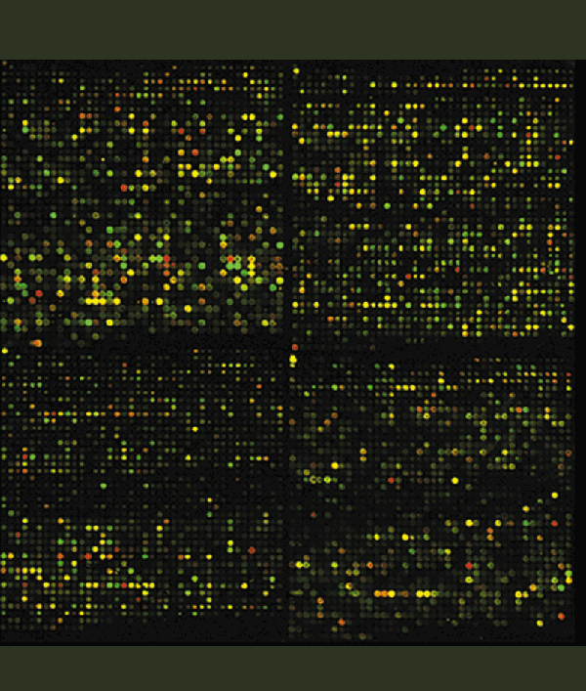
Genetics can be used for more accurate diagnosis of cancer type
A
B

Slide 33
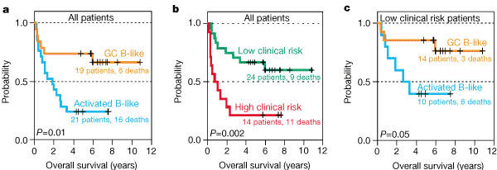
Genetics can affect survival

Slide 34

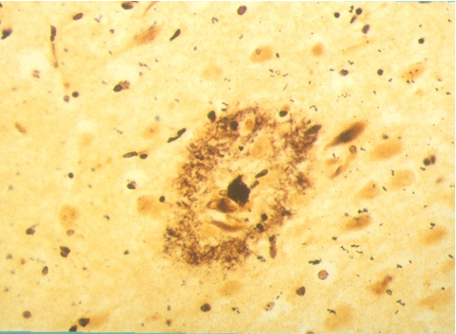
Alzheimer’s Disease
Clinical AD
pre-clinical AD
Cognitive Decline
Amyloid accumulation
0 5 10 15 20 years

Slide 35
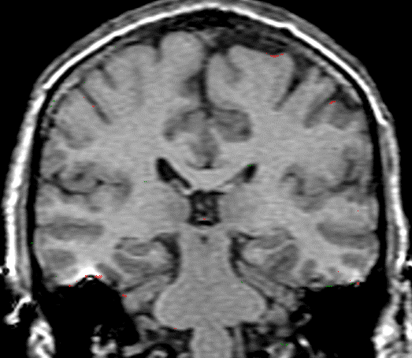
Control: Scan 1-Scan 2
1 year interval
Rate of volume loss (% year)
0.2% ± 0.3
2.8% ± 1
Controls
AD
Controls
0
Brain Volume
(% change)
-5
AD
-10
Alzheimers: Scan 1-Scan 2
1 year interval
-15
0
2
4
6
time (years)
(Red = issue loss)

Slide 36
Genetics can affect disease severity
Alzheimer Disease
?
30
0
Diagnosis
Loss of functional independency
Behavioural problems
Nursing home placement
Death
slow decliner
Cognition MMSE
fast decliner
Time (5-10 y)

Slide 37
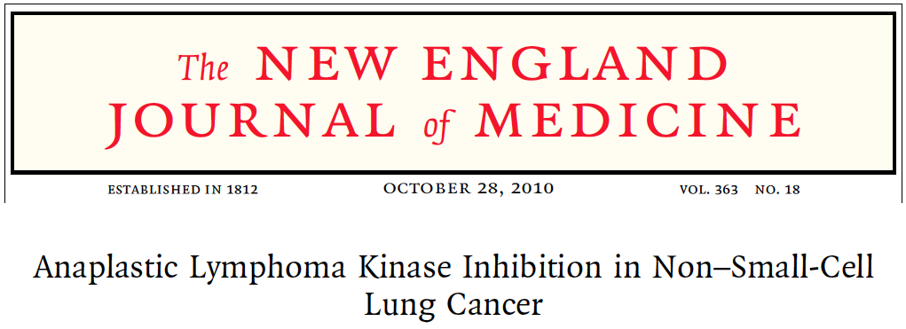
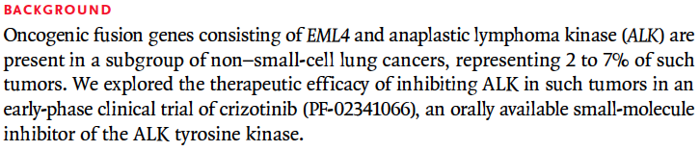


Slide 38
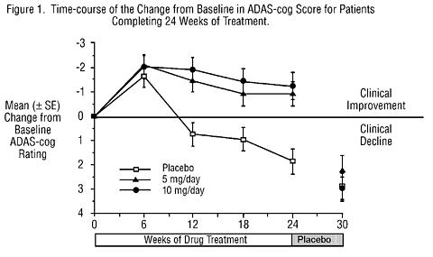
ADAS-cog changes with Aricept

Slide 40
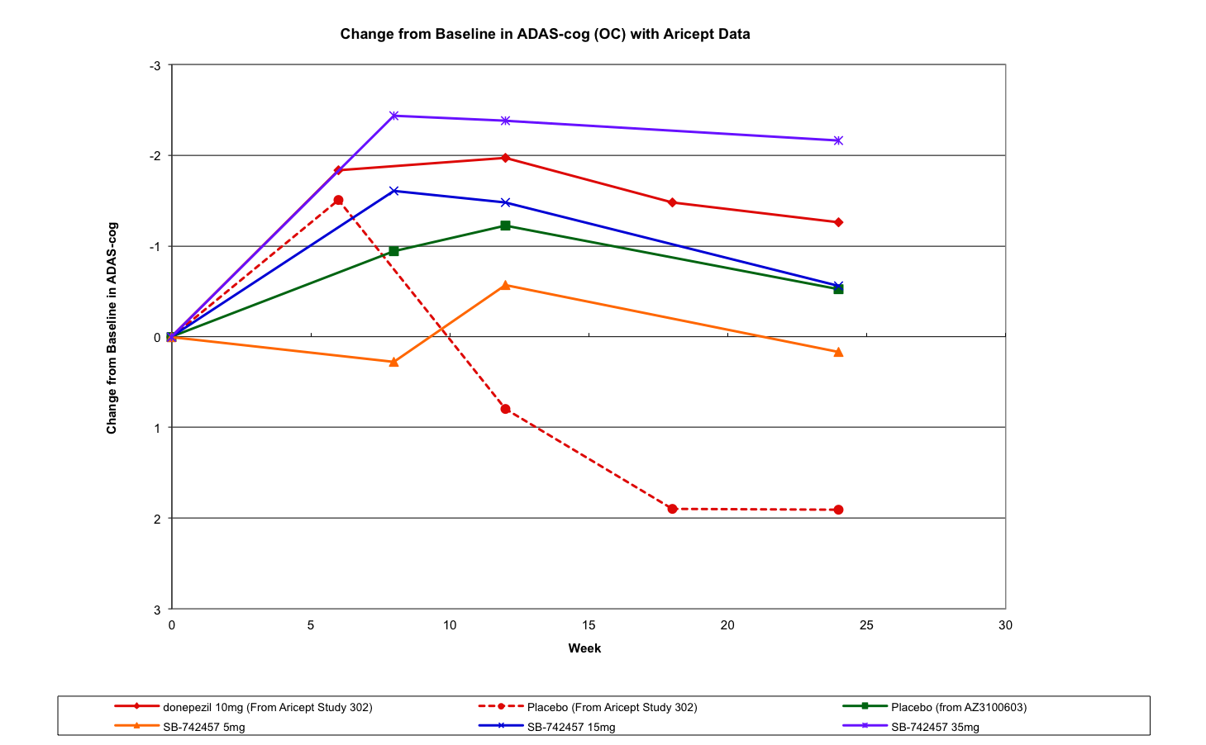
Placebo profiles in different trials

Slide 41
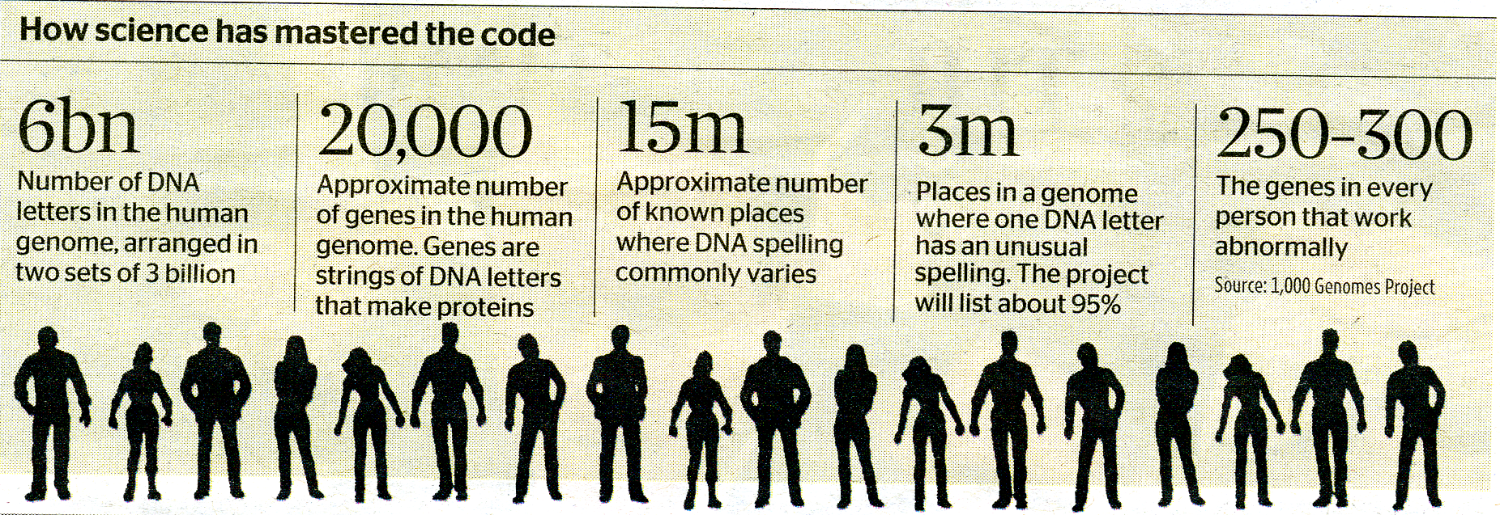
Nobody is perfect

Slide 42
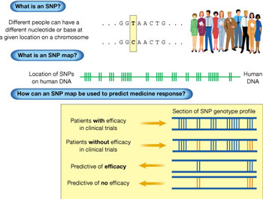
What is a SNP
Different people can have a
different nucleotide or base at
a given location on chromosome
. . . G G T A A C T G . . . .
. . . G G C A A C T G . . . .
What is a SNP map
Location of SNPs on human DNA

Slide 43
How a SNP map can be used to
predict a response to a drug
Genotype profile
Patients with good
response to drug X
Patients with poor
response to drug X
Predictive of efficacy
Predictive of
a poor response

Slide 44
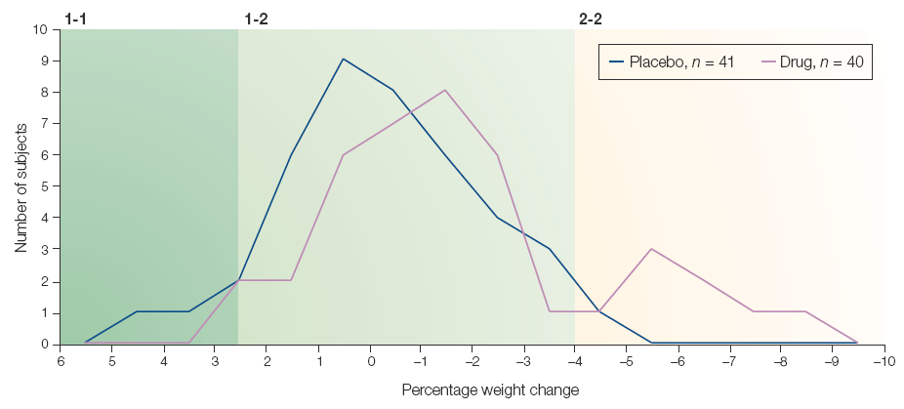
Distribution of weight change by genotype
Genotype 1
Genotype 2
Genotype 3
Notes:
Figure 1 | Efficacy pharmacogenetics for an obesity drug. The graph illustrates the results of a small double-blind Phase-IIA
efficacy clinical trial of a molecule intended for the treatment of obesity. Weight change in the 40 drug-treated patients (purple line)
is compared with 41 placebo-treated patients (blue line) during the 2-month double-blind trial. There is an obvious hyperresponder
subgroup in the treated patients, with patients losing as much as 9% weight during the trial. Two SNPs from two
candidate genes that are related to the proposed mechanism of action of this molecule, and one SNP from another candidate
gene that is thought to be implicated in theories of obesity, segregated with the hyper-responders. Each hyper-responder was
homozygous for a single allele (labelled 2-2; light shaded section of the graph) with patients on the left side of the curves being
more likely to be 1-1 homozygous (dark green section). Heterozygous patients (1-2; light green section) clustered in the middle. In
this experiment, treated patients with the 2-2 genotype for any of the three SNPs on average lost ~3.3 Kg, whereas treated
patients with the 1-1 genotype gained an average of ~1.3 Kg. This pattern reassures us that the molecule has efficacy and that
subsequent Phase-IIB trials might be enriched by using only patients who are 1-2 heterozygous and 2-2 homozygous, with the
exclusion of 1-1 homozygous patients. In addition, although the 1-1 subgroup might be less responsive to this specific treatment,
this subgroup could be used in clinical trials of other obesity-drug candidates, which might subsequently allow a drug to be
developed that is complementary to the first. n, total number of patients in study group.

Slide 45
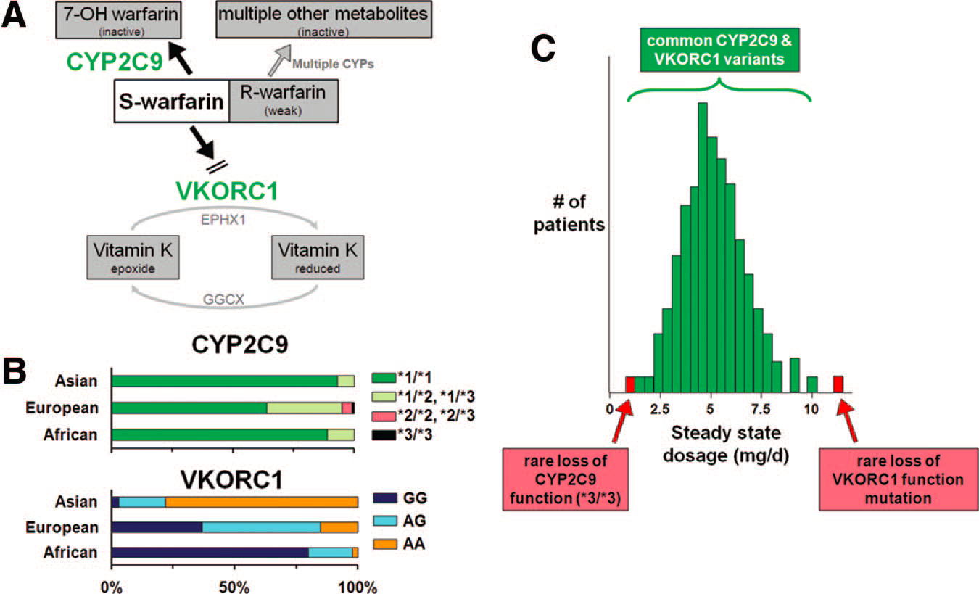
PK and PD variants and warfarin dose

Slide 46
Genomics: A powerful tool for drug target identification and validation
7,000 rare diseases worldwide
Medicines for only 80-90 of them
Know the cause, have the target, can recruit the right patients

Slide 47
Motor Neuron Disease (MND)
Amyotrophic Lateral Sclerosis (ALS)
Rare
Multifactorial pathogenesis?
Diagnosis based on clinical features and exclusion of other diseases
Homogeneous pathological features but heterogeneous clinical findings
- Incidence 1-2 per 100.000
- Prevalence 4-6 per 100.000
- 5000 new cases per year
- 30.000 cases in the US
- Diagnosis often delayed after onset of symptoms
- False positive and negative occur
Notes:
Each study should have prediction of how many subjects per arm required in future drug efficacy trials

Slide 48
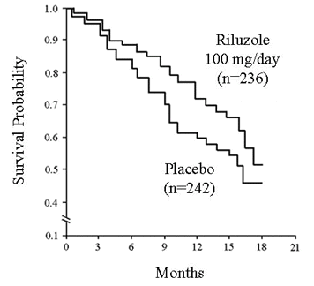
Clinical Trials in Motor Neuron Disease
Large numbers of patients required due to high variability in disease progression
Multi-centre trials required due to low incidence/prevalence
Clinical assessment and survival rate as primary outcomes
Limited use of spirometry and muscle strength tests due to poor reliability and low sensitivity to change
No reliable surrogate markers available

Slide 49
Clinical Trials in MND
As yet, the only agent that has shown improved survival in ALS is riluzole
The benefit is modest, prolonging life expectation for an average of 3 months … if the drug is taken for 18 months!
Mitchell & Borasio, Lancet 2007

Slide 50
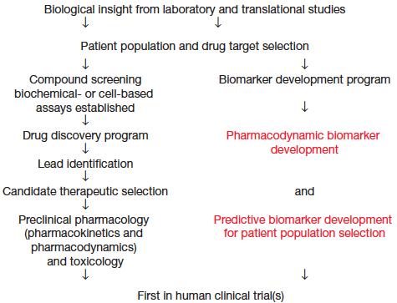
Recommended schema for anti-cancer drug development

Slide 51
Drug Development
Pre-IND
IND
Gene
to target
Target to Lead
Lead to Candidate
Safety
& Develop
Phase I
POC
Phase II
Phase III
Registration
Phase IV

Slide 52
The drug development process
  12,000 compounds synthesised
  80 compounds, fully screened
  10 compounds to man
  4 compounds to full clinical trials
  1 compounds to market

Slide 53

The drug development process
  Pre-clinical - 4 years
  Phase I – 2 years
  Phase II – 2 years
  Phase III – 3 year
  Regulatory review – 2 years
  Total 13 years
  > £ 1 billion

Slide 54
The drug development process
Preclinical
Phase I-II
Phase III
Reg.
£1000 M
Most DD programs ‘fail’ in Phase I-IIa, with an attrition rate of 85-90% due to lack of safety or efficacy
0
4 8 12 years
Notes:
Trials designed to evaluate clinical outcomes are highly expensive and of long duration
Most programs “fail” (lack of efficacy and/or safety) with 85-90% attrition after FTIH
Pipeline are clogged with many molecules that will fail
It is critical to develop laboratory and/or physical tools to be used as an alternative outcome for (or in addition to) clinically meaningful endpoints.
PK/PD modelling are needed to aid PK at site of action and dose selection for human studies.

Slide 55
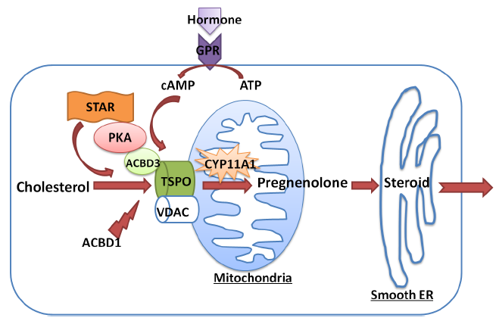
Translocator Protein

Slide 56
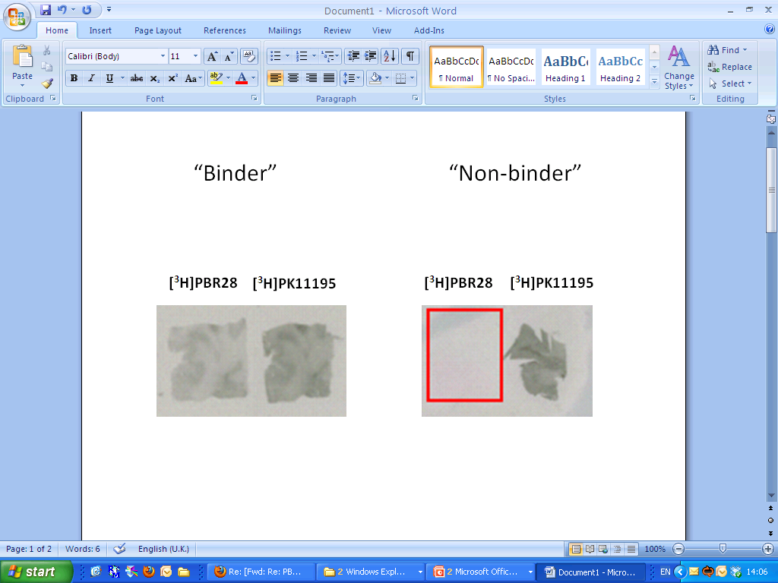
Autoradiography:
[³H]PBR28 (0.5nM)
Normal
(80%)
Non binder
(20%)

Slide 57
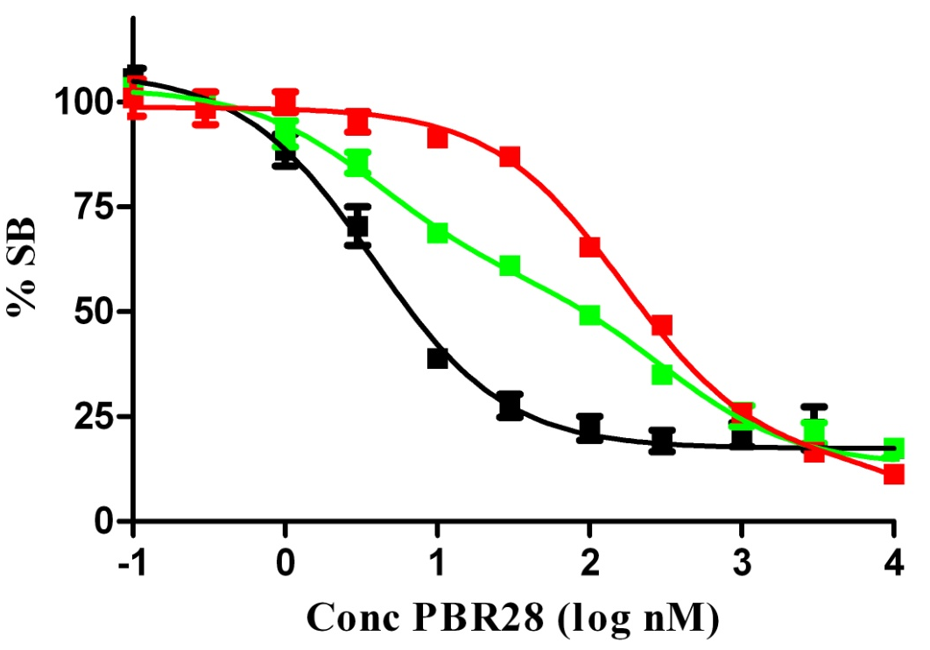
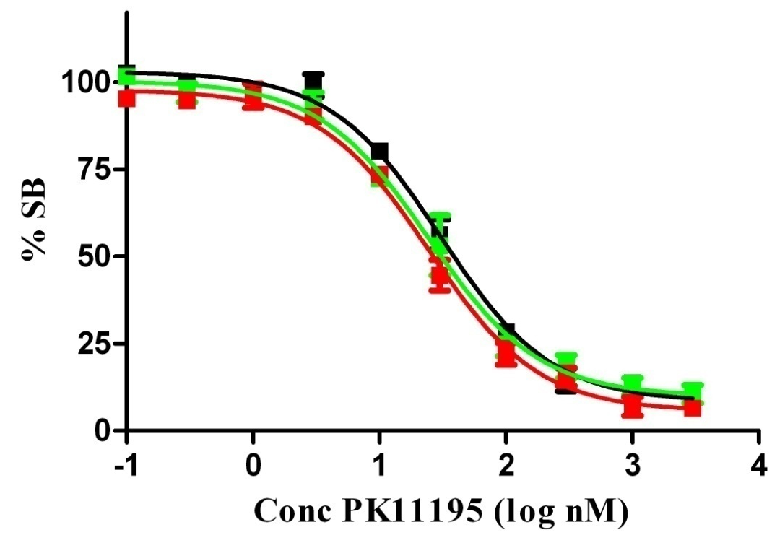
Three types of binders
Unlabelled PBR28 Unlabelled PK11195
HAB High affinity binder (n=6)
MAB Mixed affinity binder (n=4)
LAB Low affinity binder (n=5)

Slide 58
TSPO polymorphism
Ala147Thr
Genetic screen “responders”
  PET ligands
  Anxiolytic drugs
Functional significance

Slide 59
Hurdles to implementation
Physicians
  Education - number of variants growing
  Needs a laboratory test – inconvenience and associated costs
Regulators
  The level of evidence required to adopt a specific genetic test as a guide to practice is not established.
Pharmaceutical companies
  Dissects the market
Patients
  Suspicion and sensitivity to genetic testing

Slide 60
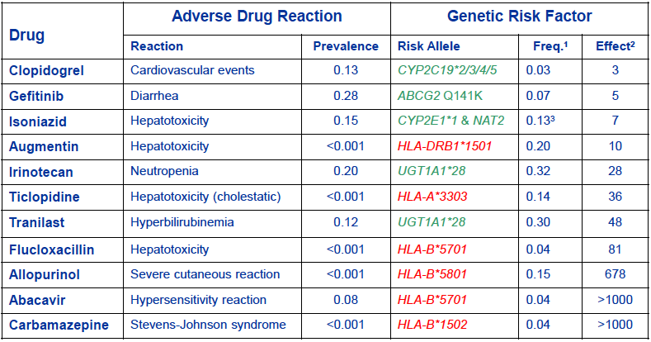
Pharmacogenomics and adverse events

Slide 61
Drugs with pharmacogenomic tests in label
Antiviral Abacavir HLA-B*5701
Miraviroc CCR5
Cardiology Warfarin 2Cp, VKCOR1
Neuropharm Carbemezepine HLA-B*1502
Oncology Trastuzumab HER2
Irotecan UGT1A*28
Azothioprine TMPT status
Gefitinib EGFR status
Cetuximab KRAS status
Panitumumab
Pain Codeine 2D6

Slide 62
Francis Collins
“The limiting factor right now is that oftentimes, if you are ready to write a prescription, you do not want to wait a week to find out the genotype before you decide whether you’ve got the right dose and the right drug. But if everybody’s DNA sequence is already in their medical record and it is simply a click of the mouse to find out all the information you need, then there is going to be a much lower barrier to beginning to incorporate that information into drug prescribing. If you have the evidence, it will be hard, I think, to say that this is not a good thing. And once you’ve got the sequence, it’s not going to be terribly expensive. And it should improve outcomes and reduce adverse events.”

Slide 63
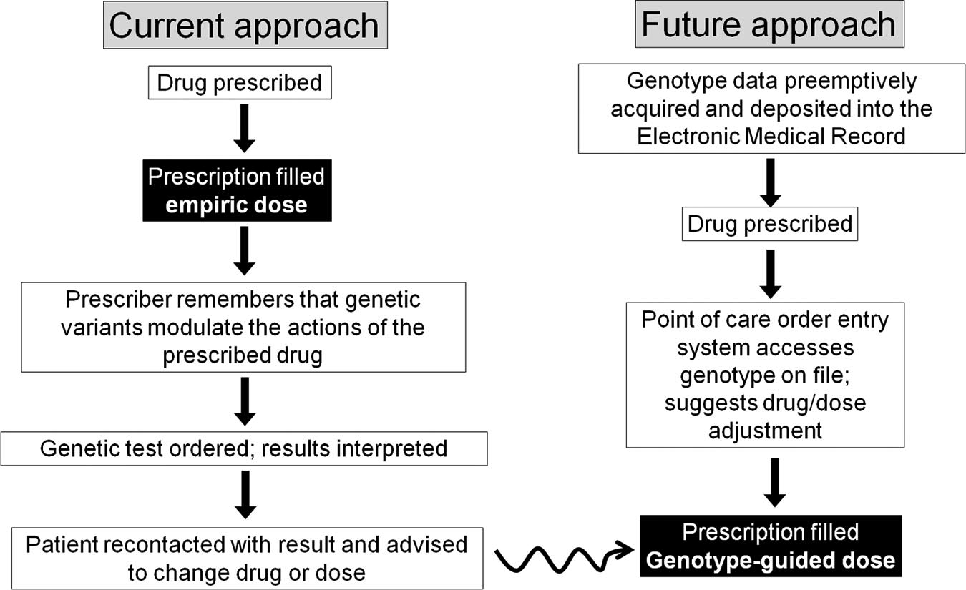
Current and future approachs

Slide 64
References
Roden et al Pharmacogenomics: The Genetics of Variable Drug Responses Circulation 2011; 123: 1661

