Slide 1
Macrophages in atherosclerosis
Joseph J Boyle

Slide 2
Learning Objectives
1. know the origins of macrophages in atherosclerotic plaques
2. know the functions of macrophages in atherosclerotic plaques
3. understand the differences between stable and unstable atherosclerotic plaques

Slide 3
Flow of lecture
Learning objectives
Unstable plaques
Increased macrophages
Reasons for increased macrophages
Effects of increased macrophages
Summary

Slide 4
Theories Of Atherogenesis
Mechanism Uncertain
Insudation Hypothesis (1852)
Thrombogenic Hypothesis (1852)
Response To Injury Hypothesis (1972)
Endothelial Dysfunction Hypothesis (1980)
Inflammation Hypothesis (1999)

Slide 5
Unstable plaques
Acute coronary syndromes
  myocardial infarction
  unstable angina
Structure
  large lipid cores
  thin fibrous cap
  Few vascular smooth muscle cells
  prominent inflammatory infiltrate with many macrophages

Slide 6
Plaque Rupture
Cause thrombosis
Exposes blood to macrophage debris in plaque centre
Macrophages rich in tissue factor - procoagulant
Collagen exposed

Slide 7
Plaques
Stable versus unstable.
Unstable plaques have more inflammation
Stable plaques
  cause chronic stable angina by progressive stenosis
  extreme (critical, >95%) narrowing, shear may provoke de-endothelialisation and acute coronary syndrome.

Slide 8
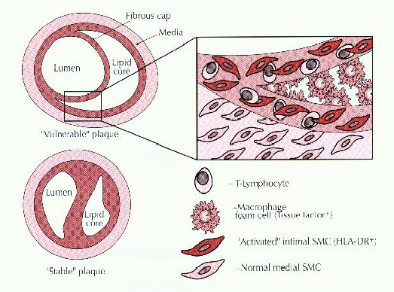
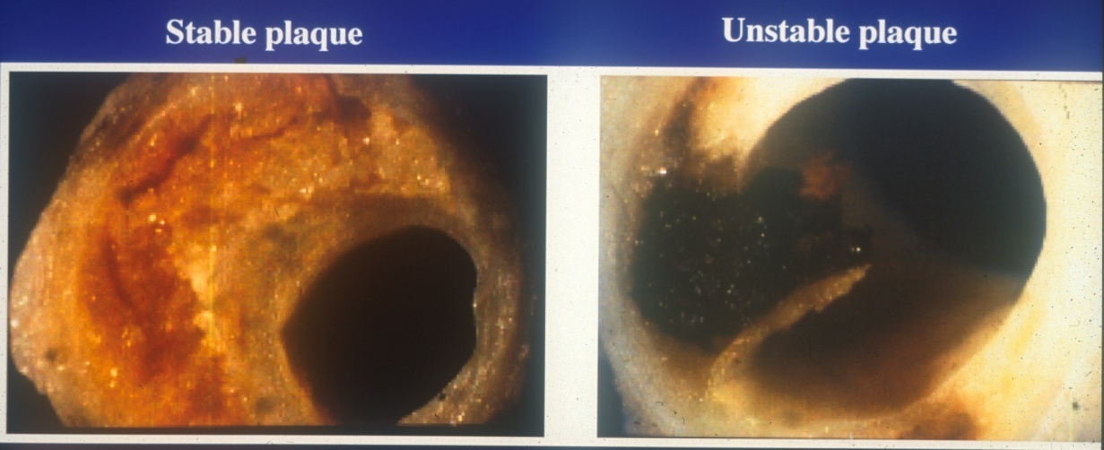
Characteristics of vulnerable and stable plaques

Slide 9
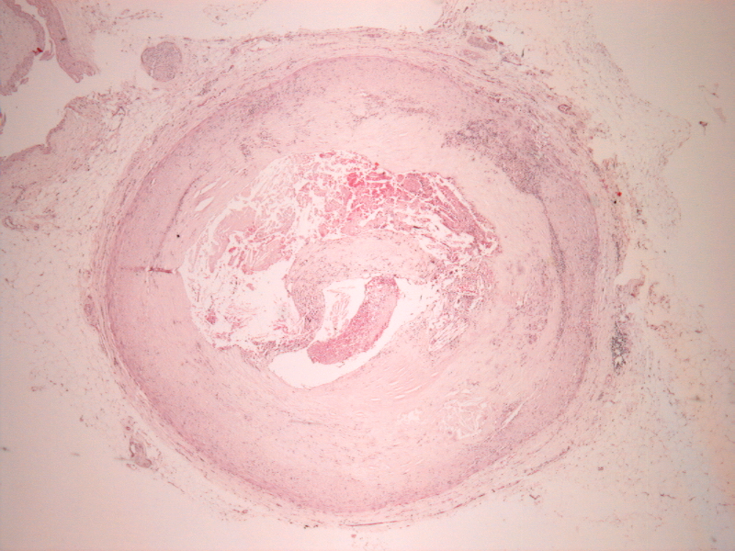
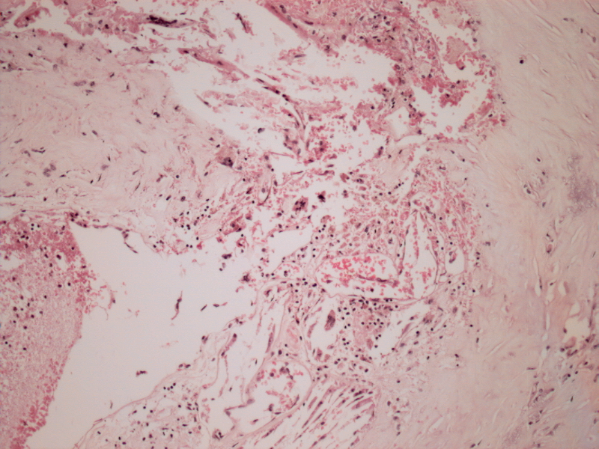
Fatal Coronary Plaque Ruptures (unstable plaques) are associated With Macrophage Inflammation
x4
x40
H&E – General stain
H&E – General stain
1mm
100μm
J.Pathol. 1997

Slide 10
Ruptured coronary plaques have more inflammation than controls
P<0.05
100
90
80
70
60
% of plaques with inflammation of superficial cap / shoulder
50
40
30
20
10
0
Coronary thrombosis (autopsy)
Control
(autopsy)
Severe IHD
(Cardiac explants)
Source of plaque

Slide 11
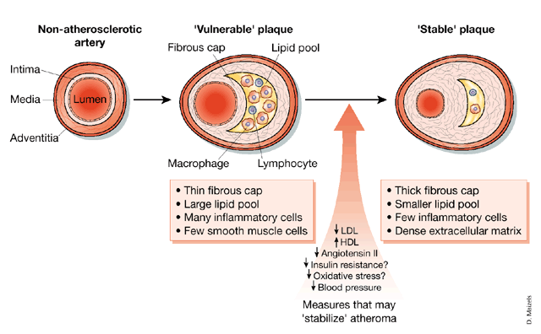

Slide 12
Questions
Why are there increased macrophages in atherosclerotic plaques ?
Are they doing anything to promote plaque rupture ?

Slide 13
Why ?

Slide 14
Hyperlipidaemia
LDL ‘bad guy’’ cholesterol rich
  Carries cholesterol from liver to tissues (including arteries)
Oxidised LDL dangerous version
  inflammation
  endothelial damage
  vascular smooth muscle cell death
HDL ‘good guy’
  reverse cholesterol transport
  Carries cholesterol from tissues (including arteries ) to liver
    Converted to bile acids
    Catabolised
    Downregulates its own synthesis (negative feedback)

Slide 15
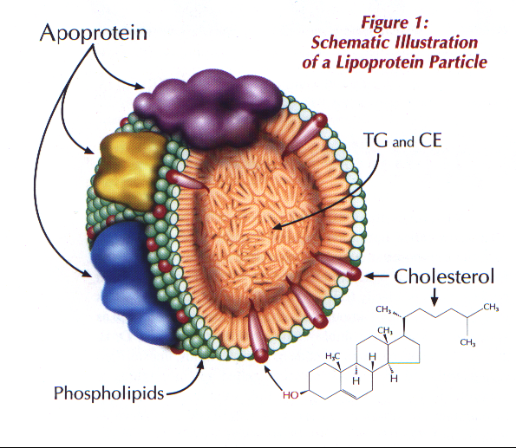
Low Density Lipoprotein

Slide 16
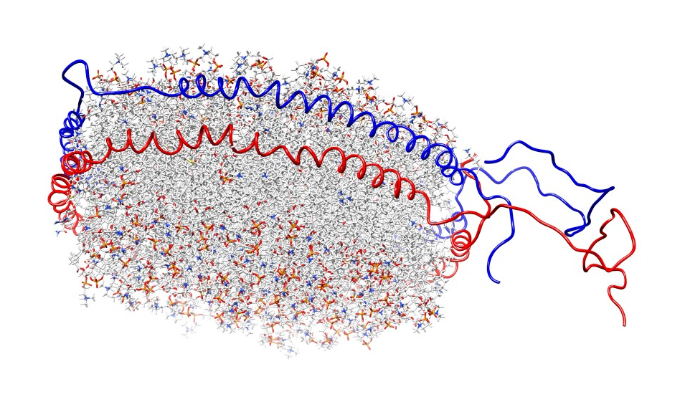
Lipoprotein structure (HDL)
Polar headgroups
Protein helices for structural integrity
Addressograph proteins for docking
Hydrophobic tails
Polar headgroups

Slide 17
LDL
  ApoE – docks to LDL-R
HDL
  ApoA – docks to ABC cholesterol exporter

Slide 18
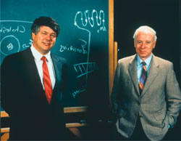
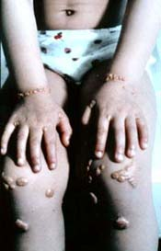
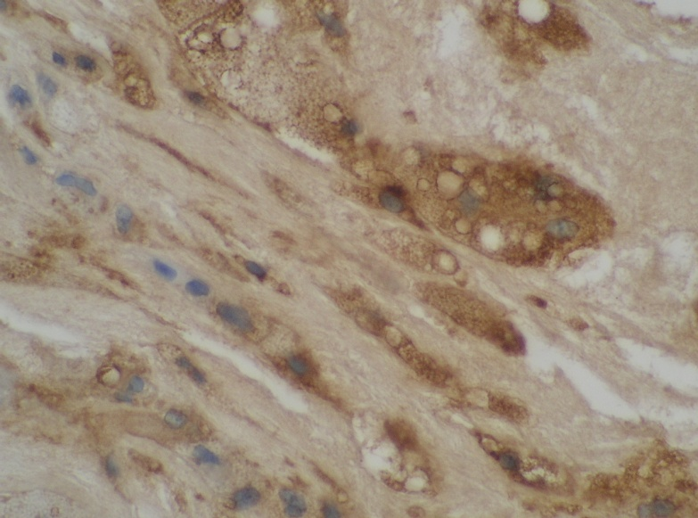
Brown & Goldstein
Lipidologists
Treating patients mostly children) with familial hypercholesterolaemia in 1970s
Genetic disease causing high LDL, severe atherosclerosis, fatal myocardial infarction in teens
Hunted for causative gene
Brown
Goldstein
Xanthoma
Foam cell

Slide 19
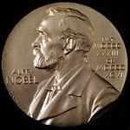

Brown & Goldstein
Gene encoded a receptor for LDL
Nobel Prize for Medicine 1985
LDLR mediates negative feedback control of cholesterol production
Proposed a second LDL receptor - not under feedback control - in atherosclerotic lesions
Called ‘scavenger’ since it hoovers up extra LDL
Actually a family of ‘scavenger receptors’ mainly in macrophages
X
?
LDLR

Slide 20
SREBP
HMGCoA reductase is the rate limiting step of cholesterol synthesis
Statins work by inhibiting HMGCoA reductase
SREBP sterol response element binding protein
SREBP are activated by low cholesterol
SREBP dock with enhancer element of selected genes – those that increase cholesterol
  hmgcr
  ldlr

Slide 21
SREBP - cholesterol feedback
SREBP – like a steroid hormone receptor but for liver cholesterol
Suppresses gene for HMGCoA reductase

Slide 22
Normal cholesterol homeostasis
Cholesterol synthesis r.l.s.
HMG-CoA reductase (hmgcr)
Acetate
Cholesterol
Cholesterol sufficiency
Cholesterol deficiency
SREBP
More HMG-CoA reductase
SCAP
SCAP
SREBP = sterol regulatory enhancer binding protein
SCAP = SREBP cytosol associated protein
Enhancer chromatin
SREBP
hmgcr

Slide 23
Feedback
Positive
Negative
A
B
A
B
Exponential tendency
Stabilising tendency

Slide 24
Liver
HMGCoA Reductase
Intracellular cholesterol
SREBP

Slide 25
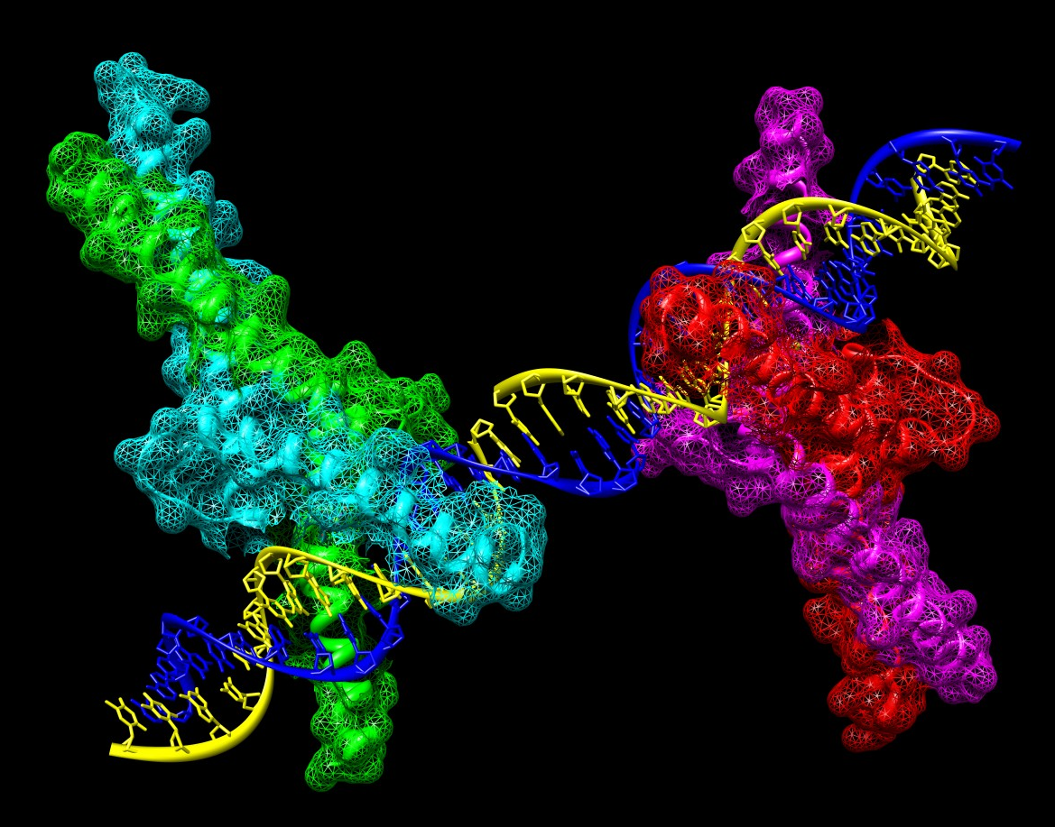

Slide 26
LDL Oxidation
Site unclear
  Extracellular matrix of intima
  Within activated macrophages
Large number of different forms, difficult to characterise precisely
  POVPC
  HNE-Lysyl
Phagocytosed by macrophages
  Generates Foam cells
  Via Scavenger receptors MSRA, CD36 and others
  CD36 → PPAR-gamma (via PGJ2) → gene transcription

Slide 27
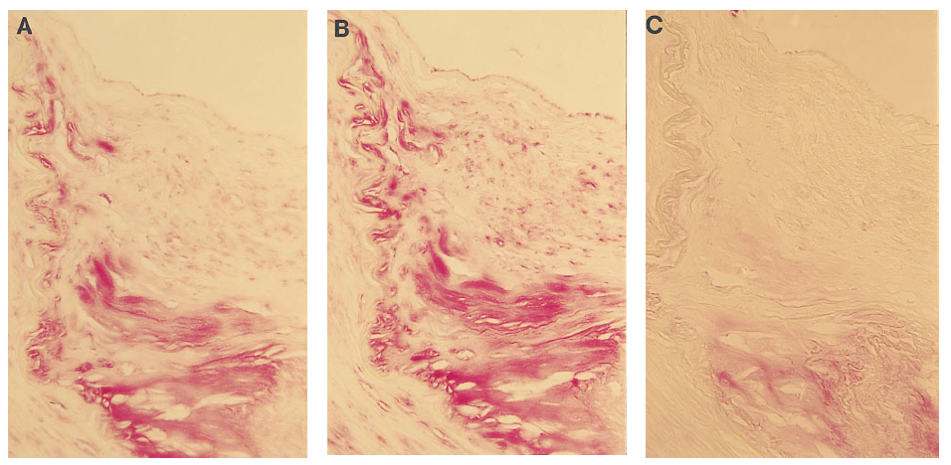
Oxidised LDL – human plaques
Immunohistochemistry detects oxidised LDL in plaques – associated with macrophages
Dye
Oxidised LDL – rabbit plaques

Slide 28
How ?

Slide 29
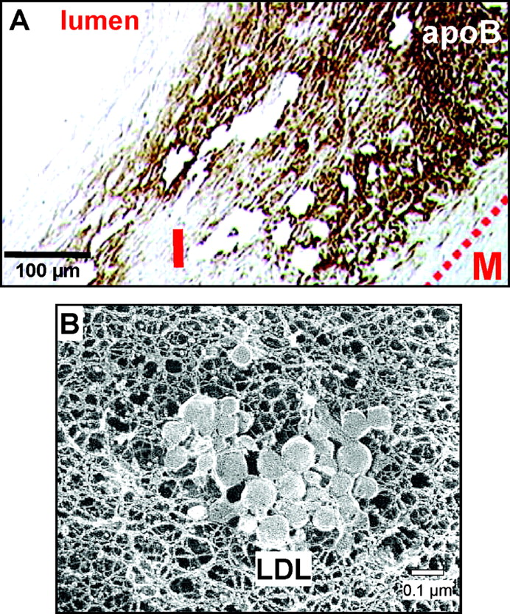


ApoB lipoproteins retained in the intima
Tabas, I. et al. Circulation 2007;116:1832-1844
Copyright ©2007 American Heart Association

Slide 30
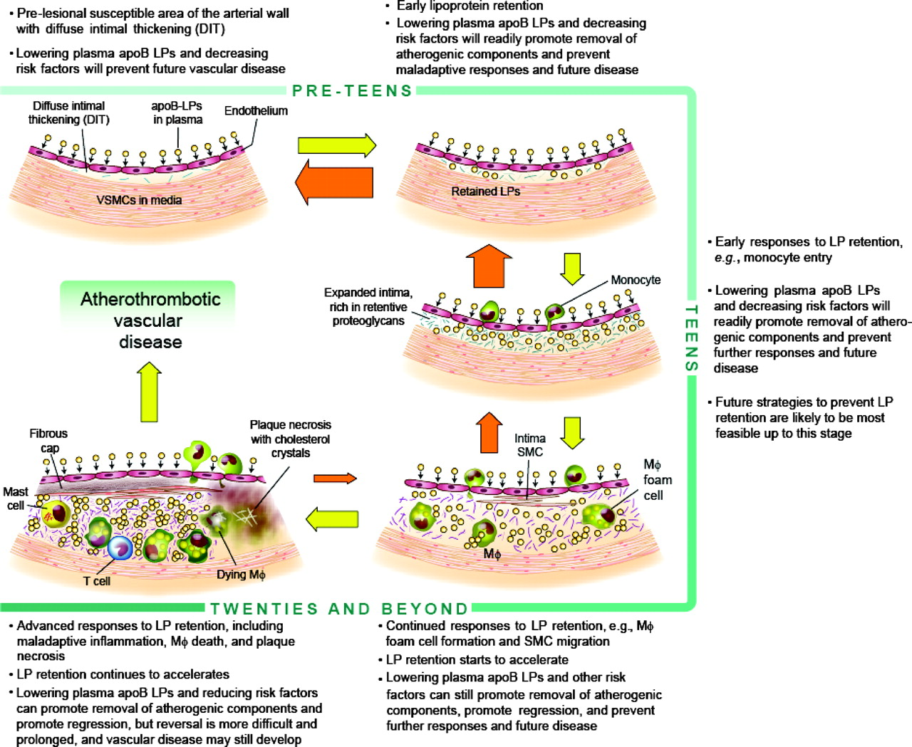
Therapeutic implications of the Response-to-Retention model of atherogenesis
Tabas, I. et al. Circulation 2007;116:1832-1844
Copyright ©2007 American Heart Association

Slide 31
Origins of macrophages in atherosclerotic plaques
From peripheral blood monocytes
  bind to endothelium
  emigrate into plaque
  differentiate to macrophages
Differentiation accompanied by shape change and altered transcriptome
  Monocyte-macrophage transcriptome change dominated by genes regulated by transcription factor NFκB
Mice with reduced Mice with knockouts for
  VCAM-1 monocyte chemoattractant protein-1 (MCP-1) or
  MCP-1 receptor
  reduced atherosclerosis and reduced plaque macrophages
Endothelium as portal
  Early plaques – arterial endothelium
  Advanced plaques – capillary endothelium
  Exit also → plaque resolution

Slide 32
Plaque macrophages
Recruited as monocytes (MCP-1)
Monocytes adhere to endothelium (VCAM-1)
Monocytes transmigrate through endothelium
Monocytes differentiate to macrophages

Slide 33
Monocyte-macrophage differentiation occurs after transendothelial migration
The macrophage foam cell as a target for therapeutic intervention
Andrew C. Li & Christopher K. Glass Nature Medicine 8, 1235 - 1242 (2002)

Slide 34
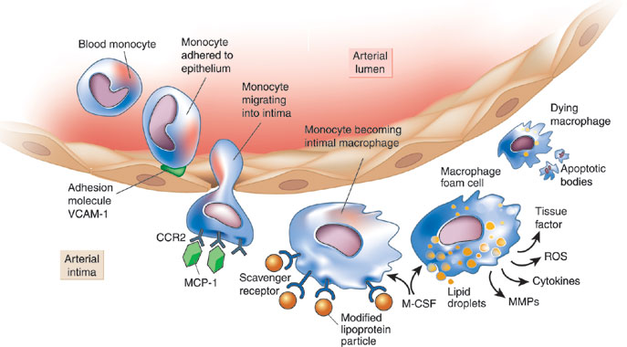
Cartoon of macrophages in atherosclerosis
P. Libby, Nature 2002

Slide 35
What do plaque macrophages do ?

Slide 36
Macrophage functions
Monocytes differentiate to macrophages and foam cells
  oxidise / modify lipoproteins
  phagocytose modified lipoproteins
  activated by modified lipoproteins
  may help export lipoproteins back out of the plaque
Degrade collagen
die by apoptosis
secrete growth factors
secrete inflammatory mediators
secrete pro-apoptotic molecules

Slide 37
Conceptual overview of macrophages
Clearance
Tissue bystander damage but bacteriocidal
Tissue Repair

Slide 38
Atherosclerosis involves inappropriate activation of wound-healing programs
After a wound (e.g. dog bite), priorities are:
  Hemostasis
  Asepsis
  Debris clearance
  Encouragement of new growth

Slide 39
Asepsis
Pathogen sensors
Activated by non-self lipids
Cross-activated by OxLDL
Stimulate macrophage respiratory burst
Further oxidises LDL
Vicious cycle

Slide 40
Scavenger receptors evolved to deal with bacteria
Inflammatory cells have a series of rapid response receptors for pathogens
Bacteria can rapidly evolve mutated proteins
Bacteria cannot rapidly evolve new lipids
Pathogen pattern recognition receptors (PRRs) largely recognise lipids because bacteria cannot change these
These do not bind to self-lipids, but do bind to most others
Modified self-lipids also bind to scavenger receptors

Slide 41
Binding patterns – specific scavenger receptors /PRRS
MSRA (CD204)
  Cu-Ox-LDL
  Acetylated-LDL
  Gram-positive organisms
MSRB (CD36)
  HOCL-modified LDL
  Peroxynitrite-modified LDL
  Not acetylated LDL
TLR4 / CD14
  Gram negative lipopolysaccharide
  May bind to some oxidised lipids and promote atherosclerosis

Slide 42
Hemostasis
Normal – cessation of blood loss from wound
Abnormal - Plaque rupture and thrombosis
  Tissue factor (activates thrombin)
  Collagen (activates platelets)
  Plaque stepwise growth by recruitment of thrombi

Slide 43
Macrophages have oxidative enzymes
NADPH Oxidase
  superoxide O₂⁻ ·
  Other (ROS) derived from superoxide
  → hydrogen peroxide H₂O₂
Inducible nitric oxide synthase (iNOS)
  High concentrations of free radical NO nitric oxide
Myeloperoxidase
  HOCl hypochlorous acid (bleach) from ROS + Cl⁻
  HONOO Peroxynitrite (NO-adduct) from ROS + NO

Slide 44
Generation of reactive oxygen and nitrogen species (RONS) cascade
Inflammatory stimuli
iNOS
HONOO⁻.
NO.
Phox
SOD
MPO
O₂
O₂⁻.
H₂O₂
HOCl
Fe²⁺
·OH
Catalase
H₂O + O₂
Safe
Highly sterilising but highly damaging
Intermediate

Slide 45
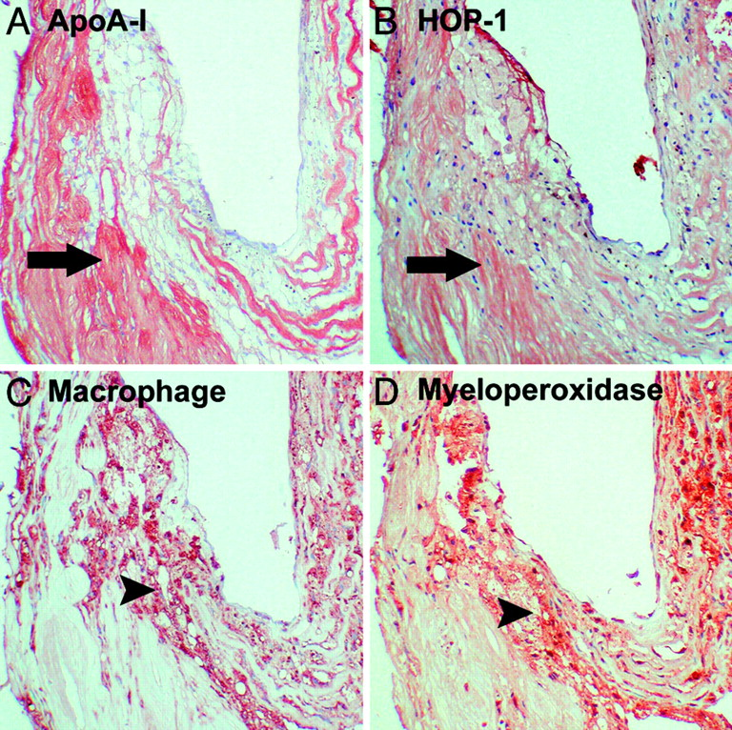
Macrophage-mediated oxidfative damage in atherosclerosis
Bergt C. et.al. PNAS 2004;101:13032-13037
Immunohistochemical analysis of apoA-I, MPO, and proteins modified by HOCl in human atherosclerotic intima
©2004 by National Academy of Sciences
Notes:
Immunohistochemical analysis of apoA-I, MPO, and proteins modified by HOCl in human atherosclerotic intima. Photomicrographs of adjacent sections of an atherosclerotic coronary artery demonstrating immunostaining for apoA-I (A), proteins modified by HOCl (B), macrophages (C), and MPO (D) are shown. Positive immunohistochemical staining is indicated by a red reaction product. HOCl-modified epitopes colocalize with extracellular apoA-I (A and B, arrows), whereas MPO staining is primarily associated with macrophages (C and D, arrowheads). Original magnification, ×100; hematoxylin counterstain.

Slide 46
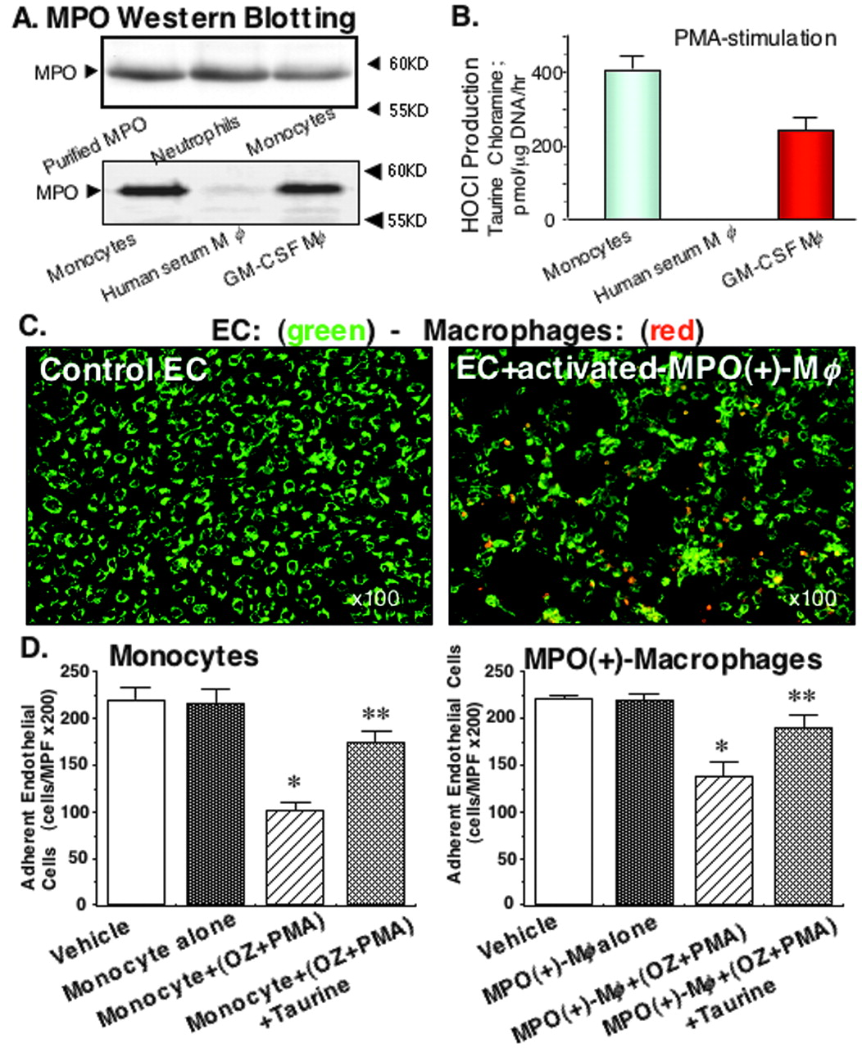

A, Western blotting of MPO in human neutrophils (upper middle lane), fresh monocytes (upper right and lower left lane), human serum-treated macrophages (M{phi}, lower middle lane), and GM-CSF-treated macrophages (M{phi}, lower right lane)
Sugiyama, S. et al. Arterioscler Thromb Vasc Biol 2004;24:1309-1314
Copyright ©2004 American Heart Association

Slide 47
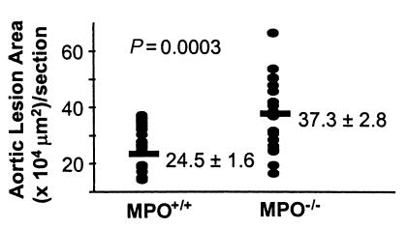
Unexpected result – MPO is protective for atherosclerosis in mice

Slide 48
Macrophages - Clearance
Pathogens
  Pathogen pattern recognition receptors
Oxidised lipoproteins
  Macrophage scavenger receptor A
  CD36
Apoptotic (dead) cells
  Phosphatidylserine receptor
Haemoglobin
  CD163

Slide 49
Clearance
Scavenger receptors
MSR-A (CD204)
MSR-B CD36 (CD36)
MSR-J (CD163)
Phosphatidylserine receptor

Slide 50
Macrophage scavenger receptors
Bind modified forms of LDL e.g. Oxidised LDL
Also bind LDL modified by several other forms of modification –
  NO-modification
  HOCl-modification,
  enzymatic removal of sugars
  partial proteolytic digestion
May stimulate macrophages
Via PGJ2 ligation of transcription factor peroxisome proleration activation receptor (PPARγ)
High uptake pathway → foam cells

Slide 51
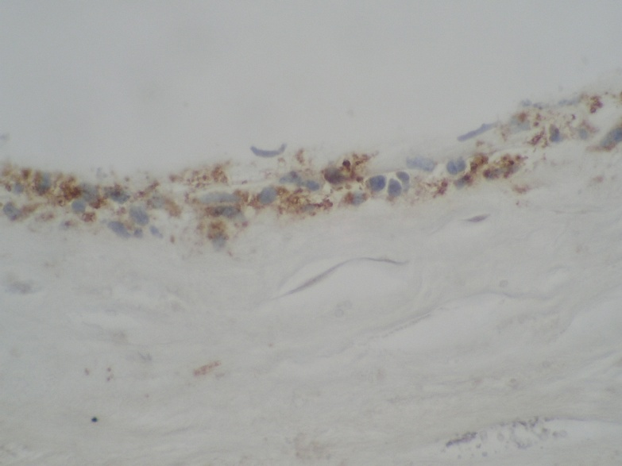
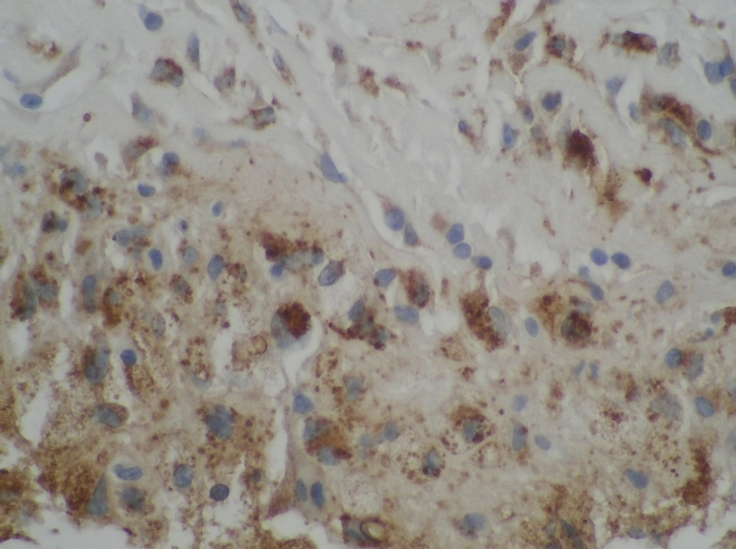
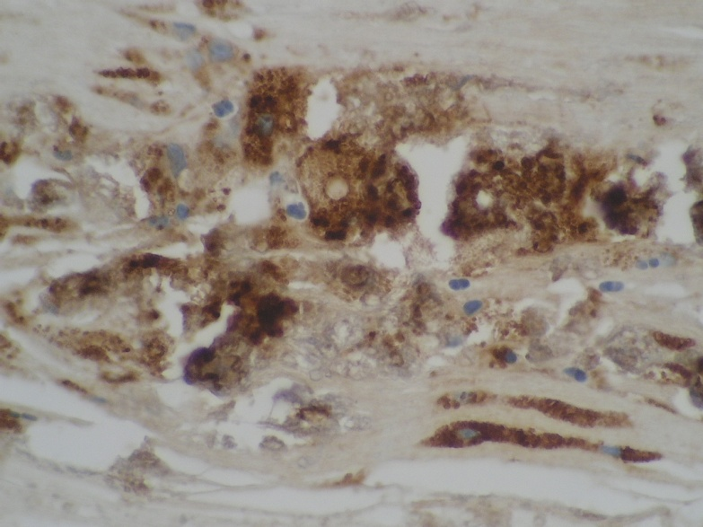
Plaque monocytes eat cholesterol and become macrophages and foam cells
All - CD68 monocyte macrophage marker
100μm
100μm
100μm
100μm

Slide 52
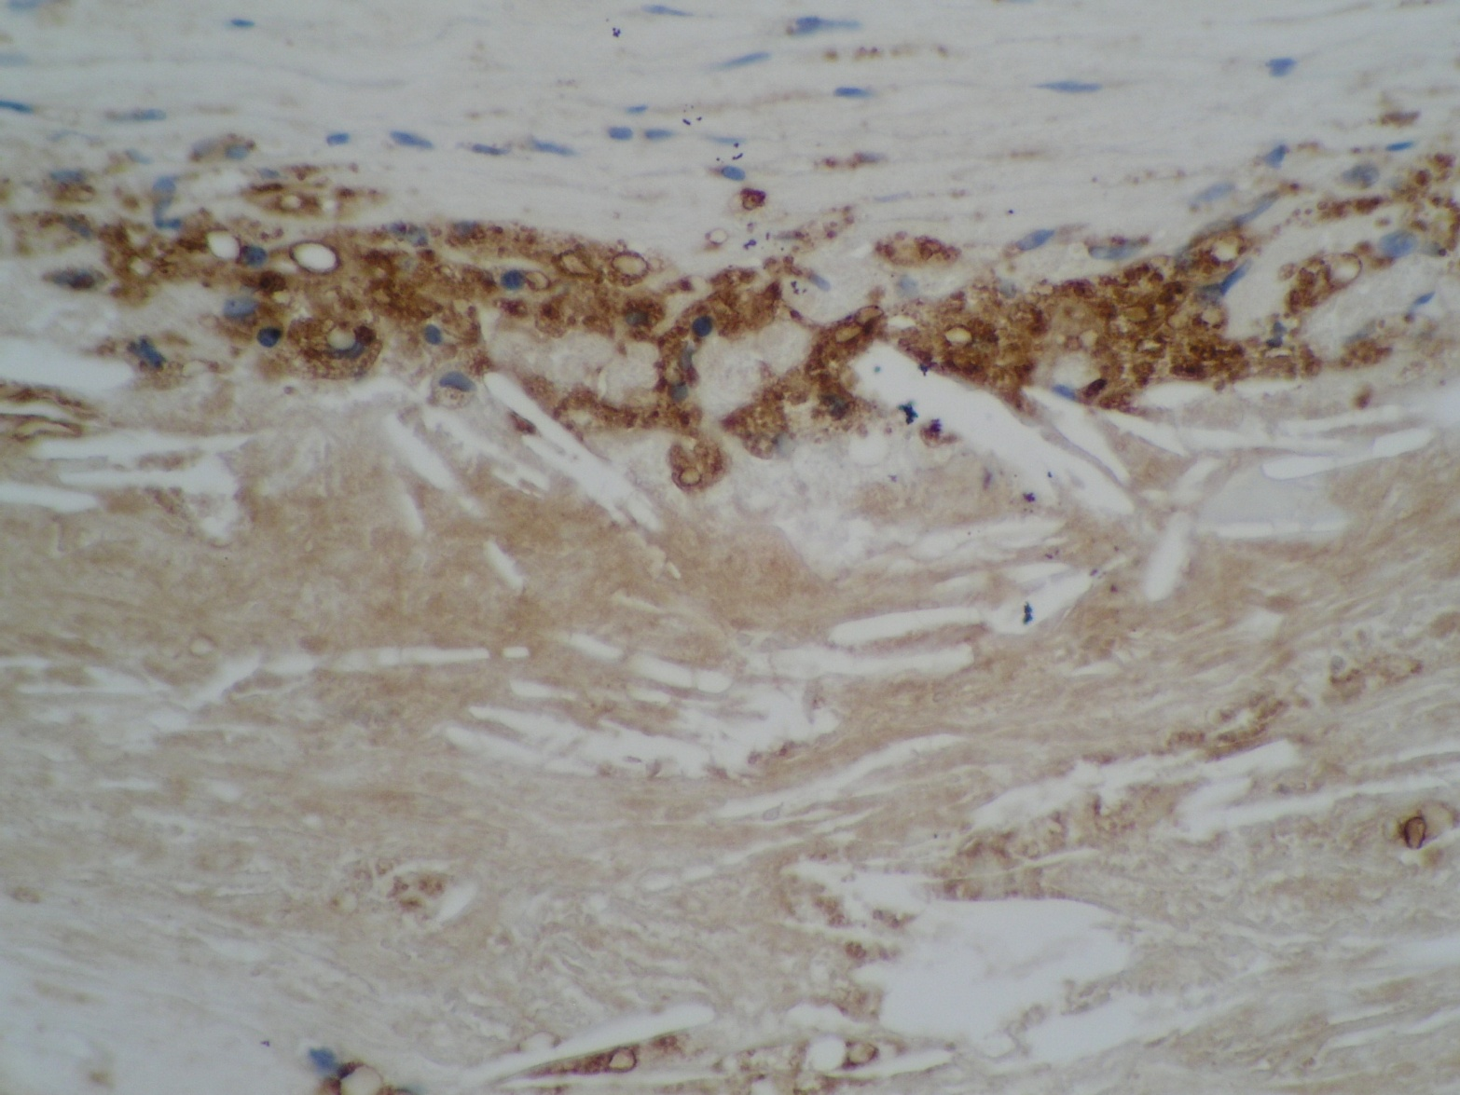
Macrophages surround areas of free cholesterol in atherosclerosis
CD68 Macrophage Molecule = Brown
Mac
Cholesterol
Crystal

Slide 53
Molecular mechanisms in foam cell activation
Scavenger receptors
Cholesterol overload
Oxysterols
Oxidised fatty acids
Phagocytosis Lysosomal degradation
Pathogen sensing signals (False alarm )
Nuclear receptors
LXR PPARγ
Kinases

Slide 54
ABCA1 and ABCG1 transporters
Cholesterol membrane pumps
ATP-driven
Dock with HDL
Upregulated by cholesterol overload

Slide 55
ABCA and ABCG transporters
Liver
ABCA
ABCG
cholesterol

Slide 56
Oxidised forms of cholesterol are toxic and inflammatory
24,25 epoxy-
Cholesterol
ROS
5,6 epoxy-
7-keto-

Slide 57
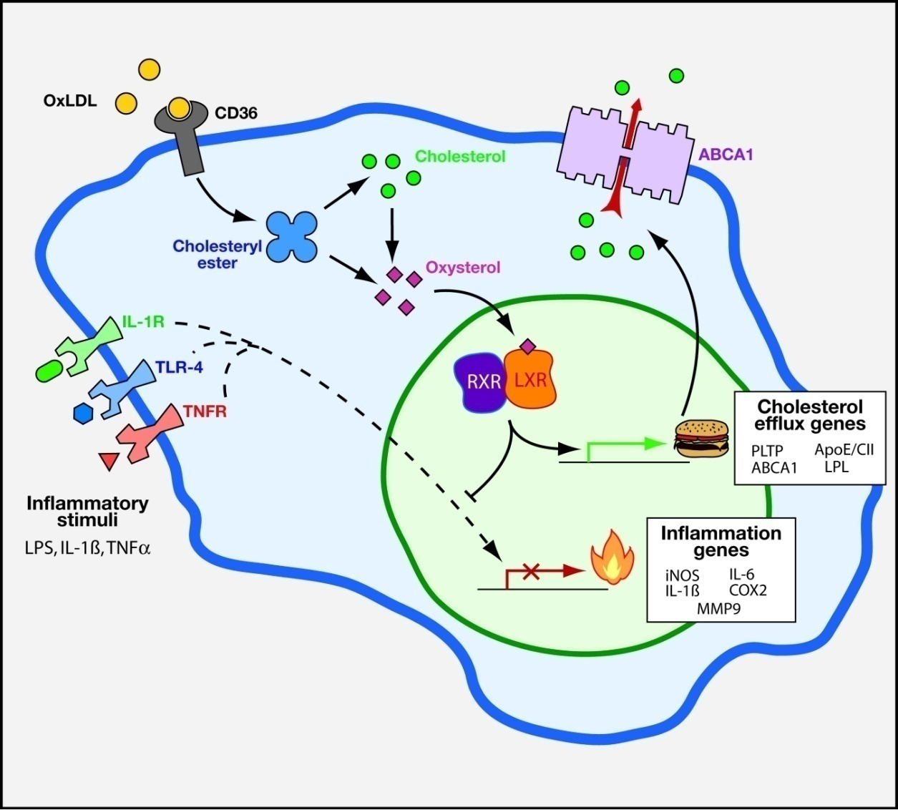
Cartoon of nuclear receptors in macrophages in atherosclerosis

Slide 58
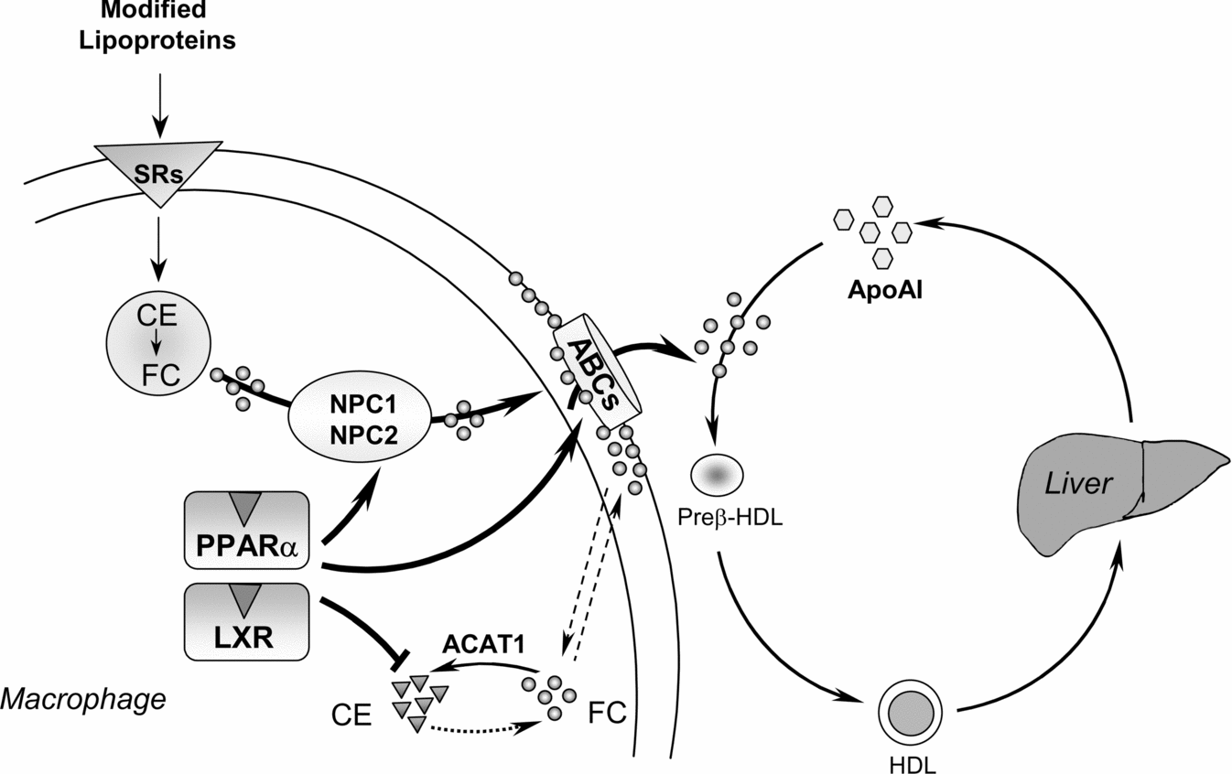
Role of PPAR[alpha] and LXRs in macrophage cholesterol trafficking
Biochemical Society Transactions www.biochemsoctrans.org Biochem. Soc. Trans. (2006) 34, 1128-1131

Slide 59
Foam cell formation requires positive feedback via PPAR-γ
OxLDL phagocytosis
Intracellular PGJ2
CD36
Activates PPARγ

Slide 60
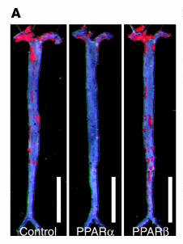
PPARs control atherosclerosis

Slide 61
Macrophages - Tissue Repair
Platelet derived growth factor
  Vascular smooth muscle cell survival and cell division
Fibroblast growth factor
  Smooth muscle cells survival, cell division
Transforming growth factor beta
  Increased collagen synthesis
Vascular endothelial growth factor
  New capillary formation

Slide 62
Macrophage growth factors
Vascular endothelial growth factor (VEGF)
Platelet derived growth factor (PDGF)
Fibroblast growth factor (FGF)
Platelet derived endothelial cell growth factor (PDECGF) ⇒ angiogenic
Transforming growth factor-beta (TGF-β)

Slide 63
PDGF
Platelet derived growth factor
PDGF AA, AB, BB dimers
Secreted by macrophages
Macrophages secrete Il-1 which triggers PDGF release from VSMCs
PDGF activates transmembrane tyrosyl kinase receptors (classical growth factor receptor) activating phospholipase-C gamma and phosphoinositide-3-kinase
Potent chemoattractant for VSMCs
mitogen, stimulates matrix synthesis, survival factor,

Slide 64
Macrophages
Recruitment requires Monocyte chemotactic factor 1 (MCP-1) (a chemokine)
Endothelial Attachment [intercellular adhesion molecule-1 (ICAM-1) and vascular adhesion molecule (VCAM-1) for adhesion]
Transendothelial migration – has an effect on monocyte-macrophage differentiation itself

Slide 65
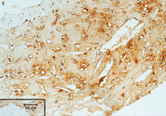
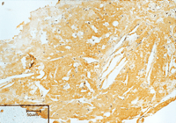
Plaque macrophages regulate coagulation
Intrinsic (Hageman) and Extrinsic (Tissue Factor) pathways
Macrophages are a rich source of tissue factor, which activates the tissue factor pathway in plaque rupture
CD40L activates macrophage CD40 upregulating Tissue Factor
CD40L – TNF homologue
CD40 – TNFR homologue
CD68
Tissue Factor
Moreno et.al. Circulation 1996

Slide 66
Matrix Lysis

Slide 67
Macrophage-induced VSMC apoptosis
VSMC apoptosis is increased in atherosclerotic plaques
Fewer VSMCs in ruptured than unruptured plaques
VSMCs are the main cell type that synthesise collagen in plaques
TNF-α, IFN-γ, IL-1 in synergistic combination induce VSMC apoptosis
Do macrophages induce VSMC apoptosis ?

Slide 68
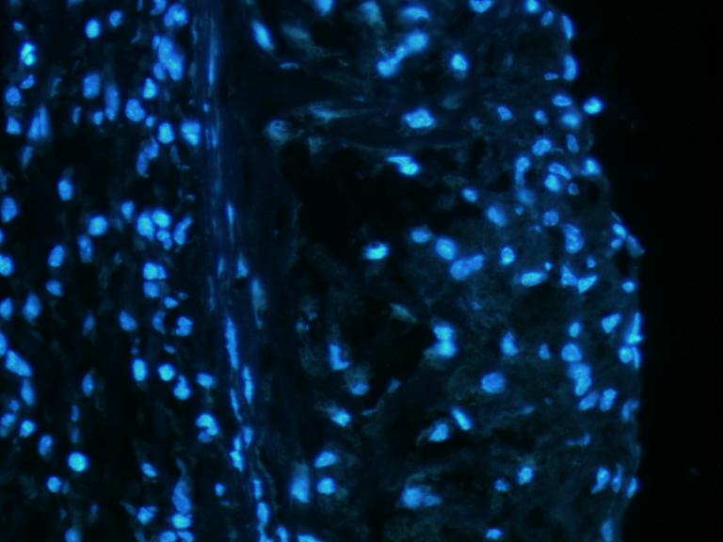
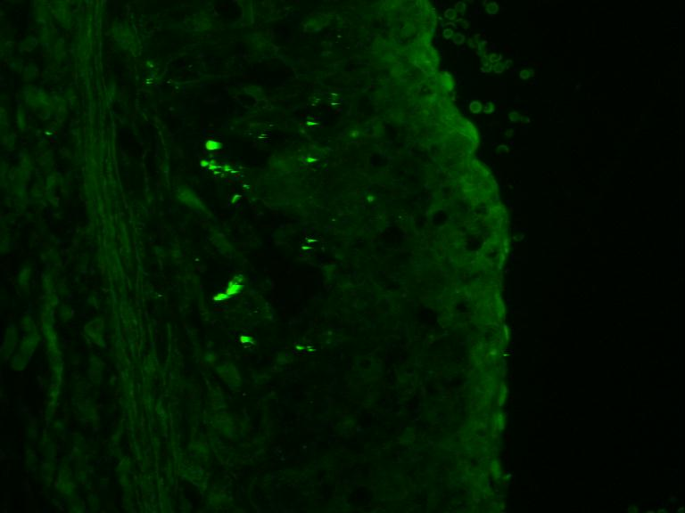
Macrophages die in plaques by a regulated process called apoptosis
Blue = nuclei
Green = dead cells with cleaved DNA (TUNEL)
Contributes to necrotic core formation
Liberates scavenged oxidised cholesterol in free form
Generates free tissue factor

Slide 69
Macrophages interact with T-lymphocytes in atherosclerosis
+
T_{h1}
Mφ
+
-
T_{reg}
Mφ
?-

Slide 70
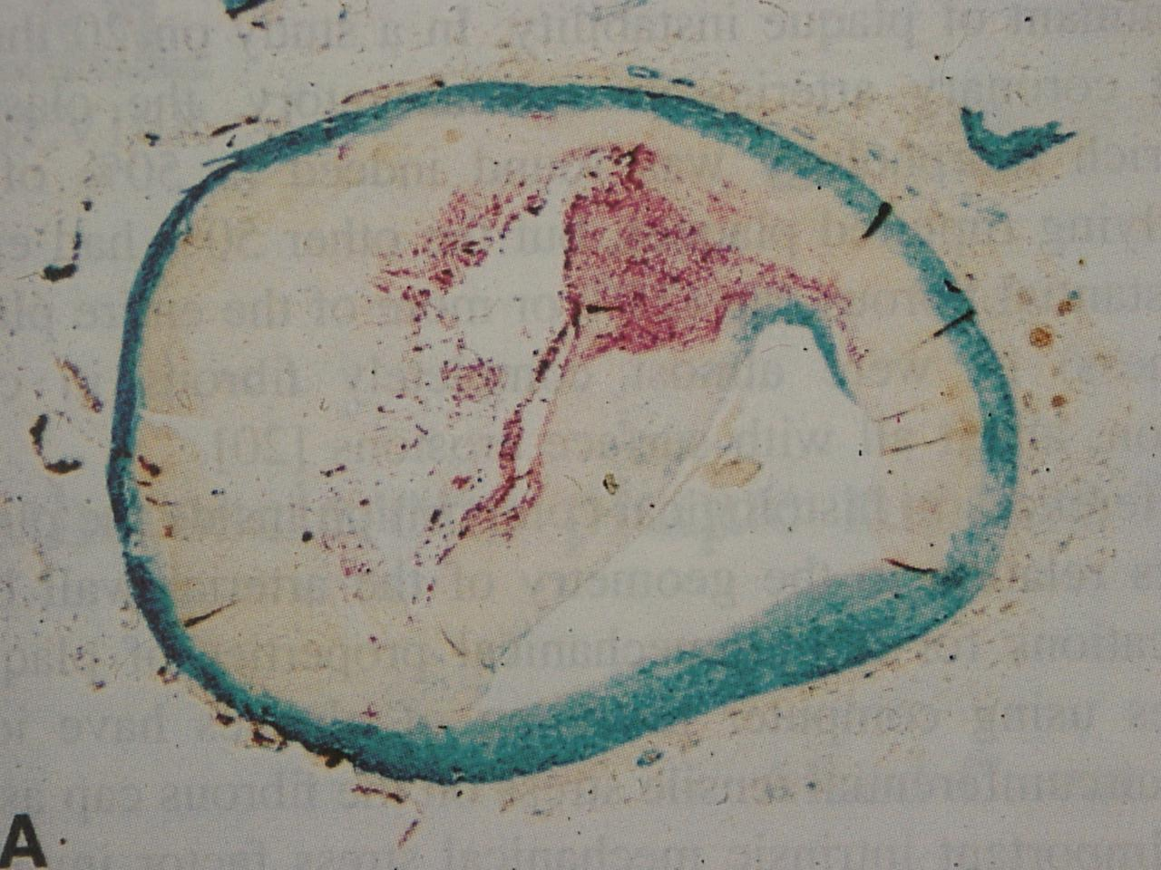
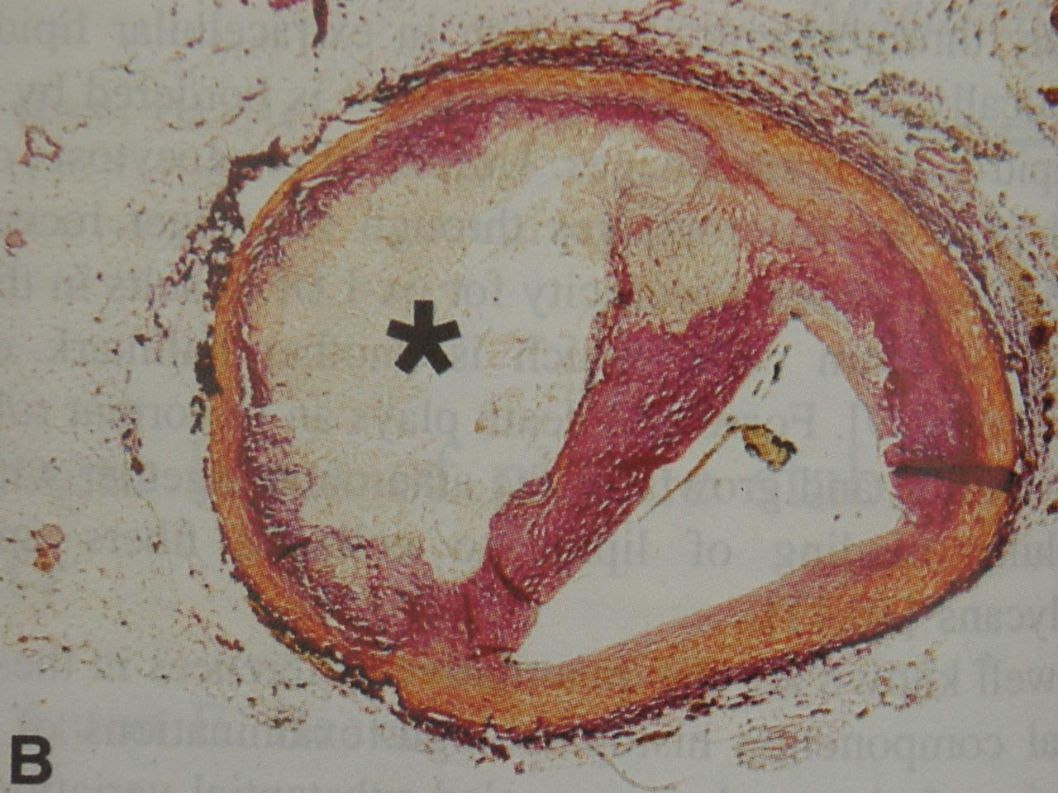
Macrophage Collagenolysis
Macrophages
Collagen
Van der Wal et al 1999 Cardiovascular Research 41:334

Slide 71
Macrophage Collagenases
Matrix metalloproteases
  MMP-1
  MMP-2
  MMP-9
  MMP-14
MMP-1, MMP-2, MMP-9 cleave collagen
Inhibited by TIMPs
TIMP-1 overexpression reduces atherosclerotic tissue weakening
Catalytic site contains Zn
Activate each other by proteolysis
MT-MMPs are transmembrane proteins that activate other MMPs

Slide 72
Matrix metalloproteinases
Matrix metalloproteinases
Family of homologous Zn-based proteases
Cascade : each member can be proteolytically activated by other MMPs
Cascade top (regulator): membrane-type metalloproteinase (MT-MMP) MMP-14
Collagenases (effector): MMP-1, MMP-3, MMP-9
Tissue inhibitors of matrix metalloproteinases
  (TIMPS)
  family of endogenous inhibitors
  Safety system

Slide 73
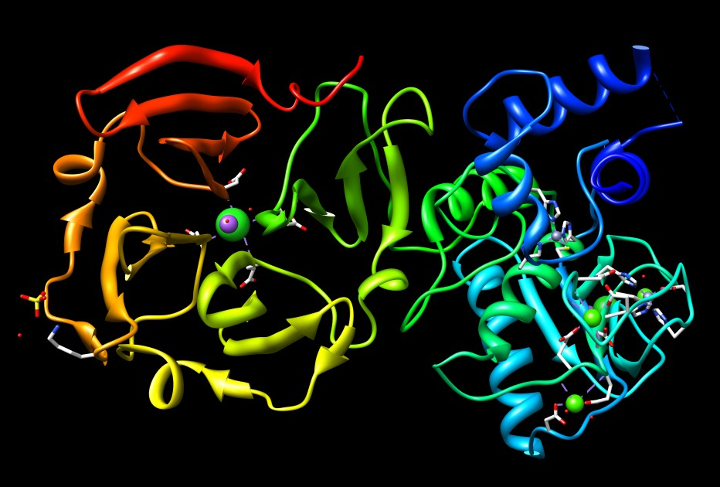
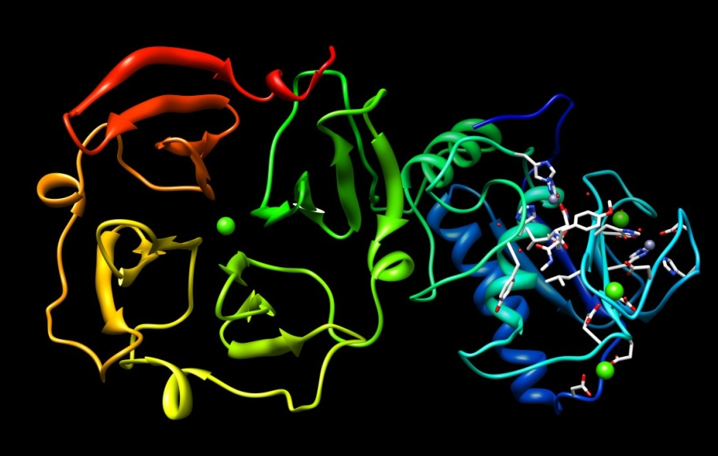
Collagenase (MMP-1) activation

Slide 74
Plaque macrophages drive a MMP cascade
MMP14
MT1-MMP
MMP1
MMP3
MMP9

Slide 75
Evidence for role of MMPs
It is possible to delete single genes from mice to examine their function in disease in vivo (knockout mice)
Ldlr knockout mice – familial hypercholesterolaemia
Apoe knockout – loss of LDLR ligand – related phenotype
Ldlr and Apoe models have more collagen in plaques (stronger and less rupture-prone) if also knockout for:
  Mmp14
  Mmp13
  Mmp9
Timp1 overexpressing mice – also more collagen in plaques (stronger and less rupture-prone)
Caveat : people are different to mice
Drug companies are now developing pharmacological inhibitors

Slide 76
Summary
1. macrophages in atherosclerotic plaques are from monocytes via endothelium
2. macrophages in atherosclerotic plaques lyse matrix via MMPs, secrete free radicals, oxidise LDL, are activated by oxidised LDL, phagocytose, release growth factors, express tissue factor and kill other cells
3. unstable atherosclerotic plaques are rupture-prone and contain increased macrophages

Slide 77
How (we think at the moment) a foam cell works

Slide 78
Response to cholesterol overload
Occupation of low-affinity cholesterol receptors
  Shuts down cholesterol synthesis
  Shuts down LDL-receptors
  Increases cholesterol efflux
  Reduces inflammation
Stress response to stiffened endoplasmic reticulum
If this fails, the cell dies

Slide 79
PPARγ-CD36 positive feedback loop
PPARγ-CD36 positive feedback loop drives foam cell formation
CD36 admits oxLDL in to the cell
Phagocytosed oxLDL is molecularly dismembered in the lysosome
Releases oxidised fatty acyl tails
One is prostaglandin J2 (PGJ2)
PGJ2 binds to and actiavtes PPARγ
PPARγ upregulates CD36
This increases OxLDL entry

Slide 80
LXRs in macrophages in atherosclerosis
Figure 1 Role of PPAR[alpha] and LXRs in macrophage cholesterol trafficking
Biochemical Society Transactions www.biochemsoctrans.org Biochem. Soc. Trans. (2006) 34, 1128-1131

