Slide 1
Mechanotransductive pathways induce vulnerable plaque
Rob Krams
Department of Bioengineering

Slide 2
Overview
Background
Pilot work
Current work

Slide 3
Background: Why are we interested in mechanotransduction
Atherosclerosis has the largest mortality in the Western World (~36% mortality).
In the UK this accounts for ~200.000 deaths per annum
And an expenditure of £1.7 billion pounds per year.

Slide 4
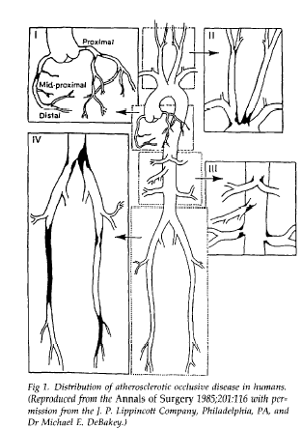
Background: Why are we interested in mechanotransduction
However, plaques are not evenly distributed over the arterial system
These predilection sites are:
  Curved vessels
  Side branches
  Bifurcations
From DeBackey et al.

Slide 5
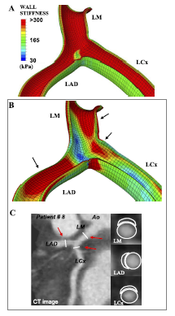
Background: Differences in endothelial stress/strain may also important

Slide 6
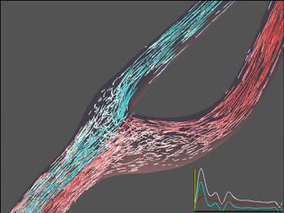
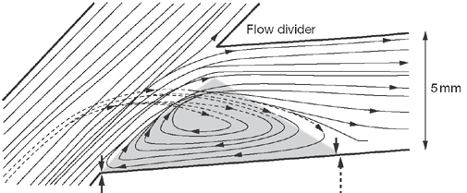
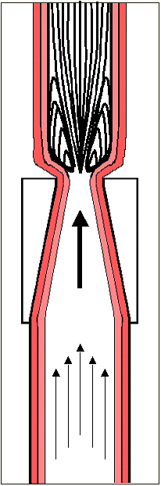
Background: Blood flow might underlie predilection sites
Peter Davies et.al. 2007
David Steinman
Caroline Cheng et.al. 2005
Notes:
Definition of SS

Slide 7
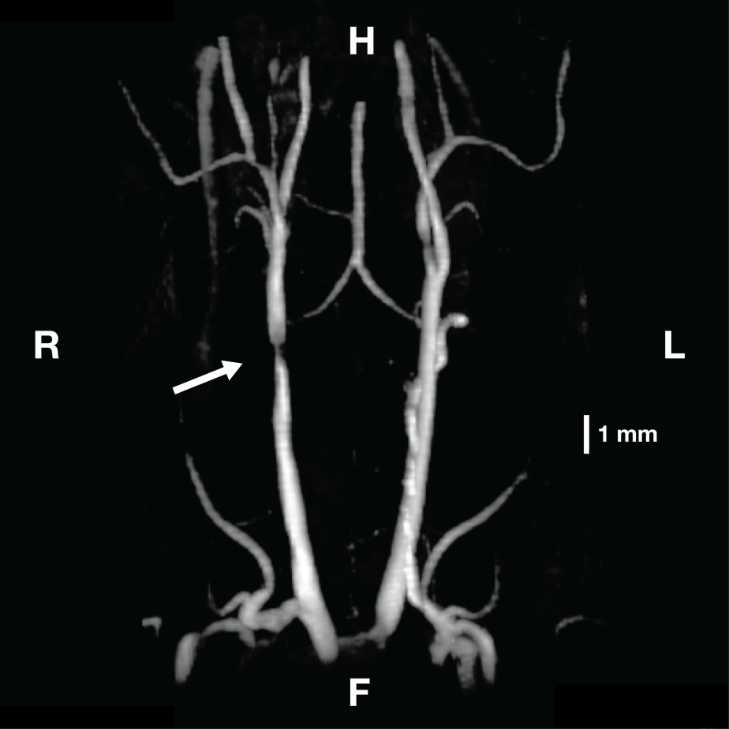
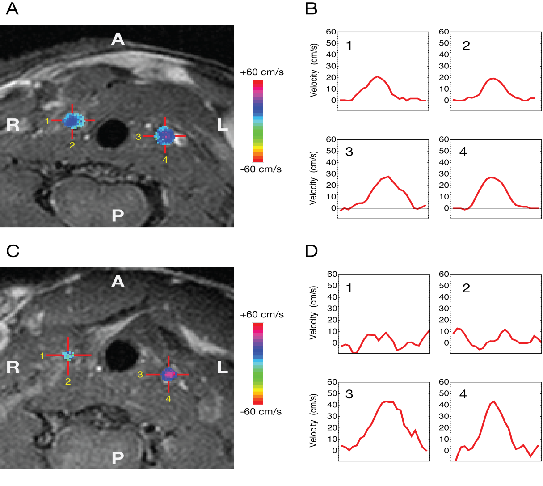
Validation with micro-MRI measurements
Figure 3
Van der Boechove et.al.MAGMA. 2010:77-84.

Slide 8
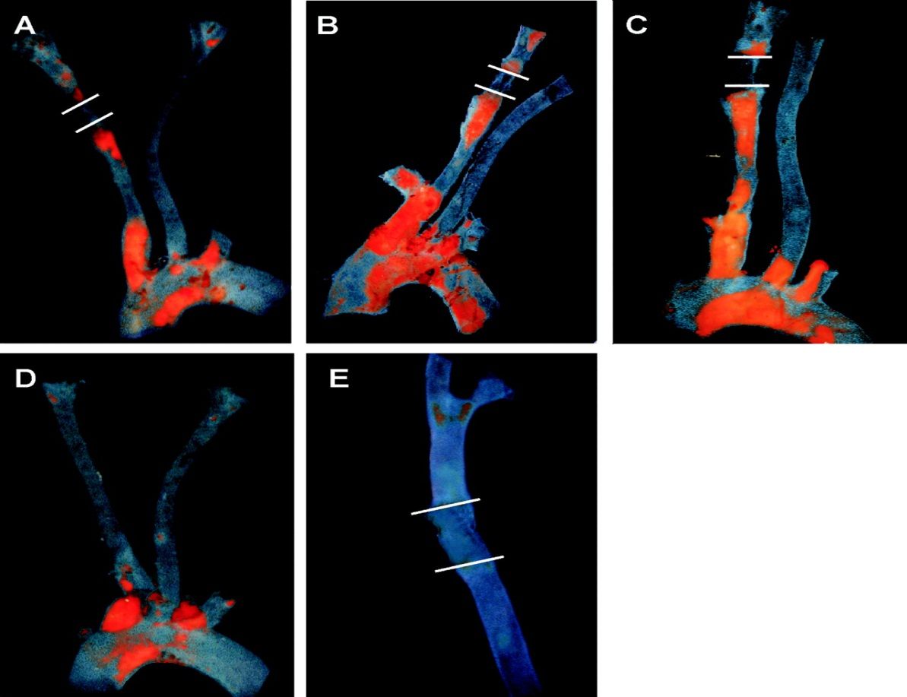

Lowered shear stress and vortices with oscillatory shear stress induce atherosclerosis.
Cheng C et al. Circulation 2006;113:2744-2753
Copyright © American Heart Association
Notes:
Figure 2. Lowered shear stress and vortices with oscillatory shear stress induce atherosclerosis in apoE−/− mice fed an atherogenic Western diet. Whole-mount aortic arches and carotid arteries were stained with Oil red O for atherosclerotic lesions. White lines demarcate the previous position of the cast with the increased shear stress region. Upstream from the cast is the lowered shear stress region, and downstream from the cast are the vortices with an oscillatory shear stress region. Animals were instrumented with a cast 2 weeks after starting the diet and were humanely killed after 6 (A), 9 (B), or 12 (C–E) weeks of cast placement. No lesions were detected in the carotid arteries of either sham-operated mice (D) or animals instrumented with a nonconstrictive cast (E). Representative images are shown from groups consisting of 6 to 8 animals.

Slide 9
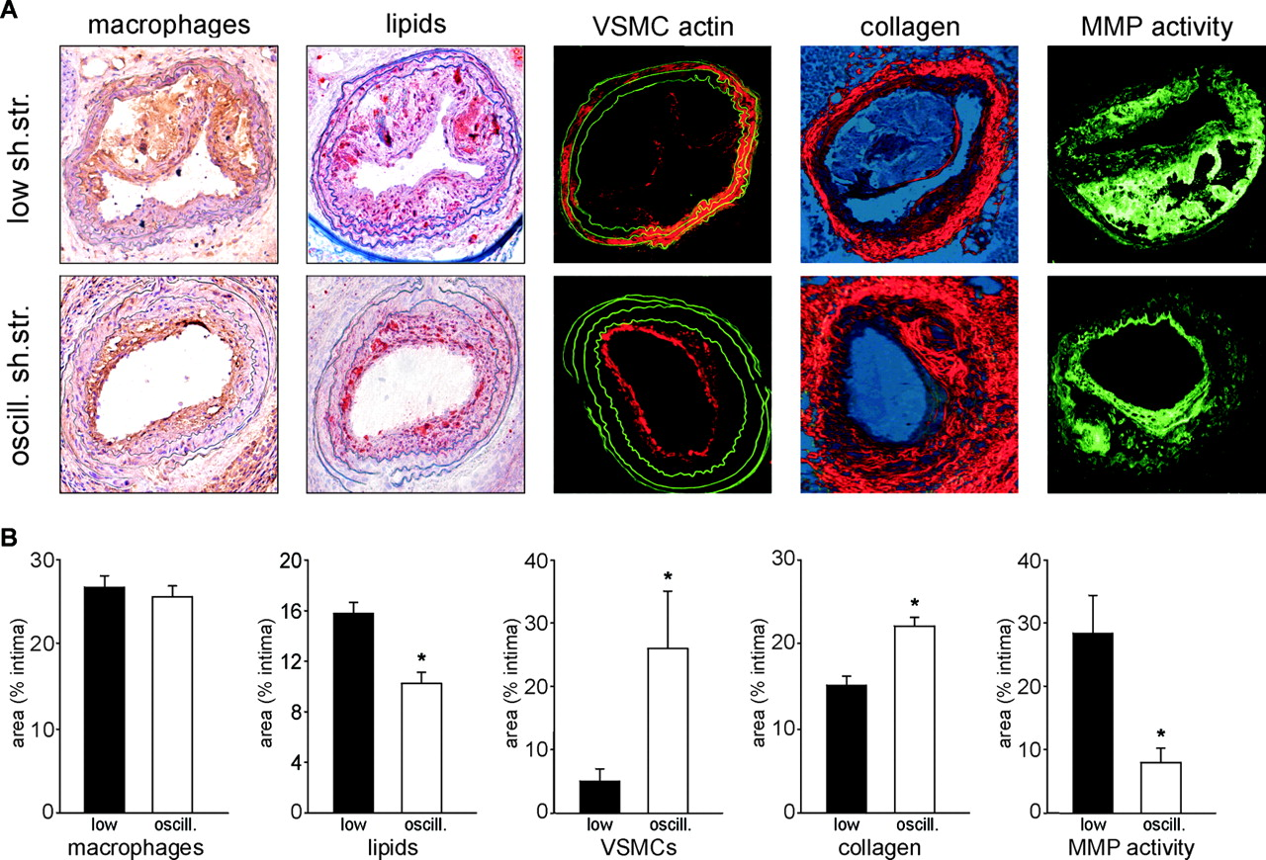
Histology shows that blood flow determines plaque composition
Cheng C et al. Circulation 2006;113:2744-2753
Copyright © American Heart Association
Notes:
Figure 4. A, Cross sections of carotid arteries taken 9 weeks after cast placement from apoE−/− mice fed a Western diet (×100 magnification) and stained for macrophages,34 lipids (oil red O), vascular smooth muscle cells (anti–α-actin), or collagen (picrosirius red) in the lowered shear stress (low sh. str.) and the vortices/oscillatory shear stress (oscill. sh. str.) region. MMP activity was studied by DQ gelatinase assay. B, Quantification of macrophages, lipids, vascular smooth muscle cells, and collagen in the intimal area of the lowered shear stress (low) and the vortices/oscillatory (oscill.) shear stress region and of MMP activity. Data are the mean values of sections from 5 different animals. VSMC indicates vascular smooth muscle cell. *P<0.05 vs lowered shear stress.

Slide 10
Working hypothesis
Mechanosensitive pathways induce vulnerable plaque.
Aim 1: To develop a platform for identifying pathways in vivo
Aim 2: To define molecular imaging techniques to identify them in vivo

Slide 11
A platform for studies on the systems biology of atherosclerosis
Preprocess
  Imaging: μCT, μMRI, μscope
  Segmentation, 3D-reconstruction
  Computational Fluid Dynamics (CFD)
Genomics
  Cell Isolation, RNA isolation, Laser Capture, Deconvolution
  Microrarray analysis, Next Generation Rapid Sequencing
BioInf
  Co-expression analysis for Gene Networks
  Essential small networks
SynBio
  Synthetic Biology of small networks
  Testing new therapies

Slide 12
A platform for studies on the systems biology of atherosclerosis
Preprocess
  Imaging: μCT, μMRI, μscope
  Segmentation, 3D-reconstruction
  Computational Fluid Dynamics (CFD)
Genomics
  Cell Isolation, RNA isolation, Laser Capture, Deconvolution
  Microrarray analysis, Next Generation Rapid Sequencing
BioInf
  Co-expression analysis for Gene Networks
  Essential small networks
SynBio
  Synthetic Biology of small networks
  Testing new therapies

Slide 13
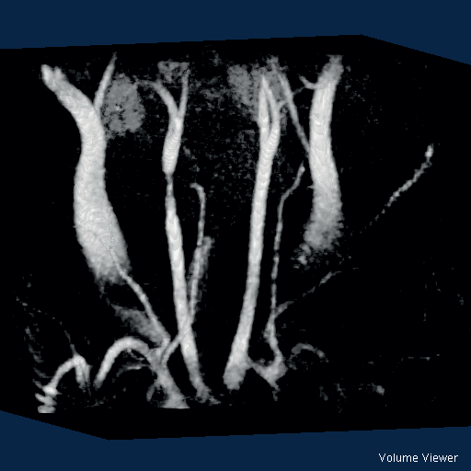
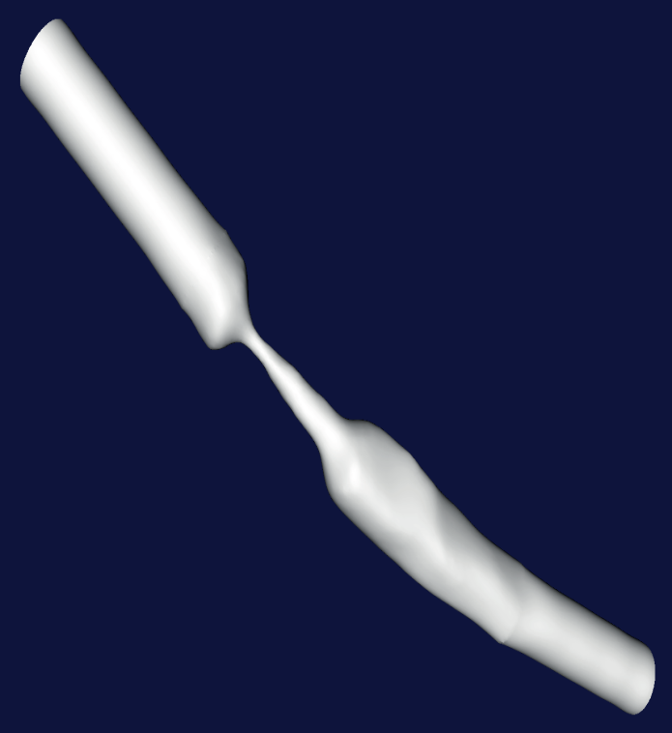
Preprocess module: imaging and segmentation

Slide 14
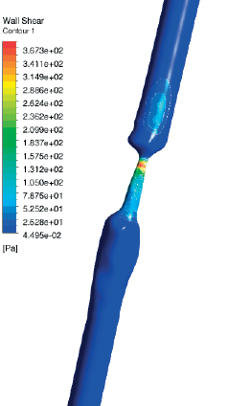
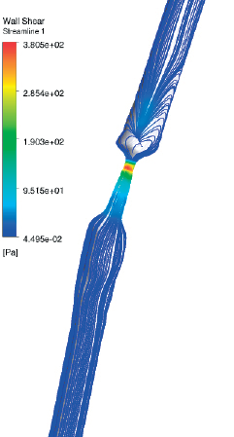
Preprocess module: Computational fluid dynamics: fluid flow

Slide 15
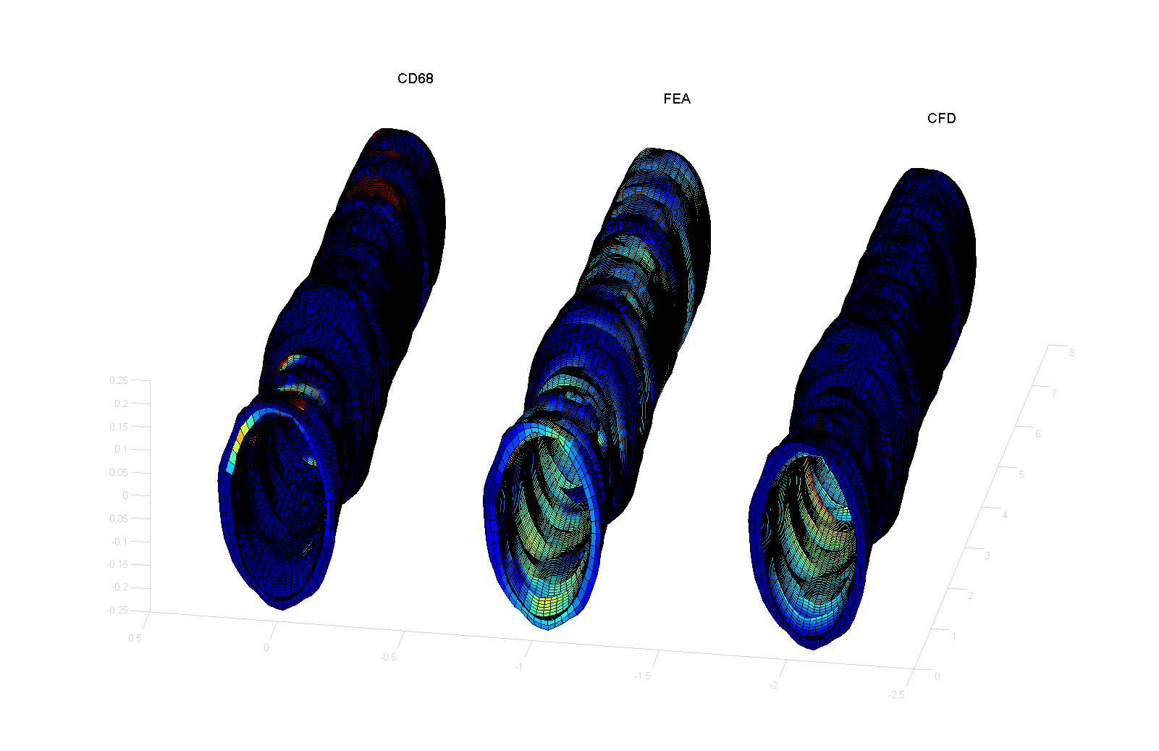
Preprocess module: Regional shear stress and strain determine local phenotype changes of endothelial cells
Strain
Shear stress

Slide 16
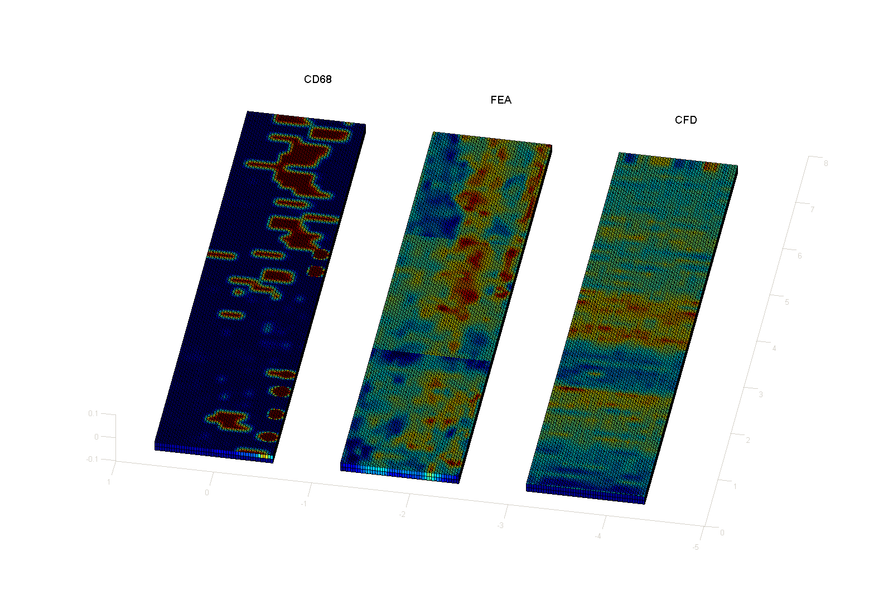
Preprocess module: Regional shear stress and strain determine local phenotype changes of endothelial cells
Strain
Shear stress

Slide 17
A platform for studies on the systems biology of atherosclerosis
Preprocess
  Imaging: μCT, μMRI, μscope
  Segmentation, 3D-reconstruction
  Computational Fluid Dynamics (CFD)
Genomics
  Cell Isolation, RNA isolation, Laser Capture, Deconvolution
  Microrarray analysis, Next Generation Rapid Sequencing
BioInf
  Co-expression analysis for Gene Networks
  Essential small networks
SynBio
  Synthetic Biology of small networks
  Testing new therapies

Slide 18
Problem we ran into
Mouse vessels are small and amount of RNA obtained is low
Hybridisation of microarray requires about 1 μg of total RNA

Slide 19
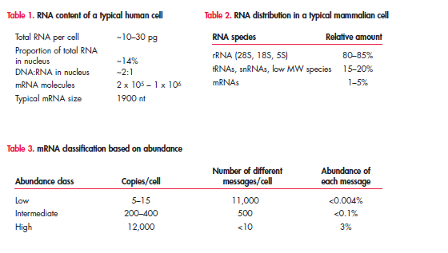
RNA-concentration per cell

Slide 20
Problem we ran into
Mouse vessels are small and amount of RNA obtained is low
Hybridisation of microarray requires about 1 μg RNA
We have about 20 pg of RNA per cell. Hence one needs either 10⁸ cells or a RNA amplification method.
A decade ago, linear amplification reduced the requirements to 10-20,000 of cells
We need to pool 10 blood vessels for that!

Slide 21
How to compare time series with pooled data
By pooling, we assume all animals are similar and by studying time series we assume cellular content remains unchanged over time
We have a 100% variation in cell number in our animal model over time.

Slide 22
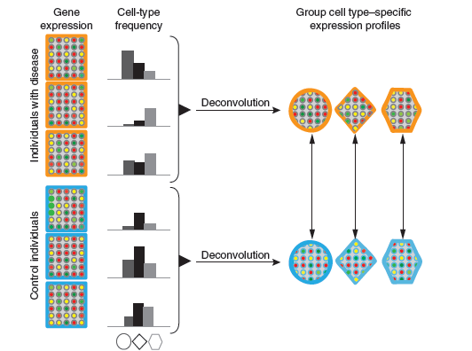
The solution: deconvolution of gene expression

Slide 23
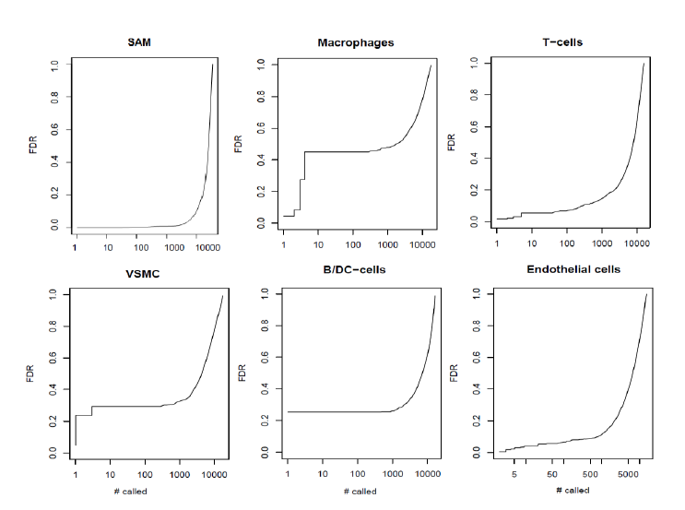
Deconvolution of gene expression data: comparing stable vs. unstable plaques

Slide 24
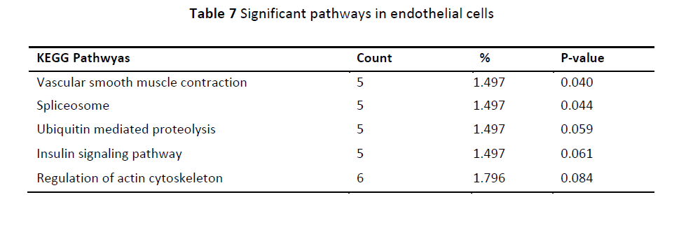
Endothelial cell signalling pathways

Slide 25
Linear amplification kits have improved
name | Conc. RNA | Number of cells | publication
Ambion Expression Kit | 50 ng | 2,500 | 2005
Arcturas Paradise Plus 2 round | 5 ng | 250 | 2010
Arcturas RiboAmp | 0.1 ng | 20 | 2012

Slide 26
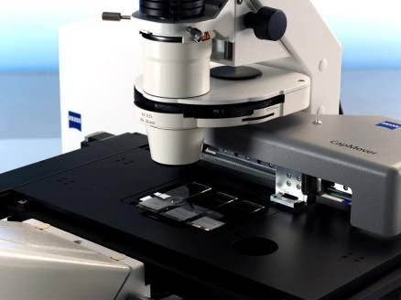
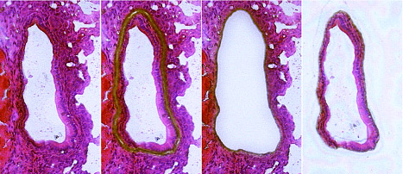
Genomics module: shear or strain fields drive robot driven laser capture system

Slide 27
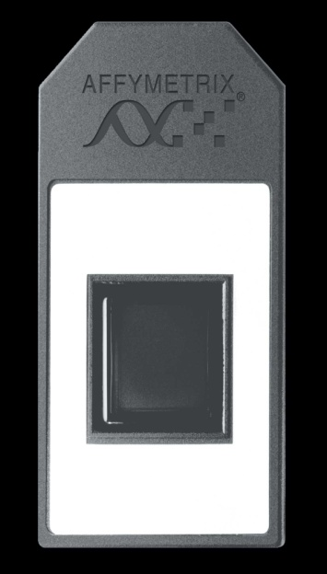
Genomics module: shear or strain fields drive robot driven laser capture system

Slide 28
A platform for studies on the systems biology of atherosclerosis
Preprocess
  Imaging: μCT, μMRI, μscope
  Segmentation, 3D-reconstruction
  Computational Fluid Dynamics (CFD)
Genomics
  Cell Isolation, RNA isolation, Laser Capture, Deconvolution
  Microrarray analysis, Next Generation Rapid Sequencing
BioInf
  Co-expression analysis for Gene Networks
  Essential small networks
SynBio
  Synthetic Biology of small networks
  Testing new therapies

Slide 29
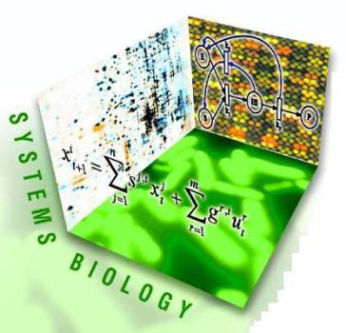

Bioinf-module; co-expression analysis to systems biology
IV.ODE

Slide 30
A platform for studies on the systems biology of atherosclerosis
Preprocess
  Imaging: μCT, μMRI, μscope
  Segmentation, 3D-reconstruction
  Computational Fluid Dynamics (CFD)
Genomics
  Cell Isolation, RNA isolation, Laser Capture, Deconvolution
  Microrarray analysis, Next Generation Rapid Sequencing
BioInf
  Co-expression analysis for Gene Networks
  Essential small networks
SynBio
  Synthetic Biology of small networks
  Testing new therapies

Slide 31
Mechanosensors postulated in literature
From: Chatzizisis YS, et al. 2007. Role of endothelial shear stress in the natural history of coronary atherosclerosis and vascular remodeling: molecular, cellular, and vascular behavior. J Am Coll Cardiol 49(25):2379-2393.
Notes:
But how can endothelial cells sense shear stress?? Here a single endothelial cell is illustrated with membrane molecules and cellular microdomains on all ECs surfaces (basal, junctional and luminal) that have been proposed to detect and respond to shear stress. These include: ion channels, receptor tyrosine kinases, the apical glycocalyx, primary cilia, heterotrimeric G proteins and G protein coupled receptors, xanthine oxidase, growth factor receptors, nicotinamide adenine dinucleotide phosphate (NADPH) oxidase, caveolae, cell membrane phospholipid bilayer, platelet EC-adhesion molecule (PECAM)-1, vascular endothelial (VE)-cadherin, integrins and the cytoskeleton. The exact mechanism by which endothelial cells sense shear stress is not completely understood. After shear stress sensing many molecules get consecutively activated, and they form a signalling cascade which in the end lead to modification in gene activation. These complex shear stress sensitive signalling pathways are not fully characterized either.

Slide 32
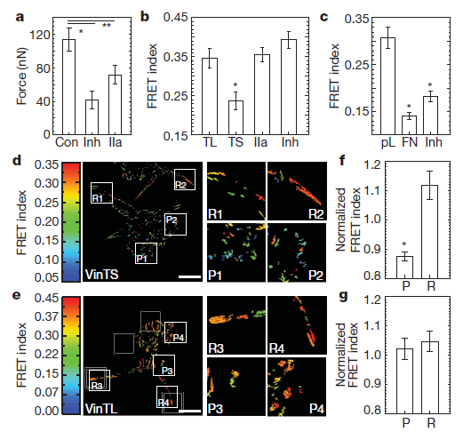
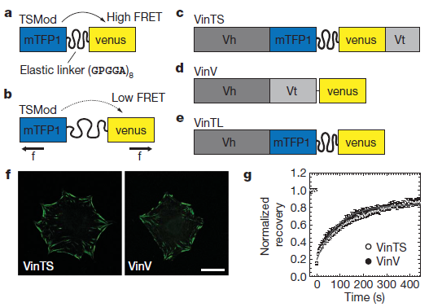
Mechanosensors force detection
Carsten Grashoff et.al., Nature, 466|, 2010

Slide 33
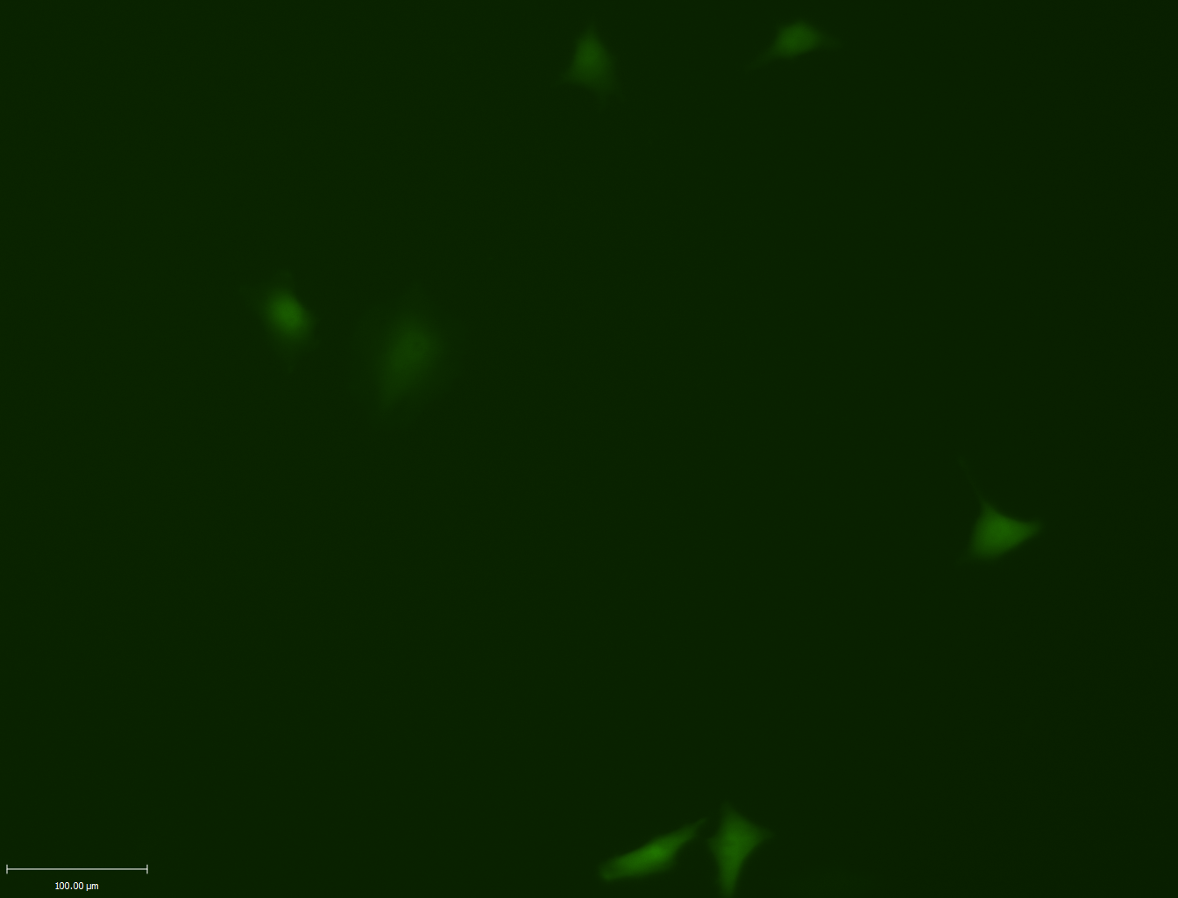

Probing activity of mechanosensors
A synthetic signaling cascade will be inserted (expressed) in endothelial cells
Based on the Tango assay
Endothelial shear
stress
Components of the system:
shear stress sensors (B₂ bradykinin GPCR) – TEV (Tabaco Etch Vitus) Cleavage site – tTA (transcription factor)
Arrestin (Signaling protein) – TEV protease (Tabaco Etch Vitus protease)
Reporter gene (eGFP)
^{Modified from:} Barnea et al. 2008. The genetic design of signaling cascades to record receptor activation. PNAS 105, 1:64-69.
Zoltan Kis, Imperial College London

Slide 34
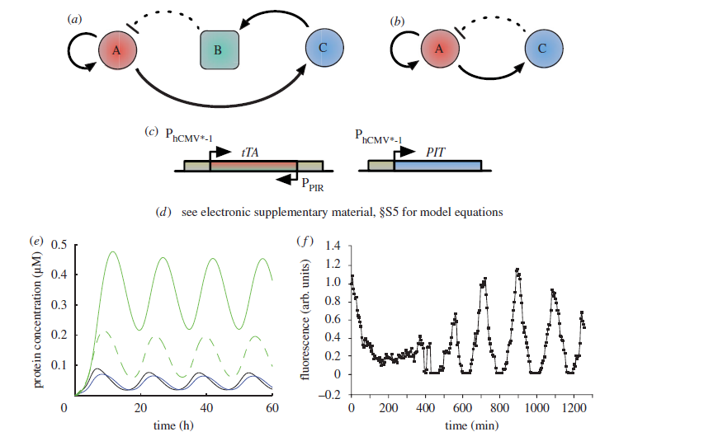
Simple genetic oscillators

Slide 35
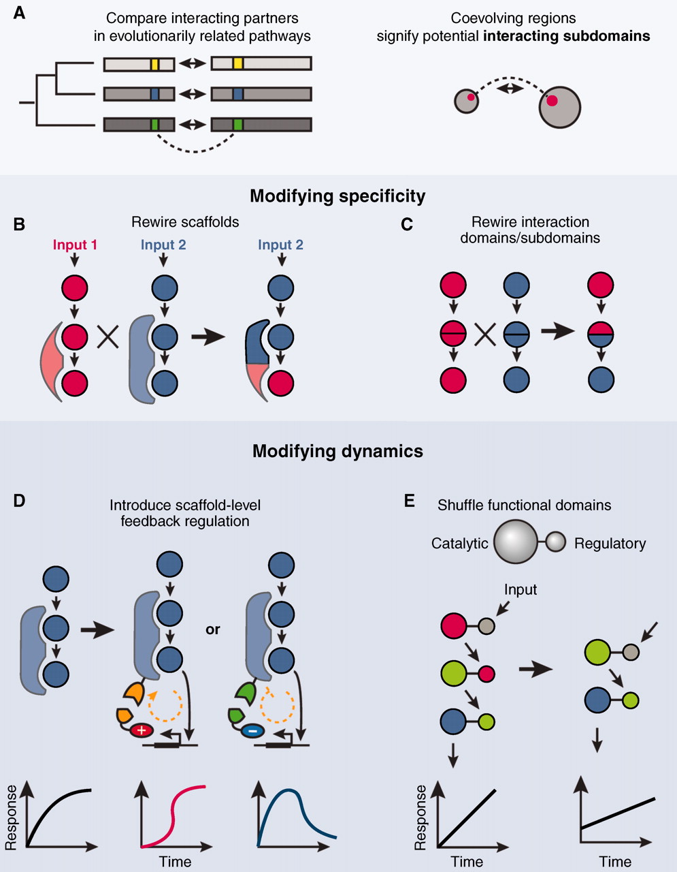

Building synthetic signalling pathways
N Nandagopal, M B Elowitz Science 2011;333:1244-1248
Notes:
Diversifying signaling pathways through rewiring. (A) Sequence correlations among proteins from a large family (left, SCA, also see text) can be used to identify interacting subdomains (right). Interaction specificity can be altered by rewiring scaffolds (B) or by shuffling specificity-determining domains or subdomains (C). The dynamic behavior of a pathway can be modified by (D) introducing new autoregulatory connections or by (E) altering regulation directly at the protein level by generating new combinations of catalytic and regulatory protein domains.

Slide 36
Acknowledgements
Molecular Bioengineering
Taka Homma
Sandra Bovens
Ryan Pedegri
Glaucia Da conceição pereira
Nataly Maimari
Zoltan Kis
Vikram Mehta
Anusha Seneveratne
Mika Falck-Hansen
Hugo
Rob Krams
Biomedical Engineering
Pensylvania
Peter Davies
PathologyDenmark
Erwin Falk
Biopharmaceutical Leiden
Johan Kuiper
Pathology Amsterdam
Mat Daemen
NHLI Cardiology
Michael Schneider
Dorian Haskard
Ranil de Silva
Immunology
James Pease
Molecular Biology
Jon Lamb
Kennedy Institute
Marc Feldmann
Claudia Monaco
Chemistry
Nick Long

