Slide 1
Angiogenesis and disease
Anna M. Randi
MD PhD
National Heart and Lung Institute

Slide 2

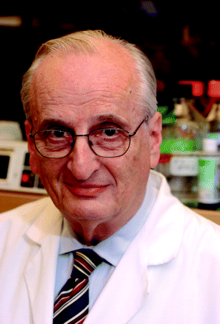
Angiogenesis and cancer: history
1971 - Surgeon Dr. Judah Folkman hypothesizes that tumor growth is dependent upon angiogenesis.
1992: The first clinical trial of an antiangiogenic drug (TNP-470) begins in cancer patients
1999: Dr. Richard Klausner, Director of the U.S. National Cancer Institute, designates the development of antiangiogenic therapies for cancer as a national priority.
2004: Avastin (Bevacizumab) is FDA approved for the treatment of advanced colorectal cancer.
Moses Judah Folkman:
1933 - 2008
www.angio.org

Slide 3
ANGIOGENESIS
Health
Embryonic development
Menstrual cycle
Wound healing
Disease
Cancer
Chronic inflammatory diseases (RA, IBD, kidney…)
Diabetic retinopathy
Cardiovascular disease
Psoriasis
Vascular malformations (angiodysplasia, haemangioma)
……………
Modified from P. Carmeliet - Nature. 2005;438:932-6

Slide 4
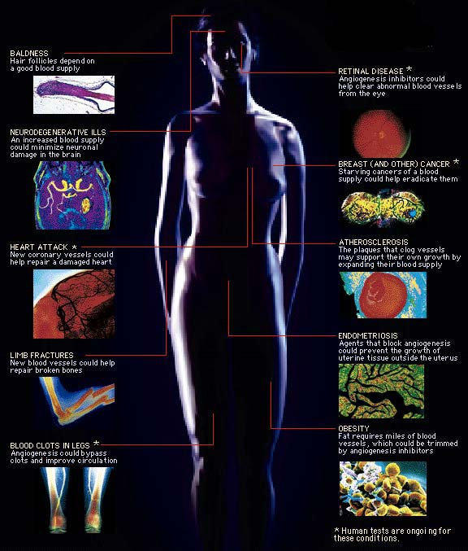
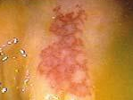
ANGIOGENESIS AND DISEASE
Insufficient
Excessive
Baldness
Retinal Disease
Vascular Malformations
MI - Ischemia
Angiodysplasia
Cancers
Limb Fractures
Atheroscerosis
HHT
Thrombosis
Obesity
Notes:
When extra blood vessels could help…
Baldness: Hair follicles depend on a good blood supply
Neurogenegenerative ills: An increased blood supply could minimize neuronal damage in the brain.
Heart Attack*: New coronary vessels could help repair a damaged heart.
Limb Fractures: New blood vessels could help repair broken bones.
Blood Clots in Legs*: Angiogenesis could bypass clots and improve circulation.
When blood vessels are part of the problem…
Retinal Disease*: Angiogenesis inhibitors could help clear abnormal blood vessels form the eye.
Breast (and Other) Cancer*: Starving cancers of a blood supply could help eradicate them.
Atherosclerosis: The plaques that clog vessels may support their own growth by expanding their blood supply.
Endometriosis: Agents that block angiogenesis could prevent the growth of uterine tissue outside the uterus.
Obesity: Fat requires miles of blood vessels, which could be trimmed by angiogenesis inhibitors
* Human tests are ongoing for these condition

Slide 5
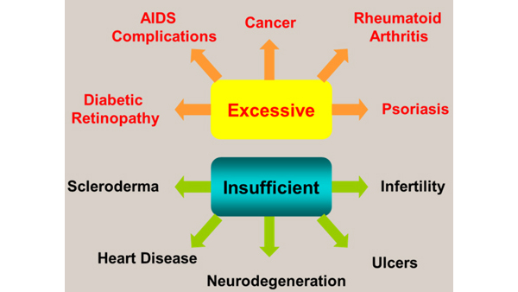
Too much or too little angiogenesis....
Therapeutic intervention
Inhibitors
Activators

Slide 6
Tumor angiogenesis

Slide 7
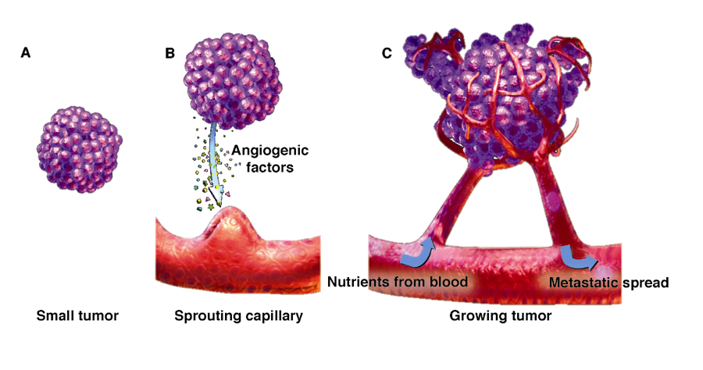
Tumor Angiogenesis and Neovasculature
A, Tumors less than 1 mm³ receive oxygen and nutrients by diffusion from host vasculature. B, Larger tumors require new vessel network. Tumor secretes angiogenic factors that stimulate migration, proliferation, and neovessel formation by endothelial cells in adjacent established vessels. C, Newly vascularized tumor no longer relies solely on diffusion from host vasculature, facilitating progressive growth.

Slide 8
Tumor Blood vessels
Tumour blood vessels are architecturally different from normal vessels:
irregularly shaped, dilated, tortuous and can have dead ends.
not organized into definitive venules, arterioles and capillaries
tumours’ vascular network is often leaky and haemorrhagic, partly due to the overproduction of VEGF (induced by ischemia)
perivascular cells, usually in close contact with the endothelium, often become more loosely associated
some tumours may recruit endothelial progenitor cells from the bone marrow

Slide 9
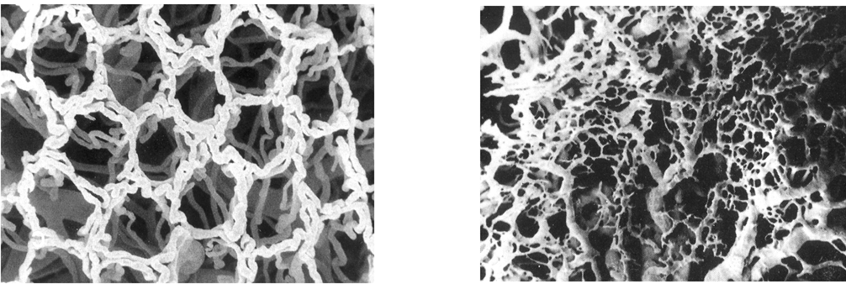
Tumor Neovasculature: Comparative Tortuosity and Disorganization
Normal colorectal mucosa
Nearby colorectal cancer
From Konerding et al. In Molls and Vaupel, eds. Blood Perfusion and Microenvironment of Human Tumors, 2002.

Slide 10
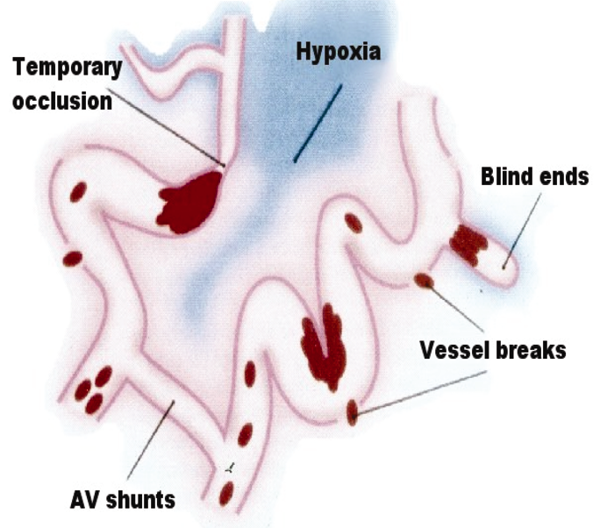
Abnormal Structural Features of
Tumor Microvasculature
AV = arteriovenous.
From Brown and Giaccia. Cancer Res. 1998;58:1408-1416.

Slide 11
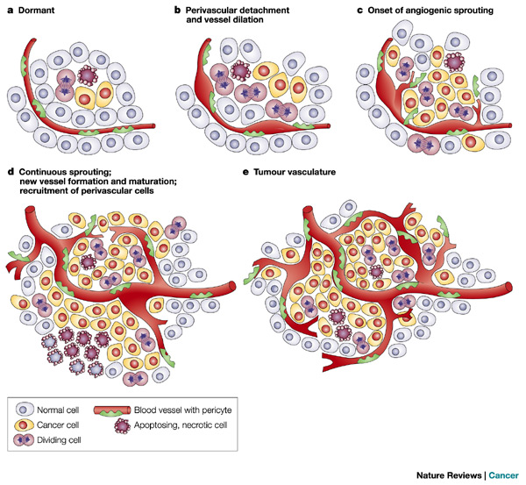
The angiogenic switch
The angiogenic switch is a discrete step in tumour development that can occur at different stages in the tumour-progression pathway, depending on the nature of the tumour and its microenvironment
Notes:
The angiogenic switch is a discrete step in tumour development that can occur at different stages in the tumour-progression pathway, depending on the nature of the tumour and its microenvironment. Most tumours start growing as avascular nodules (dormant) (a) until they reach a steady-state level of proliferating and apoptosing cells. The initiation of angiogenesis, or the 'angiogenic switch', has to occur to ensure exponential tumour growth. The switch begins with perivascular detachment and vessel dilation (b), followed by angiogenic sprouting (c), new vessel formation and maturation, and the recruitment of perivascular cells (d). Blood-vessel formation will continue as long as the tumour grows, and the blood vessels specifically feed hypoxic and necrotic areas of the tumour to provide it with essential nutrients and oxygen (e).

Slide 12
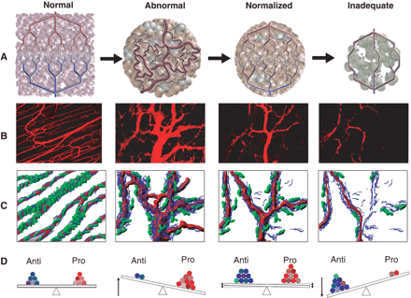
Normalization of tumor blood vessels
Jain R
Notes:
Fig. 1. Proposed role of vessel normalization in the response of tumors to antiangiogenic therapy. (A) Tumor vasculature is structurally and functionally abnormal. It is proposed that antiangiogenic therapies initially improve both the structure and the function of tumor vessels. However, sustained or aggressive antiangiogenic regimens may eventually prune away these vessels, resulting in a vasculature that is both resistant to further treatment and inadequate for the delivery of drugs or oxygen [reproduced, with permission, from (11)]. (B) Dynamics of vascular normalization induced by VEGFR2 blockade. On the left is a two-photon image showing normal blood vessels in skeletal muscle; subsequent images show human colon carcinoma vasculature in mice at day 0, day 3, and day 5 after administration of VEGR2-specific antibody [reproduced, with permission, from (24)]. (C) Diagram depicting the concomitant changes in pericyte (red) and basement membrane (blue) coverage during vascular normalization (24, 29). (D) These phenotypic changes in the vasculature may reflect changes in the balance of pro- and antiangiogenic factors in the tissue.

Slide 13
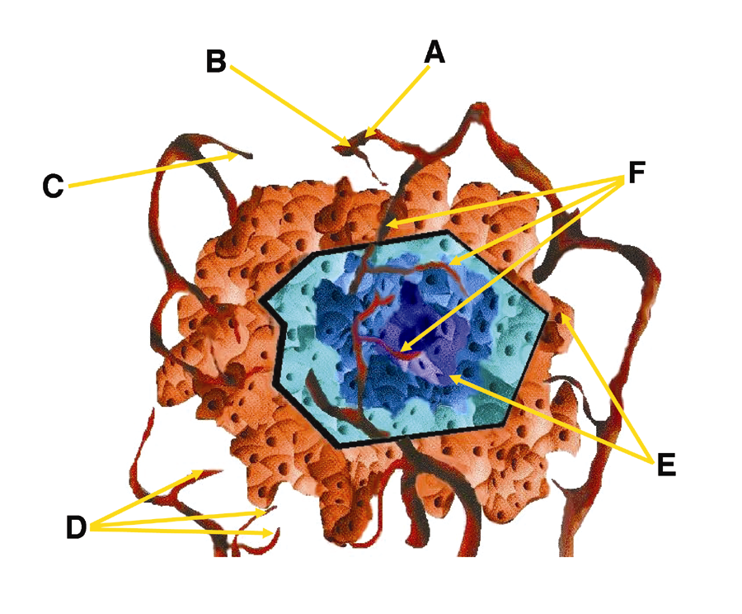
Approaches to Compromising
Tumor Neovasculature
A, Matrix breakdown inhibition; B, signal transduction inhibition; C, receptor antagonism; D, inhibition of endothelial cell function (eg, proliferation, migration, and tube formation); E, blockade of activators of angiogenesis; F, compromise existing tumor vasculature.
From Siemann et al. Radiother Oncol. 2000;57:5-12.

Slide 14
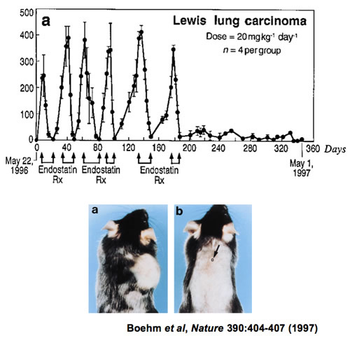
In vivo proof of concept studies:
Endostatin inhibits solid tumor growth
Endostatin: endogenous anti-angiogenesis peptide

Slide 15
Vascular Endothelial Growth Factor (VEGF)
Family of 5 members: VEGF-A, VEGF-B, VEGF-C, VEGF-D, and placental growth factor(PlGF)
Three tyrosine kinase receptors: VEGF receptor (VEGFR)-1, VEGFR-2, and VEGFR-3
VEGFR-2 is the major mediator of VEGF-dependent angiogenesis
In mice, loss of even a single VEGF allele results in embryonic lethality at days 11 -12 due to vascular defects

Slide 16
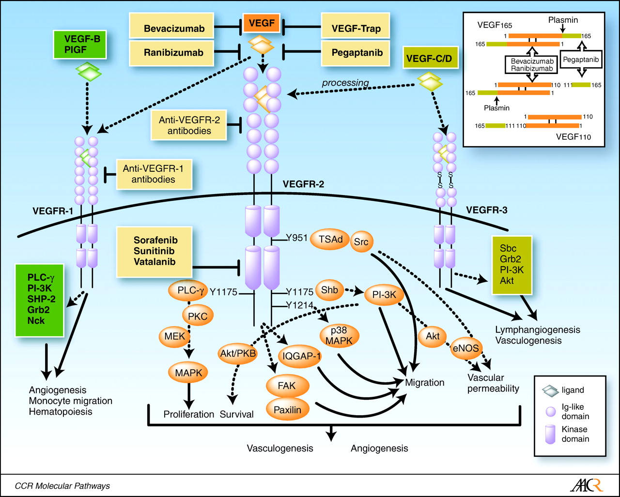

Signal transduction and biological processes mediated by VEGFRs and various therapeutic strategies to inhibit VEGF signaling.
Kowanetz M , Ferrara N Clin Cancer Res 2006;12:5018-5022
©2006 by American Association for Cancer Research
Notes:
Signal transduction and biological processes mediated by VEGFRs and various therapeutic strategies to inhibit VEGF signaling. Major tyrosine autophosphorylation sites (number) and intracellular effectors of activated VEGFR-2. Signaling cascades triggered by VEGFR-1 and VEGFR-3 are still incompletely understood. Inhibition of VEGF signaling can be achieved by monoclonal antibodies targeting VEGF (bevacizumab and ranibizumab), aptamers that bind the heparin-binding domain of VEGF165 (pegaptanib), chimeric soluble receptors, such as VEGF-Trap, monoclonal antibodies targeting VEGFRs, various small-molecule tyrosine kinase inhibitors (sorafenib, sunitinib, and vatalanib), and antisense and short interfering RNA strategies (not shown). Top right inset, because pegaptanib binds to VEGF within heparin-binding domain (yellow), it inactivates only VEGF165. In contrast, bevacizumab and ranibizumab inactivate all biologically active forms of VEGF, such as VEGF110. eNOS, endothelial nitric oxide synthase; FAK, focal adhesion kinase; Grb2, growth factor receptor-bound protein 2; MAPK, mitogen-activated protein kinase; MEK, mitogen-activated protein kinase/extracellular signal-regulated kinase kinase; PI-3K, phosphatidylinositol 3′-kinase; PKB, protein kinase B; PKC, protein kinase C; PLC-γ, phospholipase C-γ; Shb, Src homology 2 and β cells; SHP-2, Src homology phosphatase-2; TSAd, T-cell-specific adapter; PlGF, placental growth factor.

Slide 17
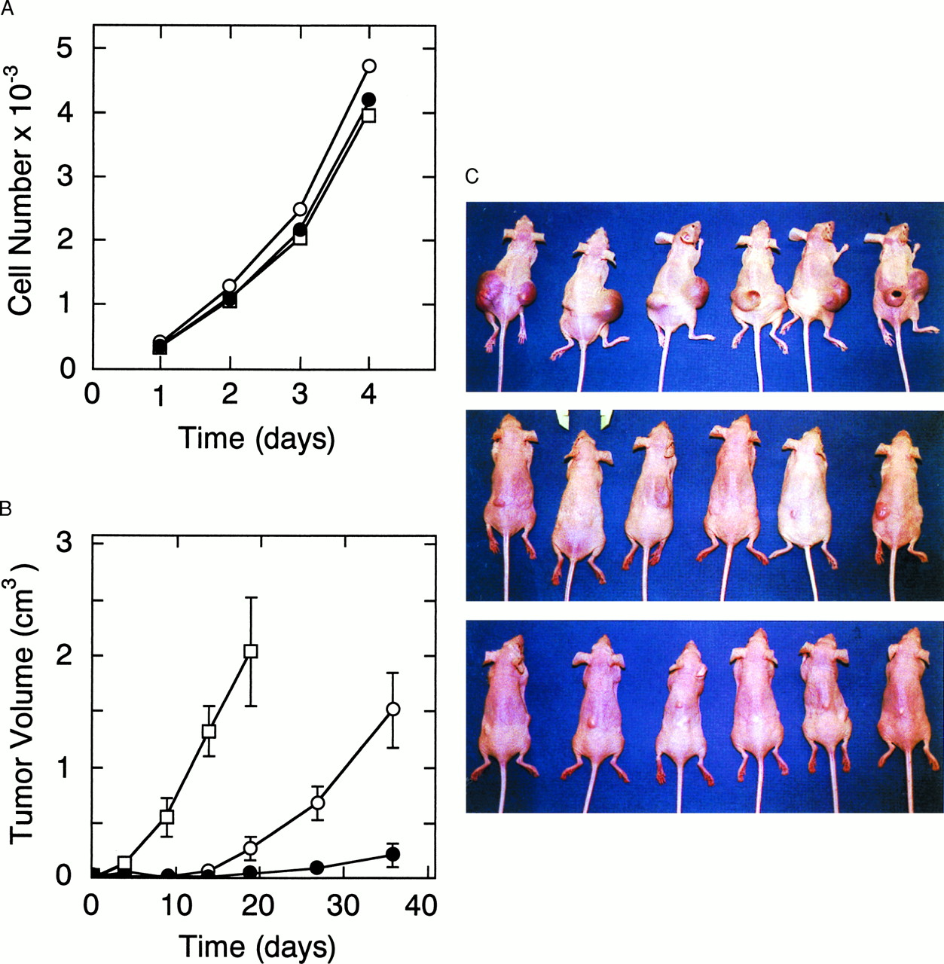
VEGF inhibition: soluble VEGFR1 (Flt-1)
Cells stably transfected with control or sFlt-1 plasmid
Control
Tumor cell growth
Flt-1
Flt-1
Tumor volume
Goldman C K et al. PNAS 1998;95:8795-8800
©1998 by National Academy of Sciences
Notes:
In vitro and in vivo growth of HT-1080 clones stably transfected with sflt-1 cDNA. HT-1080 tumor cells were stably transfected with control pcDNA3 plasmid (open square) or the corresponding pCIsflt-1 plasmid incorporating HCMV intron A (pCIsflt-1) from which clones C4 (open circles) and B3 (filled circles) were selected. (A) In vitro the control (pcDNA3), moderate (C4) sFLT-1-expressing, and high (B3) sFLT-1-expressing clones grew with equivalent rates in culture. (B) In nude mice (n = 6/group) tumors developing from two s.c. injections totaling 3 × 106 cells/animal of either the control (pcDNA3), moderate sFLT-1-expressing (C4), or high (B3) sFLT-1 expressing clones grew at high, intermediate, and low rates, respectively. (C) Tumors are shown in situ 19 days after injections of HT-1080 cells either stably transfected with control plasmid DNA (pcDNA3, top) or clones stably expressing intermediate (C4, middle) and high (B3, bottom) levels of sFLT-1.

Slide 18
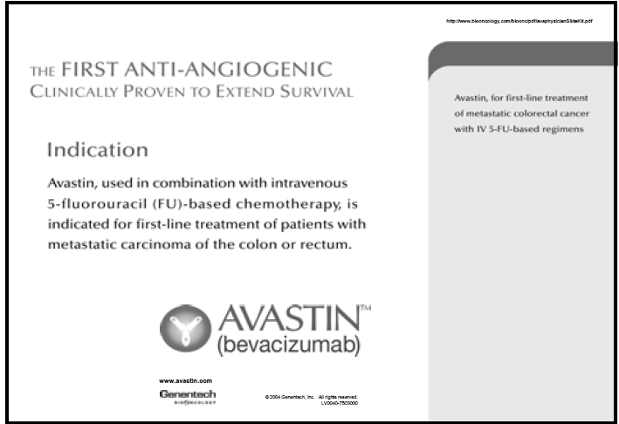
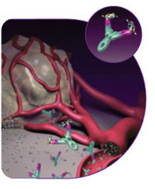
Anti-VEGF humanised MAb: Avastin
www.avastin.com

Slide 19
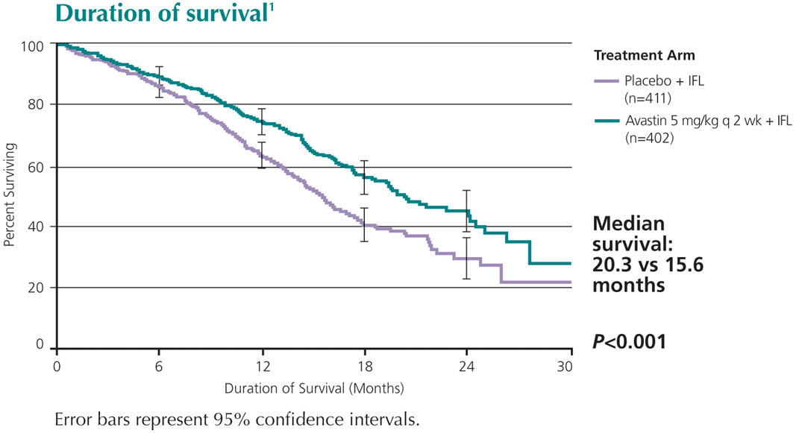
Avastin significantly extends survival in colorectal cancer
Randomized, double-blind study of >900 patients. Primary end-point: survival
30% increase in median survival in combination with chemotherapy (N=813)
The survival benefit associated with Avastin was observed early in treatment and persisted throughout the course of the trial

Slide 20
Types of Cancer in Active Phase III Treatment Clinical Trials of Angiogenesis Inhibitors
Breast cancer
Esophageal cancer
Gastrointestinal Stromal Tumors (GIST)
Kidney (renal cell) cancer
Leukemia
Liver (adult primary) cancer
Lymphoma
Melanoma
Multiple myeloma
Non-small cell lung cancer (NSCLC)
Ovarian epithelial cancer
Pancreatic cancer
Prostate cancer
Stomach (gastric) cancer
National Cancer Institute
www.cancer.gov

Slide 21
Avastin: accelerated approval for the treatment of cancer (combination therapies)
Avastin first approved in 2004 for treatment of advanced colon cancer
Approved since for advanced lung (2006), kidney and brain (glioblastoma) cancers (2009).
Avastin approved for metastatic breast cancer in 2008 under the accelerated approval program
FDA approval withdrawn for metastatic breastcancer 2010
FDA website http://www.fda.gov/Drugs

Slide 22
Avastin – side effects
GI perforation
Hypertension
Proteinuria
Venous thrombosis
Haemorrage
Wound healing complication

Slide 23
The Avastin Story
Mikkael A. Sekeres, M.D.
N Engl J Med. 2011 Oct 13;365:1454-5
“Avastin received accelerated approval from the FDA for metastatic breast cancer in 2008 on the basis of a study in which patients who were treated with Avastin, in combination with paclitaxel (Taxol) had a progression-free survival advantage of 5.5 months over paclitaxel alone but no overall survival advantage.
Toxic effects were substantial, but this interim end point suggested real clinical benefit. Unfortunately, in what were supposed to be confirmatory studies enrolling almost 2000 women, progression-free survival was shorter than in the initial study, and no quality-of-life or survival advantage could be shown for Avastin-containing regimens.”.. .......................................................
“We do not want to provide false hope”

Slide 24
NICE: Avastin is not recommended for the treatment of metastatic breast cancer
: “The evidence for the effectiveness of bevacizumab (Avastin) in prolonging survival was not robust and overall did not show enough of a demonstrable benefit for it to be considered a cost-effective use of NHS resources.” (Sir Andrew Dillon, NICE Chief Executive, 23 Feb 2011)
http://www.nice.org.uk/newsroom/pressreleases/AvastinBevacizumabNotRecommended.jsp

Slide 25

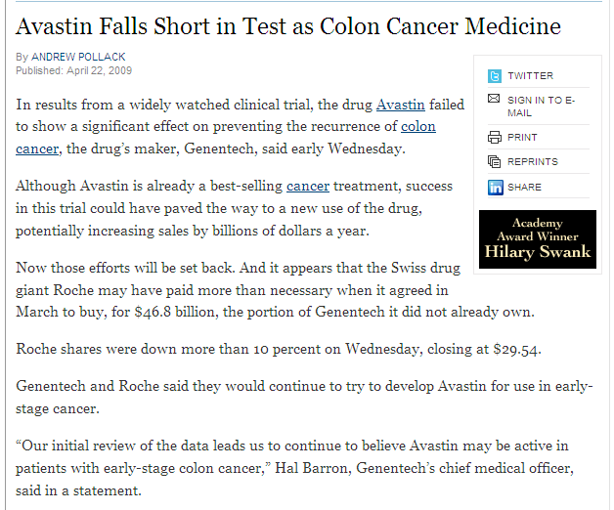

Slide 26
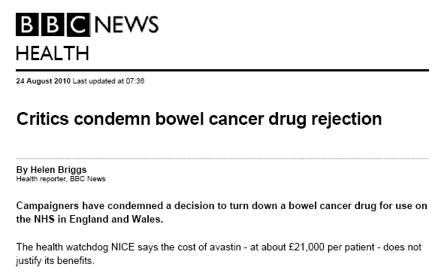

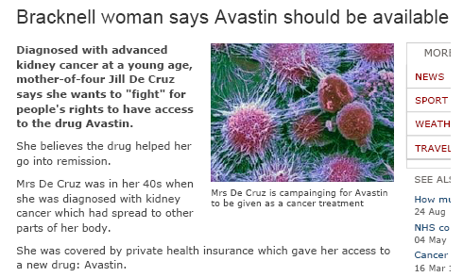

Anti-VEGF antibody in cancer

Slide 27
Anti-angiogenic therapy in cancer – does it work?
In some cases benefits are transitory, and followed by a restoration of tumour growth and progression
In other cases there is no objective benefit
Two modes of unconventional resistance:
  evasive resistance, an adaptation to circumvent the specific angiogenic blockade
  intrinsic or pre-existing indifference
Notes:
Angiogenesis inhibitors targeting the vascular endothelial growth factor (VEGF) signalling pathways are affording demonstrable therapeutic efficacy in mouse models of cancer and in an increasing number of human cancers. However, in both preclinical and clinical settings, the benefits are at best transitory and are followed by a restoration of tumour growth and progression. Emerging data support a proposition that two modes of unconventional resistance underlie such results: evasive resistance, an adaptation to circumvent the specific angiogenic blockade; and intrinsic or pre-existing indifference. Multiple mechanisms can be invoked in different tumour contexts to manifest both evasive and intrinsic resistance, motivating assessment of their prevalence and importance and in turn the design of pharmacological strategies that confer enduring anti-angiogenic therapies.

Slide 28
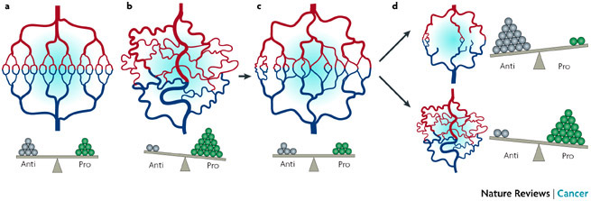
Possible mechanisms of resistance to anti-angiogenic therapy
normalised by
anti-angio therapy
healthy
tumor
Loss of response
reduced blood supply and reduced access by chemotherapeutic drugs
other angiogenic growth factors take over : resistance to VEGF-based therapies.
increased access and efficacy of chemotherapeutic drugs
Notes:
a | The normal vasculature is maintained by pro- and anti-angiogenic signals. b | However, in tumours, excessive amounts of pro-angiogenic factors, such as vascular endothelial growth factor (VEGF) are produced that result in a disrupted and chaotic vasculature. c | Inhibiting VEGF seems to normalize the vasculature and enable a better blood supply to be transiently established, producing a window where the access and efficacy of chemotherapeutic drugs will be increased. d | However, this window often closes, possibly as a result of over-inhibition of VEGF resulting in reduced blood supply and access by chemotherapeutic drugs. Alternatively, other angiogenic growth factors are secreted and result in abnormal growth of the vasculature and resistance to VEGF-based therapies.

Slide 29
The future?
Anti-angiogenic therapy in combination with other anti-cancer therapies
  Colorectal cancer and others
Resistance: combinatorial strategies involving angiogenesis inhibition integrated with drugs targeting resistance mechanisms
Novel non-VEGF targets – novel molecular mechanism
Anti-angiogenic therapy in other diseases:
  Rheumathoid Arthritis
  Retina vascularization (AMD, diabetic retinopathy)
Pro-angiogenic therapy in ischemia

Slide 30
The future?
Anti-angiogenic therapy in combination with other anti-cancer therapies
Resistance: combinatorial strategies involving angiogenesis inhibition integrated with drugs targeting resistance mechanisms
Novel non-VEGF targets – novel molecular mechanism
Anti-angiogenic therapy in other diseases:
  Rheumathoid Arthritis
  Retina vascularization (AMD, diabetic retinopathy)
Pro-angiogenic therapy in ischemia

Slide 31
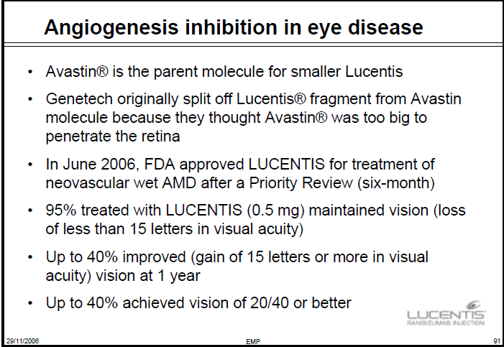
AMD: Age-related Macula Degeneration

Slide 32
The future?
Anti-angiogenic therapy in combination with other anti-cancer therapies
Resistance: combinatorial strategies involving angiogenesis inhibition integrated with drugs targeting resistance mechanisms
Novel non-VEGF targets – novel molecular mechanism
Anti-angiogenic therapy in other diseases:
  Rheumathoid Arthritis
  Retina vascularization (AMD, diabetic retinopathy)
Pro-angiogenic therapy in ischemia

Slide 33
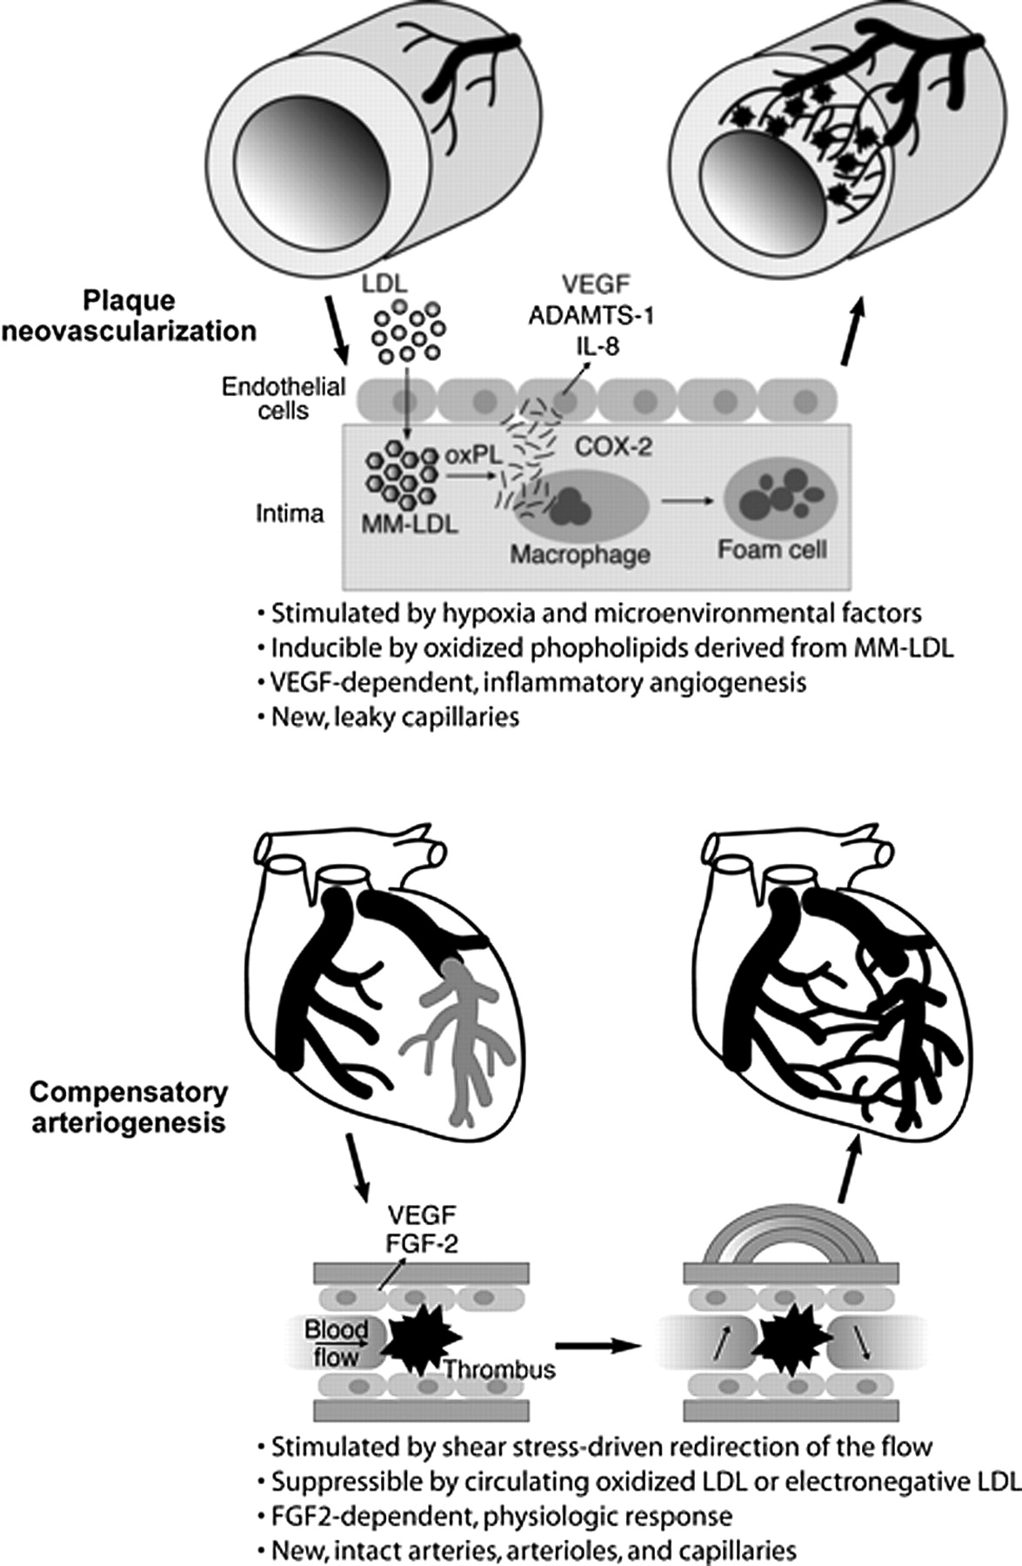
Angiogenesis in cardiovascular disease
Plaque angiogenesis
Compensatory angiogenesis
from Chen, C.-H. et al. Circ Res 2006
Notes:
The ability of endothelial cells to maintain homeostasis is what allows cells to respond to normal environmental stimuli by regulating their key functions, and then return to the statusquo. Chronic exposure to activating stimuli, such as long term exposure to stimuli that we know are risk factors for atherosclerosis, high cho, high BP etc, result in loss of homeostasis. What I have been interested in for year is the concept that understanding the key pathways that maintain homeostasis would allow us to target these to restore the balance and thus prevent and control activation and the development of vascular diseases. Instead of targeting individual pathways, we think that identifying master regulators that control multiple pathways could provide new targets for therapeutic intervention.
Homeostasis is of course modulated during the important process of angiogenesis, i.e. the formation of new blood vessels, that plays such a critical role in many diseases, from cancer to inflammation. In CV disease, angiogenesis has a dual function, both negative and positive: on one hand new vessels at the base of athero plaques can promote growth and rupture, and thus a possible (although controversial) therapeutic target. On the other hand the formation of new vessels following ischema such as in MI is important to restore vascularization therefore therapeutic angiogenesis is a recent exciting development in the treatment of acute and chronic ischemic diseases.

Slide 34
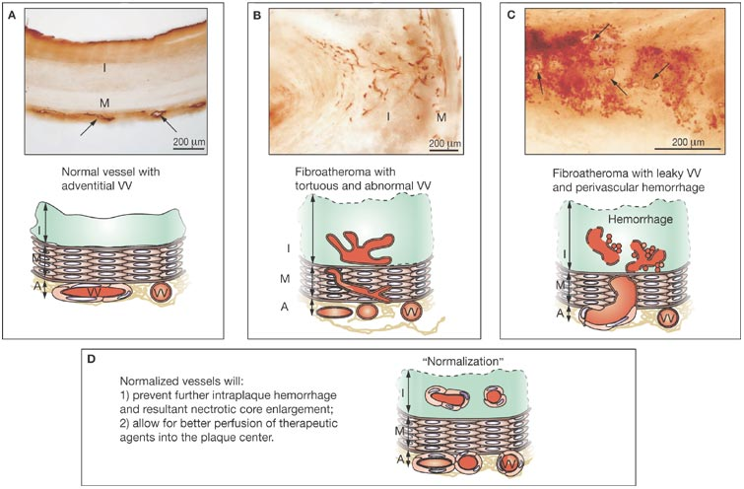

Proposed 'normalization' of plaque microvasculature and its implications in atherosclerotic angiogenesis
Jain RK et al. (2007) Antiangiogenic therapy for normalization of atherosclerotic plaque vasculature: a potential strategy for plaque stabilization Nat Clin Pract Cardiovasc Med 4: 491–502 doi:10.1038/ncpcardio0979

Slide 35
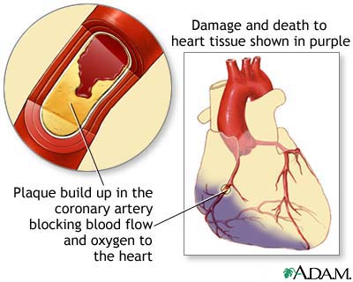
Reduced blood flow: ischemia
Therapeutic Angiogenesis for Coronary Artery Disease:
deliver pro-angiogenic factors to the ischemic heart muscle to induce new vessel growth

Slide 36
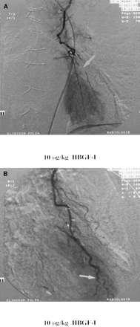
first therapeutic angiogenesis for myocardial ischemia
Schumacher B, et al.
Induction of neo-angiogenesis in ischemic myocardium by human growth factors: first clinical results of a new treatment of coronary heart disease.
Circulation 1998;97(7):645-650.
20 patients with three-vessel coronary disease undergoing coronary bypass
FGF-I injected close to the vessels after bypass
Twelve weeks later, formation of capillaries in all cases around the site of injection demonstrated by imaging
Notes:
Figure 7. A, Collateralization of stenoses (arrow): a diagonal branch occluded just distal to its origin is filled through the newly grown capillaries. B, Collateralization of stenoses (arrow) by newly grown capillaries: the peripherally stenosed LAD is filled through these vessels. HBGF-I indicates human FGF-I. At the site of injection of the FGF-I, a capillary network could be seen sprouting out from the coronary artery into the myocardium. This enabled retrograde imaging of a stenosed diagonal branch to be performed (Fig 7A ). Such "neocapillary vessels" can also provide a collateral circulation around additional distal stenoses of the LAD (Fig 7B ) and bring about retrograde filling of a short segment of the artery distal to the stenosis. In none of the angiograms of the treated patients taken 12 weeks after the operation were any new stenoses of the LAD detectable.

Slide 37
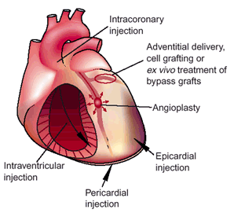
approaches to therapeutic angiogenesis
Protein therapy
Gene therapy
Cell Therapy
Nat Med 2003;9:694-701

Slide 38
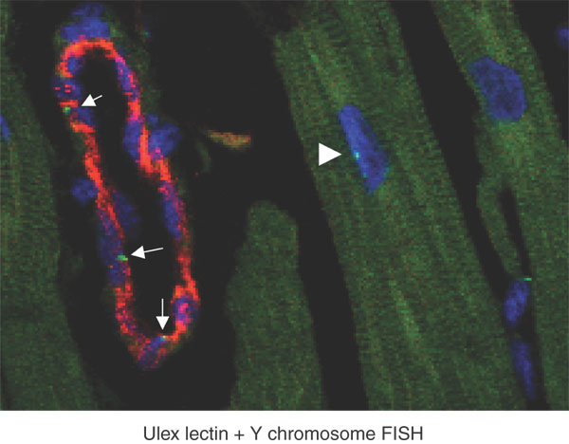
circulating cells can re-populate the heart
Chimerism in a transplanted human heart
Hearts from male patients receiving female hearts, one year after transplantation.
Red staining identifies the endothelium of the (female) heart
Bright green dots identify cells containing the Y chromosome, i.e. cells from extracardiac sources.
Three endothelial cells within a single venule are Y+ (arrows).
a single Y+ cardiomyocyte is shown by the arrowhead
+
Nature Biotech 23, 845 – 856; 2005

Slide 39
Heart repair with bone marrow (BM)-derived progenitor cells
Can BM-derived cells regenerate the ischemic heart?
BM one of the most investigated sources of adult stem cells
  easy to access, isolate and administrate to patients
BM contains several cell subpopulations:
  differentiated cells (stromal mesenchymal cells, vascular cells, adipocytes, osteoblasts,....)
  progenitor cells
The bone marrow mononuclear cell (BMMC) fraction of progenitors includes:
  mesenchymal stem cells (MSC)
  hematopoietic progenitor cells (HPC)
  endothelial progenitor cells (EPC)
Preclinical studies (animal models) show formation of new cardiomyocytes and endothelial cells in ischemic areas following BMMC injection after AMI

Slide 40
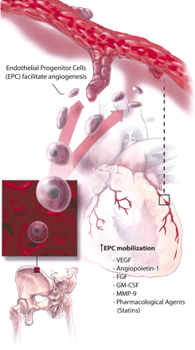
Bone marrow-derived
Endothelial Progenitor Cells
Bone marrow-derived CD34+ hematopoietic progenitor cells from adults can differentiate ex vivo to an endothelial phenotype.
Circulating EPCs facilitate angiogenesis and re-endothelialization at sites of vascular damage (Ashara, Science, 1997)
Mobilization of EPCs from BM is enhanced by growth factors, statins, erythropoietin,…
Levels of circulating “EPCs” as an indicator of vascular health and as marker of cardiovascular disease risk
Szmitko et al, Circulation. 2003;107:3093

Slide 41
Heart repair with bone marrow (BM)-derived progenitor cells
Can BM-derived cells regenerate the ischemic heart?
BM one of the most investigated sources of adult stem cells
  easy to access, isolate and administrate to patients
BM contains several cell subpopulations:
  differentiated cells (stromal mesenchymal cells, vascular cells, adipocytes, osteoblasts,....)
  progenitor cells
The bone marrow mononuclear cell (BMMC) fraction of progenitors includes:
  mesenchymal stem cells (MSC)
  hematopoietic progenitor cells (HPC)
  endothelial progenitor cells (EPC)
Preclinical studies (animal models) show formation of new cardiomyocytes and endothelial cells in ischemic areas following BMMC injection after AMI

Slide 42
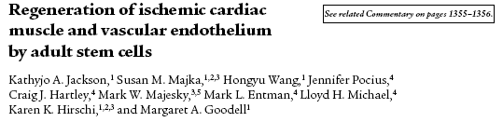
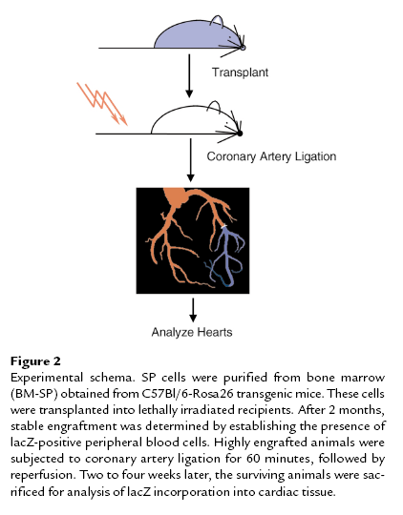
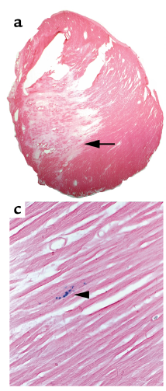
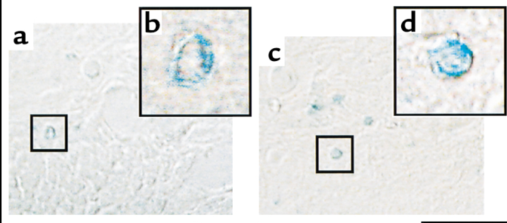
Transplanted cells express LacZ
> donor-derived cells found in myocardium and endothelium

Slide 43
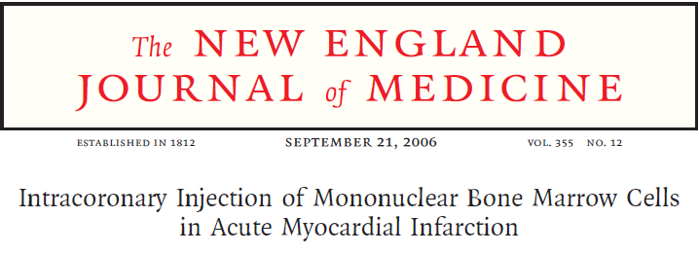
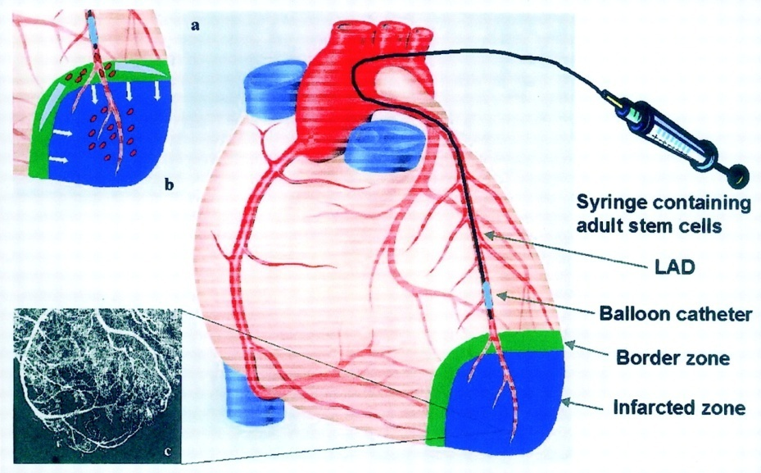
REPAIR-AMI TRIAL
Repair of Infarcted Myocardium by Autologous Intracoronary Mononuclear Bone Marrow Cell Transplantation in Humans
204 patients with acute MI (placebo control group)
Improvement in ejection fraction in post-MI patients following infusion of bone marrow stem cells.
Notes:
REPAIR-AMI an improvement in ejection fraction was observed in post-MI patients following infusion of bone marrow stem cells

Slide 44
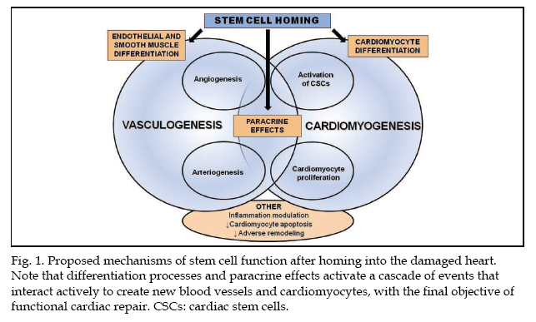
http://www.intechopen.com/books/stem-cells-in-clinic-and-research/randomized-clinical-trials-in-stem-celltherapy-
for-the-heart-old-and-new-types-of-cells-for-cardiov

Slide 45
Adult stem cell therapy for the heart
Aim: to repair damaged myocardium and restore cardiac function
Patients: acute MI, ischemic heart disease, chronic ischemic heart failure
Safety studies : Phase I and II studies ok
Efficacy results: variable, because of
  lack of standardization of cell isolation and delivery procedures
  absence of a universally accepted nomenclature
  large number of stem cell types under investigation in different clinical settings

Slide 46
Stem cell treatment for the heart – review of the situation in 2012
Thirty-three randomised clinical trials (1765 participants)
Stem/progenitor cell treatment was not associated with statistically significant changes in mortality or morbidity
In short-term follow up, stem cell treatment improved left ventricular ejection fraction (LVEF) significantly
Improvement in LVEF was maintained over long-term follow up of 12 to 61 months
Conclusions:
high degree of heterogeneity
moderate improvement in global heart function is significant and sustained long-term
larger number of participants required to assess the full clinical effect of this treatment
Required standardisation of
  Methodology
  cell dosing
  cell product formulation
  timing of cell transplantation
  patient selection
From: Clifford DM et al. Stem cell treatment for acute myocardial infarction. Cochrane Database Syst Rev 2012; 2

Slide 47
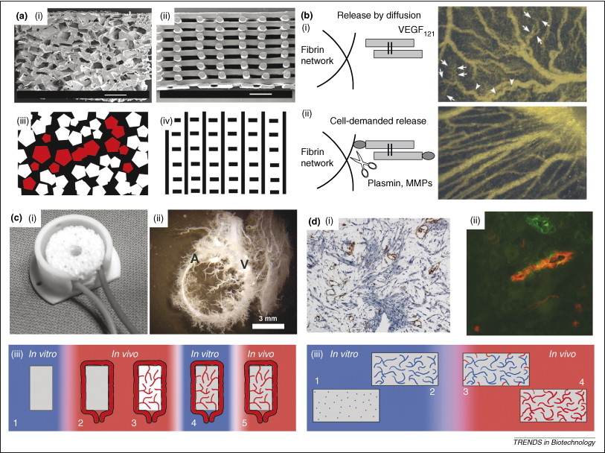
Tissue engineering: making blood vessels
Figure 1 Different strategies for improving vascularization in tissue engineering.
Scaffold design
Growth factor delivery
In vivo pre-vascularization
1: Tissue construct preparation in vitro. 2: Implantation at the prevascularization site, supplied by a vascular axis. 3: Formation of a microvascular network by vessel ingrowth from the vascular axis. 4: Explantation of the prevascularized construct with the vascular axis. 5: Implantation of the construct at the defect site and surgical connection of the vascular axis to the vasculature.
In vitro pre-vascularization
Trends in Biotechnology Volume 26, Issue 8 2008 434 - 441
Notes:
Figure 1. Different strategies for improving vascularization in tissue engineering. (a) Scaffold design. Panel (i) shows a scaffold that was prepared with compression molding and salt leaching. The scaffold in panel (ii) was obtained by 3D fiber deposition. Panels (iii) and (iv) schematically illustrate the scaffold geometries of (i) and (ii), respectively. Note that in the irregular scaffold (iii), some pores (depicted in red) cannot be reached from the outside, so vascular ingrowth will be prevented in these pores. Partly adapted, with permission, from Ref. [51]. (b) Growth factor delivery. Fibrin gel matrices were placed on a chicken chorioallantoic membrane (a membrane of the chicken egg). Panel (i) shows the effects of freely diffusible VEGF₁₂₁, which resulted in the formation of vessels with a disturbed morphology. Many of the newly formed vessel branches were characterized by malformed, corkscrew-like structures (indicated by the arrowheads). Furthermore, many of those branches appeared to abruptly drain into zones of irregular capillary enlargement and growth (indicated by the arrows). In panel (ii), VEGF₁₂₁ was released enzymatically by MMPs in a cell-demanded release. Note that upon cell-demanded release, a more regular organization of the vascular structures can be observed. Adapted, with permission, from Ref. [32]. (c) In vivo prevascularization. An artery (A) and a vein (V) were joined via a loop, which was then placed around a bone-tissue-engineered scaffold and implanted. Panel (i) shows the construct before implantation with plastic tubing instead of the arteriovenous loop for illustration. Panel (ii) shows the highly vascularized construct that was obtained eight weeks after implantation. Panel (iii) schematically depicts in vivo prevascularization. 1: Tissue construct preparation in vitro. 2: Implantation at the prevascularization site, supplied by a vascular axis. 3: Formation of a microvascular network by vessel ingrowth from the vascular axis. 4: Explantation of the prevascularized construct with the vascular axis. 5: Implantation of the construct at the defect site and surgical connection of the vascular axis to the vasculature. Partly adapted, with permission, from Ref. [34]. (d) In vitro prevascularization. Mouse myoblast cells (C₂C₁₂) were combined with human umbilical vein endothelial cells (HUVECs) and mouse embryonic fibroblasts (MEFs) and seeded on a scaffold, resulting in the formation of a 3D prevascular network. After implantation, the network anastomosed to the mouse vasculature. The prevascular network that is formed in vitro is shown in (i). This picture shows a cross section of the scaffold after in vitro culture in which endothelial cells are stained brown and muscle cells are stained blue. Note the presence of cross sections of tubular structures in brown, which shows that the endothelial cells have organized into vascular structures. The anastomosis of the prevascular network after implantation is illustrated in (ii), which shows a cross section of the scaffold after implantation. The vascular network that was formed in vitro is stained in green and all vessels that were perfused with blood at the time of explantation are stained red. The double staining demonstrates that the preformed vessels connected to the host vasculature and were perfused with blood. Panel (iii) schematically depicts in vitro vascularization. 1: A tissue construct containing endothelial cells is prepared in vitro. 2: The endothelial cells organize into a vascular network (blue). 3: The tissue construct is implanted and host vessels (red) grow into the construct. 4: When the host vessels reach the precultured vascular network, the vessels connect and the entire construct becomes perfused. Partly adapted, with permission, from Ref.

