Slide 1
Von Willebrand Factor
Professor Mike Laffan
Imperial College London

Slide 2
Von Willebrand disease: history
1924 Erik von Willebrand
  Familial bleeding in families from Aaland islands
  Several members died from bleeding (mostly female)
  Others had milder bleeding symptoms
Different from Haemophilia: inheritance & bleeding pattern
Bleeding defect corrected by haemophilic plasma even though both have low levels of Factor VIII

Slide 3
Von Willebrand Factor: learning objectives
Understand
  Synthesis & Processing
  VWF function
  Consequence of VWF deficiency
  Consequences of excessive VWF function

Slide 4
Von Willebrand Factor: functions
1. Form a bridge between damaged vessel wall
(collagen) and platelets (primary haemostasis)
2. Stabilise and protect Factor VIII
3. Regulate vascular inflammation?

Slide 5
VWF synthesis and structure

Slide 6
VWF polypeptide and domains
Furin
ADAMTS13
Propeptide
VWF
SP D1 D2 D’ D3 A1 A2 A3 D4 B1 2 3 C1 C2
2050
2813
1
23
FVIII
Heparin
GPIb
Heparin
Collagen
Collagen
GPIIb/IIIa
Multimer
Dimer

Slide 7
C
Cell
N
Plasma
ADAMTS13

Slide 8
VWF processing in plasma
VWF is in ultralarge multimers when released
  Cleavage by ADAMTS 13 reduces multimer size
  Generates smaller multimers and ‘triplets’
  Regulates functional activity

Slide 9
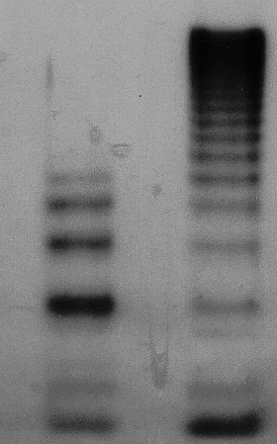
VWF function depends on multimeric composition
VWF
VWF multimeric size
UL-VWF
VWF
Platelet
&
Collagen
Binding
Affinity
VWF
monomer

Slide 10
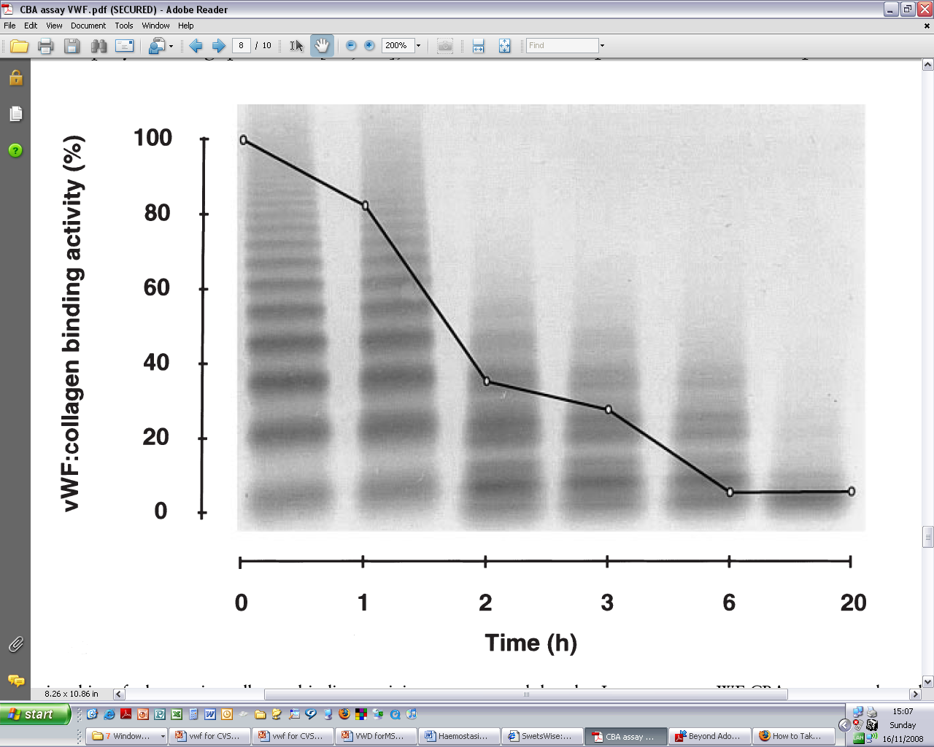
VWF cleavage by ADAMTS-13
Siekmann 1998

Slide 11
Electrophoresis to analyse plasma VWF multimers
High molecular
weight multimers
dimers

Slide 12
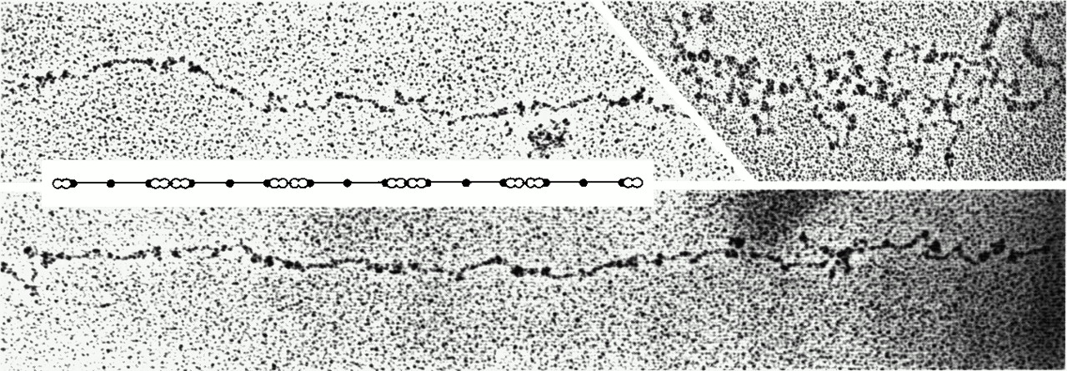
VWF circulates as extremely large multimers: up to 20MD
Electron micrographs of VWF molecules rotary shadowed with platinum.
The extended molecules correspond to the monomer repeats (insert)
Tangled molecules (upper right) were observed most frequently and probably reflect the conformation in solution.

Slide 13
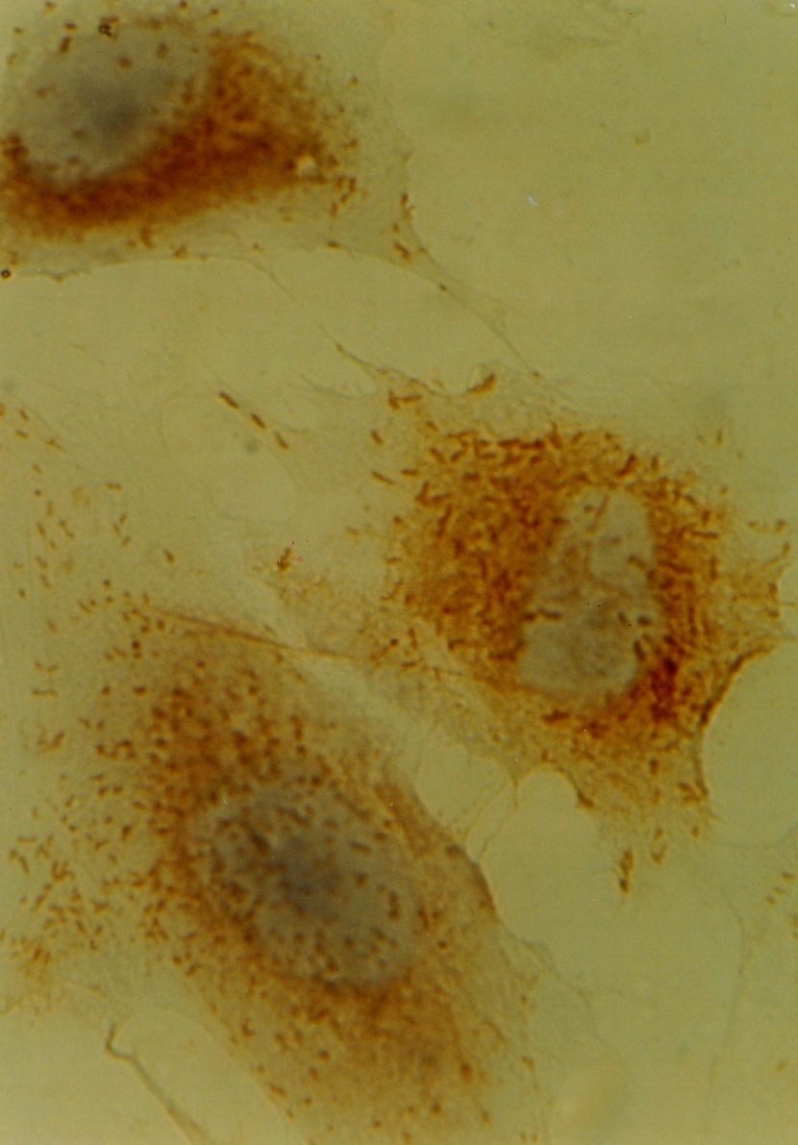
VWF synthesis and storage
Synthesis
  Endothelial cells
    Weibel Palade bodies
  Megakaryocytes
    Platelet α granules
  Plasma VWF entirely derived from endothelial cells

Slide 14
VWF: synthesis (1): Endothelial cells
Lumenal
Constitutive path (minority)
Weibel-Palade bodies
Basal secretion &
Storage for regulated release
Golgi
ER
Sub endothelial
matrix
Ablumenal

Slide 15
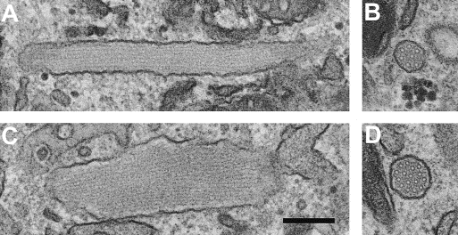
VWF can induce WPB formation
HUVEC
HEK + VWF
Notes:
HEK do not normally have intracellular storage granules. VWF can do this in some cells but not others.

Slide 16
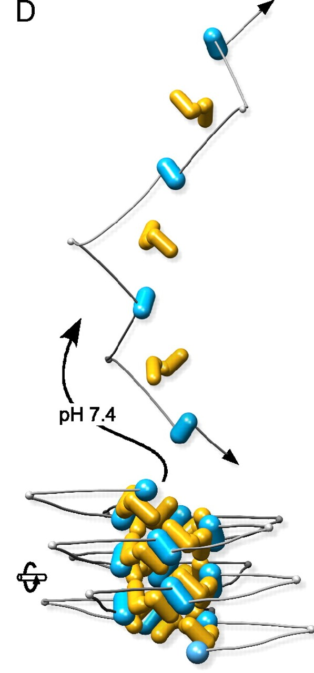
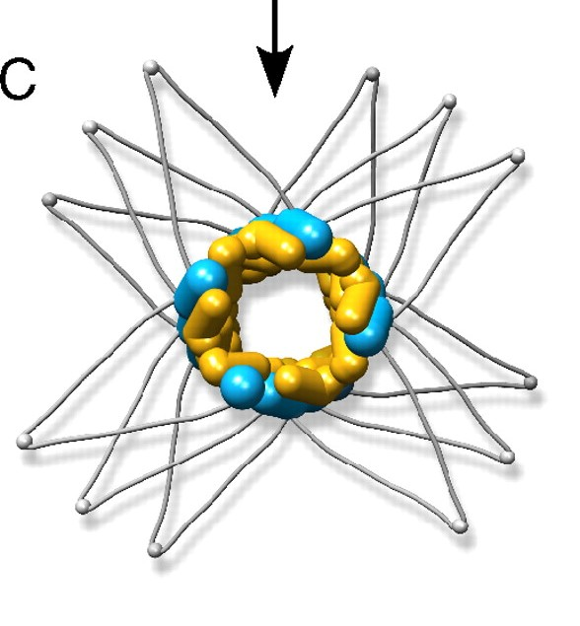
Weibel –Palade bodies
HUVEC
HEK + VWF
Notes:
HEK do not normally have intracellular storage granules. VWF can do this in some cells but not others.

Slide 17
VWF and Weibel Palade bodies (WPB)
WPB found only in endothelial cells
VWF is required for WPB formation
WPB contain HMW VWF
Also contain
  P-selectin and CD63
  Angiopoietin 2
  Endothelin
  IL-8
  Osteoprotegerin ……… and others
Notes:
However multimerisation and sorting to WPB are separate processes. Truncated mutants fail to poly but still go to WPB.

Slide 18
VWF: synthesis (2): Megakaryocytes
All platelet VWF is stored in alpha granules
Does not contribute to plasma VWF (BMT effect)
VWF released on platelet activation
ABO antigens are not added
Not subject to degradation in plasma

Slide 19
VWF plasma levels
VWF plasma levels vary over a six fold range
  40 – 240%
VWF levels are elevated at birth
VWF levels rise slowly with age (~10% per decade)

Slide 20
VWF level in plasma varies over 6 fold range
Genetic
Environmental
  Age
  Stress
  Exercise
ABO blood group
20%
40%
40%
vWF gene
5`SNPs vWF gene
Secretor blood group

Slide 21
VWF glycosylation
12 N-linked and 10 O-linked glycans (Titani 1986)
4 potential NLG sites in propeptide
~20% VWF is glycan by weight
~13% of NLGs carrry ABO blood sugars (Matsui 1992)
16-17 N-glycans
D'
D3
A1
A2
A3
D4
B
B
D1 D2
B
C1
C2
CK
10 O-glycans

Slide 22
Plasma VWF:Ag and ABO genotype.

Slide 23
Influence of ABO blood group on vWF:Ag values in
volunteer blood donors
VWF:Ag
Geometric mean
± 2SD
35.6 - 157.0
48.0 - 233.9
56.8 - 241.0
63.8 - 238.2
VWF :Ag
Geometric mean
74.8
105.9
116.9
123.3
ABO type
O
A
B
AB
n
456
340
196
109

Slide 24
VWF structure: summary
Multimeric glycoprotein that exists in plasma and platelets
VWF is a complex molecule
  Each monomer has multiple functional sites
  Monomers are assembled into large multimers up to 20MDa
  Multimers undergo extensive processing
    Propeptide cleavage, Glycosylation
    Cleavage to regulate size
  Multimers can adopt globular or linear configuration
VWF plasma levels vary widely
  ABO blood group is a major modifying factor

Slide 25
VWF: Function
1. Primary haemostasis – adhesion

Slide 26
Effect of shear stress on immobilised VWF
Shear stress
Siediecki 1996

Slide 27
lumen
platelet
platelet
platelet
platelet
platelet
platelet
Collagen
Tissue Factor
Primary Haemostasis
Notes:
Consider damaged vessel. 2 crucial molecules exposed. Forget TF.

Slide 28
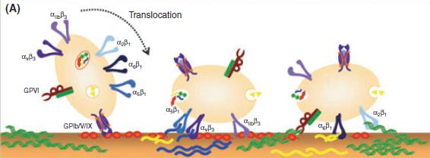

Slide 29
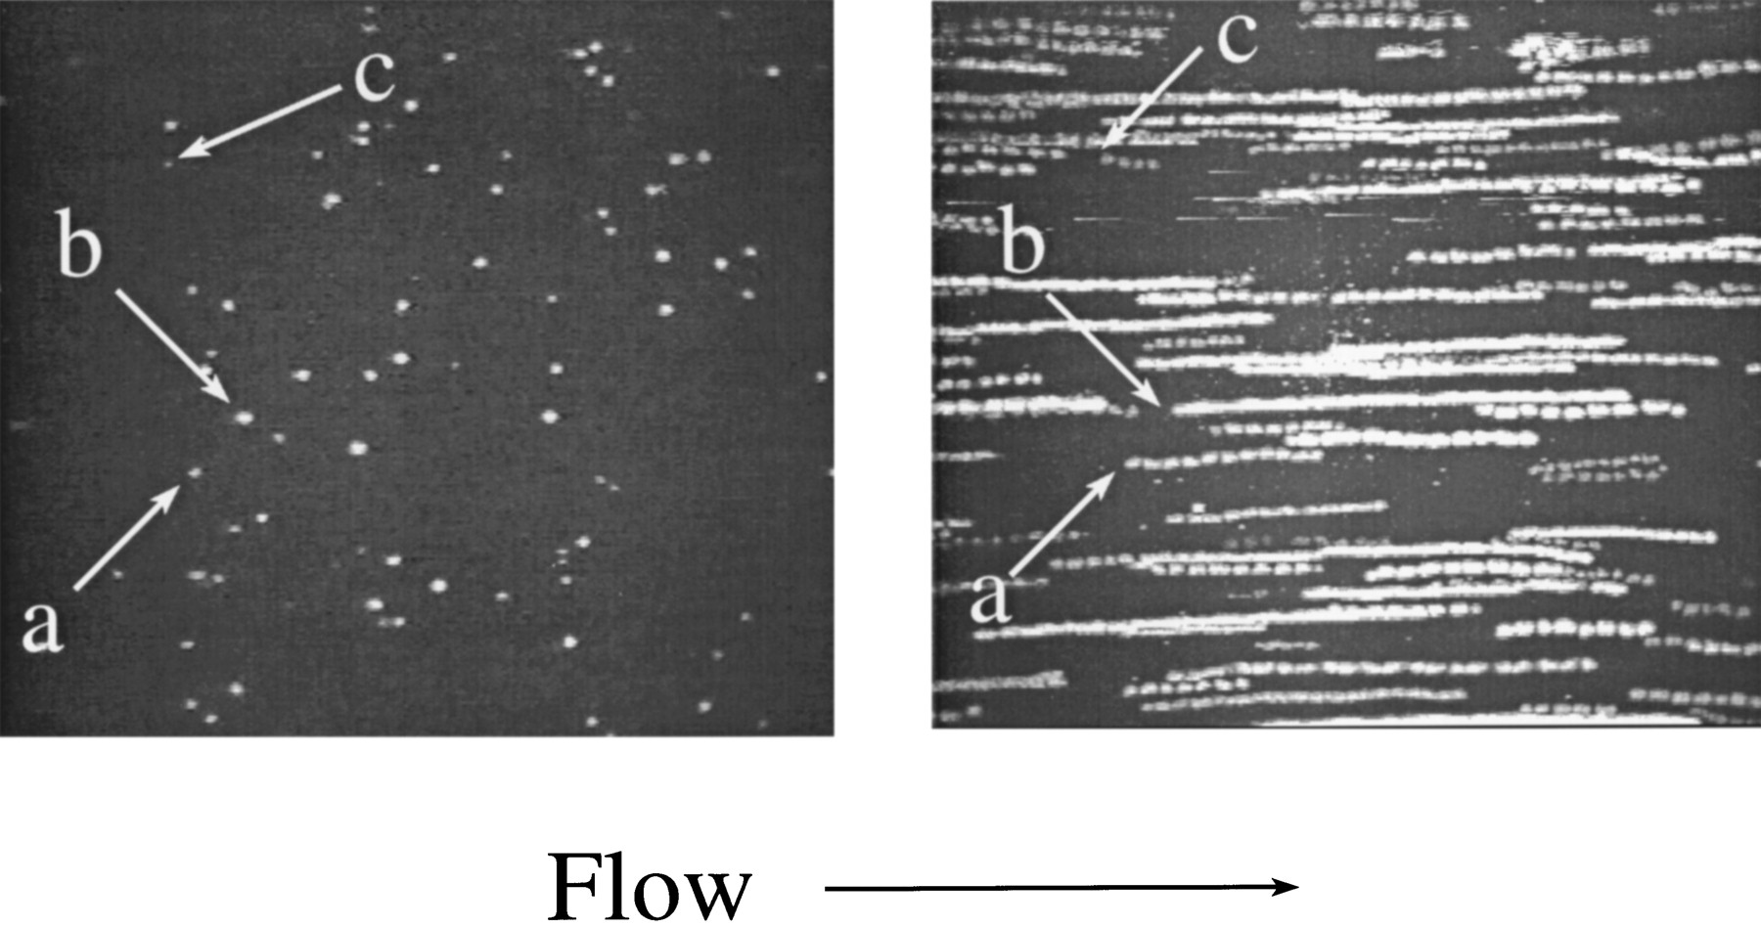
Fluorescent platelet binding to vWF: tethering and rolling
Single frame 1/30s
30 frames over 30s
Shear =1.5s⁻¹
Binding is abolished by blocking GpIb but not GpIIb
Ruggeri

Slide 30
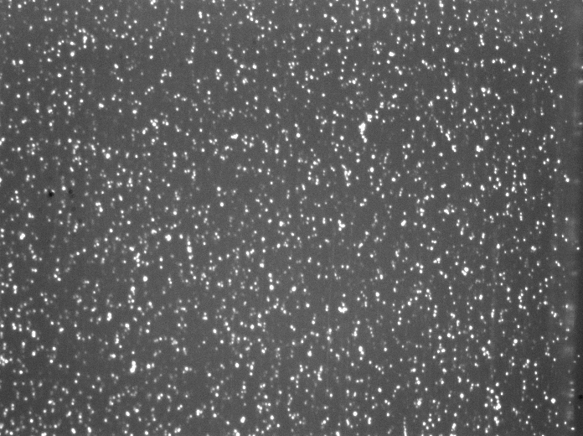
Platelet capture by VWF

Slide 31
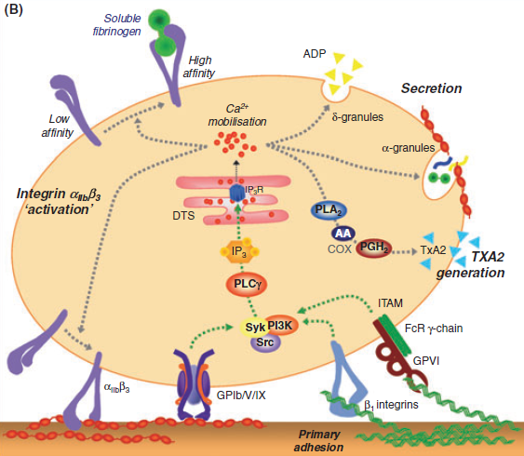
Platelet activation
ADP release
Thromboxane synthesis
α_{IIb}β₃ activation
Phospholipid exposure
Shape change

Slide 32
Mechanisms of platelet activation
Platelet agonists Platelet ligands
  Collagen GpIa, GpVI, GpIIa
  VWF Gp1b
  Thrombin PAR
  ADP PY2, PY12
  Thromboxane Thromboxane receptor
  Fgn, Fcn, Vcn, VWF GpIIbIIIa
All of these are therapeutic targets

Slide 33
Membrane phospholipid
Arachidonic acid
Leukotrienes
Cycloxygenase
COX-1 or COX-2
PGG and PGH2 (endoperoxides)
Tissue specific isomerases
Prostacyclin (PGI₂)
PG(E₂), PGD₂,F₂
Thromboxane A₂
Platelet activator Vasoconstrictor
Antiplatelet
Vasodilator
Notes:
33

Slide 34
Steps in primary haemostasis
VWF binds to exposed collagen
Shear stress elongates VWF exposing multiple binding sites
Shear stress opens GpIb – catches on VWF
Platelets roll along VWF via GpIb
GpIIbIIIa adopts active configuration
Platelets ‘fixed’ to VWF via IIbIIIa
Platelets degranulate, releasing more VWF
Further platelets captured forming platelet plug
Fibrinogen and fibronectin contribute to plug stability (RGD)

Slide 35
VWF: Function
Primary haemostasis
Factor VIII

Slide 36
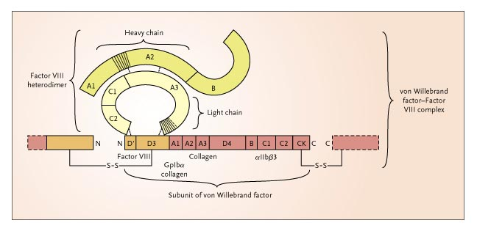
Factor VIII binding to VWF
Mannucci 2004

Slide 37
VWF and Factor VIII
Factor VIII and VWF circulate as a complex in plasma
Protects VIII from degradation
Prevents premature association with Factor X, phospholipids
Free FVIII half life ≈ 2 hours
VWF bound FVIII half life ≈ 12 hours
FVIII activation by thrombin releases it from vWF

Slide 38
Von Willebrand Disease
Deficiency of VWF function

Slide 39
Von Willebrand Disease
A quantitative or qualitative deficiency of VWF:
leading to an increased tendency to bleeding
Features:
defect of primary haemostasis
  Prolonged bleeding time
Reduced level of Factor VIII
  Coagulation defect – deep bleeding

Slide 40
von Willebrand Disease - Classification
Primary Classification
Type 1: quantitative deficiency 75% 10⁻³-10⁻⁴
Type 2: qualitative deficiency 20%
Type 3: virtual complete deficiency 5% 10⁻⁶

Slide 41
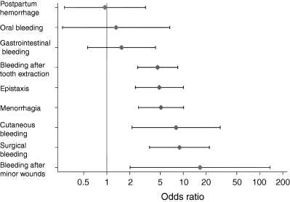
Bleeding symptoms and Type 1 VWD
Tosetto 2005
Notes:
From the european study. Note cutaneous bleeding is the feature most closely associated with VWD diagnosis.

Slide 42
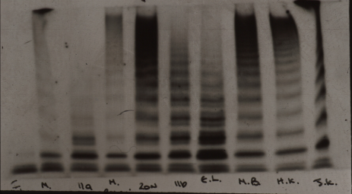
Multimer analysis in VWD
3 2A 2A 1 N 2B

Slide 43
Desmopressin (DDAVP)
Vasopressin derivative
Acts via V2 receptors
Releases VWF from WPB
2-5 fold rise in vWF-VIII (VIII>vWF)
Type 1 vWD
Dose
Peak response
0.3µg/kg i.v
30-60 mins
300µg i.n.
60-90 mins

Slide 44
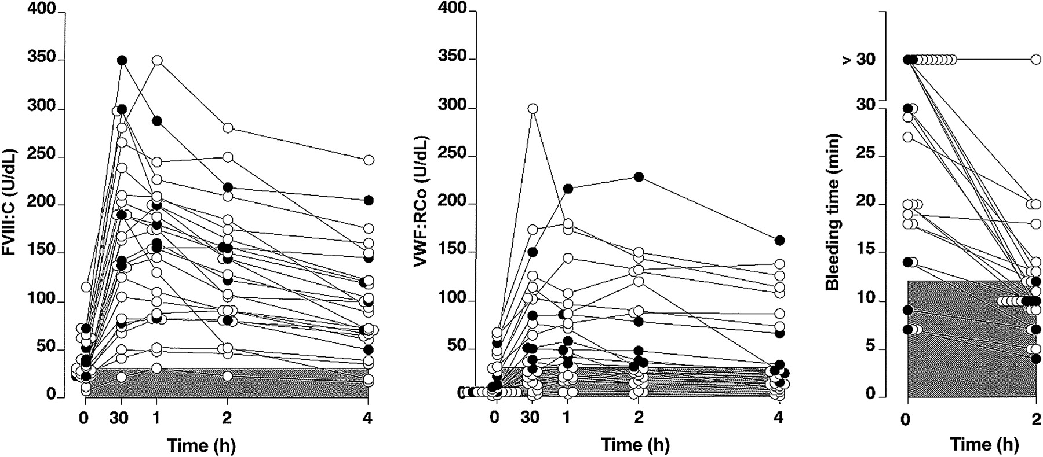
DDAVP response in Type 1 VWD
Federici 2004

Slide 45
Excess VWF activity
ADAMTS 13 deficiency

Slide 46
Thrombotic thrombocytopenic purpura
Clinical features
microangiopathic haemolytic anaemia (MAHA)
thrombocytopenia
neurological abnormalities
renal impairment
fever

Slide 47
TTP - pathophysiology
Loss of ADAMTS 13 activity
  Congenital (rare)
  Acquired (more frequent: due to autoantibody)
Ultra large VWF multimers
Platelet capture and deposition in arterioles
Thrombocytopenia
Microangiopathy & Haemolytic anaemia
Organ dysfunction (esp brain and kidney)

Slide 48
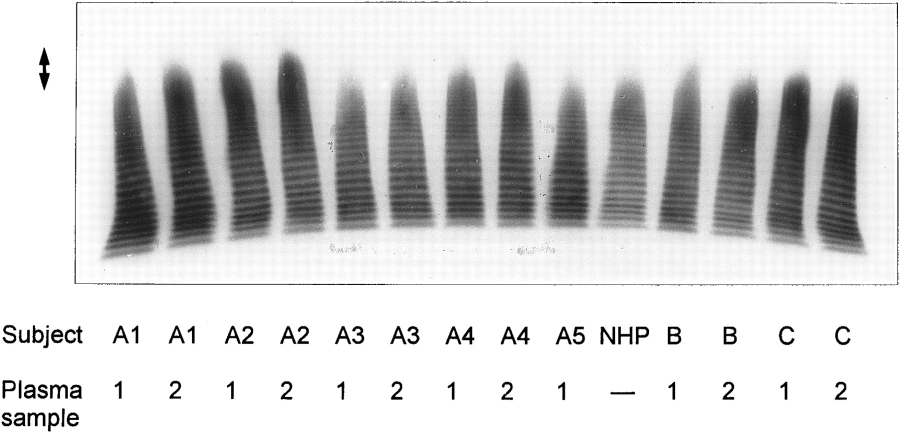
Ultra-large multimers in TTP
Familial TTP: plasma VWF
Patients A1, A2, B, C
Unaffected members A3, A4, A5.

Slide 49
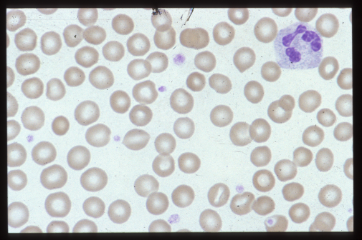
Normal blood film

Slide 50
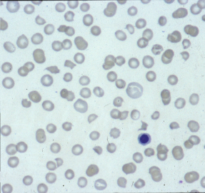
MAHA - TTP

Slide 51
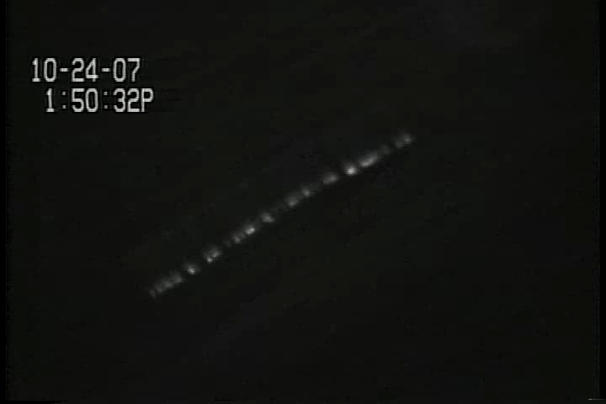
VWF capture of platelets on EC

Slide 52
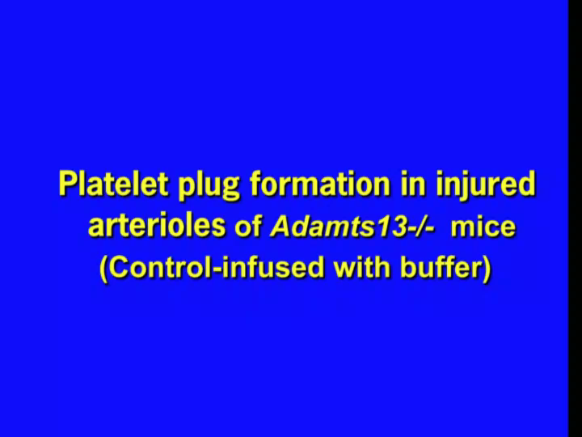
ADAMTS13 and thrombus formation

Slide 53
The TTP cycle
ULM
Pt activation
X
ADAMTS 13
X
ADAMTS 13
Trigger – inflammation?
Notes:
1

Slide 54
EC-VWF-Platelets
Ultra large VWF multimers are retained and adhere to EC
Regulated by ADAMTS13
VWF strings capture platelets and set up a cycle of inflammation
This occurs pathologically in TTP
May also participate in generation of atheromatous plaques

Slide 55
TTP - pathophysiology
Loss of ADAMTS 13 activity
  Congenital (rare)
  Acquired (more frequent: due to autoantibody)
Ultra large VWF multimers
Platelet capture and deposition in arterioles
Thrombocytopenia
Microangiopathy & Haemolytic anaemia
Organ dysfunction (esp brain and kidney)

Slide 56
VWF and thrombosis

Slide 57
VWF and arterial disease
Mediates platelet adhesion and aggregation at high shear
Contributes to clot formation via effect on FVIII
Regulates/mediates inflammatory response of endothelium
Simply a marker of endothelial damage/activation?

Slide 58
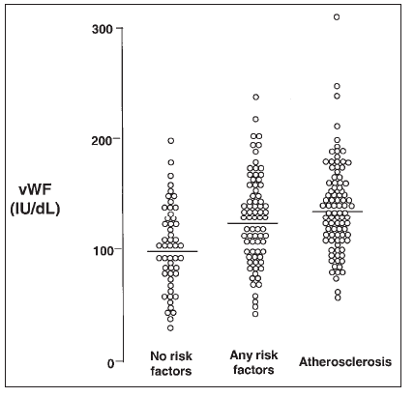
VWF and atherosclerosis: cause or effect?
Blann 2002

Slide 59
VWF and risk of arterial disease
Plasma VWF often appears as a weak risk for IHD
  Eg 1.7 for highest v lowest quartile in the ARIC study
  Risk reduces greatly after correction for other risks
BUT
Elevated VWF is associated with acute occlusions
Platelet VWF may be the source of VWF in arterial occlusions
Expression of VWF may mediate inflammation and atheroma formation

Slide 60
VWF as a therapeutic target

Slide 61
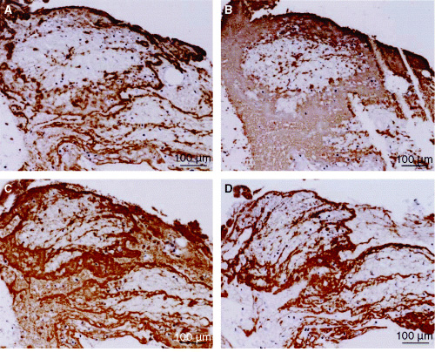
VWF is an important component of occlusive thrombi
prominent presence of VWF, especially at sites of accumulation of platelets.
consecutive slice of the coronary thrombus specimen in (A) showing co-localization of platelet-specific anti-GP IIb/IIIa antibody with the VWF.
Staining of tissue factor
Fibrin fibers co-localized with tissue factor.

Slide 62
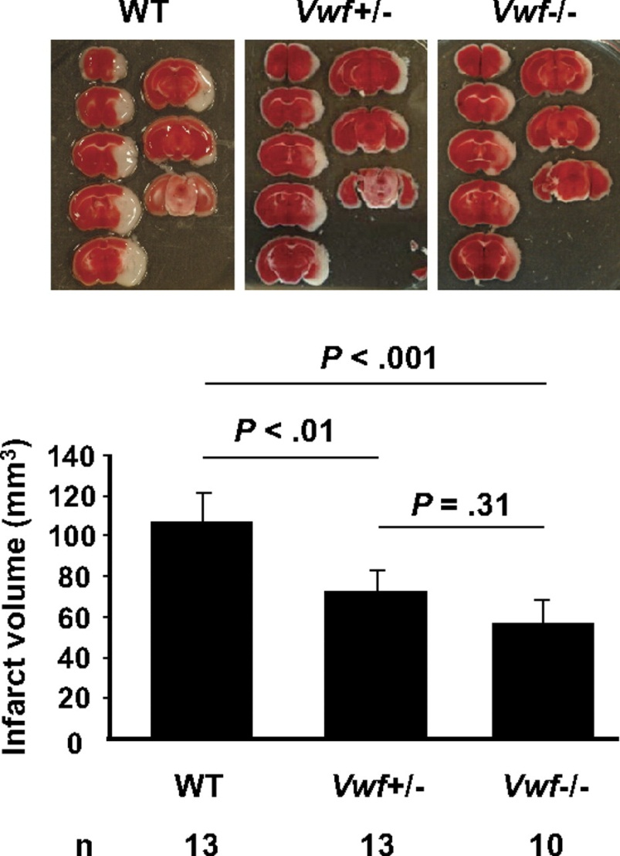
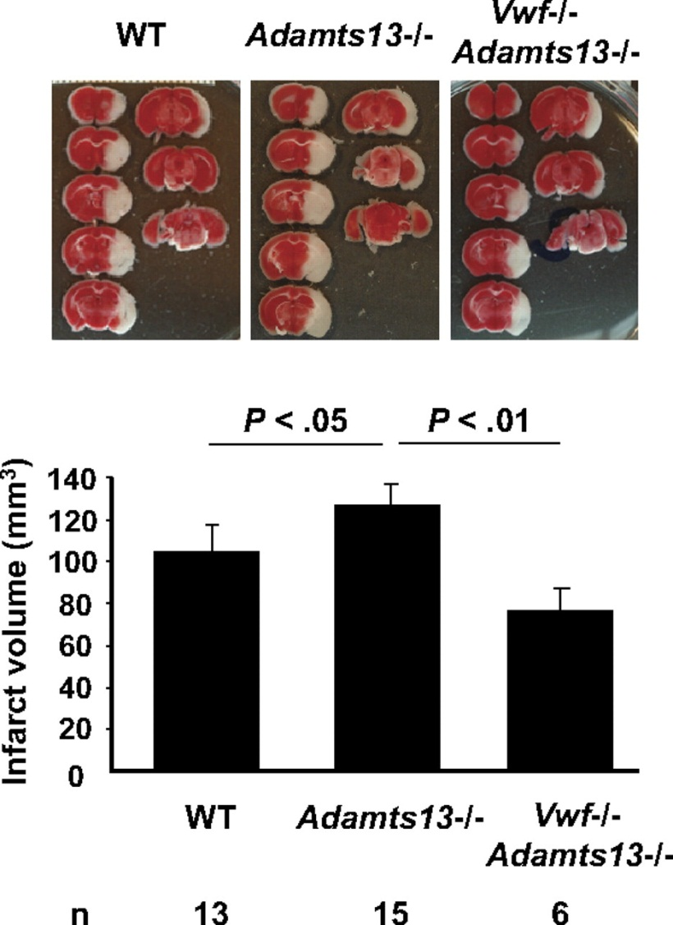
VWF in murine stroke model Zhao 2009
VWF increases infarct size
ADAMTS 13 reduces infarct size

Slide 63
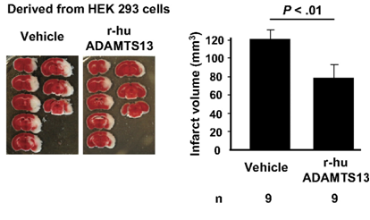
Additional ADAMTS 13 reduces infarct size
Zhao 2009

Slide 64
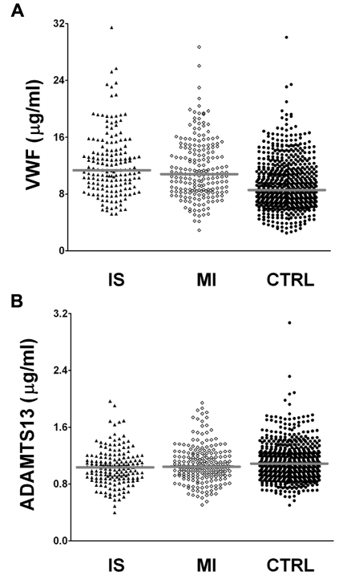
VWF and ADAMTS: risk of stroke and MI in young women
Andersson Blood 2012

Slide 65
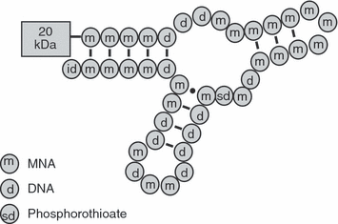
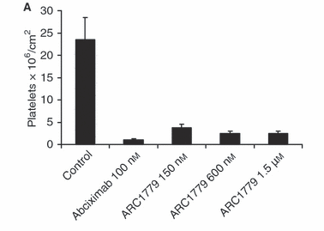
An anti-A1 aptamer blocks platelet adhesion to porcine aorta under high shear
Diener 2009

Slide 66
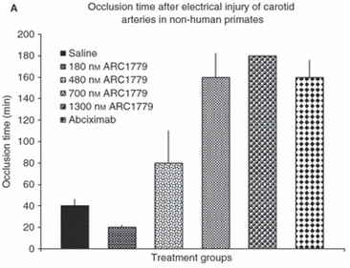
Anti –A1 aptamer reduces time to occlusion in arterial thrombosis
Diener 2009

Slide 67
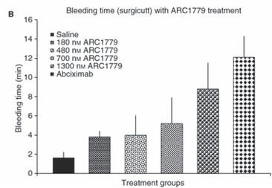
Aptamer has better therapeutic index than abciximab
Occlusion time
Bleeding time

Slide 68
VWF and the development of atheroma

Slide 69
VWF and vascular disease
VWF directs production of WPB which contain numerous inflammatory and angiogenic mediators
VWF is widely but not universally expressed in the endothelium but particularly at sites of atheroma formation

Slide 70
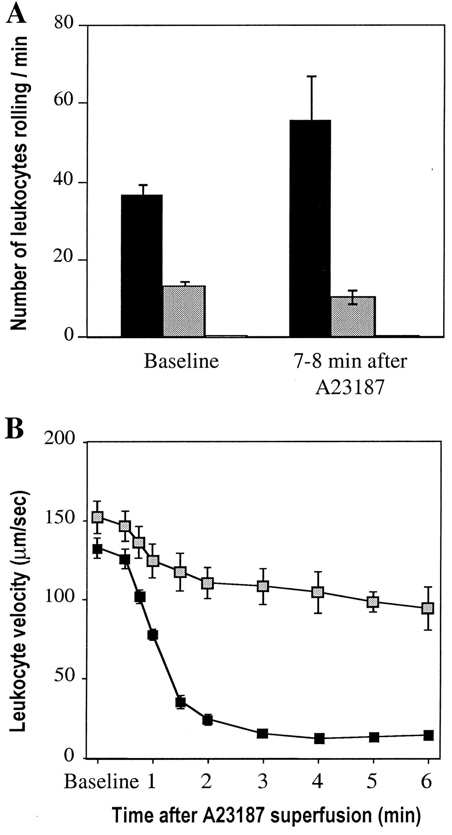
Leukocyte rolling in vWf −/− venules stimulated by A23187 – loss of P-selectin regulation
VWF +/+
VWF -/-
Denis 2001

Slide 71

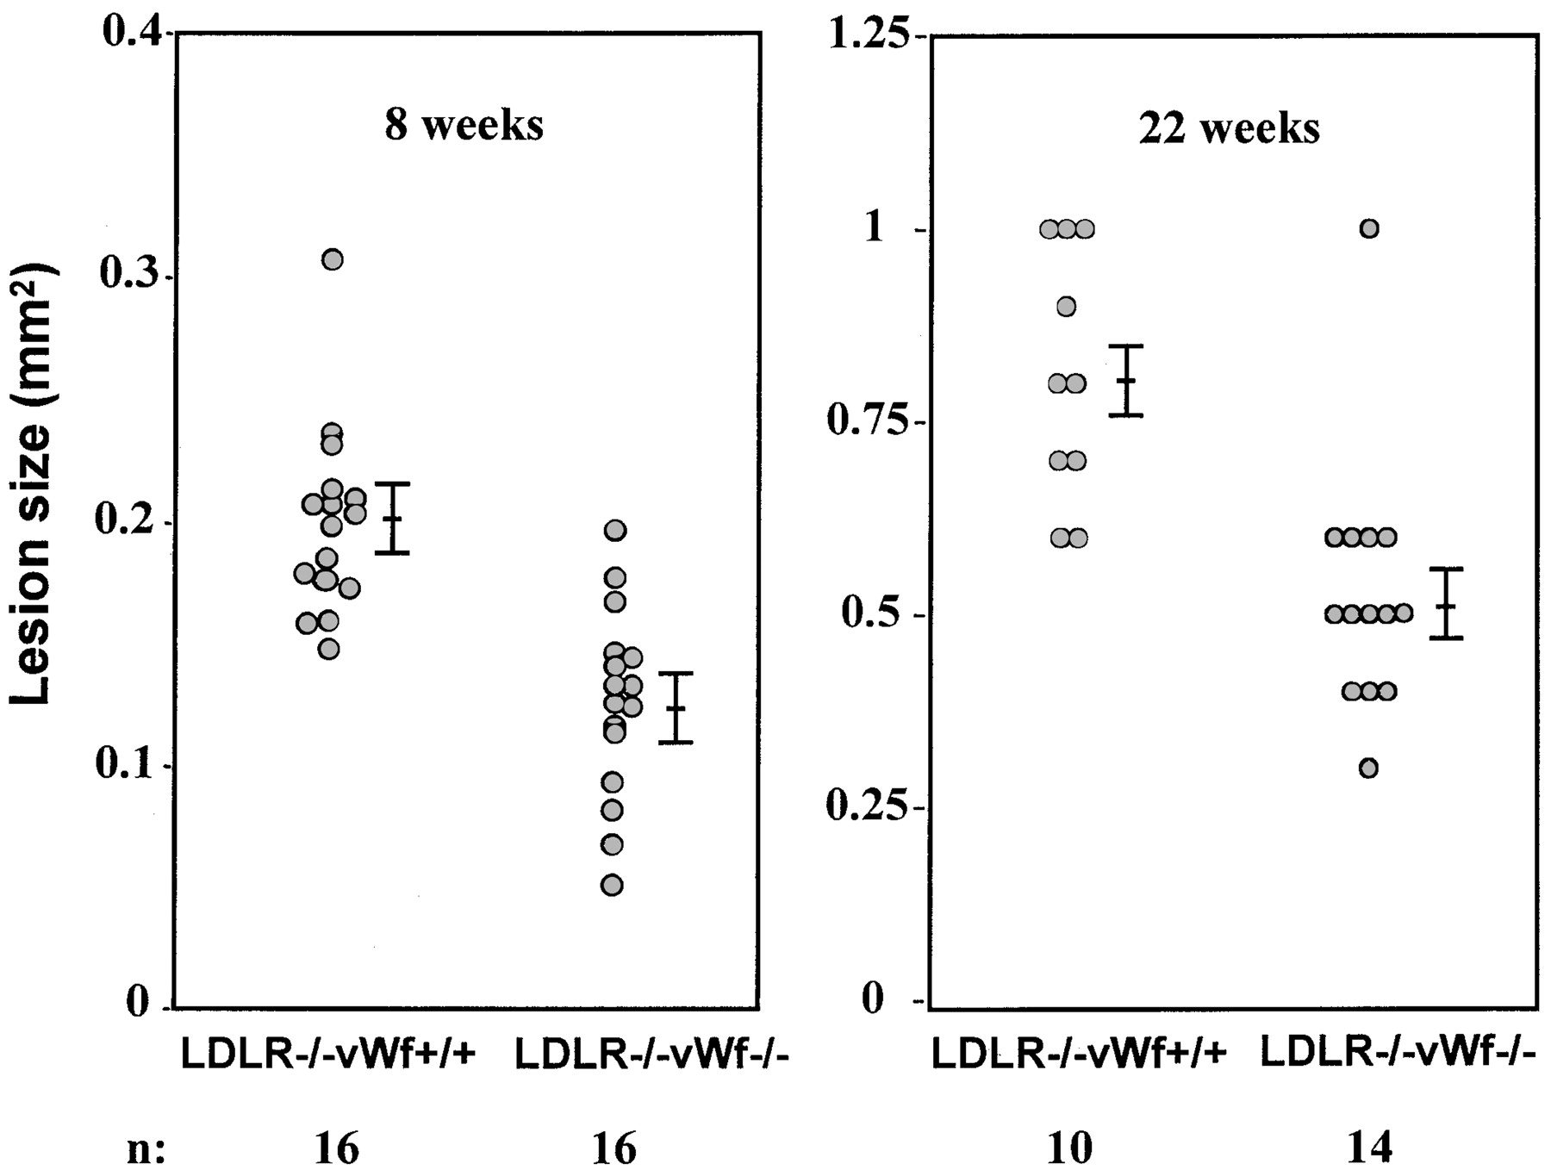
Reduced aortic sinus atheroma in VWF deficient mice
Methia, N. et al. Blood 2001;98:1424-1428

Slide 72
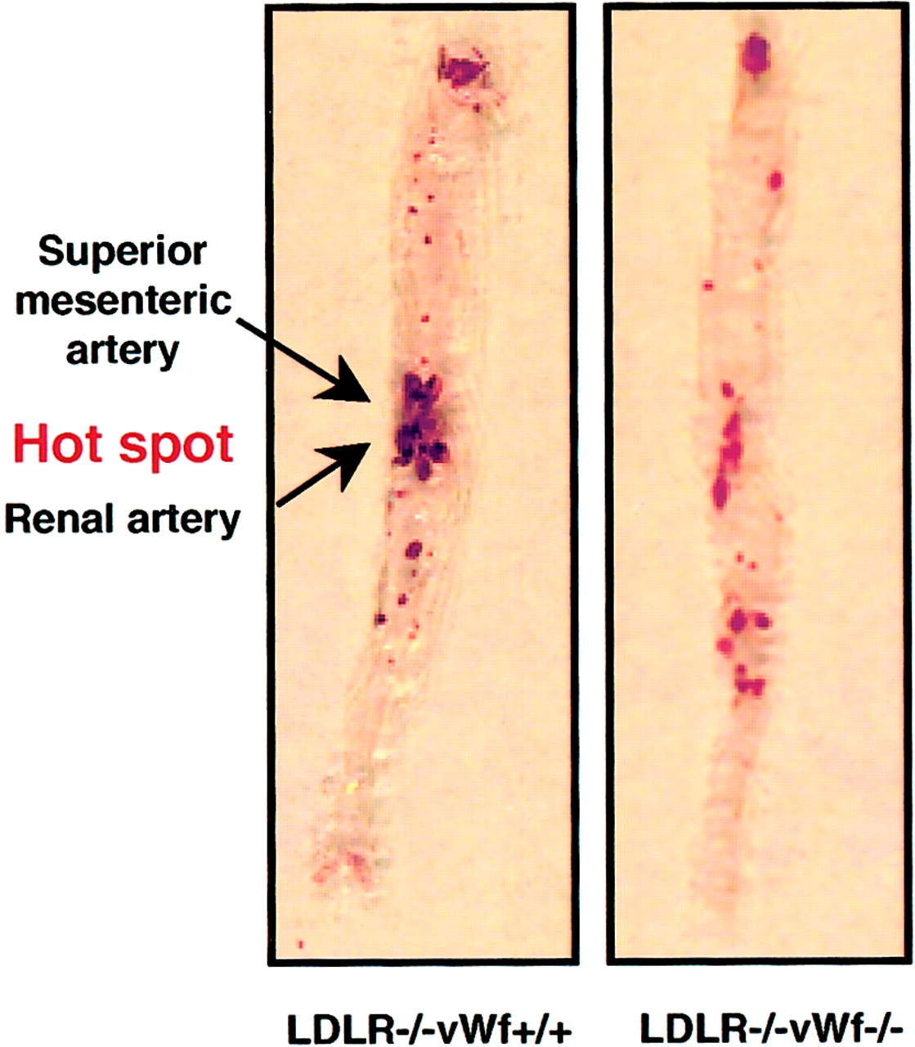
Localised reduction in atheroma in VWF deficient mice
Methia, N. et al. Blood 2001;98:1424-1428

Slide 73
VWF: Summary
Complex multidomain molecule
Assembles into large multimeric structures
Structural determinants responsible for multiple properties and storage
Levels of VWF modulated by other genetic polymorphisms
Deficiency results in VWD
Excess activity associated with TTP
EC released VWF mediates platelet and neutrophil adhesion and inflammation
High VWF levels associated with thrombosis and arterial disease
VWF adhesive function is a possible therapeutic target

