Slide 1
Introduction to pulmonary arterial hypertension
K. Dimopoulos MD MSc PhD FESC
Royal Brompton Hospital
Imperial College London
k.dimopoulos02@gmail.com

Slide 2
Outline and objectives
PAH is a devastating disease which in the absence of effective treatment progresses rapidly to death
Early diagnosis: difficult due to low prevalence and non-specific symptoms
There are 9 PH specialist centres within the UK and they offer important benefits e.g. resources to aid an accurate and timely diagnosis and access to advanced therapies
Notes:
PAH is a devastating disease that in the absence of treatment progresses rapidly to right heart failure and death. Recent data from the EARLY trial have underscored the importance of early diagnosis and subsequent early intervention. However, we are faced with many challenges in attaining an accurate diagnosis of PAH. During this presentation, we will discuss the challenges that you all face in attaining an accurate diagnosis and the ways that will help to aid attaining a timely (and accurate) diagnosis and hence initiation of effective therapy at the earliest opportunity. The benefits that are offered by the specialist centres will also be described.

Slide 3
40y old
Progressive SOB over last 2 years
Now can manage less than 50m on flat
Ankle swelling, abdominal swelling
Mother, grandmother died in their 30s-40s
IHD? DCM/Heart failure? Lungs?........

Slide 4
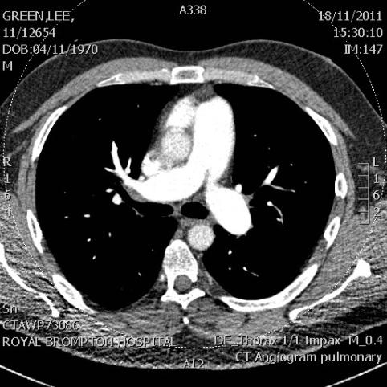
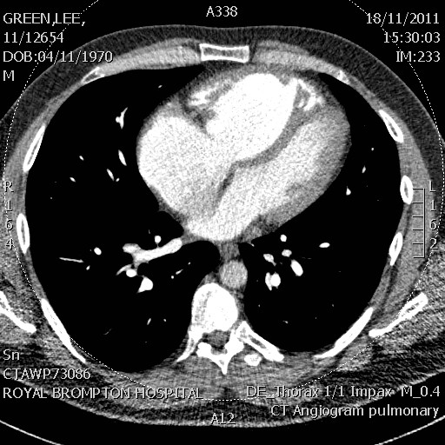
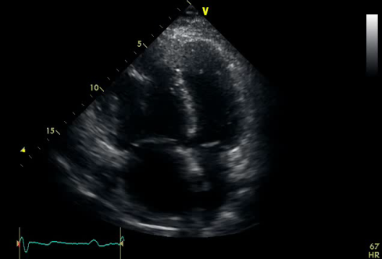
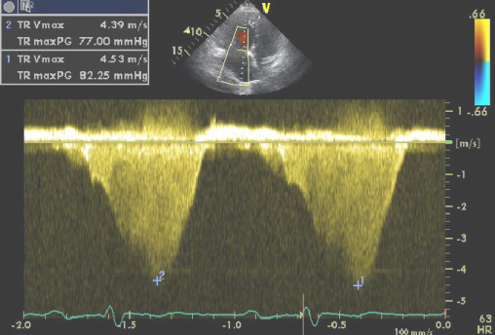
RV
LV
Ao
PA
TR

Slide 5
Definition of PH
35
30
32
25
S
mean PAP (mmHg)
20
17
15
13
10
D
5
4
0
Normal resting
PAH resting
PH definition: mPAP>25 mmHg at rest
Galiè N, et al. Eur Heart J 2009; 30:2493-2357.
Notes:
PH is defined as a resting mean pulmonary arterial pressure (mPAP) 25 mm Hg. The subgroup of PH known as PAH adds the criterion that the pulmonary arterial wedge pressure must be 15 mm Hg. Some definitions have also included PVR, requiring that it be 2 or 3 Wood units.
Galiè N, et al. Eur Heart J 2009; 30: 2493-2357.

Slide 6
Cardiopulmonary Physiology
VCO₂
PERIPHERAL TISSUES
CO=HRxSV
Hb
AIR
V/Q
CO₂
O₂
LUNG
VENTILATION
LUNG
PERFUSION
BLOOD/
PERIPHERY
VO₂
HEART
MUSCLE
Obstruction
Restriction
Myoskeletal
iPAH
R-L shunt
PE
CHF
CHF
CHD
Valve disease
Anaemia
PVD
Skeletal muscle
Obesity
Detraining
Endothelial dysfunction
Notes:
VO2 must match muscle O2 consumption:
Aerobic metabolism=Effective
When VO2 does not match muscle O2 needs:
Anaerobic metabolism=
Ineffective: high consumption of glucose, slow ATP regeneration
Piruvate production, buffered by HCO3, increased CO2 production

Slide 7



Normal iPAH
↑PVR
↓PBF
↓CO
Dilated and impaired RV
Notes:
7

Slide 8
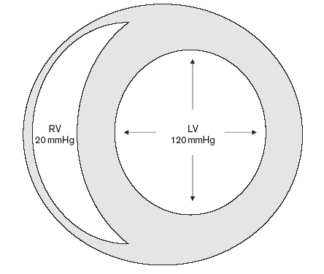
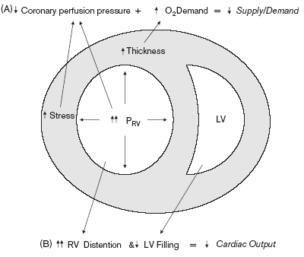
Notes:
8

Slide 9
WITHIN THE LUNGS?
COMING FROM THE LEFT HEART?

Slide 10
Pre versus postcapillary PH
TP gradient
R=V/I
PVR=TPgradient/CO
LV
Ao
Normal
RV
Systemic circulation
PVR
PA
Lungs
LA
RA
RA
RA
LV
RV
Ao
Pre-capillary
PA
PVR
>25mmHg
Systemic circulation
Lungs
<15mmHg
RA
LA
RA
LV
RV
PVR
Ao
PA
Post-capillary
>25mmHg
>15mmHg
Systemic circulation
Lungs
LA
RA
RA

Slide 11
DCM iPAH
Notes:
11

Slide 12
WITHIN THE LUNGS?
COMING FROM THE LEFT HEART?

Slide 13
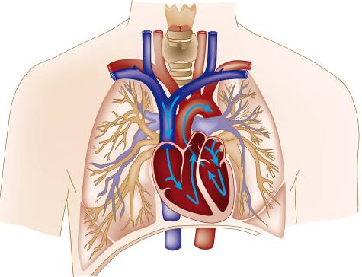
Clinical classification of PH
1. Pulmonary arterial hypertension (PAH)
  Idiopathic PAH (IPAH)
  Heritable PAH
  Drug- and toxin- induced
  Associated PAH (APAH)
    Connective tissue diseases
    HIV infection
    Portal hypertension
    Congenital heart diseases
    Others
  Persistent PH of the newborn
1’ Pulmonary veno-occlusive disease (PVOD) and /or pulmonary capillary hemangiomatosis (PCH)
2. PH owing to left heart disease= POSTCAPILLARY
3. PH owing to lung diseases and/or hypoxia
  COPD
  Interstitial lung disease
4. Chronic thromboembolic pulmonary hypertension (CTEPH)
5. PH with unclear multifactorial mechanisms
  Sarcoidosis
Galiè N, et al. Eur Heart J 2009; 30:2493-2357.
Notes:
This slide shows the revised clinical classification (i.e. from the 4th World Symposium on PH, Dana Point 2008) for PH. As you can see, PAH represents the Group 1 of the classifcation system, there being 5 groups in total. Response to therapy represents one factor that determines the classification of different forms of PH. Therefore, it is important to recognise that there are many other causes of PH other than PAH (in most cases these are more common than PAH) and that the cause/substrate determines the therapeutic response.

Slide 14
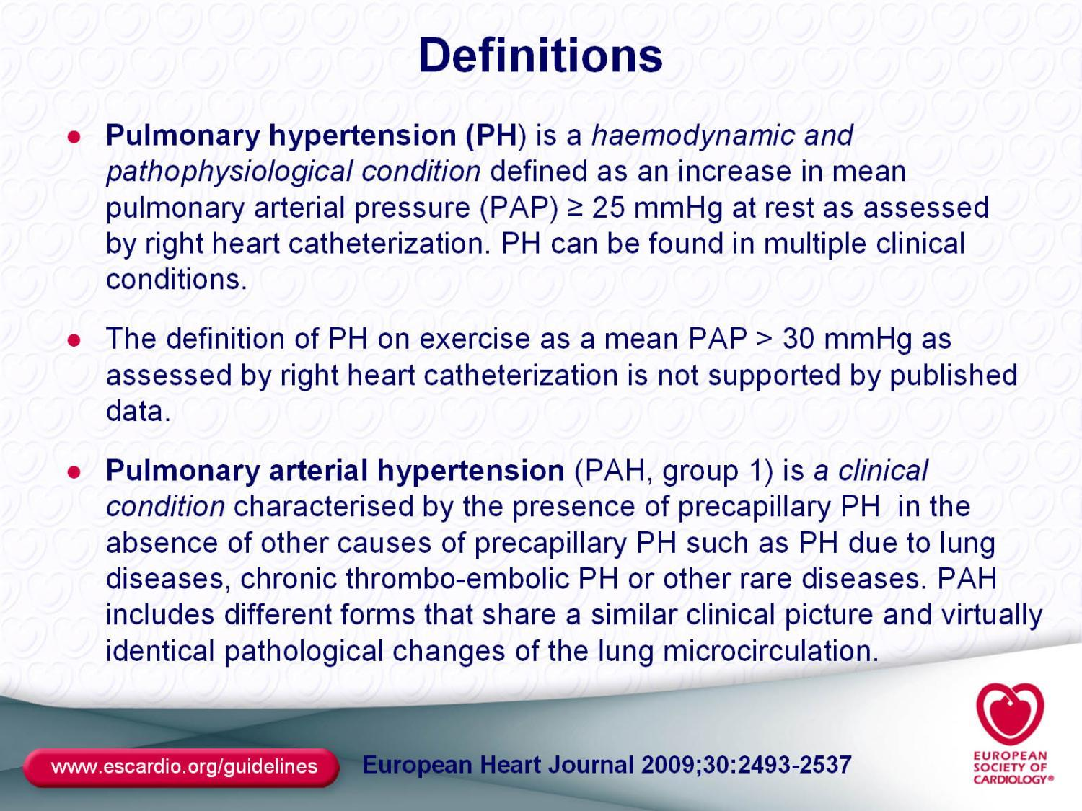

Slide 15
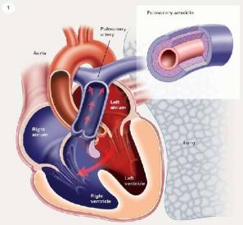
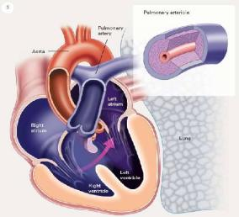
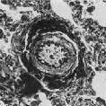
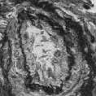
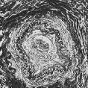

PAH associated with L-R shunt
Eisenmenger syndrome
Shunt
L-R
Bidirectional/RL shunt
R-L
Endothelial dysfunction
Shear stress & stretch
Vascular Remodeling
Histology
I
II
III
IV-V
PVR
PVR
Notes:
15
15

Slide 16
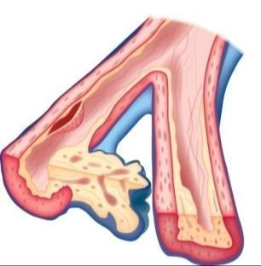
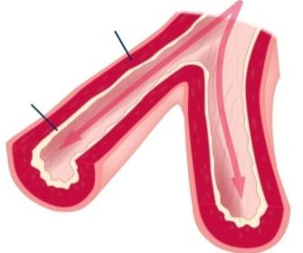

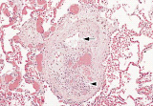
The malignant nature of PAH
Smooth muscle
dystrophy
1
Intimal proliferation & fibrosis
1
Thrombosis
Early intimal
proliferation
Medial
hypertrophy
Medial
hypertrophy
Plexiform
lesions
Intimal thickening
Narrowing of lumen
Increased wall thickness
Plexiform lesion
Angiogenesis & evasion of apoptosis²
Self-sufficient in growth signals & insensitivity to anti-growth signals²
Tissue invasion and limitless replicative potential²
Hallmarks shared with cancer
1. Gaine S. JAMA 2000; 284:3160-8.
2. Rai PR, et al. Am J Respir Crit Care Med 2008; 178:558-64.
Notes:
The pathobiological mechanism in PAH involves multiple factors. Vasoconstriction, remodelling of the pulmonary vessel wall, and thrombosis all contribute to increasing pulmonary vascular resistance.^{1,2}
The malignant nature of PAH relates to 1) The relentlessly progressive nature of PAH (similar to the prognosis of advanced cancers) as well as similarities in the histopathological changes associated with PAH, which share several hallmarks with cancer^{3,4} :
1. No apoptotic cells in lesions and express anti-apoptotic proteins
2. Impaired TGF-B signalling makes endothelial cells in lesions insensitive to growth controlling effects of TGF-B-these could even be released from complex vascular lesions and recirculate in the lung
3. Cells seem to develop a strategy to divide and grow eg loss of prostacyclin synthase (PG is anti-proliferative), and expression of survivin – anti-apoptotic
Reference
Gaine S. Pulmonary hypertension. Jama 2000; 284:3160-8.
Rai PR, et al. Am J Respir Crit Care Med 2008; 178:558-64.

Slide 17
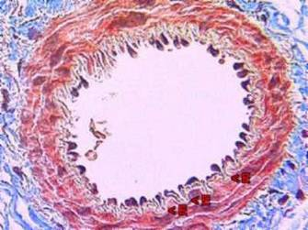
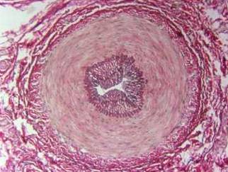
Pathogenesis of PAH
Normal
Abnormal
Increased pulmonary vascular resistance and raised pulmonary artery pressure:
  Vascular proliferation and remodelling
  Distal muscularisation of normally non-muscular arteries
  Increased muscularisation of muscular pulmonary arteries
  Neointima formation
  Formation of plexiform lesions
ACT 08/1308 October 09
Jeffery T, Morrell N. Prog Cardiovasc Dis 2003;45:173–202
Notes:
17
The pathobiological mechanism in PAH involves multiple factors. Vasoconstriction, remodelling of the pulmonary vessel wall, and thrombosis all contribute to increasing pulmonary vascular resistance.¹ [pages 174-176]
Vascular proliferation and remodelling [page 174, column 2]
Vascular remodelling is characterised by thickening of all 3 layers of the pulmonary vessel walls due to hypertrophy (cell growth) or hyperplasia (cell proliferation) of one or more cell types as well as increased deposition of extracellular matrix components.¹
Muscularisation of non-muscular arteries [page 174, column 2]
Appearance of layer of smooth muscle in small peripheral pulmonary arteries which are not normally muscular. ¹
Process not completely understood. Differentiation of pericytes and recruitment of fibroblasts from surrounding lung parencyma may contribute to this process. These cell types differentiate to take on smooth-muscle-like phenotypes. ¹
Increased muscularisation of muscular pulmonary arteries [page 175 column1]
Proximal muscular arteries experience a higher intraluminal pressure due to the vasoconstriction and remodelling taking place in the smaller peripheral arteries. ¹
Proliferation and hypertrophy of medial smooth muscle narrows the vessel diameter and new elastic layers are deposited between the muscle layers and increased deposition of type 1 collagen deposition stiffens vessel walls. ¹
Neointima formation [page 175, column 1]
Formation of a layer of cells and extracellular matrix between endothelium and internal elastic lamina (called the neointima). ¹
This occurs in small and large arteries and significantly contributes to increased vascular resistance. ¹
It is thought to be a non specific response to vascular injury. The cells may arise due to differentiation of endothelial cells, migration of smooth muscle like cells or migration of adventitial fibroblasts. The specifics are not fully understood. ¹
Formation of plexiform lesions [page 175, column 2]
Disorganised proliferation of endothelial cells leads to the formation of plexiform lesions in 80% of cases of iPAH and in severe cases of secondary PAH. ¹
The lesions themselves may possibly be a marker of endothelial abnormality in primary pulmonary hypertension, and could also be involved in its pathogenesis. ¹
Reference
Jeffery T, Morrell N. Prog Cardiovasc Dis 2002; 45: 173–202

Slide 18
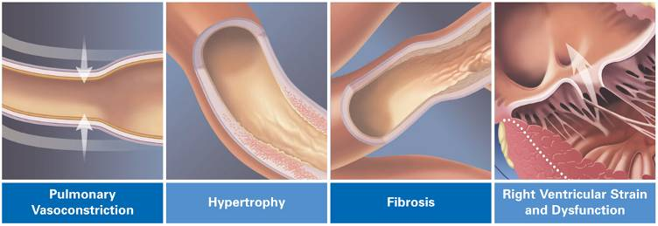
PAH is more than just vasoconstriction
Disease progression
Narrowing of the small pulmonary arteries occurs¹
Increased pulmonary vascular resistance and right ventricle afterload leads to right-ventricular failure²
Vascular proliferation and remodelling are the main contributing factors to PAH pathogenesis^{1,2}
1. Farber HW et al. N Engl J Med 2004;351:1655–65
2. Humbert M et al. J Am Coll Cardiol 2004;43:13S–24S
ACT 08/1308 October 09
Notes:
Main changes are vasoconstriction, smooth-muscle cell and endothelial proliferation, and thrombosis
The homeostatic imbalances are probably consequences of pulmonary endothelial-cell dysfunction or injury
Reference:
Farber HW, et al. The New England Journal of Medicine; 2004; 351:1655-65

Slide 19
Basis of grades of hypertensive PVD found in association with large VSDs and functionally related diseases
Grade of hypertensive pulmonary vascular disease
1
2
3
4
5
6
None
Type of intimal reaction
Cellular
Fibrous & fibroelastic
Plexiform lesion
State of media of arteries and arterioles
Hypertrophied
Some generalized dilatation
Local “dilatation lesions”
Pulm hemosiderosis
Necrotizing
arteritis
Heath, Edwards. Circulation 1958
Notes:
19

Slide 20
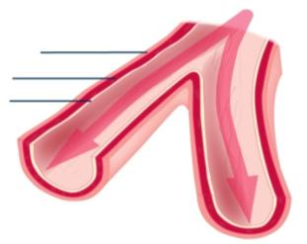


The rapidly progressive nature of PAH
Disease is often advanced before it is apparent
1.
REVERSIBLE
IRREVERSIBLE
Smooth muscle
dystrophy
Intimal proliferation & fibrosis
Adventia
Thrombosis
Media
Early intimal
proliferation
Medial
hypertrophy
Intima
Plexiform
lesions
Pre-symptomatic
Symptomatic / decompensating
Declining / decompensated
2.
CO
Symptom
threshold
RV DYSFUNCTION
PAP
PVR
WHO FC I
WHO FC II - III
WHO FC IV
Time
1. Gaine S. JAMA 2000; 284:3160-8.
2. Domenighetti G, et al. Swiss Med Wkly 2007; 137:331-6.
Notes:
As well as recognising that mild symptoms ≠ mild disease, it is important to note that despite patients being asymptomatic/mildly symptomatic in the early stages, haemodynamic compromise as a result of pathological changes in the pulmonary vasculature is already occurring.
This has important clinical implications as it highlights the difficulty in diagnosing patients before „reversible“ changes in the vasculature have occurred as the patient is unlikely to present until symptoms are apparent – in which case, the disease has typically progressed to a relatively advance stage. This important issue is discussed further later on in the presentation.
(In the early stages of disease when patients are asymptomatic, their CO is normal both at rest and with exercise because the right ventricle is able to adapt to its increased workload. Eventually the right ventricle cannot sufficiently increase CO, particularly during exercise. This is usually when patients become symptomatic and their presenting symptom is exertional dyspnoea, due to limitation of an increase in CO during exercise. The hallmark of severe PAH is reduced CO, which causes a decrease in the amount of blood flowing through the lungs. This leads to decreasing activity tolerance, increased exertional symptoms and signs of right heart failure.

Slide 21
Prognosis is extremely poor in PAH
Median survival 2.8 years
100
68%
80
48%
60
Survival (%)
34%
40
20
0
0
0.5
1
1.5
2
2.5
3
3.5
4
4.5
5
Follow-up (years)
D’Alonzo GE, et al. Ann Internal Med 1991; 115:343-9.
Notes:
The extremely poor prognosis of PAH (in this case IPAH) in the absence of PAH-specific therapies is illustrated here:
The data on this slide represent the Patient Registry for the Characterisation of Primary Pulmonary Hypertension. NIH Registry that included a cohort of prospectively followed IPAH patients (n=194) treated with conventional therapy prior to the availability of epoprostenol and bosentan.
In these patients with IPAH (all classes), the median survival was reported in 1991 to be 2.8 years with survival rates of 68%, 48% and 34% at 1, 3 and 5 years, respectively.
D’Alonzo et al. Ann Internal Med 1991;115:343

Slide 22
Survival in patients with untreated PAH of different aetiologies
1
0.9
0.8
CHD
0.7
0.6
Proportion of patients surviving untreated PAH
0.5
IPAH
0.4
CTD
0.3
0.2
HIV
0.1
0
0
1
2
3
4
5
Time (years)
McLaughlin VV, et al. Chest 2004; 126:78S-91S.
Notes:
As shown earlier, the prognosis of PAH is extremely poor. There are, however, differences between subgroups as illustrated here i.e. PAH-CTD and PAH-HIV having a worse prognosis than both IPAH and PAH-CHD.

Slide 23
Severity and classification of PAH
WHO functional classification
I | No limitation of physical activity. Ordinary physical activity does not cause undue dyspnoea, fatigue, chest pain or near dyspnoea | ASYMPTOMATIC
II | Slight limitation of physical activity. Comfortable at rest. Ordinary physical activity causes dyspnoea, fatigue, chest pain or near syncope | MILDLY SYMPTOMATIC NON-SPECIFIC
III | Marked limitation of physical activity. Comfortable at rest. Less than ordinary activity causes dyspnoea, fatigue, chest pain or near syncope | SYMPTOMATIC SPECIFIC
IV | Inability to carry out any physical activity without symptoms. Signs of right-heart failure. Dyspnoea and fatigue may even be present at rest. Discomfort increased by any physical activity
Galiè N, et al. Eur Heart J 2009; 30:2493-2357.
Notes:
The severity of PAH is classified according to the WHO classification system (also referred to as the NYHA classification) – FC I being the ‘mildest’ stage and class IV being the most severe. Also highlighted on this slide is the asymptomatic/non-specific nature of PAH in the early stages. Only when the disease progresses to its advanced stages do more tell-tale signs (e.g. syncope) emerge. This is an important point (and will be discussed in more detail) as it illustrates the potential difficulties in attaining a timely diagnosis of PAH.
Galiè N, et al. Eur Heart J 2009; 30:2493-2357.

Slide 24
FRENCH REGISTRY: CTD and CHD ARE THE LEADING CONDITIONS ASSOCIATED WITH PAH
Idiopathic
39%
Connective tissue diseases
15%
Congenital heart diseases
11%
Portal hypertension
10%
Appetite suppressant exposure
9.5%
HIV infection
6%
Familial
4%
(% of population)
2 RISK FACTORS 4%
ACT 08/1308 October 09
Humbert M, et al. AJRCMM 2006; 173:1023–30.

Slide 25
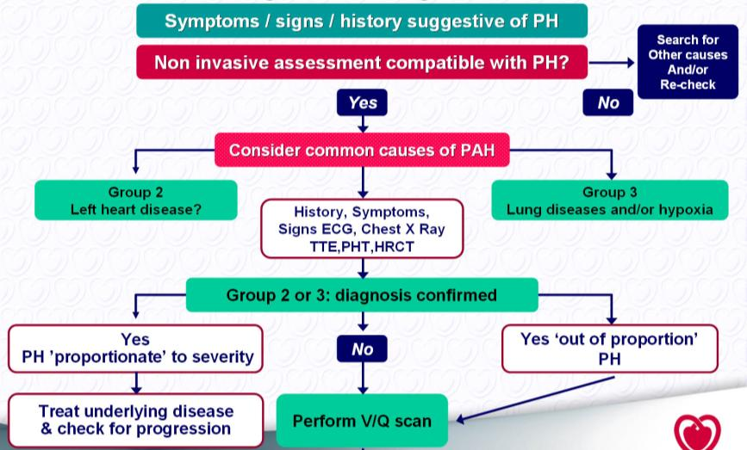
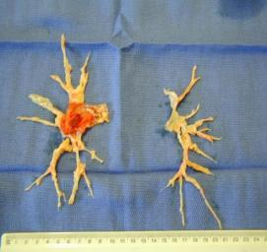
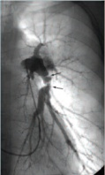
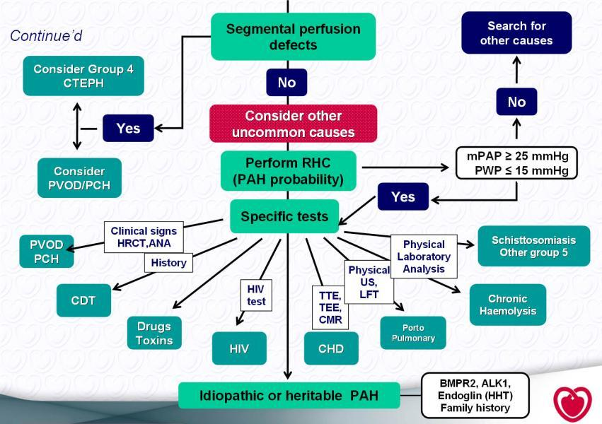
Images courtesy of Joanna Pepke-Zaba
Thrombo-
Endo-
Arterectomy
Lung Transplantation
PH and CTD treatment, aggressive
PH and HIV treatment, effective

Slide 26
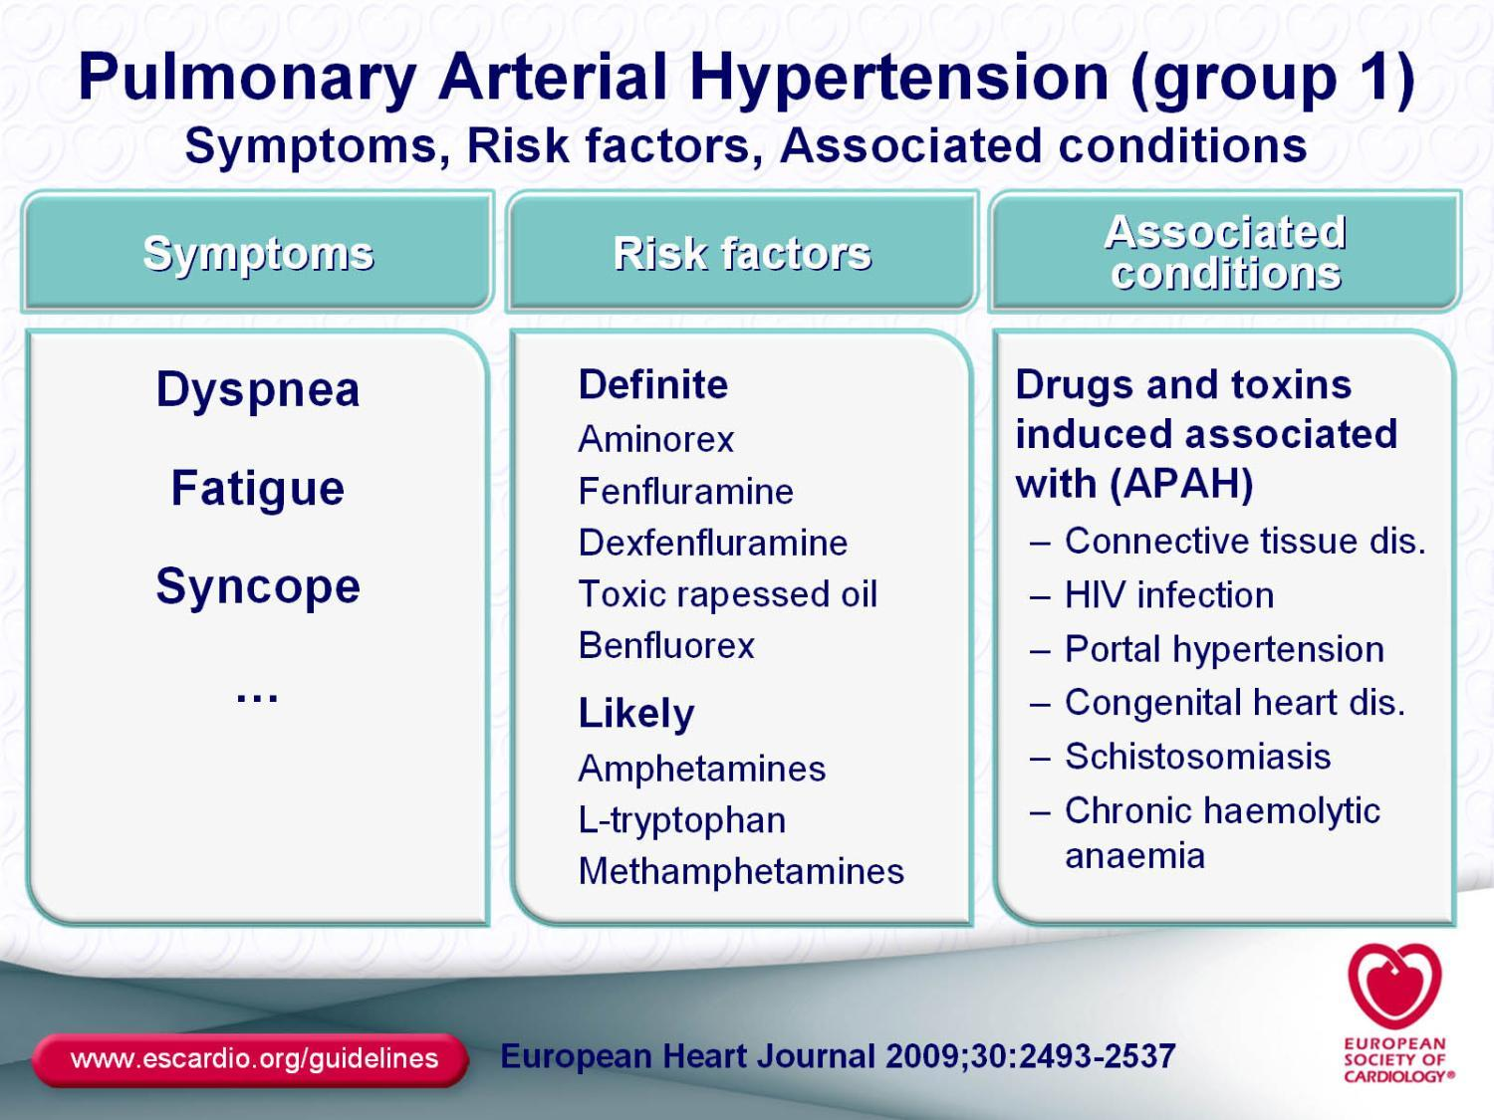

Slide 27
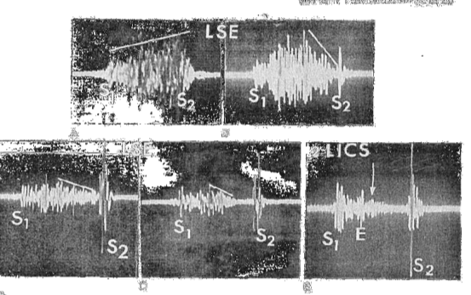
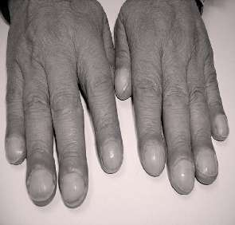
Examination
Restrictive VSD
Peripheral oedema, JVP
Right ventricular heave
Accentuated P2
Abdominal tenderness
Central cyanosis
Clubbing
Murmurs: valvar regurgitation (tricuspid or pulmonary)
Relating to underlying congenital defect
Eisenmenger

Slide 28
Investigations

Slide 29
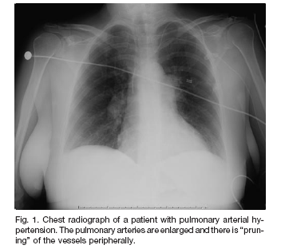
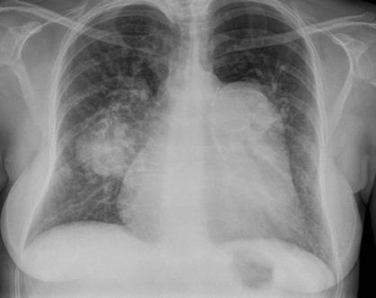
Diagnosis of PAH – initial investigations
Chest x-ray
Can be first clue to presence of PAH¹
Signs include:
  enlarged main and hilar pulmonary arterial shadows (>17mm)
  attenuation of peripheral pulmonary vascular markings (pruning)²
Can also reveal presence of comorbid or causal conditions (pulmonary venous congestion, COPD, interstitial lung disease)²
Chest radiograph of a patient with pulmonary arterial hypertension. The pulmonary arteries are enlarged and there is “pruning” of the vessels peripherally³
1. McLaughlin V and McGoon, M. Circulation 2006; 114:1417-31.
2. Rubin et al. Ann Intern Med 2005; 143:282-92.
3. Levine DJ. Respir Care 2006; 51:368–81.
Eisenmenger PDA
Notes:
Chest x-ray can be first clue to presence of PAH.¹ Tell-tale signs include: enlarged main and hilar pulmonary arterial shadows (>17mm) and attenuation of peripheral pulmonary vascular markings (pruning).²
It can also reveal presence of comorbid or causal conditions (pulmonary venous congestion, COPD, interstitial lung disease)²

Slide 30
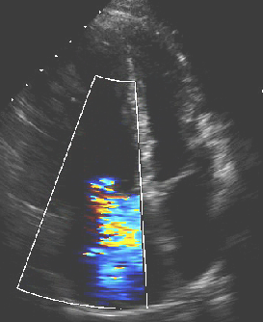
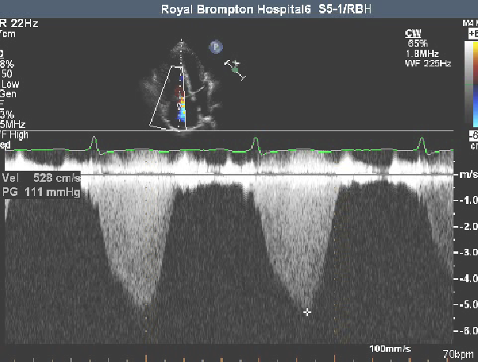
PAPsyst=TRgradient+JVP
PAPsyst=4V²+JVP
TR Velocity | PAPsystolic
3 | 36+JVP
4 | 64+JVP
5 | 100+JVP

Slide 31
Additional echocardiographic variables
Increased velocity of pulmonary valve regurgitation and a short acceleration time of RV ejection into the PA
Increased dimensions of right heart chambers, abnormal shape and function of the interventricular septum
Increased RV wall thickness, and dilated main PA are also suggestive of PH, but tend to occur later in the course of the disease
Their sensitivity is questionable
Galiè N, et al. Eur Heart J 2009; 30:2493-2357.
Notes:
Most PAH patients present at the time of diagnosis with:¹
At least a moderate tricuspid regurgitation and a pulmonary artery systolic pressure of ≥60 mmHg (normal 18-25 mmHg)
Significant pulmonary insufficiency may also be seen
Acceleration time of <100 ms which reflects an abnormal mean pulmonary artery pressure
Galiè N, et al. Eur Heart J 2009; 30:2493-2357.

Slide 32
RHC is the only way to make a definitive diagnosis of PAH
100
r²=0.4515
False
positive
80
Trans-Tricuspid pressure difference (echo) (mmHg)
60
40
20
False negative
0
0
20
25
40
60
80
mPAP (mmHg) measured invasively (RHC)
1. Gibbs JSR. Eur Respir Rev 2007; 16:8-12.
2. Mukerjee D, et al. Rheumatology 2004;43:461-6.
Notes:
This figure shows the correlation of tricupsid regurgitant (TR) jet velocity measured by echo with mPAP measured by RHC in SSc patients. The values do not correspond in all patients (Gibbs, 2007).
False positives and false negatives are possible with echo, so if there is any doubt confirmatory RHC should be undertaken (Gibbs, 2007).
Using conservative thresholds (TG>40 mmHg), nearly half the patients with symptomatic PAH are left without a firm diagnosis. With lower echo TG thresholds the number of false-positive diagnoses increases progressively (Mukerjee, 2004).
Confirmation of PAH by RHC is warranted before embarking on extensive evaluation for an underlying cause or considerations for prognosis or treatment (Barst, 2004).
As well as diagnosing PAH, RHC can also characterise intracardiac shunting and can indicate presence of left heart disease or pulmonary vein obstruction (Barst, 2004).

Slide 33
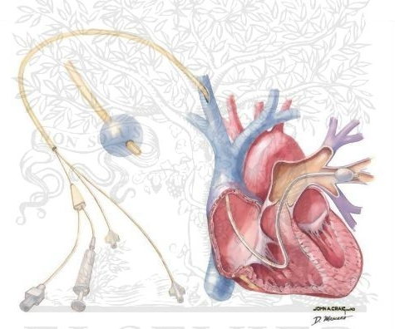
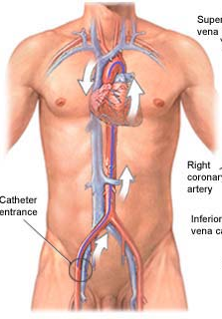
Right heart cath

Slide 34
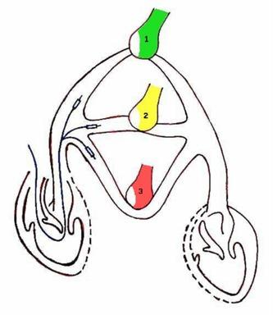

Slide 35
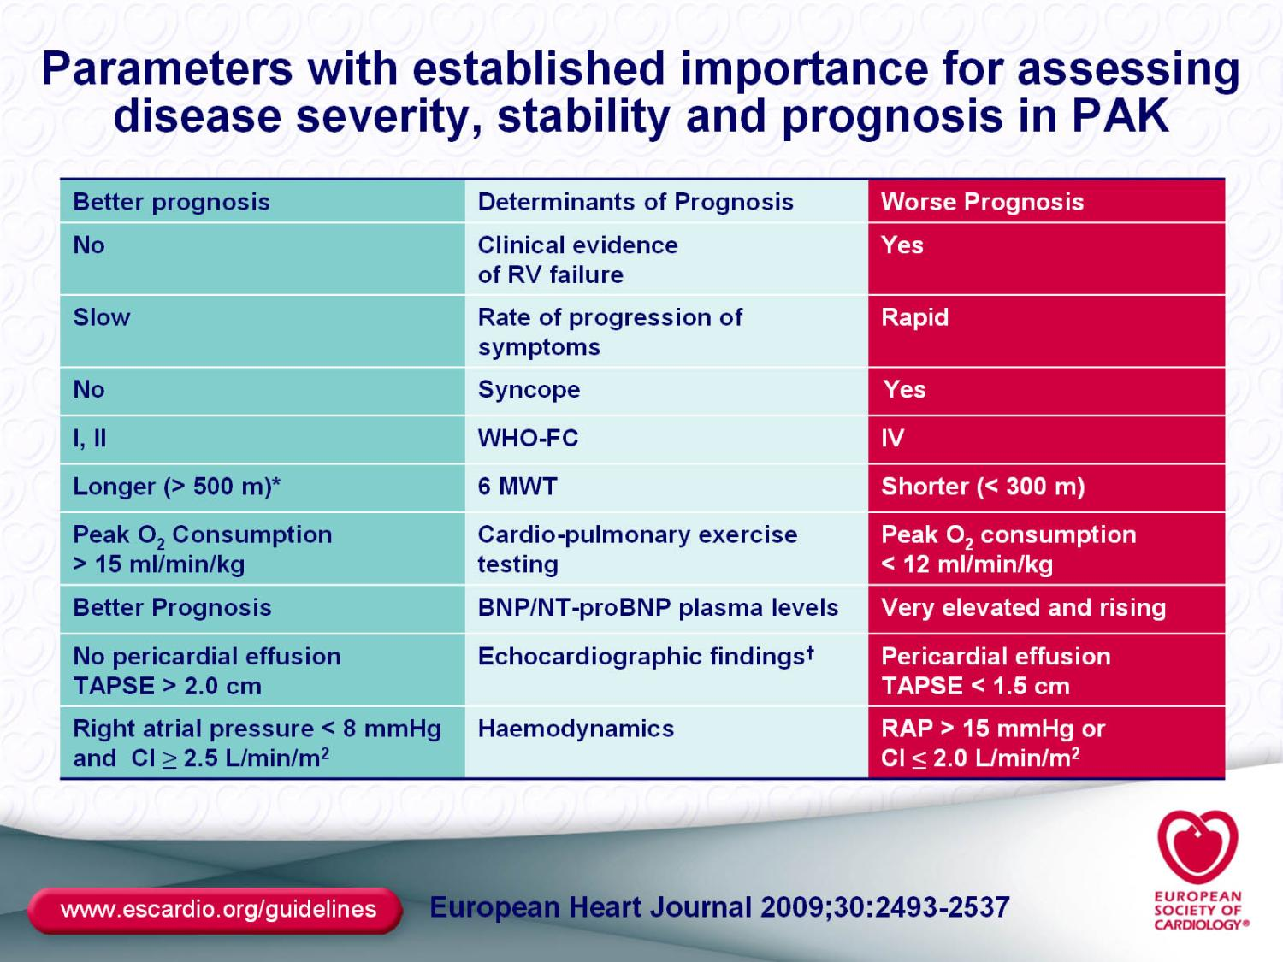

Slide 36
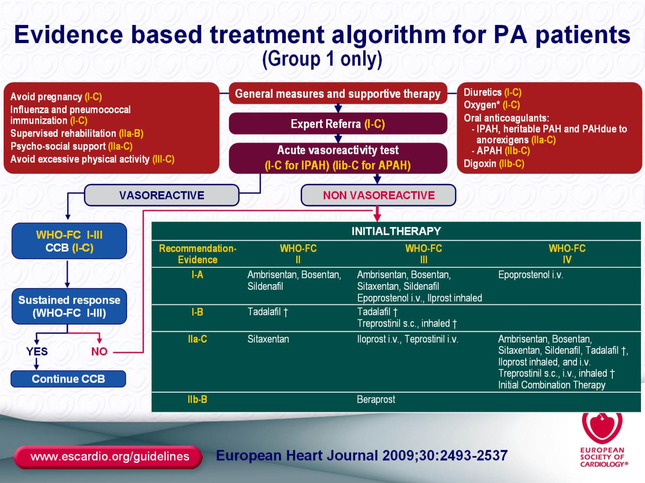

Slide 37
Mortality risk of pregnancy in PAH related to CHD
iPAH
p=0.047
CHD-PAH
oPH
60
56
50
40
36
33
28
30
%
30
20
17
10
Also interruption of pregnancy carries significant risks!!!
0
1997-2007
1978-1996
Bedard, Dimopoulos, Gatzoulis, EHJ 2009
Notes:
37
37
37

Slide 38
General measures
General management principles
  Avoid dehydration, extreme isometric exercise
  Avoid high altitude (cyanosis)
  Air travel is safe in cyanotic pts: mobilise^{Broberg et al Heart 2006}
  Special anaesthetic management
    Special care around angiography and
    non-cardiac surgery (GA or sedation)
  Avoid pregnancy
  (30-50% maternal mortality)
    Contraception issues
Notes:
38

Slide 39
Management of PH:
Depends on type
“Advanced” targeted therapies available for Class I patients only:
Pulmonary ARTERIAL Hypertension

Slide 40
Prostacyclin
Nitric oxide
Endothelin
Tromboxane
Notes:
Even though knowledge in the pathophysiology of PH has improved significantly in recent years, there are complex mechanisms involved of which we know very little

Slide 41
Notes:
There are 3 main pathways by which modern ATs act: the …….
On the PC pathway…

Slide 42
PROSTANOID (PCI) THERAPIES
Reported deficiency of prostacyclin & metabolites in PAH pts (expression of prostacyclin synthase in lung tissue)
Prostacyclin:
- potent vasodilator
- anti-platelet
- anti-proliferative activity
Prostanoids in clinical use
- Epoprostenol requires IV infusion due to very short plasma
half-life¹
- Iloprost: the inhaled route targets the lungs, thus reducing
systemic exposure - must be given 6-9x/day.
- Treprostinil: plasma half-life 3-4 hours, suitable for SC
administration
Notes:
The development of prostanoid therapies to correct endogenous prostacyclin deficiencies has had a significant impact on the treatment of moderate-to-severe PAH.
Prostanoids are available as different molecules and in a range of modes of administration.
References
1. Badesch D, McLaughlin V, Delcroix M et al. Prostanoid therapy for pulmonary arterial hypertension. J Am Coll Cardiol 2004; 43: 56S–61S.
2. Tuder RM, Cool CD, Geraci MW et al. Prostacyclin synthase expression is decreased in lungs from patients with severe pulmonary hypertension. Am J Respir Crit Care Med 1999; 159(6): 1925–1932. http://ajrccm.atsjournals.org/cgi/reprint/159/6/1925

Slide 43

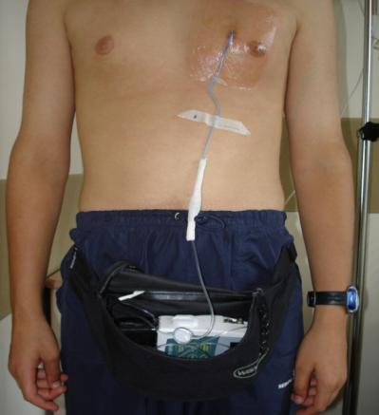
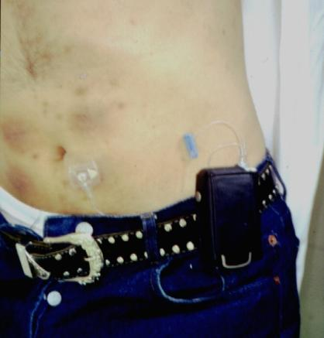
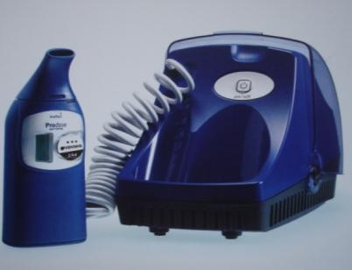
Prostacyclin in PAH
Epoprostenol
Treprostinil
Iloprost
Only I.V.
Need permanent cath
Cath infections
S.C. or I.V.
Local pain
Inhale
6 to 12 times a day
Long term efficacy?
Notes:
PX itself can be administered either IV, s.c. or inhaled.
All 3 routes have significant disadvantages, epoprostenol needs a permanent Hickman cath and the main problem is the cath infections what is a important issue in CHD p
Treprostinil produce as main side effect, significant local pain and many patients don’t tolerate it
Iloprost needs to be inhaled 6 to 12 times a day for 20 minutes each time, and is not tolerated for many patients
…important issue in CHD

Slide 44
Prostacyclin in PAH
100
Observed (n=162)
1
0.8
80
*
0.6
IV epoprostenol
(n=178)
Cumulative survival
% Survival
*
60
*
0.4
p<0.0001
0.2
Historical control
(n=135)
40
Expected
*p<0.001
0
20
0
12
24
36
48
60
72
84
96
108
120
0
6
12
18
24
30
36
Months
Months
Sitbon O, et al. J Am Coll Cardiol. 2002; 40: 780-788
McLaughlin VV, et al. Circulation.
2002; 106: 1477-1482.
Notes:
However, IV epoprostenol is the only AT for which we have evidence of a survival benefit in PAH in general.

Slide 45
PROSTANOID THERAPIES
Side effects
- systemic hypotension
- headaches, sinusitis, jaw pain, muscle cramps
- flushing, sweating
- cellulitis, skin abscesses, line sepsis
- pulmonary oedema
Drug interactions
- anticoagulants, vasodilators
- anticonvulsants, TCAs, opiates, antihistamines
Contra-indications
- LVFailure
- Pregnancy, breast feeding
- Bleeding disorders, severe liver disease
Notes:
Nitric oxide plays a key role in pulmonary vasoregulation.¹
While inhaled NO is unsuitable for therapeutic use, enzymatic regulation via inhibition of phosphodiesterases has been studied for the treatment of PAH.¹
References
1. Ghofrani H, Pepke-Zaba J, Barbera J et al. Nitric oxide pathway and phosphodiesterase inhibitors in pulmonary arterial hypertension. J Am Coll Cardiol 2004; 43: 68S–72S.
2. Ide H, Nakano H, Ogasa T et al. Regulation of pulmonary circulation by alveolar oxygen tension via airway nitric oxide. J Appl Physiol 1999; 87(5): 1629–1636. http://jap.physiology.org/cgi/reprint/87/5/1629.

Slide 46
Notes:
Lets now focus on the NO pathway
PDE-5 inhibitors such as sildenafil act by blocking NO degradation, thus causing…

Slide 47
PHOSPHODIESTERASE (PDE) INHIBITORS
NO is a key component in pulmonary vasoregulation¹
- promotes smooth muscle relaxation via cGMP pathway
- regulates pulmonary perfusion according to alveolar
ventilation, optimising ventilation/perfusion match
- PDE inhibition (subtype 5 – mainly lung tissue + right
ventricle) could potentially vascular effects of NO & PCI
PDE5 inhibitors in clinical use
- Sildenafil
- Tadalafil
Notes:
Nitric oxide plays a key role in pulmonary vasoregulation.¹
While inhaled NO is unsuitable for therapeutic use, enzymatic regulation via inhibition of phosphodiesterases has been studied for the treatment of PAH.¹
References
1. Ghofrani H, Pepke-Zaba J, Barbera J et al. Nitric oxide pathway and phosphodiesterase inhibitors in pulmonary arterial hypertension. J Am Coll Cardiol 2004; 43: 68S–72S.
2. Ide H, Nakano H, Ogasa T et al. Regulation of pulmonary circulation by alveolar oxygen tension via airway nitric oxide. J Appl Physiol 1999; 87(5): 1629–1636. http://jap.physiology.org/cgi/reprint/87/5/1629.

Slide 48
PDE5 INHIBITORS
Side effects
- systemic hypotension
- headaches, sinusitis
- GI disturbance (dyspepsia, altered bowel habit)
- muscle cramps
- ischaemic optic neuropathy
Drug interactions
- nitrates, alpha-blockers, cimetidine
- cyclosporine, anti-fungals, protease inhibitors
Contra-indications
- recent CVA or MI, IHD
- Retinal disease
Notes:
Nitric oxide plays a key role in pulmonary vasoregulation.¹
While inhaled NO is unsuitable for therapeutic use, enzymatic regulation via inhibition of phosphodiesterases has been studied for the treatment of PAH.¹
References
1. Ghofrani H, Pepke-Zaba J, Barbera J et al. Nitric oxide pathway and phosphodiesterase inhibitors in pulmonary arterial hypertension. J Am Coll Cardiol 2004; 43: 68S–72S.
2. Ide H, Nakano H, Ogasa T et al. Regulation of pulmonary circulation by alveolar oxygen tension via airway nitric oxide. J Appl Physiol 1999; 87(5): 1629–1636. http://jap.physiology.org/cgi/reprint/87/5/1629.

Slide 49
PDE-5 inhibitors in PAH
p < 0.001
Sildenafil
Sildenafil
N=278 p
Change in 6-Minute Walking Distance (m)
Placebo
Weeks
p < 0.001
Change in PVR (din · sec· cm⁻⁵)
Placebo
Sildenafil
Galie N, et al. N Eng J Med 2005; 353: 2148-2157
Notes:
In PAH in general, the only RCT available of sildenafil is the SUPER1 trial, which showed….

Slide 50
PDE-5 inhibitors in PAH
Tadalafil
N=405 p
p < 0.001
Tadalafil
Change in 6-Minute Walking Distance (m)
Placebo
Weeks
Galie N, et al. Circulation 2009; 119: 2894-2903
Notes:
Tadalafil is another active and selective inhibitor of PDE-5. A recent RC study in 405 PH patients showed a significant improvement in exercise capacity and also

Slide 51
PDE-5 inhibitors in PAH
p<0.041
Galie N, et al. Circulation 2009; 119: 2894-2903
Notes:
And also an improvement in time to clinical worsening between tadalafil 40 mg group compared to placebo.

Slide 52
Notes:
Lets now focus on the NO pathway
PDE-5 inhibitors such as sildenafil act by blocking NO degradation, thus causing…

Slide 53
ENDOTHELIN RECEPTOR ANTAGONISTS (ERAS)
Endothelin (ET-1) levels are elevated in PAH & directly correlate with disease severity & prognosis¹⁻³
ET-1 binds to two receptor sub-types (ET_{A} and ET_{B})
- pulmonary & coronary vasculature⁴
- excessive binding causes acute & chronic effects including
vasoconstriction, inflammation, fibrosis, hypertrophy and
hyperplasia^{1,5,6}
ERAS:
  Bosentan (ETA+B)
  Ambrisentan (ETA>B)
Notes:
Hypertropy –

Slide 54
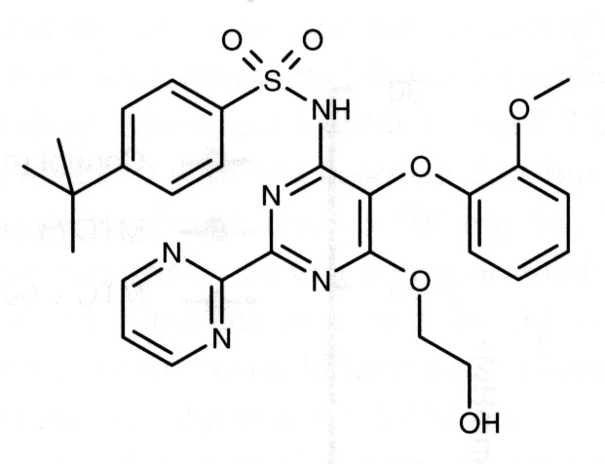
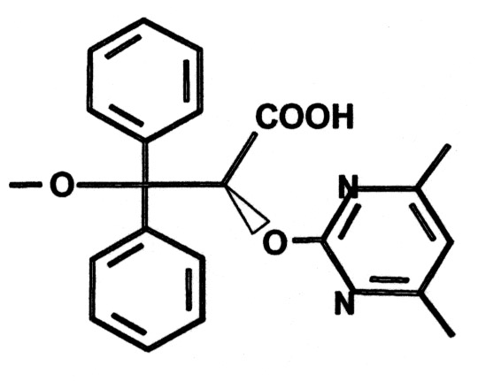
ERAs in PAH: Bosentan & Ambrisentan
Endothelial cell
Endothelin-1
ET_{B}
ET-1 Clearance
Endothelial cell
Pro-ET-1
NO
PGI2
Endothelin-1
ET_{B}
ET_{A}
Smooth muscle cell
Vasoconstriction
Proliferation
Vasodilatation
Anti-proliferation
Ambrisentan (A)
Bosentan (A, B)
Courtesy of Dr. M. Humbert
Notes:
ERAs act on the ET receptros A and B.
ET rec A and B are found in smooth muscle cell and when they are activated by endothelin 1 induce vasocontriction and proliferation.
However, ETB is also found in endothelial cells and when this is activate by endothelin produce the oposite effect increasing the levels of NO and PCI2 thus produce vasodilatation and antiproliferation
Bosentan is a non-selective ERA
Subsequent drugs were developed to have a selective action on the Eta thus maintaining the effects of endothelin-1 on ETb on endothelial cells

Slide 55
ERAs
Side effects
- systemic hypotension
- anaemia
- headaches, sinusitis, flushing
- GI disturbance (dyspepsia, altered bowel habit)
- muscle cramps
- fluid retention (pulmonary oedema)
- abnormal liver function (monthly testing needed)
Drug interactions
- warfarin, statins, CONTRACEPTIVES
- cyclosporine, anti-fungals, protease inhibitors
Contra-indications
- significant liver disease
- pregnancy, breast-feeding
Notes:
Nitric oxide plays a key role in pulmonary vasoregulation.¹
While inhaled NO is unsuitable for therapeutic use, enzymatic regulation via inhibition of phosphodiesterases has been studied for the treatment of PAH.¹
References
1. Ghofrani H, Pepke-Zaba J, Barbera J et al. Nitric oxide pathway and phosphodiesterase inhibitors in pulmonary arterial hypertension. J Am Coll Cardiol 2004; 43: 68S–72S.
2. Ide H, Nakano H, Ogasa T et al. Regulation of pulmonary circulation by alveolar oxygen tension via airway nitric oxide. J Appl Physiol 1999; 87(5): 1629–1636. http://jap.physiology.org/cgi/reprint/87/5/1629.

Slide 56
BREATHE-1: Bosentan significantly improved TTCW up to 28 weeks
100
89 %
75
p = 0.0038
p = 0.0015
63 %
Event-free (%)
50
25
Bosentan (n = 144)
Bosentan (n = 35)
Placebo (n = 69)
Placebo (n = 13)
0
0
4
8
12
16
20
24
28
Time (weeks)
ACT 08/1308 October 09
Adapted from Rubin L, et al. NEJM 2002; 346:896-903.
Notes:
Similarly, the results of the BREATHE-1 trial showed that treatment with bosentan significantly improved TTCW following 28 weeks of treatment compared with placebo:
Time to clinical worsening was defined as the shortest time to either death, hospitalisation or premature withdrawal due to worsening PAH, initiation of epoprostenol therapy, lung transplantation, or septostomy (no patients had a lung transplantation or septostomy).
Bosentan significantly delayed the time to clinical worsening compared to placebo after 28 weeks of therapy (p = 0.0015).
The difference between the treatment groups was apparent at week 16. The difference was statistically significant when data from patients who continued to period 2 were censored at the week 16 assessment (p = 0.0038).
Each component of the combined end-point was consistently more frequent in the placebo group than among bosentan-treated patients (during Period 1 and up to 28 weeks).

Slide 57
EARLY: Effect of bosentan on time to clinical worsening
100
In 6 months, 14% of FCII patients without treatment experienced clinical worsening
80
Placebo
60
Bosentan
Patients without the event (%)
40
Hazard ratio = 0.227
(95% CI: 0.065, 0.798)
20
p=0.0114
0
0
4
8
12
16
20
24
28
32
Time from treatment start (weeks)
92
90
89
86
84
83
77
18
9
Patients at risk
93
92
87
85
84
83
80
27
15
ACT 08/1308 October 09
Galiè N, et al. Lancet 2008; 371:2093-100.
Notes:
57
There was a delay in time to clinical worsening with bosentan compared with placebo (hazard ratio 0.227, 95% CI 0.065–0.798; p=0.0114).
Fewer patients in the bosentan group reached at least one of the components of clinical worsening by month 6 than did those in the placebo group. All 14 of the patients who survived at the first event of clinical worsening showed one or more of the following signs of deterioration: premature discontinuation from the trial, subsequent hospitalisation, worsening haemodynamics, or worsening exercise or functional capacity by the end of the study.

Slide 58
COMBINATION THERAPIES
No large RCTs but small studies show potential benefits with respect to:
- symptoms, QOL
- FC, 6MWT
- pulmonary haemodynamics
Studies include pts with IPAH, CTD, CHD, HIV
Current used regimens include:
- Sildenafil + Bosentan or Sitaxsentan
- Prostacyclin plus ERA or PDE5I
- Triple therapy

Slide 59
Progressive nature of PAH = Early treatment, continual monitoring & treatment escalation
No functional impairment (FC I)
Regular monitoring &
treatment escalation
Functional capacity
Prompt referral, early diagnosis and timely intervention
Right heart failure
(FC IV)
Late diagnosis & intervention
Time
Adapted from assimilated information within:
Galie N, et al. Lancet 2008; 371:2093-100. Provencher S, et al. Eur Heart J 2006; 27:589-95.
Hoeper MM, et al. Eur Respir J 2005; 26:858-63.
ACT 08/1308 October 09
Notes:
59
This schematic illustrates the multifacted approach that is required for optimal outcomes in PAH.
As shown, prompt referral and subsequent early diagnosis and appropriate intervention alongside continual monitoring to guide treatment evolution are crucial to optimise functional status.

Slide 60
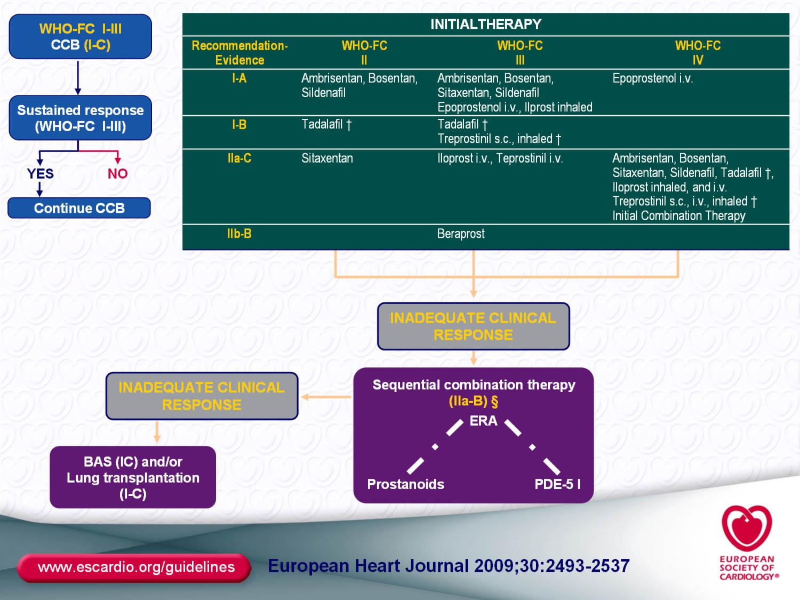

Slide 61
Incidence and prevalence of PAH
IPAH:
  ~1–8 individuals per million per year^{1,2}
PAH-CTD (SSc):
    affects ~ 8-12% of CTD patients^{3,4}
Prevalence of PAH associated with CHD:
  10% of adults with CHD⁵
Prevalence of all types of PAH is 30-50/m/y²
1. Taichman DB, et al. Clin Chest Med 2007; 28:1-22.
2. Peacock AJ, et al. Eur Resp J 2007; 30:104-9.
3. Hachulla E, et al. Arthritis Rheum 2005; 52:3792-800.
4. Mukerjee D, et al. Ann Rheum Dis 2003; 62:1088-93.
5. Duffels MGJ, et al. Int J Cardiol 2006; doi:10.1016/j.ijcard.2006.09.017:1-7.
Notes:
Although the true incidence (i.e. the number of new disease cases reported in a population over a given period of time) of PAH is unknown, conservative estimates suggest that IPAH affects only 1–2 individuals per million per year.¹ Although more recent registry studies suggest that this may be an underestimate and that the incidence may be higher; at around 7–8 cases per million per year, the disease is nevertheless extremely rare.²
There are however, groups of patients who are known to be at increased risk of PAH e.g. patients with CTD (thought to affect around 5–6 individuals per million per year; occurring in up to 40% of patients with CTD and 16% of SSc patients³) and targeted screening can therefore be useful in attaining an early diagnosis in these patients.³
However, the low frequency of the disease, its often non-specific presentation and the difficulties associated with diagnosis, mean that PAH is probably under-diagnosed and under-reported, making a precise calculation of incidence difficult.
¹Taichman et al, Clin Chest Med 2007; 28: 1–22;
²Peacock et al, Eur Resp J 2007; 30: 1–6;
³McGoon et al. Chest 2004;126;14-34;

Slide 62
Diagnosis of PAH is typically delayed
Low prevalence^{1,2}
Low suspicion³
Asymptomatic in early stages⁴
Non-specific symptoms³
DIAGNOSIS IS TYPICALLY DELAYED BY
≥ 2 YRS³
1. Taichman DB, et al. Clin Chest Med 2007; 28:1-22.
2. Peacock AJ, et al. Eur Resp J 2007; 30: 104-9.
3. Gibbs JSR. Eur Respir Rev 2007; 16:8-12.
4. Barst R, et al. JACC 2004; 43: 40S–47S.
Notes:
In summary, low prevalence and no/non-specific symptoms lead to a low suspicion for PAH in initial diagnosis – leading to a substantial delay in attaining a detinitive diagnosis.

Slide 63
Who should be screened for PAH?
Known genetic mutation associated
with PAH
  Screening frequency uncertain
  Screen first degree relatives of index IPAH patients?
Scleroderma and mixed connective
tissue disease
Annual screening
Portal hypertension
If liver transplantation considered
ACT 08/1308 October 09
McGoon M, et al. Chest 2004; 126:14S-34S.

Slide 64
Pulmonary complications are now the leading cause of death in SSc
50
Scleroderma renal crisis
PAH
40
Interstitial lung disease
p <0.001
30
Frequency (%)
p <0.05
20
10
p <0.0001
0
1972-1976
1977-1981
1982-1986
1987-1991
1992-1996
1997-2001
ACT 08/1308 October 09
Steen VD and Medsger TA. Ann Rheum Dis 2007; 66:940-4.
Notes:
64

Slide 65
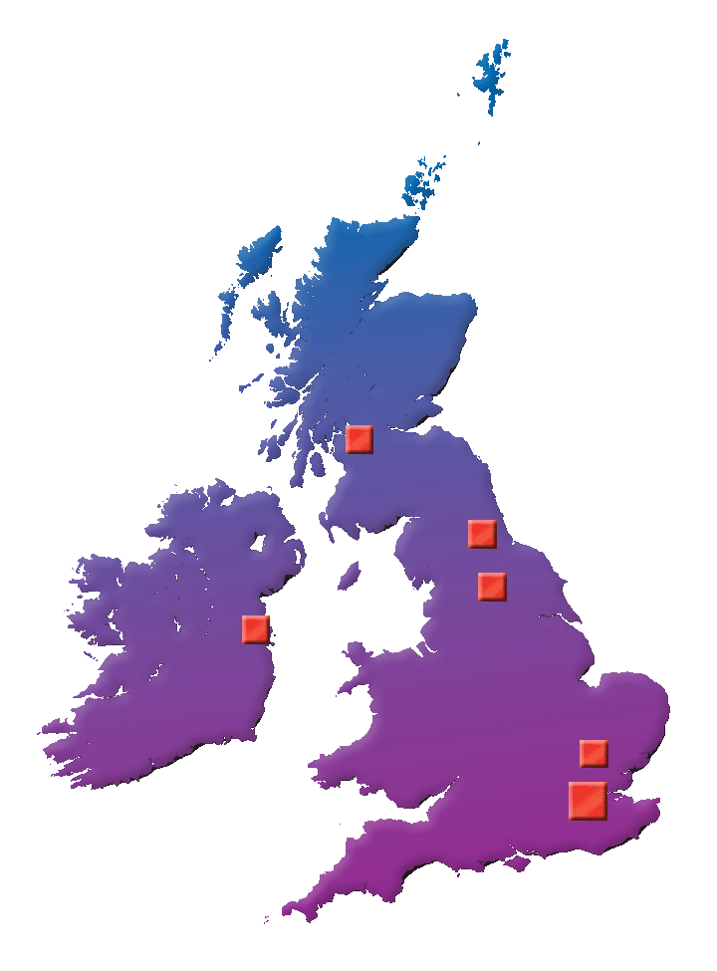
Introducing the UK and EIRE specialist centres
Glasgow: Western Infirmary
Dublin: Mater Misericordiae
Cambridge: Papworth
Newcastle: Freeman
Sheffield: Royal Hallamshire
London Centre:
  Royal Free
  Royal Brompton
  Great Ormond Street
  Hammersmith
Gibbs S, et al. Heart 2008; 94 (Suppl 1):i1-41.
Notes:
Centres designated to manage PH. There are seven hospitals in England, one in Scotland, and one in Ireland (UK Consensus Statement).

Slide 66
What do specialist centres have to offer?
High level of performance due to referral of a sufficient number of patients –
critical mass
Specialist examinations, confirmatory and prognostic diagnostic procedures, right heart catheterisation
Specialist designated PAH centre
Multidisciplinary approach to patient care
Fully staffed and resourced for optimal investigation
Galiè N, et al. Eur Heart J 2009; 30:2493-2357.
Notes:
To be effective, the major centres must have sufficient volumes of patients and procedures to develop and maintain high levels of performance Specialist centres have a full range of medical, nursing and support staff that can extend beyond the immediate provision of multidisciplinary care Centres that specialise in PAH offer physicians with expertise and experience in this complicated disease, nursing staff specially trained to assist in the management of PAH patients and the complex therapies for this disease, and often clinical trials

Slide 67
Take home messages (1)
Pulmonary Hypertension (PH), a haemodynamic and pathophysiological condition, should not be confused with Pulmonary Arterial Hypertension (PAH) a clinical group of rare diseases.
The current clinical classification of PH includes 37 clinical conditions which are classified into six groups according to similar pathological, pathophysiological and therapeutic characteristics.
Doppler-echocardiography does not measure pulmonary arterial pressure but gives only an estimate of it: Right heart catheterization is mandatory for the confirmation of the diagnosis of PAH.
The correct clinical diagnosis in a patient with demonstrated PH requires the application of an appropriate diagnostic algorithm.

Slide 68
Take home messages (2)
The prognostic assessment and the definition of clinical status of PAH patients is multidimensional: assessing symptoms (e.g. WHO functional class), exercise capacity (e.g. 6-minute walk test) and right ventricular function (e.g. right heart catheterization).
The evidence-based treatment algorithm is appropriate only in patients with PAH (Clinical group 1).
Acute vasoreactivity test preferably with inhaled nitric oxide is strongly recommended in particular in idiopathic PAH.

Slide 69
Take home messages (3)
Despite recent progress, the current treatment strategy for PAH remains inadequate because the mortality rate continues to be high and the functional and haemodynamic impairment is still severe in many patients.
Lung transplantation is often required in particular in young patients.
The optimal treatment of the underlying left heart disease is recommended in patients with PH due to left heart disease. The specific PAH drugs are not recommended.
The optimal treatment of the underlying lung disease including long-term O2 therapy in patients with chronic hypoxaemia is recommended in patients with PH due to lung diseases. The specific PAH drugs are not recommended.
Surgical pulmonary endarterectomy is the recommended treatment for patients with chronic thromboembolic pulmonary hypertension.

Slide 70
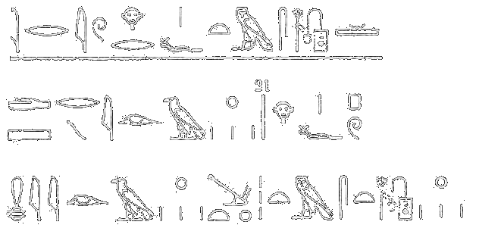
Thank you
Translation: “His lips are cyanotic”
Hieroglyph for the Smith Papyrus (3000 B.C)
Special thanks to
Dr Rafa Alonso-Gonzales
Dr Phil Marino
Actelion UK
Rashkind WJ, Circulation 1983
Notes:
70

Slide 71
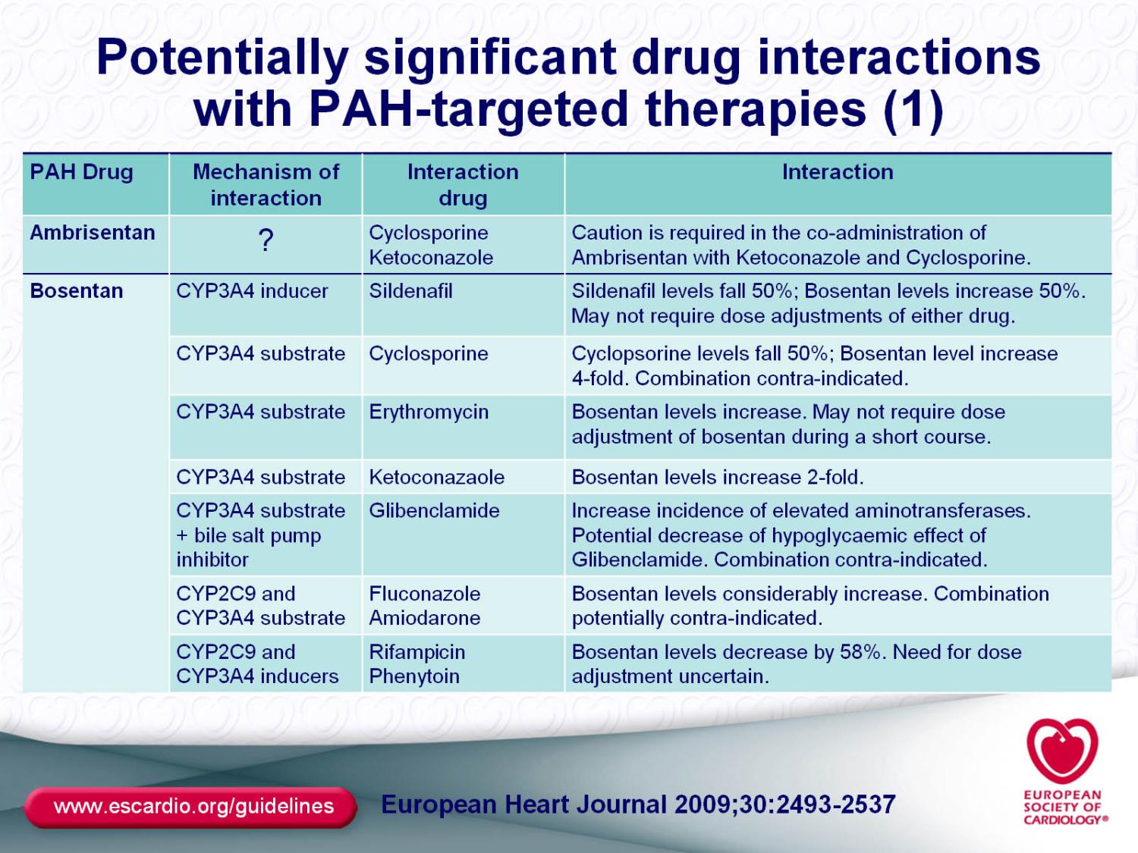

Slide 72
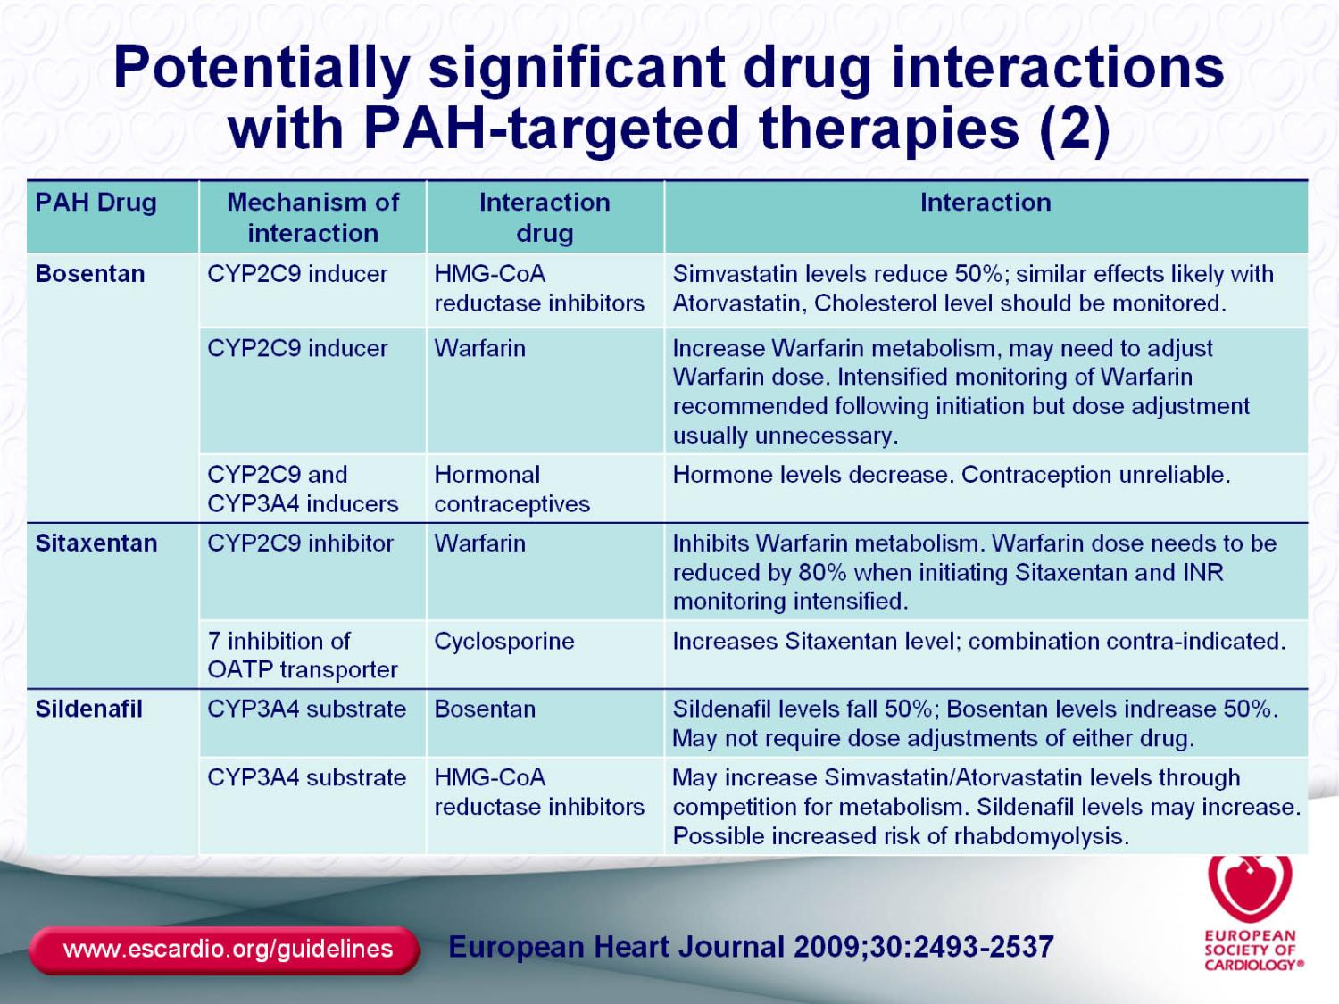

Slide 73
