Slide 1
First steps in statistical analysis
Alun Hughes

Slide 2
Outline
The lecture will provide a very simple background to statistical approaches for the analysis of continuous data
Using the data you provided we will go through some simple statistical approaches that are useful and common

Slide 3
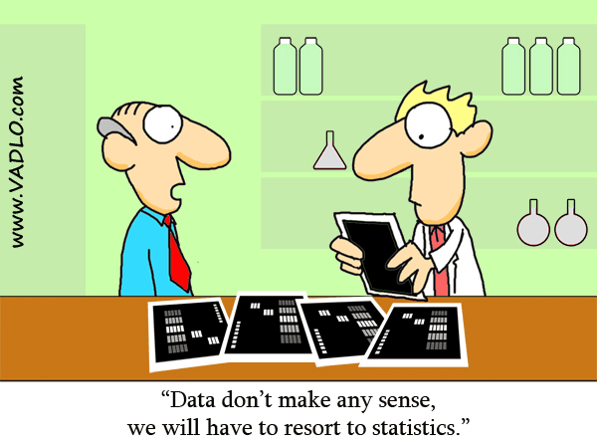
Why do we do experiments or trials?
The aim of an experiment or trial is derive an expectation about a population based on a sample of that population. i.e. we don’t have to measure everyone to get a pretty good idea of what to expect.

Slide 4
Learning point 1. Design your experiment or trial
Define your aims
Formulate testable hypotheses (or define what you want to estimate)
Calculate required sample size to detect meaningful difference (or what is an acceptable degree of precision in your estimate)
Plan your statistical analyses before you start the study
Seek advice if you are not sure how to proceed.

Slide 5
Our study: Define aims
Questions
Are men heavier than women?
Null: hypothesis: weight of men = weight of women
Two way two sided Student’s t-test
Is there a linear correlation between height and weight
Null: no correlation between height and weight
Pearson’s Product Moment Correlation Coefficient
What is the quantitative linear relationship between height and weight
Linear regression
Muliple linear regression/analysis of covariance (ANCOVA) including gender
Is there a difference in height between people with different preferences for primary colours?
Null: no difference in height by colour preference
One way analysis of variance

Slide 6
Calculate estimated sample size
Meaningful difference in weight = 15kg (opinion/experience)
Standard deviation in weight = 10kg (literature)
(effect size = 12kg/10kg = 1.5)
With these assumptions we should be able to detect a 15kg difference between men and women with 80% power at the 5% significance level with a comparison of 8 men and 8 women (1:1 matching).

Slide 7
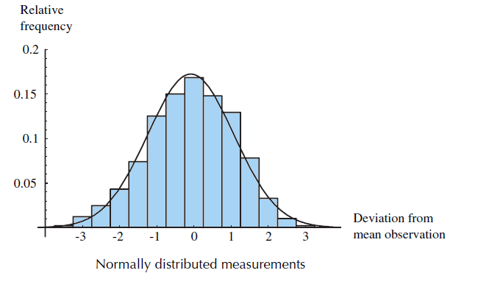
Data distributions: the normal distribution
Many statistical tests assume that data are ‘normally distributed’, i.e. their distribution is Gaussian - this is an assumption that needs to be checked.
S. Stahl The Evolution of the Normal Distribution. Mathematics Magazine (1996)

Slide 8
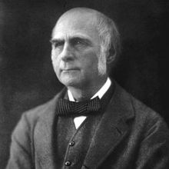
Why is there a normal distribution?
Francis Galton (1822 - 1911)

Slide 9
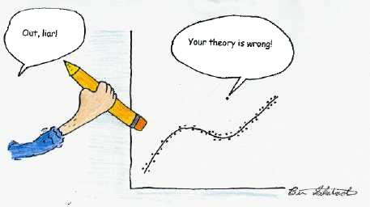
Learning point 2: Look at the data
http://davidmlane.com/hyperstat/outlier.jpg
Look at a frequency histogram of the data
Does it conform to a normal distribution or is it skewed?
Are there outliers? If so are they credible?

Slide 10
Statistical analysis: frequency histogram of weights

Slide 11
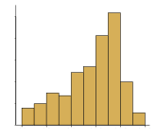
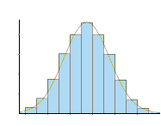
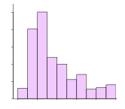
What do I do if the data are not normally distributed?
Left skewed
(negatively skewed)
Normal distribution
Right skewed
(positively skewed)
Transform the data (log transformation is common)
Rule of thumb - right skewed (log), left skewed (square root)
Use an approach that does not assume normality (termed non-parametric test) often based on ranks rather than values.

Slide 12
Learning point 2. Describe the data
For normally distributed data we can summarise the data using only two values
A measure of central tendency (arithmetic mean [average])
A measure of dispersion or scatter (standard deviation)

Slide 13
What is a standard deviation?
Sum of errors
Sum of squared errors (SSE)
We want a measure of dispersion (scatter). We can’t use the sum of the differences since they will add up to zero. So we square them (sum of squared errors).
Now we divide the sum of the squares by the number of samples -1 to calculate the sample¹ variance
Now we take a square root of the sample variance to calculate the standard deviation of the sample.
¹ sample variance uses n-1 for complex reasons.

Slide 14
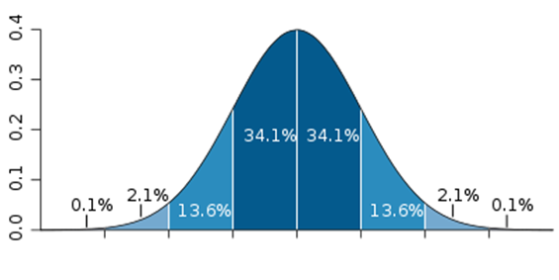
Why calculate a standard deviation?
68.2%
3SD 2SD 1SD mean 1SD 2SD 3SD
A standard deviation (SD) is a useful descriptor of sample scatter since ~⅔ of the observations in the sample will fall within ±1SD of the mean.
For non-normally distributed data the median and interquartile range (25th to 75th centile) are roughly equivalent.

Slide 15
Calculate the summary descriptive data on weights

Slide 16
What is the difference between a standard deviation and a standard error? And what is a 95% confidence interval and a p value?
The standard deviation (SD) describes the scatter of a sample
The standard error of the mean (SEM) is an estimate of the precision of the estimate of the mean of the population based on a sample of n observations:
The 95% confidence interval (95% CI) is the interval where the sample mean would fall 95% of the time if the sampling were repeated infinitely (i.e. the true population mean is unlikely to fall outside the 95% CI)
Upper limit of 95% CI = mean + (1.96 * SEM)
Lower limit of 95% CI = mean - (1.96 * SEM)
The p value is the probability of observing a test statistic (e.g. mean) equal or greater to that observed if the null hypothesis is true (i.e. both samples are drawn from the same population).

Slide 17
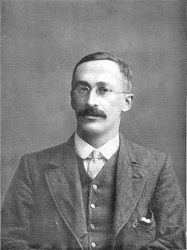
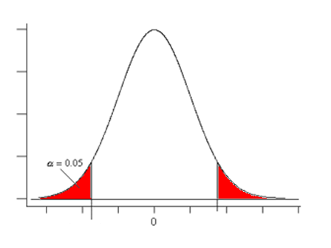
Do heights between men and women differ? The Student’s t-test
William Sealy Gosset (Student)
(1876-1937)
The t-test is based on the t-distribution, which is related to the normal distribution but applicable to small samples
Normally in biology we cannot assume that differences cannot be greater or smaller, so we use 2-sided tests.

Slide 18
Data analysis: t-test on weights

Slide 19
Is there a linear correlation between height and weight?
Principle underlying Pearson’s correlation coefficient (R)
The relationship between two variables (height and weight) in terms of their covariance in proportion to their standard deviations.
R is a measure of strength of the linear association between the variables
R² (the coefficient of determination) is a measure of the explained variance
Correlation assumes that
Relationship is linear
That the errors (residuals) are normally distributed

Slide 20
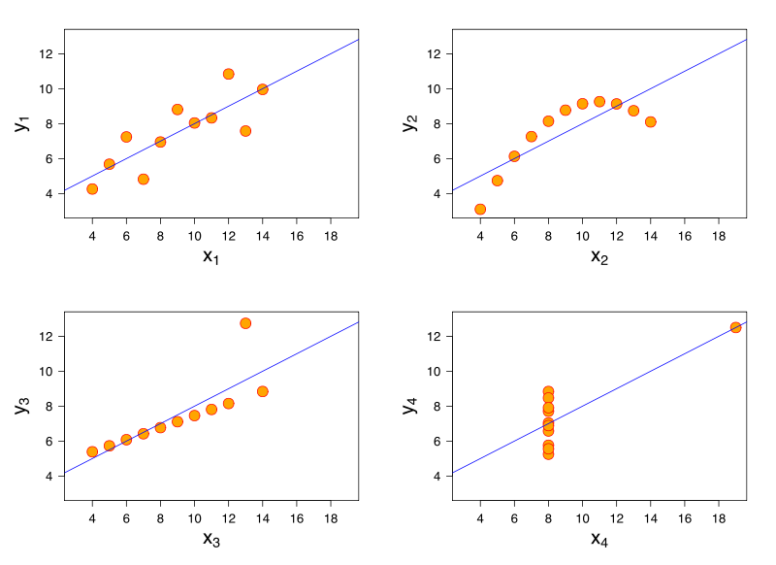
Checking linearity and residuals
Four sets of data with the same correlation of 0.816 (Anscombe Quartet) http://en.wikipedia.org/wiki/File:Anscombe%27s_quartet_3.svg
Look at the data (in a scatter plot)
Plot residuals

Slide 21
Data analysis: correlation weight and height

Slide 22
Linear regression
Correlation and linear regression are closely related and often confused.
Correlation assesses the strength of association between variables
Linear regression measures the quantitative linear relationship between variables
e.g. for a 1 unit rise height there is a X unit rise in weight
Assumptions of linearity, normality of residuals etc apply to both.

Slide 23
Data analysis: linear regression of weight and height

Slide 24
Multiple regression: weight vs. height & sex
More than one independent variable can be included in a regression model.

Slide 25
Overview of the analytical approaches
weight
weight
All
Women
Men
weight
weight
height
height

Slide 26
Further reading
Practical Statistics for Medical Research. D Altman (1990) ISBN-13: 978-0412276309
In my view the most readable of the larger medical statistics textbooks
An introduction to medical statistics. JM Bland (2000) ISBN-13: 978-0192632692
Shorter than Altman but clear .and very good on medical statistics. Martin Bland is an excellent statistician and lecturer.
Statistics at Square One. MJ Campbell (2009) ISBN-13: 978-1405191005
Good brief guides to basic statistical analyses
Dicing with Death. Chance, Risk and Health. S Senn, (2003) ISBN-13: 978-0521540230
Stephen Senn is my favourite writer on statistics (I know I’m sad); he’s witty, informative and a top notch statistician. Not a textbook but if you read any author on statistics read him.
How to Lie with Statistics. D Huff (1991) ISBN-13: 978-0140136296
Amusing book on the uses and particularly misuses of statistics
The Lady Tasting Tea. D Salsburg (2002) ISBN-13: 978-0805071344
A highly readable popular account of the history 20th century statistics which also gives a good insight into the origins of many basic approaches that are widely used.
Chance Rules: an informal guide to probability, risk, and statistics. B Everitt (2012) ISBN-13: 978-1461274407
An excellent simple introduction to probability and chance.

