Slide 1
Measurement of membrane currents and an introduction to the mechanisms of channel gating
Dr Ken MacLeod
Cardiac Medicine, NHLI, Faculty of Medicine, Imperial College London, UK

Slide 2
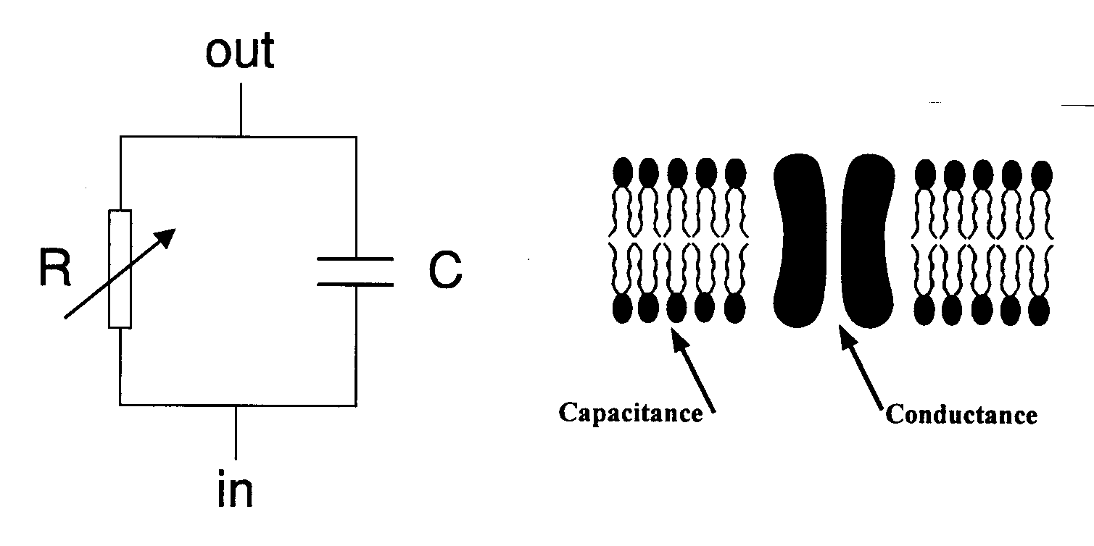
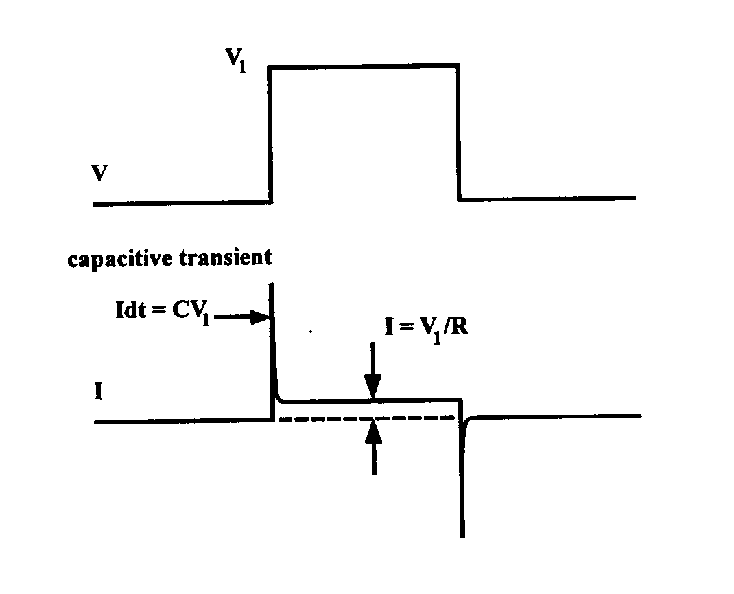
Measurement of membrane currents
Ionic current is measured to yield information about
  Permeability properties of channels
  Mechanisms by which channels open and close
Voltage clamp used to measure ionic currents
Measure current when voltage is not changing

Slide 3
What is current?
Current or the rate of flow of a particular ionic species is the conductance of the membrane to the species multiplied by the driving force for that species.
Remember driving force is (E_{m} – E_{ion})
The conductance (g) is the reciprocal of resistance g = 1/R
I = g * (E_{m} – E_{ion})
Ohm’s Law is V = IR
Conductance is related to permeability however they are not the same.
Conductance depends on membrane potential, the type of ion and the concentration of the ion.
Permeability depends on the membrane potential and the type of ion but not the concentration of the ion.

Slide 4
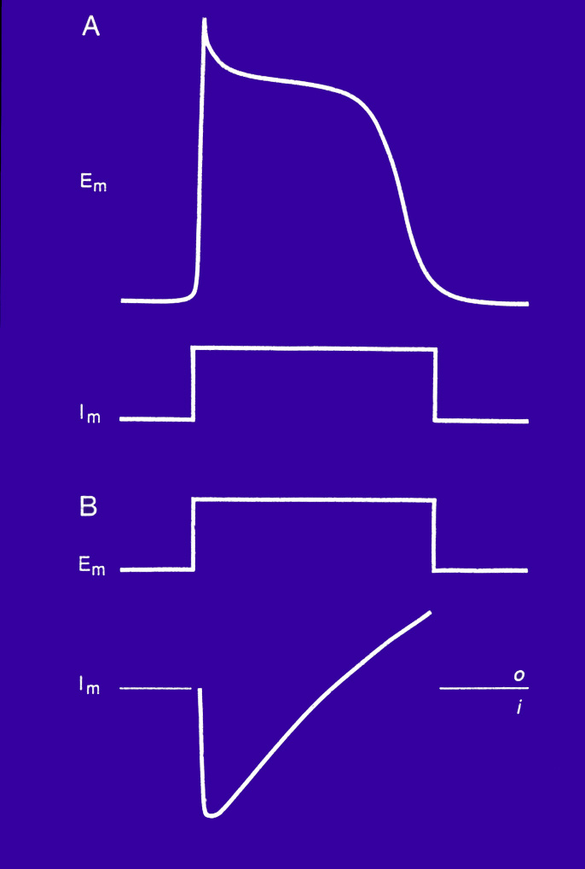
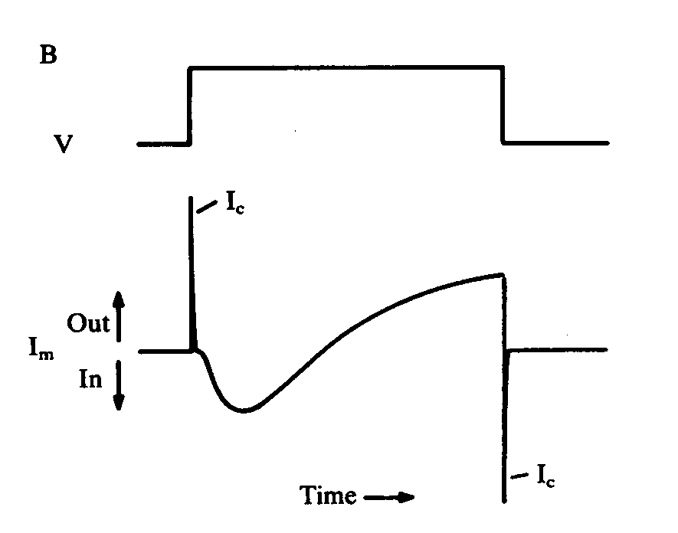
Voltage clamp
Inward current = positively charged ions moving into cell
Inward current = downward deflection
Inward current depolarizes cell under voltage clamp

Slide 5
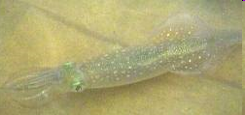
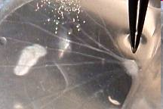
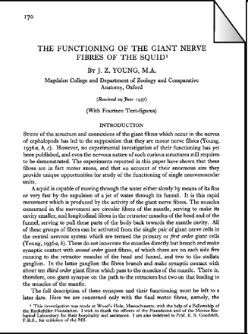
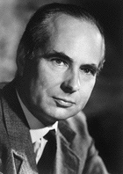
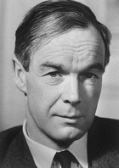
Giant axon
Loligo vulgaris
Preparation first described by “JZ”
Nobel Prize - 1963
Andrew Huxley (step brothers - Sir Julian Huxley, the biologist and Aldous Huxley, the writer.
Alan Hodgkin

Slide 6
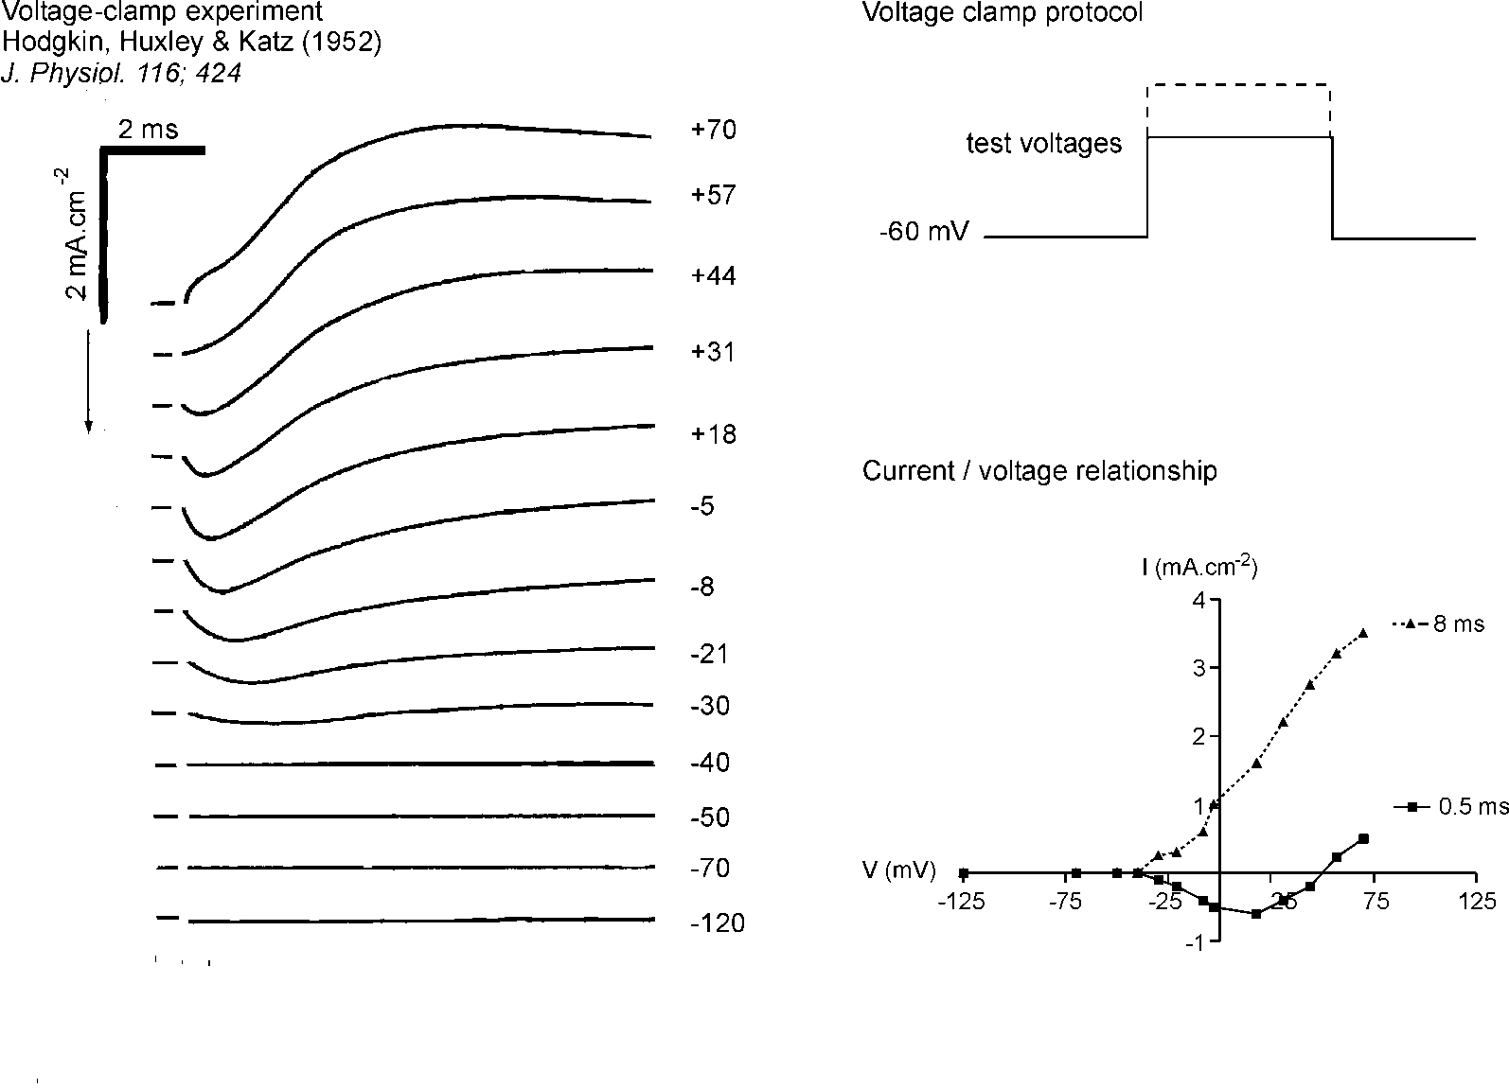
Giant axon experiments of Hodgkin & Huxley (1948-52)

Slide 7
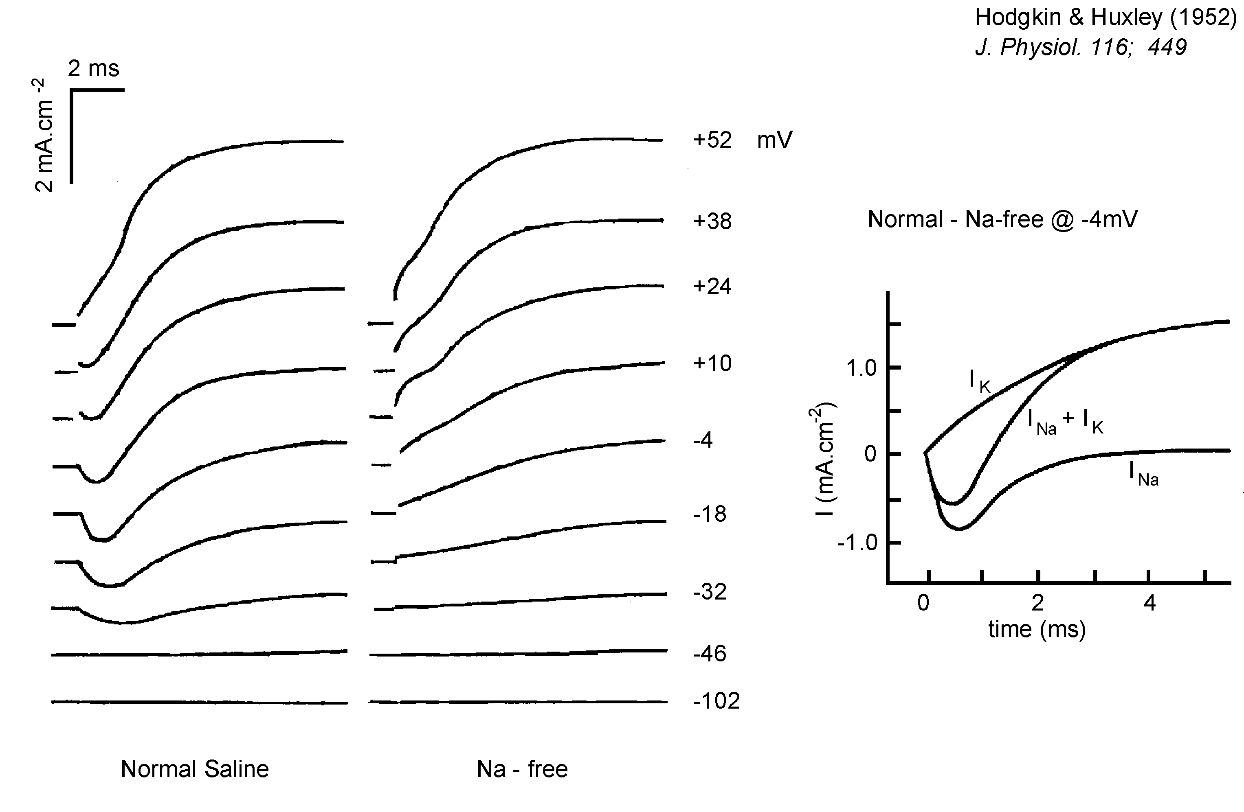
Separation of currents
Early inward current associated with movement of Na ions
Late outward current associated with movement of K ions
H & H described results in terms of conductances (g) (1/R)
Na channels first become conductive then K channels become more conductive

Slide 8
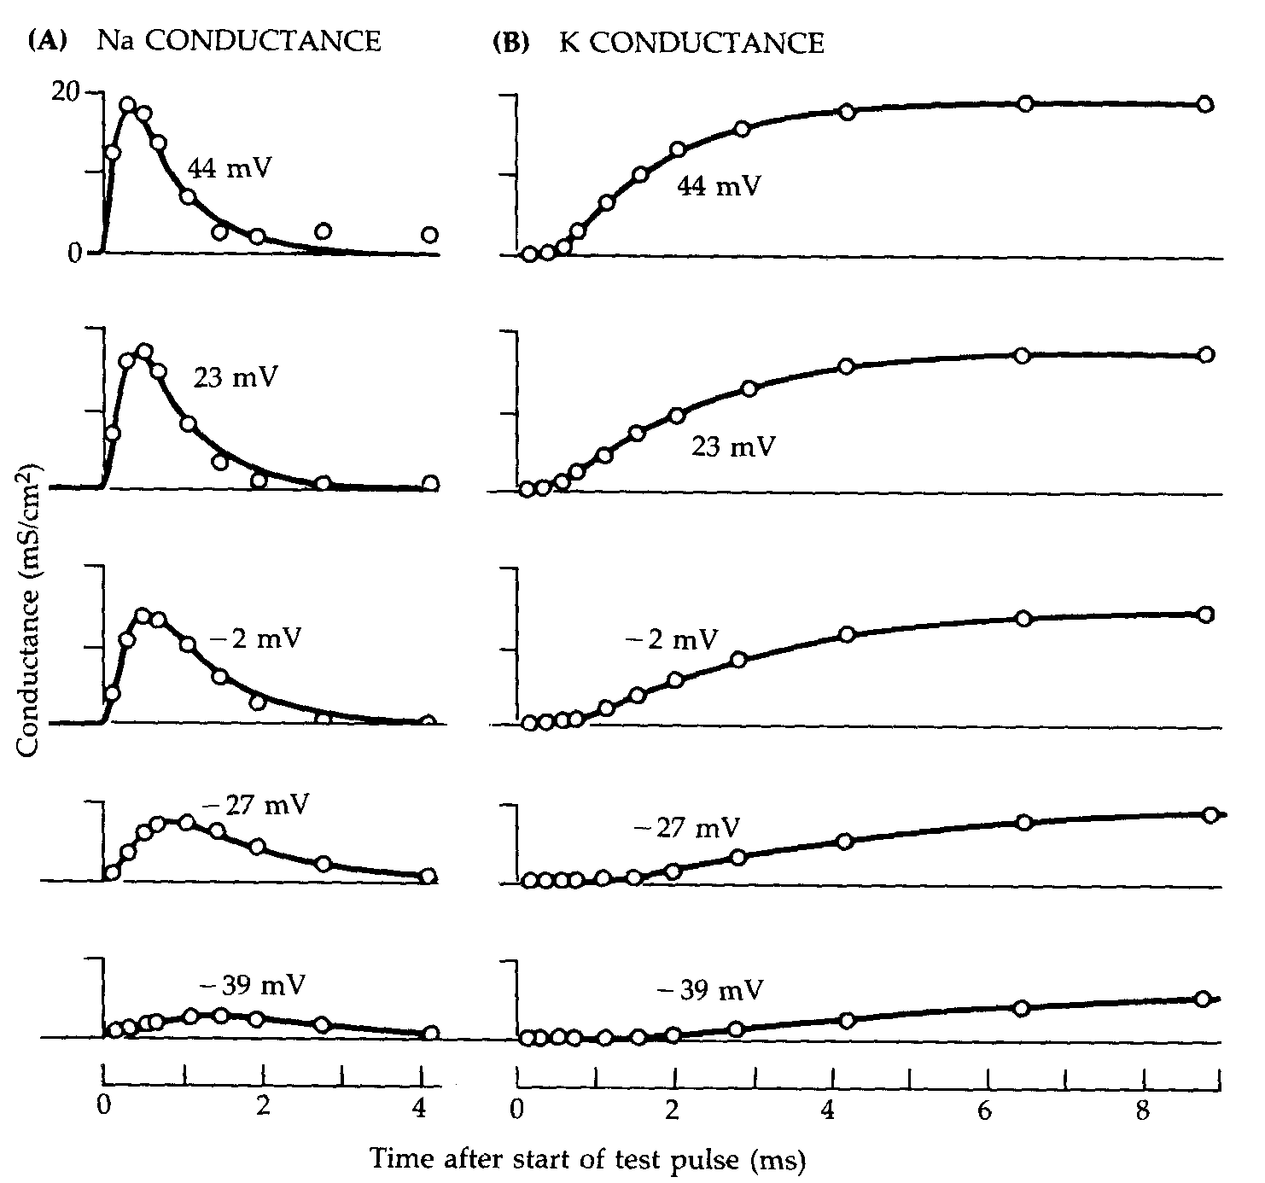
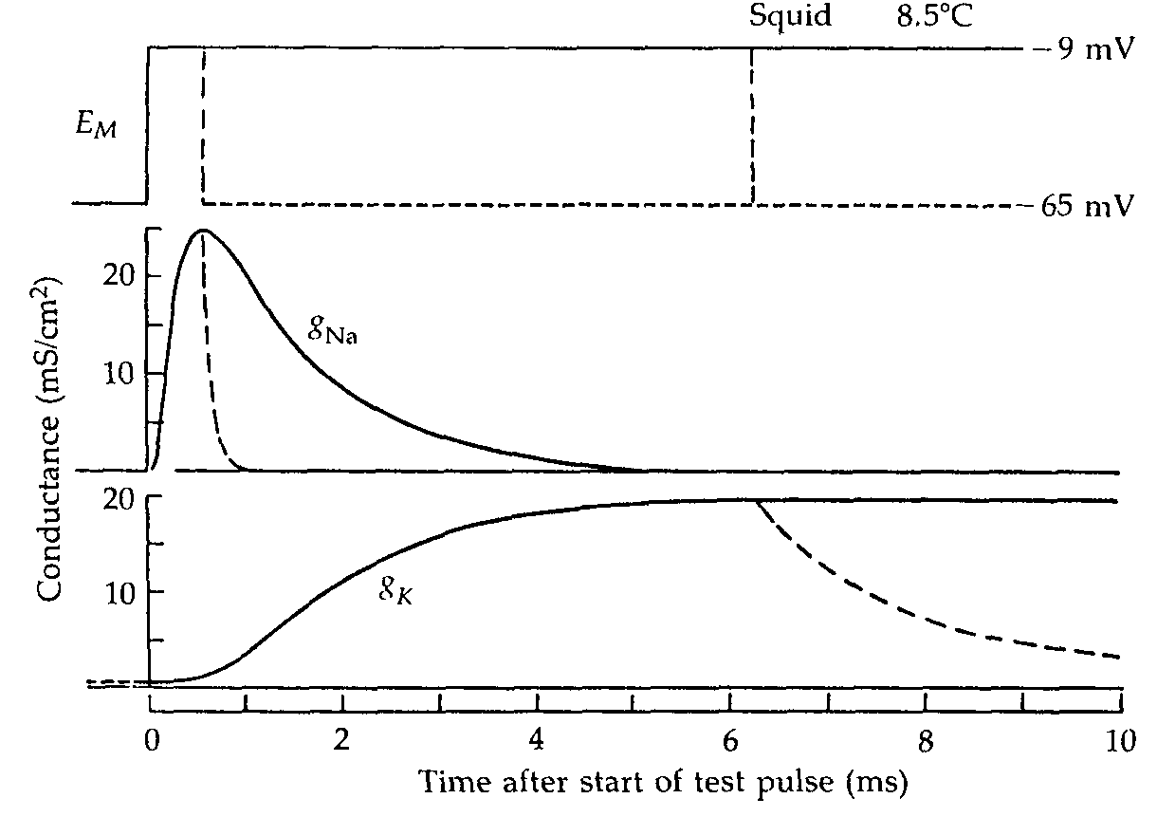
Conductance changes during depolarization and repolarization
Na permeability increases rapidly then decays
Larger depolarizations produce larger and faster conductance changes

Slide 9
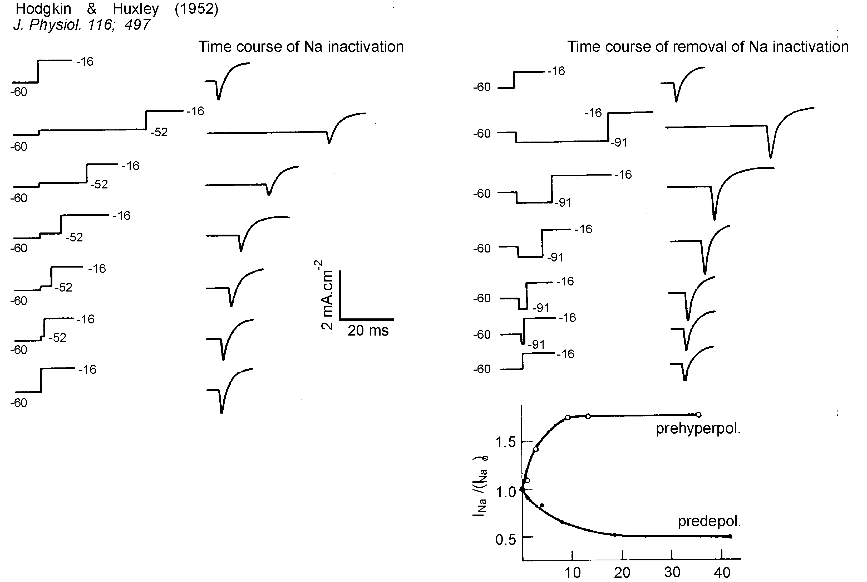
Activation and inactivation
H & H considered that depolarization had two effects on Na channel
  Activation (increased conductance)
  Inactivation (develops more slowly than the process of activation and “turns off” channel)
Inactivation process is time-dependent
If prepulse is hyperpolarizing then inactivation effect is removed – this process is also time-dependent

Slide 10
More points about inactivation
If there were no inactivation process
  gNa would increase to new steady-state level very rapidly (less than a millisecond) with any depolarization
  gNa would decrease to new steady-state level very rapidly with any hyperpolarizing step
  opening and closing of channels could be repeated as often as needed
Once Na channels have been inactivated the membrane must be repolarized (or hyperpolarized) to remove the inactivation
Inactivated Na channels cannot be activated to their conducting state directly – inactivation must be removed
repolarization
open
inactivated
closed

Slide 11
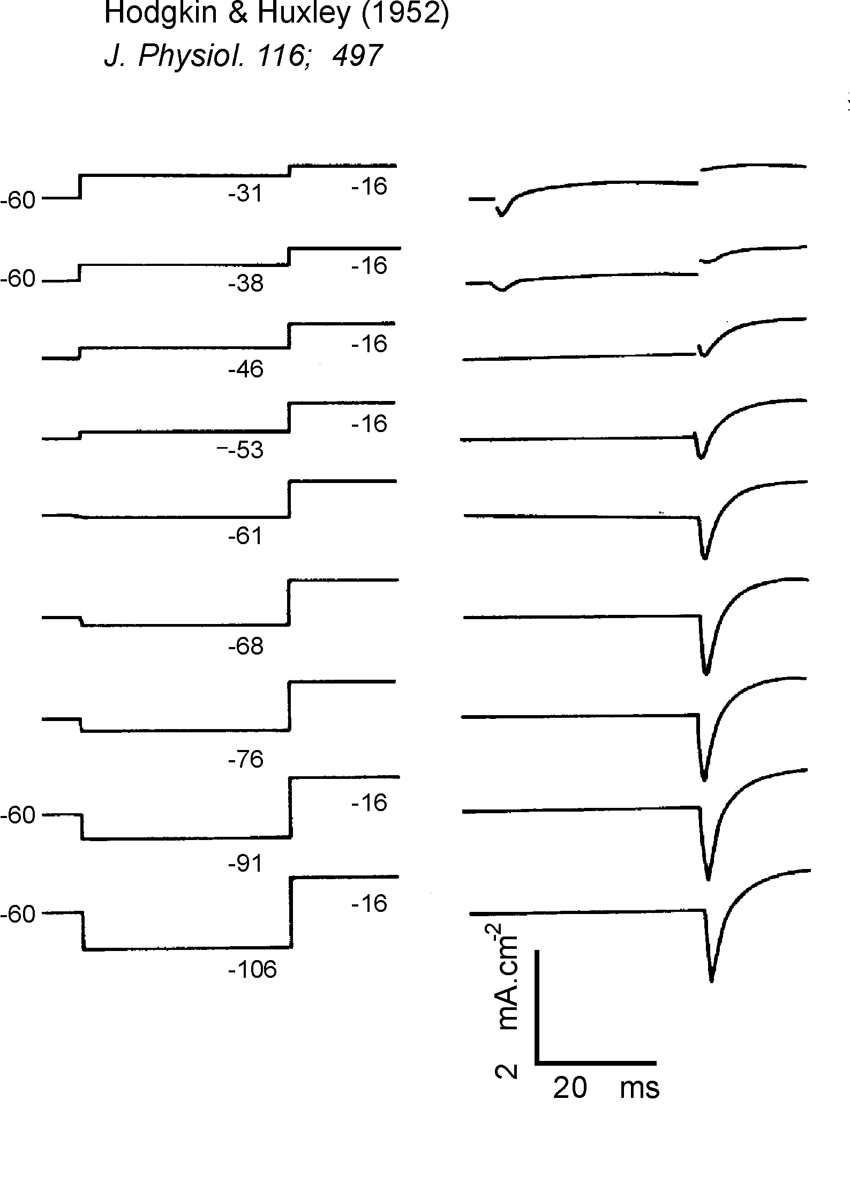
Voltage dependence of inactivation
Experiment uses long (~36msec) conditioning pulses so that the effects develop maximally
Large predepolarizations inhibit inward current in response to test pulse
Prehyperpolarization augments inward current arising from test pulse

Slide 12
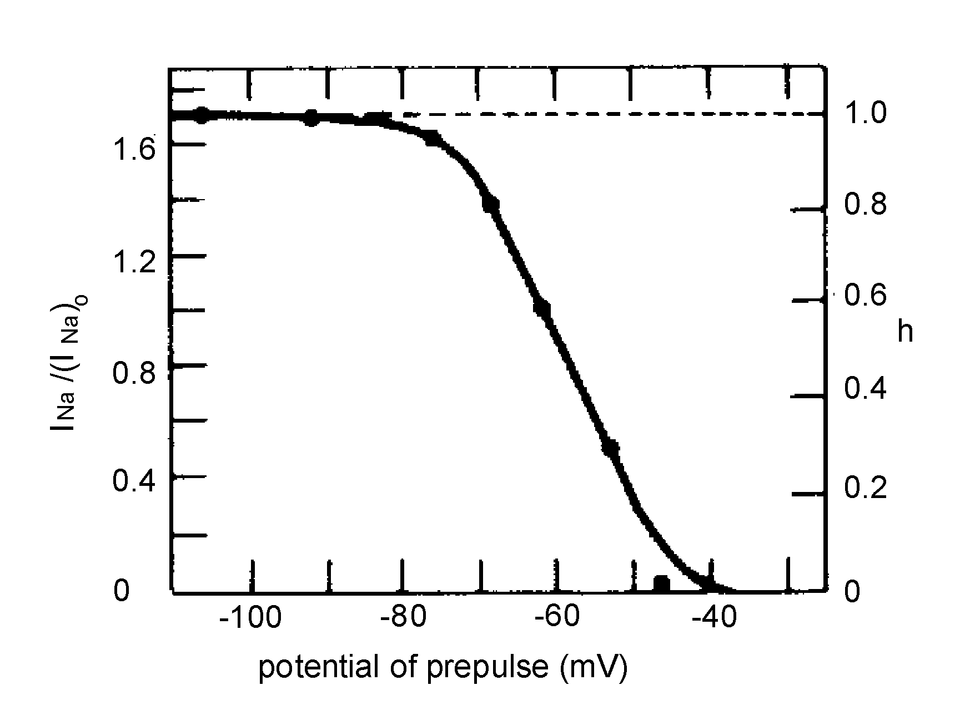
Analysis of voltage-dependent inactivation
H & H used equation of the form below where:
  h = a parameter proportional to inward Na current
  V = depolarization of prepulse measured from resting membrane potential
  V_{h} = value of V at which h = ½

Slide 13
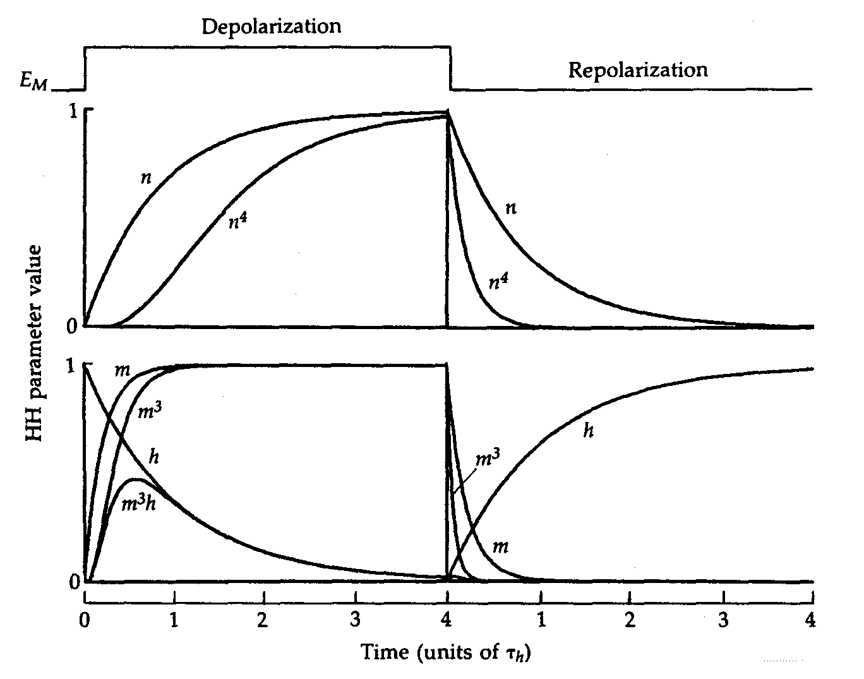
H & H analysis of voltage clamp currents – K current
K current at any one time given by:
  where (bar) g_{K} = max. K conductance
  n = dimensionless variable that varies from 0 – 1 as a function of voltage and time
n⁴ needed to describe slow build-up of g_{K} following a step depolarization

Slide 14
H & H analysis of voltage clamp currents – Na current
Na current at any given time:
  here (bar) g_{Na} = max. Na conductance
  m = activation parameter (like n is dimensionless) that varies from 0 – 1 as a function of voltage and time
  h = inactivation parameter that varies from 0 –1 also as function of voltage and time
m³h describes conductance changes
Variables n,m and h called gating charges or voltage sensors

Slide 15
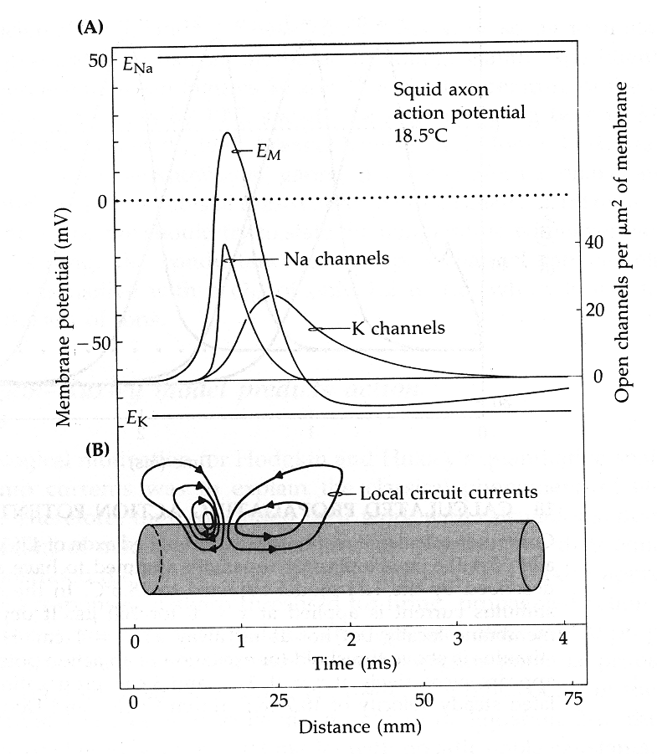
Hodgkin-Huxley model predicts action potentials

Slide 16
Mechanistic implications of m, n and h
Na and K channels activate (and for Na inactivate) over time in a manner implying that several components (or steps) are involved.
For example, for a Na channel to be open, all 3 “m particles” and the “h particle” would require to be in (say) one orientation
Many possible “gating” states
open
inactivated
closed
repolarization
open
inactivated
closed

Slide 17
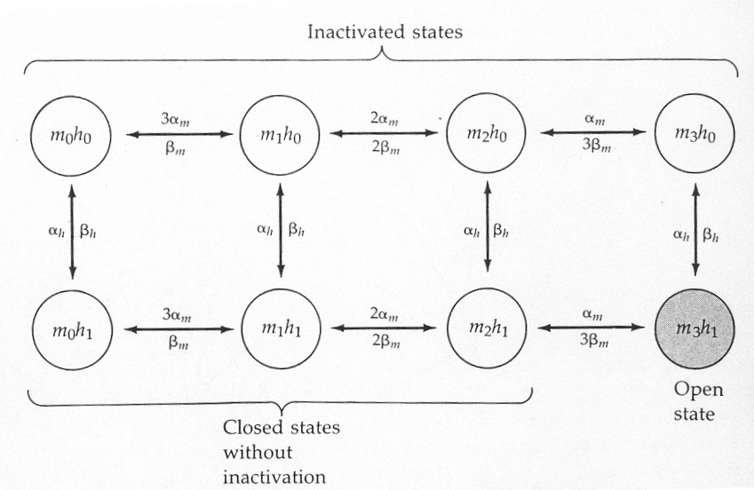
Kinetic gating states of H&H Na channel
inactivation

Slide 18
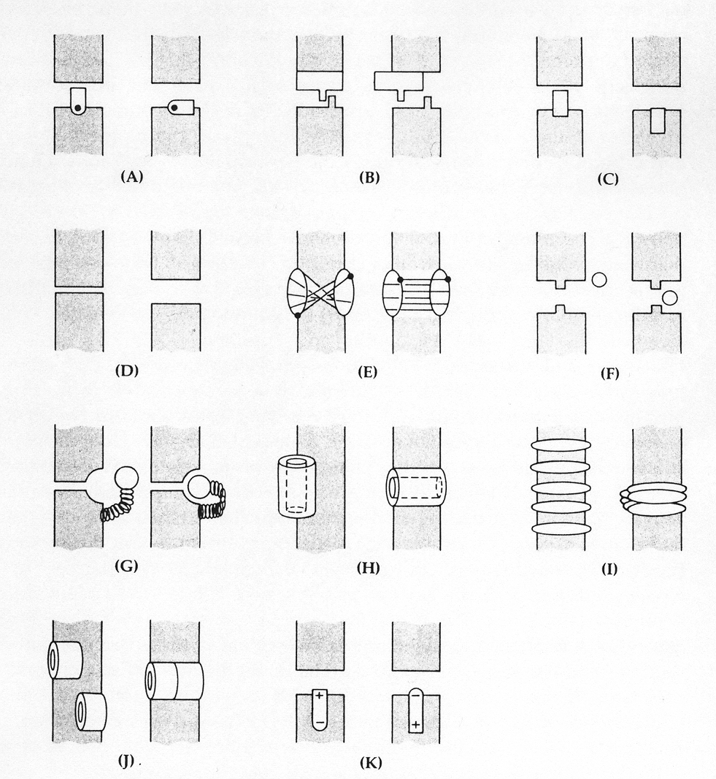
Many functional possibilities for channel gating
Thermo-dynamically possible
Rotate or slide
Pinch shut or twist
Become blocked by free or tethered particle (F & G)
Assemble from subunits

Slide 19
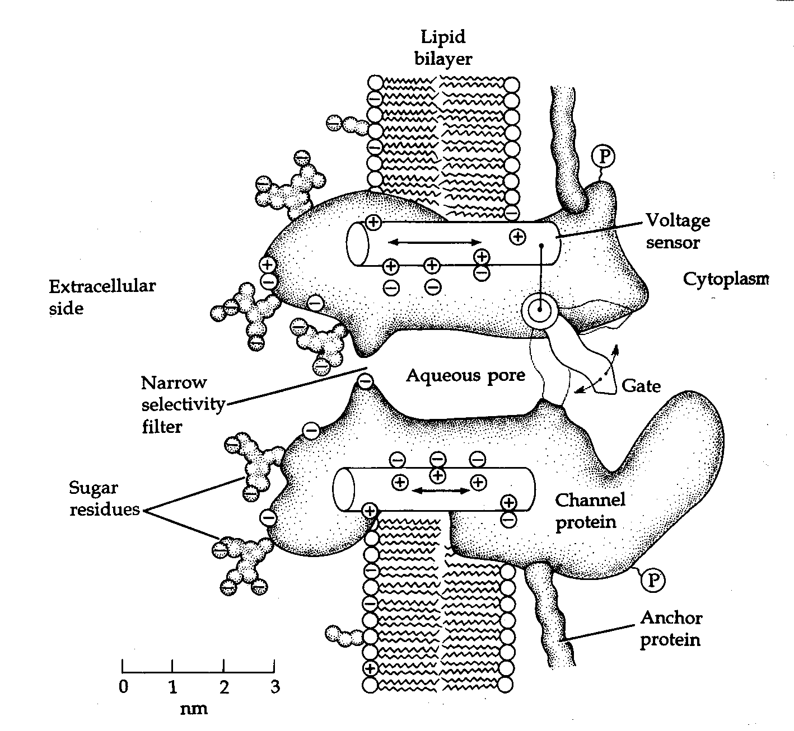
Where are the gating particles and voltage sensors and how might they function?
How is activation (a change in membrane potential, ligand binding etc.) translated into a conformational change in the channel protein?

Slide 20
Channels classified in terms of the stimulus for activation.
Classes of Ion Channel
Activating stimulus
Chemical Ligands
Membrane potential
Mechanical
Extracellular ligands (Ach, glutamate, ATP, GABA, glycine, etc.)
Intracellular ligands (lipids, ions, nucleotides)
Na⁺
Cations
Depolarisation
Hyper-polarisation
Cations
Cl⁻
Ca²⁺
Cations
K⁺
Cl⁻
Ca²⁺
Na⁺
K⁺
Cl⁻
K⁺
Cl⁻
K⁺
K⁺
Cations

Slide 21
Channel structure
P-loop
S4 span of each domain (or monomer for K channel) is highly conserved
+ve charge on every third amino acid in S4
Mutations (sometimes only single amino acids) cause changes in voltage-dependence of activation
S4 thought to move in response to electric field

Slide 22
The S4 voltage-sensor of a voltage-gated K⁺ channel
The S4 trans-membrane helix of each monomer has 4 arginine (R) residues that are positively charged at physiological pH.
From: Long et al (2005) Science 309;903-908.

Slide 23
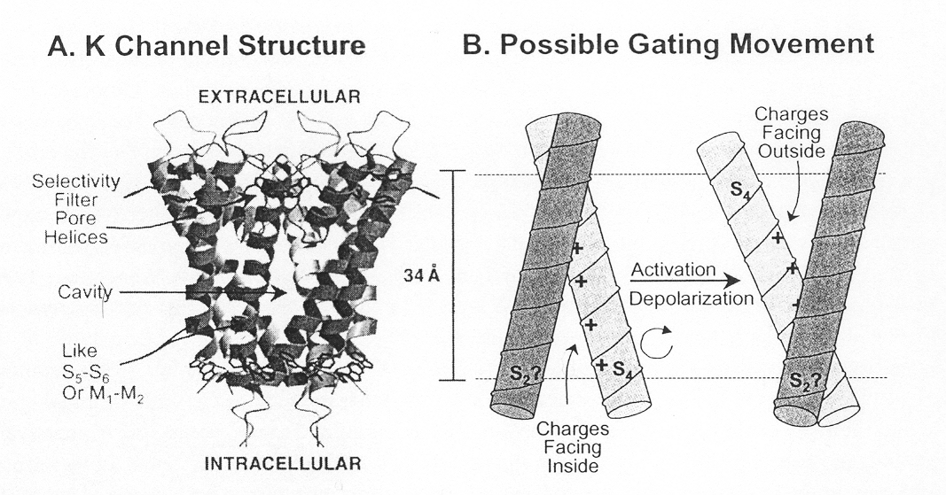
Possible gating movement
Movement of S4 may cause conformational changes to S5 and S6 allowing opening of the channel

Slide 24
How is the movement of the voltage-sensor mechanically coupled to the opening and closing of the channel pore?
“Oversimplified” proposed mechanism of voltage-dependent gating

Slide 25
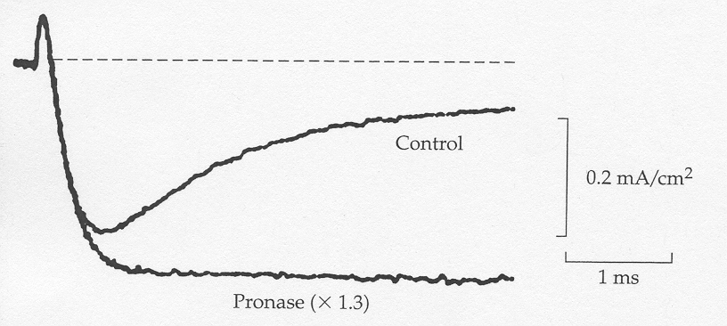
N-type inactivation
Following activation by changing trans-membrane potential some channels show time-dependent inactivation even though trans-membrane potential is maintained. This is known as rapid inactivation or N-type inactivation.
An indication of the mechanism underlying this process arose from application of proteolytic enzymes to the intracellular surface of the membrane.
Activating voltage step
Removal of N-type inactivation by proteolytic enzymes suggests the involvement of a component of the channel or an associated protein.

Slide 26
Molecular mechanisms of N-type or rapid inactivation
Some voltage-activated K⁺ channels display time-dependent inactivation:
Closed Open Inactivated
The inactivated state is in effect a state in which the open channel is blocked by part of the channel – N-terminus inactivation peptide.
extracellular
☞
✄
cytosolic
✄
open
inactivated

Slide 27
Molecular mechanisms of N-type or rapid inactivation
46N-terminal a/a deletion mutant channel does not inactivate
Inactivation can be reinstated by the addition of exogenous free peptide.
extracellular
☞
cytosolic
open
inactivated

Slide 28
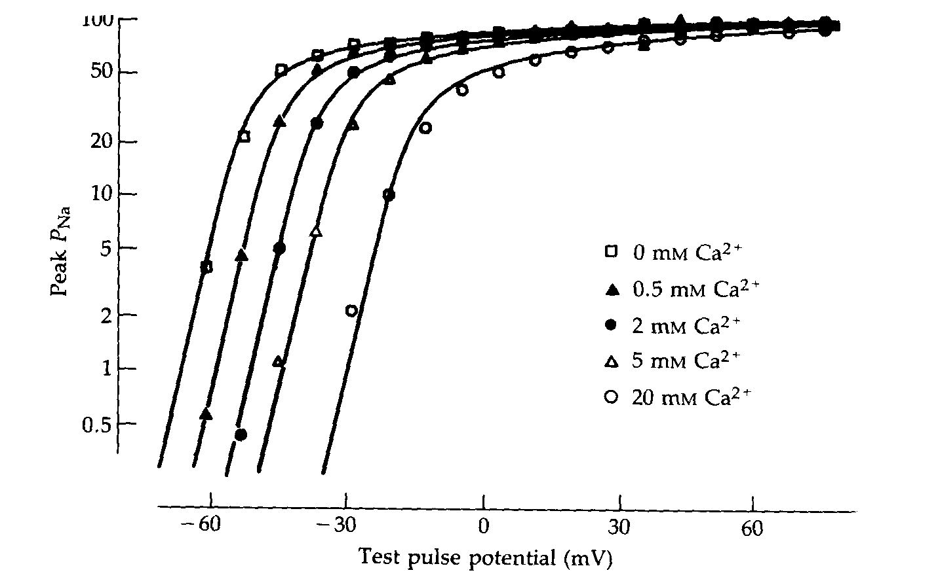
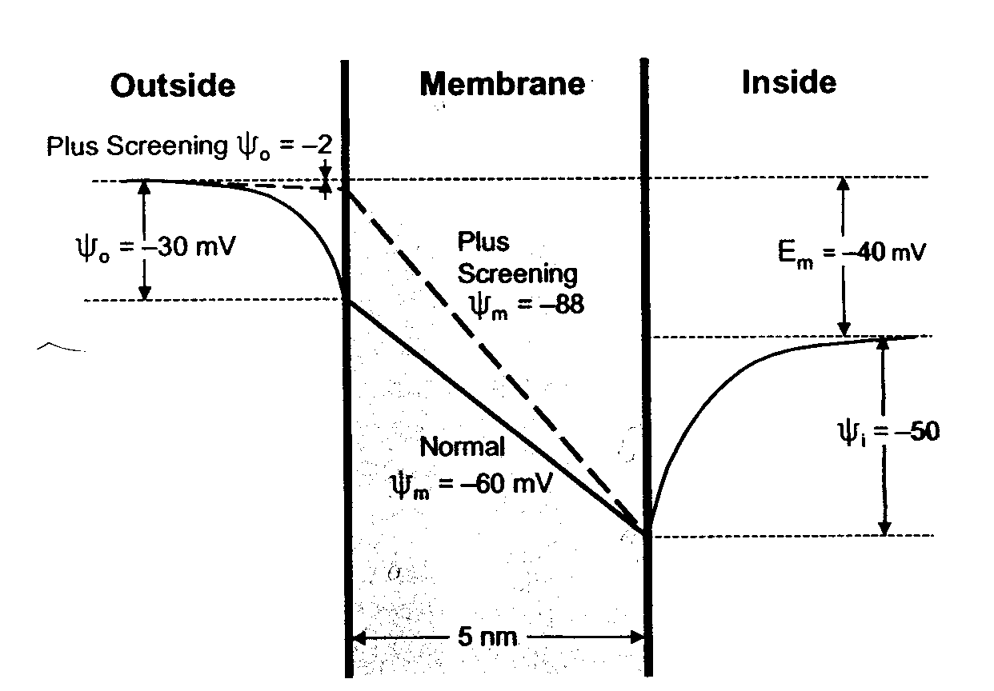
Modifying gating by changing surface charge
Changing [Ca]_{o} shifts Na channel activation
Ca changes surface potential (ψ_{o})
Increases electrical potential profile across membrane (ψ_{m})
Larger depolarization required for activation of channel
Surface charge important for two reasons:
  modifies the concentrations of ions near the entrances to the channel, increasing the cation concentration and decreasing the anion concentration
  modifies the potential across the membrane so affecting channel gating

