Slide 1
Stem cells – a spotters guide
BSc Foundation Course 2012
Professor Sian E. Harding
Imperial College
London

Slide 2
Natural history of heart failure
Myocardial infarction
Valve disease
Genetic defect
Alcohol/drugs
Infection/sepsis
Damage
Repair
Repair
Repair
Hypertrophy
Dilatation
Volume loading
Sympathetic stimulation
Apparent recovery/
compensation
Gene therapy
Revascularisation
Drugs
Drugs
Decompensation/
Heart failure
Devices
Transplantation
Death

Slide 3
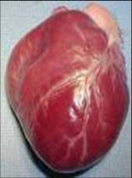
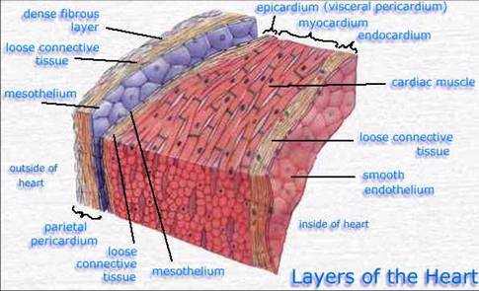
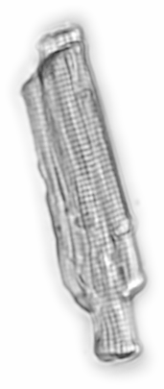
Structure of the contracting myocardium
0.1mm
Myocyte (muscle cell)
Dying myocyte
Classic paradigm of the heart as a terminally
differentiated organ with no capacity for self-repair
1.0

Slide 4
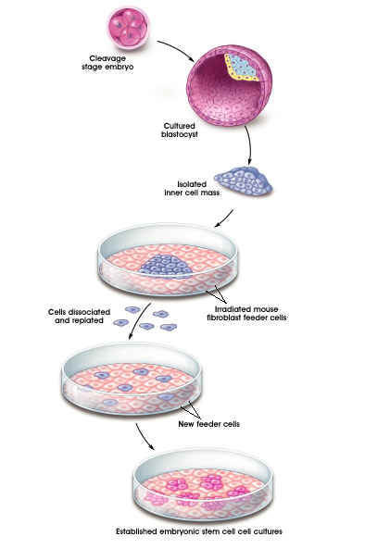
Human embryonic stem cells discovered in 1998
In vitro fertilization day 1
Embryos frozen at 1-7 days
(at this point, ~80% embryos do not implant either naturally or after IVF)
Unused embryos must be destroyed
Permission requested at that point to use
for research
Cell line made
Held in Stem Cell Bank
Distributed free to researchers
1 day after
fertilization
4-6 days

Slide 5
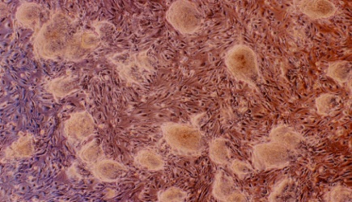
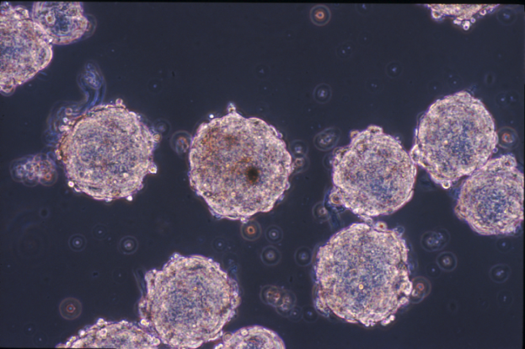
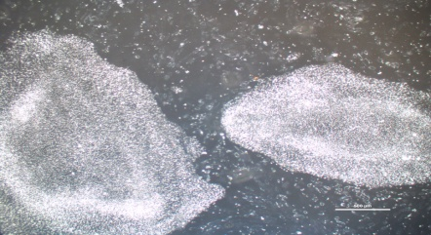
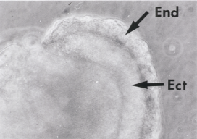
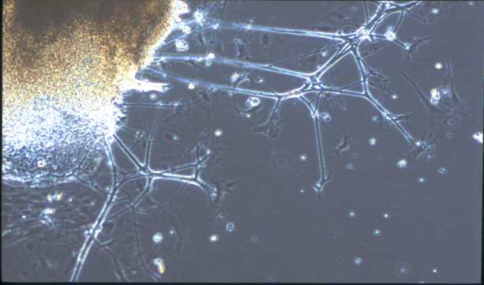
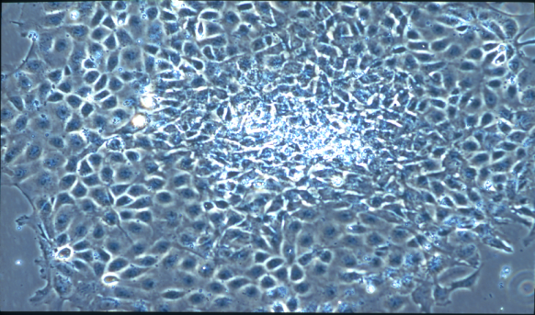
Method of generation of embryonic stem cell-derived cardiomyocytes
mESC
(D3 line) - LIF/ feeder fibroblasts
+FCS
Embryoid bodies
hESC
(H7 line) – bFGF + MEF-conditioned medium
Undifferentiated ESC colonies
Neuronal
Human (from day 9-12)
Epithelial
Cardiac
Notes:
5
Via geron method, cells then seeded onto biomaterials
I have used the conventional method of differentiating ESCs into cardiomyocytes via embroid body formation.
I used both murine and human ESCs.
Add nadire slide

Slide 6
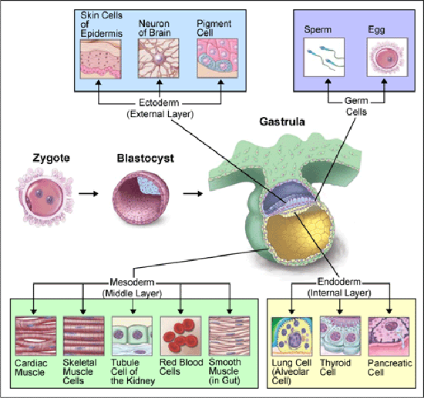

Slide 7
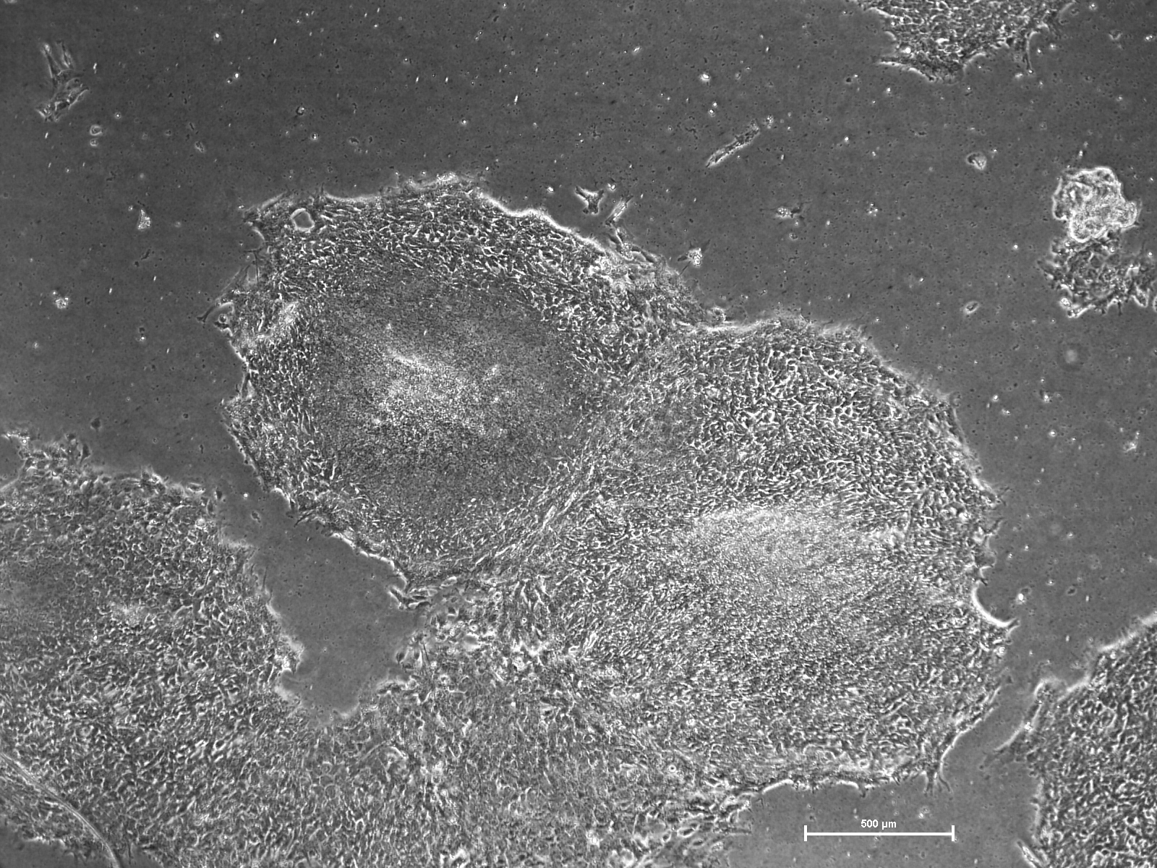
Activin/BMP4 treatments to induce cardiomyogenesis
hESC-CM-enriched
beating monolayer
H7 ESC colonies
200 x 10³ – 400 x 10³ cells/well
isolated hESC-CM
Activin BMP4
d0
d1
d5
d11
d18
RPMI/B27
Nadire Ali

Slide 8
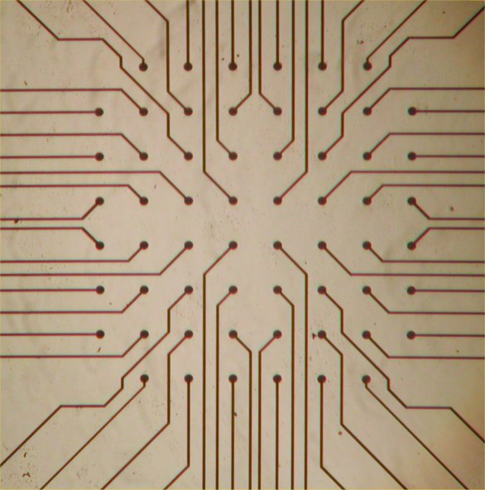
Microelectrode array measurements
EB method
Cesare Terracciano

Slide 9
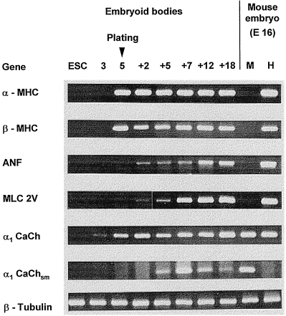
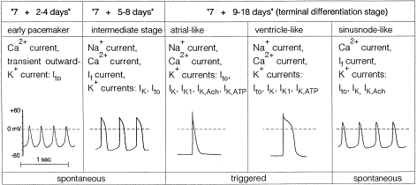
Development of a variety of cardiomyocyte phenotypes from ES cells
Differentiating cardiomyocytes

Slide 10
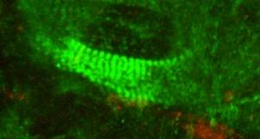
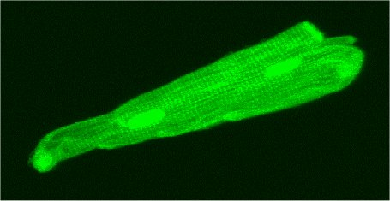
Myosin heavy chain (MHC) (green); Propidium Iodide (red) ;x400
Human ESCM
X40
Adult cardiomyocyte

Slide 11
hES-derived cardiomyocyte
Adult human ventricular
cardiomyocyte
Day 78 of differentiation
Nadire N. Ali, Philip Poole-Wilson, Sian Harding (unpublished)

Slide 12
Imaging of calcium transients with fluo-4 in human ESCM

Slide 13
Human Embryonic Stem Cells for cardiac repair
ADVANTAGES
Unlimited supply
Perfectly designed for regeneration
Form cardiomyocytes, vessels and connective tissue
ESC-CM can mature, and have responses similar to adult cardiomyocytes
Immediate availability – ‘off the shelf’
Tissue engineering

Slide 14
Embryonic stem cells-hurdles to be overcome
Ethical problems
Exposure to animal products during derivation and culture
Tumour formation
Only in undifferentiated cells
Safe when turned into cardiomyocytes etc
Immune rejection
Immunosuppression as for organ transplant
Patient-specific ES-like cells
Matching of hESC-derived cardiomyocytes to mature ventricle
Arrhythmias

Slide 15
Ethical considerations addressed by experimentation
Nature. 2005 Oct 16
Generation of nuclear transfer-derived pluripotent ES cells from cloned Cdx2-deficient blastocysts. Meissner, Jaenisch.
Embryonic and extraembryonic stem cell lines derived from single mouse blastomeres. Chung Y, Klimanskaya I, Becker S, Marh J, Lu SJ, Johnson J, Meisner L, Lanza R.
Nature. 2006 Aug 23
Human embryonic stem cell lines derived from single blastomeres. Klimanskaya I, Chung Y, Becker S, Lu SJ, Lanza R.

Slide 16
Animal product-free conditions for hES cells
Feeder-free growth
Xu C et al (2001) Nat Biotechnol.19:971-4 ------(matrigel and MEF-CM!)
Gold J et al 2005 (Abst. ISSCR SF) -----------------(serum coated plates)
Chemically defined medium
Xu R-H, et al Nature Methods 2: 185-190-----------(+ Noggin)
Xu C et al (2005) Stem Cells 23: 315-323----------(+high bFGF)
Human feeders
Stojkovich P et al (2005) Stem Cells 23:306–314--(+hES-derived FBs)
Derivation of ES cells with human feeders
Derivation of ES cells w/o exposure to feeders
Lanza R (Advanced Cell Technology) – Lancet (2005)-(sterilsable ECM)

Slide 17
Teratoma formation
Differentiated ES cells do not form teratomas
Formation of human myocardium in the rat heart from human embryonic stem cells. Laflamme, Murry, Am J Pathol. 2005 167:663-71
But:-
Human adult mesenchymal stem cells undergo spontaneous transformation after prolonged culture
Spontaneous human adult stem cell transformation. Rubio et al Cancer Res. 2005 65:3035-9

Slide 18
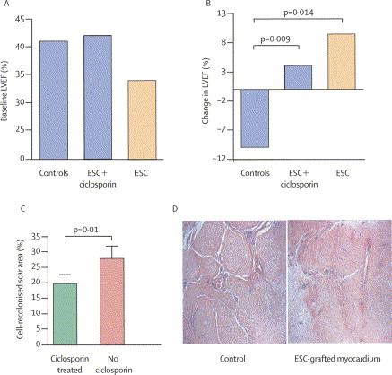
Immunogenicity of embryonic stem cells in the heart
Survey of 8 papers, with allogenic ES cell transplantation to mouse or rat,
8 reported survival of cells/improved function
of these, only 3 used athymic animals or immunosuppression
Sheep with implanted mouse ES cells, greater improvement in non-immunosuppressed animals
Transplantation of cardiac-committed mouse embryonic stem cells to infarcted sheep myocardium: a preclinical study. Menard, Menasche Lancet. 2005 366:1005-12.

Slide 19
Overall prospect for embryonic stem cell-derived cardiomyocytes for cardiac repair
-promising source of cardiac muscle, but still not ready for the clinic

Slide 20
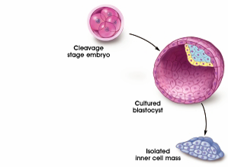
Tissue repair with hESC-derived cells
Geron: FDA-approved clinical trial of nerve cells for spinal crush injury
Cells implanted in spinal cord.
Immunosuppression for 60 days after implantation
Animal studies show tumour risk only at >5% undifferentiated hESC

Slide 21
Other advantages of stem cell research-hESC-CM as a model system
In vitro model systems for cardiac physiology, pharmacology or pathology have been lacking –poor culture and transfection
hESC-CM have many of the phenotypic characteristics of authentic cardiomyocytes
Maturation in culture can occur
Contraction and electrical properties are sufficiently stable and reproducible for hESC-CM to be used as a pharmacological preparation
Potential for use in toxicology and drug discovery studies
Stem cells for Safer Medicines
High throughput measurement screening systems – cellomics can match genomics in rate of discovery

Slide 22
Human Cardiomyocytes
A new era in safety screening with human cell models.
GE Healthcare’s cardiomyocytes are derived from human embryonic stem (hES) cells and provide a biologically-relevant alternative to current cell models and primary cells, for predictive toxicity testing.
Highly characterised Funtionally verified Representative myocyte population Karyotype verified Scalable Cryopreserved for ease of use | Phenotype characterized by flow cytometry, subcellular imaging, and electrophysiology. Electrical properties verified using patch clamping. Comprise ventricular, atrial, and nodal subtypes. Produced from undifferentiated hES cells shown to have normal karyotype. Available in quantities to match a range of applications. Ready-to-use on thawing, and can be maintained for at least 7 days once recovered into culture.

Slide 23
Other advantages of stem cell research-understanding stem cell biology
Changing adult cells into embryonic-like stem cells
Therapeutic cloning – somatic nuclear transfer
Induced pluripotent stem cells
New appreciation of the role of foetal stem cells
Identification and manipulation of natural stem/progenitor cells
Heart
Testes
Fat
Menstrual blood
Cord blood

Slide 24
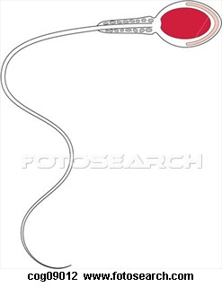
Normal
reproduction
+
egg
sperm
Therapeutic
cloning
Nucleus removed
Human egg
Skin cell nucleus
added
Skin cell
Human skin cell
Embryonic stem cell line
Human/animal
chimera
Skin cell
Human skin cell
Cows egg

Slide 25
Induced pluripotent stem cells
Somatic cell e.g. skin (but neural easier)
Sox2
Oct4
Nanog
KLF
Lin28
cMyc
Retroviral vectors
Embryonic stem-like cell
Takahashi,Yamanaka.
Cell. 2007 Nov 30;131(5):861-72
Differentiated derivatives

Slide 26
Induced pluripotent stem cells
Person-specific stem cells for repair or modelling
But – problems with spontaneous dedifferentiation and tumour formation in vivo
Removal of oncogenic cMyc
Use of vectors e.g. piggybac Transposon, Cre/lox technology, which excises vectors afterwards
Use of non-integrating vectors
Use of proteins only
miRNA-Mediated Reprogramming Cell Stem Cell, 8: 376 (2011)
Induced pluripotent stem cells--alchemist's tale or clinical reality?
Rashid ST, Vallier L. Expert Rev Mol Med. 2010 Aug 13;12:25.

Slide 27
Arrhythmias in iPSC-CM from patients with Long QT syndrome
e.g. iPSC-CM - Long QT Syndromes
Moretti, et al. NEJM 2010
Itzhaki, et al. Nature 2010 (HERG)
Yazawa, et al. Nature 2011 Timothy – (LTCC)
Matsa, et al. Eur Heart J 2011 (HERG)

Slide 28
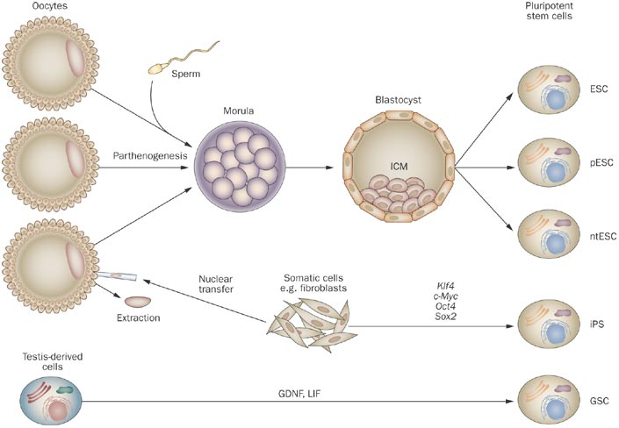

Slide 29
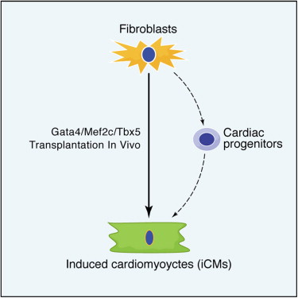
Direct reprogramming of fibroblasts into functional cardiomyocytes by defined factors.
Ieda M, Fu JD, Delgado-Olguin P, Vedantham V, Hayashi Y, Bruneau BG, Srivastava D
Cell. 2010 Aug 6;142(3):375-86.

Slide 30
Other advantages of stem cell research-understanding stem cell biology
Changing adult cells into embryonic-like stem cells
Therapeutic cloning – somatic nuclear transfer
Induced pluripotent stem cells
New appreciation of the role of foetal stem cells
Identification and manipulation of natural stem/progenitor cells
Heart
Testes
Fat
Menstrual blood
Cord blood

Slide 31
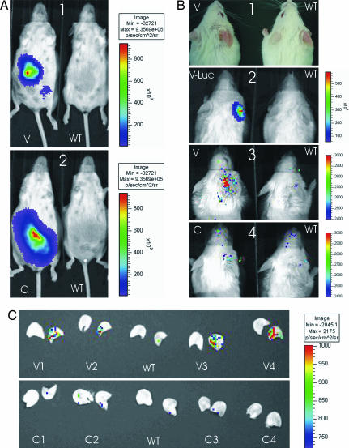
Fetal stem cells repair maternal injury in mouse and human
Site of ear
inflammation
Luciferase-positive
fetus
Maternal neoangiogenesis during pregnancy partly derives from fetal endothelial progenitor cells Huu/Khosrotehrani PNAS. 2007 104(6): 1871–1876.
Microchimeric fetal cells cluster at sites of tissue injury in lung decades after pregnancy O'Donoghue/ Fisk. Reprod Biomed Online. 2008 Mar;16(3):382-90.

Slide 32
Other advantages of stem cell research-understanding stem cell biology
Changing adult cells into embryonic-like stem cells
Therapeutic cloning – somatic nuclear transfer
Induced pluripotent stem cells
New appreciation of the role of foetal stem cells
Identification and manipulation of natural stem/progenitor cells
Heart
Testes
Fat
Menstrual blood
Cord blood

Slide 33
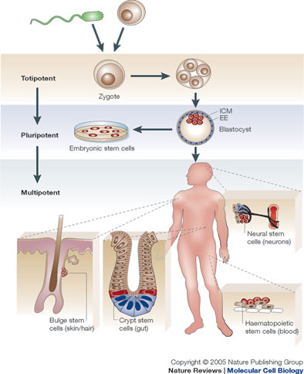
Adult stem cells

Slide 34
Cardiac myocyte regeneration potential
Primary isolated myocytes do not expand or passage in culture
Cardiac tumours are very rare
DNA turnover non-existent in normal myocardium
Low level in diseased tissue
(Soonpa & Field Circ Res 1998;83:15-26)
Mitosis and new myocardial cell formation at low level
in pathological states only

Slide 35
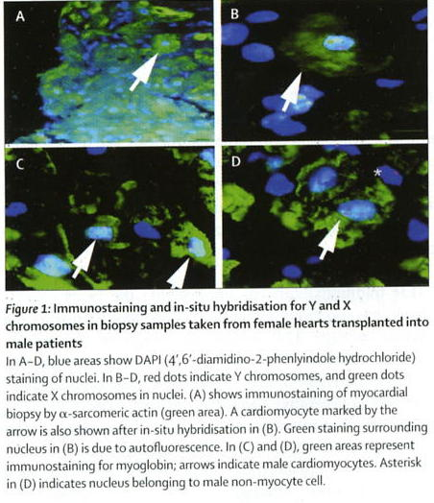
Does Cardiac Regeneration Occur Naturally?
Human sex-mismatched transplants
Female heart transplant into male recipient
25% of microvascular endothelial cells in male recipients with female hearts have a Y chromosome
Male bone marrow transplant into female recipient
Controversy whether Y chromosomes are in myocytes or leukocytes

Slide 36
Carbon dating the heart
14C levels in
the atmosphere
Your birthdate
Your myocytes
birthdate
50% of cardiomyocytes are present at birth. Turnover rate is ~1% per year at age 25, and 0.45% per year at age 75
Bergmann, Science 2009

Slide 37
Intrinsic cardiac progenitor cells
 | CSC markers | Source | Cardiac differentiation | Clonogenic | Proliferative capacity | Multipotent | Other markers
 | SP | Mouse | Yes, coculturing | ND | Yes | Yes | (+) Sca-1 , (−) CD31
 | Abcg2 | Mouse | Yes, coculturing | ND | Yes | Yes | (+) Sca-1 (high), c-kit (low), CD34 (low), CD45 (low)
 | c-kit | Human, rat, and dog | Yes, spontaneous | Yes | Yes | Yes | (−) CD34, CD45, Lin skeletal markers, smooth muscle markers, (+) GATA4, Nkx2.5, Mef2
 | Sca-1 | Rat | Yes, 5-azacytidine | ND | ? | Yes | (−) c-kit, CD34, CD45, Lin, Nkx2.5, sarcomeric proteins
 | Sca-1 | Mouse | Oxytocin | ND | ? | Yes | (+) SP, GATA4, Mef2, CD45 (40%), CD34 and c-kit (10%)
 | CSps | Human, mouse, guinea pig, and pig | Yes, spontaneous and coculturing | Yes | Yes | Yes | (+) c-kit (20%-30%), cardiac and vascular markers
 | isl1 | Human, rat, and mouse | Yes, coculturing | ND | Yes | Yes | (−) Sca-1, c-kit, sarcomeric proteins, (+) Nkx2.5, GATA4

Slide 38
Cardiac progenitor
In the developing fetus, as seen by fate mapping – not human
In the cardiac niche in adult hearts, as a cell which will develop into cardiomyocytes, and possibly smooth muscle, endothelium
From the hESC and their relatives, as partially committed cells e.g. cardiac mesoderm, which are multipotent and can produce cardiomyocytes, smooth muscle, endothelium.

Slide 39
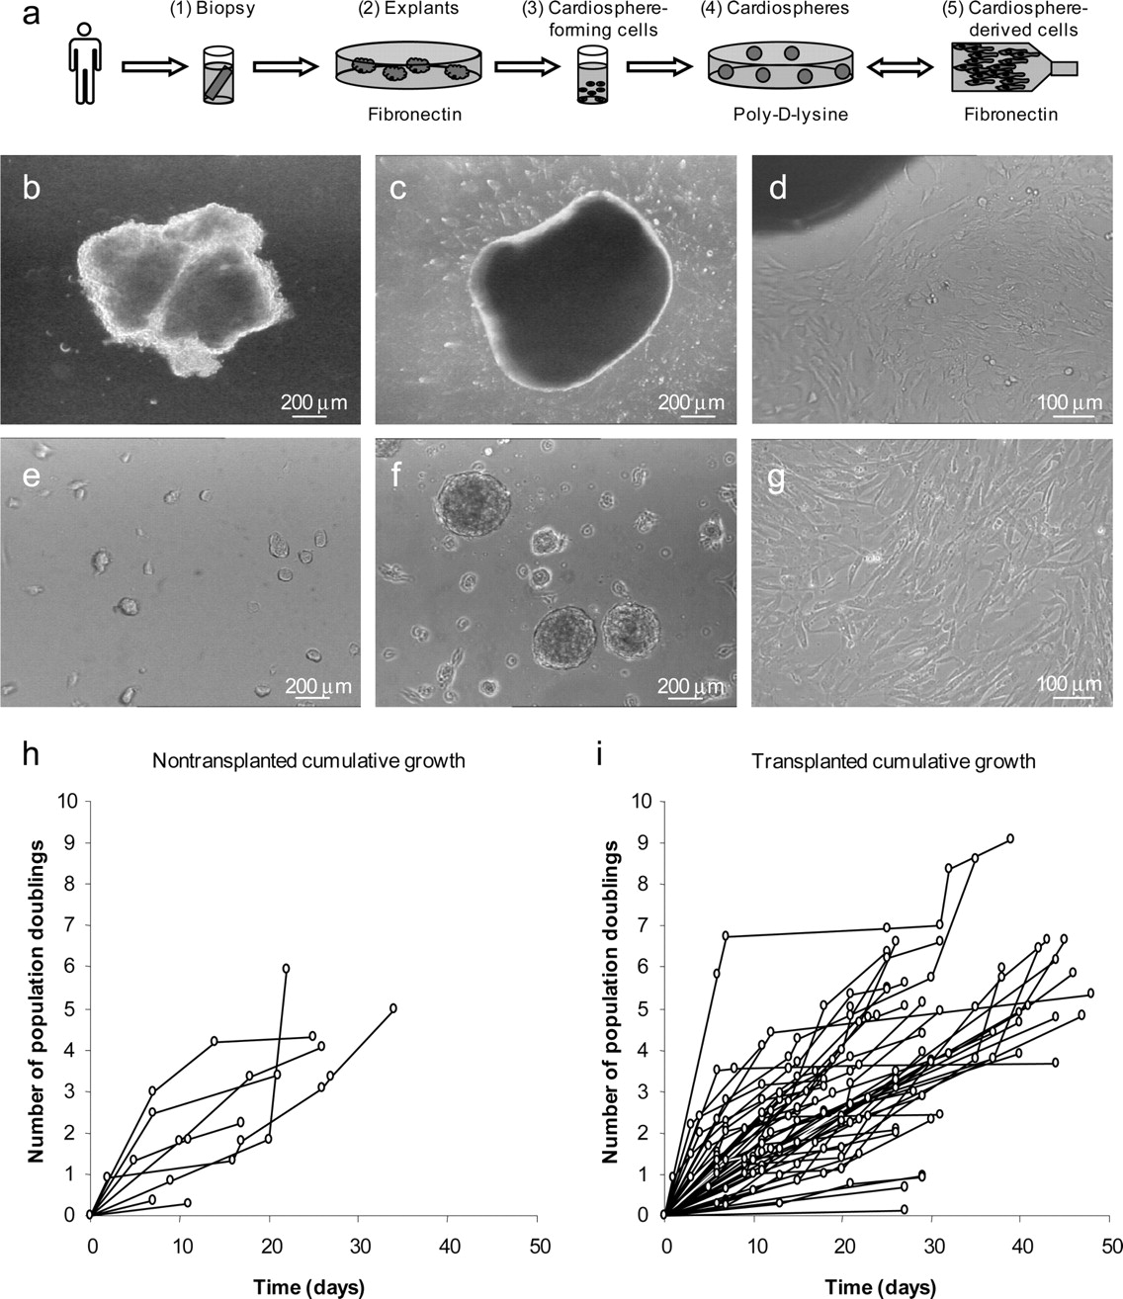
Regenerative potential of resident cardiac progenitor cells expanded from percutaneous endomyocardial biopsy specimens.
Smith, R. R. et al. Circulation 2007;115:896-908
Challenging the paradigm of the non-repairing heart

Slide 40
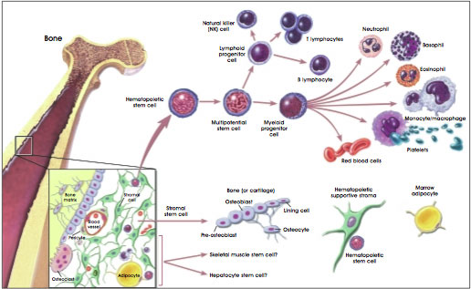

Slide 41
Bone Marrow Stem Cells Mouse Model of BMSC therapy in Acute Myocardial Infarction

Slide 42
Bone Marrow Stem Cells Mouse Model of BMSC therapy in Acute Myocardial Infarction - Controversies
Not reproducible
Murry et al injected Haematopoietic BMSC population with cardiac specific promoter (αMHC) driven label – not detected in 117 cases
Balsam et al Injected eGFP+ve BMSCs into infarcts – formed granulocytes, no cardiomyocytes, but LVEF improved ? altered infarct remodelling
Nygren et al –Rosa mice with GFP BM – fusion but no transdifferentiation
Ausoni et al – WT heterotopic heart transplant into GFP rats – 0.008% Cardiomyocyte GFP +ve
Orlic-Anversa data not reproducible in Macque monkeys - ? rodent/species specific
Therefore BM cells only rarely form CM, and mechanisms are controversial – transdifferention vs fusion vs paracrine

Slide 43
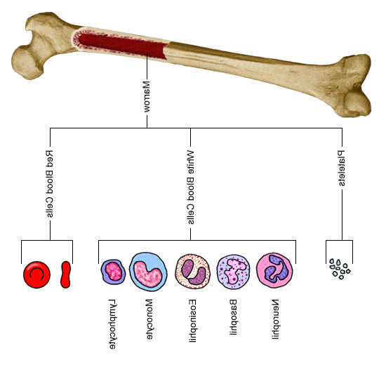
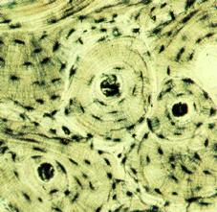
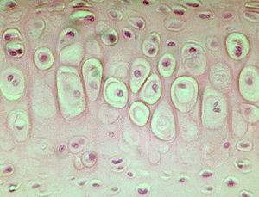
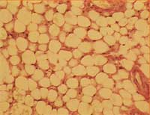
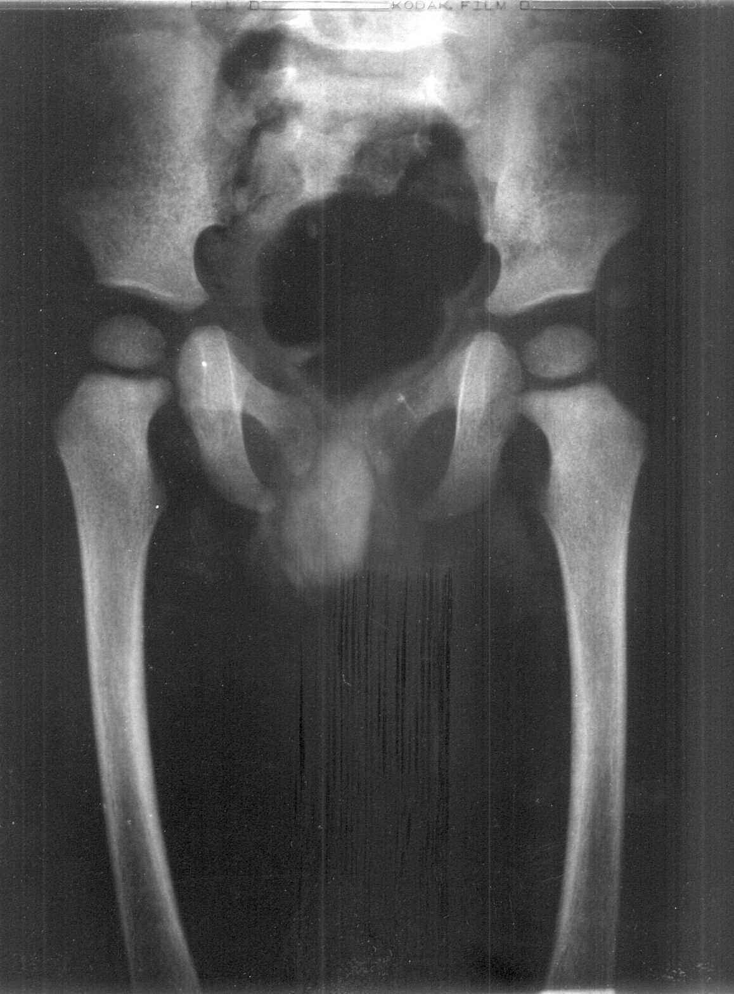
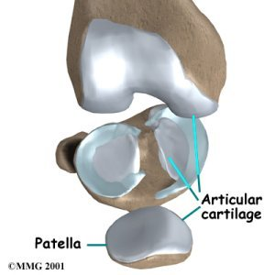
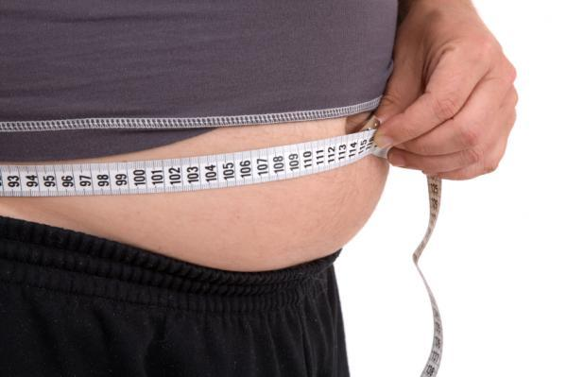
ADULT BONE MARROW DERIVED STEM CELLS
Mesenchymal stem cells
Mesenchymal stem cells
osteocytes
chondrocytes
adipocytes
bone
cartilage
fat
Notes:
43

Slide 44
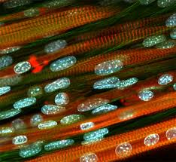
Skeletal myoblasts

Slide 45
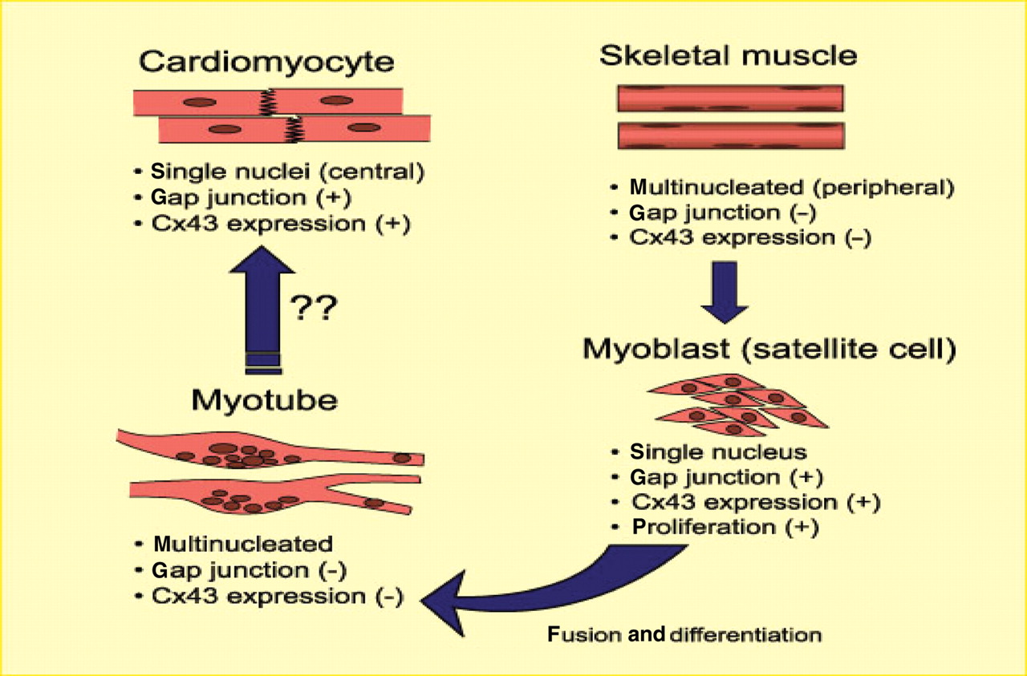
Skeletal myoblasts

Slide 47
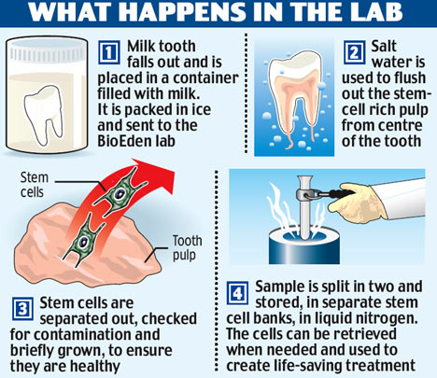

Slide 48
Which Stem Cells for Cardiac Repair?
 |  | Skeletal myoblasts | Bone marrow-derived stem cells | Heart-derived stem cells | Induced pluripotent stem cells /induced cardiomyocytes | Embryonic stem cells
Immune matching
Forms true cardiomyocytes
Large scale proliferation
Clinical safety
Ethically neutral

