Slide 1



BHF Centre of Research Excellence
Imperial College London
Big Science:
Gene- and other ‘omics
Professor Michael D. Schneider FMedSci
Head of Cardiovascular Science, NHLI
BHF Simon Marks Chair in Regenerative Cardiology
Director, BHF Centre of Research Excellence

Slide 2
‘omics - V1.0
”all constituents considered collectively” (OED)
DNA
gene sequence & variation
genomics
RNA
mRNA levels
transcriptomics
protein
protein levels
proteomics

Slide 3
‘omics – V2.0
chromatin
structure
DNA methylation, histone modifications, polycomb
epigenomics
DNA
gene sequence & variation
genomics
mRNA & non-coding
RNA levels
RNA
transcriptomics
protein levels &
modifications
protein
proteomics
metabolites
small molecules
metabolomics
cell, tissue &
organism
function
phenotypes
phenomics

Slide 4
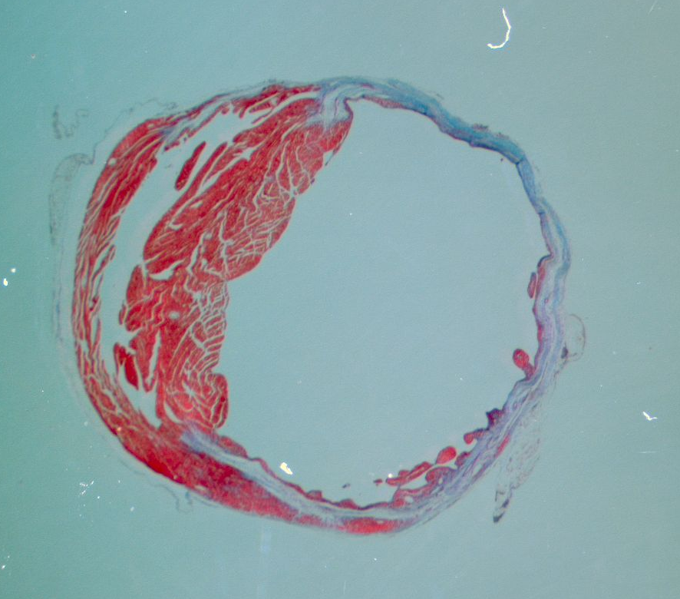
Cardiac muscle cell number as a therapeutic target
The clinical imperative:
Myocyte loss, without
myocyte replacement
Existing therapies aspire to improve the mechanical performance of surviving muscle, not correct the underlying defect

Slide 5
Cardiac regeneration occurs in newborn mice, through the proliferation of pre-existing muscle cells
αMHC-MerCreMer:
Rosa26-lacZ reporter
Tamoxifen at birth
Amputation at age 1 day

Slide 6
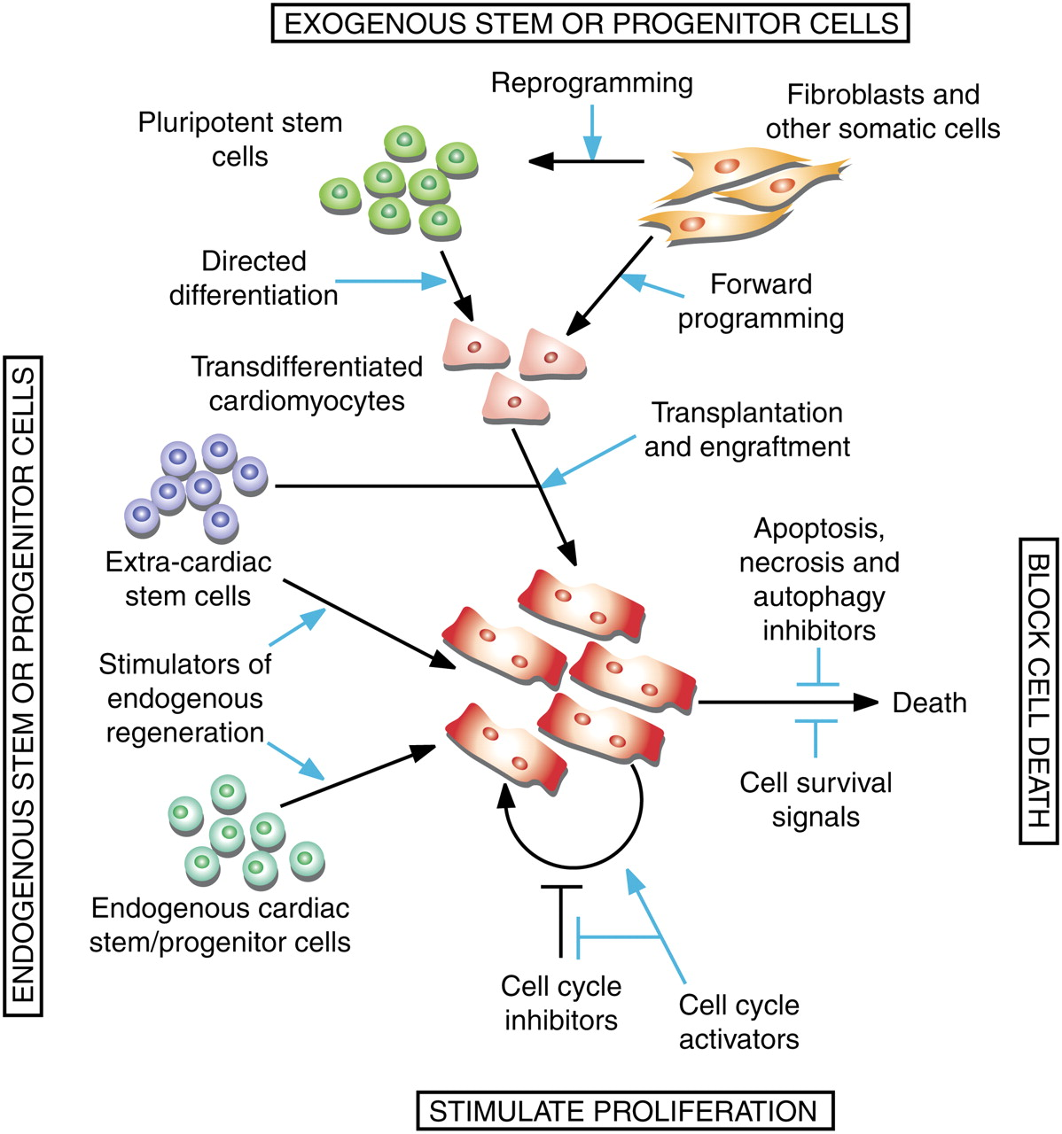
Cardiac muscle cell number as a therapeutic target:
Four over-arching strategies
Exogenous stem or progenitor cells
Cardiac muscle regeneration: lessons from development
Mark Mercola, Pilar Ruiz-Lozano, Michael D. Schneider
Genes Dev. 2011 25: 299-309
Endogenous stem or progenitor cells
Block cell death
Stimulate proliferation

Slide 7
How to override the cell cycle constraint in adult mammalian heart muscle?
Exogenous stem or progenitor cells
Endogenous stem or progenitor cells
Block cell death
Stimulate proliferation

Slide 8
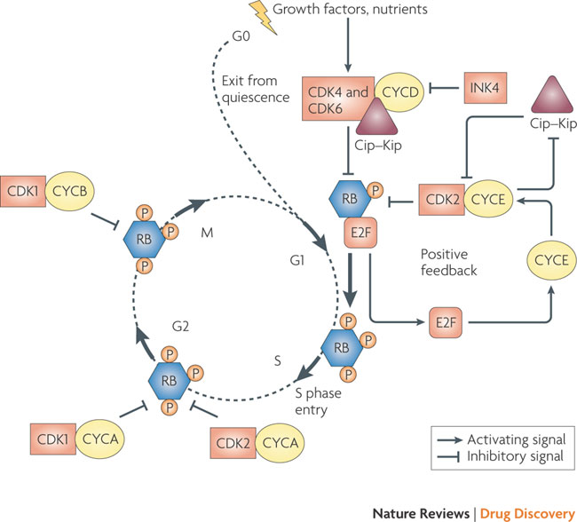
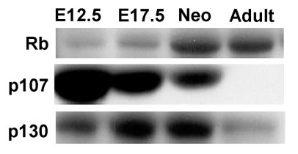
Standard “candidate gene” approach: Is the switch between two pocket proteins responsible?
p107
Rb
Age
Lapenna, Nat Rev Drug Discovery 2009
MacLellan, Mol Cell Biol 2005

Slide 9
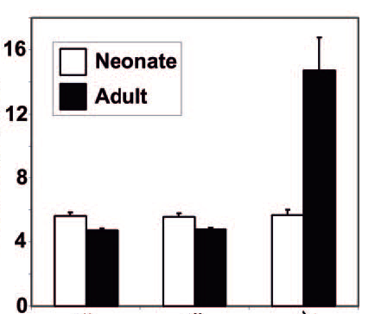
Deleting the anti-oncogenes Rb and p130 causes extensive muscle cell proliferation in adult hearts
Heart-restricted deletion of Rb
Germline deletion of p130
αMyHC-Cre:
Rb:
p130
+
+/+
+/+
+
F/F
-/-
+
F/F
+/+
+
F/F
-/-
+
F/F
+/+
+
F/F
-/-
Phospho-H3
% of nuclei
Heart weight/
body weight
(mg/g)
BrdU
αMyHC-Cre:
Rb:
p130
+
+/+
+/+
+
F/F
+/+
+
F/F
-/-
MacLellan, Mol Cell Biol 2005

Slide 10
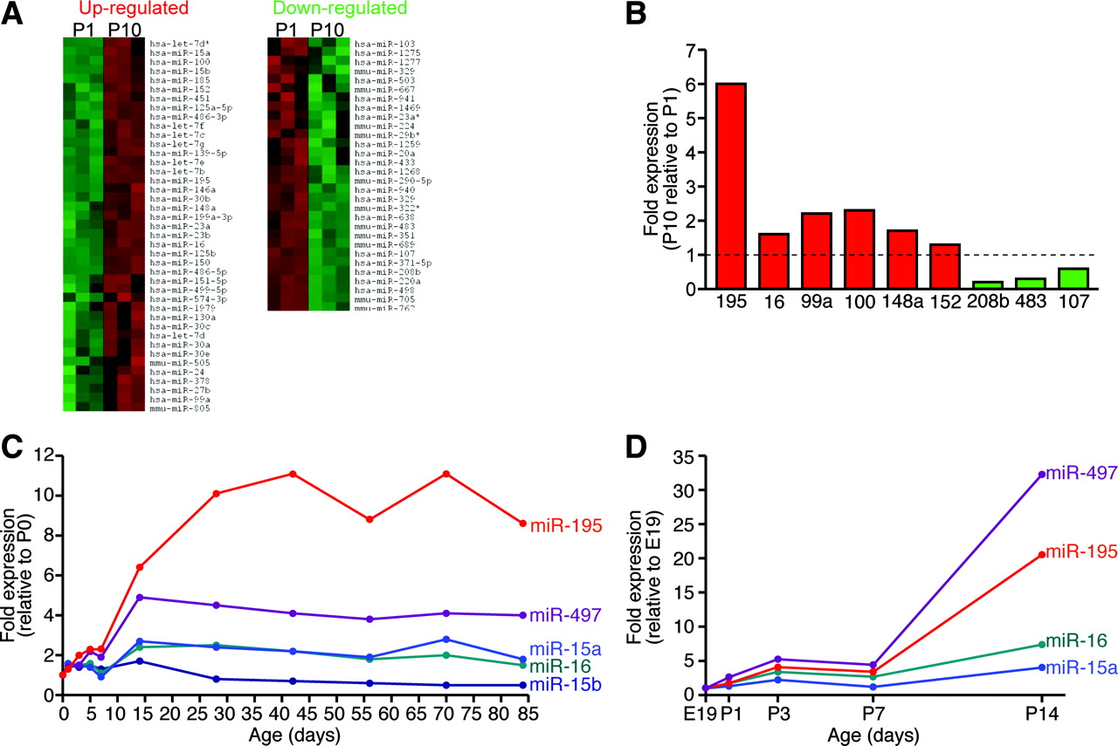
MicroRNA expression profiling during cardiac growth arrest provisionally implicates the miR-15 family
Porello, Circ Res 2011

Slide 11
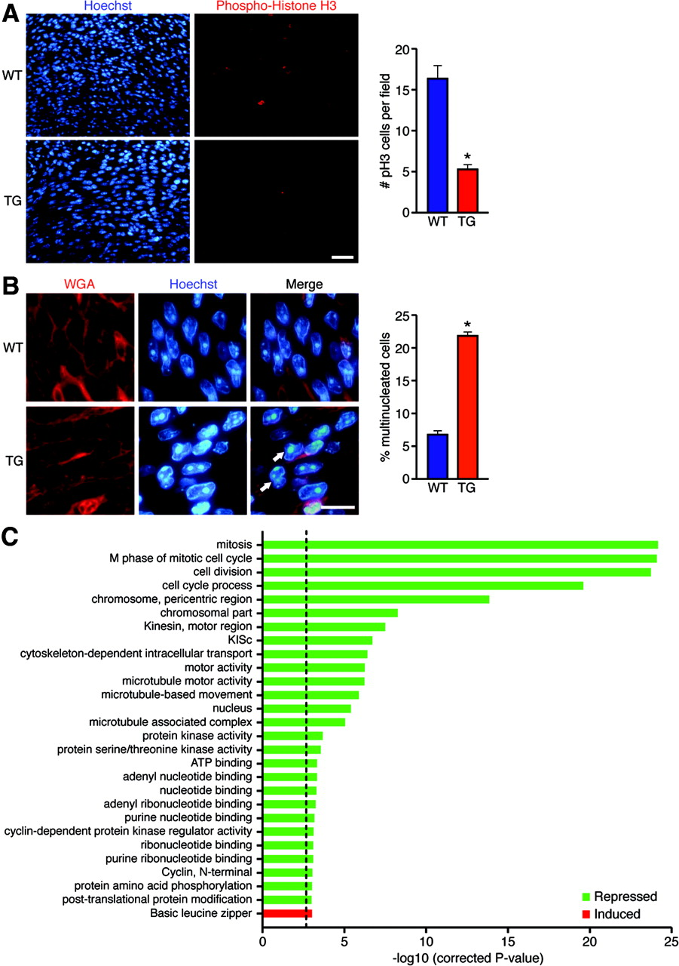
Cardiac over-expression of miR-195 suppresses the cardiac muscle cell proliferation in mice
Porello, Circ Res 2011

Slide 12
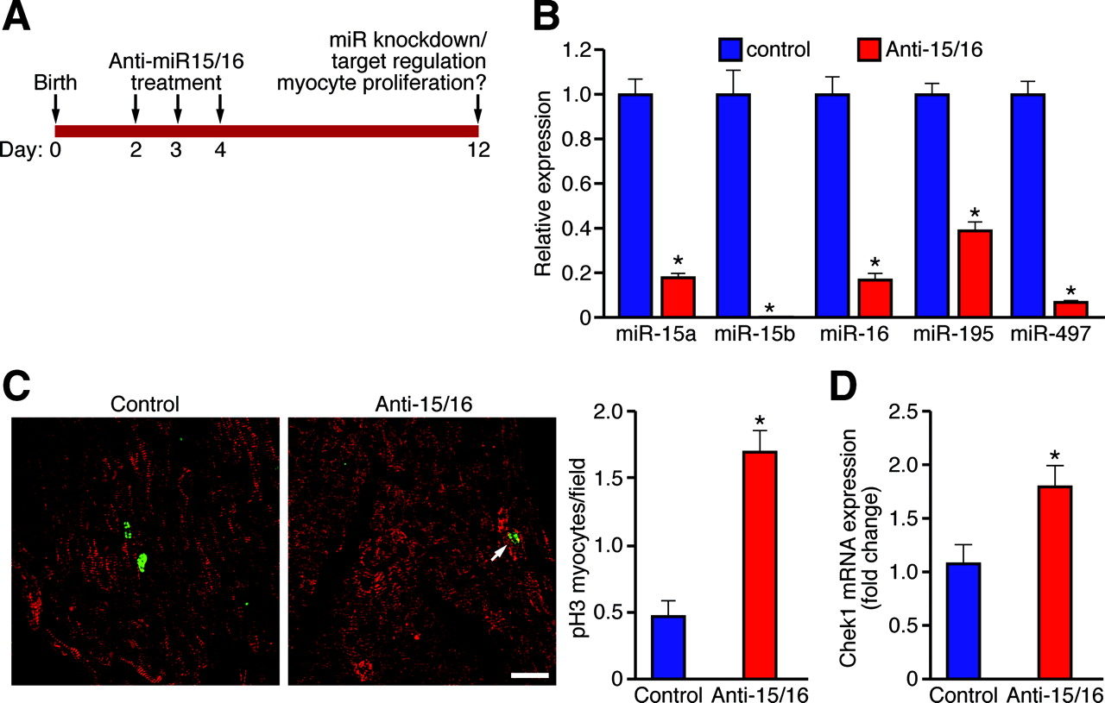
Inhibition of the miR-15 family after birth augments cardiac muscle cell proliferation in mice
Porello, Circ Res 2011

Slide 13
Cardiac muscle cell number as a therapeutic target
Exogenous stem or progenitor cells
Cells that make heart muscle
Endogenous stem or progenitor cells
Block cell death
Stimulate proliferation

Slide 14
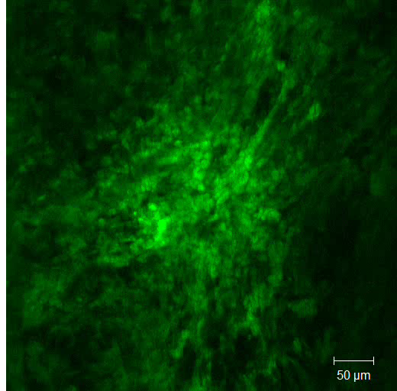
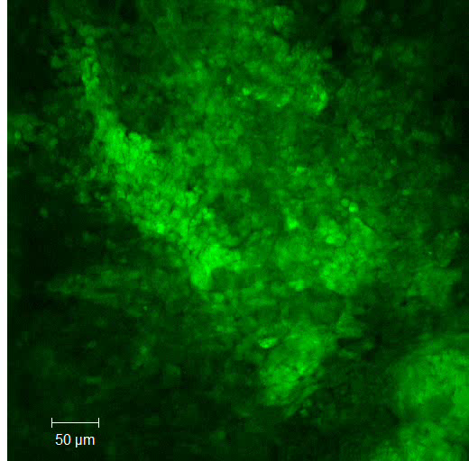
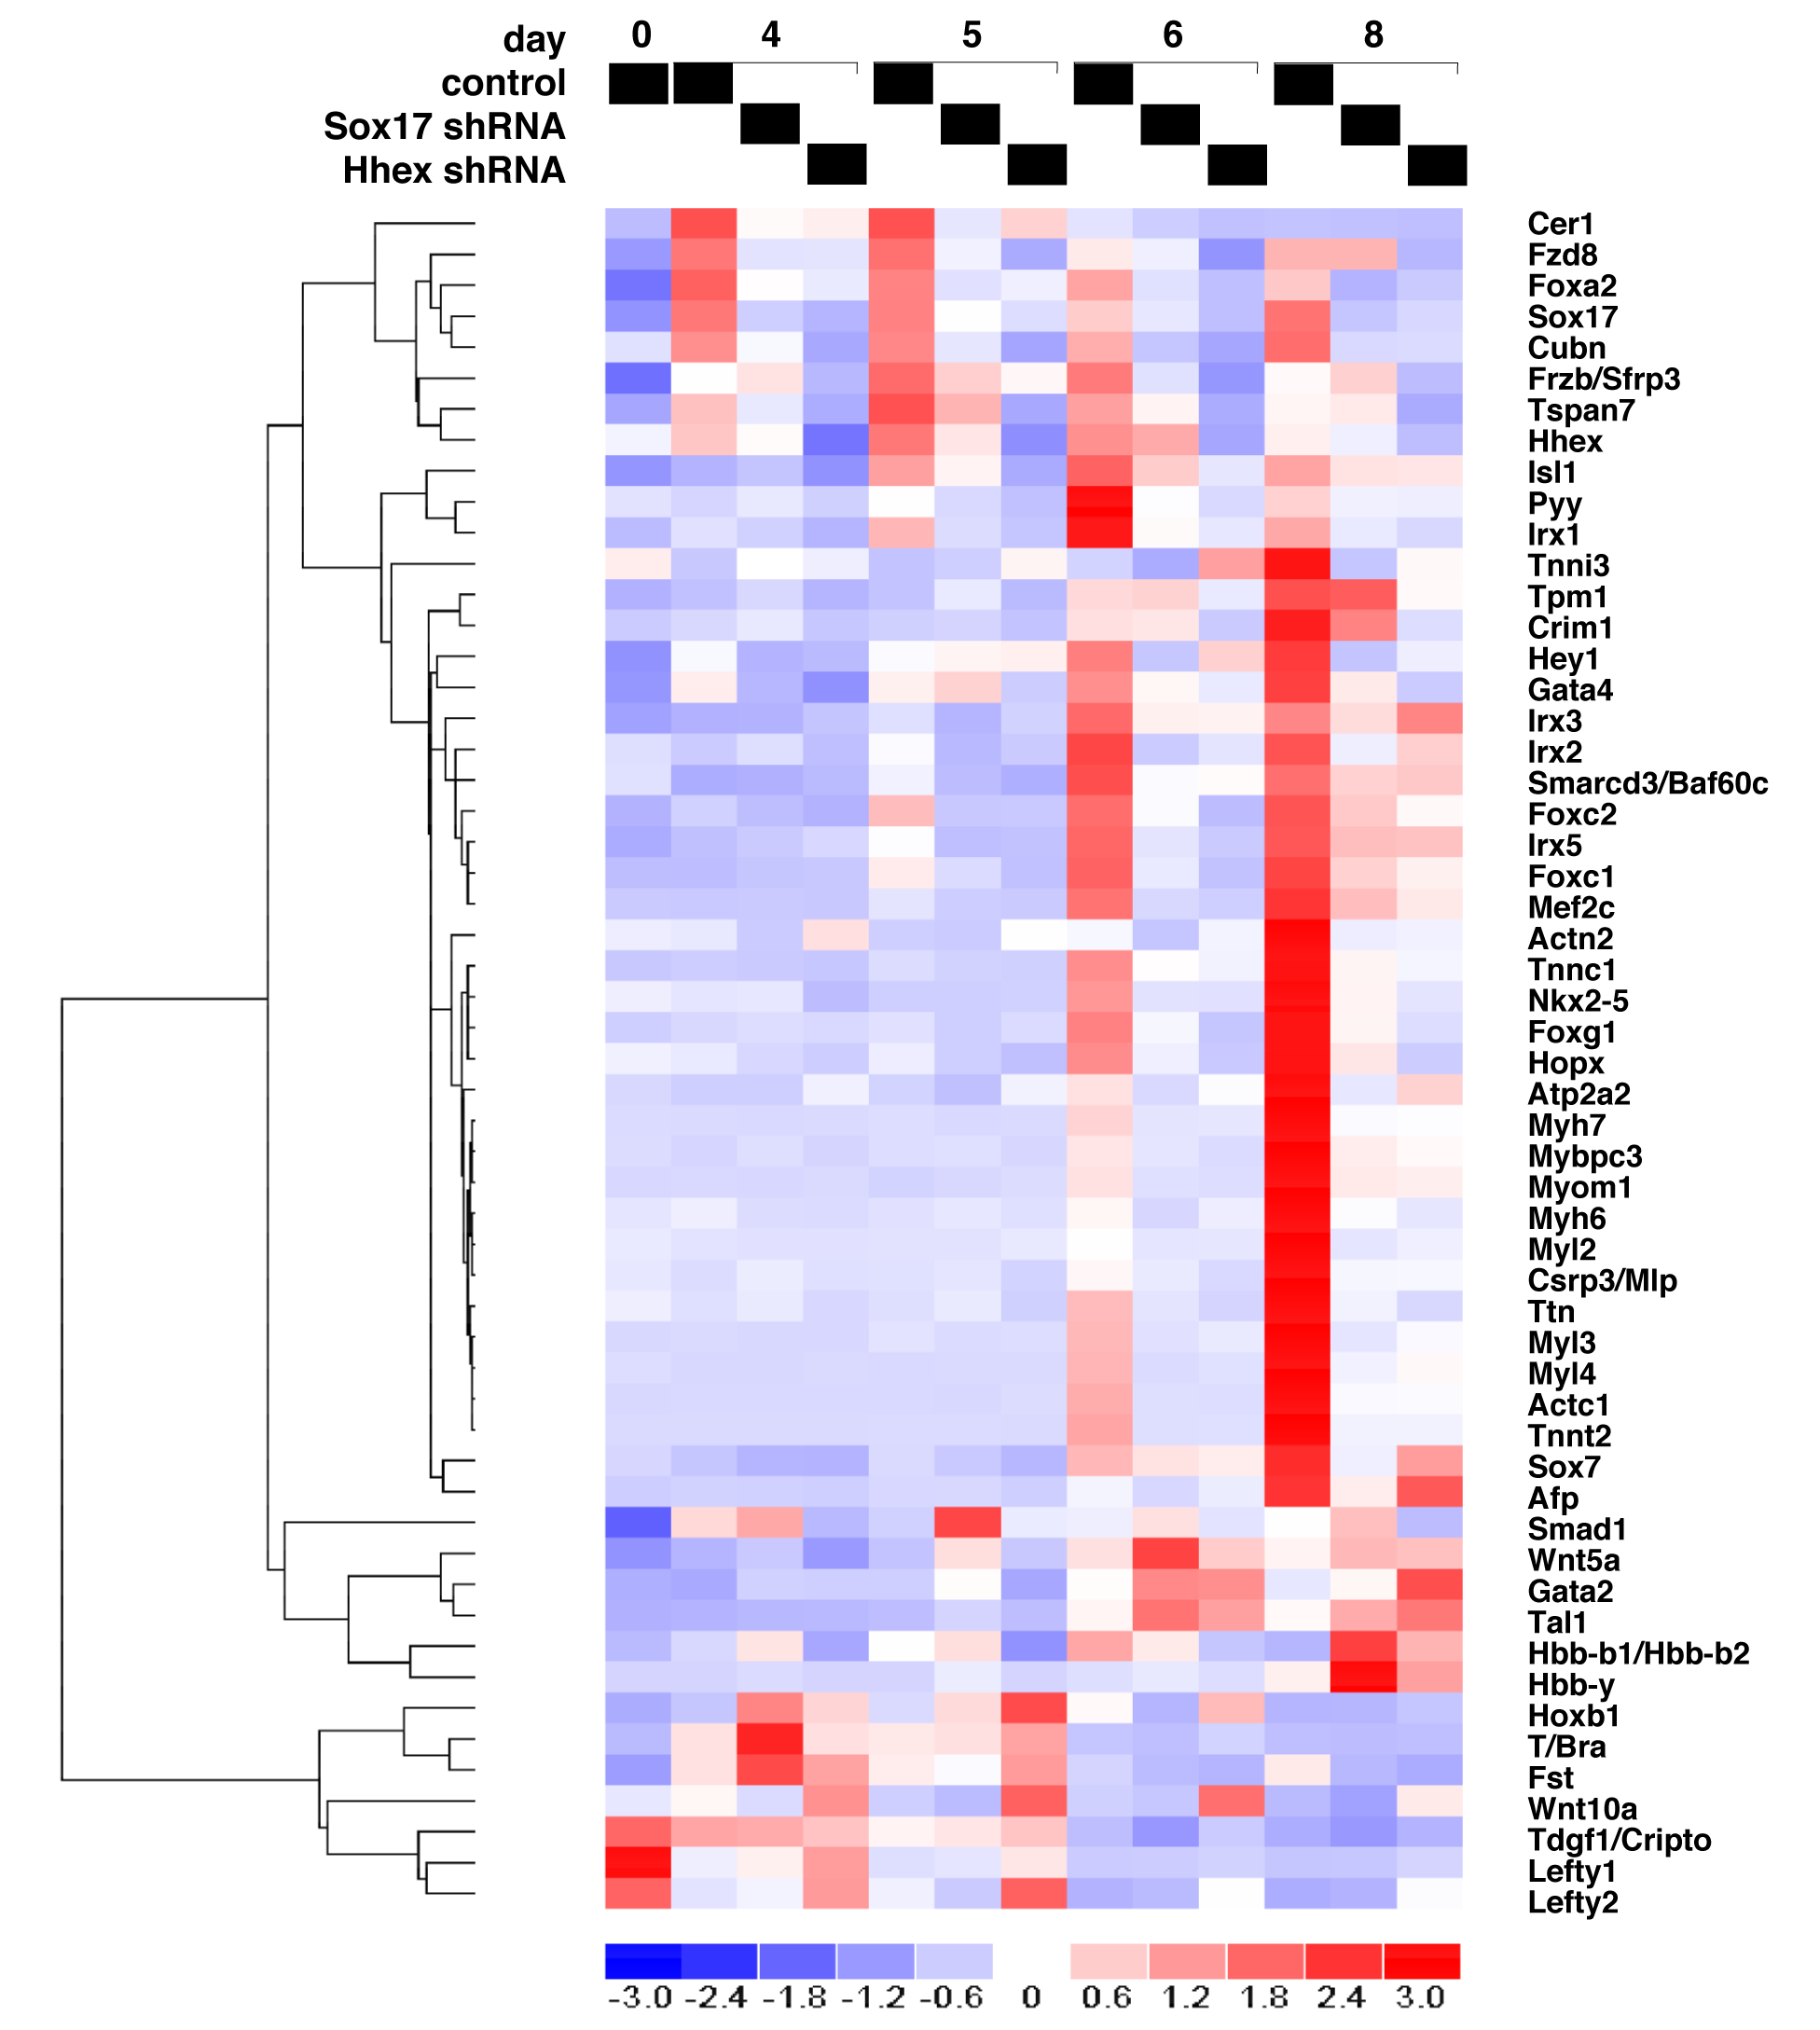

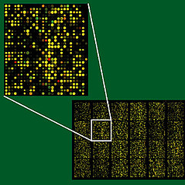
Decoding the circuits for cardiac muscle creation by iterative gene profiling and RNA interference
+/- growth factors, blockers
Differentiating ES cells
control
(beating)
+ Sox17 shRNA
(non-beating)
“Gene chip” profiling of 20K genes
Suppress single genes by lentiviral delivery of short hairpin RNAs

Slide 15
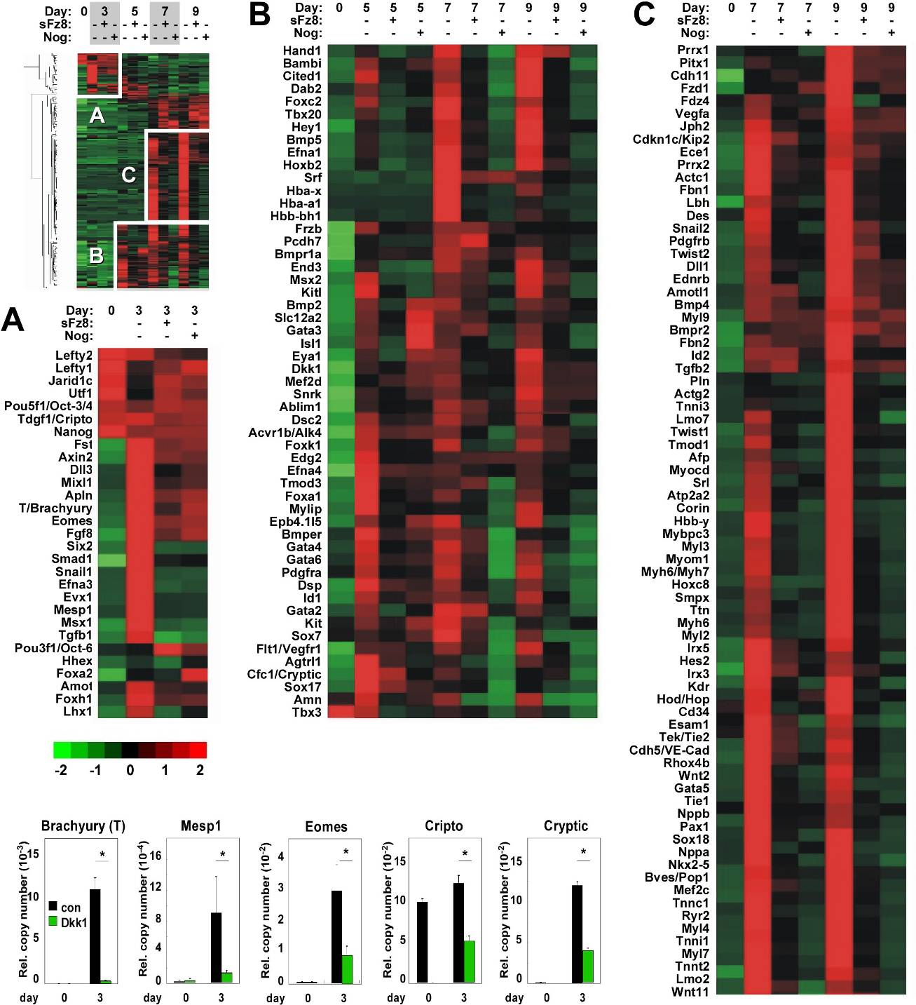
Wnt- and BMP-dependent genes
(days 5-9):
Cardiac structural proteins
Actc1, Atp2a2, Des, Mybpc3, Myh6, Myh6/Myh7, Myl2, Myl3, Myl4, Myl7, Myl9, Myom1, Nppa, Pln, Ryr2, Srl, Tmod1, Tnnc1, Tnni1, Tnni3, Tnnt2, Ttn
Cardiac Transcription Factors
Cited1, Gata4, Gata5, Gata6, Hand1, Hod/Hop, Irx3, Irx5, Isl1, Mef2c, Mef2d, Myocd, Nkx2-5, Srf, Tbx20
Liu et al. PNAS 2007
Notes:
We next performed microarray to screen for Wnt- and BMP- dependent genes. ES cells were treated with soluble frizzed or Noggin, and whole-genome gene expression profiles were captured. I won’t have time to go through the list, but I would like to draw your attention to a few highlights. Both inhibitors suppressed cardiac transcrition factors at mid-to-late time points, and concordingly suppressed cardiac structural proteins at late time point. mesoderm-related genes, as represented by brachyury T, were normally induced in EB culture day 3 but were suppressed by both inhibitors, or specific canonical Wnt inhibitor Dkk. So It appears that Wnt and BMP pathways are required for prerequisite steps for cardiac myogenesis, namely, the processes of gastrulation, mesoderm formation and patterning. In prioritizing among other Wnt-dependent genes, we preferred genes that might function beyond the prerequisite stages, and Sox17 had attracted our interest.

Slide 16
Genome-wide profiling of Sox17-dependent genes:
GO categories for endoderm and heart formation
1
2
3
4
5
6
7
8
shLuc:
shSox17:
day:
0
2
3
4
5
6
8
10
-3
0
3
4% (852 unique genes) for the global transcriptome
28% (126 genes) of a manually curated set of 445 genes relevant to heart development

Slide 17
The Sox17-Hhex-Cer1 pathway controls mesoderm patterning to a cardiac fate
Primitive mesoderm
Precardiac mesoderm
Cardiac mesoderm
Cardiac myocytes

Slide 18
‘omics – V2.0
chromatin
structure
DNA methylation, histone modifications, polycomb
epigenomics
DNA
gene sequence & variation
genomics
mRNA & non-coding
RNA levels
RNA
transcriptomics
protein levels &
modifications
protein
proteomics
metabolites
small molecules
metabolomics
cell, tissue &
organism
function
phenotypes
phenomics

Slide 19
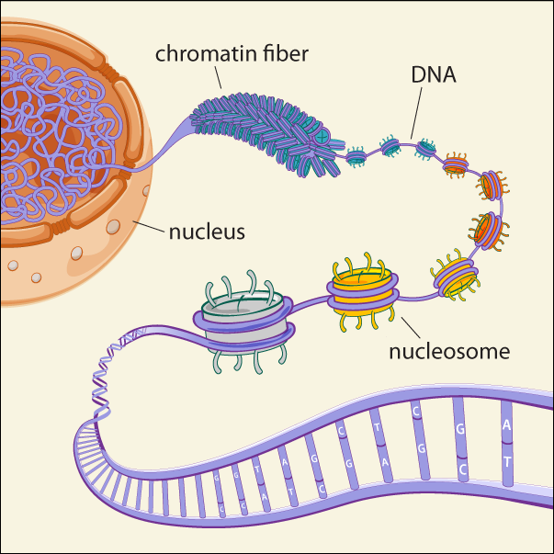

The epigenome
blogs.nature.com/news/2009/10/
on_methylome_metaphors.html
www.broadinstitute.org/news/1504

Slide 20
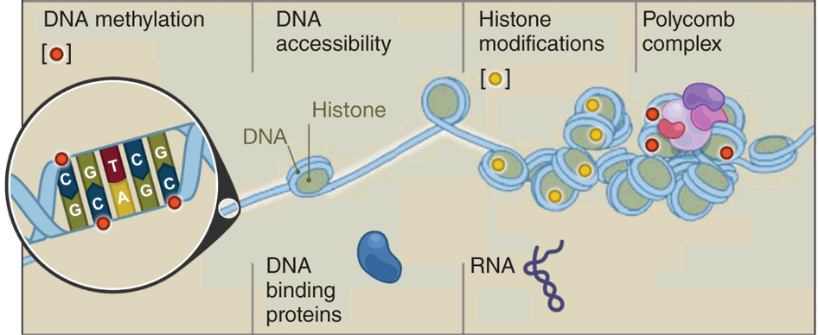
The epigenome
Nucleotide-level
DNaseI footprinting
ChIP-Seq
BS-Seq
MeDIP-Seq
MRE-Seq
ChIP-chip
ChIP-Seq
Bernstein et al., Nature Biotechnology 28:1045–1048 (2010)

Slide 21
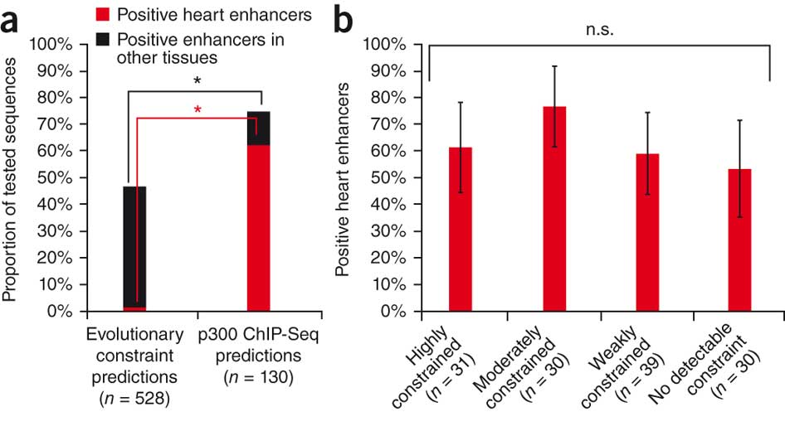
p300 ChIP-Seq identifies weakly conserved DNA sequences that drive heart-specific gene expression
Blow et al., Nature Genetics 42:806-810 (2010)

Slide 22
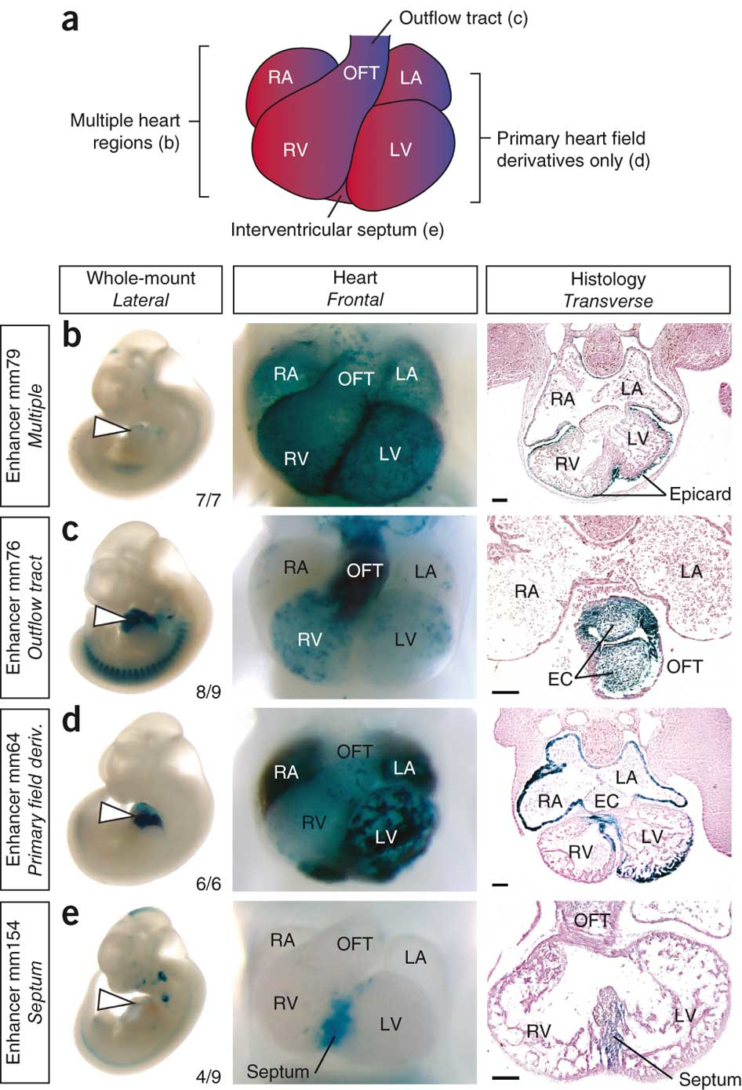
p300 ChIP-Seq identifies weakly conserved DNA sequences that drive heart-specific gene expression
Blow et al., Nature Genetics 42:806-810 (2010)

Slide 23
Epigenetic regulation of transitions in the cardiac lineage
Wamstad et al., Cell 151:206-220 (2012)

Slide 24
Epigenetic regulation of transitions in the cardiac lineage
Distal
enhancers
≤ 2kb from start site
Poised: H3K4me1+
only
Active:
H3K4me1+/-
H3K27ac+
active
inactive
pSer5
mRNA level
Wamstad et al., Cell 151:206-220 (2012)

Slide 25
Epigenetic regulation of transitions in the cardiac lineage
Wamstad et al., Cell 151:206-220 (2012)

Slide 26
‘omics – V2.0
chromatin
structure
DNA methylation, histone modifications, polycomb
epigenomics
DNA
gene sequence & variation
genomics
mRNA & non-coding
RNA levels
RNA
transcriptomics
protein levels &
modifications
protein
proteomics
metabolites
small molecules
metabolomics
cell, tissue &
organism
function
phenotypes
phenomics

Slide 27
A genome-wide siRNA screen detects many regulators of stem cell self-renewal
Hu et al., Genes Dev 23:837-48 (2009)

