Slide 1
Specific allergy diagnosis
Dr Robert Boyle
Clinical Senior Lecturer, Department of Paediatrics
Imperial College London

Slide 2
Specific Allergy Diagnosis
Principles and practice of commonly used tests
Interpretations of allergy tests
Role of novel allergy tests/ CAM tests

Slide 3
Hypersensitivity
Allergy
Immune mediated
Intolerance
Non-Immune mediated
IgE
mediated
Non-IgE
mediated
Toxic
PharmacologicalEnzymatic
J Allergy Clin Immunol 2004;113:832-6

Slide 4
Allergy Tests
In Vivo Challenge
Skin Tests
Specific IgE Blood Test

Slide 5
Allergy vs Atopy
Clinical Allergy
Atopy
[allergy antibodies]

Slide 6
Allergic Inflammation
APC
Th2
cell
IL5
Eos
IL4
Y
Y
Y
Y
Y
Y
B
cell
IgE
Y
Mast
Y
Y
Y
Y
Y
Y
Y
Y

Slide 7

Detection of Allergen Specific IgE
Skin tests
  Skin Prick
  Intradermal
Blood test for specific IgE
eg Radioallergosorbent test [RAST]

Slide 8
Skin Testing
Prick test
  quick, virtually painless
Intradermal test
  more difficult to perform
  more painful
  increased sensitivity – useful when potent extracts are not available Eg: drug allergy

Slide 9
Skin Testing
Appropriate panel of allergens
  environmental prevalence, population, disease
Restrict testing to allergens that
  commonly cause or exacerbate symptoms
  can be targeted by environmental control or immunotherapy
Individualise testing to each clinical setting
Tests should help the patient’s management

Slide 10
Skin Testing
Positive control
  Histamine 1mg/ml and 10mg/ml
  identify presence of antihistamines or other medications that may affect wheal and flare
Negative control
  Glycerol carrier solution
  identify false positive reactions due to dermatographism or factors within the carrier

Slide 11
Factors That Affect Skin Testing
Age
  skin tests can be performed in early infancy
Medications
  Antihistamines should be withheld 2-4 days
  Injected Adrenaline can inhibit SPT for up to 6hr
  Anti-IgE affects skin tests
  Inhaled β2 agonist, corticosteroid, theophylline, LTRAs, calcineurin inhibitors
Reagents
  histamine releasing factors (strawberry, spinach)
X
X
X

Slide 12
Factors That Affect Skin Testing
Circadian rhythm
  variations in histamine, bradykinin and other mediators can affect wheal size
  SPT decreased in am, peak in pm
Seasonal variation
  SPT greater in relevant allergen season

Slide 13
Factors That Affect Skin Testing
SPT device used
Skin location – increased reactivity back versus forearm
Standardisation and quality of extracts
Stability of relevant allergen epitope

Slide 14
Skin Testing – Common Errors
Tests too close (<2cm)
Excessive physical force - false positive
Insufficient entry into skin - false negative
Reading reaction at the wrong time
Dermatographism or abnormal skin
Reagent is irrelevant, unstable, or at incorrect concentration

Slide 15
Allergy Testing Precautions
Risk of systemic reaction
  Skin prick testing 1 in 10,000
  Intradermal skin tests increased risk
  In vivo challenges
MUST have ready access to
  Physician experienced in Rx systemic reactions
  Emergency equipment and oxygen
  Adrenaline and other resuscitation medications

Slide 16
http://www.bsaci.org
http://www.greerlabs.com/index.php/human_allergy/products/skin_test_devices/greerpick/

Slide 17
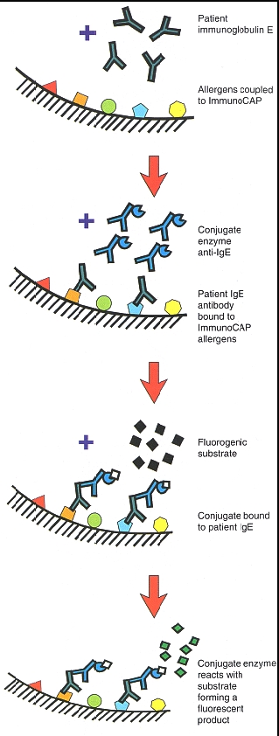
Immunocap Phadia
Fluorescent antibody test using whole allergen adsorbed onto cellulose sponge

Slide 18
Skin Tests
  inexpensive
  quick, painless
  easy to perform
  immediate results
  high NPV
  fair PPV
  Carries small risk of a systemic allergic reaction
Blood SpIgE Tests
  more expensive
  blood sample required
  slower result turnaround
  NPV lower than for SPT
  false +ve with high IgE
  is an alternative to SPT
    severe skin disease or dermatographism
    recent anaphylaxis
    on antihistamines
Skin testing is the preferred test!

Slide 19
Skin or SpIgE Testing: Applications
Screening for atopy
Prediction for development of asthma/rhinitis
Specific allergy diagnosis
  Correct avoidance measures
  Correct targeted treatment
  Specific immunotherapy

Slide 20
Skin or SpIgE Testing: Indications
Any patient with asthma or rhinitis requiring maintenance antiinflammatory therapy
Any patient with moderate or severe eczema
Any patient with suspected food allergy
Any patient with possible IgE mediated drug or sting allergy

Slide 21
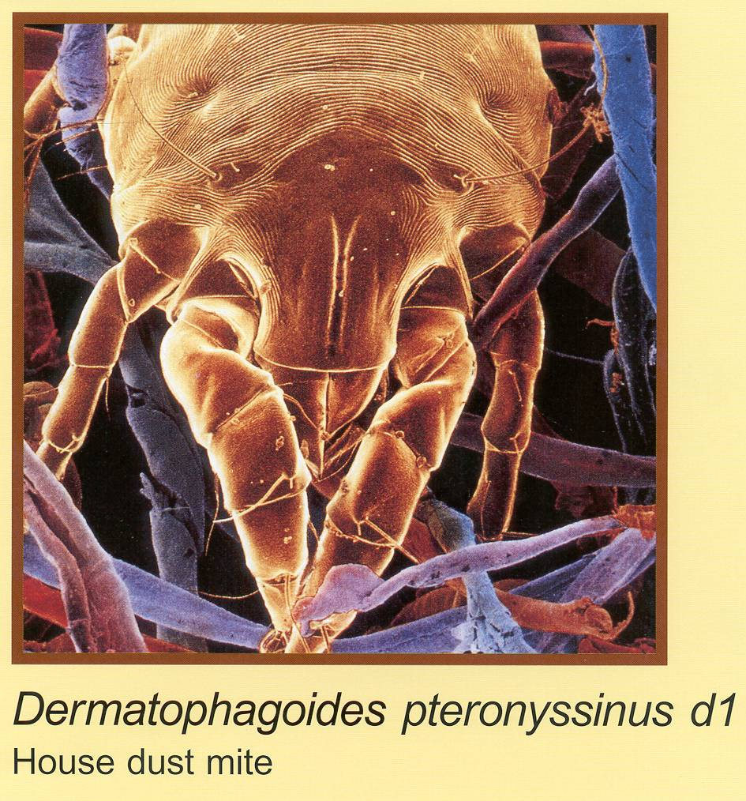





Allergy Testing: Inhalant Allergens
Dogs
Horses

Slide 22
Allergy Testing: Ingestant Allergens
>90% food allergy caused by 1 of 8 foods:
    Milk
    Soy
    Egg
    Peanut
    Tree Nuts
    Wheat
    Fish
    Shellfish
Seeds eg Sesame Legumes eg lentil Fruits eg kiwi

Slide 23
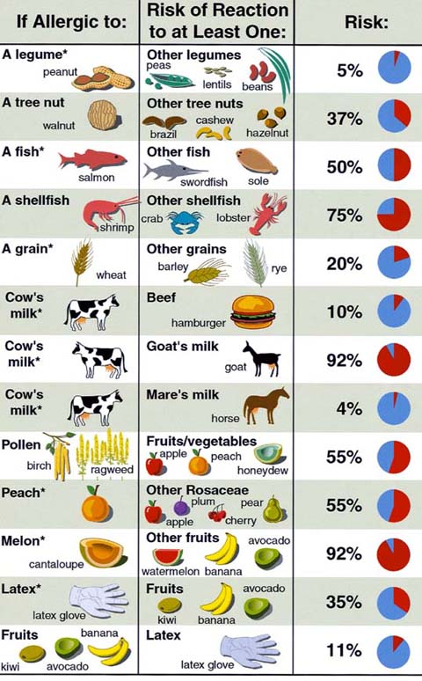
Cross Reactivity in Food Allergy
Paediatric Practice – Active Screening for associated food allergies
Adult Practice – Screen for associated food allergies if the relevant food is unusual or not part of patient’s diet

Slide 24
Conformational and Linear Epitopes
Y
Y
Y
Y
Y

Slide 25
Abra ca dabra!

Slide 26
Specific Allergy Diagnosis
Principles and practice of commonly used tests
Interpretations of allergy tests
Role of novel allergy tests/ CAM tests

Slide 27
Skin or SpIgE Testing: Interpretation
  Negative test has good NPV for excluding IgE mediated allergy
  Positive test has moderate PPV for diagnosing IgE mediated allergy. PPV highest when test result is high (large SPT wheal, high SpIgE level)

Slide 28
Skin or SpIgE Tests: Interpretation
40% of young adults will have a positive skin test if tested to common allergens
Only ~20% develop symptoms if challenged
Minor skin test reactions less significant
Skin test results must be correlated with the history and examination findings

Slide 29
Allergy vs Atopy
Clinical Allergy
Atopy
[allergy antibodies]

Slide 30
How test results are reported
Sensitivity and specificity
  Widely used
  Difficult to interpret what it means for an individual
Predictive values
  Easy to understand
  Depend on assumptions about the prevalence of the condition in your population
Likelihood ratios
  Difficult to understand, not widely used
  Require an estimate of the individual’s pretest probability (not always available)

Slide 31
Performance of tests
Specificity is the proportion of true negative results that are correctly identified as negative by the test.
100% specificity means that all those with a positive test have the disease

Slide 32
Performance of tests
Sensitivity is the proportion of true positive results that are correctly identified as positive by the test.
100% sensitivity means that all those with a negative test do not have the disease

Slide 33
Prediction of clinical reactivity
Positive predictive value: Proportion of truly positive patients in relation to the total number of test positive patients
Negative predictive value: proportion of truly negative patients in relation to the total number of test negative patients
Affected by the prevalence of the disorder in the population

Slide 34
Likelihood ratios
What is the chance that a person with food allergy would have a positive test compared to the chance that one without food allergy would have a negative test
Pre test probability X likelihood ratio gives Post test probability
Independent of the population prevalence
Clinically useful tests have a LR of > 10 or <0.1

Slide 35
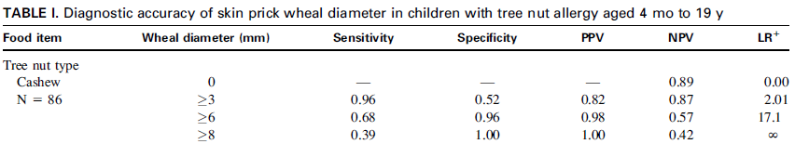
Diagnosis of Cashew Nut Allergy
Ho et al. J Allergy Clin Immunol 2006

Slide 36
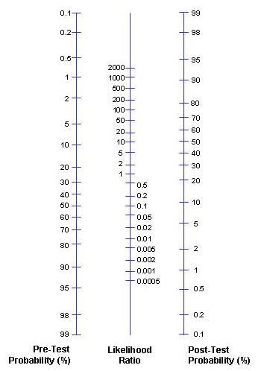
LR is the most intuitive measure of diagnostic performance
LR<0.1=‘strongly negative result’
LR>10 = ‘strongly positive result
LR 1 = not informative

Slide 37
In Vivo Challenge
Fundamental tool for diagnosis of food allergy
Allergen Challenge may be
  double blind placebo controlled
  single blind placebo controlled
  open
Double Blind Placebo Controlled (DBPC) is gold standard for evaluation food allergy

Slide 38
Specific Allergy Diagnosis
Principles and practice of commonly used tests
Interpretations of allergy tests
Role of novel allergy tests/ CAM tests

Slide 39
Component Resolved Diagnostics
Component resolved diagnostic testing of single allergenic peptides (CRD) (Phadia)
Immunocap ISAC
(VBC Genomics/Phadia): Chip based allergy test; recombinant or purified allergen components; 103 allergen components from 50 allergens

Slide 40
Peanut polysensitisation associated with severity
Score of clinical severity
Ara h8 = PR10 protein (Bet v1 homologue) involved in cross reactivity with pollen
Astier JACI 2006

Slide 41
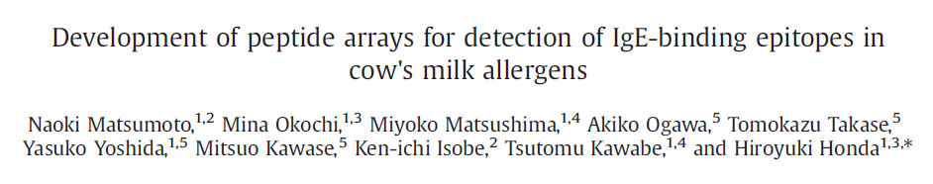
Component diagnostics for CMA?
J Biosci Bioeng 2009;107:324-30

Slide 42
Bet v 1-related allergens PR10 homologues | Bet v 2-related allergens Profilins
Allergen Source Mal d 1 Apple Pru av 1 Cherry Pru ar 1 Apricot Pyr c 1 Pear Api g 1.01 Celery root Api g 1.02 Celery root Dau c 1.0103 Carrot Cor a 1.0401 Hazelnut SAM22 Soybean Ann N.Y.Acad.Sci. 2002;964: 47-68 | Allergen Source Pru av 4 Cherry Pyr c 4 Pear Mal d 4 Apple Api g 4 Celery root Gly m 3 Soybean Ara h 5 Peanut Mus xp 1 Banana Lit c 1 Lychee Ana c 1 Pineapple Cor a 2 Hazelnut Lyc c 1 Tomato Cap a 2 Bell pepper

Slide 43
Applications of component resolved diagnostics
Predicting cross-reactivity
Predicting clinical course
  Likelihood of True Allergy
  Severity of Allergic Reactions
  Persistence of Allergy
Tailoring immunotherapy

Slide 44
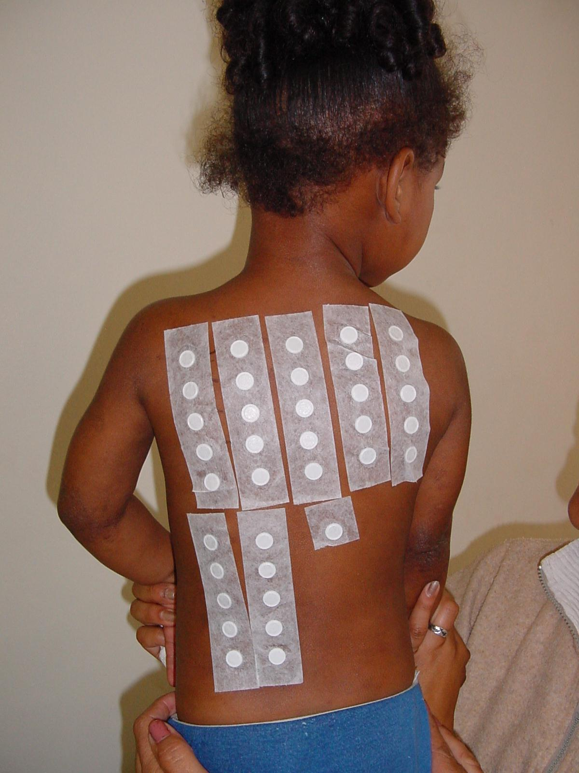
THE ATOPY PATCH TEST

Slide 45
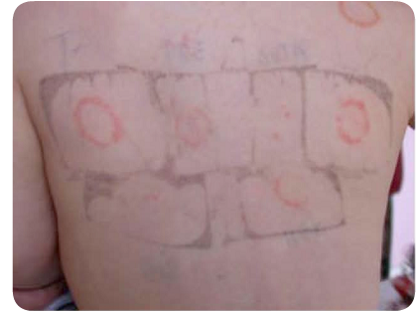
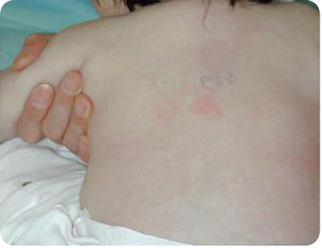
Atopy Patch Test
Irritant reaction
Positive test

Slide 46
Atopy Patch Tests: Interpretation
Sensitivity
(%)
Specificity
(%)
PPV (%)
NPV (%)
p
72 hour reading
N%
Erythema + induration
Erythema + papules (7 or more)
Induration + papules (7 or more)
Erythema + induration + papules
(7 or more)
Erythema or induration
Erythema or papules (7 or more)
Induration or papules (7 or more)
Erythema or induration or papules (7 or more)
6 (4)
7 (4)
11 (4)
6 (4)
44 (27)
29 (18)
35 (21)
43 (26)
8
8
15
8
41
27
31
36
100
99
100
100
86
90
87
82
100
86
100
100
70
69
66
63
57
56
58
57
64
60
60
61
0.008
0.03
0.0002
0.008
0.001
0.005
0.007
0.008
Heine RG, Verstege A, Mehl A et al. Pediatr Allergy Immunol 2006; 17: 213-17
Mehl A, Rolinck-Werninghaus C, Staden U et. J Allergy Clin Immunol 2006; 118:923-9.

Slide 47
Basophil tests
Basophil histamine release
Basophil activation
  CD63
  CD203a
  Phosphorylated p38 MAPK

Slide 48
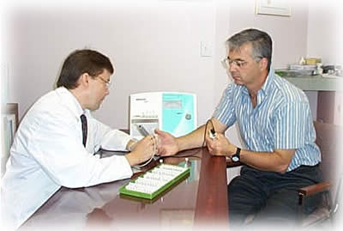
Alternative tests
Histamine release test
Cellular Allergen Stimulation test (CAST)
Leucocytotoxic test (ALCAT or Nutron)
Applied Kinesiology
Electrodermal tests (VEGA)
Hair analysis
Provocation-neutralisation tests
IgG antibody tests

Slide 49
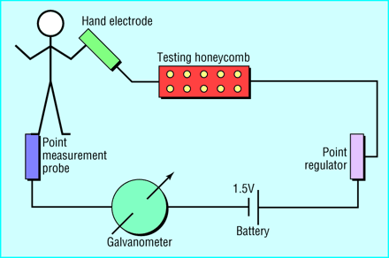
Electrodermal Testing (VEGA)
Theory:
-extract in contact with aluminium plate inserted into circuit between skin and galvanometer
- Any change in electromagnetic conductivity indicates allergy/intolerance

Slide 50
The York test
YorkTest is the UK’s leading food intolerance, sensitivity and allergy testing laboratory.
The FoodScan 113 test is a 100% home test with gives reliable results from the comfort of your own home.
We’ll tell you which to avoid, which are borderline and which cause no reaction
Give you a comprehensive results pack including 12 week food diary and sensible tips to make the change easy
Cost £265
[Download the original study].

Slide 51
Dietary advice based on food specific IgG results
Dr G Hart (BSC Hons, PhD– Technical director)
Questionnaire based survey of 5286 patients
Wide range of chronic medical conditions
  Gastrointestinal, dermatological, neurological, psychological
All patients asked to eliminate or reduce certain foods based on IgG test results to 113 foods
No patient not offered a diet
No placebo group

Slide 52
Results of study
Benefit (high/considerable/moderate) 72%
Benefit (slight/low/zero) 27%
Rigorous dietary elimination 75% benefit
Reasonable dietary adherence 66% benefit

Slide 53
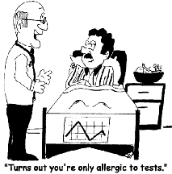
Unproven and costly
Reliability
Reproducibility
Specificity/Sensitivity

Slide 54
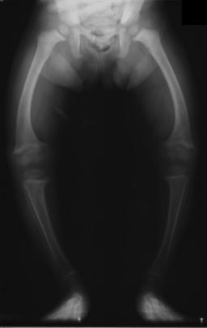
Unsupervised diets can be dangerous

Slide 55
Specific Allergy Diagnosis
Allergy Tests are relatively simple to perform
Interpretations of allergy tests is harder
Role of novel allergy tests is evolving
No role for CAM tests

