Slide 1
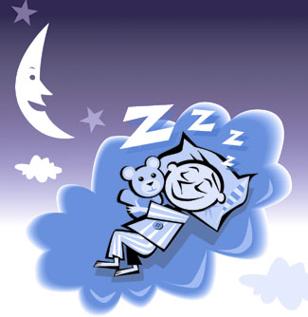
Sleep disorder of childhood at St Mary’s
Dr Parviz Habibi
Polysomnography Lab
Paediatric Research Unit
Notes:
1st Grand Round presentation related to this new addition to Paediatrics at SMH

Slide 2
Sleep Disorders In Children
25% of children experience some type of sleep problem during childhood
Sleep problems are more prevalent in children with chronic medical, neurodevelopmental and psychiatric conditions
3-12% of children are habitual snorers (~12% between 5 and 10 years)
1-3% have SRBD (rising to 13% in morbidly obese children)
American Academy of Pediatrics, 2002
Notes:
25% prevalence of some type of SD – not surprising given that overall, approx. 50% of a child’s life is spent asleep
Up to 12% of children are habitual snorers – peeks between 5 and 10 years of age when tonsils are rapidly enlarging
Up to 3% have some form of SRBD (OSA, CSA, UARS), unsurprisingly worsening for morbidly obese children
Often an overlap between snoring and SRBD – not all snorers have SRBD, but almost all SRBD’s are snorers!

Slide 3
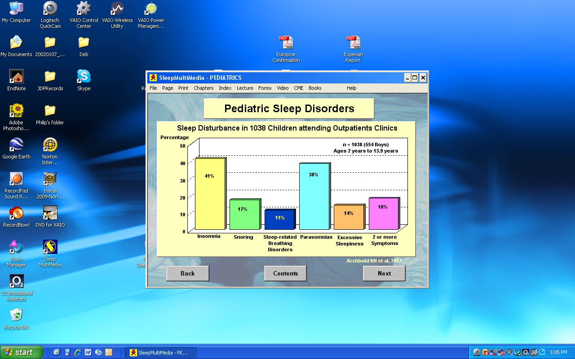

Background
No epidemiological studies in the UK yet.
Notes:
Sleep disorders are one of the commonest problems that occur in children, with approximately 25% of children experiencing sleep problems at any point in their childhood
They have a negative effect on academic, behavioural and developmental outcomes.
Sleep problems, in particular sleep related breathing disorders occur more frequently with co-morbidities such as Downs syndrome , neuromuscular disorders and craniofacial abnormalities, therefore treatment of sleep problems in these children greatly improves outcomes.
A large American survey by Archbold in 2002 measured the frequency of sleep symptoms in children visiting a general outpatient clinics. This revealed that certain sleep disturbances were very prevalent in children with 40% of children complained of insomnia, shown here
Despite the high prevalence of sleep disturbances in children, they are frequently underdiagnosed in clinical practice.
Although there have been epidemiological studies published for sleep disturbances and disorders in different countries, there is no information availiable about the prevalence of sleep problems among children in the UK.

Slide 4
BSc Project: Isma Qureshi
Investigated:
Prevalence of sleep problems among children
Associations between sleep complaints and quality of life
Level of sleep disorder awareness among doctors.

Slide 5
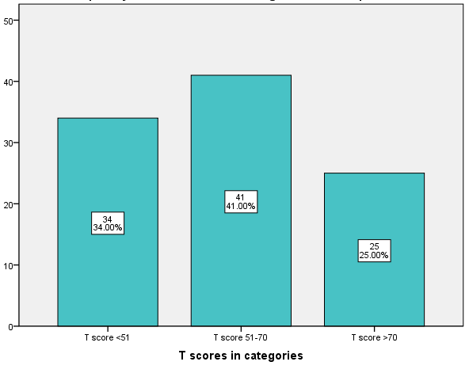
Prevalence of Sleep Problems Age 4-16 year
25% prevalence of significant sleep problems among the cohort.
Notes:
There was a 25% prevalence of significant sleep problems, as illustrated by this graph showing the number of cases according to T scores. To remind you, the total SDSC scores were converted into T scores, of which >70 was considered a significant sleep problem, 51-70 was borderline and below 50 was considered normal.
41% of children were in the borderline range. Although meriting a borderline score, These included some significant subscale scores which were balanced by normal scores in other categories.

Slide 6
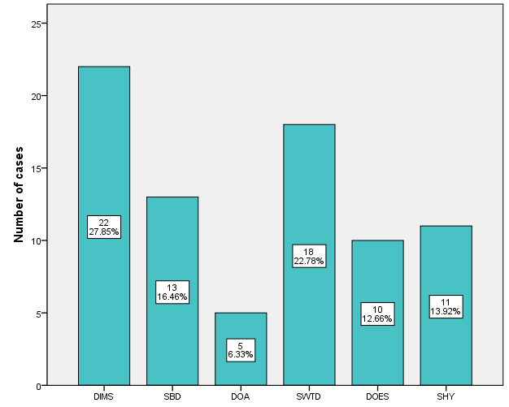
Prevalence of Sleep problem categories
Abbreviations
DIMS: Disorders of initiating and j maintaining sleep
SBD: Sleep breathing disorders
DOA: Disorders of arousal
SWTD: Sleep-wake transition k disorders
DOES: Disorders of excessive j somnolence
SHY: Sleep Hyperhydrosis
DIMS
SBD
DOA
SWTD
DOES
SHY
SDSC Disorder Subscales
Notes:
We also looked at the prevalence's of the 6 sleep disorder subscales as defined by the SDSC, and found that that Disorders of initiating and maintaining sleep were most commonly reported by parents, accounting for 22% of the cases as shown by this graph. These included symptoms such as bedtime resistance, insomnia, difficulty sleeping and sleep fragmentation. This percentage was exactly the same as an Australian Primary care study
As mentioned before, these subscale scores were significant if they were above the Tscore=70 line on the scoring tool.
The second highest were sleep-wake transition disorders such as sleep talking and teeth grinding.
Sleep breathing disorders are commonly picked up in clinic and attended to, but it is interesting to see how many others are in fact investigated.

Slide 7
Sleep Disorders And Health
Primary sleep pathology → daytime symptoms
Co-morbid sleep pathology → daytime symptomatology → eliminate SD → improve responsiveness of other condition to treatment
Impact on family members → affect ability to care → treatment benefits child & family alike.
Notes:
Diagnosis and management of SDs in children has unique significance in at least three very important ways:
Primary sleep-related pathology often has daytime consequences (ranging from mild inattention to, at the other end of the spectrum, significant failure to thrive) – only achieve resolution of daytime symptoms through identification and treatment of the sleep problem
Sleep-related pathology (most often SRBDs) are often co-morbid with other medical conditions (e.g., freq. the afroementioned chronic medical, neurodevelopmental and psychiatric conditions) – by treating the SD (eliminating its contribution to the overall symptomatology) the co-morbid condition is likely to better respond to treatment thereafter.
Children do not usually complain of sleep problems – usually parents or caregivers observe sleep problems in children (often causes emotional and physical distress, which can impact their ability to provide care – creating a downward spiral). Thus, recognition and treatment often benefits more than the affected child!

Slide 8
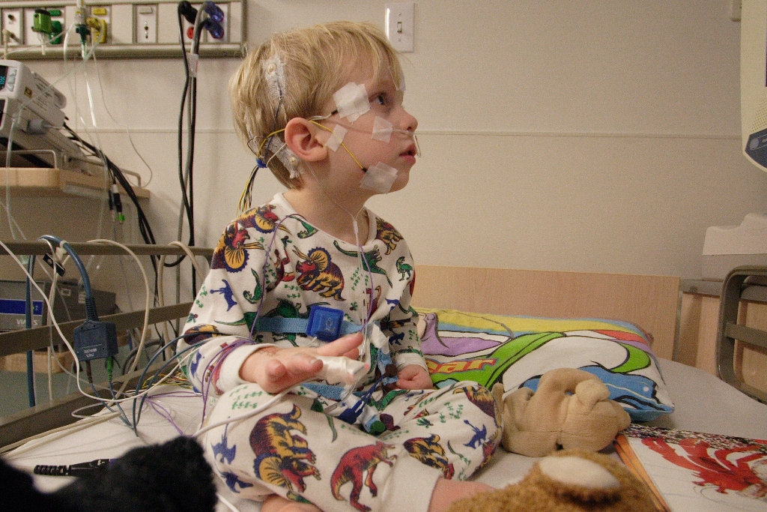
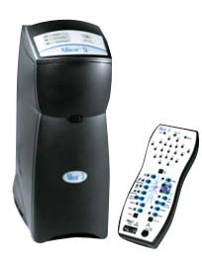
Sleep Medicine
Mid-1970’s ‘Polysomnography’ (PSG)
        EEG
        EOG
        EMG
        Airflow
        CO2
        Oxygen saturation
        Chest & abdominal effort
        ECG
        Limb movements
Multidisciplinary – inc. neurology, respiratory, ENT, psychiatry, psychology, dentistry
Notes:
By the mid-1970’s the term “Polysomnography” came into use to describe the simultaneous multi-physiological recording of sleep, which includes not only EEG, EOG and EMG, but also air flow, chest and abdominal effort, ECG, oxygen saturation and sometimes measurement of CO2 and limb movements.
As a consequence, sleep began to evolve into a multi-disciplinary field with involvement from neurologists, respiratory physicians, ENTs, dentists, psychiatrists and psychologists.

Slide 9
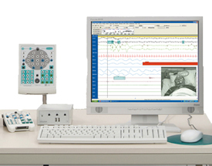
Sleep Diagnostic Tests
Oximetry – good PPV, poor NPP
Cardio-respiratory study (polygraphy)
Comprehensive polysomnography (PSG) ‘gold standard’
      Overnight PSG
      Overnight PSG with extended EEG
      Multiple Sleep Latency Test (MSLT)
      Maintenance of Wakefulness Test (MWT)
      PAP titration studies (CPAP, BiPAP)
Notes:
2009 RCPCH report refers to these 3 groups as:
Screening studies
Second line studies
Third line studies
Oximetry – the traditional ‘sleep study’ at SMH and is a useful screening tool in uncomplicated patients (good PPV, but a negative result doesn’t exclude SRBD so further investigation is usually required)
Cardio-respiratory studies – an extension to traditional oximetry through addition of respiratory effort and airflow
- usually unattended, home (advantage) or ward-based studies
- good for uncomplicated patients who don’t require detailed assessment of CO2, EEG or Video monitoring
- difficult to setup and reasonably high failure rate, and risk of damage to expensive equipment
Polysomnography - ‘gold standard’ in adults and children
- comprehensive assessment of neurologic aspects of sleep, cardiovascular and respiratory parameters in an attended setting
- can be coupled with oesophageal pH
- low failure rate (good)
- BUT, relatively expensive and performed in a ‘foreign’ environment (the sleep lab, different bedding and temperature – although custom built to minimise disruption)
Range of tests: explain briefly

Slide 10
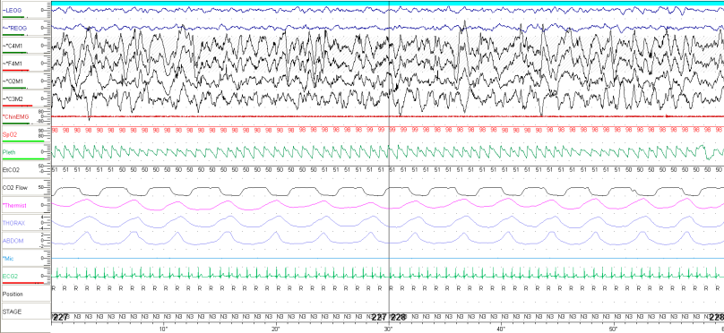
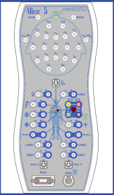
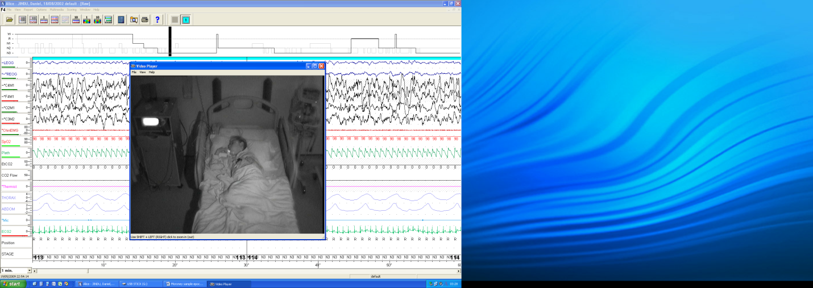
Polysomnography (PSG)
Notes:
NORMAL PSG shows:
Highlight traces on the Y axis
1 minute epoch
Time-linked, IR digital video (with PTZ function)

Slide 11
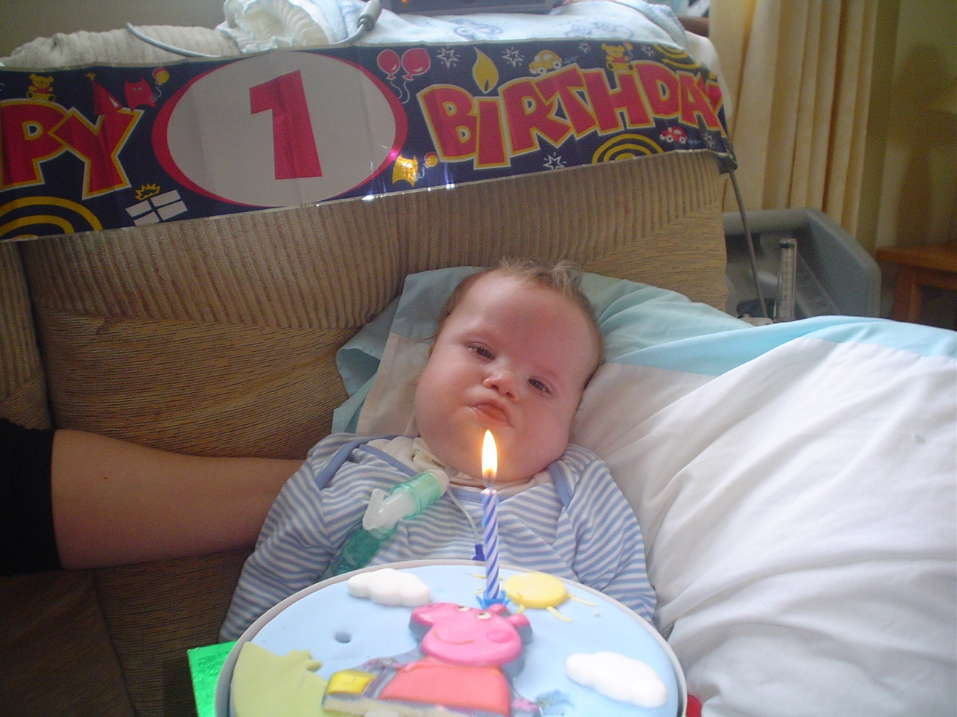
Sleep Disorders And Health
Notes:
Diagnosis and management of SDs in children has unique significance in at least three very important ways:
Primary sleep-related pathology often has daytime consequences (ranging from mild inattention to, at the other end of the spectrum, significant failure to thrive) – only achieve resolution of daytime symptoms through identification and treatment of the sleep problem
Sleep-related pathology (most often SRBDs) are often co-morbid with other medical conditions (e.g., freq. the afroementioned chronic medical, neurodevelopmental and psychiatric conditions) – by treating the SD (eliminating its contribution to the overall symptomatology) the co-morbid condition is likely to better respond to treatment thereafter.
Children do not usually complain of sleep problems – usually parents or caregivers observe sleep problems in children (often causes emotional and physical distress, which can impact their ability to provide care – creating a downward spiral). Thus, recognition and treatment often benefits more than the affected child!

Slide 12
Conditions at high risk of SRBD
Condition | Prevalence of SRBD
Down’s syndrome | 70-100%
Neuromuscular disease | 42%
Craniofacial abnormalities | Depends on severity; 100% in severe cases
Sickle Cell disease | 50-79%
Achondroplasia | 48%
Mucopolysaccharidoses | 90%
Prader-Willi syndrome | 25-75%
Notes:
All with very high prevalence of SRBD, including Obstructive type (e.g. more common in Down’s and Craniofacial abnormalities), and Central type (most pronounced in neuromuscular disease)

Slide 13
Common sleep-related diagnoses
Snoring
Sleep Apnoea
  Hypoventilation
  OSA
Narcolepsy
Insufficient night sleep
Delayed sleep-phase syndrome
Restless leg syndrome
REM and NREM Parasomnias
Notes:
Snoring – ‘simple’ snoring (not associated with sleep-related consequences), or ‘problem’ snoring (associated with sleep apnoea and/or sleep fragmentation)
Sleep Apnoeas - Obstructive and Central
Hypoventilation – if present, is it related to obstruction, interstitial lung disease, or congenital central hypoventilation syndrome – PSG provides one avenue to differentiate btw these
Narcolepsy – typical prevalence is about 1 in 2,000, but age of onset shows a bimodal distribution. Of the ‘early-onset’ narcoleptics, 2/3 had a peak age-onset of 15yrs, so onset of symptoms occurs in childhood in at least half of adult narcolepsy sufferes (but diagnosis of narcolepsy is usually made 10yrs after symptom onset due to poor recognition)
Insufficient night sleep – insomnia, poor sleep-hygiene
Delayed sleep-phase syndrome – primarily circadian phase delay in adolescents
Restless Leg syndrome – in a study of adults with RLS symptoms, over ¹/₃ reported onset of symptoms before the age of 10; another study identified RLS in 6% of 538 children in a sleep disorder centre - 72% of these had family history of RLS
Parasomnias – broadly differentiated into REM- and NREM-related groups. These are undesirable, usually bizarre behaviours during sleep which are more common in children than in adults.

Slide 14
Lauren C aged 11 years
Global Developmental delay
Epilepsy
GORD
  Nissen fundoplication
  Gastrostomy
Recurrent pulmonary aspiration
Chronic snoring
Obstructive sleep apnoea syndrome?

Slide 15

Lauren C – Sleep Apnoea

Slide 16
Airway & Breathing problems during Sleep
SNORING OSAS
Diagnosis of OSA is often delayed:
    31% wait >4 years to treatment
    40% self-referring, despite GP being aware of their symptoms
Notes:
Airflow limitation and obstructed breathing exist along a continuum, which ranges from simple snoring to severe sleep apnoea.

Slide 17
Airway & Breathing problems during Sleep:
Night-time Features
Snoring, gasps, snorts, witnessed apnoeas, restlessness, laboured breathing
Loudness does not predict severity of obstruction
Unusual sleep postures (extended neck, etc.)

Slide 18
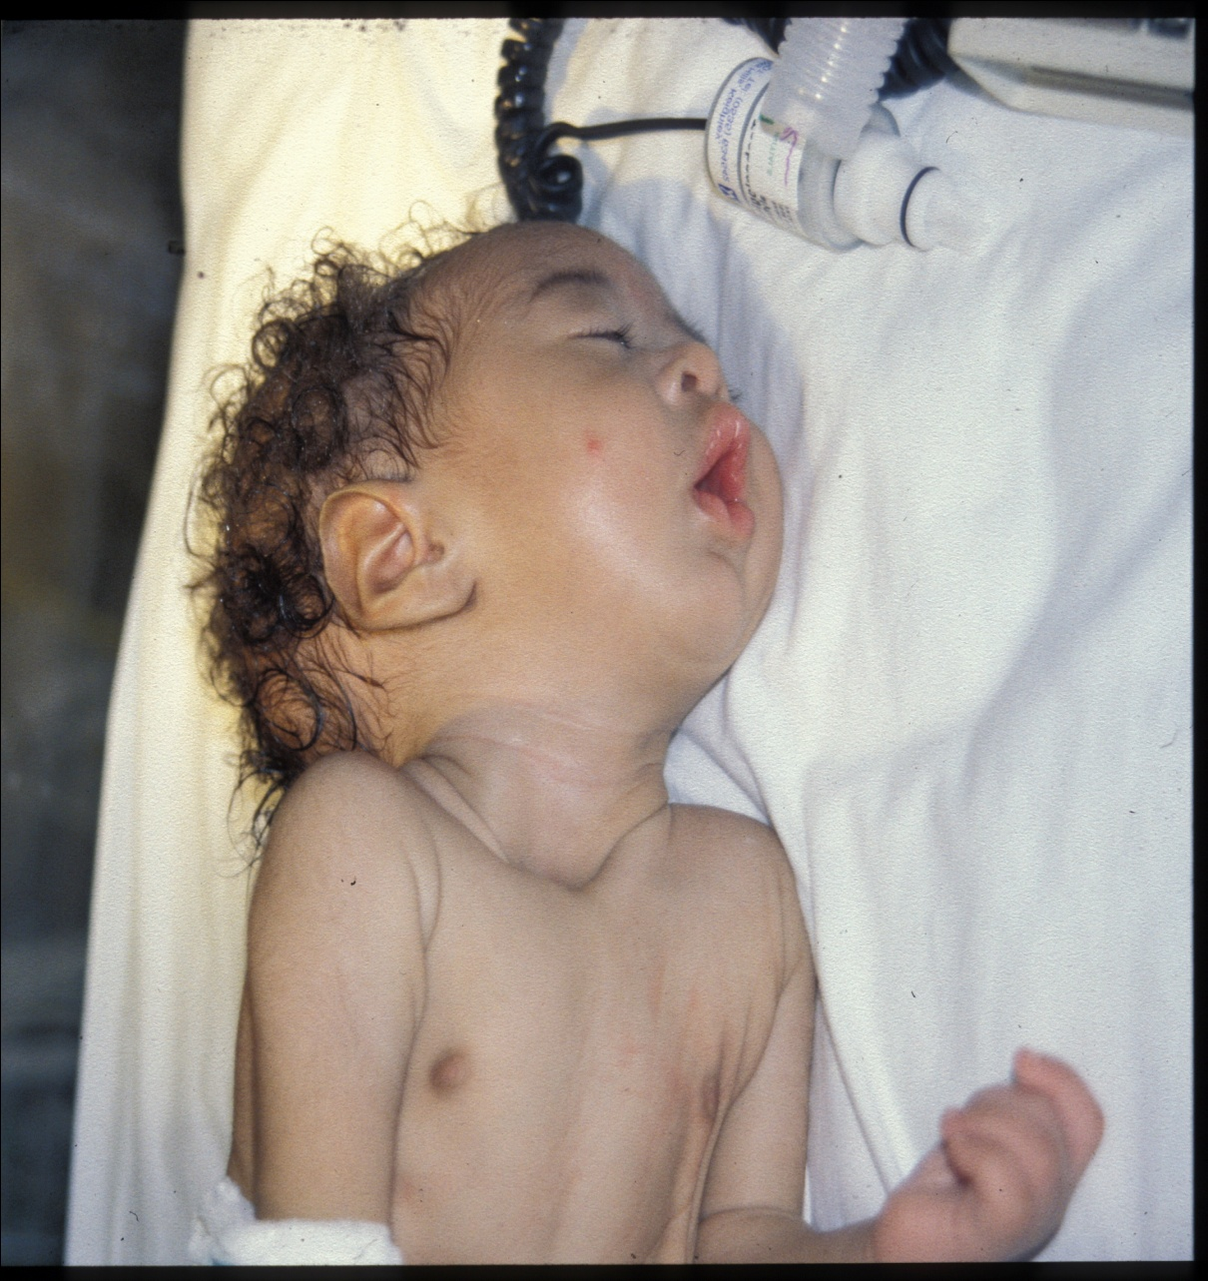
Upper airway Obstruction
Head back
Extended neck
Mouth breathing
Signs of WOB

Slide 19
Airway & Breathing problems during Sleep:
Night-time Features
Carers may witness cyanosis
Morning headache, excessive sweating
    CO₂ retention
Enuresis common in children with OSA

Slide 20
Airway & Breathing problems during Sleep:
Daytime Features
Tiredness & irritability on waking
Excessive daytime tiredness
    unusual in children
Hyperactivity is common
    inattention
Behavioural problems
Poor executive function
Failure to thrive (severe OSA)

Slide 21
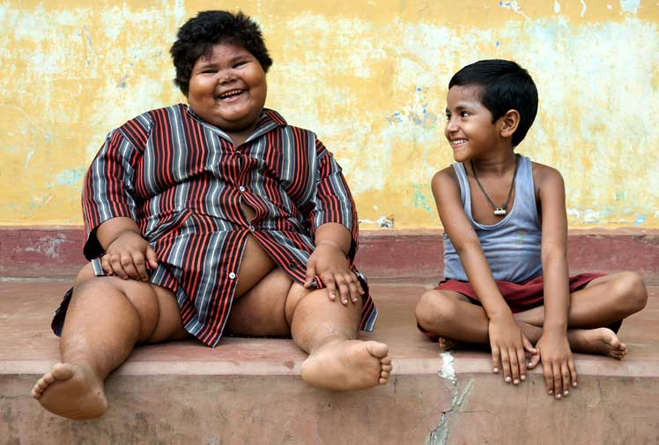
Sleep Disordered Breathing:
Physical Signs
Nasal obstruction
Mouth breathing
Adenoidal facies
Enlarged tonsils
Nasal speech
Retrognathia
High arched palate
Midface hypoplasia
Nasal polyps
Deviated nasal septum
Choanal stenosis/atresia
Harrison’s sulcus
Marked obesity

Slide 22
Consequences of OSA
Failure to thrive
    52% of infants <18 months AT for OSA
      - 87% significant weight gain post T&A
    short stature (reversible)
Cardiac
    Cor pulmonale
    pulmonary oedema
    Hypertension
    increased left ventricular mass
Neurodevelopmental

Slide 23
Consequences of OSA
Neurodevelopmental
    cerebral blood flow, inflammatory processes…
    impaired academic performance
Increased healthcare utilisation
    226% increase in year before diagnosis
    215% increase from birth to diagnosis

Slide 24
Management of OSA in Children
Adenotonsillectomy (AT) for OSA:
    improves clinically & on PSG (~ 85% cases)
    improves growth, infants & older
    Improves behaviour & attention
    Improves quality of life
      sleep quality
      decreases enuresis
AT or tracheostomy:
    Improves cor pulmonale & other CVS complications
Adenoidectomy alone is often insufficient

Slide 25
Management of OSA in Children
Oxygen as a temporary measure (e.g. while awaiting AT)
    Check CO2 levels not rising during treatment
Positive Airway Pressure (CPAP, or bi-level) where AT has failed or is contraindicated
Tracheostomy may be required where all other options have failed
Follow up Sleep study to ensure normalisation of physiology

Slide 26
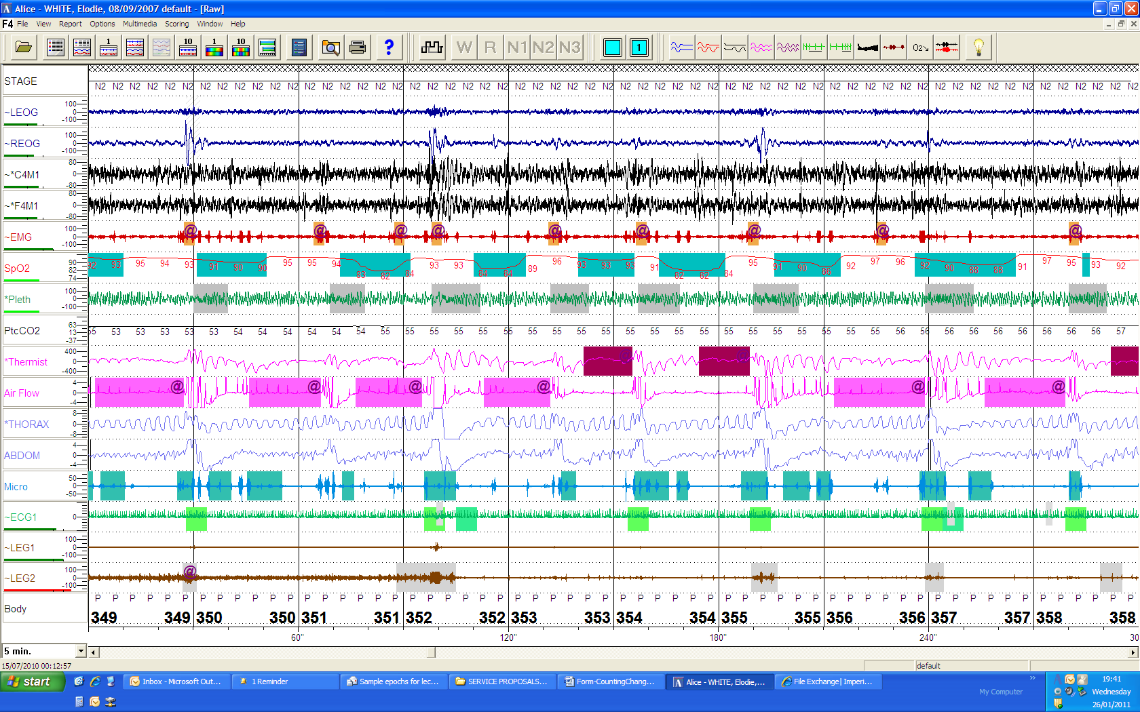
PSG findings: OSA
5 minute epoch of PSG
EW: age 3yrs. Height 102, Weight: 12Kg, BMI: 12
Recommendation: For urgent Adenotonsillectomy (AT)

Slide 27
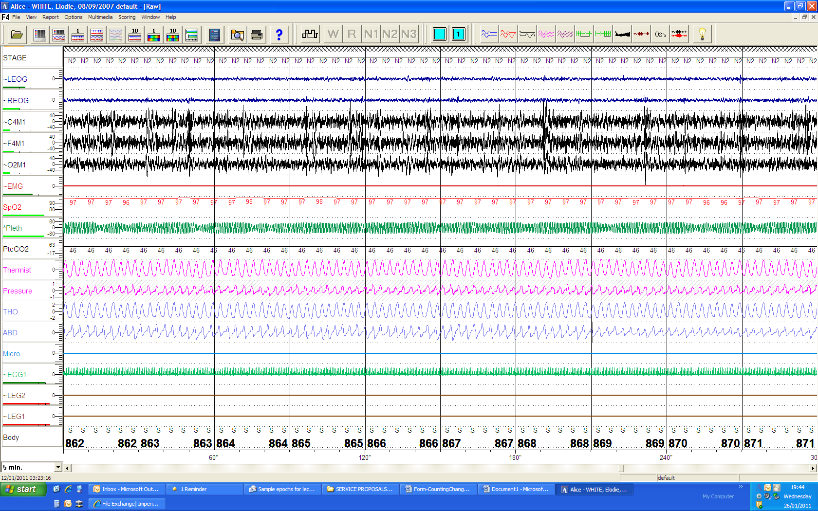
PSG findings: Post AT for OSA
5 minute epoch of PSG
EW: age 3yrs. Height 105, Weight: 14Kg, BMI: 13
Significant clinical and PSG improvement

Slide 28
Baby Mia aged 5 months
24 hr cough, ↓ feeding
“Stopped breathing, blue colour, floppy”
  Dad gave mouth to mouth
  Called 999
SMH A&E
Several apnoeic episodes
  Bag mask ventilation

Slide 29
Diagnosis?
Apparent Life Threatening Event (ALTE)
    Aspiration syndrome?
    Infection?
    Neurological?
    Other?
MRI under sedation:
  Multiple apnoeas!

Slide 30
ALTE work up:
Cranial ultrasound + MRI -normal
EEG - unremarkable
ECG/Echo -normal
Ba swallow- no GORD/hernia
Central hypoventilation?
  PHOX2B gene -Normal allele

Slide 31
ALTE work up:
Barium swallow:
  NO GORD/H hernia
Video fluoroscopy
  Silent aspiration
MLB:? Tracheomalacia
Contrast CT: indentation of ant trachea
  R bracheocephalic artery
High risk patient for sleep disordered breathing
Referred for PSG

Slide 32
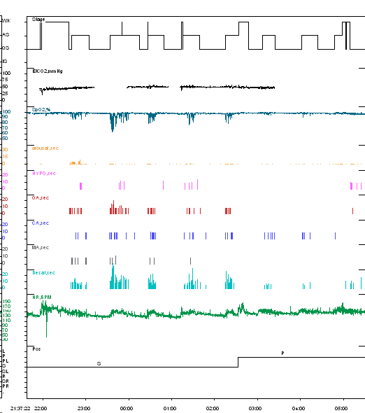
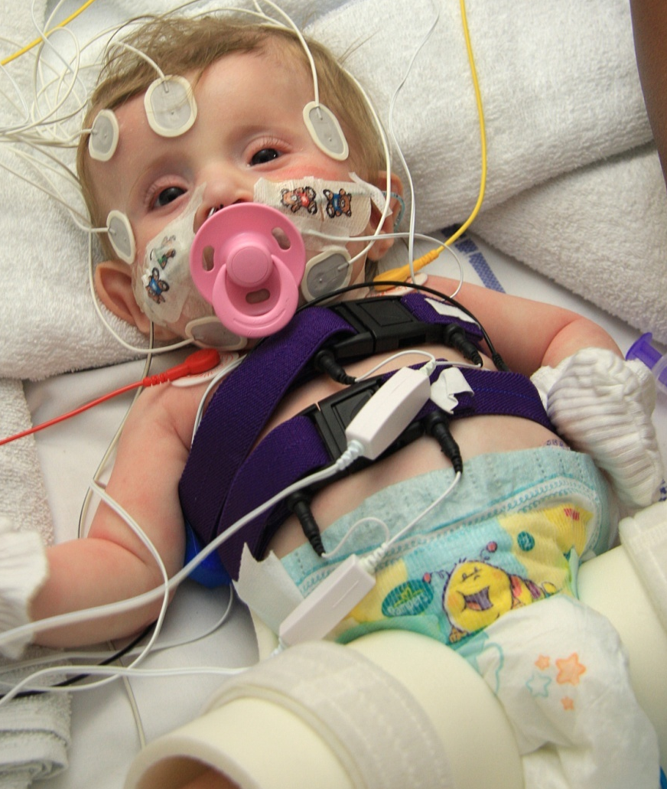
Baby M – Summary Hypnogram
Notes:
Highlight:
Y Axis = Variable being measured
X Axis = Time
Sleep architecture (Wake, AS – REM, QS – NREM), sleep cycles every 40 minutes or so (at this age)
EtCO2 evolution (excluding unreliable periods/fails)
Oxygen saturation profile (with multiple significant desaturations clustered together)
Micro-Arousal distribution (EEG measure)
HYPO: >50% reduction in airflow without cessation of effort
OA: >90% reduction in airflow (usually complete cessation) with continued effort
CA: no effort = no airflow
MA: both central and obstructive components in a single apnoea
Desaturation profile (events >3% drop)
HR profile: variability associated with wake vs. sleep, REM vs. NREM sleep, disordered breathing vs. normal breathing
Body position: supine vs. prone

Slide 33

Baby M – Sleep Apnoea
Notes:
Baby M:
Example during REM sleep showing:
- OA associated with desat, snoring and arousal
- CA associated with desat
- MA associated with snoring and desat, then desat associated with arousal
Micro-Arousals from sleep (minimum 3s duration) are a measure of sleep fragmentation and sympathetic NS activation. This distribution provides a breakdown of relative contributions of event type to Arousal index.
Severely elevated (doubled!) in this case (normal range ~5-8/hr)

Slide 34
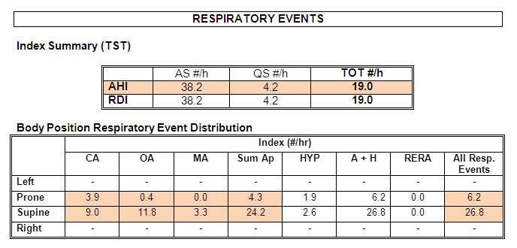
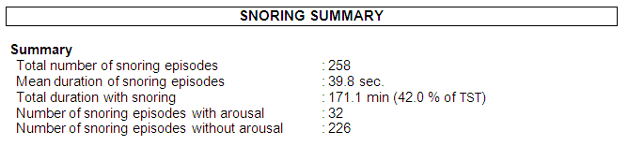
Baby M – Respiratory Events
Notes:
Baby M:
Highlight:
Overall index of ‘Respiratory Disturbance’/Apnoea Hypopnoea Index: Markedly elevated (mild during NREM sleep; severe during REM sleep)
Positional component: more frequent when supine, but less of a positional influence on CA (as expected)
Significant snoring (over 40% of the night)

Slide 35
Baby M
Maintained on nocturnal mask CPAP
Now aged 26 months
Otherwise healthy
Growing ~ 50th centile
Developing ~ “normally”
No unifying diagnosis

Slide 36
Non-Respiratory causes of Excessive Daytime Sleepiness (EDS) in children
Many possible causes:
1. Inadequate sleep-quantity :
    Insomnia
    Delayed sleep-phase syndrome
    Erratic sleep-wake pattern
2. Inadequate sleep-quality:
    Caffeine, alcohol, nicotine, illicit drugs
    OSA, PLMD
    Parasomnias
3. Increased need for sleep :
    Narcolepsy/cataplexy syndrome
    Ideopathic hypersomnia
    Kleine-Levin syndrome

Slide 37
Non-Respiratory causes of Excessive Daytime Sleepiness (EDS) in children
Narcolepsy
General prevalence: 1:2,000
Early-onset group (66%) had peak age of onset 14.7
Can profoundly influence QoL and safety
Not yet well recognised in children; may be dismissed as laziness
Cataplexy can be misdiagnosed as epilepsy

Slide 38
Narcolepsy diagnosis:
Daytime Multiple Sleep Latency Test (MSLT)
  Diagnostic test to objectively confirm narcolepsy
Patient undergoes 4-5 daytime naps (2 hour intervals)
  Purpose: to measure sleep-latency and REM-latency
  2 or more Sleep-Onset REM (SOREM) periods confirm narcolepsy
  mean average sleep latency =<8 minutes confirms daytime hypersomnolence, not narcolepsy (found in 30% of ‘normals’)

Slide 39
Narcolepsy diagnosis:
      Low CSF hypocretin-1 levels are found in patients with narcolepsy cataplexy syndrome
      Over 90% of patients with narcolepsy-cataplexy carry HLA-DQB1*0602.

Slide 40
Bradley aged 16 yrs
Epilepsy
  Grand mal seizures
  Well controlled, Epilim
EEG:
  Multiple sharp waves
  Poly spike activity
PMH: asthma, well controlled
FH:
    M Gm – OSAS; nocturnal CPAP

Slide 41
Bradley- Sleep history
Routine:
    Bed ~ 10 pm
    Wake up ~ 7 am (struggles to get up!)
      Lives with G mother
    Wakes feeling not refreshed; feels sluggish
      Sleeps till noon WE
Slept OK as a baby
    ~ age 9 yrs: Started napping during day
    Increasing daytime sleeping
      Naps 2-5 times/day
      10 minutes - 4 hours

Slide 42
Bradley- Sleep history
“Feeling weak in legs with laughing”
  Conscious throughout
Cataplexy?
“Could not move but could hear G mother”
Sleep paralysis?
“On Waking see/hear what was in my dream”
Hypnopompic hallucinations
Diagnosis:?

Slide 43
Admitted for PSG 17 Feb 2010
Overnight polysomnography (PSG):
  Exclude other sleep disorders, e.g., Periodic Limb Movement Disorder, OSA
  Document sleep architecture; likely to be fragmented
  Document sleep-onset latency and REM onset latency;
  Document adequate sleep (minimum 6 hours) prior to MSLT study

Slide 44
Bradley’s studies 18 Feb 2010:
      SOREM
      MSLT: sleep onset < 90 seconds!
      Diagnosis: Narcolepsy
      Genetics : positive test for HLA DQB1 *0602
      Treatment:
      Sleep Hygiene/routine
        CNS stimulants: Amphetamines
        Modafinil- novel wake-promoting agent
        Tricycylics

Slide 45
Genetics of Narcolepsy
Hypocretin: hypothalamus
‘critical of promoting awake state
Narcolepsy in Dogs!:
Mignot et al (Nature Medicine, 2000)characterized gene and receptor for hypocretin
Narcoleptic patients have absent/very low hypocretin
-degenerative changes in brain cells

Slide 46
Genetics of Narcolepsy
Hypocretin: hypothalamus
‘critical of promoting awake state
Hypothesis:
Auto immune mediated degeneration of hypocretin producing cells
Association:
HLA DQB *0602 in narcolepsy/cataplexy

Slide 47
Non-Respiratory causes of EDS in children
Insufficient Night Sleep
Adolescents (who require as much sleep as they did as pre-adolescents: 8.5 to 9.25 hrs/night)
Sleep deprivation worsens cognitive function
Delayed Sleep Phase Syndrome
Occurs when the major sleep episode is delayed in relation to the desired clock time by >2 hours
Normal circadian change associated with adolescence
Adolescent boys most affected
Major health burden in USA!

Slide 48
Non-Respiratory causes of EDS in children
Restless Leg Syndrome (RLS) & Periodic Limb Movement Disorder (PLMD)
“disagreeable leg sensations” which usually delay sleep onset, may disturb sleep and result in EDS
irresistible urge to move legs
often associated with PLMD during sleep
sometimes misdiagnosed as “growing pains”
autosomal dominant familial pattern in about 50% of patients
72% of children with low serum ferritin levels have PLMD and/or RLS
About 1/3 of adults with RLS report symptom onset before age 10
PLMD may be associated with ADHD in children

Slide 49
Episodic Behaviours in Sleep: Parasomnias
Bizarre behaviour or unusual experiences in relation to sleep (parents may think something seriously “wrong” with child)
Although they may be dramatic & worrying for parents, they do not usually indicate psychological or medical illness
Usually age-limited
Diagnosis & understanding can significantly alleviate parental concern

Slide 50
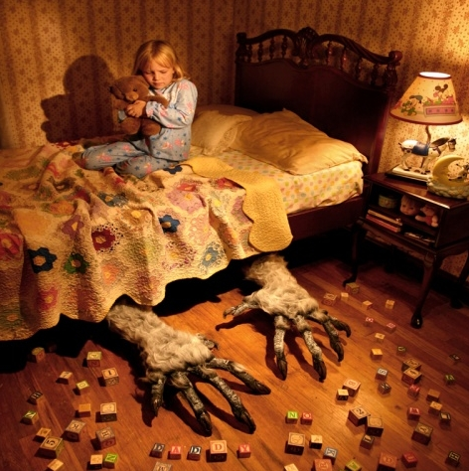
Episodic Behaviours in Sleep: Parasomnias
REM-related:
    REM Sleep Behaviour Disorder (RBD)
    Nightmare disorder
NREM (Partial Arousal Disorders):
    Confusional arousals
    Sleepwalking
    Sleep terrors
Notes:
Parasomnias are undesirable physical phenomena that occur predominantly during sleep. They are grouped as REM and NREM ‘types’ which share similar many features in common.
Common parasomnias associated with REM sleep include nightmares and REM behaviour disorder
Classical NREM Parasomnias include sleep walking, sleep terrors and confusional arousals (so called “Partial Arousal Disorders”).
Confusional Arousals:
Relatively common (17%), but usually present as a transient phase during childhood – subsequently “grow-out” of it
Sometimes persist into adolescence, but rare in normal adults
Some studies have shown an increased likelihood of developing sleepwalking if a diagnosis of Confusional Arousals already exists, so extra attention to safety is warranted.

Slide 51
Taking a Sleep History
What is the sleep problem? In what way does your child not sleep well? (Is it problems at bedtime, troublesome waking during the night, waking up very early in the morning, or a combination of these things?)
How much sleep does he/she get & is this age appropriate?
Do other family members have a sleep problem &, if so, what type?
Is the bedroom environment likely to help him/her get off to sleep easily & then sleep soundly? (light, noise, hygiene, co-sleeping)
Are there any medical or psychological conditions that might disturb sleep?
When did it begin & what has happened since?
Has it been linked with any other problems or with difficulties or changes in the family? (illness, emotional upset, disability, family discord)
Has the sleep problem affected the family?

Slide 52
Summary
Sleep disorders in children:
are common;
treatable;
can have serious consequences;
are often undiagnosed & untreated due to poor awareness & inadequate facilities; and,
fertile area of future research!

