Slide 1






Why do I need care pathways when our allergy service is so great??
John O. Warner
Chair, RCPCH Allergy Care Pathways Project
Professor of Paediatrics and Head of Department, Imperial College London

Slide 2

ICHT paediatric allergy service.
High demand.
High level of patient/parent satisfaction.
Balanced budget.
So we’re alright Jack!

Slide 3

The cost of allergy?
Affects at least of 30% of the population.
Asthma constitutes 1% of total global disease burden with 15,000,000 lost disability adjusted life years (WHO).
Global cost of asthma alone exceeds that of HIV and TB combined.
Direct health care costs in UK – GP consultations £300M, hospital admissions £100M, medication £800M, OTC £80M.
Indirect costs 10 fold higher.

Slide 4
Problems in UK paediatric allergy
Little if any focus in the U/G curriculum
Rudimentary competence in primary care
Limited competence in DGHs
Very few tertiary services

Slide 5
Consequences
Inadequate management
Shunting through several system specialist services
Children managed in adult services
Help sought from Complementary and Alternative Medicine (CAM)

Slide 6
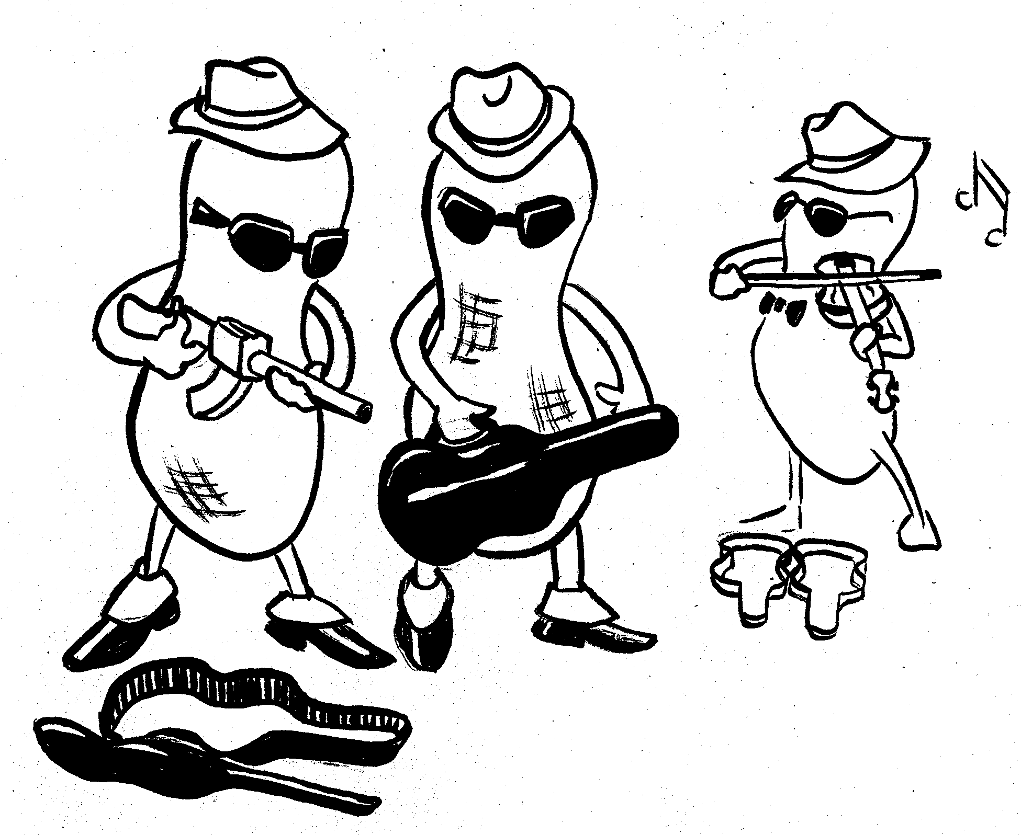

Slide 7
Not-alright Jack – Aged 9 Years
Aged 2 yrs had facial angio-oedema and vomited after a taste of peanut butter
Media publicity about anaphylactic deaths
Parents requested a referral
GP agreed and prescribed an epi-pen without training
Anxious about delay in appointment
Resorted to CAM and had vega tests which suggested milk, egg, wheat and fish but not peanut allergy

Slide 8
Not-alright Jack…
Milk, egg, wheat and fish free diet – misery!
2 weeks prior to allergy clinic appointment attended a party.
Allowed to have a peanut but spat it out.
Within 2 minutes angio-oedema, stridor, wheeze and collapsed.
Despite having adrenalin injector, did not know how to use it.
Thankfully recovered - no thanks to CAM or the NHS provision of services.
Solution = increase consultant numbers??

Slide 9
OK – we have more consultants
7 year old girl with diagnosed hazel nut allergy
Party at school – given a Roses chocolate by teacher.
Ingested in play-ground
Developed throat swelling, respiratory difficulties and felt faint.
Teachers panicked – she administered her epi-pen herself.
Didn’t she and we do well?

Slide 10
OK – we have more consultants
Mother called
Taken to local A&E
Told by A&E doctor that she should not have had or used the epi-pen!!!!
Solution lies beyond our ivory tower!

Slide 11
Patient reported experience
1%
27%
24%
86%
15%
48%

Slide 12
More consultants aren’t preventing this
CK age 7 months - A&E with acute vomiting and wheeze after 1 ts of porridge
Eczema from 3 mths - used topical oatmeal cream
Eczema very severe and recurrent wheeze for 2 months – only treatment Salbutamol MDI.
Weight and head circumference static for 3 months
Solution lies beyond our ivory tower!

Slide 13
100 referral letters and clinic outcomes
No clinical history - 42%
Referral correctly reflected severity/complexity – 7%
Under treatment – 42%
Thus referral letter triage impossible

Slide 14

UK initiatives
RCP – Allergy; the unmet need 2003 (A postcode lottery)
Parliamentary Health Committee 2004/5 Endorsed RCP report and recommendations
Dept. of Health response 2005/6. No action on main recommendations…..more information required
Science and Technology Committee (HoL) 2007…focus on research but accepted this was compromised by lack of service provision

Slide 15

Have we made any progress?

Slide 16
Summertime Blues
Eddie Cochrane 1958
…Well I called my congressman and he said Quote:
“I’d like to help you son but you’re too young to vote

Slide 17
Where do we go from here?
Management guidelines – NICE, BTS/SIGN, BSACI etc
Pilot network in NW region
More research
JOW
DH
DH
JOW
Integrated care pathways

Slide 18

Care pathways are not “sat-navs” to the hospital

Slide 19

Local partnerships including all agencies involved with the care of children in a locality
Emphasis on efficient service provision
“What is needed is a common vision that is strong enough to bind all the agencies together while taking account of different perspectives ... The future must be one of a holistic approach to the child or young person.”
Getting it right for children - Kennedy report Sept. 2010

Slide 20
Definition of integrated care pathways
Patient focussed tools to provide the sequence and timings of actions to achieve patient outcomes with the greatest efficiency
They follow patients from the initial point of presentation to the final outcome
The outcome is the desired endpoint for the patient
They are not management guidelines which set out the clinical care suitable for patients with a specific condition

Slide 21
The aim of the RCPCH allergy pathways project was to develop…
…ideal national care pathways that can be adopted for local use.
Gold standard
Evidence based
Focus on competence
Involving all stake-holders

Slide 22
Competences
Define the steps in pathway based on the competences of the health care team not the setting in which the care should be provided.

Slide 23
8 Pathways
Anaphylaxis
Asthma/Rhinitis
Food Allergy
Eczema
Urticaria/Mastocytosis/Angio-oedema
Drug allergy
Venom allergy
Latex Allergy

Slide 24
THE NETWORK APPROACH
Common training programme and management protocols
Community clinics
Primary
Care
Community
Nursing
Patient
and
their family
ICHT
Childrens
Services
Supported care at home by increased patient /carer involvement
Team
around
the family
Integration of all stake-holders in one management structure
Extended
Schools
Modified image courtesy of Dr Mando Watson
© Imperial College Healthcare NHS Trust

Slide 25
Overview
An algorithm of the stages of care of the ideal pathway
The competences required to deliver the ideal pathway
The pathways documents are in two sections:
Each pathway has a set a core knowledge documents

Slide 26
Initial recognition
Initial recognition
Consider onward referral
Confirmed diagnosis
History is paramount !
Competence for investigations
Communication
Management
Written management plan
Consider onward referral
Ongoing management
Review diagnosis, management plan

Slide 27
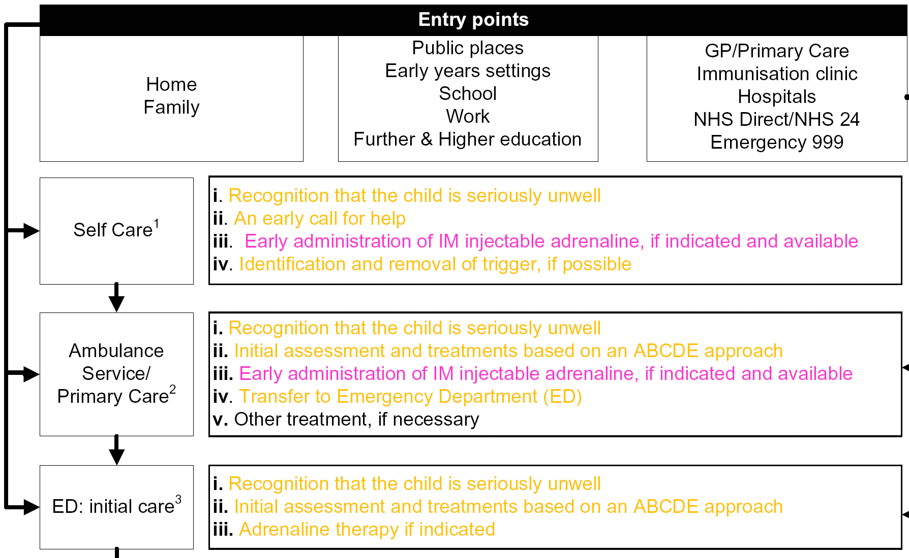
Acute management

Slide 28
Barriers to implementation
Local adoption of national pathways
Convincing commissioners to fund
Finding time and location for training and meetings
Getting ‘buy-in’ from local champions
Families seeking tertiary care referrals
Changing service provision landscape

Slide 29
€ 218 million
€ 213 million
25 %
43 %
37 %
20 %
10 %
21 %
28 %
16 %
1 600 €/per patient
1 000 €/per patient

Slide 30
Progress
All pathways completed and approved by RCPCH and published in Arch. Dis. Child.
Endorsed by RCGP, RCP, RCPath, RCN, and many other stakeholders
Full final report for DH and commissioners
DH have refused to endorse the pathways
We have CLAHRC funding to pilot the pathways in NW London

Slide 31
Project Team
Lead commissioner for paediatric services
Lead GPs in commissioning group
Education and Early Years Settings
School nursing
Community nursing
Health visitors
Ambulance service
Community dietetics
Retail pharmacists
Patients and parents
Patient support groups
Paediatric allergists

Slide 32
What is happening in our patch??
Variable prevalence of diagnoses;
    for asthma 1.39-20.4% in adjacent practices.
    Very low eczema and apparent high psoriasis rates.
Lowest rates associated with highest referral to hospital services.
Clustering of unscheduled visits.
Large numbers of allergic A&E recidivists.

Slide 33
Greatest achievements to date;
Local children’s commissioner chairs the group.
Local QOFs to include pathways
PCT and GP sign-up
Involvement of diverse stake-holders
Training programme
Consultant led clinics in primary care settings
Web-site

Slide 34
The Pyramid of Development
INDIVIDUAL
DEVELOPMENT
CONDITION SPECIFIC
INTRODUCTORY
SESSIONS
ROVING WORKSHOPS
SCHOOL PROGRAMME

Slide 35
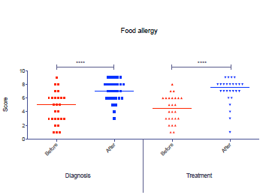
GP confidence in managing food allergy before and after training

Slide 36
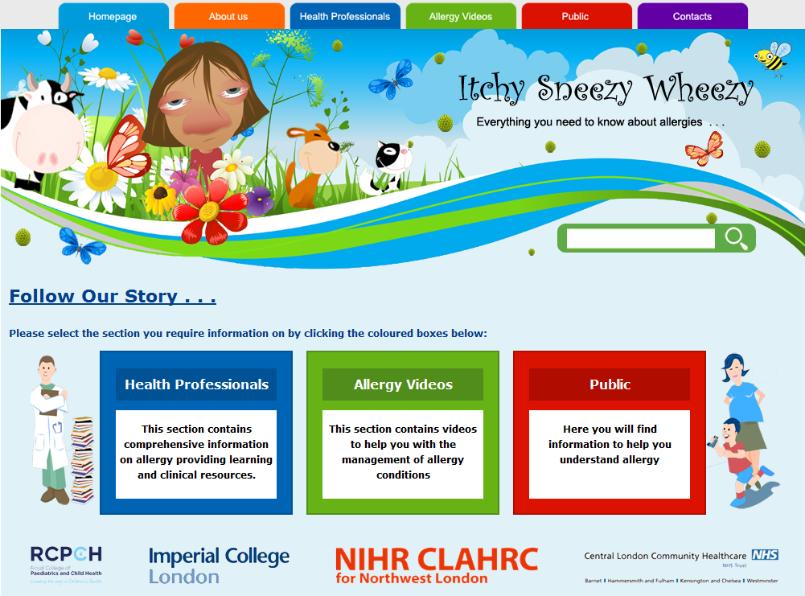

Slide 37
Outcome targets
Reduced un-scheduled visits to GP, A&E, emergency admissions.
Increased diagnostic ascertainment.
Reduced referral of mild disease and timely referral for those that need it.
Improved patient experience and QoL.

Slide 38
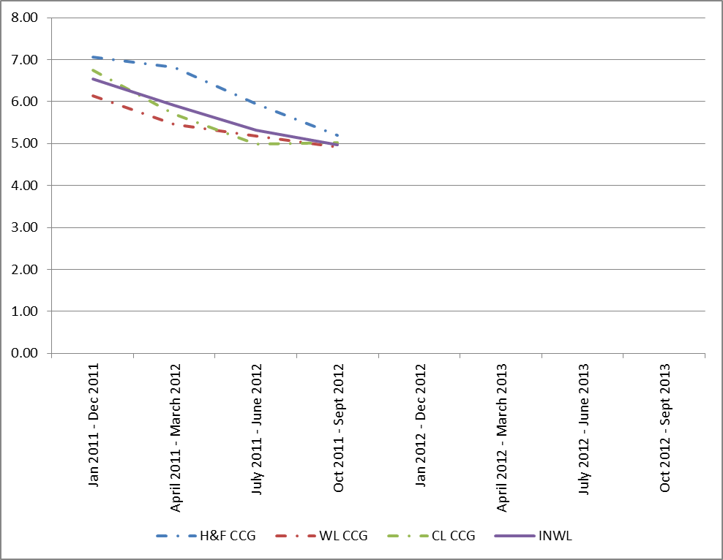
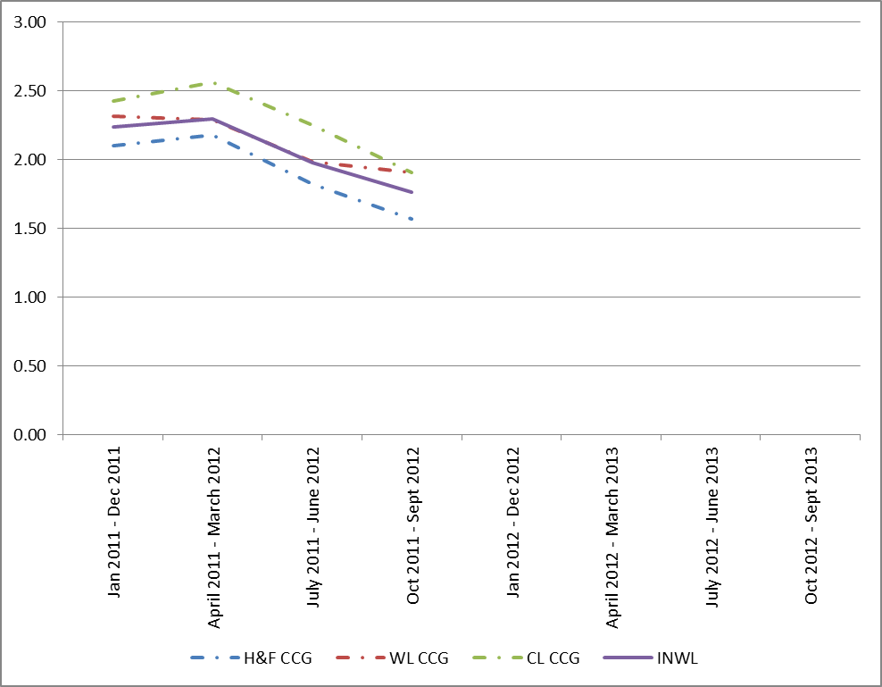
Quarterly 12 month rolling, admissions from each CCG for children <18 yrs.
Asthma
Food Allergy

Slide 39


Research
Expanding interest in early-life origins and prevention.
Renewed interest in immunotherapy
New therapeutic modalities
Paediatric Implementation Plans

Slide 40
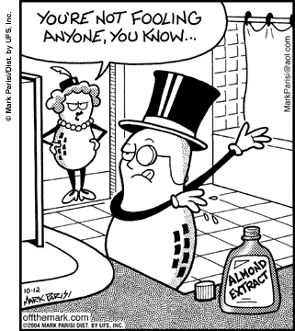
Food labelling; similitude or simulacrum?

Slide 41

Food labelling problems
FSA funding for thresholds research
56% of items, “may contain nuts.”
18% no substitute available.
9% only a poor quality substitute.
11% increase in cost.
39% increase in shopping time.
May contain labelling- the consumers
perspective. FSA publ. May 2002

Slide 42


