Slide 1
Food allergy
Dr Eleanor Minshall MB BCh PhD MRCPCH
Locum Consultant in Paediatric Allergy
St Mary’s Hospital

Slide 2
Welcome
Pick up a sticker with a number on as you enter !!
No eating in the lecture theatre
Pay attention – there are chocolates to be won
Wrong answer = no chocolate
Flavours include: (nil guaranteed nut-free !!)
  Dark
  Milk
  Almond
  Ginger
  Butterscotch

Slide 3
Learning Objectives
An understanding of the pathopathysiology of food allergies
Recognition of the common and diverse manifestations of food allergies
An appreciation of the management of food allergies

Slide 4
Overview
Definition of food allergy
Prevalence
Classification of food allergy
Sensitization
IgE versus non-IgE dependent food allergy
Management of food allergy
Prognosis

Slide 5
Definitions: AAAAI Expert Panel 2010
Food allergy: An adverse health effect arising from a specific immune response that occurs reproducibly on exposure to a given food.
Hypersensitivity: Often used to describe food allergy, used by some to describe all food reactions
Allergic diseases: Clinical conditions associated with altered immunological reactivity that may be either IgE or non-IgE mediated.
Sensitization: The presence of allergen-specific IgE to food allergens, insufficient in itself to define food allergy
Food intolerance: Adverse reactions to food elicited via non-immunological mechanisms

Slide 6
Food Intolerance
Non-allergic hypersensitivity
Pharmacological i.e. tyramine, caffeine, alcohol
Metabolic i.e. lactase deficiency (lactose intolerance), galactosaemia
Toxins i.e. scromboid toxin in tuna
Neurological i.e. gustatory flushing
Psychological reaction
Notes:
Name any food intolerances ??

Slide 7
Atopy versus allergy
Atopy is defined as the genetic propensity to develop IgE antibodies on exposure to allergens, assessed by either skin prick testing or circulating allergen-specific IgE
A specific IgE-mediate food allergy requires both the presence of sensitization and the development of specific signs and symptoms on exposure to that food.
Notes:
Difference between atopy and allergy - Case study of sensitization and allergy

Slide 8
Relationship between allergy and sensitization
Sensitization
Food
allergy
IgE mediated
Non
IgE mediated

Slide 9
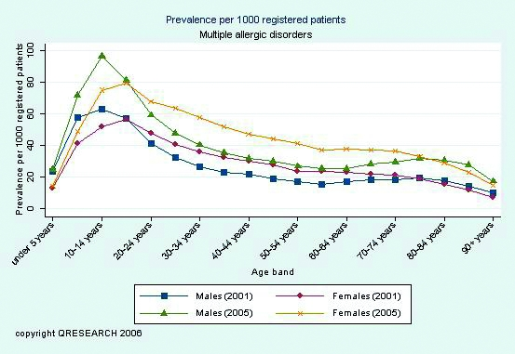
Prevalence of multiple allergic disorders over time
Notes:
Simpson et al., 2008; national primary care database of over 9 million UK patients, increased consultation rate to GPs over this time, 525 GP practices Lifetime prevalence of multiple allergic disorders, 28 % increase in patients having at least one allergic condition, 50 % increase in patients having more than 1 allergic condition. Due to ? Increased sensitization or increased recognition, profile of food allergy depends on age, local dietary i.e. peanuts in Israel, form of allergen – boiled versus roasted, genetic and environmental factors

Slide 10
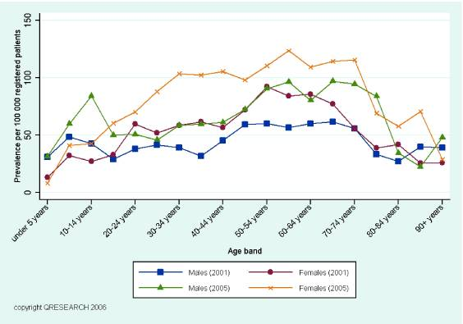
Anaphylaxis rates in UK
Notes:
Age-sex variations in lifetime prevalence of anaphylaxis per 100,000 patients over a 5 year period in the UK using primary care database. Incidence rate increased 19 % over this period and 51 % increased in recorded lifetime prevalence of anaphylaxis over those 5 years, due to ? Increased recognition ? Change in local diet – introduction of peanuts and kiwi

Slide 11
Prevalence of food allergies in children
Food | Prevalence (% population)
Milk | 2.5
Egg | 1.5
Peanut | 1.0
Tree nuts | 0.5
Fish | 0.1
Shellfish | 0.1
Wheat | 0.4
Soya | 0.4
Sesame | 0.1
Notes:
In UK (Isle of Wight) 5.5 % children food allergy in first year of life, drops to 2.5 % in 6 year olds and 2.3 % in 11 – 15 year olds whole population birth cohort study. Common up to 8 % population (difficulties in getting accurate values) history is key, limited repertoire of food allergens responsible, legal requirement for labelling

Slide 12
Classification of adverse reactions to food
Adverse reaction to food
Non toxic
Toxic
Immune mediated
(Food Allergy)
Non-immune mediated
(Food Intolerance)
IgE Mediated
Non IgE Mediated
Enzymatic
Coeliac disease
Eosinophilic oesophagitis
Eosinophilic gastroenteritis
Eosinophilic enteropathy
Eosinophilic procto-colitis: ‘allergic colitis’
Food protein-induced enterocolitis syndrome (FPIES)
Pharmacological
Immediate food allergy
Oral allergy syndrome
Other

Slide 13
Classification
Immune mediated
(Food Allergy)
IgE Mediated
Mixed IgE/
non IgE Mediated
Non IgE Mediated
Immediate food allergy
Oral allergy syndrome
Eosinophilic oesophagitis
Eosinophilic gastroenteritis
Eosinophilic enteropathy
Eosinophilic procto-colitis: ‘allergic colitis’
Food protein-induced enterocolitis syndrome (FPIES)
Food protein-induced enteropathy
Coeliac disease
Notes:
Possibly question – largest surface area in body ? Lungs 70 square metres Skin 1.5 – 2 square metres ?gut 400 metres square

Slide 14
Routes of sensitization
Skin
Lungs
Gastrointestinal tract

Slide 15
Routes of sensitization
Skin
Lungs
Gastrointestinal tract
70 m²
1 – 2 m²
400 m²

Slide 16
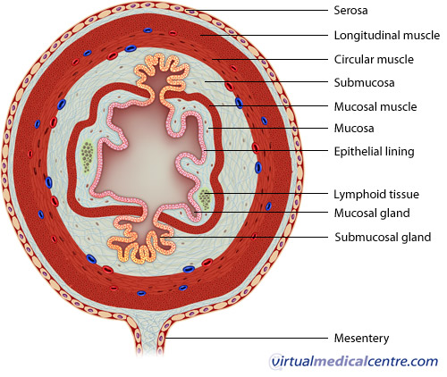
Pathogenesis of food allergy
Notes:
GIT encompasses largest surface area in human body, single layer columnar epithelial cells, separates sterile internal environment from externa, processes food for growth, prevents penetration of harmful bacteria and viruses etc into body. Epith cell joined by tight junctions, thick layer mucus traps particles, enzymes, bile acids, extremes pH destroy pathogens and makes allergens less allergenic. Immaturity in infants may predispose to allergy, use of antacids facilitates antigen absorption, 2% intact antigens absorbed.

Slide 17
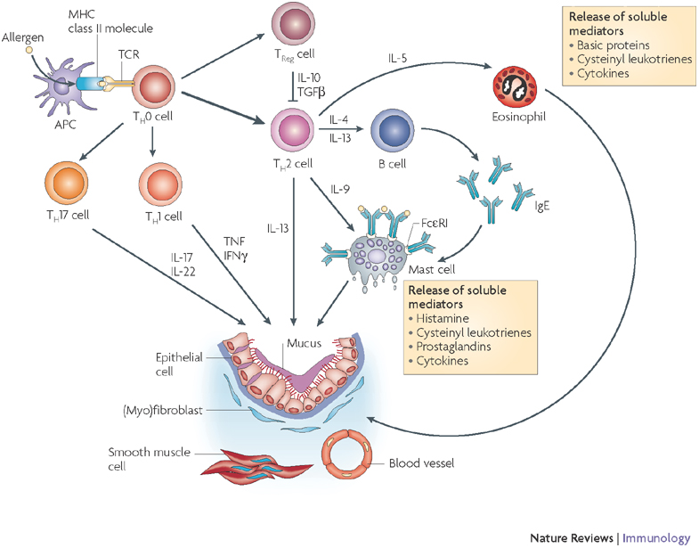
Sensitization
Notes:
Steps in sensitization process – antigen uptake, antigen processing and expression, dendritic cell – T cell interaction, establishment of T cell phenotype, T cell – B cell interaction, B cell switching, T cell elaboration of cytokines

Slide 18
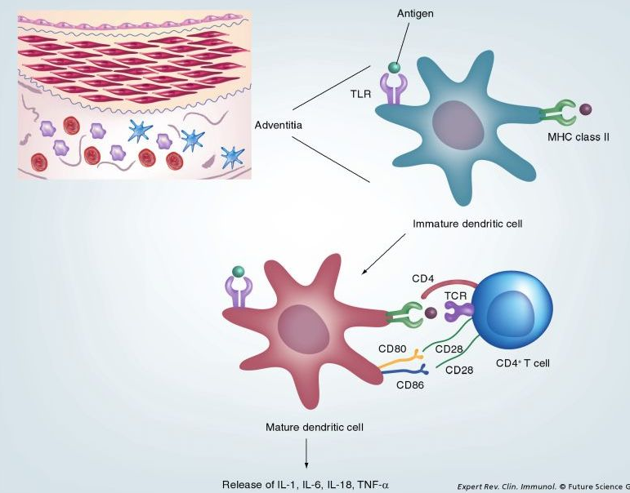
Antigen presentation
Notes:
Sequence identities > 62 % to human homologs typically exclude food being allergic in man. TLR = toll-like receptor

Slide 19
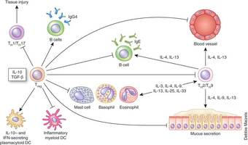
‘Th2’ pathway

Slide 20
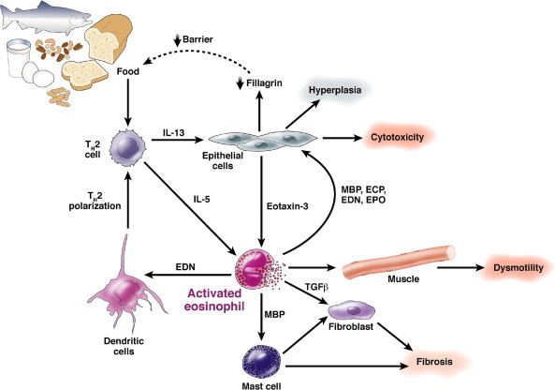
Eosinophil recruitment

Slide 21
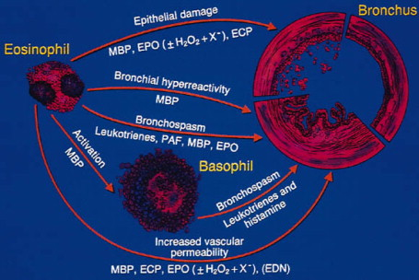
Actions of eosinophils
Notes:
Would be better without bronchus !!

Slide 22
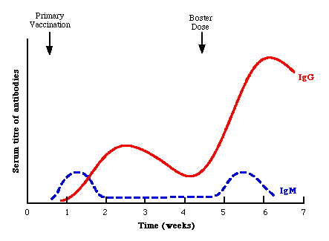
Primary and secondary immune responses
Notes:
Get data from Swedish study – IgE food and aeroallergens
Get data from Perth study – presence of allergen-specific lymphocytes in blood at 6 months

Slide 23
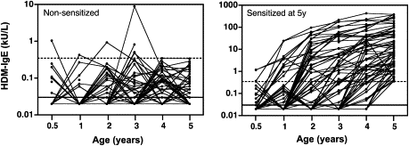
IgE responses in atopics and non-atopics
Notes:
IgE production occurs in non-atopics – ability to regulate switching/production, cohort of babies from highly atopic parents, examined circulating sIgE upto 5 years of age. Primary response normal in atopics – secondary response lack of inhibition

Slide 24
Risk factors for the development of food allergy
Local Factors Genetic susceptibility Pepsin digestion Gastrointestinal infections Malabsorption Rate of absorption Antigen processing Nature and dose of Antigen | Host Factors Age (esp neonates) Genetic susceptibility Family Hx of atopy Family Hx of food allergy Atopic dermatitis Transdermal food exposure (peanut)
Notes:
Talk about fillagrin – loss of function mutation associated with food sensitization and not allergy – enhances percutaneous allergen penetration, form of antigen i.e. roasted peanuts associated with adjuvants, form encountered i.e. baked egg, presence of glycosylation, carbohydrate epitopes i.e. galactose-α 1,3 galactose in beef/port/lamb anaphylaxis

Slide 25
Associated food allergies
Notes:
Related allergies

Slide 26
Associated food allergies
Food allergy | Other foods | % children with associated allergy
Peanut | Most beans | 5 %
A tree nut | Other tree nuts | 35 % (higher for walnut-pecan, pistachio-cashew, almond-hazel)
A fish | Other fish | 50 %
Shellfish | Other shellfish | 75 %
Grain | Other grains | 20 %
Cows milk | Goats/sheeps milk Mares milk Beef | greater than 90 % 5 % 10 %

Slide 27
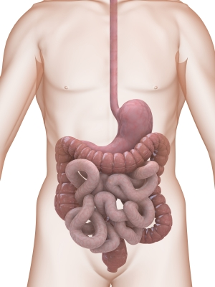
Eosinophilic oesophagitis
Allergic
dysmotility
FPIES
Enteropathy
Proctocolitis
Notes:
What does FPIES stand for ?

Slide 28
IgE-mediated food allergy manifestations
Notes:
Name 4 manifestations of food allergy

Slide 29
IgE-mediated food allergy manifestations
Organ system | Manifestations
Skin | Urticiaria, erythema, angioedema
Respiratory | Cough, wheeze, hoarse voice, respiratory distress, nasal congestion, rhinorrhoea, sneezing
Gastrointestinal | Vomiting, diarrhoea, abdominal pain, reflux, nausea
Cardiovascular | Hypotension, sudden sleepiness, pallor, cardiovascular collapse

Slide 30
Non-IgE mediated food allergy manifestations

Slide 31
Non-IgE mediated food allergy manifestations
Organ system | Manifestations
Skin | Angioedema
Respiratory | Respiratory distress, nasal congestion
Gastrointestinal | Vomiting, diarrhoea, abdominal pain, reflux, nausea, blood/mucus in stools, constipation, faltering growth, iron deficient anaemia, colic
Cardiovascular | Hypotension, lethargy
Neurological | Developmental delay, failure of head growth
Immunological | Hypereosinophilia, hypogammaglobulinaemia, increased susceptibility to infection, hypoalbuminaemia
Notes:
Name 4 non-IgE manifestations

Slide 32
Non IgE-mediated food allergy
 | FPI Enterocolitis | FPI Enteropathy
Age | 1-6 months | 1-6 months
Symptoms | Profuse diarrhoea, vomiting Blood in stools, faltering growth, ⇓ albumin; hypovolaemia | Protracted D&V, malabsorption, FTT, +/- dist. abdo, ⇓Alb
Food Antigen | Cows milk, soya, solid foods | Cows milk>Soya>others
Site | Small/large bowel | Small bowel
Biopsy | Crypt abscesses, oedema, inflammation | Villous injury; intraepithelial lymph’s few eosinophils
Immunology | Circulating T-cells ⇑TNFα; ⇓TGFβ ⇑ permeability | T-cells (TH1) response: ⇑IFN ⇑IL4 ⇓IL10
Other | Challenge may lead to shock
Notes:
Data from Israel r.e. FPIES onset

Slide 33
IgE versus non-IgE mediated allergy

Slide 34
IgE versus non-IgE mediated allergy
 | IgE mediated | Mixed/Non-IgE mediated
Onset of symptoms | Within 2 hours of ingestion | Hours to days after ingestion
Resolution of symptoms | Usually resolve within 12 hours | Resolve in hours to days
Symptoms | Urticaria, angioedema, vomiting, respiratory distress, hypotension | Often non-specific symptoms (colic, vomiting, abdominal pain, flare of eczema, food refusal)
Diagnosis | Specific IgEs, skin prick testing, food challenges | Elimination diet (2 – 6 weeks) and re-introduction
Examples | Food-induced urticaria or angioedema, anaphylaxis | Food protein-induced enterocolitis syndrome, allergic protocolitis, allergic enteropathy

Slide 35
Eosinophilic gastrointestinal disorders

Slide 36
Eosinophilic oesophagitis

Slide 37
Eosinophilic oesophagitis
Rare disorder – increasingly recognised
Clinically characterised by vomiting, food/textural aversion, dysphagia, early satiety, abdominal pain, irritability, faltering growth
Biopsy > 15 eosinophils per hpf
Subset responsive to proton pump inhibitors
Evidence for local IgE production, food/aeroallergen sensitization
Management food avoidance, elemental diet, immunotherapy, topical steroids
Notes:
Seen particularly in children and young adults, males more at risk, incidence greatly underestimated – 4 - 18 fold increase over the past 10 – 20 years, diagnosis often delayed, seasonal variation (more spring and summer)

Slide 38
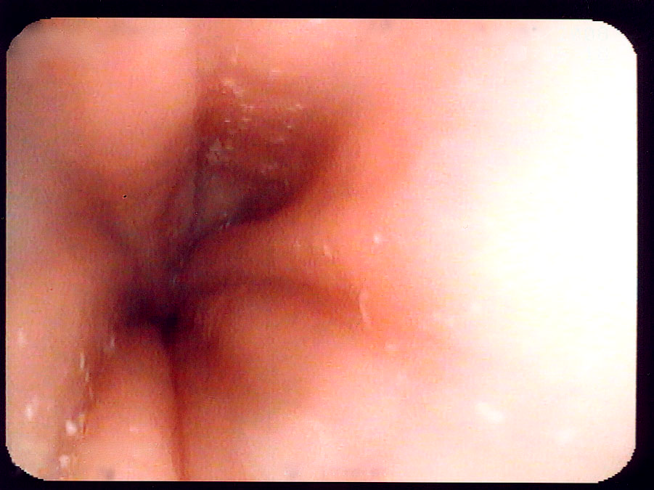
Endoscopy findings
Notes:
Prominent furrowing, trachealisation, white plaques dd candida, can be normal at endoscopy

Slide 39
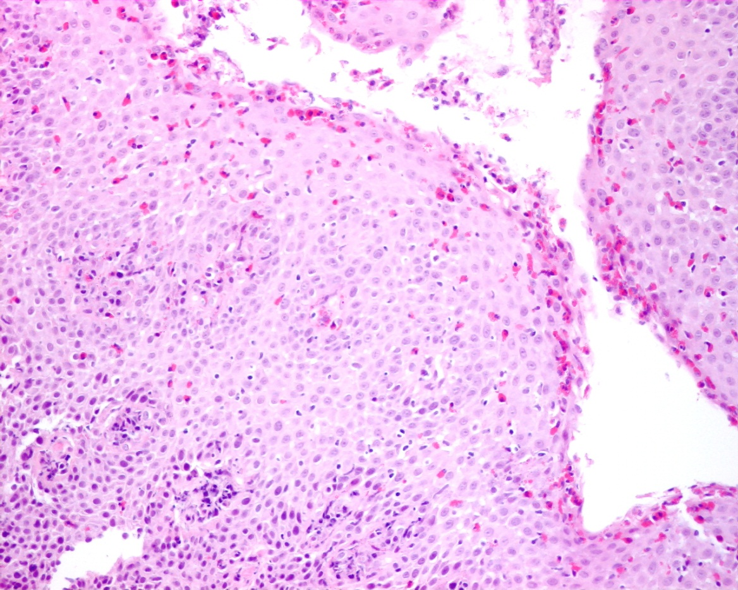
Biopsy findings
Notes:
Severe tissue eosinophilia, eosinophilic microabscesses, oesophagus normally devoid of eosinophils

Slide 40
Eosinophilic Enteropathy

Slide 41
Eosinophilic Enteropathy
Presents with protracted diarrhoea, occasional vomiting and faltering growth
If undetected may result in poor head growth and developmental delay
Management is maternal cow’s milk (and possibly other allergen) avoidance or hypoallergenic formula
Prognosis good and generally resolves by 12 – 24 months of age
If specific IgE/SPT negative, safe to re-introduce at home
Notes:
Pathology – difficult to ascertain as rarely biopsied

Slide 42
Food protein-induced enterocolitis syndrome

Slide 43
Food protein-induced enterocolitis syndrome
Severe gastrointestinal reaction to cow’s milk characterised by profuse diarrhoea and vomiting, pallor and hypovolaemic shock
May present as sepsis
Usually in the first month of life and rare in exclusively breast fed infants
Treatment is amino acid formula
Tolerance is usually seen between 18 months and 3 years
Not for home introduction of milk, needs facilities for resuscitation

Slide 44
Protocolitis

Slide 45
Protocolitis
Presenting within first 2 months of life
Colic-like symptoms and blood/mucus in stools
Thriving
More common in breast-fed babies
Differential diagnosis viral gastroenteritis or anal tear
Treatment is maternal exclusion of cow’s milk and/or soya or hypoallergenic formula
Most infants tolerant by 12 months of age
If specific IgE/SPT negative, safe to re-introduce at home

Slide 46
Disorders associated with food allergy

Slide 47
Gastro-oesophageal reflux disease
Persistent regurgitation, poor feeding, food/textural aversion, persistent cough
Generally partially responsive to proton pump inhibitors
Generally resolves by 12 – 18 months due to a combination of factors
  Dietary changes
  Upright position
  Less milk/development tolerance
Biopsy if haematemsis or faltering growth

Slide 48
Colic
Frequent and inconsolable crying, abdominal distension
Starts at approximately 1 month of age and generally resolves by 4 – 6 months of age
Trial of hypoallergenic formula
Re-challenge after 4 – 6 months of age

Slide 49
Constipation
Passage of infrequent or hard stools
Onset usually associated with the introduction of cows milk protein
Management is trial of cow’s milk free diet in combination with laxatives
Re-introduction at home may be attempted at 6 – 12 monthly intervals
Consider rectal biopsy if severe
Usually resolves in 12 – 18 months
Notes:
Must rule out coeliac disease

Slide 50
Management of IgE-mediated food allergy
Avoidance
Awareness
Antihistamines
Adrenaline autoinjectors
Asthma control
Management plan
Oral desensitization (SOTI)
Xolair
Notes:
SOTI – specific oral tolerance induction, associated with reduction in IgE, increase in IgG, decrease in SPT, reduced basophil activation

Slide 51

Skin prick testing
Notes:
Skin prick testing – immediate, risk of local or systemic reactions, false positives/negatives, more cost effective, needs training in performance and interpretation, needs facilities for resuscitation

Slide 52
Specific IgEs
Previously known as ‘RASTs’
Can test to a wide variety of foods on a single blood sample
Ability to check associated pathology (anaemia, iron deficiency, vitamin D deficiency)
Components allow determination of antibodies directed towards specific proteins i.e. Ara h2
Caution in interpretation (eczema, hypogammaglobulinaemia E, cross-reactivity)

Slide 53
Management of non-IgE mediated food allergy
Awareness
Avoidance
Management plan
Adjuvant therapies i.e. laxatives, eczema management

Slide 54
Investigations in non IgE-mediated food allergy
Patch testing
Basophil activation test
Exclusion diet for 4 – 6 weeks
Re-introduction of food
Biopsy
Notes:
Patch testing no standardized reagents, methodology varies, interpretation varies

Slide 55

Patch testing

Slide 56
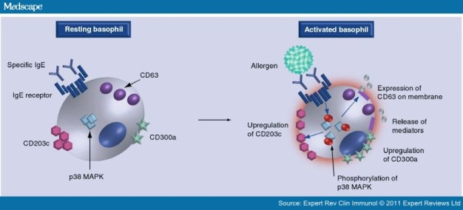
Basophil activation test

Slide 57
Prognosis
IgE mediated reactions depends on food
  Milk - 42 – 85 % by 8 years of age
  Egg - 80 % by 5 years of age
  Peanut – only 30 % develop tolerance
  Tree nuts – only 20 % develop tolerance
Non IgE-mediated reactions depends when symptoms started
  Early onset i.e. FPIES good prognosis resolves by 3 years of age
  Later onset i.e. eosinophilic oesophagitis poorer prognosis
Notes:
Tolerance required acquired after 12 years of age

Slide 58
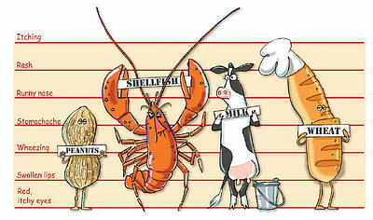
Thank you
Notes:
Questions ?

