Slide 1
Allergic disease in the 21st Century – a modern epidemic
Dr Robert Boyle
MB ChB, PhD Clinical Senior Lecturer in Paediatric Allergy
Imperial College London/St Mary’s Hospital

Slide 2
Aim
To introduce the allergy epidemic, and discuss the epidemiology of allergic diseases

Slide 3
Learning Objectives
Knowledge: To understand the patterns of allergic disease prevalence
Skills: To formulate a hypothesis to explain the recent epidemic of allergic disease
Attitudes: To value the importance of research into the causes of allergic disease

Slide 4
Overview – 3 core questions
What is the allergy epidemic?
What are the possible causes?
How might we intervene to halt the epidemic?

Slide 5
Overview – 3 core questions
What is the allergy epidemic?
What are the possible causes?
How might we intervene to halt the epidemic?

Slide 6
The Allergy Epidemic
BMJ 2004;329(7464):489-90

Slide 7
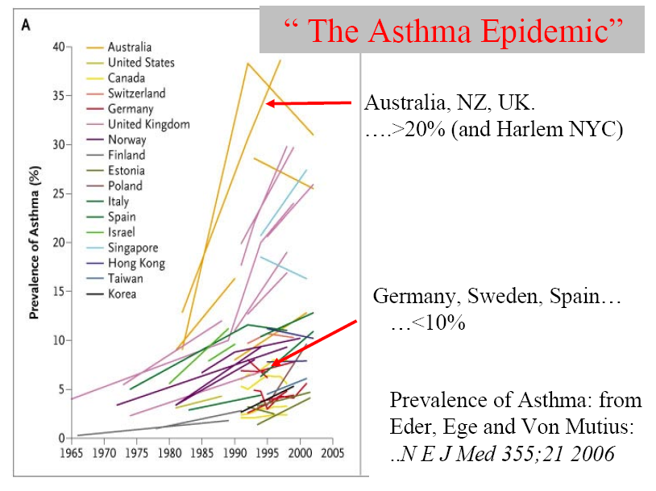

Slide 8
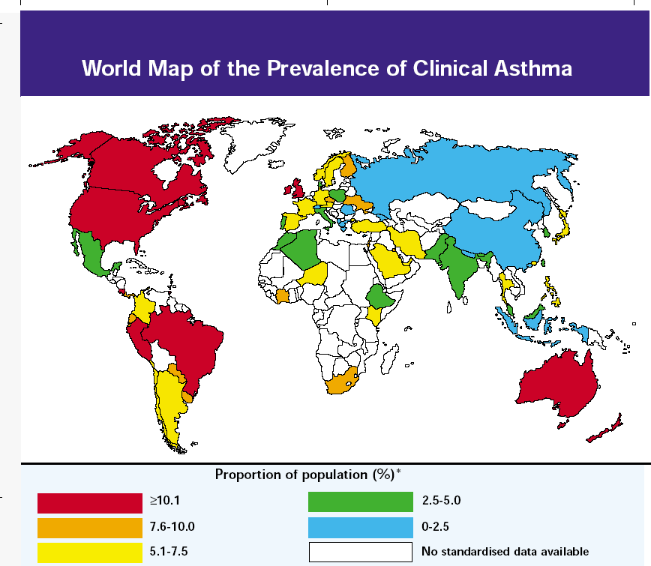

Slide 9
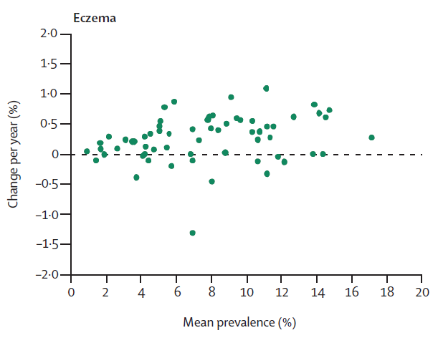
Eczema in 6-7 year old children – ISAAC III
Lancet 2006;368:733-43

Slide 10
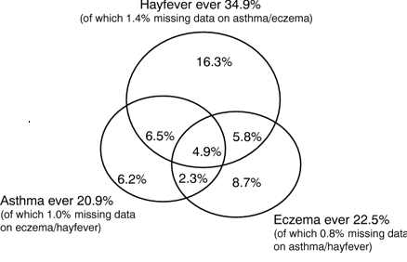
Overlap of Atopic diseases

Slide 11
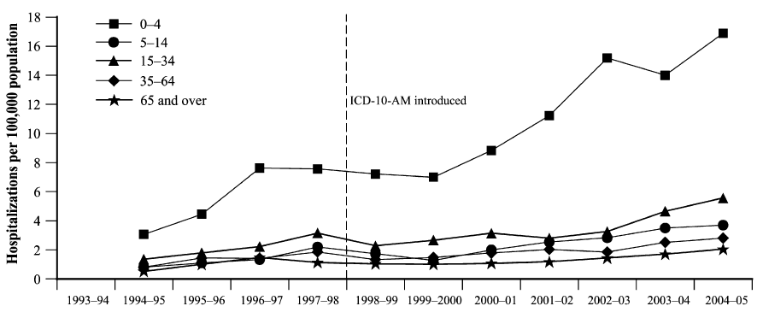
The Allergy Epidemic – Anaphylaxis
J Allergy Clin Immunol 2007;120:878-84

Slide 12
Prevalence of food allergy in 1 year old infants: 2007-10
 | Positive SPT | Positive oral food challenge
Raw egg | 11.7 | 8.9
Peanut | 6.4 | 3.0
Sesame | 1.6 | 0.8
 | Parent reported reaction | Immediate type reaction
Cow’s milk | 6.7 | 2.7
J Allergy Clin Immunol 2011;127:668-76

Slide 13
National Health and Nutritional Examination Surveys II and III
Allergen | NHANES II 1976-1980 | NHANES III 1988-1994
Ragweed | 12.5 | 26.2
Ryegrass | 5.8 | 26.9
Oak | 5.2 | 13.2
Bermuda grass | 4.5 | 18.1
Cat | 3.1 | 17.0
A.alternata | 4.5 | 12.9
At least 1 allergen | 21.8 | 41.9
J Allergy Clin Immunol 2005;116:377-83

Slide 14
Early and Late Phase IgE responses
Y
Y
Y
Y
Y
Preformed mediators
Newly formed mediators
Immediate response
Mast
Y
Y
Y
Y
Cytokines
Cytokines
Th2
cell
Late response
IL5
Eos
MBP
ECP
APC

Slide 15
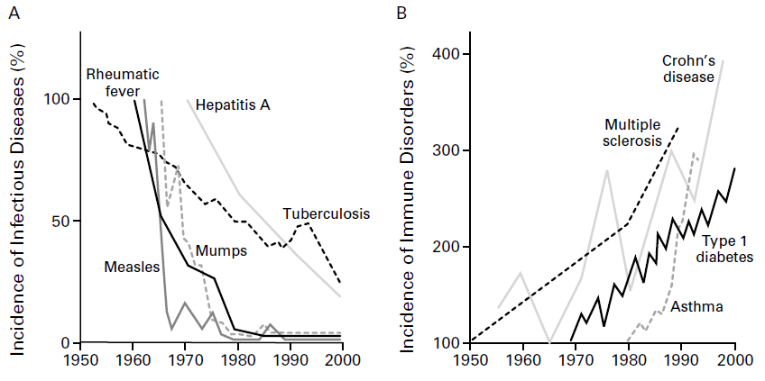
The Immunopathology Epidemic
N Eng J Med 2002;347:911-20

Slide 16
Overview – 3 core questions
What is the allergy epidemic?
What are the possible causes?
How might allergy be prevented?

Slide 17
Genetic Predisposition
Twin studies
Asthma risk – estimated 73% inherited¹
Concordance for eczema risk:
0.23 dizygotic twins
0.72 monozygotic twins²
¹Eur Resp J 1999;13:8-14 ²J Am Acad Dermatol 1993;28:719-23

Slide 18
Defective Skin Barrier
Nat Genet 2006;38:441-6

Slide 19
Defective Skin Barrier
Filaggrin gene defects present in ~ 10% of European
population
Associated with:
OR of eczema 1.99
OR of allergic sensitisation 1.91
Increased risk for allergic rhinitis (in those with or
without eczema)
Increased risk for asthma (only in those with eczema)
BMJ 2009;339:b2433; J Allergy Clin Immunol 2009;123:911-916

Slide 20
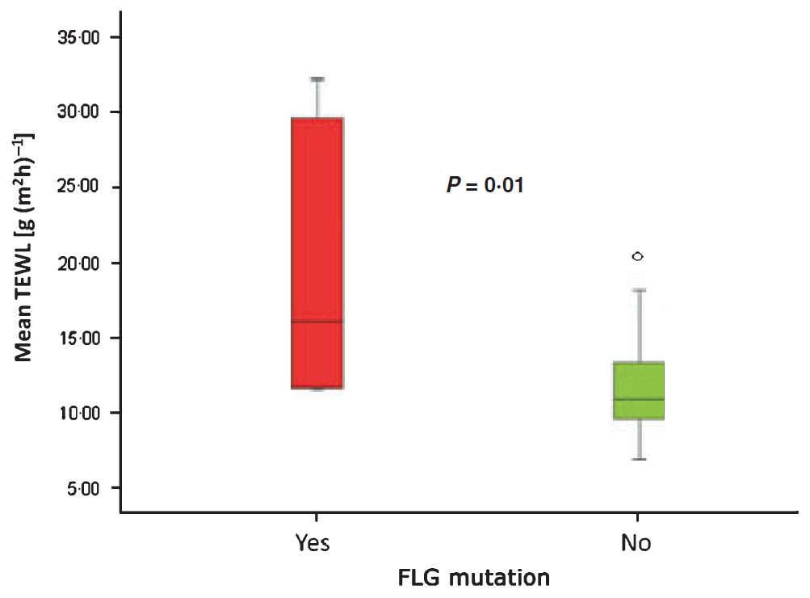
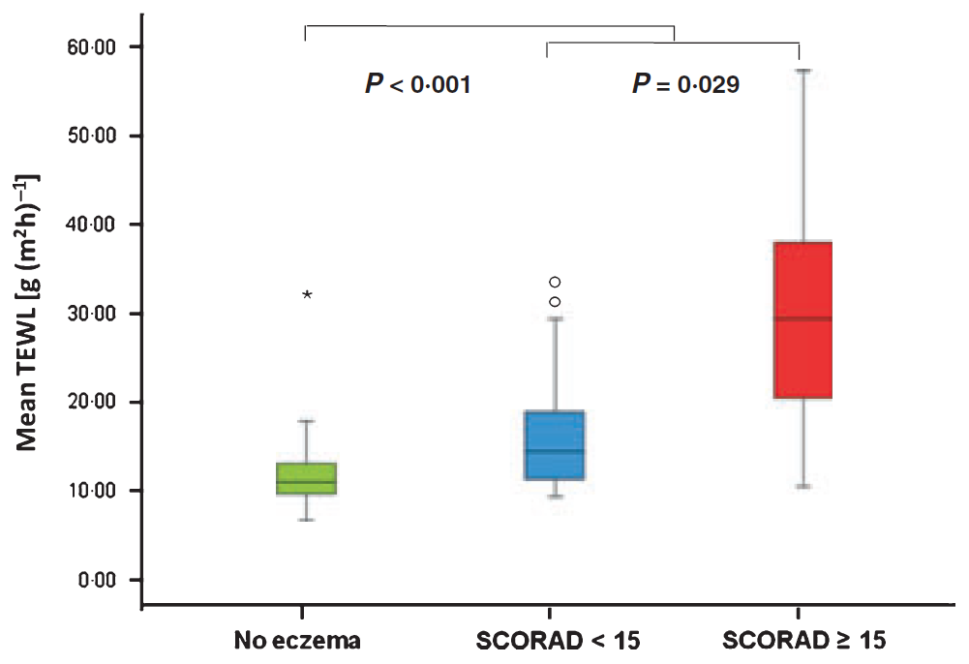
Skin barrier function
Br J Dermatol 2010:163(6):1333-6

Slide 21
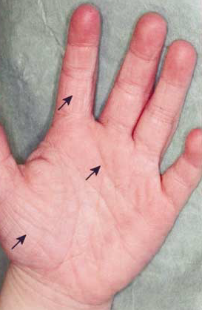

Slide 22
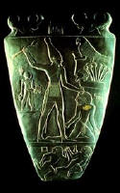

Slide 23
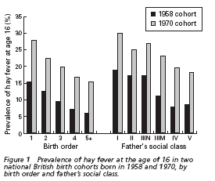
BMJ 1989;299:1259-60

Slide 24
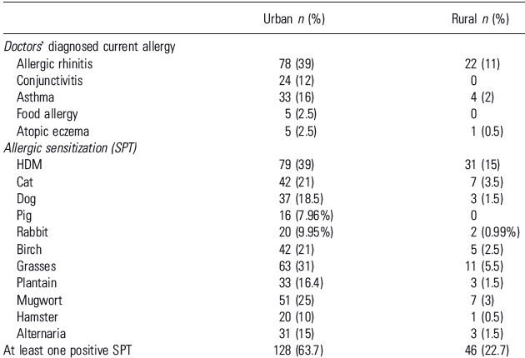
Allergy 2007;62:1044-50

Slide 25
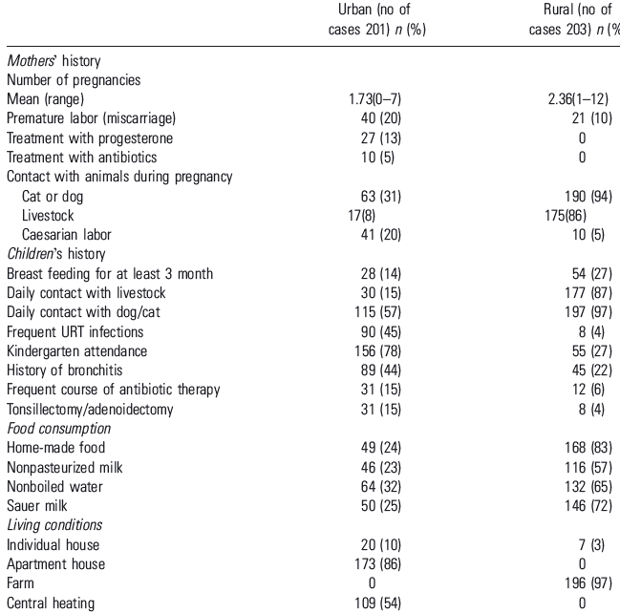
Allergy 2007;62:1044-50

Slide 26
Urban Developed vs Urban Underdeveloped
Germany
West East
Asthma/Hayfever 5.9 3.9
Atopy 36.7 18.2
BHR 8.3 5.5
Bronchitis 3.7 16.7
Germany
Am J Resp Crit Care Med 1994;149:358-64

Slide 27
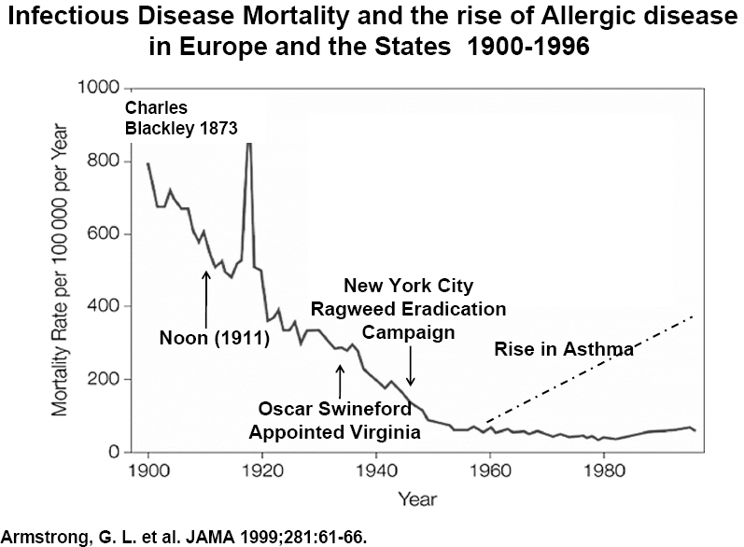

Slide 28
The anthroposophic life-style
PARSIFAL study
Prevention of Allergy - Risk factors for Sensitisation
in children related to Farming and Anthroposophic Life style
“Allergic Disease and Sensitization in
Steiner School Children”
Journal of Allergy & Clinical Immunology
January 2006
Rudolf Steiner
6,600 from five European countries ages 5 to 13 yr
Restrictive use of antibiotics and fever antipyretics
No combined measles, mumps, rubella vaccination.
Organic or biodynamic food and spontaneously fermented vegetables
Significant reduced risks for rhinoconjunctivitis, atopic eczema, and atopic sensitization

Slide 29
Farming environments confer protection against the development of allergy

Slide 30
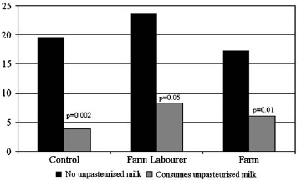
Effect of Unpasteurised Milk
% Positive skin prick test
J Allergy Clin Immunol 2006;117:1374-81

Slide 31
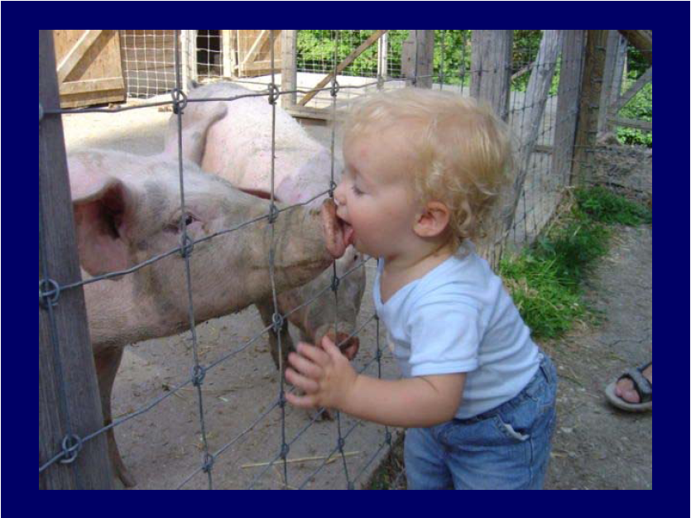

Slide 32
Overview – 3 core questions
What is the allergy epidemic?
What are the possible causes?
How might we intervene to halt the epidemic?

Slide 33
Hierarchy of evidence…
Overview of systematic reviews
Expert panel guideline
RCT
Systematic review
RCT
Meta-analysis
RCT
RCT
Observational studies
Expert opinion
BMJ 2001;323:334-6

Slide 34
Primary prevention of eczema - overview of systematic reviews
All systematic reviews of interventions for preventing eczema, up
to August 2010
7 reviews identified – 39 RCTs; 11,897 participants
Interventions with relevant systematic review(s) were:
Exclusive breastfeeding
Hydrolysed protein formula
Soy formula
Maternal antigen avoidance
Omega 3/6 oil supplementation
Prebiotics
Probiotics
Evid.-Based Child Health 2011;6:1322-39

Slide 35
Interventions (no trials; no participants) | RR (95%CI) | Heterogeneity (%)
Exclusive breastfeeding ≥6 vs 3-6 months (2;3731) | 0.75 [0.42, 1.32] | 61
Hydrolysed formula vs cow’s milk formula (8;1478) | 0.87 [0.70, 1.08] | 0
eHF vs cow’s milk formula (3;912) | 0.84 [0.58, 1.23] | 19
pHF vs cow’s milk formula (7;823) | 0.92 [0.72, 1.17] | 0
Soy formula vs cow’s milk formula (3;744) | 1.23 [0.99, 1.53] | 0
Maternal antigen avoidance vs standard diet (3;360) | 0.95 [0.63, 1.44] | 21
Omega-3 vs placebo (2;664) | 1.10 [0.78, 1.54] | 45
Omega-6 vs placebo (2;259) | 0.80 [0.56, 1.16] | 0
Prebiotic vs no prebiotic (2;432) | 0.79 [0.21, 2.94] | 80
Probiotic vs no probiotic (6;1492) | 0.85 [0.66, 1.08] | 46

Slide 36
Skin barrier function
3 of 20 (15%) infants with high familial risk of eczema developed the
disease, when treated from birth with Cetaphil emollient daily²
Pilot RCTs of emollient for eczema prevention:
UK - ISRCTN84854178
Japan - UMIN000004544
 | Eczema | No Eczema | OR | P
¹Vaseline use | 30/49 (61%) | 52/63 (84%) | 0.33 (0.14, 0.80) | 0.02
¹Trop Doct 1991: 21(3): 104-6.
²J Am Acad Dermatol 2010: 63(4): 587-93

Slide 37
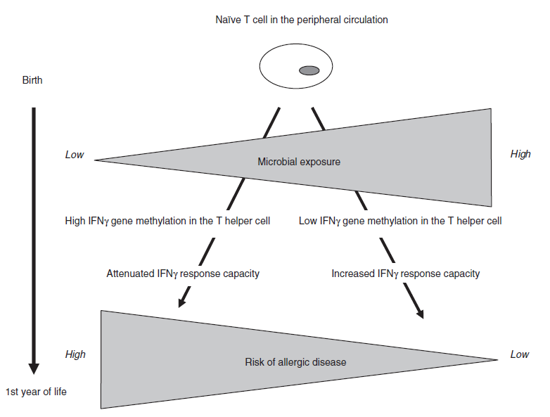
Promotion of immune development
Allergy 2009;64:348-53

Slide 38
Summary
Allergic diseases are the commonest chronic disease of
childhood in UK
There has been a recent increase in prevalence
Reasons unclear, but may relate to early life microbial
exposure or diet
Major focus on strategies for primary prevention of
allergic disease

