Slide 1
Study design and data interpretation
Robert Boyle MB ChB PhD
Clinical Senior Lecturer in Paediatric Allergy
Imperial College, London

Slide 2
Learning Objectives
Knowledge – to understand the main types of study design and their strengths and weaknesses
Skills – to be able to appraise the results of a research study
Attitudes – to value the role of data analysis and study design in research, and recognise some common weaknesses

Slide 3
Overview
Introduction to main types of study design
Overview of levels of evidence
Case studies

Slide 4
Overview
Introduction to main types of study design
Overview of levels of evidence
Case studies

Slide 5
Types of study design
All Studies
Do you wish to simply describe, or make comparisons
Descriptive
Analytic
Do you wish to make an active intervention as part of the study
Survey
(Cross sectional)
Qualitative
Intervention trial (usu.randomised)
Observational study
Cohort
Cross sectional (analytic)
Case control

Slide 6
Formulating a hypothesis
Descriptive studies:
Population + Outcome
Analytic studies:
Population
Intervention or Exposure
Comparison
Outcome

Slide 7
Overview
Introduction to main types of study design
Overview of levels of evidence
Case studies

Slide 8
Data synthesis and expert opinion
Expert panel guideline
RCT
Systematic review
RCT
Meta-analysis
RCT
RCT
Observational studies
Expert opinion
BMJ 2001;323:334-6

Slide 9
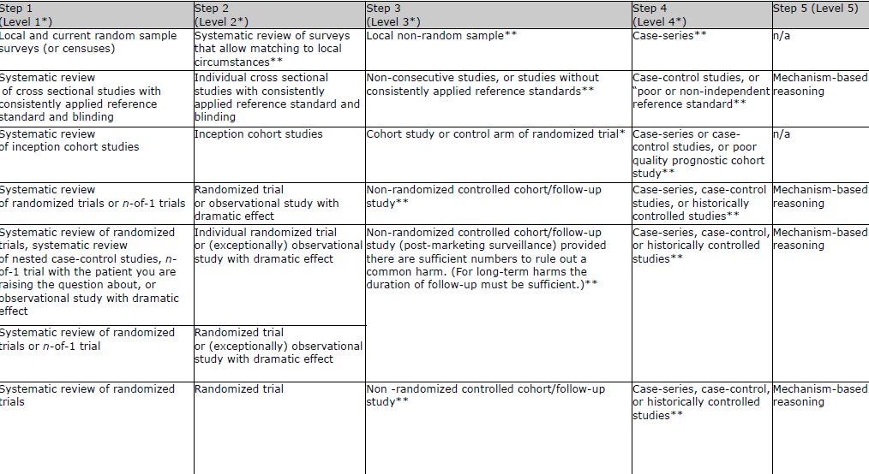
Levels of Evidence
http://www.gradeworkinggroup.org/

Slide 10
Evidence Based Medicine – Guidelines
Validity – source, date, use of evidence levels
Local context – disease burden, cost effectiveness
Local barriers – patients (belief/culture), organisations (law, authority, tradition)
Consistency – internal, and between guidelines
Sackett et al. Evidence Based Medicine 2nd edition

Slide 11
Register a RCT
http://www.who.int/ictrp/en/
Australian New Zealand Clinical Trials Registry (ANZCTR) Brazilian Clinical Trials Registry (ReBec)
Chinese Clinical Trial Registry (ChiCTR) Clinical Research Information Service (CRiS), Republic of Korea
Clinical Trials Registry - India (CTRI) Cuban Public Registry of Clinical Trials(RPCEC)
EU Clinical Trials Register (EU-CTR) German Clinical Trials Register (DRKS)
Iranian Registry of Clinical Trials (IRCT) ISRCTN.org
Japan Primary Registries Network (JPRN)(in Japanese) The Netherlands National Trial Register (NTR)
Pan African Clinical Trial Registry (PACTR) Sri Lanka Clinical Trials Registry (SLCTR)

Slide 12
Common weaknesses in RCTs
Wrong hypothesis/ outcome measure/ design
Poor randomisation/ failure to stratify
Inadequate sample size
Blinding/ allocation concealment/ loss to follow-up
Analyses – repeated measures/ multiple outcomes
No compliance measures (negative studies)
Conflict of interest present or not declared
Semin Neonatol 2000;5:141-8

Slide 13
Overview
Introduction to main types of study design
Overview of levels of evidence
Case studies

Slide 14
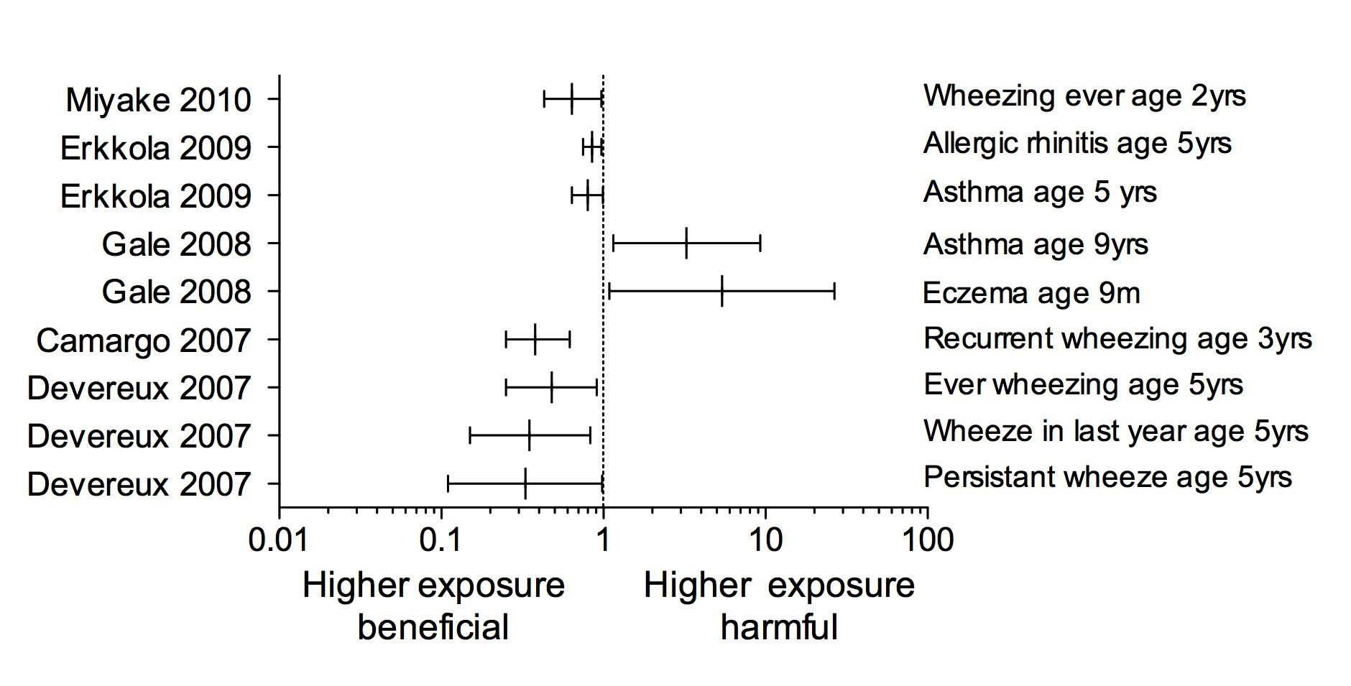
Vitamin D for preventing allergic disease
Curr Resp Med Rev 2011;7:396-403
Notes:
Work by Camargo – OD of 0.38 (significant) for recurrent wheezing
But this data based on dietary intake. We know that diet makes relatively little comtribution, and blood levels of 25(OH)VD are the gold standard measurement.
In fact where bld levels were measured they showed adverse outcomes with inceased asthma at 9ys and eczema at 9m
Objective: To test the hypothesis that prenatal vitamin D supplementation can prevent early childhood wheezing

Slide 15
Probiotics for Treating Eczema
Ann Allergy Asthma Immunol 2008;101:508-516

Slide 16
Case Studies
Organic baby food for preventing allergy
Identify genetic determinants of IgE production, using human B cells
Validate a new diagnostic test for bacterial infection in febrile children
Prevention of neonatal pertussis
Identification of the key cause(s) of the allergy epidemic
Descriptive study……Case-control……Cohort……Intervention……

