Slide 1
Asthma: basic mechanisms and management
J.O. Warner

Slide 2
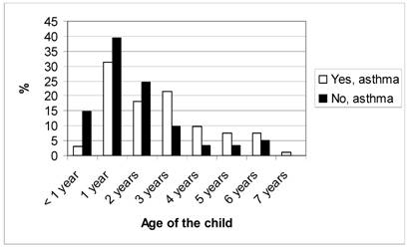
Age of first wheeze and asthma at 10 years
Eduardo Roel et al Int J Med Sci 2009; 6:348-357

Slide 3
Wheezing pheno-types
(Henderson et al Thorax 2008;63:974-80)
Prevalence %
Associated with allergy
20
Late onset 16%
Transient 16%
Early prolonged 9%
10
Persistent 7%
Intermediate onset 3%
Age in years
1
2
3
4
5
Allergy tests will facilitate prognosis and therefore treatment.

Slide 4
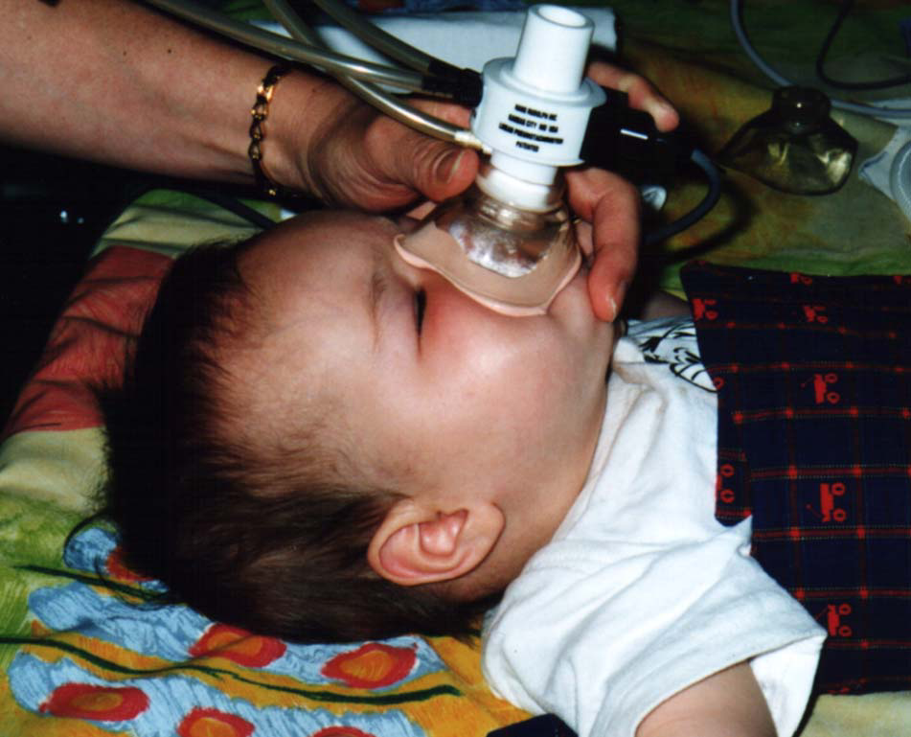

Slide 5
Normal rapid thoracic compression flow volume loop
Vmax FRC

Slide 6
Loop from a 4 week infant of a maternal smoker who wheezed by 6 months

Slide 7
Ontogeny of Asthma
Bronchial hyper-responsiveness (BHR) at 1 month of age associated with asthma (p<0.001) and abnormal lung function (p<0.01) at 6 and 11 years
  (Palmer et al. AJRCCM 2001:163:37-42;
  Turner et al AJRCCM 2004;169:921-7)
Outcome of childhood asthma at 21 years of age predicted by abnormal BHR and lung function at 7 years
(Gerritsen et al. Am. Rev. Resp. Dis. 1989:140:1325)
Independent of allergy

Slide 8
Lung function trends
(% of predicted)

Slide 9
Children with asthma at 5 years
%
100
90
80
70
60
50.2
50
40
28.1
30
20
12.2
10
0
FH - AD -
AD +
FH + AD +
FH = Atopic Family History
AD = Atopic Dermatitis
Bergmann et al. Clin Exp Allergy 1998;28:965-970.

Slide 10
Asthma severity and allergy.
Carroll et al Arch Dis. Child. 2006;91:405-9

Slide 11
Food allergy and asthma.
Food allergy is a risk factor for life-threatening asthma in children. (OR=8.58, 95%CI=1.85-339). (Roberts et al JACI 2003;112:168-74)
Asthma is a risk factor for deaths from food induced anaphylaxis. (Sampson et al N. Eng J. Med 1992;327:380-4)
Food allergy is a risk factor for brittle asthma in adults. (Miles et al Clin Exp Allergy 1995;25:1074-82)

Slide 12
Allergy onset and asthma persistence.
50
%
40
30
20
10
0
Current wheeze Bronchial hyper-responsive
Early onset atopy < 8 years
Late onset atopy 10-14 years
Non-atopic by 14 years.
Peat et al JACI 1990;85:65-74

Slide 13
Allergen challenge and Asthma

Slide 14
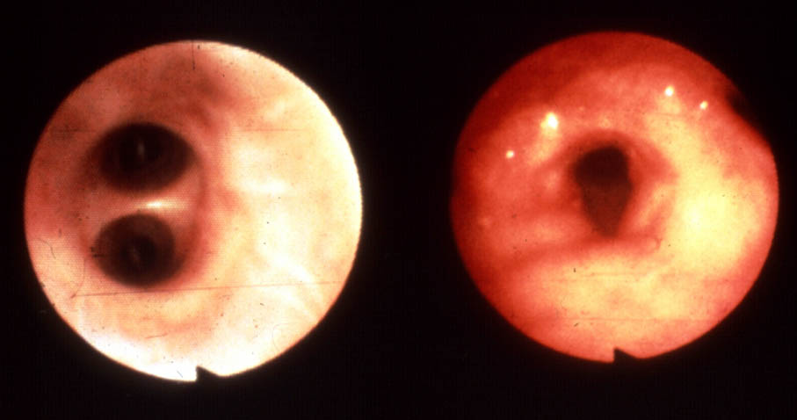
Bronchoscopic Appearance of Airways
Normal Asthma

Slide 15
Bronchial allergen challenge dual reaction.
100
Lung function as a % of predicted
90
80
Allergen
0
10
20
30
1
4
8
12
Minutes
Hours
Warner JO Arch Dis. Child 1976;51:905-11

Slide 16
Effects of β-agonist on immediate and late allergen induced reactions.
100
Effect of β-agonist
Lung function as a % of predicted
90
80
0
10
20
30
1
4
8
12
Minutes
Hours

Slide 17
Effect of prior ICS on bronchial allergen induced dual reaction.
100
Lung function as a % of predicted
90
80
0
10
20
30
1
4
8
12
Minutes
Hours

Slide 18
Late allergen induced bronchial responses;
Enhance bronchial hyper-responsiveness for up to 2 weeks.
Are associated with early airway neutrophilia and later eosinophilia.
Cause small airway narrowing.
Occur in asthmatics with more severe disease.
A model of persistent asthma.

Slide 19
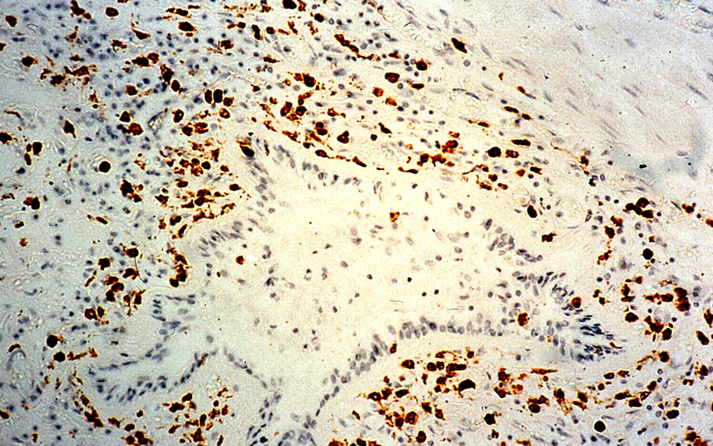

Slide 20
Eosinophils in lamina propria in pre-school wheezers with or without later asthma.
Pohunek et al Pediatr. Allergy Immunol 2005:16:43.51
No asthma
Asthma

Slide 21
Allergy shots; immunotherapy.

Slide 22
Specific immunotherapy for asthma.
A meta –analysis.
Compared with placebo significant improvements in;
Asthma symptoms
Medication needs
BHR
(for house dust mite; pollens; cat and dog)
No head to head comparisons with pharmaco-therapy particularly in relation to risk/benefit profiles.
Abramson et al Cochrane library; Issue 3; 2001

Slide 23
Allergic Rhinitis and Asthma
58% of patients with asthma have associated allergic rhinitis¹
38% patients with allergic rhinitis also have asthma²
Rhinitis preceded asthma in 59-85% patients with both conditions ²
1. Walsh et al Mayo Clinic Proc 1987;62:125.
2. Pederson et al. Allergy 1983;38:25-29.
Notes:
23
Significance?
Nasal inflammation is a marker for increasing dysfunction of the entire respiratory tracj
allergic rhinitis contributes to asthma
TO address cause and effect relationship need to look at studies of allergic rhinitis therapy in asthma

Slide 24
PAT study follow-up
p<0.05
p<0.05
number of children
Möller et al J Allergy Clin Immunol 2002
Niggemann et al Allergy 2006

Slide 25








IgE a worthy therapeutic target
IgE
IgE
IgE production
FCεR1
Omalizumab complexes with circulating IgE
MAST cell
Omalizumab blocks IgE binding with reduced FCεR1 density

Slide 26
Mechanisms of action.
(Established and likely)
Reduced circulating IgE.
Reduced FCεR1 density.
Reduced MAST cell and basophil activation.
Reduced IgE facilitated antigen presentation.
Reduced pro-inflammatory mediators including ICAM1

Slide 27
Reduction in asthma exacerbation rates.
0.039 <0.001 0.027 <0.001 <0.001 0.165 0.077

Slide 28
Paediatric study (6-12 years)
First 24 weeks – primary analysis
Second 28 weeks
Δ –31%
p=0.007
Δ –54.2%
p<0.001
1.0
0.8
0.6
0.4
0.2
0
1.0
0.8
0.6
0.4
0.2
0
Omalizumab
(n=384)
Placebo
(n=192)
Omalizumab
(n=384)
Placebo
(n=192)
Notes:
Patients treated with omalizumab experienced a significantly lower rate of clinically significant asthma exacerbations compared with placebo at Week 24 (0.45 vs 0.64) which equated to a 31% reduction (rate ratio [RR], 0.69 [95% CI: 0.53, 0.90]; p=0.007). The improvement in exacerbation rate in omalizumab-treated patients compared with placebo was maintained during the subsequent 28 weeks of treatment (p<0.001).

Slide 29
Allergy and asthma
Allergy in the child and family is the major risk factor for asthma.
Early onset allergy is a poor prognostic factor for childhood asthma.
Allergens incite an asthmatic reaction.
Severity of asthma is associated with degree of allergy and with food allergy.
Anti-IgE improves asthma.
Allergen immunotherapy modifies long term outcomes.
BUT………

Slide 30
Attributable fraction of asthma due to atopy.
France
U.K.
Australia
Sunyer et al from ECRHS JACI 2004;114:1033-9

Slide 31
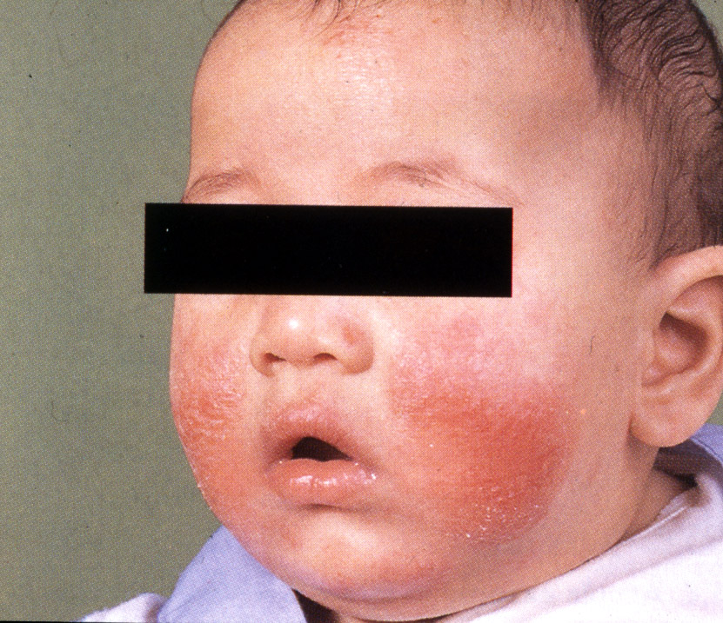
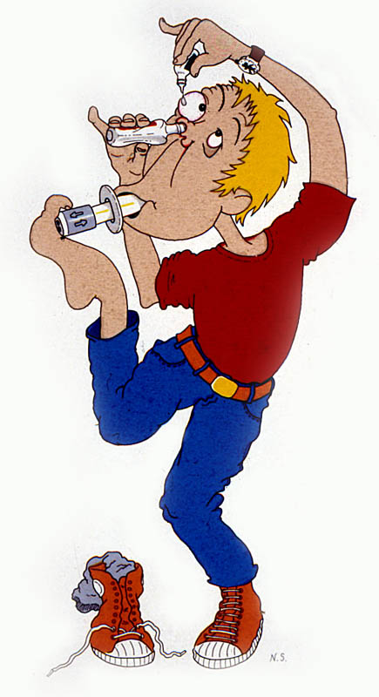
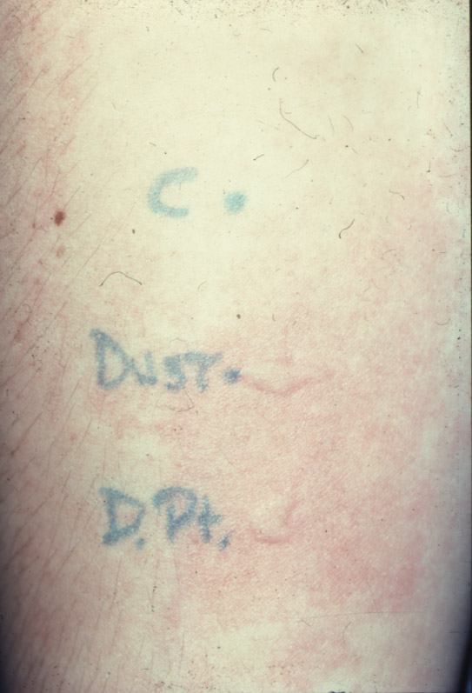
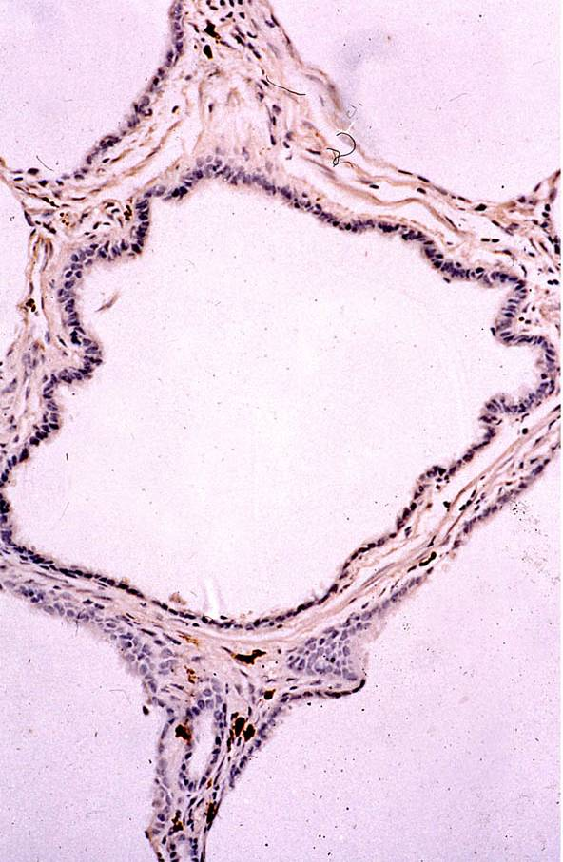
?

Slide 32
Asthma; inflammation and airway wall remodelling
Notes:
Remodelling denotes the structural changes in the asthmatic wall
Here we have an image of the remodelled airway in asthma compared to a normal airway.
In the remodelled airway there is
Generalised Airway wall thickening
Mucus metaplasia (resulting in increased muscus hypersectrtion and narrowing of the lumen)
Epithelial damage
Subepithelial fibrosis below the bm (collagens 1,3,5, laminin, tenascin and fibronectin
Ecm changes including destruction and fibrosis
Incrased inflammatory cell infiltration
Smooth muscle cell hypertrophy and hyperplasia
These changes were described over 75 years ago in patients with fatal asthma

Slide 33
Lamina reticularis thickness in pre-school wheezers with or with out later asthma.
Pohunek et al Pediatr. Allergy Immunol 2005:16:43.51
No asthma
Asthma

Slide 34
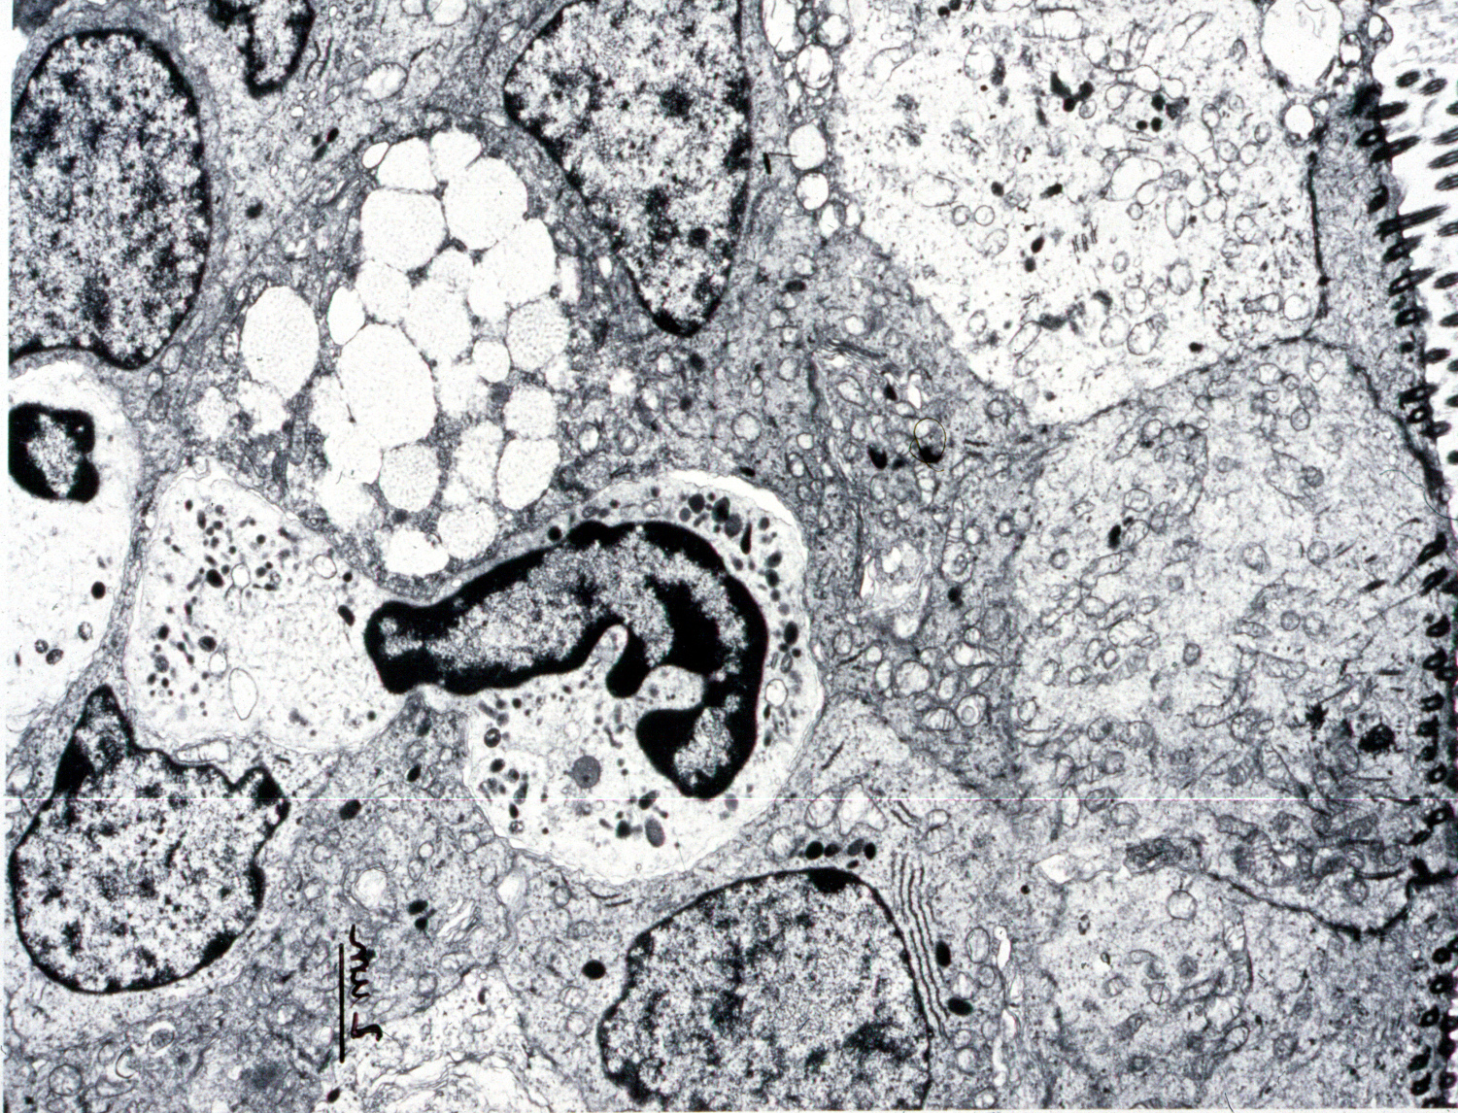
Neutrophils and asthma.
CILIA
NEUTROPHIL
BRONCHIAL
EPITHELIUM

Slide 35
Broncho-alveolar lavage neutrophils and asthma
Increased neutrophils in BAL from infant wheezers and asthmatics.
BAL neutrophils correlate with wheeze severity.
BAL IL-8 levels correlate with neutrophil numbers.
BAL neutrophils correlate with oxidised protein, MMP-9 and TGF-β1 levels.
Marguet et al Am.J.Resp.C.C.M.1999;159:1533
and Pediat.Allergy Immunol.2001;12:27

Slide 36
Effect of instilled TGF-β1 on airway fibrosis in mice.
Matrix protein staining score
Kenyon et al Thorax 2003;58:772-7

Slide 37
Age and allergen induced airway changes in Brown Norway rats.
μm of
Fibro-
nectin
per
μm of
BM
Age at immunisation
Palmans et al AJCCM 2002;165;1280-1284

Slide 38
Airway matrix modelling/remodelling in asthma.
MMP-9 from neutrophils
TIMP-1 inhibits MMP-9
Fibroblast stimulation and accumulation of matrix collagens.
Matrix breakdown to facilitate cell traffic. Release of cytokines.
Matrix re-modelling
TGF-β release
Notes:
It is proposed that inflamatory cells in the airway release proteases such as MMP-9 lead to breakdown of the matrix.
This then leads to inappropriate repair mechanisms such as the profibrotic gf TGFb AND TIMP (THE COGNATE INHIBITORS OF MMPs) which cause accumulation of the matrix and possibly fibrosis
enzymes such as MMPS break up the lung matrix during inflammation
Poorly understood mechanisms lead to activation of inappropriate repair processes which are thought to involve enz like TIMPS and GF such as TGF-β
Through various signalling pathways this is thought to lead to increased matrix deposition and structural changes in the airways

Slide 39
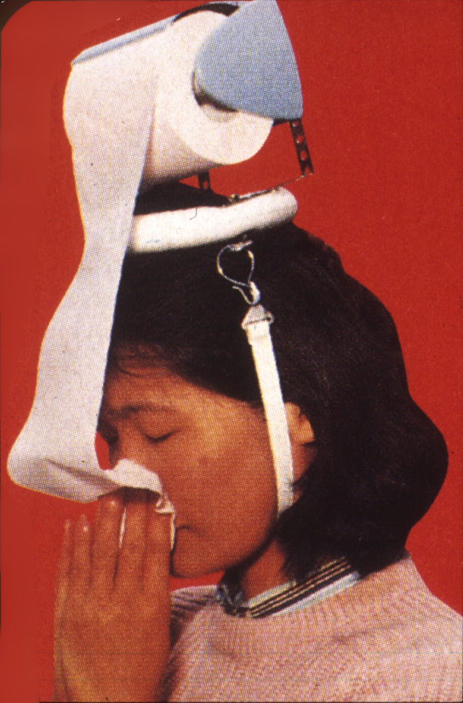
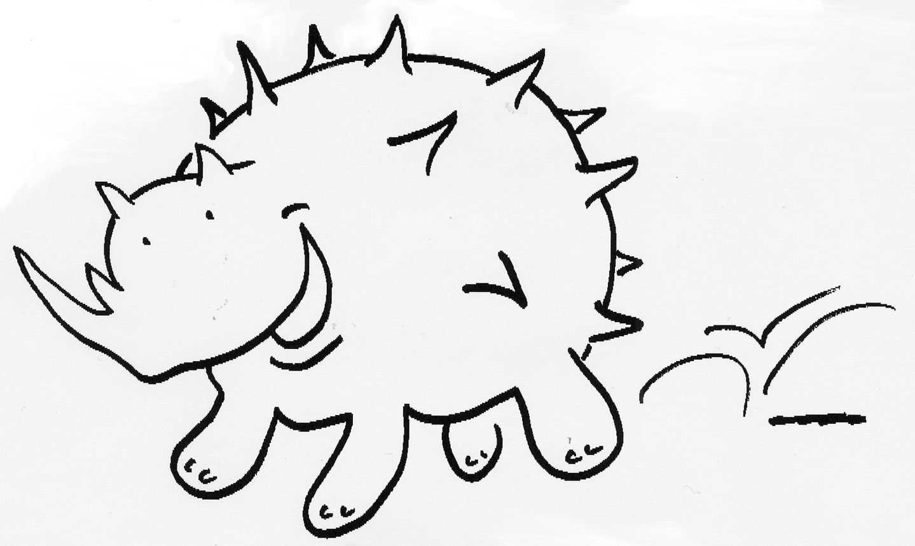

The rhinovirus

Slide 40
Virus induced wheeze in infancy and asthma at 6 years.
COAST study. Jackson et al Amer. J Crit. Care Med. 2008;178:667-72

Slide 41
Rhinovirus RNA in nasal lavage after acute asthma.
100
75
50
25
0
%
82
44
25
6 weeks 6 months
Kling et al Clin. Exp. Allergy 2005;35:672-8

Slide 42
Asthma exacerbation, allergy and viruses.
Sensitised + - + + +
Exposed - - + - +
Virus - + - + +
Murray et al Thorax 2006;61:376-82

Slide 43
Up-regulation of ICAM-1
Rhinovirus
Allergen
ICAM-1
I-κB
degradation
Pro-
inflammatory
mediators
Oxidant generation
NF-κB

Slide 44
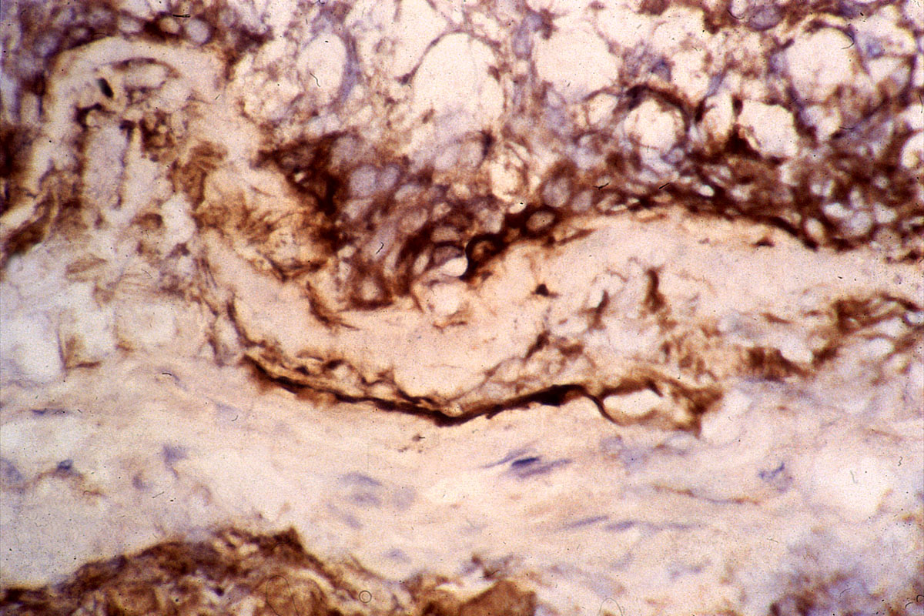
Bronchial Biopsy Stained for ICAM-1 (in brown)

Slide 45
sICAM at presentation in transient and persistent wheeze

Slide 46
Normal epithelial cell response to rhino-virus - up-regulation of IFN-β
Rhinovirus
ICAM-1
No more viral uptake or replication
Apoptosis
IFN-β

Slide 47
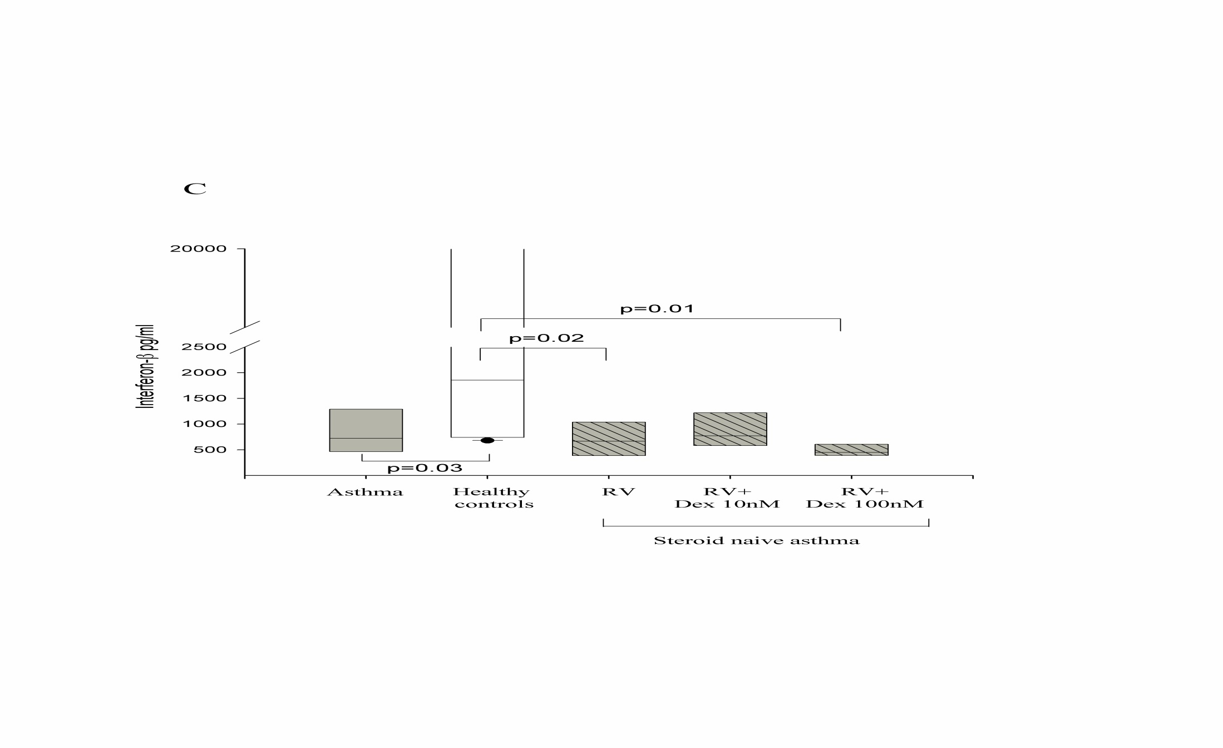
IFN-β in epithelial cell culture supernatants
Wark et al J. Exp. Med 2005;201:937-47

Slide 48
No rhino-virus induced up-regulation of IFN-β in asthma.
Rhinovirus
ICAM-1
Virus replication and cell lysis.
Apoptosis
IFN-β
Wark et al J. Exp. Med 2005;201:937-47

Slide 49

Choice of therapy is dictated by;
Knowledge of the natural history.
Understanding the basic mechanisms.
Age.
Severity.
Co-morbidities.

Slide 50
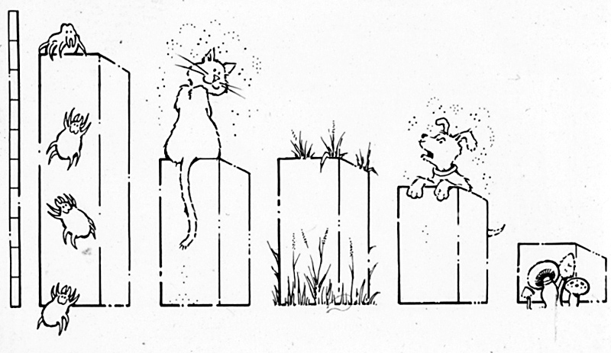
Avoidance of triggers.

Slide 51
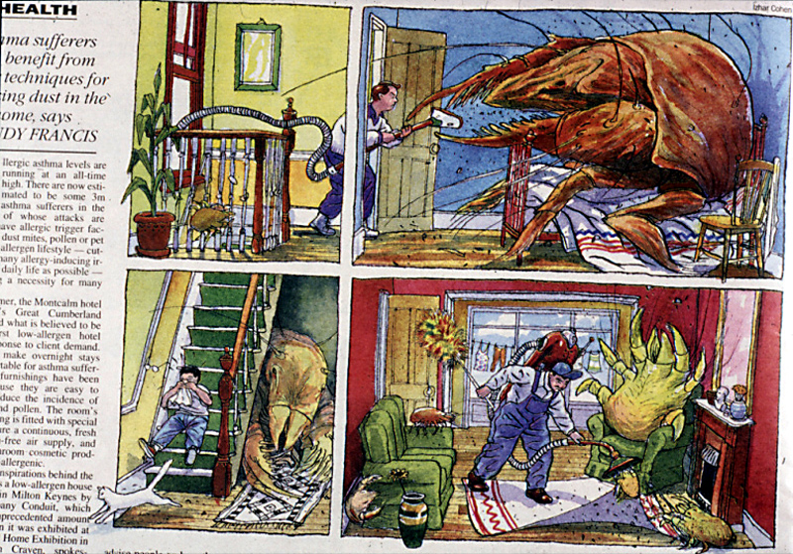

Slide 52
House mite avoidance.
A meta-analysis
There is not enough evidence to show that current (single modality) chemical and physical methods aimed at reducing exposure to house dust mite allergens are effective in reducing the severity of asthma.
Heterogeneity of outcomes suggest that physical methods may be effective.

Slide 53

The ideal mite free environment

Slide 54
Schooling at high altitude and asthma
Total IgE (IU/ml)
100
Methacholine PD20 (ug)
600
80
40
400
60
200
20
October January June October
Total IgE
PD20
Warner and Boner 1988

Slide 55
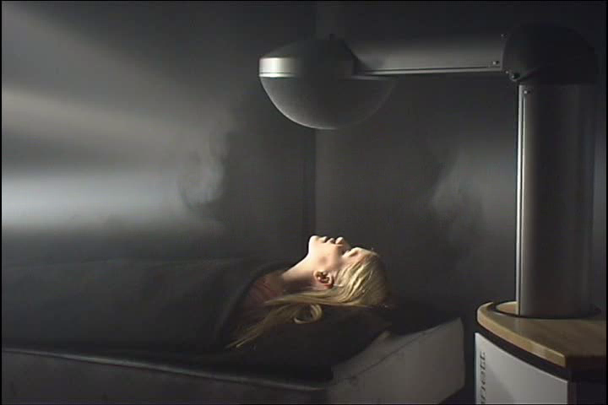
A novel environmental control system

Slide 56
Nocturnal environmental control trial;
Quality of life improvements over 1 year
p=0.02
p=0.04
80 %
76 %
61 %
64 %
Placebo
Placebo
TLA
TLA
ITT
ITT <12yrs
OR = 1.92
OR = 5.57

Slide 57
Exhaled NO change from baseline
All participants
Participants with FENO >45ppb
Mean
change
[ppb]
10
Mean
change
[ppb]
10
5
5
4.06
0
0
P=0.03
-2.30
-5
-5
-6,44
-10
-10
P=0.03
-15
-15
-20
-20
-25
-25
-27.3
-30
-30
-35
-35
0 3 12 months
0 3 12 months
Placebo, N=75
TLA, N=159
Placebo, N=24
TLA, N=56
Notes:
57

Slide 58
Other allergens.
No evidence base from which to recommend any other form of allergen avoidance.
Cat/dog allergic patients are advised to remove pets from their homes.
BUT
BTS/SIGN 2002

Slide 59
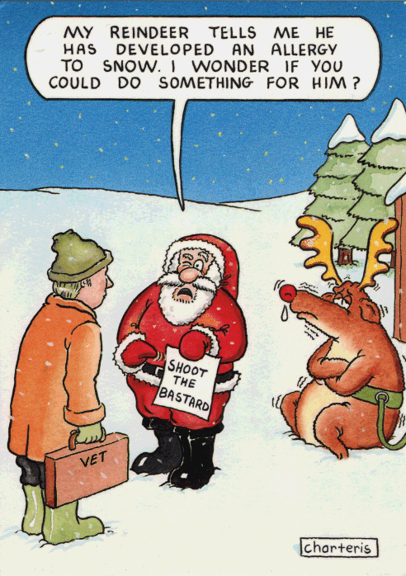

Slide 60
Other non-pharmacological approaches.
Patient/parent smoking cessation is good for health and decreases the asthma severity and ICS responsiveness.
No evidence base to recommend any form of complementary medicine or dietary supplements.
In difficult asthma there may be a role for family psycho-therapy.
Weight reduction the obese may improve asthma.
Anti-reflux treatment improves reflux not asthma

Slide 61
Therapy for different phenotypes of asthma
Intermittent = Transient infection induced and non-allergic.
Treat to improve quality of life.
Persistent = Abnormal lung function between episodes and often allergic.
Treat to control airway inflammation and quality of life.

Slide 62
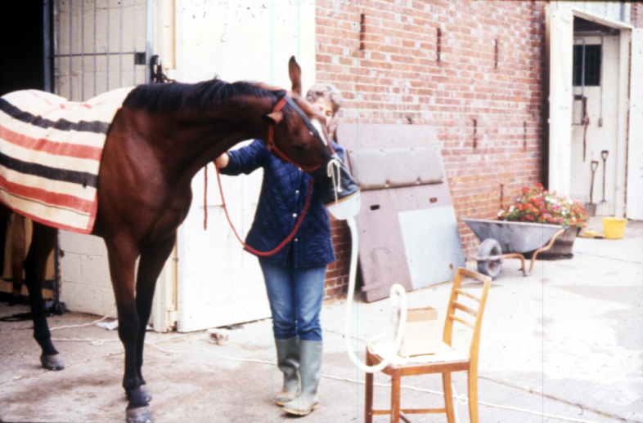
Pharmaco-therapy
Efficacy and side effects dictated by:
Age
Stage in disease evolution.
Disease genotype and phenotype.
Pharmaco-genetics.
i.e. Horses for courses!

Slide 63
Approach to β-agonist therapy
Minimise need for short-acting preparations.
Only use LABAs if moderate dose ICS combined with LTRAs are ineffective.
Frequent use of SABAs means poor control and requires step-up of therapy.

Slide 64
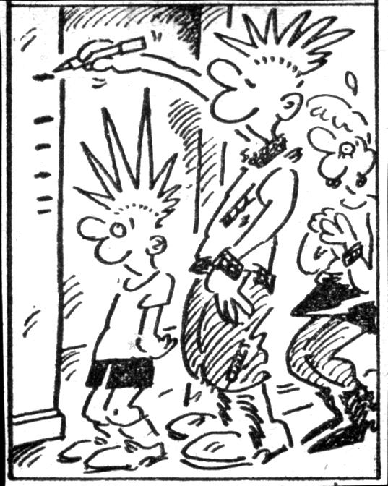

Slide 65
Growth
Asthma causes severity related delay in pubertal growth but not stunting of ultimate height.
ICS cause dose related short term growth suppression at >400μg/day of BDP or equivalent.
Long term consequences for bone density unknown.

Slide 66
Growth on budesonide v placebo
N. Engl. J. Med 2012;367:904-12
2
1
Cms.
0
-1
-2
0 2 4 12
Years since randomisation

Slide 67
Dose response for ICS efficacy and systemic activity.
100
Therapeutic response
% probability of effect
Systemic activity
50
200
400
600
800
1000
Micrograms/day of BDP

Slide 68
Strategies to reduce the systemic effects of I.C.S.
Pro-drugs, activated in the airway... Ciclesonide.
Add-on therapy with LABAs and/or LTRAs.

Slide 69
Concordance problems with inhaled corticosteroids
Concordance with inhaled
corticosteroid
(% prescribed
dose)
100
95%
80
58%
60
40
32%
20
0
Reported by
patient / parent
Actual concordance
Doses taken at
correct times
Adapted from Milgrom H et al J Allergy Clin Immunol 1996;98:1051–1057.
Notes:
Slide 4
Although inhaled corticosteroids are widely used in the treatment of childhood asthma, compliance may be less than optimal.
A prospective study specifically assessed compliance in 24 asthmatic children aged 8–12 years who required inhaled corticosteroids and beta-agonists for control and who were thought to be compliant. Although patient diaries reported a compliance rate of 95.4% with inhaled corticosteroids (i.e., that 95.4% of prescribed doses were taken), electronic monitoring of metered dose inhalers (MDIs) revealed that fewer than 60% of doses were actually taken. Moreover, only 31.8% of prescribed doses were taken at the correct time of day. Overall, 92% of patients exaggerated their corticosteroid use.⁸
Likewise, compliance with beta-agonist therapy was also poor. Diary entries stated that median use of beta-agonists was 78.2% of prescribed dose, while electronic monitoring revealed median compliance was 62.1% and that only 48% of doses were taken at the correct time. Overall, 71% of patients exaggerated the use of beta-agonists in their diaries.⁸
It was concluded that not only did these children fail to comply with therapy, but they misrepresented their use and did so with the tacit approval of their parents.⁸

Slide 70
Concordance is an essential component of asthma control
100
p=0.008
Concordance
(%)
80
68.2%
60
40
20
13.7%
0
Children with
stable asthma
(n=16)
Children requiring oral corticosteroid rescue
(n=8)
Adapted from Milgrom H et al J Allergy Clin Immunol 1996;98:1051–1057.
Notes:
Slide 5
Poor compliance in this 13-week study was strongly correlated with loss of asthma control.⁸
Of 8 children who required oral corticosteroid rescue, only 13.7% of their prescribed doses of inhaled corticosteroid were taken, compared with a compliance rate of 68.2% for children with stable asthma, that is, children who did not require corticosteroid rescue (p=0.008). Five of eight children who required courses of oral corticosteroid during the study were among the least compliant, including two who were hospitalised.
These findings suggest that inadequate control of asthma may reflect noncompliance, a problem that is widespread and that may not be confined to obviously uncooperative patients.⁸

Slide 71
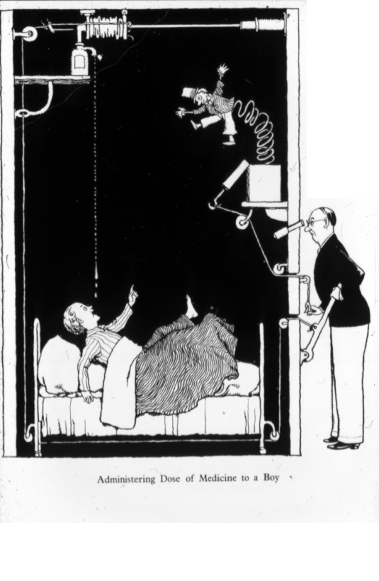

Slide 72
Concordance
REDUCED
Poly-pharmacy.
Multiple doses and devices.
Prolonged therapy.
Poor self image.
Emotional stress.
Peer influence.
INCREASED
Consistency and continuity.
Education.
Packaging.
Sustained action medications
“Aide memoire”

Slide 74
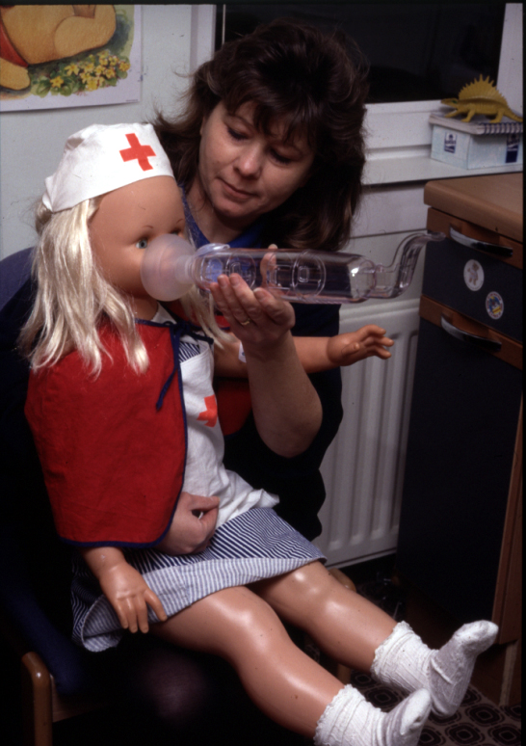

Slide 75
THERAPEUTIC ALGORITHM
FOR ASTHMA
INFREQUENT
INTERMITTENT
INHALED SHORT ACTING
BETA-AGONIST AS REQUIRED
AVOIDANCE OF TRIGGERS

Slide 76
THERAPEUTIC ALGORITHM
FOR ASTHMA
INFREQUENT
INTERMITTENT
INHALED SHORT ACTING
BETA-AGONIST AS REQUIRED
FREQUENT
INTERMITTENT
LTRA OR
LOW DOSE ICS
AVOIDANCE OF TRIGGERS

Slide 77
THERAPEUTIC ALGORITHM
FOR ASTHMA
INFREQUENT
INTERMITTENT
INHALED SHORT ACTING
BETA-AGONIST AS REQUIRED
FREQUENT
INTERMITTENT
LTRA OR
LOW DOSE ICS
MILD
PERSISTENT
ICS (MAXIMUM 4-800µg/DAY)
AVOIDANCE OF TRIGGERS

Slide 78
THERAPEUTIC ALGORITHM
FOR ASTHMA
INFREQUENT
INTERMITTENT
INHALED SHORT ACTING
BETA-AGONIST AS REQUIRED
FREQUENT
INTERMITTENT
LTRA OR
LOW DOSE ICS
MILD
PERSISTENT
ICS (MAXIMUM 4-800µg/DAY)
AVOIDANCE OF TRIGGERS
ADD LTRA BEFORE
LONG-ACTING BETA-AGONIST
MODERATE
PERSISTENT

Slide 79
THERAPEUTIC ALGORITHM
FOR ASTHMA
INFREQUENT
INTERMITTENT
INHALED SHORT ACTING
BETA-AGONIST AS REQUIRED
FREQUENT
INTERMITTENT
LTRA OR
LOW DOSE ICS
MILD
PERSISTENT
ICS (MAXIMUM 4-800µg/DAY)
AVOIDANCE OF TRIGGERS
ADD LTRA BEFORE
LONG-ACTING BETA-AGONIST
MODERATE
PERSISTENT
ORAL STEROIDS; CYCLOSPORIN;
ANTI-IgE; MACROLIDES

Slide 80
