Slide 1
Imperial College
London
January 2013
Tuberculosis
Dr Shobana Dissanayeke
Research Associate
Paediatric Infectious Disease
s.dissanayeke@imperial.ac.uk

Slide 2
Aim
To provide an overview of the characteristics of tuberculosis (TB) and its causative agent (i.e. Mycobacterium tuberculosis - MTB)

Slide 3
Learning outcomes
By the end of this session students should be able to:
Briefly outline the key points in the history of the discovery and treatment of M. tuberculosis
Highlight the main characteristics of M. tuberculosis
List the regions of the world with the highest incidence of TB
Suggest possible reasons for these high endemic areas

Slide 4
Plan
History of TB
Mycobacterium tuberculosis
  The organism – characteristics
Tuberculosis
  The disease – disease manifestations and epidemiology

Slide 5
History of Tuberculosis
“Whatever happened to the good old days: you know, dirty attics, tuberculosis and general all-round suffering?”
Arnold Wesker

Slide 6
Perceptions of TB
It’s from the “olden days”
  Doesn’t exist anymore
Associated with squalor or poverty
  Only found in poor third world countries
Causes suffering

Slide 7
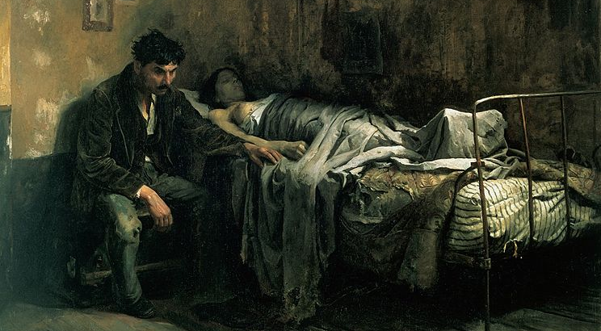

Slide 8
Famous people who’ve had TB
Died:
King Tutankhamen 1358-1340 B.C.
John Keats 1795-1821
Emily Bronte 1818-1848
Robert Louis Stevenson 1850-1894
Eleanor Roosevelt 1884-1962
Suffered from:
Francois Voltaire 1694-1778
Adolf Hitler 1889-1945
Nelson Mandela b.1918
Ringo Starr b.1940

Slide 9
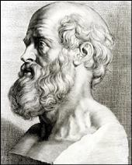
History of Tuberculosis
Consumption, phthisis, scrofula, Pott's disease, and White Plague are all names for tuberculosis
TB is an ancient disease and symptoms of the disease have been found in the remains of Egyptian mummies.
It appears in Chinese and Indian texts from as early as 2700 BC
Hippocrates describes it as a disease most fatal
"I cannot sufficiently admire that anyone, at least after he comes to the flower of his youth, can die without a touch of consumption” (Morton 1700’s)

Slide 10
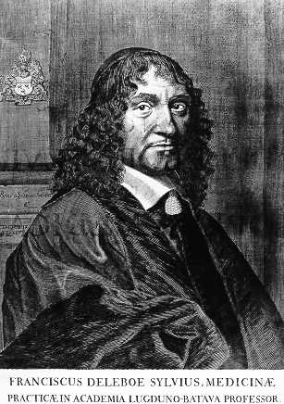
17th century - infectious nature of TB described in Italian literature
1679 – Franciscus Sylvius began differentiating between the various forms of tuberculosis.
1720 Benjamin Marten, a British physician was first to hypothesise that TB is caused by “wonderfully minute living creatures”
19th century - 1:4 Londoners dying of TB
20th century UK’s biggest health problem

Slide 11
Symptoms of TB
Persistent cough of more than three weeks that brings up phlegm, which may be bloody
Breathlessness, which is usually mild to begin with and gradually gets worse
Lack of appetite and weight loss
High temperature of 38C (100.4F) or above
Night sweats
Extreme tiredness or fatigue
Unexplained pain for more than three weeks

Slide 12
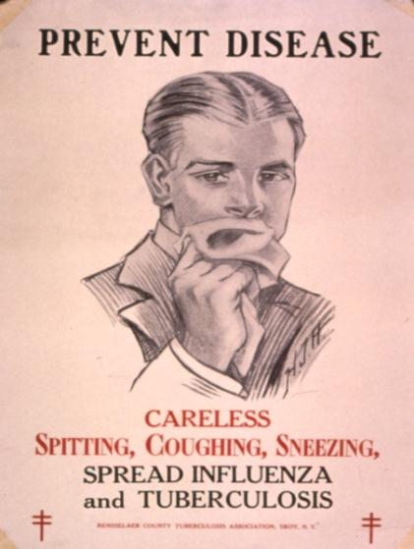
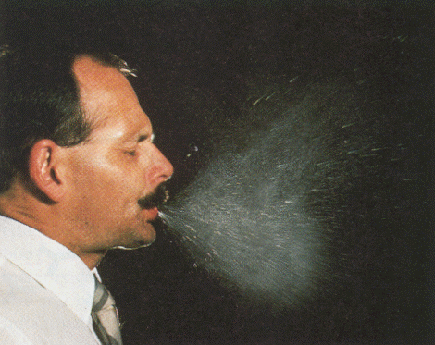
Transmission
Spread by droplet nuclei

Slide 13
Extrapulmonary TB
Different symptoms depending on area of infection
More common in children and those with weakened immunity
Not infectious

Slide 14
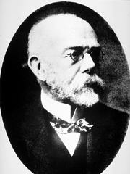
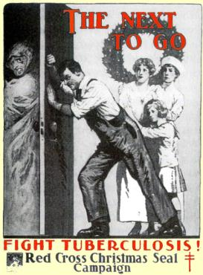
1882 Robert Koch isolates MTB
Wins Nobel prize for medicine in 1905
The fight against a known organism had begun!

Slide 15
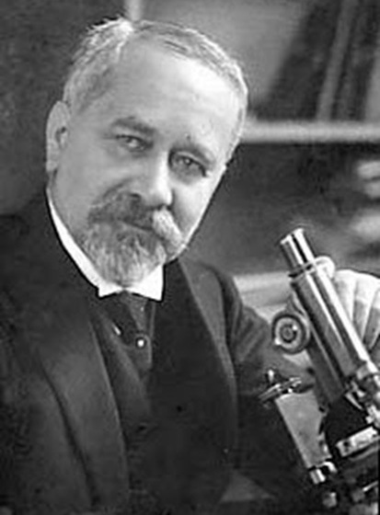
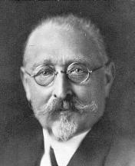
History of BCG
1854 – Jean Antoine Villemin recognised bovine TB
Related to the history of the smallpox vaccine
Albert Calmette
Subcultured virulent strains in different media
    glycerin-bile-potato mixture
    ≈13 years
    ≈230 passages
Camille Guerin

Slide 16
1890 Koch develops tuberculin
1908 Mantoux uses it as an interdermal test for TB
1921 BCG first used
1944 Streptomycin first used to successfully treat a patient
1953 BCG vaccination introduced in secondary schools
1987 UK TB rates lowest since records began

Slide 17
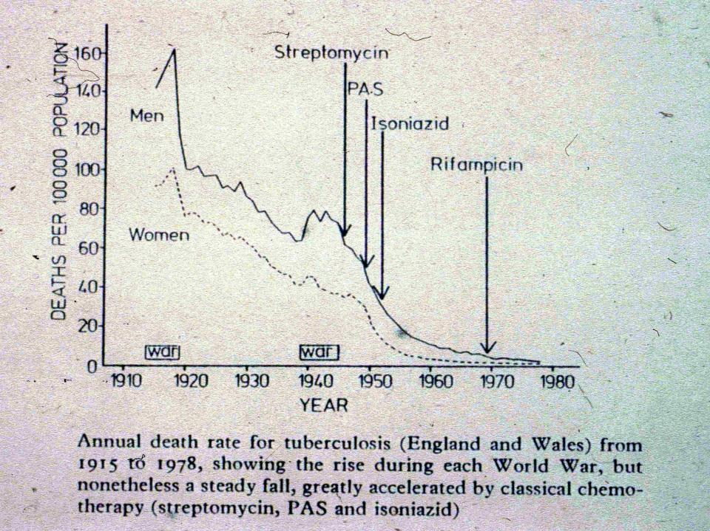
BCG
Pyrazinamide

Slide 18
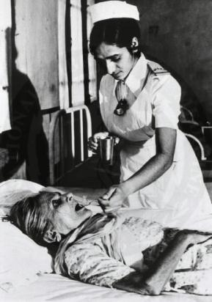
1 new tuberculosis infection every second
Approx. 4400 people will die today from tuberculosis
1/3 of the world population is infected
1993 - the World Health Organisation declares TB a global emergency

Slide 19
True or false
TB is a relatively new disease
TB is no longer a health problem
People with extrapulmonary TB are not infectious
The BCG vaccine helped to bring TB rates down
BCG is a live vaccine and therefore highly dangerous

Slide 20
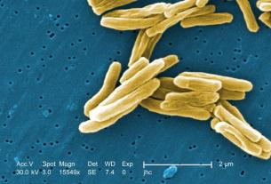
M. tuberculosis
Gram positive facultative anaerobe
Complex cell wall >60% mycolic acids
  - Lipid, sugar, proteins
  - Resists degradation, complement, hydrolases
  - Highly antigenic, immunostimulatory
Replicates intracellularly and extracellularly-human reservoir
Adapted to chronic infection - survival mechanism

Slide 21
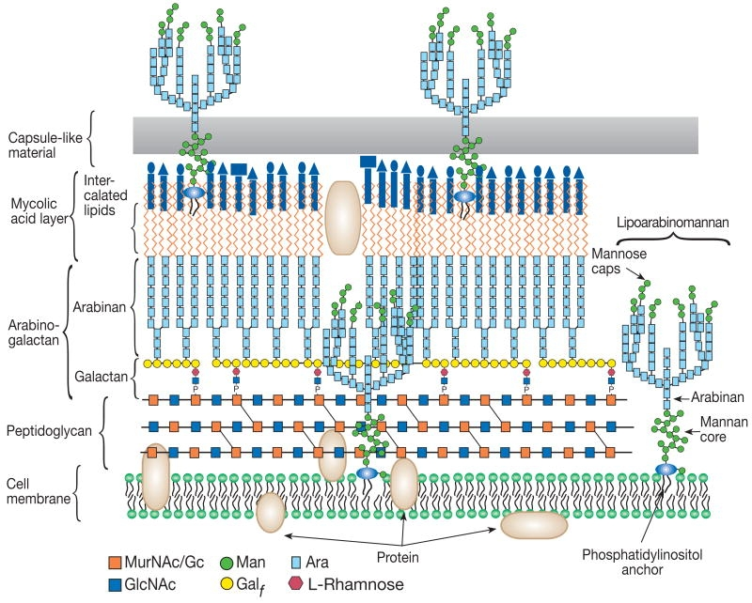
The cell wall of M. tuberculosis
MTB Cell Wall

Slide 22
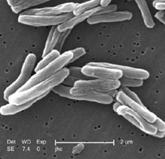
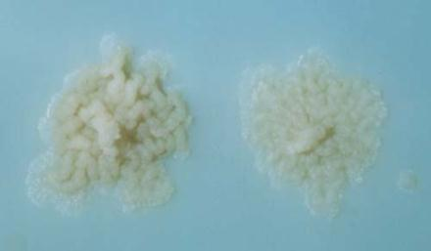
MTB - Characteristics
Size: 2-4 μm x 0.2-0.5 μm
Motility: non-motile
Shape: rod
Growth: very slow
-selective medium
  -doubling time ~20 hours
-(cf. E. coli ~40 minutes)

Slide 23
Visualising MTB
Resists decolorisation by acids during staining procedures – Acid Fast
Ziehl Neelson stain
Carbul fuchsin, driven into MTB with heat
Acid alchol decolourisation removes colour in non acidfast cells
Counter stain eg. crystal violet colours nonacid fast cells
http://www.microbelibrary.org/images/shoeb/ziehl-neelsen.html

Slide 24
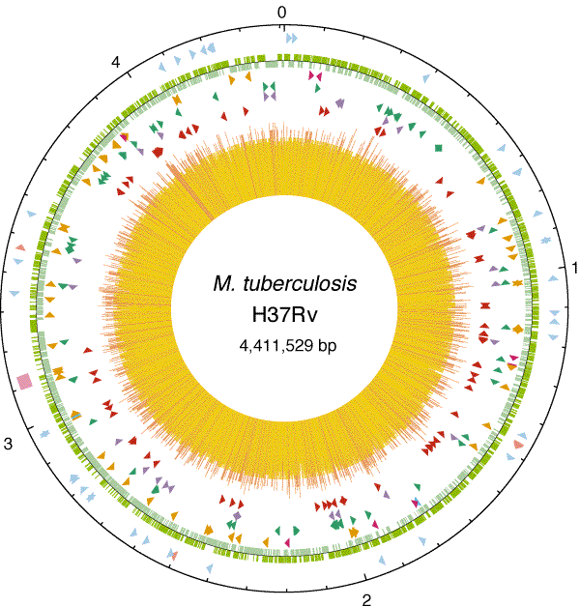
The genome of M. tuberculosis
~ 4,000 genes
High GC base content
>250 lipid metabolism genes
Cole et al. 1998
Nature 393, 537-544

Slide 25
Global population structure and geographical distribution of MTB
Gagneux et al PNAS 2006
- LSPs -define global phylogeny
- 6 lineages are geographically structured
Theory - lineages have adapted to particular host populations

Slide 26
The burden of tuberculosis today…
1993 -WHO declared TB global emergency
8.8 million new cases annually (1.4 million children)
2 million deaths annually (450,000 in children)
Over 350,000 deaths due to TB/HIV (? in children)
1/3 of world’s population is infected with
M. tuberculosis - One new infection per second
~ 5-10% will develop active disease

Slide 27
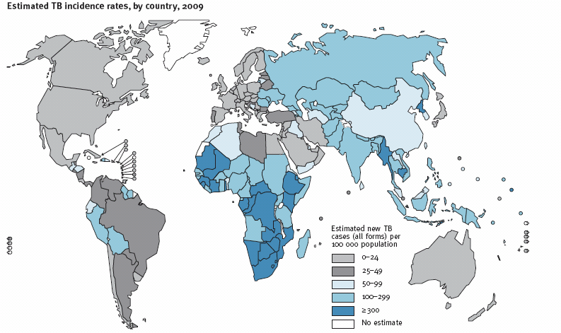
Estimated TB incidence rate, 2009
WHO

Slide 28
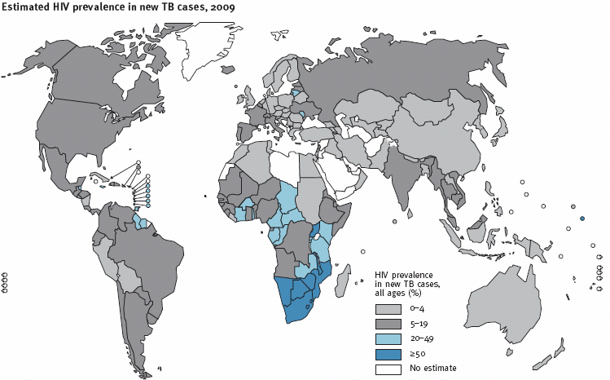
Estimated HIV prevalence in new TB cases, 2009
WHO

Slide 29
Why in the world is there TB?
Subsaharan Africa has the highest rates of TB
Eastern Europe and Asia also has high rates of TB
TB incidence in Southern Africa follows those of HIV but what about the other African and Asian countries?

Slide 30
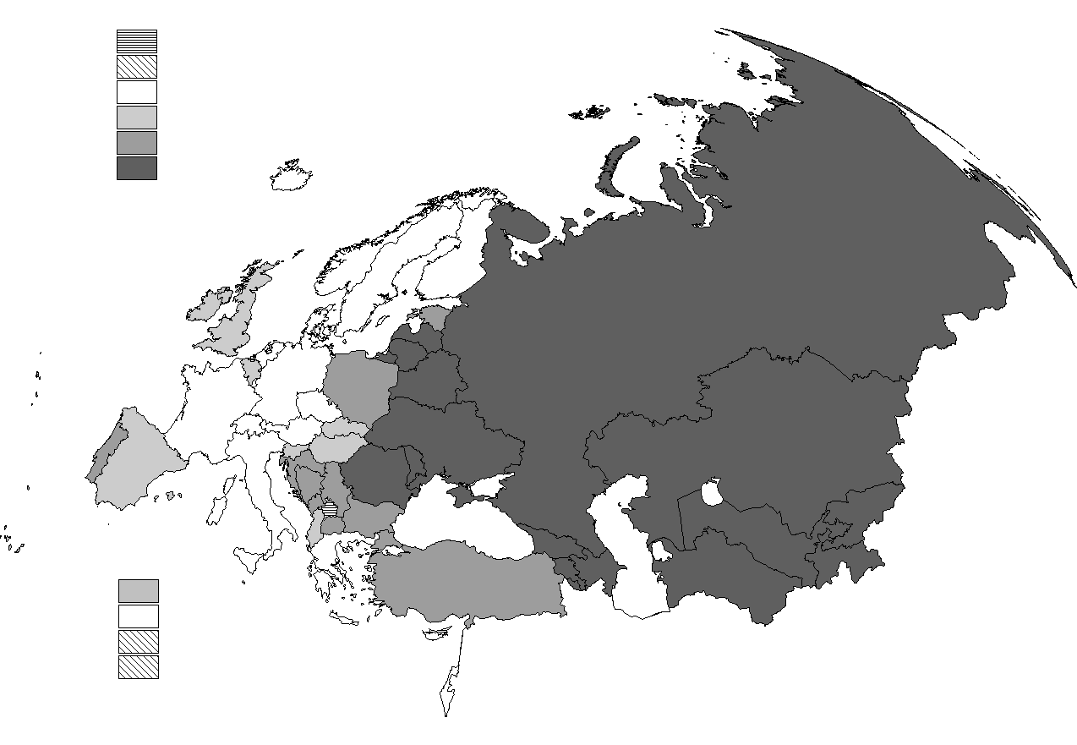
Tuberculosis notification rates WHO European Region, 2006
TB cases per 100 000 population
Not included
Not reporting to EuroTB
< 11
11 – 20
21 – 50
> 50
Andorra
Malta
Monaco
San Marino
EuroTB

Slide 31
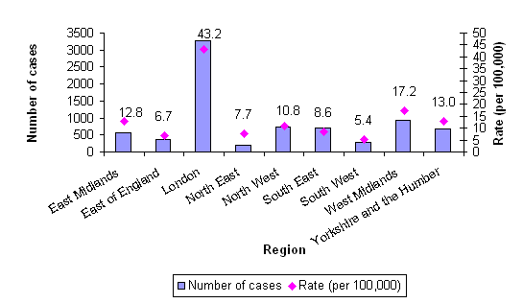
Tuberculosis, UK
Tuberculosis case reports and rates by region, England, 2007

Slide 32
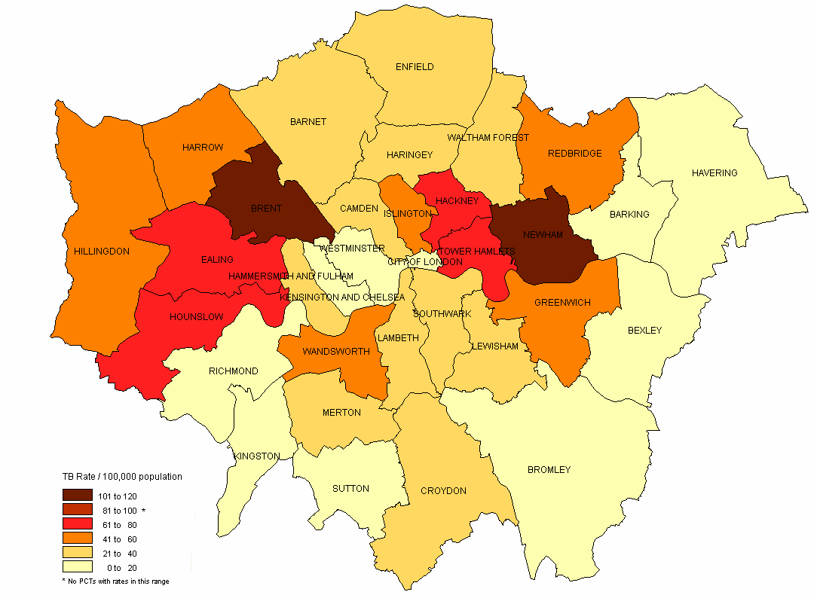

LONDON
HPA, 2007

Slide 33
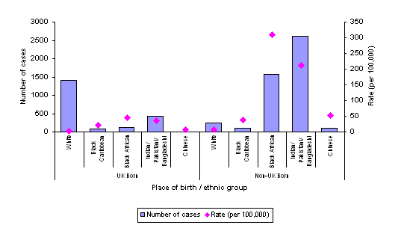
Tuberculosis case reports and rates by place of birth and ethnic group, UK, 2007

Slide 34
True or False
The Zeihl Neelson test is used to visualise MTB
MTB is highly resistant to acid degradation
South America has the highest rates of TB in the world
TB in Sub-Saharan Africa may have increased due to HIV
Different populations are infected with different strains of MTB

Slide 35
Summary
TB is an ancient disease
The beginning of the 20th century saw advances in combating TB with the use of antibiotics and vaccination
BCG vaccine provides some protection
TB strains vary between populations
Drug resistance and HIV are factors which have contributed to an increase in TB
TB is now a major global health problem

Slide 36
Host response to MTB

Slide 37
Aims
Provide an introduction to how the human host deals with MTB infection and the increased risk factors associated with developing disease.
Provide an outline of the current strategies to combat TB, including prevention, diagnosis and treatment

Slide 38
Learning outcomes
By the end of this sessions students should be able to:
Define and differentiate the terms ‘latent TB infection’ and ‘active TB disease’
Explain what host, environmental and bacterial factors predispose to TB
Identify the problems and successes of the BCG vaccine
Outline the limitations of TB diagnostic methods in children
Discuss future TB research strategies required to combat TB

Slide 39
Lesson plan
Infection vs. Disease
How the immune system deals with MTB
Factors predisposing to disease
Diagnosis
Prevention
Treatment
The future

Slide 40
Infection ≠ Disease

Slide 41


EXPOSURE
MTB
Pulmonary infection
-Kills/Contains live MTB
Remain well
No symptoms
Not infectious
-Does not kill/ contain live MTB
-Get sick
-Symptoms
-Infectious
- Latent infection
-1/3 population worldwide
-Active disease
-5-10% of those infected
reactivation

Slide 42
T Cell
IFNγ
IL12
MHC II
IFNγR
TLR2
STAT1
Mannose binding R
MyD88
Complement R
NFκB
NO
Granuloma formation
TNF

Slide 43
Acquired response
T-cells
Reactivation
Disease (<10%)
Primary disease
Latent infection
Bacterial
load
Innate
response
Few weeks
Years /decades
Time

Slide 44
Determinants of tuberculosis outcome
2 billion people
But only 15 million people have tuberculosis
  Differences in outcome of infection
  Differences in disease variability
  WHY?
Environmental
Host
Pathogen

Slide 45
Factors that predispose to tuberculosis
Host response
HIV infection
Other acquired immunodeficiency
Genetic immunodeficiency
Age
Damaged lungs
Socioeconomic status
Homelessness
Malnutrition
Pathogen attributes
• Transmissibility
• Virulence differences between strains
• Drug resistance

Slide 46
True or False
Children <1 year of age are more at risk of TB
Every one who gets infected with TB will have disease
Primary disease is often seen in children as they have a weaker immune system
People with latent infection are infectious
Being poor means that you will get TB disease

Slide 47
Diagnosis

Slide 48
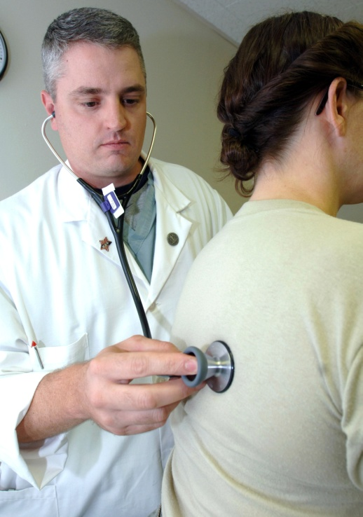
Diagnosis
Clinical presentation
Family history
Epidemiology
CXR
Read the case study in your handout

Slide 49
You are a GP in East London. Your next patient, Mr. Robinson, is a 50 year well-travelled businessman, who comes in complaining of a cough. On questioning, he reveals that he has had this cough for the last six months, that it was initially dry but that he has recently started coughing up a small amount of blood. He has been feeling generally tired and might have lost a bit of weight as his appetite seems to have gone. He is worried that he might have picked up an infection on one of his many business trips to India.
You find out that he is a heavy smoker, having smoked since he was 16. His grandmother and father both died of breathing problems but Mr. Robinson is not sure of details.
He tells you that aside from a longstanding, well-controlled asthma, he is healthy. On examination you find possible abnormalities of percussion note and breath sounds at the left apex.
As an asthmatic you tell him that he should be getting his annual flu jab but Mr Robinson has never had any vaccinations as his parents “didn’t believe in them”

Slide 50
WHAT IS WRONG WITH MR. ROBINSON?

Slide 51
Clinical presentation in children
TB mimics many common childhood diseases
  Pneumonia
  Bacterial and viral infections
  Malnutrition
  HIV
Children often presents with disseminated TB

Slide 52
Microbiological
Organism
smear culture DNA
Immunological
Host response
skin test antigen-specific
production of IFNγ
Diagnosis in resource poor settings

Slide 53
Immunological tests

Slide 54
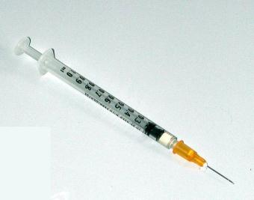
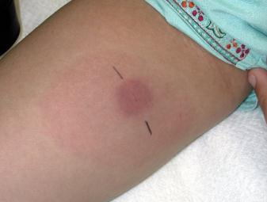
Tuberculin Skin Test
-Used since 1890
Mantoux test
Cheap
UK - 2 units of SSI tuberculin (PPD)
> 200 antigens
Technically difficult
Measures
Production and degree of hypersensitivity to specific antigenic components
10mm = infected, 15mm = disease

Slide 55
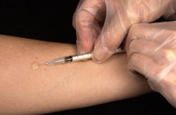
Problems with TST
  poor specificity, does not distinguish between
  -TB disease
  -TB infection (LTBI)
  -BCG
  -environmental mycobacteria
  -false positive
  PPD antigens shared with M. tuberculosis
  poor sensitivity
  -early infection
  -disseminated disease
  -severe malnutrition
  -other acute infections (measles, pertussis)
  -immunocompromised
  -false negative
*In children negative test does not exclude TB

Slide 56
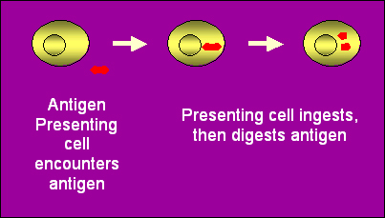
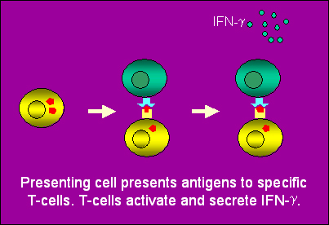
Interferon-γ release assays (IFNGRA)
IFN-γ
Whole blood
or PBMC
}
ESAT 6
CFP 10
from MTB complex
NOT BCG, strongly immunogenic

Slide 57
Problems with IFNGRA
More specific than tuberculin (PPD)
Do not distinguish between infection and disease
Technically challenging
Expensive
Ethical concerns regarding venepuncture in children

Slide 58
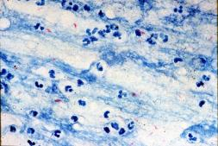
Microscopy
Staining and microscopic examination of smear
Respiratory secretion
    Sputum (unlikely to see AFB unless >500/ml
    Gastric washings
    BAL
CSF, bone marrow, tissue, etc.
Problems with children:
Difficult to obtain samples
Need high numbers of bacilli

Slide 59
Culture
Grow in broth
Conventional media
    4-6 weeks
    Cheap
BATEC system
    9-16 days
    Expensive
Must be suitable for poor resource setting

Slide 60
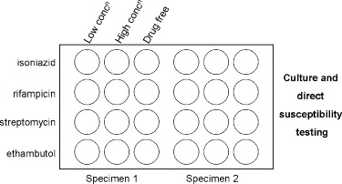
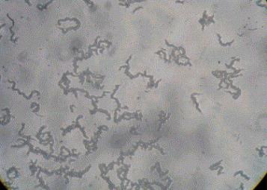
MODS – Microscopic observation drug susceptibility testing
Based on observation that MTB ‘cords’ in liquid culture
Sputum – Decontaminated, cultured in liquid broth
  Inverted light microscope
  +ve cultures identified by cording of MTB growth in liquid media (drug-free control wells) – 15 days
  NTM - lack cording
  Low-tech, sensitive, high specificity, low cost, fast
Plate set-up
Characteristic MTB
‘cord-like tangles’
Moore D et al., NEJM 355:1539-50,2006

Slide 61
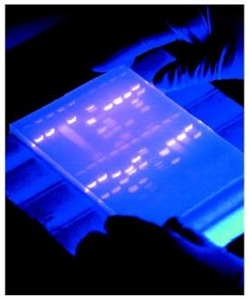
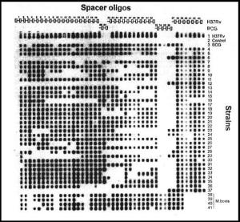
New diagnostic methods
PCR and DNA typing methods
  Amplification of regions of MTB complex DNA
  Costly, in house
  Absence of reproducibility
  Assessment difficult
  - Commercial – high specificity, sensitivity high in smear positive sputum, moderate in smear negative / extrapulmonary specimens
Gel electrophoresis

Slide 62
True or false
TB clinically presents in the same way as many other respiratory diseases
TST is the only way to distinguish between infection and disease
It is easier to obtain specimens from children because they are smaller
Children often give false negative test results

Slide 63
Preventing Tuberculosis

Slide 64
LECTURES ON DISEASES OF CHILDREN
R. HUTCHISON. 4th Edition 1920
Treatment
“Here I would say that treatment is not satisfactory. It is a condition which should be prevented rather than cured.
Essential points are:
  - guard children from contact with tuberculous adults
  - boiling of milk
  - keep bodily health at a high level
  - after illness make sure that convalescence is complete by ensuring a sufficiently long stay at the seaside”

Slide 65
Vaccination
Bacille Calmette-Guérin (BCG)
Derived from M. bovis from cows by serial passage
  - 230 times, 1908-1921
Lost virulence in animals
• Preserved immunogenicity
• Effective in experimental models
• Safe
• Inexpensive
• 1st child vaccinated 1921, since then > 1 billion doses/yr
Many ‘daughter’ strains; Pasteur, Copenhagen, Tokyo, Glaxo

Slide 66
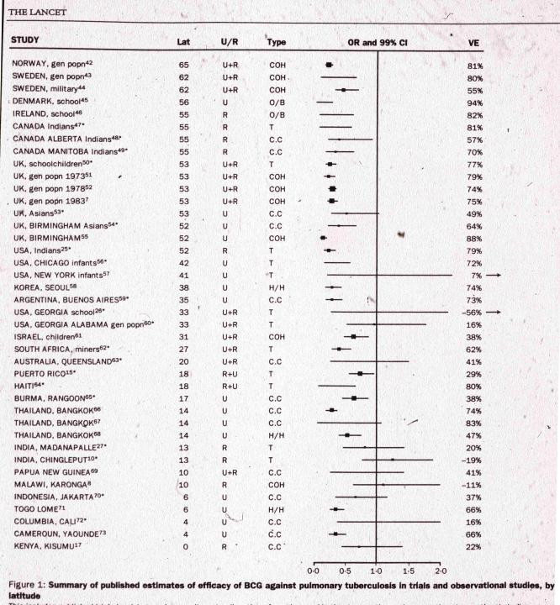
Works
well
How well does
it work?
Does
not
work

Slide 67
Is BCG effective in humans?
• Debated for 70 years – 0-80% efficacy across studies in
prevention of pulmonary TB
• Protects against disseminated disease in children
• Protects against leprosy
• Efficacy varies by geographic location and population
Why?
• ‘Interference’ by environmental mycobacteria?
• Genetic differences between populations?
Background frequency of exposure to TB and age of vaccination
Differences between BCG sub-strains?
Too attenuated?
Notes:
Reasons for variable efficacy
The reasons for the variable efficacy of BCG in different countries is difficult to understand. A number of possible reasons have been proposed but none have been proven.
Background frequency of exposure to tuberculosis It has been hypothesised that in areas with high levels of background exposure to tuberculosis, every susceptible individual is already exposed prior to BCG, and that the natural immunising effect of background tuberculosis then appears to wipe out any benefit of BCG. [citation needed]
Genetic variation in BCG strains There is genetic variation in the BCG strains used and this may explain the variable efficacy reported in different trials.[9]
Genetic variation in populations Difference in genetic make-up of different populations may explain the difference in efficacy. The Birmingham BCG trial was published in 1988. The trial was based in Birmingham, UK, and examined children born to families who originated from the Indian subcontinent (where vaccine efficacy had previously been shown to be zero). The trial showed a 64% protective effect, which is very similar to the figure derived from other UK trials, thus refuting the genetic variation hypothesis.[10]
Interference by non-tuberculous mycobacteria One hypothesis is that the presence in the environment of mycobacteria other than members of the M. tuberculosis complex are able to elicit an immune response in the population being studied, and the prevalence of environmental mycobacteria increases the closer one gets to the equator. The hypothesis is then that BCG is unable to elicit a further immune response, because the population has already built up a natural immune response to mycobacteria. Whether this natural immune response is protective is again debatable. This hypothesis was first made by Palmer and Long.[11]
Interference by concurrent parasitic infection Another hypothesis is that simultaneous infection with parasites changes the immune response to BCG, making it less effective. A Th1 response is required for an effective immune response to tuberculous infection; one hypothesis is that concurrent infection with various parasites produces a simultaneous Th2-response which blunts the effect of BCG.[
BCG
It has had a chequered history in efficacy triALs, providing more than 70% protection in triALs in the United Kingdom, no significant protection in South India, and intermediate levels in a range of other studies in different countries. BEHR and SmALl have previously suggested that differences in efficacy might have arisen as a result of changes in the vaccine strain over time (3). Their new study provides further support for this notion, demonstrating that the subculture of BCG in different laboratories resulted in a series of genETic delETions and the evolution of a number of BCG substrains.

Slide 68
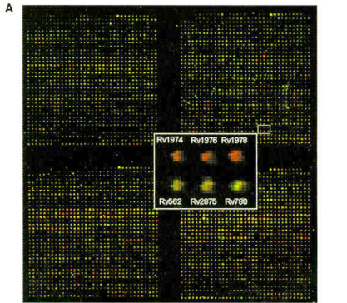
Comparative genomics by microarray hybridisation
Postulated that differences in BCG vaccine efficacy in human trials might have arisen as a result of changes in vaccine strain over time
Compared genomes of M. bovis and BCG strains with M. tuberculosis using parrallel DNA hybridisation microarray – to determine differences in genes

Slide 69
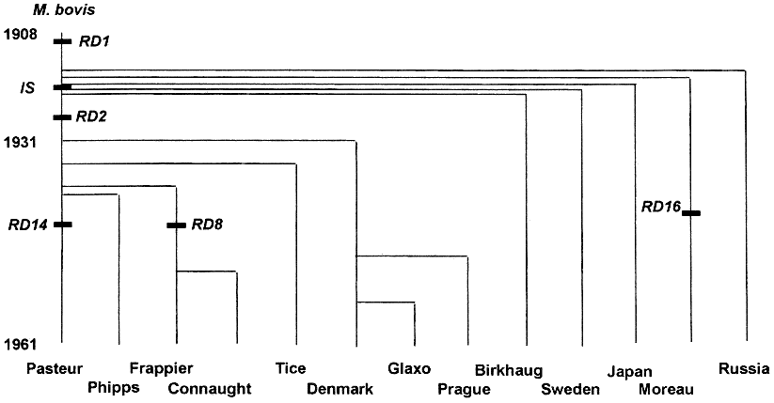
Genealogy of Bacille Calmette Guérin
Behr MA et al. (1999) Science 284:1520
Time
Subculture of BCG in different laboratories series of genetic deletions and evolution of different BCG sub strains
Calmette and Guerin “lost” 10-kilobase fragment from M. bovis progenitor strain during initial process of attenuation
2nd fragment deleted in 1920s + 3 fragments deleted during passage in separate laboratories to generate the current BCG sub-strains

Slide 70
True or False
BCG is a live vaccine and is therefore dangerous
The BCG vaccines available in different countries are all identical
BCG is not effective in countries below the equator so there is no reason to give it to children in these areas

Slide 71
Treatment of Tuberculosis

Slide 72
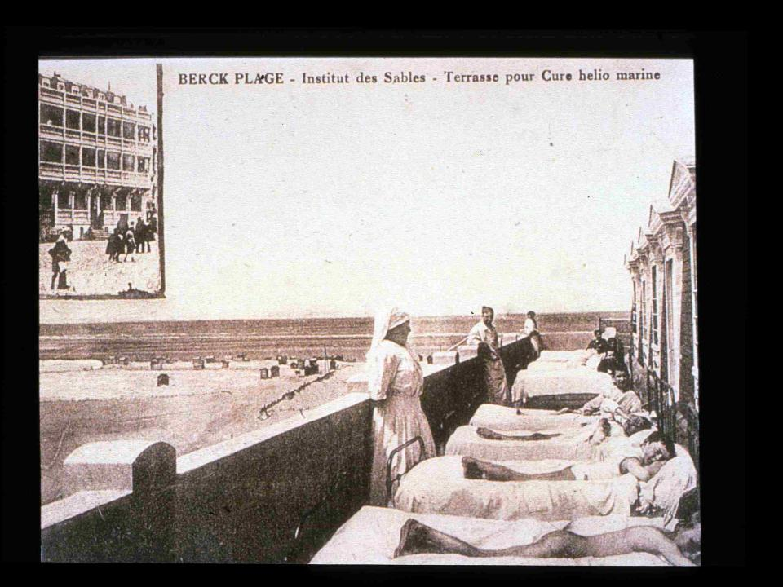
Sanitoria
-Isolate source of infection
-Enforce rest
-Balance diet
-Clean air
-Sunshine
France 1906

Slide 73
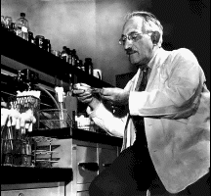
STREPTOMYCIN
Discovered by Selman Waksman 1943
(Nobel prize 1952)
-Trial in 1945
-In first 6 months no mortality in treated patients
-By 9 months, mortality same as for untreated TB
Resistance develops rapidly unless combination therapy
-Now only a 2nd line TB drug

Slide 74
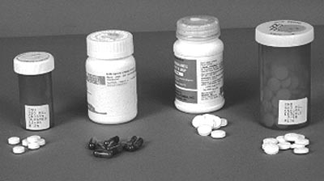
‘Short course’ chemotherapy
- Isoniazid- 6 months
Rifampicin- 6 months
Pyrazinamide / Ethambutol- 2 months
99% cure rate
Pulmonary disease
Fully sensitive organism
Usually unknown in paediatrics

Slide 75
Multiple drug resistant TB (MDRTB)
Resistance to at least Isoniazid and Rifampicin
    generally treatable, expensive, adverse drug reactions
  Primary
    Initial infection with drug resistant MTB
  Secondary (acquired)
    Development of resistance as a result of inadequate treatment
Potential public health disaster

Slide 76
Other Drugs with Anti-TB Activity
Streptomycin Cycloserine
Amikacin Clarithromycin
Capreomycin Rifabutin
Ciprofloxacin Ethionamide
Ofloxacin Prothionamide
Moxifloxacin Clofazamine
PAS Thiacetazone
IFN γ
Complex toxicities and interactions
XDR-TB "Extensively drug-resistant TB”
- defined as MDR-TB that is resistant to quinolones and also to any one of kanamycin, capreomycin, or amikacin
serious threat to control TB

Slide 77
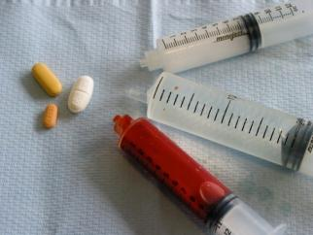
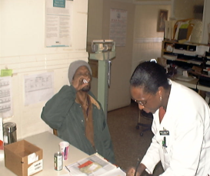
Poor adherence
“If you don’t take the drugs, the drugs won’t work”
Support
-hospital TB clinic
-community
-health care workers
-social services
DOTS - Directly Observed Therapy Short-course
-WHO global TB eradication programme
-accurate record of treatment
-successful treatment
-prevention of resistance

Slide 78

Drugs for tuberculosis
Current drug treatment is effective if managed
  lengthy and compliance is poor, resistance - major problem
  Clinical trials usually done in adults
  Lack of pharmacokinetic studies in children
MTB adapted to long term human infection
  DOTS not effective for latent TB
  Need to target this phase
  Find targets essential for
    persistent and latent infection
    active replication

Slide 79
Directly Observed Therapy Short-course
Sustained political and financial committment.
Diagnosis by quality ensured sputum-smear microscopy. Chest symptomatics examined this way helps to reliably find infectious patients.
Standardized short-course anti-TB treatment (SCC) given under direct and supportive observation (DOT). Helps to ensure the right drugs are taken at the right time for the full duration of treatment.
A regular, uninterrupted supply of high quality anti-TB drugs. Ensures that a credible national TB programme does not have to turn anyone away.
Standardized recording and reporting. Helps to keep track of each individual patient and to monitor overall programme performance.

Slide 80

What’s required to combat TB?
  Better diagnostic tests
    differentiate between infection and disease
    global application
      -cheap, robust and simple
    monitor success of therapy
  Better vaccination
  Better treatments
    drugs
    immunotherapy
  Better delivery of healthcare
  Better understanding of TB

Slide 81
Summary
TB is an ancient disease that is still a major problem worldwide
MTB has mechanisms to evade the immune system
Methods of diagnosing children are difficult
MTB quickly becomes resistant to drug therapy particularly making it difficult to treat
Prevention measures include more effective vaccines, higher standards of living and better healthcare support
Further work on TB should remain a global priority

Slide 82
Further reading
Newton SM et al (2008) Lancet Infect Dis 8: 498-510
Stewart GR et al (2001) Nat Med 7:732
Ginsberg AM (2000) Clin Infect Dis 30 suppl 3:233
Glickman MS and Jacobs WR Jr (2001) Cell 104:477
Brosch R et al (2002) Proc Natl Acad Sci U S A. 99:3684
Newton SM et al (2006) Proc Natl Acad Sci U S A.103: 15594–15598
Dye, C. (2006). Lancet 367, 938-940
Cooper, A.M (2009) Annu Rev Immunol 27, 393-422

