Slide 1
The stress of pregnancy on the maternal system
Dr Ruth Curry BSc(Hons) MBBS MRCOG
Clinical Lecturer/SubSpec Trainee in Maternal & Fetal Med
Institute for Women’s Health
UCL

Slide 2
Introduction
Physiological adaptation to pregnancy is the most rapid and profound change that a woman’s body will undergo in her lifetime
The changes which occur are essential for a normal pregnancy

Slide 3
CARDIOVASCULAR CHANGES DURING PREGNANCY
Blood pressure and haemoglobin changes reflect adaptation to pregnancy, facilitating placental perfusion and fetal growth

Slide 4
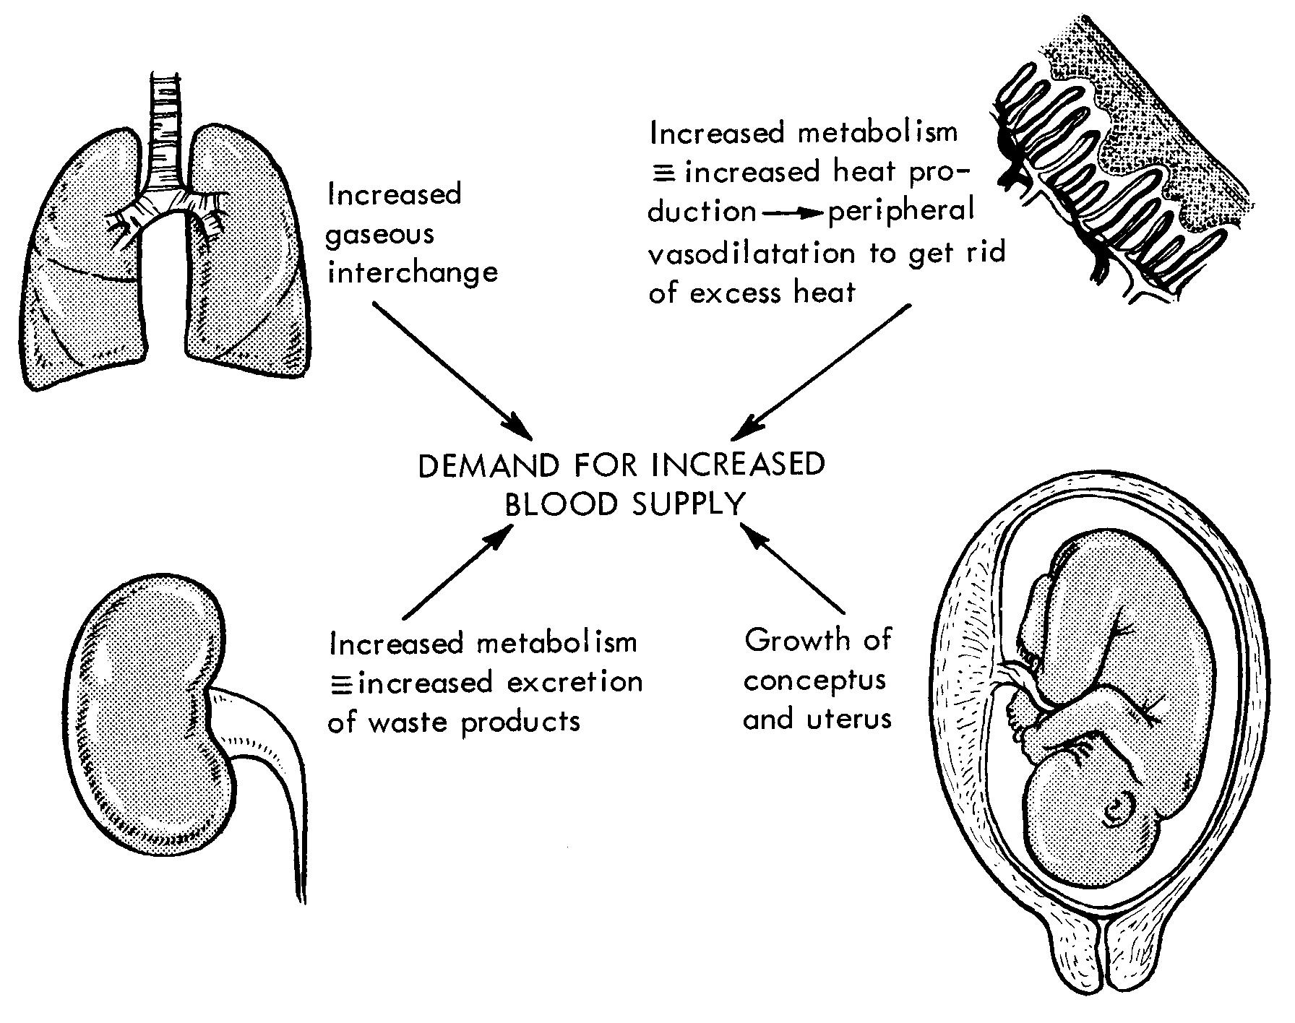
In pregnancy the circulation becomes hyperdynamic

Slide 5
Cardiovascular System Adaptations
Key elements are changes in:
  Systemic vascular resistance
  Blood volume
  Cardiac output

Slide 6
Cardiovascular System Adaptations
Vascular Resistance : resistance to flow that must be overcome to push blood through the circulatory system
Systemic Vascular Resistance (SVR) : resistance offered by the peripheral circulation
Cardiac Output (CO) : volume of blood pumped by the heart in 1 minute

Slide 7
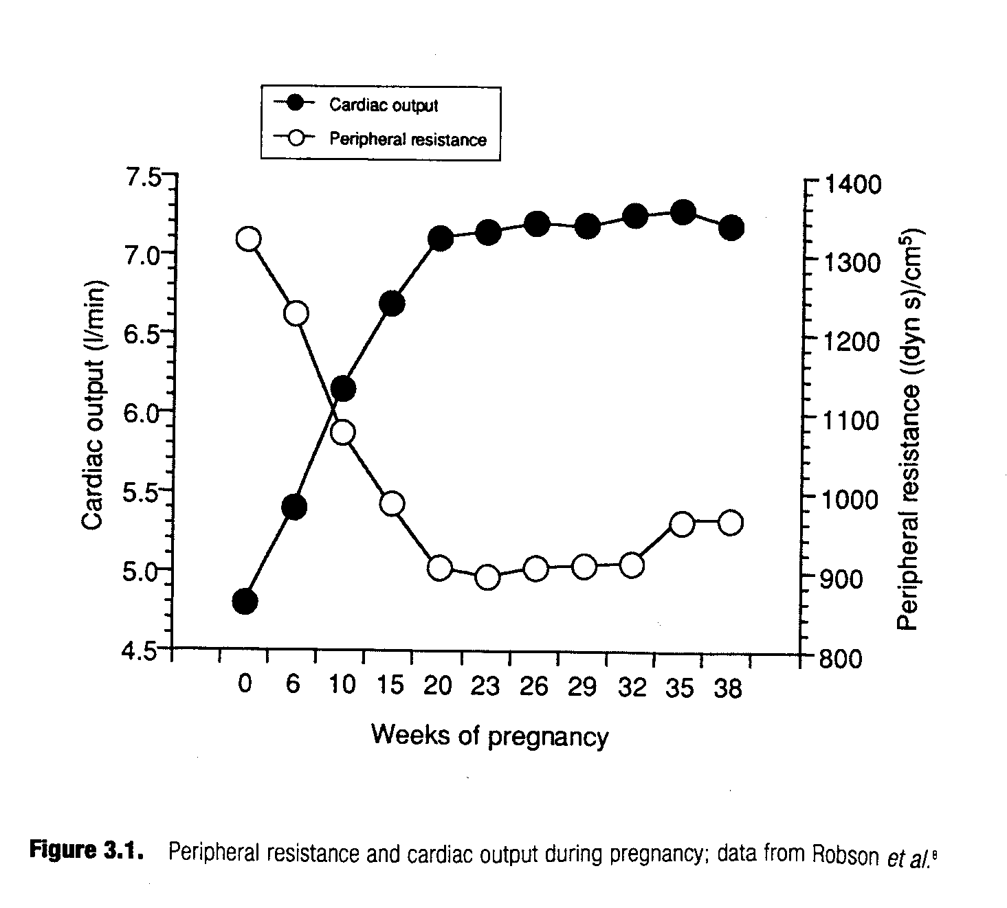
SVR falls to 70% of non-pregnant values by 8/40¹
1. Gelson et al. In: Heart Disease and Pregnancy. Pub RCOG Press.

Slide 8
This leads to a relative state of vascular underfill and……….

Slide 9
…..increase in plasma volume and cardiac output

Slide 10
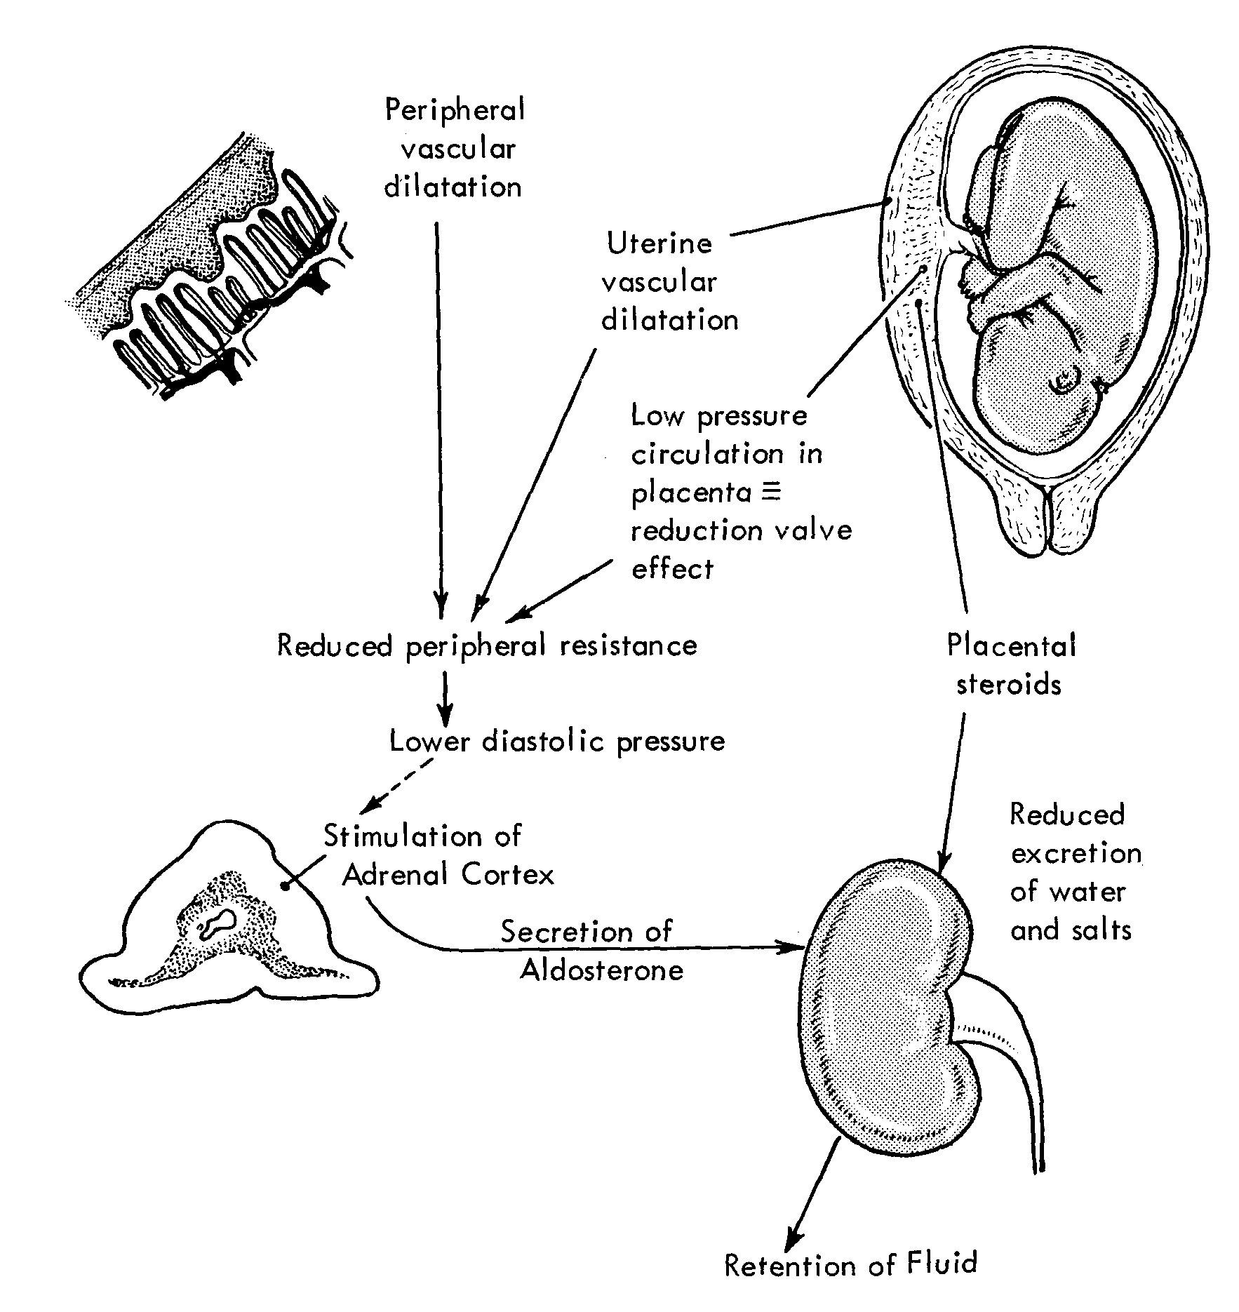
Plasma volume expansion

Slide 11
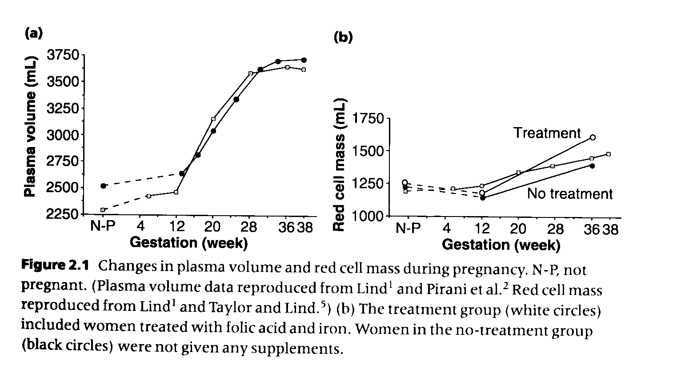
  50% increase in blood volume (more in multiple pregnancy)¹
  2. Robson et al. Am J Physiol 1989;256:H1060-5

Slide 12
Blood Volume
Plasma volume increases more than red cell mass
Leads to fall in:
  Packed cell volume
  Haemoglobin concentration
  Red cell count

Slide 13
Plasma volume increases faster than red cell mass
Relative haemodilution and fall in Hb concentration

Slide 14
Hormonal Factors
Unifying hypothesis:
  Peripheral vasodilatation is a primary determinant of body fluid regulation in pregnancy¹
1. Schrier et al. N Engl J Med 1988;319:1127-34
This triggers haemodynamic and subsequent hormonal responses that result in sodium and water retention and coincides with activation of the renin-angiotensin-aldosterone system

Slide 15
Hormonal Factors
? Fall in SVR secondary to increased circulating levels of:
  ? Oestrogens – increase in prostacyclin
  ? vasodilatory peptides and factors:
    Calcitonin gene-related peptide
    Nitric oxide

Slide 16
Hormonal Factors
Haemodynamic changes during the luteal phase of the menstrual cycle mimic those of early pregnancy
Suggests that changes seen in early pregnancy are independent of placenta
? Dependent on corpus luteum

Slide 17


Haemoglobin changes in pregnancy
Pauline Brocard
and
Mark Little
517,381 pregnancies
In NW Thames
1988-2000
Birthweight
Perinatal mortality

Slide 18
442,074 women of all parities

Slide 20
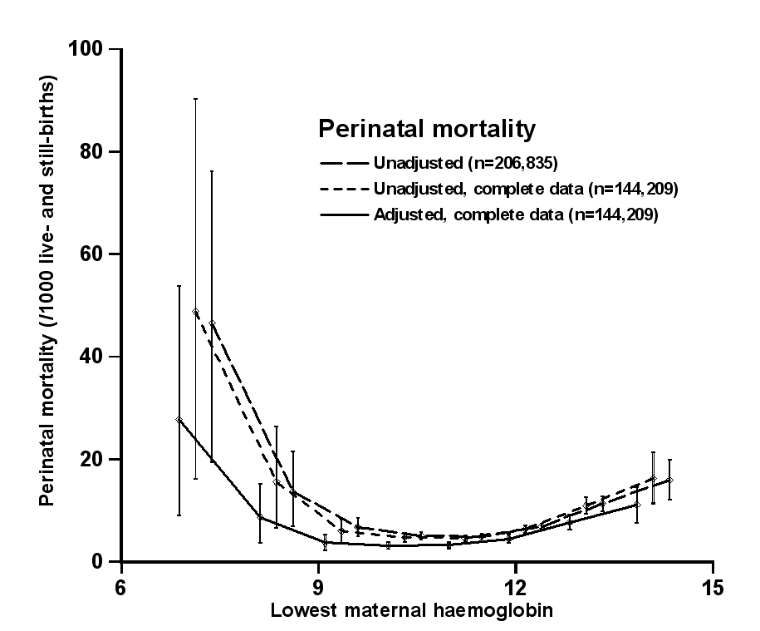
M. P. Little, P. Brocard, P. Elliott, and P. J. Steer.
Am.J.Obstet.Gynecol. 193 (1):220-226, 2005.
adjusted for mother’s ethnic group, smoking habits, maternal height, maternal weight,
mother’s age at first antenatal check, Carstairs’ index and calendar year

Slide 21
Cardiac Output
Rise in CO is disproportionally greater than rise in heart rate
Attributable to increase in stroke volume
As pregnancy advances HR increases becoming the predominant factor increasing CO

Slide 22
  50% increase in cardiac output¹
  1. Silversides. In:Heart Disease in Pregnancy. Pub: Blackwell

Slide 23
Heart Rate
HR is significantly increased by 5/40
Increase continues until 32/40

Slide 24
Cardiac Output in Labour
Further basal rise of 12% during labour without regional analgesia and up to 20% with contractions
  Autotransfusion – increases SV
  pain and anxiety – increase BP and HR
60-80% rise immediately after delivery

Slide 25
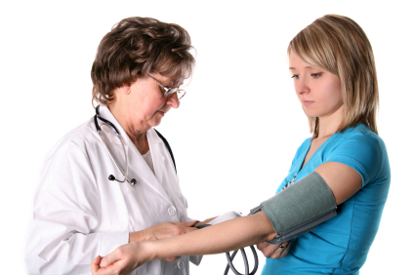
What about blood pressure?
Cardiac output ↑ 50%
Peripheral resistance ↓ 70%
Blood pressure falls

Slide 26
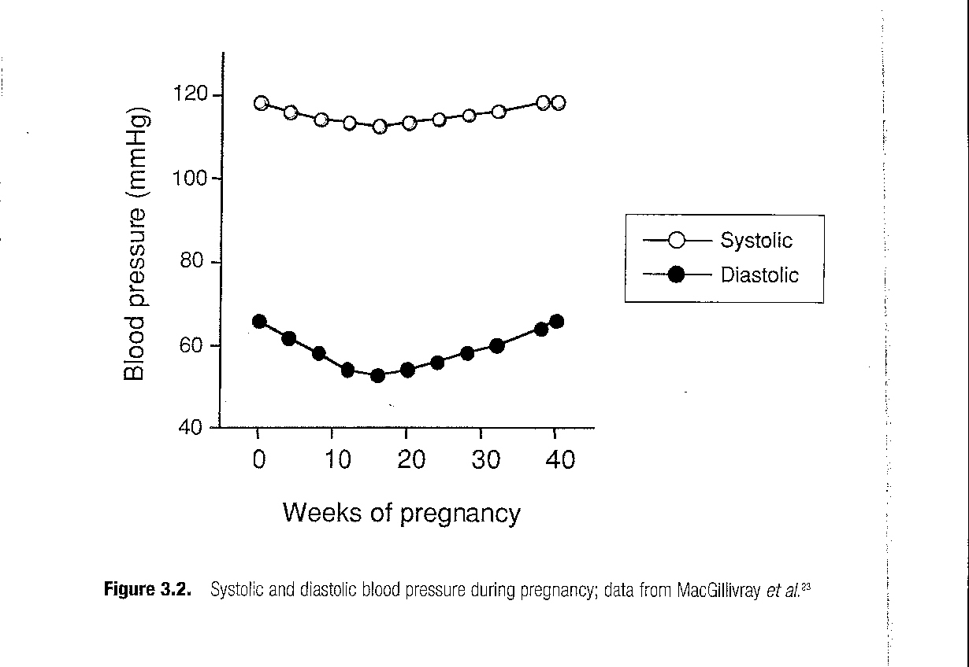
Reduction in SVR is reflected by fall in BP
Occurs in early pregnancy, continuing to the beginning of the 3rd trimester

Slide 27
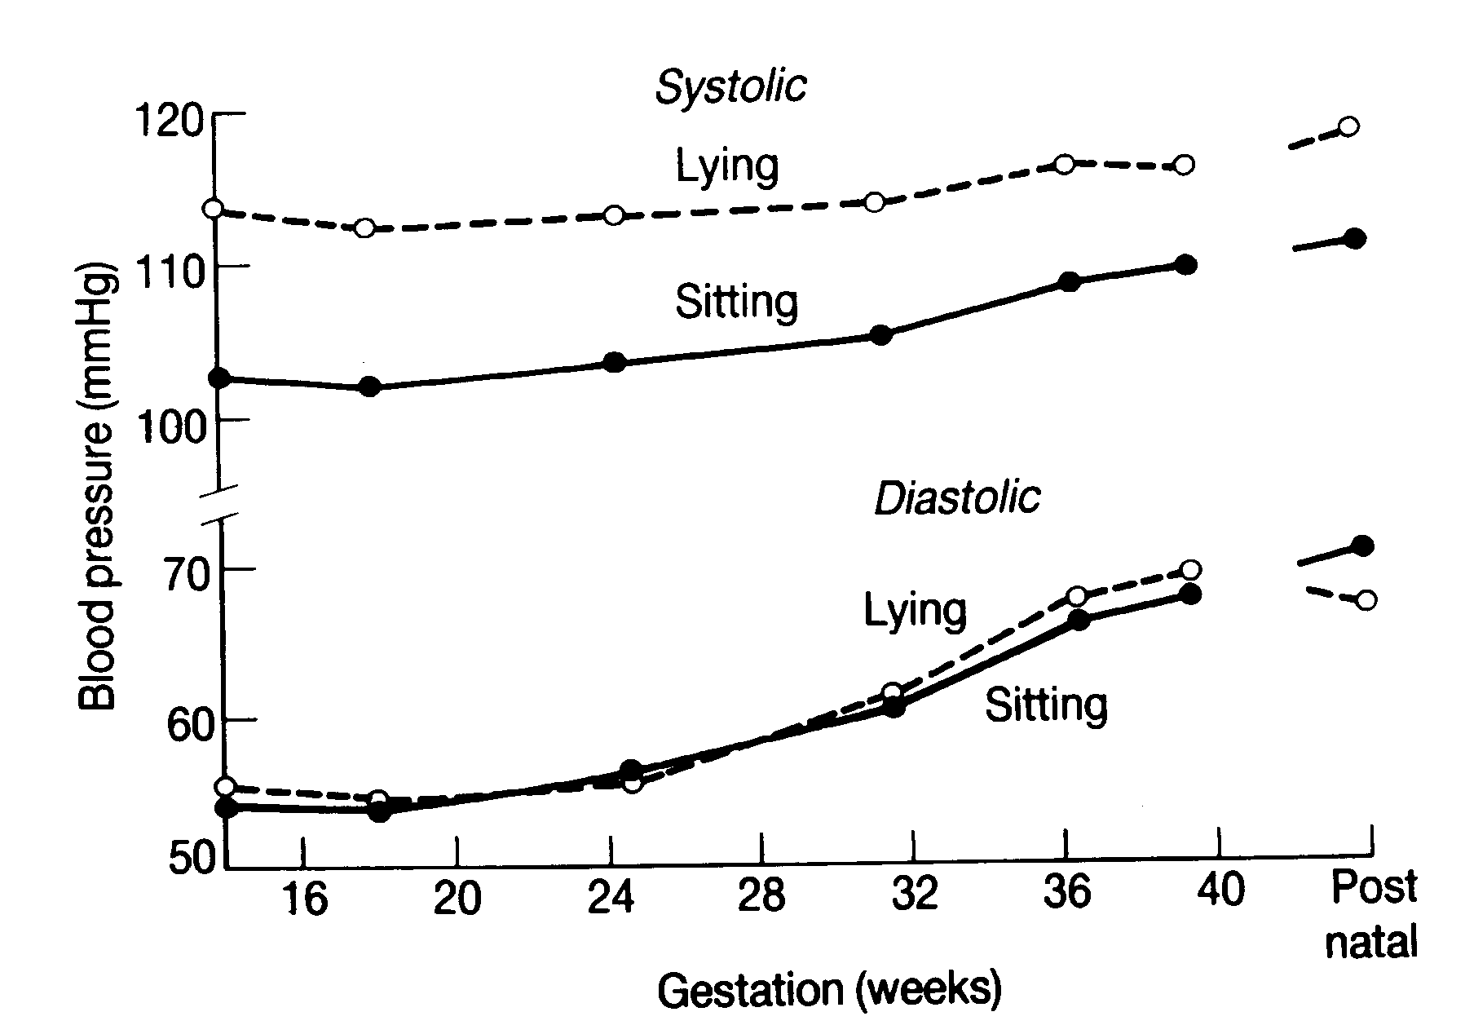
Longitudinal study of 226 first pregnancies
MacGillivray et al 1969 Clin Sci 37:395-407

Slide 28
How important are the changes in blood pressure and plasma volume to the successful outcome of the pregnancy?

Slide 29
Fetal growth is very dependent on placental perfusion

Slide 30
Blood Volume
Inadequate plasma volume expansion is associated with fetal growth restriction

Slide 32
Distribution of centile birthweight in 26 cases of repaired TOF compared with 50 controls
Major determining factor
is the degree of
pulmonary regurgitation
E. Gelson, M. Gatzoulis, P. J. Steer, M. Lupton, and M. Johnson.
Tetralogy of Fallot: maternal and neonatal outcomes. BJOG. 115 (3):398-402, 2008.

Slide 33
Mean
Birthweight
kg
Gelson, Gatzoulis, Swan, Lupton, Durbridge, Steer and Johnson 2008
TOF = 26, SRV = 15, Marfan = 22

Slide 34
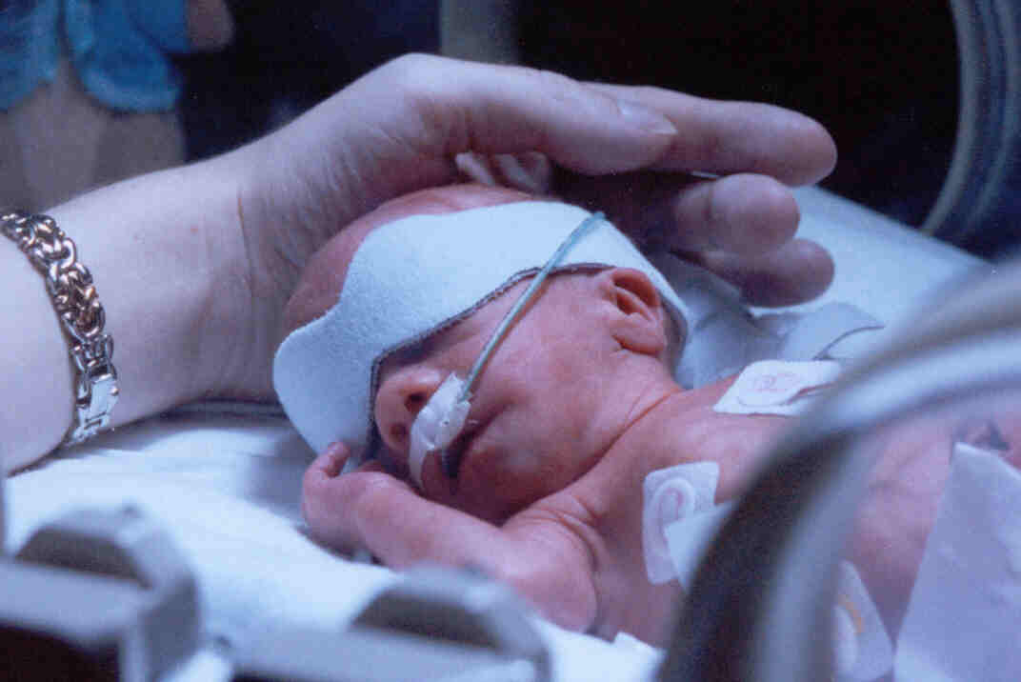
Maternal cyanosis is nearly always associated with growth restriction
and the need for preterm delivery

Slide 35
IMPLICATION:
A blood pressure of 70 – 80 mmHg is optimal for the highest birthweight
The optimal rise in BP during pregnancy depends on the starting level
The underweight woman with low blood pressure is at the highest risk of having a small baby
A trial of inotropics for poor fetal growth may be justified

Slide 36
OPTIMAL BLOOD PRESSURE
Optimal highest blood pressure in pregnancy from quadratic regression is 82.7 mmHg
11.4% of all perinatal deaths attributable to blood pressure variation from this optimum
92% of these deaths associated with low blood pressure

Slide 37
Uterine Blood Flow
Uterine vessels undergo significant structural modification in pregnancy
Spiral arteries supplying placenta may reach up to 30x pre-pregnancy diameter

Slide 38
Uterine Blood Flow
Trophoblastic invasion destroys muscular component of the vessel walls
  1st wave 10-16/40
  2nd wave 16-22/40
↑ capacity
↓ reduces ability to respond to vasoactive stimuli

Slide 39
Uterine Blood Flow
Uterine blood flow increases progressively throughout pregnancy
Mean uterine flow in a singleton pregnancy at 34-40 weeks is 500-600ml/min

Slide 40
Uterine Blood Flow
CO peaks at 20-22/40 and remains constant thereafter
? Increase in uterine blood flow after 28/40 is dependent on a reduction in flow to other tissues secondary to an increase in peripheral resistance

Slide 41
Uterine Blood Flow
BP rises with advancing gestation:
? responsible for increase in uterine perfusion

Slide 42
Uterine Blood Flow
However:
  Perfusion of all other organs except kidneys continues to rise or remain static

Slide 43
Uterine Blood Flow
? CO continues to rise with advancing gestation
? There is marked vasoconstriction of peripheral vascular beds eg renal or cerebral vasculature
? The initial fall in SVR is due to AV shunting which is reversed in later gestations

Slide 44
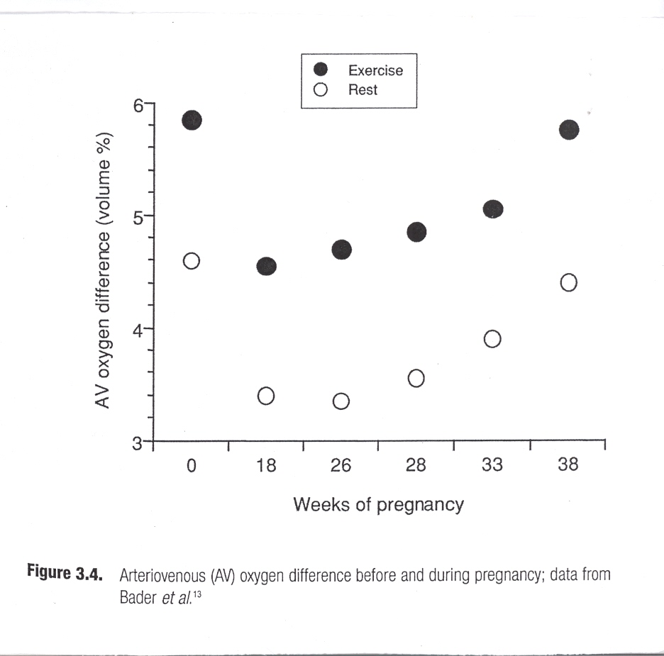
Uterine Blood Flow
• Fall in AV pO2 difference in early pregnancy

Slide 45
Uterine Blood Flow
? site of shunts:
  Hand and foot perfusion (reflect skin perfusion) increase with gestation
  Limb perfusion (reflects muscle perfusion) is unchanged

Slide 46
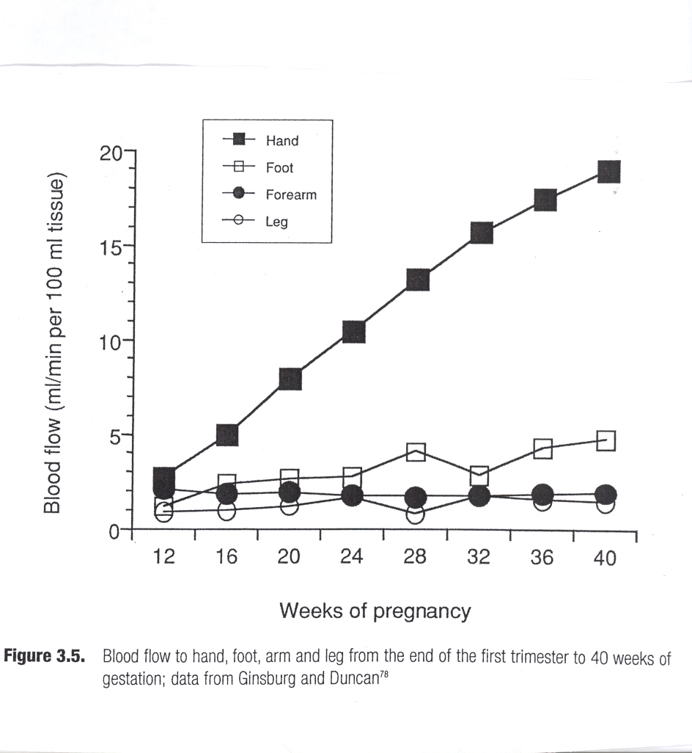
Uterine Blood Flow

Slide 47
SPECIALISED KNOWLEDGE OF THE HAEMODYNAMICS IS ESSENTIAL IN RELATION TO:
Thromboembolism
Haemorrhage
Hypertension and Pre-eclampsia

Slide 48
Number of maternal deaths 2003-5

Slide 49
Risk of Thrombosis
During pregnancy = X 6
During puerperium = X11

Slide 50
Coagulation
Pregnancy is a state of low-grade coagulopathy
Increase in potent pro-coagulatory factors from at least the end of the first trimester
Increased risk of venous thromboembolism

Slide 51
Coagulation
↑ factors VII, VIII, X
↑ plasma fibrinogen
↓ antithrombin III
↔ Protein C (inactivates factors V, VIII)
Protein S ↓
↓Plasma fibrinolytic activity during pregnacy and labour, returning to normal within an hour of delivery of placenta
? Control of fibrinolysis affected by placentally-derived mediators

Slide 52
Summary
Effective maternal adaptation to pregnancy is important to ensure a good outcome for mother and fetus

Slide 53
Summary
Outcome data from women with heart disease suggests that:
  Impairment of cardiac function is associated with a relatively less good outcome of pregnancy
  Pregnancy may have a detrimental effect on women with pre-existing heart disease

Slide 54
Summary
Challenge:
  Establish which changes are associated with normal pregnancy, in particular those cardiovascular changes occuring at the end of pregnancy which influence blood flow
  Investigate the impact of pre-existing diseases on these changes in the hope of being able to intervene to improve fetal and maternal outcomes

Slide 55
THANKS:
Professor Philip Steer, Emeritus Professor of Obstetrics, Imperial College, London

